Slide 1
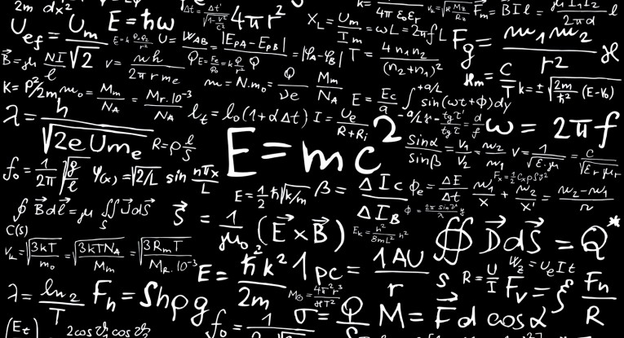

Faraz Ahmed ​
ID: 191-15-12948​
CSE​
Daffodil International University​

Slide 2

WELLCOME

Slide 3
What is LCS( longest common subsequence)
LCS using recursion
LCS using dynamic programing (Tabulation bottom up method)

Slide 4
What is LCS( longest common subsequence )

Slide 5
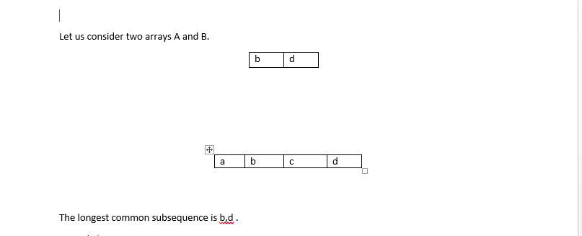


Slide 6
LCS using recursion

Slide 7
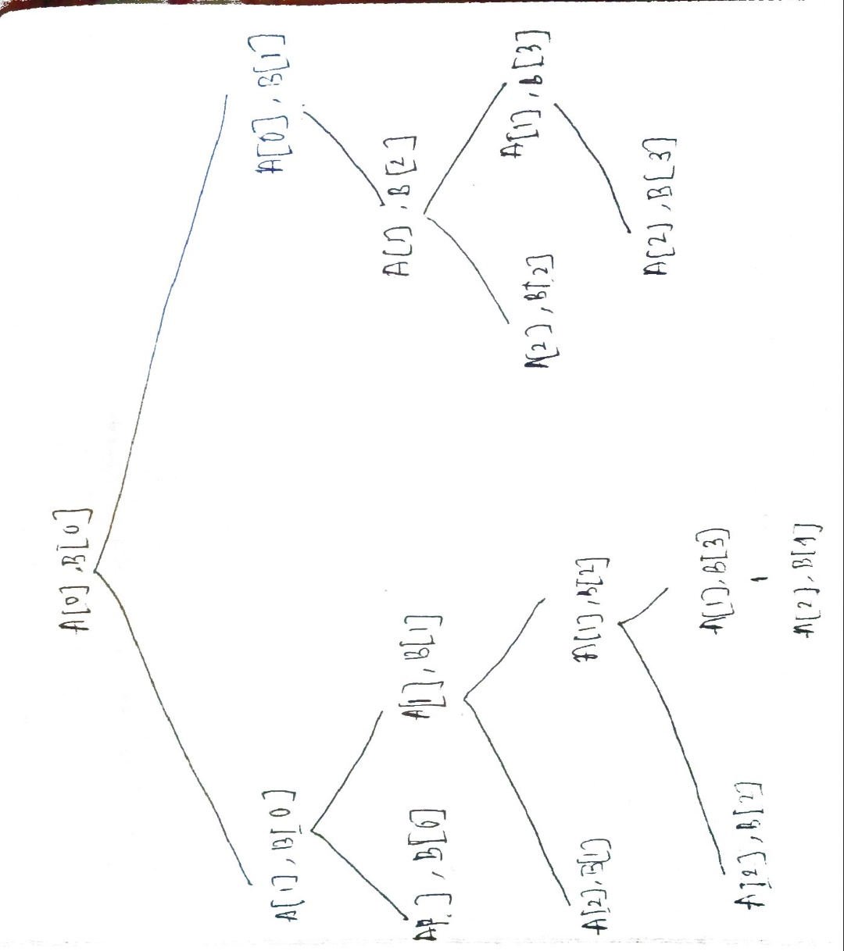
The longest common subsequence is b,d .
int Lcs(i,j)
{
if (A[i]== '/0' || B[j] == '/0')
return 0;
else if(A[i] == B[j])
return 1=Lcs(i+1,j+1)
else
return max(Lcs(i+1,j), Lcs(i,j+1));
}

Slide 8
LCS with tabulation method ( Bottom Up)

Slide 9
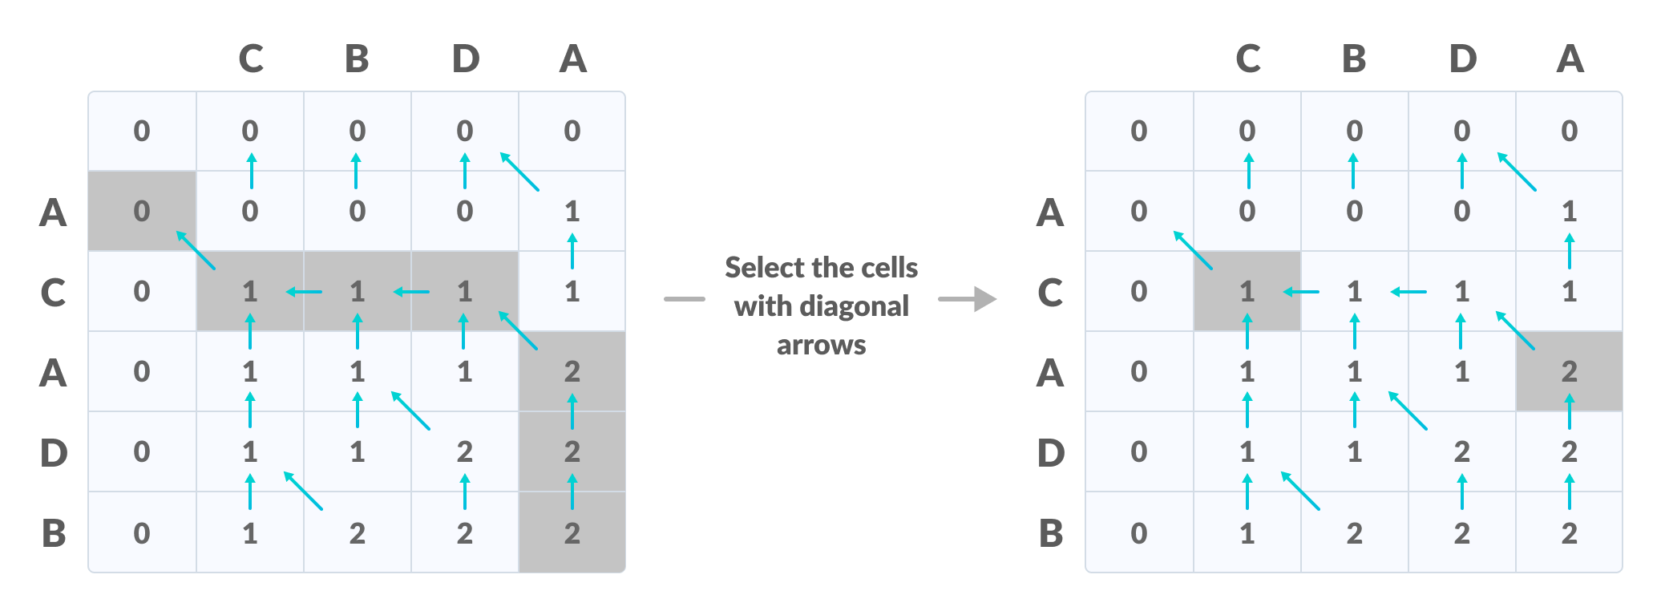

Slide 10
void lcs(char *S1, char *S2, int m, int n) {
int LCS_table[m + 1][n + 1];
// Building the mtrix in bottom-up way
for (int i = 0; i <= m; i++) {
for (int j = 0; j <= n; j++) {
if (i == 0 || j == 0)
LCS_table[i][j] = 0;
else if (S1[i - 1] == S2[j - 1])
LCS_table[i][j] = LCS_table[i - 1][j - 1] + 1;
else
LCS_table[i][j] = max(LCS_table[i - 1][j], LCS_table[i][j - 1]);
}

Slide 11
THANKS!

