Slide 1
Research ideas on Graph Machine Learning
Notes:
Good afternoon esteemed committee members, professors, and dear friends. Thank you Dr Bala for introducing me. I am going to present my research proposal on a topic

Slide 2
A generic framework for aleatoric and epistemic uncertainty in GNN
Aleatoric Uncertainty
Intrinsic randomness due to noisy or inaccurate measurements
Uncertainties associates with link connections/weights
Biological networks: links in protein interaction network are stochastic
Social network: link weights signify users influence
Stochastic Node embeddings since neighborhood of each node is probabilistic due to link uncertainties
Notes:
Therefore, we are trying to systematically incorporate all possible type of uncertainty in our learning framework. The First type of uncertainty is aleatoric which is also known as data uncertainty. It is further divide into two types based on scenario. Under the situation when no prior information of uncertainty is available, instead of using observed graph, we will take MAP estimate of graph by leveraging the ideas of graph signal processing. In the second situation where we have prior information, we will propagate those information via layers of GNN and standard feedforward network. Then along with predicting criticality scores, we will also predict confidence interval around our mean predictions.
The Epsitemic uncertainty is handled by taking multiple Monte-Carlo samples of the Deep neural network by varying the connections during prediction time. The uncertainty framework would be generic that could work for any downstream application from node classification to link prediction. This uncertainty propagation has not been done in GNN till now. I have already scripted this model and validation is needed to be done.

Slide 3
A generic framework for aleatoric and epistemic uncertainty in GNN
Epistemic Uncertainty
Incompetency of underlying models to completely explain the data/process.
GNN : Node embedding module + regression/classification module.
DNN model uncertainty: Bayesian approach by placing distribution of weights, approximate via dropout.
Notes:
Therefore, we are trying to systematically incorporate all possible type of uncertainty in our learning framework. The First type of uncertainty is aleatoric which is also known as data uncertainty. It is further divide into two types based on scenario. Under the situation when no prior information of uncertainty is available, instead of using observed graph, we will take MAP estimate of graph by leveraging the ideas of graph signal processing. In the second situation where we have prior information, we will propagate those information via layers of GNN and standard feedforward network. Then along with predicting criticality scores, we will also predict confidence interval around our mean predictions.
The Epsitemic uncertainty is handled by taking multiple Monte-Carlo samples of the Deep neural network by varying the connections during prediction time. The uncertainty framework would be generic that could work for any downstream application from node classification to link prediction. This uncertainty propagation has not been done in GNN till now. I have already scripted this model and validation is needed to be done.

Slide 4



Proposed approach to incorporate aleatoric + epistemic uncertainty
No prior
Posterior of graph model:
MAP estimate via Graph learning [1]
Epistemic
Train Bayesian GNN with random embedding vectors & MC sampling
Predict Node/Link scores with credible interval
Aleatoric
Prior
Propagate prior information(Link probability/variance) via ADF [2]
$$p_{1}$$
$$p_{2}$$
$$p_{N}$$
[1 ] Kalofolias, Vassilis, and Nathanaël Perraudin. "Large scale graph learning from smooth signals." arXiv preprint arXiv:1710.05654 (2017).
[2] Loquercio, Antonio, Mattia Segu, and Davide Scaramuzza. "A general framework for uncertainty estimation in deep learning." IEEE Robotics and Automation Letters 5.2 (2020): 3153-3160.
Notes:
Therefore, we are trying to systematically incorporate all possible type of uncertainty in our learning framework. The First type of uncertainty is aleatoric which is also known as data uncertainty. It is further divide into two types based on scenario. Under the situation when no prior information of uncertainty is available, instead of using observed graph, we will take MAP estimate of graph by leveraging the ideas of graph signal processing. In the second situation where we have prior information, we will propagate those information via layers of GNN and standard feedforward network. Then along with predicting criticality scores, we will also predict confidence interval around our mean predictions.
The Epsitemic uncertainty is handled by taking multiple Monte-Carlo samples of the Deep neural network by varying the connections during prediction time. The uncertainty framework would be generic that could work for any downstream application from node classification to link prediction. This uncertainty propagation has not been done in GNN till now. I have already scripted this model and validation is needed to be done.

Slide 5
A generic framework for aleatoric and epistemic uncertainty in GNN
Aleatoric Uncertainty
Intrinsic randomness due to noisy or inaccurate measurements
Uncertainties associates with link connections/weights
Biological networks: links in protein interaction network are stochastic
Social network: link weights signify users influence
Stochastic Node embeddings since neighborhood of each node is probabilistic due to link uncertainties
Notes:
Therefore, we are trying to systematically incorporate all possible type of uncertainty in our learning framework. The First type of uncertainty is aleatoric which is also known as data uncertainty. It is further divide into two types based on scenario. Under the situation when no prior information of uncertainty is available, instead of using observed graph, we will take MAP estimate of graph by leveraging the ideas of graph signal processing. In the second situation where we have prior information, we will propagate those information via layers of GNN and standard feedforward network. Then along with predicting criticality scores, we will also predict confidence interval around our mean predictions.
The Epsitemic uncertainty is handled by taking multiple Monte-Carlo samples of the Deep neural network by varying the connections during prediction time. The uncertainty framework would be generic that could work for any downstream application from node classification to link prediction. This uncertainty propagation has not been done in GNN till now. I have already scripted this model and validation is needed to be done.

Slide 6


Network Science
Machine Learning
Resilience
Enhancing resilience of complex networks via Machine learning
Notes:
Primarily, I am working on enhancing resilience of critical infrastructure models using the network science and machine learning. These projects are funded from US DOE and NSF.

Slide 7
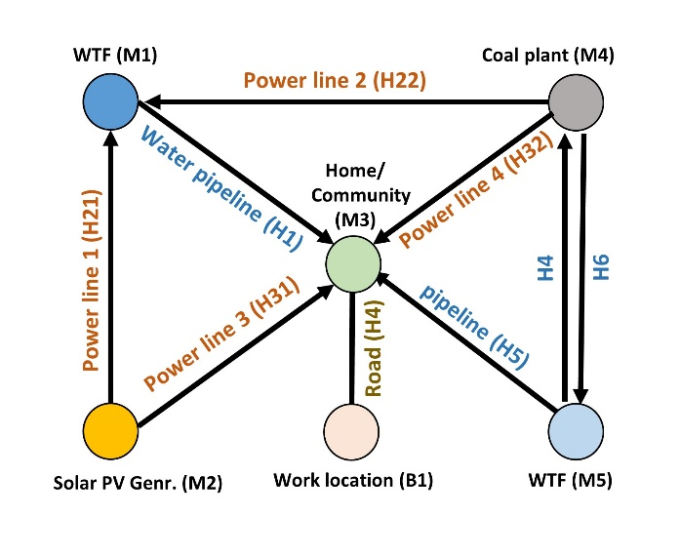
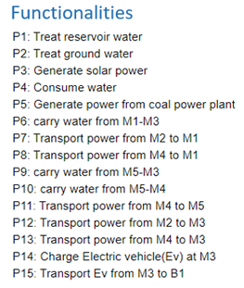
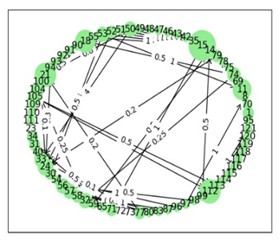
Understanding Resilience of urban interdependent networks
Process relation graph
Identify critical nodes
Optimal interdependencies
Optimum Recovery Strategy
Weighted Hetero Functional graph theory (WHFGT) for modeling interdependent infrastructure.
Robustness analysis of Process relation graph via multiple metrics : GCC, NCC, FR and SR.
Contributions: Weighted dependency, Simulated Partial, Completed, Random, Targeted attack & their combinations.
Conclusion: Securing information is more crucial than physical hardening for resilience enhancement [1].
[1] Munikoti, Sai, Kexing Lai, and Balasubramaniam Natarajan. "Robustness assessment of hetero-functional graph theory based model of interdependent urban utility networks." Reliability Engineering & System Safety (2021): 107627.
[2] Das, Laya, Sai Munikoti, Balasubramaniam Natarajan, and Babji Srinivasan. "Measuring smart grid resilience: Methods, challenges and opportunities." Renewable and Sustainable Energy Reviews 130 (2020): 109918
Notes:
To get an better understand of term resilience I studied an interdependent system of power water , transport gas and heating network. I have modeled this interdependent system with HFGT which is a recently proposed framework for modeling interdependent networks. Basically it consist of different single layer graph based models that are combined to holistically represent an complex system. This modeling framework possess various advantages over conventional multi layer network. Then I done a rigorous analysis of robustness in these interdependent weighted model. Different types of attack are simulated and the degradation of network functionality is measured at each time stamp via graph robustness metrics such as GCC, NCC, FR, SR. Apart from typical random abd targeted attack, we also simulated complete and partial attack. Multiple conclusions are drawn with one very interesting fact that securing information is more crucial than system hardening as partial targeted attack seems to have impact than complete random attack.
At the end of this study, one question that triggers my mind is that how can we develop a scalable and computationally efficient framework for
identify critical nodes in a general complex network?
Extend that framework to critical sequence of nodes?
get optimal interdependences between resources and functionalities
get a optimum recovery sequence after the onset of disruption.

Slide 8
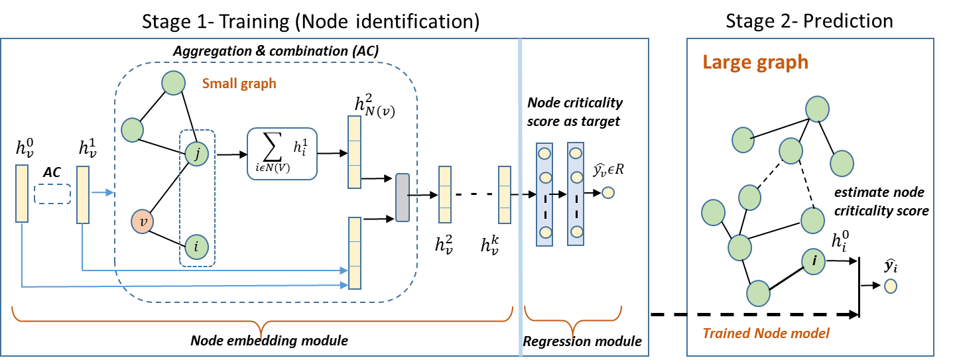
Enhancing resilience of complex networks via Machine learning
Critical nodes exist in any complex network whose removal maximally decrease the network robustness.
Most of the existing approaches to identify critical nodes are iterative based and computationally expensive.
We proposed Scalable Graph Neural Network-based inductive learning framework (ILGR) for identifying critical nodes [3]
[3] Munikoti, Sai, Laya Das, and Balasubramaniam Natarajan. "Scalable Graph Neural Network-based framework for identifying critical nodes in Complex Networks." arXiv preprint arXiv:2012.15725 (2020).
Notes:
First I have targeted the problem of identifying critical nodes. Critical nodes are those nodes whose removal from the graph maximally decrease the graph robustness. The knowledge of critical nodes is helpful in lot of application ranging from urban networks to social networks. For instance in biological network, critical nodes determine key protein interactions and help in drug discovery. Similarly in critical infrastructure networks, it help planner and operator to prepare for contingencies and mitigate the socio-economic impact of disruptions caused by natural disasters or cyber attacks. Most of the existing methods of identifying critical nodes/links in a network are based on iterative approach which does not scale well with the size of the network. Therefore, we have developed a novel identification framework using the ideas from GNN. In this regard, Critiacality scores are assigned to nodes based on the observed decrease in graph robustness when that node has been removed/compromised from the graph. Then, we developed a semi supervised learning frame work where we use subset of nodes criticality scores for training our framework. The figure shows the proposed architecture. The proposed framework is highly scalable as training can be done in relatively fewer nodes of the network but prediction can be done for all nodes of the network and even for the new network provided that network has some resemblance to training graphs. The other big offering of this learning based framework is that we can do transfer learning by training model for alternate graph type or robustness metrics can be done with even fewer nodes by using pretrained network. We are able to obtained more than 90 accuracy in both real world and synthetic networks with a execution time reduced by an order of 3. This work is under consideration.
One of the challenge with data driven analysis is uncertainty.

Slide 9
Next steps
Extend from single node/link case to critical set/sequence of nodes/link ; Combinatorial optimization on networks.
Formulate problem as MDP and leverage RL algorithms (Deep Q-learning) for identifying critical sequence.
Formulation can work for attack graphs, optimum recovery, optimal interdependencies.
WHY GNN+ RL formulation ?
Scalable, generic and computational efficient: Consistent with our current GNN framework.
RL inherently allows foresightedness in decisions: Cumulative discounting rate
Notes:
As an immediate next steps, I will be extending current work from single node case to multiple node case where I am interested in identifying sequence of nodes/links given some budget such that whose removal maximally decrease the graph robustness. The sequence of nodes/links is useful in various applications depending upon our objective. IF my objective is to get a sequence which decreases the graph robustness, then this could be useful in attack graph as security specialist will be aware of vulnerable paths and can take some proactive actions to mitigate socio economic impact of malicious attacks. Similarly if my objective is quickly gain network functionality after disruption, then this sequence can give me an optimal recovery strategy.
I am planning to formulate this problem as MDP and leverage ideas from RL to identify critical sequence. I will be using RL because of 2 reasons. First of it is offers scalable and computationally efficient approach which is consistent with the objective of my current framework. Then while identifying sequence, RL can inherently allows foresightedness in selecting nodes/links via cumulative discounting rate as it might happen that sometimes we need to pick low important nodes so as to reach nodes in later part that have larger impact in graph robustness.

Slide 10

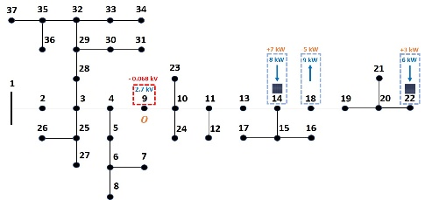




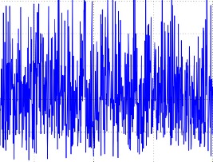
Enhancing resilience of distribution grid with high PV penetration
How can we use PV systems to react quickly to assure
service at critical locations?
Energy services at strategic location
Developed analytical Probabilistic framework for voltage sensitivity analysis (PVSA). [1,2]
Leverage PVSA and Information theoretic metrics to derive novel voltage influencing score (VIS).[3]
VIS for identifying dominant voltage influencer nodes and clustering of network.
Control power at DVI nodes to quickly restore voltages at strategic locations.
[6 ] S. Munikoti, B. Natarajan, K. Jhala and K. Lai, "Probabilistic Voltage Sensitivity Analysis to Quantify Impact of High PV Penetration on Unbalanced Distribution System," in IEEE Transactions on Power Systems, doi:10.1109/TPWRS.2021.3053461.
[7] S. Munikoti, K. Jhala, K. Lai and B. Natarajan, "Analytical Voltage Sensitivity Analysis for Unbalanced Power Distribution System," 2020 IEEE Power & Energy Society General Meeting (PESGM), Montreal, QC, Canada, 2020, pp. 1-5, doi: 10.1109/PESGM41954.2020.9282112.
[8 ] S. Munikoti, M. Abujubbeh, K. Jhala and B. Natarajan,” Analytical and Information Theoretic Method for Identifying Dominant Voltage Influential Nodes” in IEEE Transactions on Power Systems. (under review)
Notes:
I have also worked in a project where we have developed an analytical probabilistic framework for voltage sensitivity analysis which does not rely on scenario based simulations to quantify voltage change.
Then, we leverage PVSA with information theoretic metrics to derive a novel voltage influencing score that quantifies voltage influencing capacity of active node on other nodes of the network.
The VIS score is used to rank the nodes and identify the most dominant voltage influencer nodes for a particular strategic location/node.
The power can be efficiently controlled at these DVI nodes to quickly restore voltage services a strategic locations of the network and thus enhance system resilience.

Slide 11
Thank you

Slide 12
Backup slides

