Slide 1

Water Quality Anomaly Detection & Health Risk Predictor
A Full Stack AI Platform with ML-Based Anomaly Detection and AI-Powered Health Risk Analysis
-By Faraz

Slide 2

The Human Cost of Contaminated Water
Global Impact (WHO data)
2 Billion
485,000
People consuming water contaminated with biological waste..
Preventable deaths annually from diarrhoeal diseases (cholera, typhoid, dysentery).
Local Crisis in India (NITI Aayog data)
37.7 Million
Vulnerability: Children under five face the highest mortality risk, alongside severe long-term neurological risks from heavy metals like lead and arsenic.
People affected by waterborne diseases annually.

Slide 3






A Reactive, Delayed, and Manual Paradigm
The Critical Gap: Exposure Window
Contamination Occurs
By the time laboratory results return and authorities respond,
large populations have already been exposed.
Lab Report Arrives
Key Failures
Reactive: Responses only occur after an outbreak has begun, rather than preventing it.
Infrequent: Periodic sampling leaves long blind spots.
Slow: Results take days or weeks to process.

Slide 4
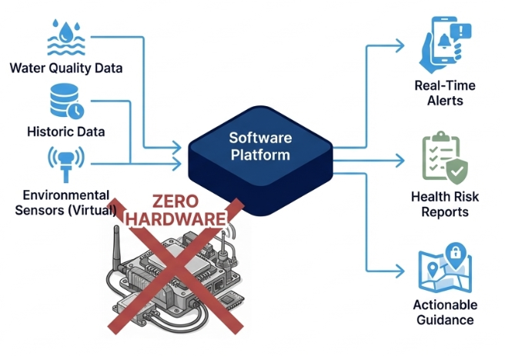
An Intelligent, Software-Only Solution
Core Concept:
A full-stack web platform combining ML anomaly detection
and AI health risk analysis to democratise water quality
monitoring.
The Differentiator:
Achieves real-time monitoring, intelligent anomaly detection,
and actionable guidance entirely through software—eliminating
the dependency on physical IoT infrastructure and making it
accessible to resource-constrained environments.

Slide 5







Core System Objectives
Five core capabilities that enable intelligent water quality monitoring
Obj 5: Real-Time Dashboard
Visualisations, anomaly feeds, and automated alerts.
Obj 4: AI Integration
Obj 3: Risk Scoring
Claude API for human-readable health risk assessments.
0–100 composite scoring based on WHO and BIS thresholds.
Obj 2: ML Detection
Obj 1: Multi-Source Ingestion
Isolation Forest & Z-score analysis across 8 parameters.
Manual, CSV, and automated API synchronisation.

Slide 6
A Modern, Scalable Technology Stack
Frontend
ML Microservice
  01
React 18, Vite, Tailwind CSS, Recharts.
Fast, component-based visualisation
  04
Python 3.11, FastAPI, scikit-learn
Async type-safe endpoints
Backend API
AI Analysis
  02
  05
Node.js 20, Express 4, node-cron
Lightweight orchestration
Anthropic Claude API
Superior contextual health domain reasoning
Database
Security
  03
  06
PostgreSQL 15
ACID compliance, strong typing for scientific data
JWT, bcrypt
Stateless, scalable authentication

Slide 7

End-to-End Data Flow
2. Normalisation
4. Flagging
6. Streaming
Backend validates and maps data to the Postgres schema.
Anomalies recorded; alert engine triggered if thresholds are breached.
Real-time health assessment streamed back to the backend.
1. Ingestion
3. ML Scoring
5. AI Analysis
7. Visualisation
Data enters via form, CSV, or cron job.
Python service calculates Isolation Forest anomalies and risk scores.
Flagged parameters passed to Claude API for evaluation.
React dashboard updates with risk gauges, radar charts, and alerts.

Slide 8




DELIVERING BROAD STAKEHOLDER VALUE
Stakeholder
Current Challenge
Proposed Benefit
  Urban Households
No visibility into tap safety.
  Instant risk scoring and health guidance.
  Rural Communities
No lab infrastructure.
  Free software-based monitoring.
  Municipal Authorities
Manual, delayed reporting.
  Automated alerts and trend analysis.
  Health Departments
Reactive outbreak response.
  Predictive early-warning systems.

Slide 9

THANK YOU

