Slide 1

Open Source

Slide 2

Open Source embodies the principles of openness, community, and empowerment, unlocking the potential for individuals and communities to collaborate, create, and make a positive impact on the world.

Slide 3
Open Source Software
Free to Use
Free to Modify
Free to Distribute

Slide 4
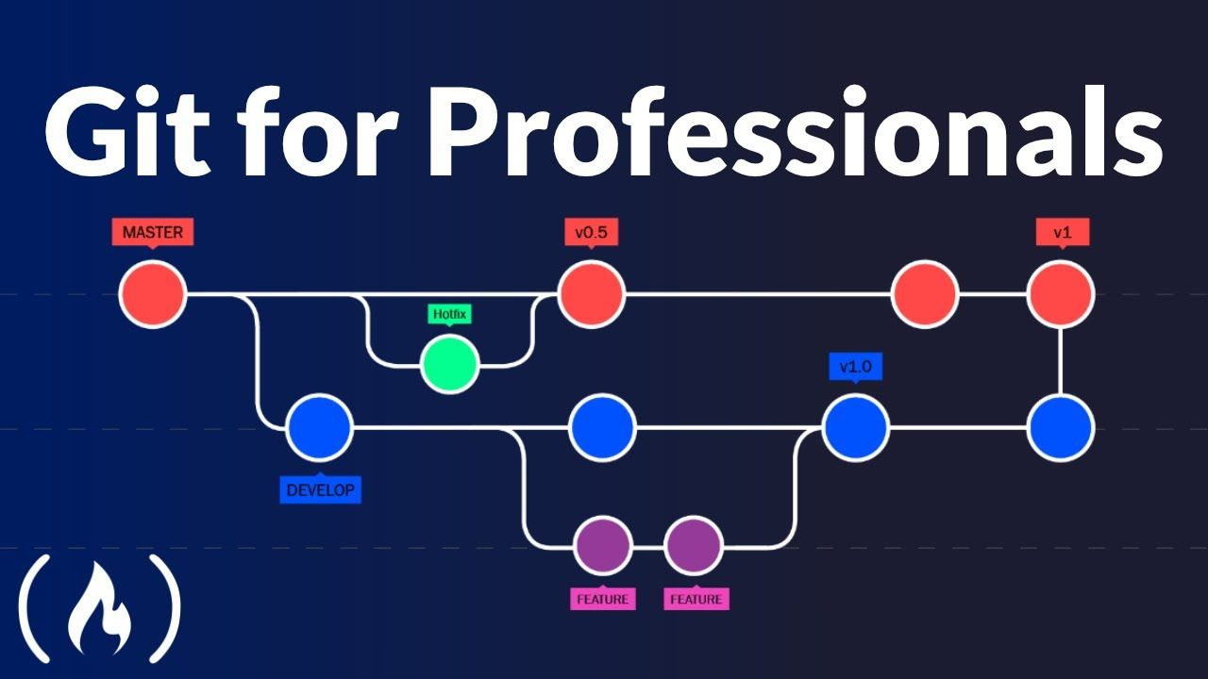

Slide 5
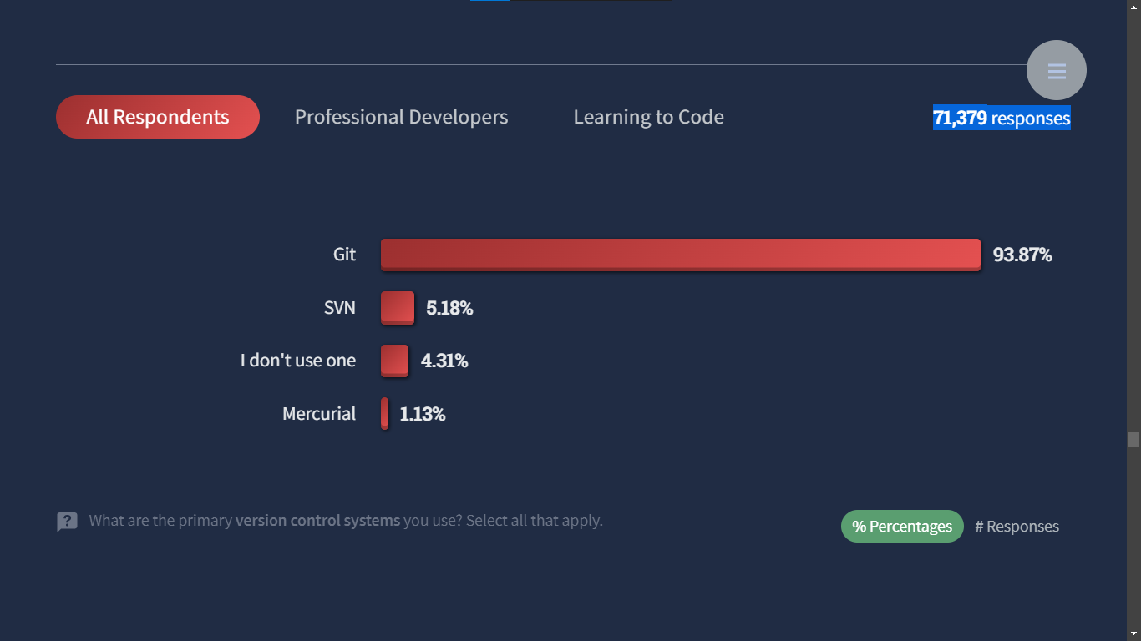

Slide 6
People
Today, more than 94 million developers are on GitHub

Slide 7
Projects
There are about 128 Million
Open-Source Projects on GitHub.

Slide 8
Contributions
There are 413 million contributions were made to open source projects on GitHub in 2022.

Slide 9
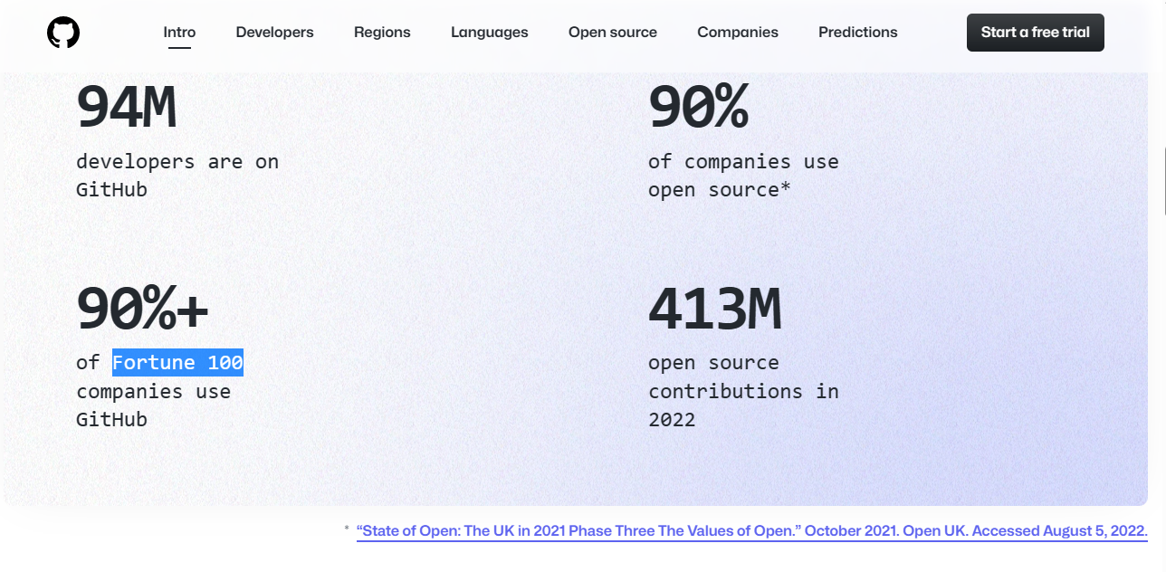

Slide 10

1.3 million packages

Slide 11
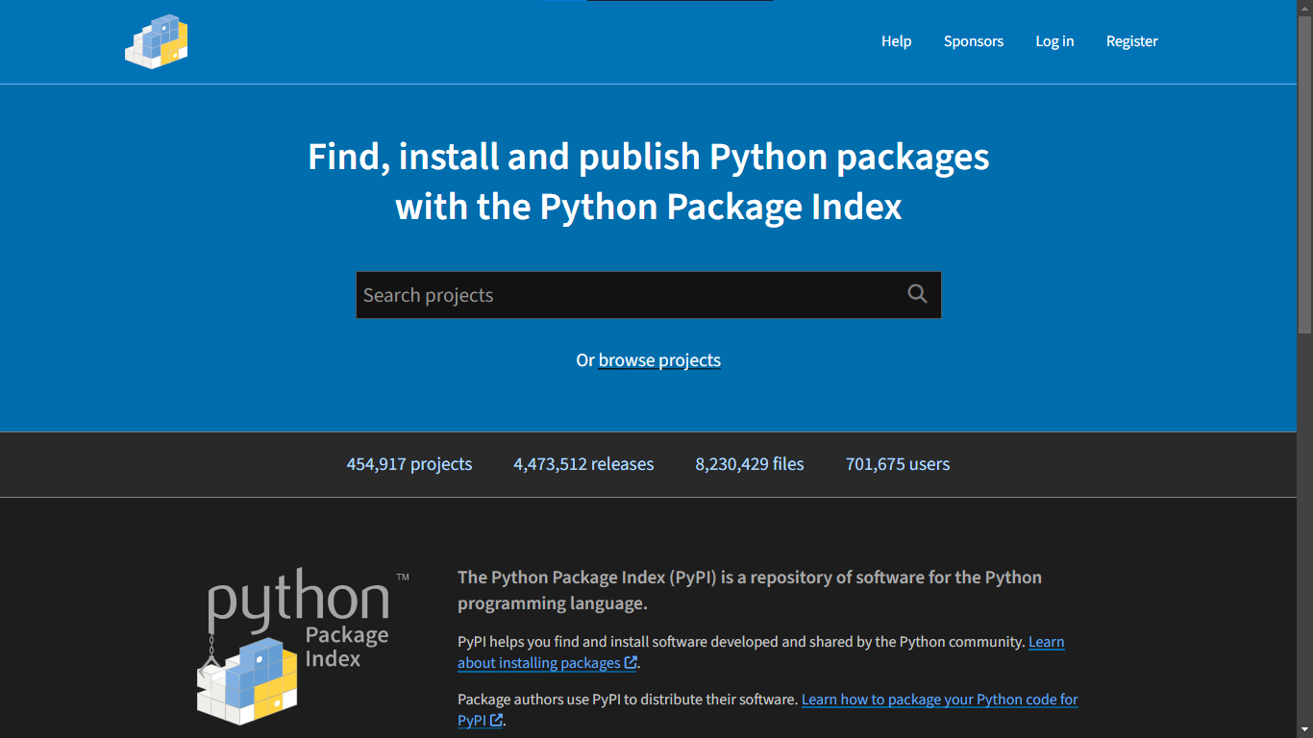

Slide 12


Slide 13
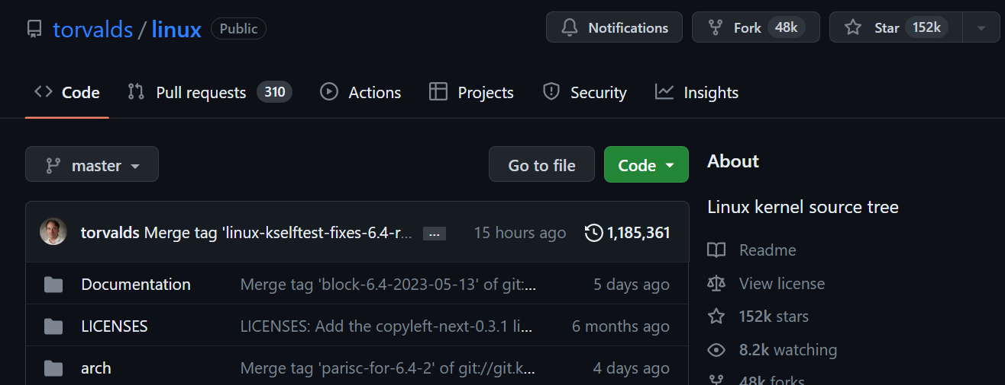

Slide 14
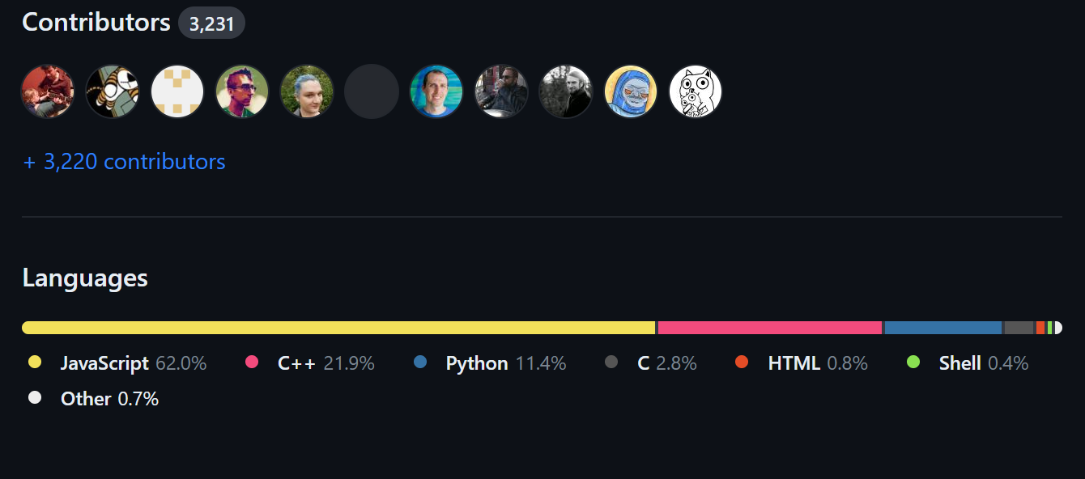

Slide 15
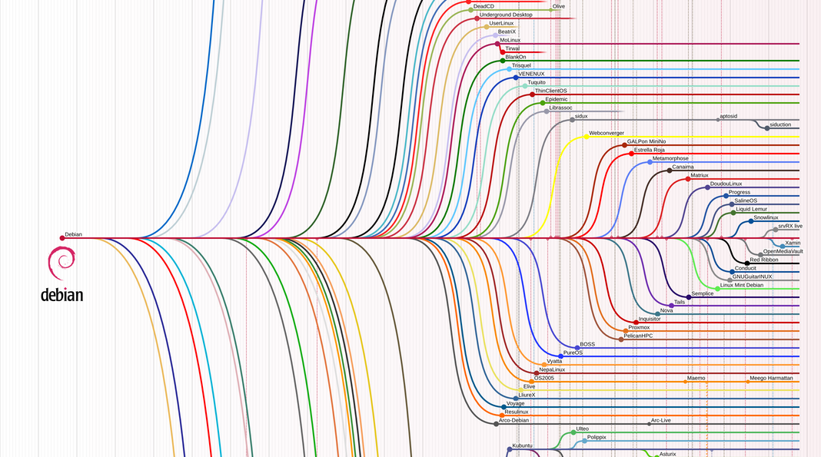

Slide 16
Popular Open Source Project
Mozilla Fire Fox
Node, Python, Flutter, React, ReactNative, Next.js, Git, Twitter, VsCode, VLC, Blender, OBS-Studio, Andriod, Linux.

Slide 17
Resume https://github.com/jaffarabbas

Slide 18
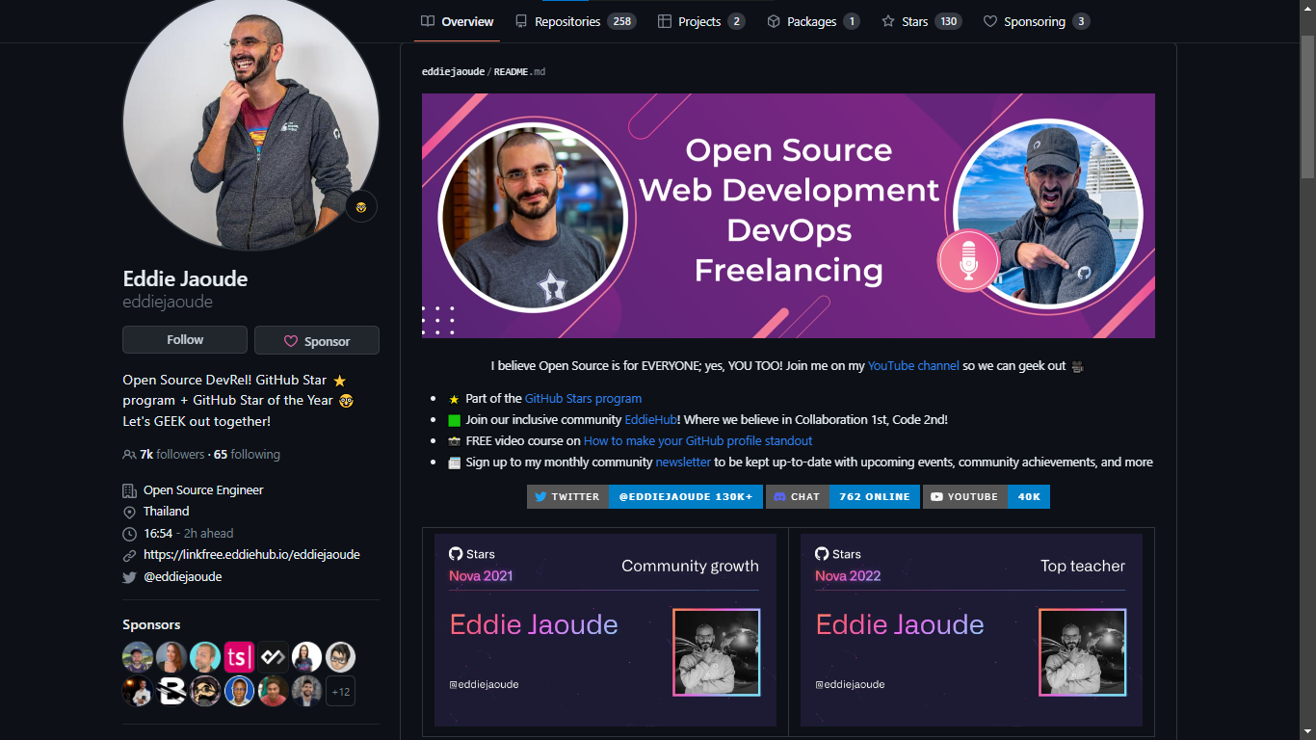

Slide 19
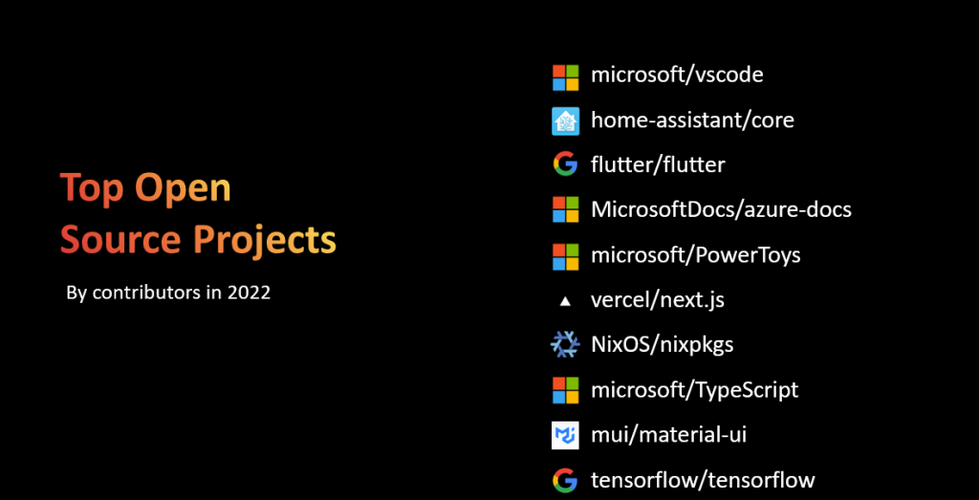

Slide 20

Thank you

