Slide 1
Tech-Edge Lab
Topic: -
Generative AI & Intelligent Application Development Bootcamp
Sub-topic:-
Industry-Oriented Training Program on LLMs, AI Tools, AI Agents & Vibe Coding

Slide 2
Module 2:- AI Foundations
Lecture 3:- How AI works(
training, inference, datasets, parameters, tokens, context window, chatgpt token prediction)

Slide 3
Index
S.No. | Topic
1. | Human learning Vs AI learning
2. | Data, Datasets, training
3. | Parameters
4. | Small Model Vs Large Model
5. | Inference
6. | Token, token prediction
7. | Context window
8. | Complete AI workflow
9. | Class Challenge
10. | Industry Oriented patterns
11. | Activity

Slide 4
Recap
Yesterday we learned
AI
ML
DL
NLP
Computer Vision
Robotics
Generative AI
We know ChatGPT is AI...
But how does ChatGPT actually learn?

Slide 5
Activity 1
Q- How did you learn to ride a bicycle?

Slide 6
Answers:-
Practice
Mistakes
Parents
Experience
Now connect
Humans learn from experience.
AI learns from data.

Slide 7
Human Learning vs AI Learning
Human | AI
Books | Dataset
Practice | Training
Memory | Parameters
Thinking | Inference
Speaking | Generated Output
Every AI model goes through a learning process just like students preparing for exams.

Slide 8
What is Data?
Examples
Images
Books
Websites
Videos
Audio
Code
Without data,
AI cannot learn.

Slide 9
Activity
Q- Can AI learn if no data exists?
A- Yes/No

Slide 10
Dataset
Definition
A dataset is a collection of organized data used to train an AI model.
Examples
Millions of books
Wikipedia
Research papers
Source code
Images
Conversations

Slide 11
Activity 2
Q- Think 20 images of cats and dogs (or simple examples).
Q- How will AI distinguish cats from dogs?

Slide 12
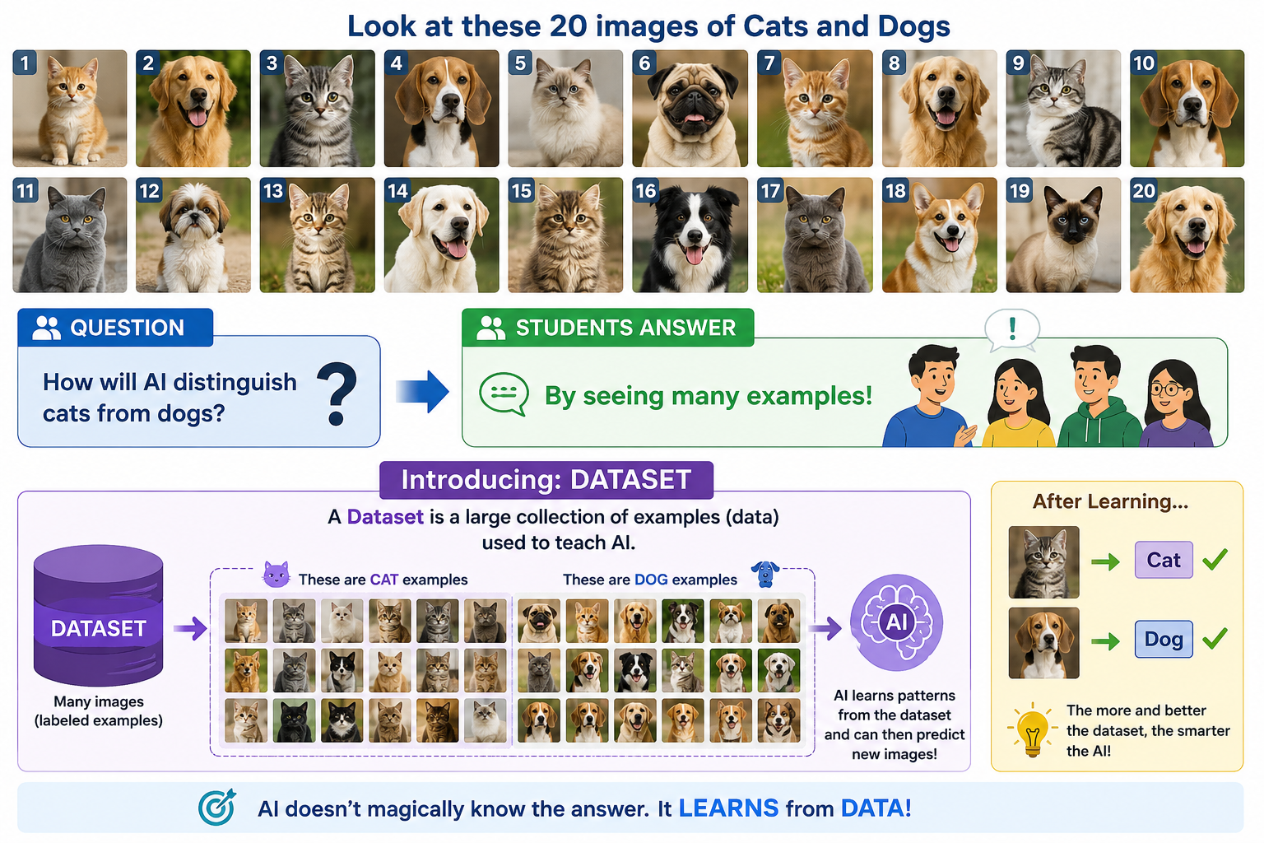

Slide 13
Training
Training is the process where AI learns patterns from data.
Dataset
↓
Training
↓
AI Model
Example:-
Students
↓
Study books
↓
Exam
AI
↓
Reads dataset
↓
Learns patterns

Slide 14
Activity
Q- How many times do students revise before exams?
A-

Slide 15
“AI also repeats training many times.”
Real Example:-
ChatGPT was trained on
Books
Websites
Code
Articles
Research Papers
Millions/Billions of examples.

Slide 16
Discussion
Q- Why does ChatGPT know Java?
A-

Slide 17
A-
Because someone programmed Java?
No.
It learned from huge datasets containing Java code.

Slide 18
Parameters
Definition
Parameters are the values AI adjusts during training to improve predictions.
In Simple terms
Parameters = AI's memory of what it has learned.

Slide 19
Activity
Q- When you prepare for exams? What stays in your brain?
A-

Slide 20
A-
Knowledge.
Similarly,
AI stores learned patterns in parameters.

Slide 21
Small Model vs Large Model
Example-
Small model
Knows basic English.
Large model
Knows
Programming
Medicine
Law
Mathematics
History
Multiple languages

Slide 22
Activity
Q- Who can answer more questions?
Class 5 student
or
BCA graduate?

Slide 23
Inference
Definition
Inference is the process of using learned knowledge to answer a new question.
Diagram
Training
↓
Model Ready
↓
User asks question
↓
Inference
↓
Answer

Slide 24
Activity
Q- Try to think training happens once or every question?
A-?

Slide 25
A-
Training:- One huge process.
(example is that feeding a specific model to solve all data structure related coding machine round questions)
Inference:- Every time you ask a specific question
(ask give some specific question on linked list asked in interviews)

Slide 26
Activity
Q- Categorize following activity into training or inference?
A-
Reading textbooks | ?
Writing exams | ?
Chatgpt answering | ?
Teaching a ChatGpt new model | ?

Slide 27
Answers:-
Reading textbooks | Training
Writing exams | Inference
Chatgpt answering | Inference
Teaching a ChatGpt new model | Training

Slide 28
Tokens
Definition
AI does not read words. It reads tokens.
Examples
"ChatGPT is amazing"
Break into:-
Chat
GPT
is
Amazing
(Not exact tokenization—just for understanding.)

Slide 29
Activity
Q- Split different sentences of you choices into pieces (tokens).
A-
compare with AI tokenization.

Slide 30
Token Prediction
ChatGPT predicts one token at a time.
Live Demo:-
Type:- "The capital of India is“ Stop.
Q- What comes next?
A-
Explain
ChatGPT predicts exactly like this.

Slide 31
Activity
Q- Given five incomplete sentences. Predict next word.
The Incomplete Sentences:-
"The dog barked at the..."
"She lost her car..."
"He took a deep..."
"Please turn off the..."
"The sun started to...“
A-
Then ask ChatGPT.
Compare.

Slide 32
Answers
sentences | Student prediction | ChatGpt prediction
The dog barked at the..." | cat / mailman / squirrel | cat / mailman / squirrel
She lost her car..." | keys | keys
He took a deep..." | breath / sigh | breath / sigh
Please turn off the..." | lights / TV / stove | lights
The sun started to...“ | set / rise / shine | set / rise / shine

Slide 33
Context Window
Definition
Context Window is the amount of information AI can remember during one conversation.
Example
Conversation
Question 1
↓
Question 2
↓
Question 3
↓
AI remembers previous questions.

Slide 34
Activity
Memory Game: Hobby chain
Student 1: "I like cricket.”
Student 2: "I like cricket, ______.”
Student 3: "I like cricket, ______, and ______.“
The Breakdown: Eventually, the list gets too long
Humans also have limited memory.
AI has context limits too.

Slide 35
Why ChatGPT Sometimes Forgets
Reasons:-
Long conversations
Context limit reached
New chat
Incomplete prompt
Q- Has anyone noticed ChatGPT forgetting earlier messages?

Slide 36
Live Demo of chatGpt forgets context
Open ChatGPT
"My name is Rahul."
Then
"What is my name?"
Works.
Now open new chat.
Ask again.
It forgets.
- understand context.

Slide 37
Complete AI Workflow
Data
↓
Dataset
↓
Training
↓
Parameters
↓
Trained Model
↓
Prompt
↓
Inference
↓
Token Prediction
↓
Generated Answer

Slide 38
Activity
Q- explain how complete AI workflow works in your own words.

Slide 39
Class Challenge
Q- Give 5 scenarios. Identify these :
Dataset
Training
Inference
Tokens
Context Window
Scenarios:-
Google Translate
ChatGPT
Face Unlock

Slide 40
Scenarios | Dataset | Training | Inference | Tokens | Context window
G translate | Millions of paired sentences translated by humans expert | AI studies these pairs | App instantly generates english version of students text | Individual word or sub-words | Specific paragraph being translated, to ensure words are interepreted accordingly

Slide 41
ChatGpt | Terabytes of public internet texts, books | Model run in supermarket for months | The chatbot generates the functional code on the screen in real-time | Chunks of text or code (roughly 4 characters each) that the model reads and outputs. | The maximum length of the conversation history the chatbot can remember at once.

Slide 42
Face unlock | Generic facial databases used by manufacturers, | The phone's neural chip learns the permanent mathematical landmarks of the user's facial structure. | The front camera scans the face in the dark and decides whether to unlock. | Small pixel patches or coordinate coordinates mapped out across the user's eyes, nose, and jaw. | The single live camera frame or brief video burst captured at that exact moment.

Slide 43
Industry Connection
Q- Where are these concepts used?
ChatGPT
Gemini
Claude
GitHub Copilot
Perplexity
Cursor
AI Agents
All follow the same basic learning pipeline.

Slide 44
Key Takeaways
AI learns from datasets.
Training is learning.
Inference is answering.
Parameters store learned knowledge.
Tokens are the units AI processes.
Context Window determines how much AI remembers.
ChatGPT predicts one token at a time.

