Slide 1
Module 2:- AI Foundation
Lecture 5:-
Deep Learning & Neural Networks
Understanding the Technology Behind Modern AI
CNN • RNN • LSTM • Backpropagation • Forward Pass • AI Applications

Slide 2
Slide 1 – Why Deep Learning?
Traditional Programming
Rules + Data
↓
Output
Machine Learning
Data + Labels
↓
Learn Rules
Deep Learning
Raw Data
↓
Automatically Learns Features
↓
Prediction

Slide 3
Why Deep Learning? Learns directly from large datasets No manual feature engineering Excels at images, speech, text, and video Foundation of modern AI systems Examples: ChatGPT Google Lens Face Unlock Tesla Autopilot

Slide 4
Slide 2 – Evolution of AI
Artificial Intelligence
│
Machine Learning
│
Deep Learning
│
Transformers
│
Large Language Models
│
ChatGPT
Every generation solved limitations of the previous one.

Slide 5
Slide 3 – What is Deep Learning?
Definition
Deep Learning is a subset of Machine Learning that uses Artificial Neural Networks with multiple hidden layers to automatically learn hierarchical patterns from data.
Characteristics
Data-driven
Multiple hidden layers
Learns features automatically
Requires GPUs
Handles unstructured data

Slide 6
Slide 4 – Human Brain vs Artificial Neural Network
Human Brain | Neural Network
Neurons | Artificial Neurons
Synapses | Weights
Learning | Training
Memory | Parameters
Decision | Prediction

Slide 7
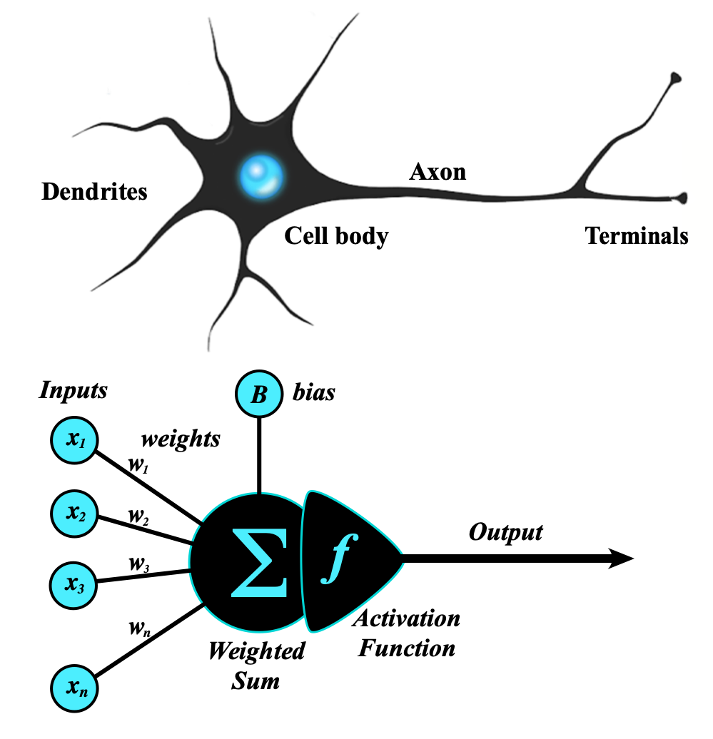

Slide 8

Slide 5 – Artificial Neuron
Every neuron receives inputs multiplies by weights adds bias
passes through activation produces output
Terms:-
Input
Weight
Bias
Activation
Output

Slide 9
Input (x): The incoming data or signals. If you are training a model to predict house prices, the inputs might be numbers representing Square Footage or Number of Bedrooms.
Weight (w): The importance or strength assigned to an input. If Square Footage matters significantly more than the color of the front door, the model assigns a much larger weight value to square footage.
Bias (b): An extra value added to the sum. It acts like an offset, shifting the entire mathematical relationship up or down to ensure the model fits the data accurately, even if all inputs are zero.

Slide 10
Activation Function (f): A mathematical formula that decides whether the neuron should "fire" (and how strongly).
Common types include ReLU, Sigmoid, and Tanh.
Output (y): The final signal calculated by the neuron. This value is either sent to the next layer of neurons or serves as the network's final prediction.

Slide 11
Numerical Example
Imagine a neuron deciding if a house price will be high based on two inputs:
Inputs (x):
x1 = 3 (Rooms)
x2 = 2 (Bathrooms)
Weights (w):
w1 = 0.5 (Importance of rooms)
w2 = 0.8 (Importance of bathrooms)
Bias (b): -1.0 (Offsets the calculation)
Activation Function: ReLU (If the total is negative, output is 0. Otherwise, keep the number).

Slide 12
Step-by-Step Calculation:
Multiply & Sum: (3 x0.5) + (2 x 0.8) = 1.5 + 1.6 = 3.1
Add Bias: 3.1 + (-1.0) = 2.1
Activation (ReLU): Since 2.1 is positive, it stays 2.1.
Output: 2.1

Slide 13
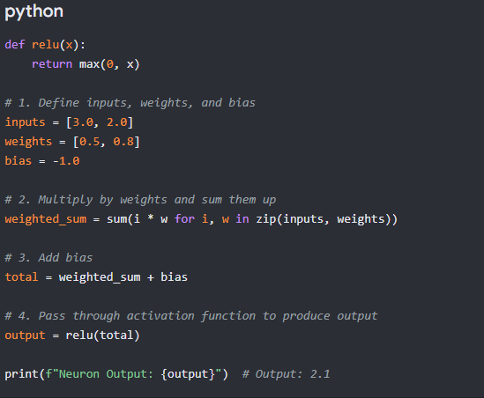

Slide 14
Slide 6 – Neural Network Architecture
Input Layer
↓
Hidden Layer
↓
Hidden Layer
↓
Output Layer

Slide 15
Input Layer
Receives raw data
Example
Pixels
Hidden Layer
Extracts patterns
Output Layer
Final prediction

Slide 16
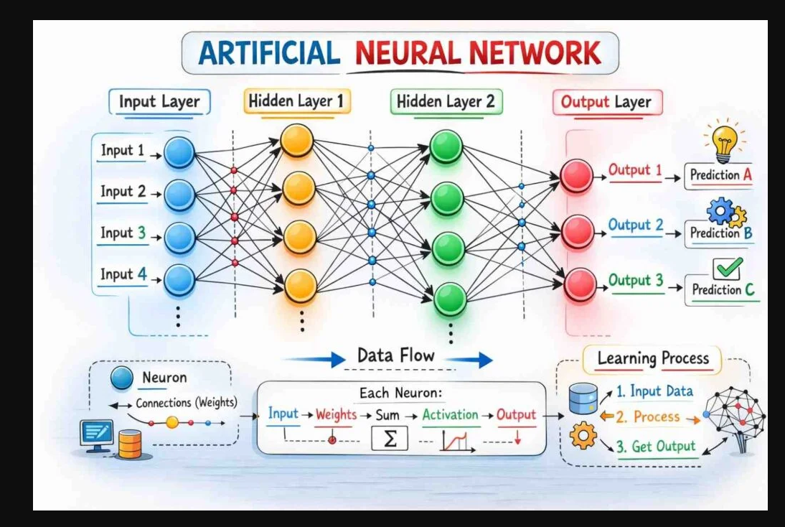

Slide 17
Slide 7 – Hidden Layers
Layer 1
Learns edges
↓
Layer 2
Learns textures
↓
Layer 3
Learns shapes
↓
Layer 4
Learns complete object

Slide 18
Example
Image
↓
Edges
↓
Eyes
↓
Face
↓
Person

Slide 19
Slide 8 – Forward Propagation
Input
↓
Layer 1
↓
Layer 2
↓
Layer 3
↓
Prediction
Definition
Forward propagation is the process where data flows from input to output to generate a prediction.

Slide 20
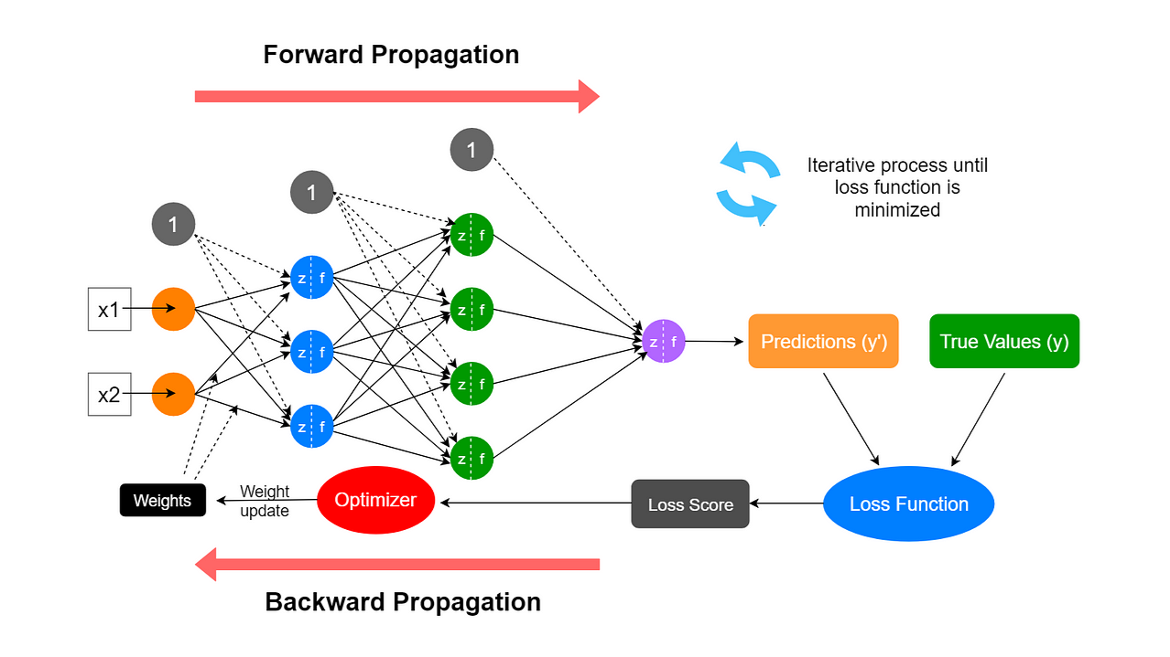

Slide 21
Slide 9 – Loss Function
Prediction
↓
Compare with Actual
↓
Calculate Error
Example
Predicted:- Dog
Actual:- Cat
↓
High Error
Loss measures how wrong the prediction is using methods like:-
Mean Squared Error
Cross Entropy

Slide 22
Backpropagation
Prediction
↓
Loss
↓
Backpropagation
↓
Update Weights
↓
Better Prediction
Definition
Backpropagation updates network weights to minimize prediction error.
Example:-
Learning = Repeated correction

Slide 23
Slide 11 – Training Process
Dataset
↓
Forward Pass
↓
Prediction
↓
Loss
↓
Backpropagation
↓
Update Parameters
↓
Repeat

Slide 24
Batch: A chunk (or group) of data fed into the network simultaneously. Example: If you have 10,000 images and train using subsets of 100 images at a time, the "batch size" is 100.
Iteration: The number of times a "parameter update" (the loop described above) is performed. Example: If processing 10,000 images in batches of 100, you must repeat the loop 100 times (= 100 iterations) to process all the data.
Epoch: A unit representing one complete pass through the entire training dataset. Example: Once all 10,000 images have been used (taking 100 iterations), "1 epoch" is complete. To make the model smarter, this process is typically repeated over dozens or hundreds of epochs.

Slide 25
Imagine you are preparing for a massive final exam by studying a 1,000-page textbook.
Epoch: Reading the entire textbook from cover to cover exactly one time.
Batch: The number of pages you choose to read at a single time before taking a short break (e.g., 100 pages per study session).
Iteration: The actual study session itself. Every time you finish a batch of 100 pages and pause to think about what you learned, you have completed one iteration.

Slide 26
Slide 12 – Activation Functions
Purpose
Introduce non-linearity. Activation functions introduce non-linearity. They bend, curve, and twist the data graph. This allows the AI to learn complex, wavy, and intricate patterns.
Types
Sigmoid
ReLU
Tanh
Softmax
ReLU is most common today.
No mathematics.

Slide 27
Slide 13 – CNN
Convolutional Neural Network
Specialized for images.
Architecture
Image (the raw data)
↓
Convolution (Scanning the image to look for specific patterns.)
↓
Pooling (Reducing the size of the data while keeping the important parts.)
↓
Fully Connected Layer (The final reasoning step where all clues are combined.)
↓
Prediction(The output decision.)

Slide 28
Simple Everyday Analogies for Each Step
Image
Analogy: A large crime scene photo handed to a detective.
Filters
Analogy: A small, magical magnifying glass slid across the photo. It glows only when it passes over specific shapes like sharp noses or round eyes.
Feature Maps
Analogy: A notepad of clues created by the magnifying glass, marking down exactly where those special shapes and lines were found.

Slide 29
Pooling
Analogy: Squinting your eyes at the notepad. It blurs out the tiny, useless details and leaves only the biggest, most important clues on a smaller page.
Classification
Analogy: The final detective report. The brain puts all the remaining clues together and makes a final guess: "This is a picture of Cat Burglar A!"

Slide 30
Slide 14 – CNN Working
Image
↓
Filters
↓
Feature Maps
↓
Pooling
↓
Classification
CNN automatically detects
Edges
Corners
Shapes
Objects

Slide 31
Slide 15 – Pooling Layer
Purpose
Reduce image size while preserving important information.
Types
Max Pooling
Average Pooling
Benefits
Faster computation
Less memory
Better generalization

Slide 32
Slide 16 – RNN Recurrent Neural Network
Designed for sequential data.
Word₁
↓
Word₂
↓
Word₃
↓
Prediction
Applications
Language Translation
Speech Recognition
Text Prediction

Slide 33
Slide 17 – Limitation of RNN
Problem
Long-term dependencies.
Example
The boy who won the competition after several rounds received his prize.
The network may forget "The boy"

Slide 34
Slide 18 – LSTM
Long Short-Term Memory
Adds memory cells.
Input
↓
Forget Gate
↓
Input Gate
↓
Output Gate
↓
Prediction

Slide 35
Purpose
Remember important information over long sequences.
Applications
Translation
Voice Assistant
Time Series
Speech Recognition

Slide 36
CNN | RNN | LSTM
Images | Sequential Data | Long Sequential Data
Parallel | Sequential | Sequential
Face Recognition | Translation | Chatbot Memory
Computer Vision | Speech | Weather Prediction

Slide 37
Slide 22 – Industry Deep Learning Stack
Python
↓
NumPy
↓
Pandas
↓
TensorFlow / PyTorch
↓
CUDA (parallel computing model, NVIDIA)
↓
GPU
↓
Model Training
↓
Deployment
↓
API
↓
Application

Slide 38
Slide 23 – Future
ANN
↓
CNN
↓
RNN
↓
LSTM
↓
Transformers
↓
LLMs
↓
AI Agents
↓ AGI?
Transition
"Today we understood how Deep Learning works. In the next lecture, we'll explore Transformers, the breakthrough architecture that powers ChatGPT, Gemini, Claude, and modern Large Language Models."

Slide 39
Slide 24 – Key Takeaways
Deep Learning is a subset of Machine Learning.
Neural Networks are inspired by the human brain.
Hidden layers learn increasingly complex features.
Forward Propagation makes predictions.
Loss measures error.
Backpropagation improves the model.
CNN excels at images.
RNN processes sequences.
LSTM handles long-term dependencies.
Modern LLMs are based on Transformers, not RNNs or LSTMs.

