Slide 1
Tech-Edge Lab
Topic: -
Generative AI & Intelligent Application Development Bootcamp
Sub-topic:-
Industry-Oriented Training Program on LLMs, AI Tools, AI Agents & Vibe Coding

Slide 2
Module 1:- AI industry and Careers
Lecture 2:- AI Ecosystem: Understanding AI, ML, Deep Learning, NLP, Computer Vision, Robotics & Generative AI

Slide 3
Index
S.No. | Topic
1. | AI Ecosystem & Diagram
2. | AI
3. | Types of AI
4. | Machine Learning(ML Workflows) & Types
5. | Deep learning
6. | Artificial Neural Network (ANN or NN)
7. | ML Vs DL
8. | Natural Language learning(NLP)
9. | NLP task
10. | Computer vision(CV) & its task
11. | Robotics
12. | Gen AI and its working, tradition AI Vs Gen AI
13. | AI Ecosystem Comparison, Real World Example
14. | Future of AI and takeaways

Slide 4
Recap: Introduction to AI World
Yesterday We Learned:
Why AI is important
AI career opportunities
AI vs Traditional Programming
Role of AI in software development
Today:
How different AI technologies work together.

Slide 5
Activity
Name 3 AI applications you used today.
Name | AI Feature used in that

Slide 6
What is an Ecosystem?
Definition
An ecosystem is a group of technologies that work together to create intelligent systems.
Human Intelligence Example:
Human uses:
Eyes → Seeing
Ears → Listening
Brain → Thinking
Memory → Learning
Decision Making → Action
AI systems also combine multiple technologies.

Slide 7
Artificial Intelligence
|
--------------------------------
| |
Machine Learning Rule Based AI
|
Deep Learning
|
-------------------------
| |
NLP Computer Vision
|
Generative AI
|
AI Applications
|
Robotics

Slide 8
Important Points AI is the biggest field. ML is a technique to achieve AI. Deep Learning is a powerful ML method. NLP helps machines understand language. Computer Vision helps machines see. Generative AI creates new content. Robotics combines AI with machines.

Slide 9
Human:
Parts → Field of AI
Eyes →?
Brain → ?
Memory → ?
Learning → ?
Language → ?
Decision → ?

Slide 10
Answers
Eyes → Computer Vision
Brain → AI
Memory → Data
Learning → Machine Learning
Language → NLP
Decision → AI Algorithms

Slide 11
Activity 1
Identify the Technology
students:
1) Face Unlock
Answer: ?
2) Google Translate
Answer: ?
3) ChatGPT
Answer:
?
4) Self-driving Car
Answer:
?

Slide 12
Answers
Face Unlock
Answer: Computer Vision + Deep Learning
Google Translate
Answer: NLP
ChatGPT
Answer:
NLP + Deep Learning + Generative AI
Self-driving Car
Answer:
Computer Vision + ML + Robotics

Slide 13
Artificial Intelligence (AI)
Definition
Artificial Intelligence enables machines to perform tasks that normally require human intelligence.
AI Capabilities
Learning
Reasoning
Planning
Decision Making
Problem Solving
Examples
Google Maps
Siri
Alexa
ChatGPT
Recommendation Systems

Slide 14
Activity 2
Is it AI or Not?
Example AI? (Yes/No)
Calculator
Google Maps
YouTube Recommendation
Simple ATM Machine
ChatGPT
Snapchat Filters
TV Remote control

Slide 15
Example | Is It AI ?
Calculator | No
Google Aps | Yes
You tube recommendation | Yes
Simple ATM machine | No
Chat Gpt | Yes
Snapchat Filters | Yes
TV Remote Control | No

Slide 16
Types of AI
1. Artificial Narrow Intelligence (ANI):- Artificial Narrow Intelligence (ANI), or weak AI, refers to AI systems designed to excel at a single, highly specific task.
Examples:
Most AI today.
ChatGPT
Google Translate
Alexa
2. Artificial General Intelligence (AGI)
AI system which develop Human-level intelligence.
Not achieved yet.
3. Artificial Super Intelligence (ASI)
AI beyond human intelligence.
Future concept.

Slide 17
Machine Learning
Definition
Machine Learning allows computers to learn from data without being explicitly programmed.
Traditional Programming
Rules + Data (C tokens, function, keywords)
Program
Output (sum.c , cal.c)
Machine Learning
Data + Output Examples (C tokens, function, keywords + examples)
ML Model (supervised, unsupervised, reinforcement)
Learn Rules

Slide 18
Example: Spam Detection
Traditional Approach:
Create rules:
Contains "free money"
Unknown sender
Suspicious links
Problem:
* Too many rules.
Machine Learning:-
Give thousands of emails.
AI learns patterns.

Slide 19
Types of Machine Learning
Supervised learning
Unsupervised learning
Reinforcement learning’
Supervised Learning
Learning with labelled data.
Examples:
Spam Detection
Disease Prediction
Student Result Prediction
Supervised learning is exactly like studying for an exam using a practice quiz that includes the answer key.

Slide 20
Unsupervised Learning
Finding hidden patterns.
Examples:
Customer Segmentation
Shopping Behavior
Unsupervised learning is like walking into a massive library where none of the books have covers, titles, or genres written on them—and there is no librarian or answer key to help you.
Instead of checking an answer key, the AI must explore the books on its own, find similarities in how they are written, and automatically group them together (e.g., grouping books with magic spells into one pile, and books with spaceships into another).

Slide 21
Reinforcement Learning
Learning through rewards.
Examples:
Game AI
Robots
Self-driving cars
Reinforcement learning is exactly like training a puppy to do a trick using treats and time-outs.
The AI does not have an answer key, and it does not have a teacher telling it what to do. Instead, it is dropped into an environment and forced to learn through trial and error. When it does something right, it gets a "reward" (a digital treat). When it crashes or fails, it gets a "punishment" (a penalty score).

Slide 22
Activity 3
Q- Which ML type is used?
1) Predict house price
Answer: ?
2) Group customers based on shopping
Answer: ?
3) Robot learning walking
Answer: ?

Slide 23
Answers:-
Predict house price
Answer: Supervised
Group customers based on shopping
Answer: Unsupervised
Robot learning walking
Answer: Reinforcement

Slide 24
Machine Learning Workflow
Collect Data
↓
Clean Data
↓
Train Model
↓
Test Model
↓
Deploy
↓
Prediction

Slide 25
Example:
Student Placement Prediction
Input:
CGPA
Skills
Attendance
Projects
Output:
Placed / Not Placed

Slide 26
Deep Learning
Definition
Deep Learning is a subset of Machine Learning that uses artificial neural networks.
Inspired by human brain.
Used for:
Images
Voice
Video
Language
Examples:
Face Recognition
ChatGPT
Image Generation

Slide 27
Artificial Neural Network
Human Brain:
Neuron → Connection → Learning
AI:
Input Layer
↓
Hidden Layers
↓
Output Layer
More layers = Deep Learning

Slide 28
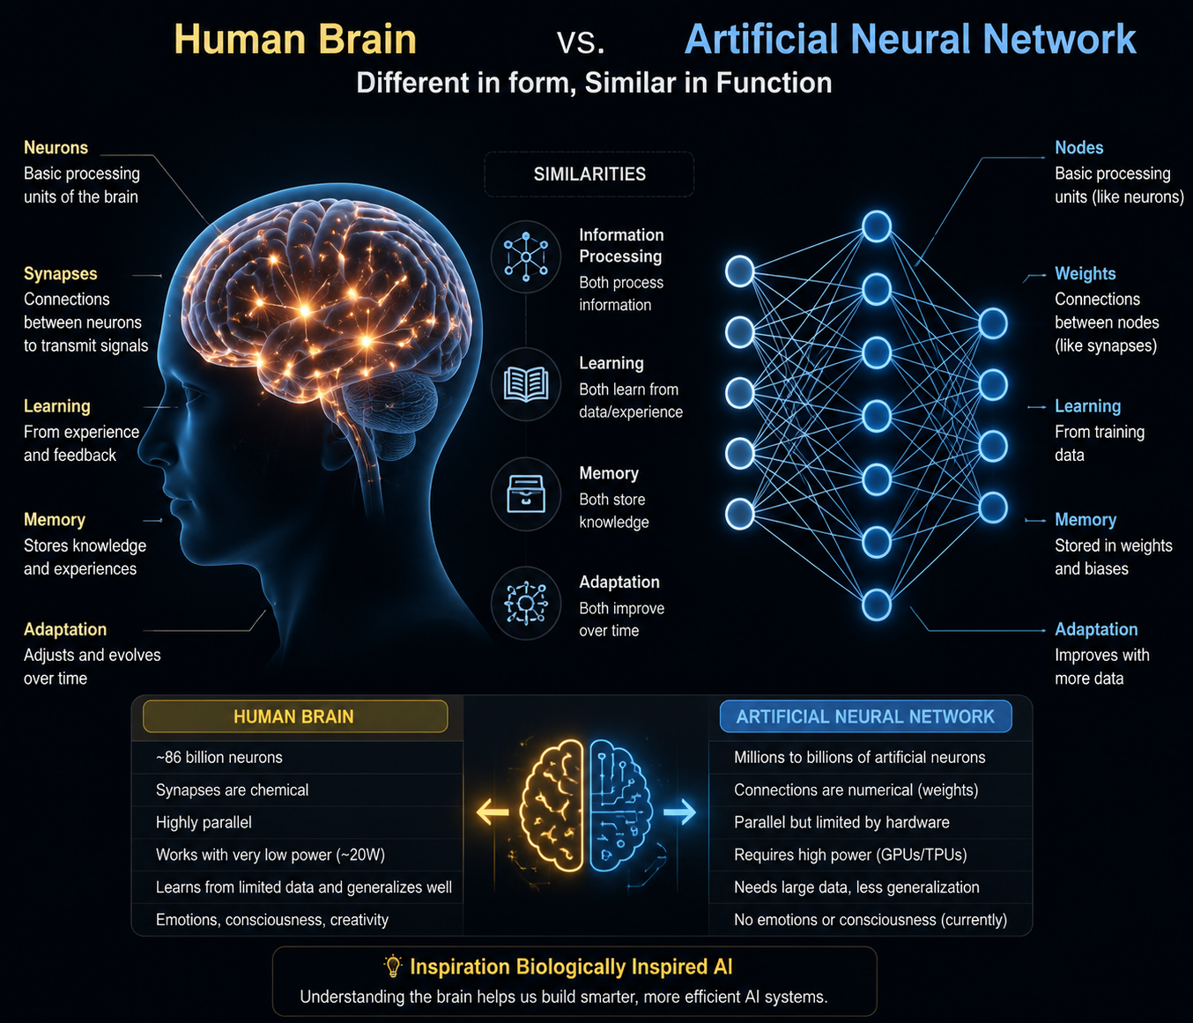

Slide 29
Activity 4
How does Face Recognition work?

Slide 30
Expected:
Camera
↓
Image
↓
AI Model
↓
Face Match

Slide 31
Facial recognition is exactly like how your smartphone uses geometry and connect-the-dots to recognize your face, turning your unique features into a secret, un-hackable password.
Instead of looking at you the way a human friend does, the AI sees your face as a massive math problem.
Here is the step-by-step process of how it works in four simple stages:
1. Step 1: Face Detection (Finding You)
2. Step 2: Facial Analysis (Connect-the-Dots)
3. Step 3: Creating your "Faceprint" (The Code)
4. Step 4: Making a Match (The Final Verdict)
Which AI Style Is This?
Facial recognition is a classic example of Supervised Learning!

Slide 32
NLP (Natural Language Processing)
Definition
NLP enables computers to understand and generate human language.
Examples:
ChatGPT
Google Translate
Voice Assistants
Chatbots

Slide 33
NLP Tasks
Translation
Text Generation
Summarization
Sentiment Analysis
Question Answering
Speech Recognition

Slide 34
Live Demo
Open ChatGPT:
Try:
1. "Translate this English sentence into hindi"
2. "Summarize this paragraph"
"Generate Java code"
3. Explain:
This is NLP.

Slide 35
Computer Vision
Definition
Computer Vision enables computers to understand images and videos.
Applications:
Face Unlock
Google Lens
Medical Imaging
OCR
Self-driving Cars

Slide 36
Computer Vision Tasks
Image Classification
Object Detection
Face Recognition
Image Segmentation
OCR

Slide 37
Robotics
Definition
Robotics combines AI with mechanical systems.
Components:
Sensors
Camera
Processor
Motors
AI Algorithms
Applications:
Factory Robots
Surgical Robots
Humanoid Robots

Slide 38
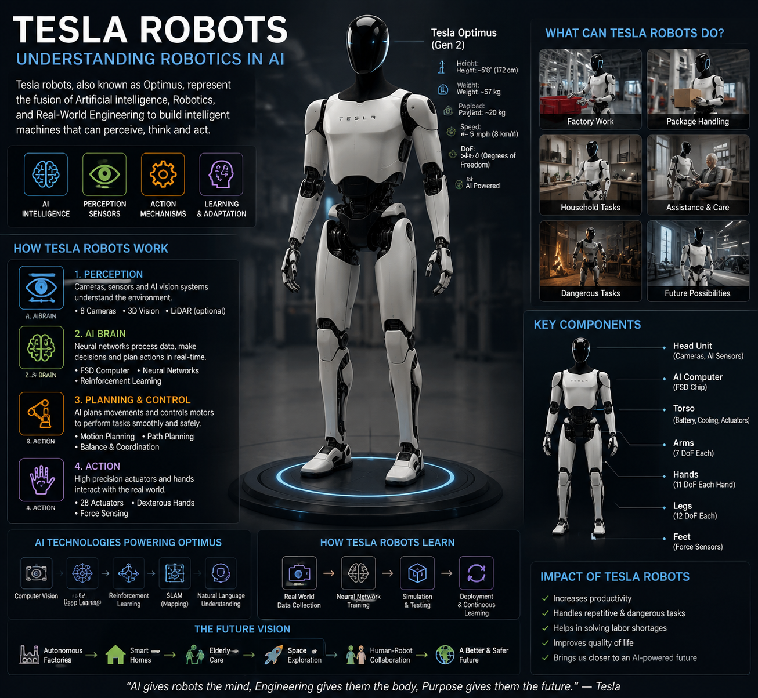

Slide 39
Generative AI
Definition
Generative AI creates new content.
Creates:
Text
Images
Videos
Audio
Code
Presentations
Examples:
ChatGPT
Gemini
Claude
GitHub Copilot

Slide 40
How Generative AI Works
Huge Data
↓
Deep Learning
↓
Large Language Model
↓
User Prompt
↓
Generated Output

Slide 41
Example:
Activity:- codex
Prompt:
"Create Java calculator program"
Output:
AI Generated Code

Slide 42
Traditional AI vs Generative AI
Traditional AI | Generative AI
Classifies | Creates
Predicts | Generates
Detects | Builds
Analyses | Designs
Example:
Spam Filter → Traditional AI
ChatGPT → Generative AI

Slide 43
Real World Example: Self Driving Car (Complete Part)
Camera
↓
Computer Vision
↓
Detect Objects
↓
Machine Learning
↓
Predict Movement
↓
AI Decision
↓
Robotics
↓
Brake / Accelerate

Slide 44
AI Technology Mapping Challenge
Divide students into groups.
Give applications:
YouTube Recommendation
Face Unlock
ChatGPT
Self Driving Car
Example:-
Amazon Recommendation
Students identify:- ?
AI technology involved.:- ?

Slide 45
Homework
AI Exploration Task
Find:
* One AI tool other than ChatGPT.
* What problem it solves.
* Which AI technology it uses.
Example:
Google Lens
Technology:- Computer Vision

Slide 46
Thank You
Questions and discussions

