Slide 1
Tech-Edge Lab
Topic: -
Generative AI & Intelligent Application Development Bootcamp
Sub-topic:-
Industry-Oriented Training Program on LLMs, AI Tools, AI Agents & Vibe Coding

Slide 2
Module 1:- AI industry and Careers
Lecture 2:- AI Ecosystem: Understanding AI, ML, Deep Learning, NLP, Computer Vision, Robotics & Generative AI

Slide 3
Index
S.No. | Topic
1. | AI Ecosystem & Diagram
2. | AI
3. | Types of AI
4. | Machine Learning(ML Workflows) & Types
5. | Deep learning
6. | Artificial Neural Network (ANN or NN)
7. | ML Vs DL
8. | Natural Language learning(NLP)
9. | NLP task
10. | Computer vision(CV) & its task
11. | Robotics
12. | Gen AI and its working, tradition AI Vs Gen AI
13. | AI Ecosystem Comparison, Real World Example
14. | Future of AI and takeaways

Slide 4
Recap: Introduction to AI World
Yesterday We Learned:
  Why AI is important
  AI career opportunities
  AI vs Traditional Programming
  Role of AI in software development
Today:
  How different AI technologies work together.

Slide 5
Activity
Name 3 AI applications you used today.
Name | AI Feature used in that

Slide 6
What is an Ecosystem?
Definition
An ecosystem is a group of technologies that work together to create intelligent systems.
Human Intelligence Example:
  Human uses:
  Eyes → Seeing
  Ears → Listening
  Brain → Thinking
  Memory → Learning
  Decision Making → Action
AI systems also combine multiple technologies.

Slide 7
Artificial Intelligence
|
--------------------------------
| |
Machine Learning Rule Based AI
|
Deep Learning
|
-------------------------
| |
NLP Computer Vision
|
Generative AI
|
AI Applications
|
Robotics

Slide 8
Important Points
AI is the biggest field.
ML is a technique to achieve AI.
Deep Learning is a powerful ML method.
NLP helps machines understand language.
Computer Vision helps machines see.
Generative AI creates new content.
Robotics combines AI with machines.

Slide 9
Human:
  Parts → Field of AI
  Eyes →?
  Brain → ?
  Memory → ?
  Learning → ?
  Language → ?
  Decision → ?

Slide 10
  Answers
  Eyes → Computer Vision
  Brain → AI
  Memory → Data
  Learning → Machine Learning
  Language → NLP
  Decision → AI Algorithms

Slide 11
Activity 1
Identify the Technology
students:
1) Face Unlock
Answer:
?
2) Google Translate
Answer:
?
3) ChatGPT
Answer:
  ?
4) Self-driving Car
Answer:
  ?

Slide 12
Answers
Face Unlock
Answer:
Computer Vision + Deep Learning
Google Translate
Answer:
NLP
ChatGPT
Answer:
NLP + Deep Learning + Generative AI
Self-driving Car
Answer:
Computer Vision + ML + Robotics

Slide 13
Artificial Intelligence (AI)
Definition
  Artificial Intelligence enables machines to perform tasks that normally require human intelligence.
AI Capabilities
  Learning
  Reasoning
  Planning
  Decision Making
  Problem Solving
Examples
  Google Maps
  Siri
  Alexa
  ChatGPT
  Recommendation Systems

Slide 14
Activity 2
Is it AI or Not?
Example AI? (Yes/No)
Calculator
Google Maps
YouTube Recommendation
Simple ATM Machine
ChatGPT
Snapchat Filters
TV Remote control

Slide 15
Example | Is It AI ?
Calculator | No
Google Aps | Yes
You tube recommendation | Yes
Simple ATM machine | No
Chat Gpt | Yes
Snapchat Filters | Yes
TV Remote Control | No

Slide 16
Types of AI
1. Artificial Narrow Intelligence (ANI):- Artificial Narrow Intelligence (ANI), or weak AI, refers to AI systems designed to excel at a single, highly specific task.
Examples:
Most AI today.
    ChatGPT
    Google Translate
    Alexa
2. Artificial General Intelligence (AGI)
  AI system which develop Human-level intelligence.
  Not achieved yet.
3. Artificial Super Intelligence (ASI)
AI beyond human intelligence.
Future concept.

Slide 17
Machine Learning
Definition
Machine Learning allows computers to learn from data without being explicitly programmed.
Traditional Programming
Rules + Data (C tokens, function, keywords)
Program
Output (sum.c , cal.c)
Machine Learning
  Data + Output Examples (C tokens, function, keywords + examples)
  ML Model (supervised, unsupervised, reinforcement)
  Learn Rules

Slide 18
Example: Spam Detection
Traditional Approach:
Create rules:
  Contains "free money"
  Unknown sender
  Suspicious links
Problem:
* Too many rules.
Machine Learning:-
    Give thousands of emails.
    AI learns patterns.

Slide 19
Types of Machine Learning
Supervised learning
Unsupervised learning
Reinforcement learning’
Supervised Learning
Learning with labelled data.
Examples:
Spam Detection
Disease Prediction
Student Result Prediction
Supervised learning is exactly like studying for an exam using a practice quiz that includes the answer key.

Slide 20
Unsupervised Learning
  Finding hidden patterns.
  Examples:
    Customer Segmentation
    Shopping Behavior
Unsupervised learning is like walking into a massive library where none of the books have covers, titles, or genres written on them—and there is no librarian or answer key to help you.
Instead of checking an answer key, the AI must explore the books on its own, find similarities in how they are written, and automatically group them together (e.g., grouping books with magic spells into one pile, and books with spaceships into another).

Slide 21
Reinforcement Learning
  Learning through rewards.
  Examples:
    Game AI
    Robots
    Self-driving cars
Reinforcement learning is exactly like training a puppy to do a trick using treats and time-outs.
The AI does not have an answer key, and it does not have a teacher telling it what to do. Instead, it is dropped into an environment and forced to learn through trial and error. When it does something right, it gets a "reward" (a digital treat). When it crashes or fails, it gets a "punishment" (a penalty score).

Slide 22
Activity 3
Q- Which ML type is used?
1) Predict house price
Answer:
?
2) Group customers based on shopping
Answer:
?
3) Robot learning walking
Answer:
?

Slide 23
Answers:-
Predict house price
Answer:
Supervised
Group customers based on shopping
Answer:
Unsupervised
Robot learning walking
Answer:
Reinforcement

Slide 24
Machine Learning Workflow
Collect Data
↓
Clean Data
↓
Train Model
↓
Test Model
↓
Deploy
↓
Prediction

Slide 25
Example:
Student Placement Prediction
  Input:
  CGPA
  Skills
  Attendance
  Projects
Output:
Placed / Not Placed

Slide 26
Deep Learning
Definition
Deep Learning is a subset of Machine Learning that uses artificial neural networks.
Inspired by human brain.
Used for:
Images
Voice
Video
Language
Examples:
Face Recognition
ChatGPT
Image Generation

Slide 27
Artificial Neural Network
Human Brain:
Neuron → Connection → Learning
AI:
  Input Layer
  ↓
  Hidden Layers
  ↓
  Output Layer
More layers = Deep Learning

Slide 28
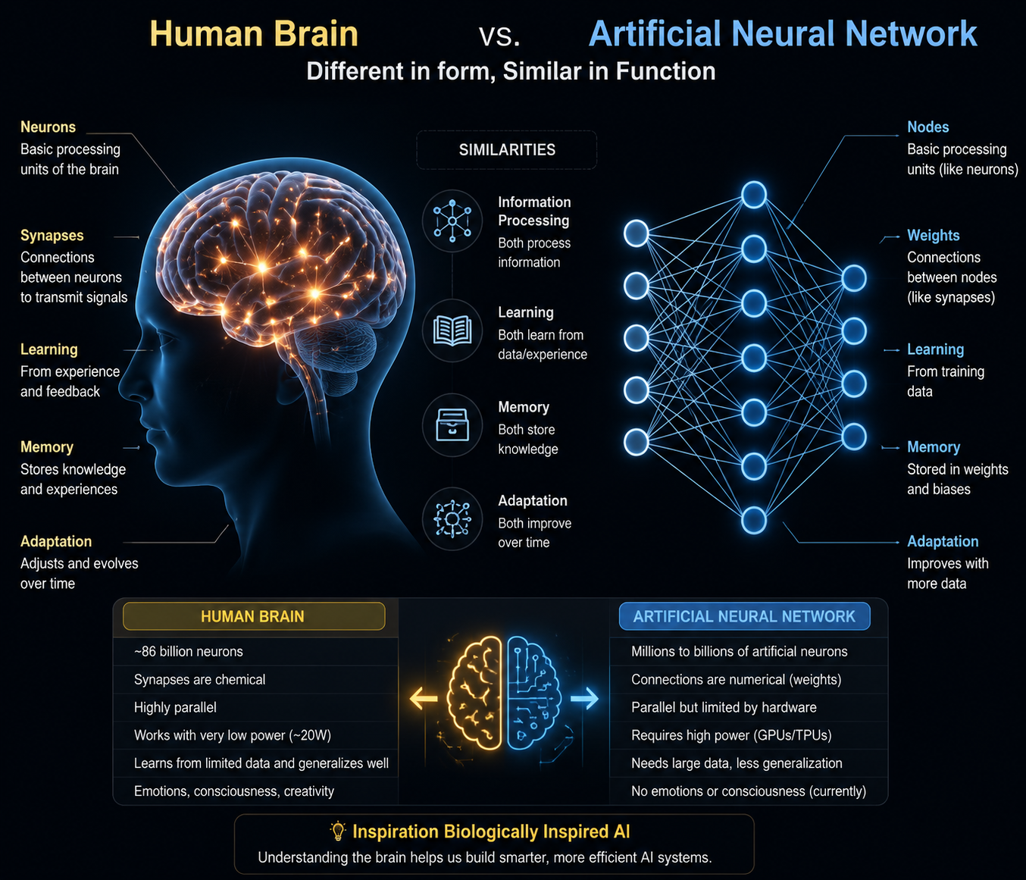

Slide 29
Activity 4
How does Face Recognition work?

