Slide 1
Slide 1 — Transformer Architecture
Understanding the Technology Behind Modern LLMs
From Text → Tokens → Attention → Transformer → LLM
Today we will understand:
How a Transformer processes text
Encoder and Decoder
Self-Attention
Query, Key, Value
Multi-Head Attention
Positional Encoding
Feed Forward Network
Masked Attention
How Transformers power modern LLMs

Slide 2
Input
Position
Self-attention
Query, Key , Value flow
Multihead attention
Tranformer block
Stacking layer
Encoder
Decoder
Cross attention
Complete architecture
GPT connections

Slide 3
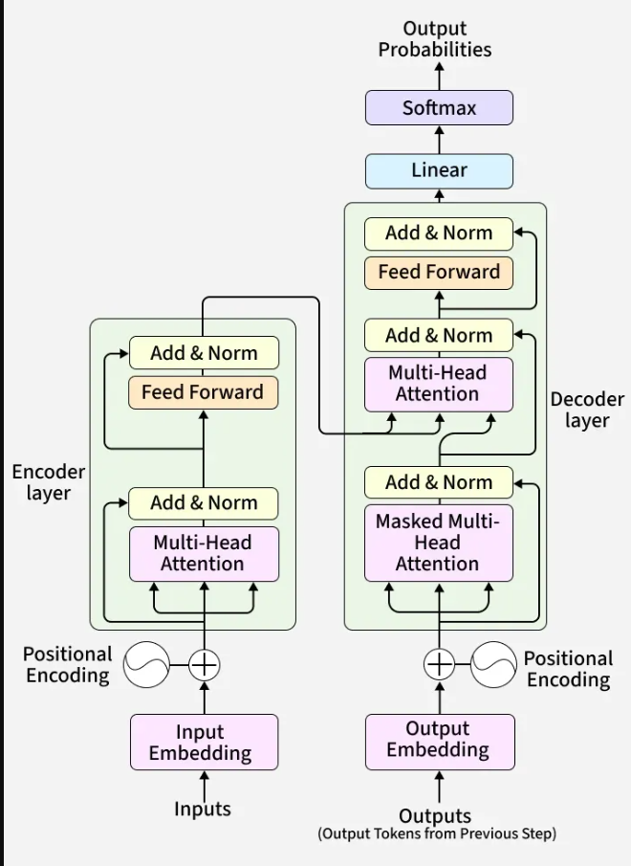

Slide 4
Slide 2 — The Big Picture
Q- What Happens When We Give Text to a Transformer?
Text
↓
Tokenization
↓
Embedding
↓
Positional Information
↓
Attention
↓
Neural Network Layers
↓
Output
Question
How does the model know which words are related?

Slide 5
Answer: Attention

Slide 6
Input
"The student submitted the project because he completed it.“
Question:
What does "it" refer to?
Project
The model needs to understand:
it ─────────→ project
Key Idea
A Transformer learns relationships between tokens.

Slide 7
PART 1 — INPUT
Slide 4 — Step 1: Tokenization
Text
"I love Artificial Intelligence.“
The text is converted into tokens:
I | love | Artificial | Intelligence
Depending on the tokenizer, a word can also be split into multiple subword tokens.
Why?

Slide 8
Neural networks work with numerical representations rather than raw text.

Slide 9
Slide 5 — Step 2: Embedding
Tokens are converted into numerical vectors.
Token
↓
Embedding
↓
Vector
Conceptually:
"cat" → [0.21, -0.45, 0.73, ...]
Important
These numbers are learned representations
.
They allow the model to work mathematically with language.

Slide 10
Slide 6 — Activity: Token → Meaning
Q- Which words are related?
"Python programmer writes Python code.“
A-
Discussion
How could a computer represent these relationships mathematically?

Slide 11
A-
Possible relationships:
Python ↔ programmer
Python ↔ code
programmer ↔ writes
A- Embeddings + Attention

Slide 12
PART 2 — POSITION
Slide 7 — Why Position Is Necessary
Consider:
Dog bites man.
and
Man bites dog.
Same words.
Different meaning
.
Why?
Because word order matters.

Slide 13
Slide 8 — Positional Encoding
The Transformer needs information about token position.
The → Position 1
cat → Position 2
sat → Position 3
on → Position 4
the → Position 5
mat → Position 6
Conceptually:
Token Embedding + Position Information
↓
Transformer Input
Key Idea
Embedding = What is the token?
Position = Where is the token?

Slide 14
Slide 9 — Activity: Rearrange the Sentence
Q- AI, students, learn, BCA
create a meaningful sentence.

Slide 15
Example:
BCA students learn AI.
Now rearrange:
AI learns BCA students.
Question
Why did the meaning change?
Position/order matters.

Slide 16
PART 3 — SELF-ATTENTION
Slide 10 — The Core Idea
Self-Attention
Each token can look at other tokens in the same sequence and determine which ones are relevant.
Example:
"The cat sat on the mat."
For "sat", relevant words may include:
cat
mat
Conceptually:
cat ─────→ sat
sat ─────→ cat
sat ─────→ mat

Slide 17
Slide 11 — Human Attention
Read:
"The bank approved the customer's loan.“
What does bank mean?
A- Financial institution
Why?
Because surrounding words provide context:
bank
↓
approved
↓
customer
↓
loan
AI Analogy
Attention helps the model focus on relevant contextual information.

Slide 18
Slide 12 — Activity: Find the Important Words
Sentence:
"The AI engineer trained the model using a large dataset."
Q- Who trained the model?
AI engineer
Q- What was used?
Large dataset
Q- What was trained?
Model
AI engineer → trained
trained → model
model → dataset
These relationships are the kind of contextual relationships attention mechanisms help models represent.

Slide 19
PART 4 — QUERY, KEY, VALUE
Slide 13 — Q, K, V
Self-attention uses three learned projections:
Query — Q
What am I looking for?
Key — K
What information might be relevant?
Value — V
What information should I contribute?
Simple Analogy
Think about searching a library:
Query → What am I searching for?
Key → Which books match?
Value → Information from selected books

Slide 20
Slide 14 — Q, K, V Flow
Input Tokens
↓
Create Q, K, V
↓
Compare Q with K
↓
Attention Scores
↓
Softmax
↓
Weighted Values
↓
New Representation
Remember
Q finds relevance. K provides matching information. V provides the information that gets combined.

Slide 21
Slide 15 — Attention Scores
For the word "sat":
Token | Example Attention Score
The | 0.05
cat | 0.40
sat | 0.15
on | 0.05
the | 0.05
mat | 0.30
Interpretation
The model gives greater weight to tokens that are more relevant to the current token.
Note: Values shown are only for demonstration.

Slide 22
Slide 16 — Activity: Attention Detective
Sentence:
"The student opened the laptop because it was needed for the presentation.“
Question:
What could "it" refer to?
Identify the most relevant words.
What other words would you want the model to consider?

Slide 23
PART 5 — MULTI-HEAD ATTENTION
Slide 17 — Why Multiple Heads?
One sentence can contain many types of relationships.
Example:
"The bank approved the customer's loan because she had excellent credit."
Different attention heads may learn different patterns.
Head 1
bank → loan
Head 2
customer → she
Head 3
credit → excellent
Important
The exact patterns learned by individual heads are not manually assigned like this; these are simplified examples for understanding.

Slide 24
Slide 18 — Multi-Head Attention
Input
↓
┌───────────┼───────────┐
↓ ↓ ↓
Head 1 Head 2 Head 3
↓ ↓ ↓
Relationship Grammar Context
↓ ↓ ↓
└───────────┼───────────┘
↓
Combined
Simple Definition
Multi-Head Attention allows the model to learn multiple attention patterns in parallel.

Slide 25
PART 6 — TRANSFORMER BLOCK
Slide 19 — What Happens After Attention?
Attention produces contextual information.
But the Transformer needs additional processing.
Feed-Forward Network
Attention Output
↓
Feed-Forward Network
↓
Transformed Representation
Think of it as:
Attention → Understand relationships
Feed Forward → Further process the information

Slide 26
Slide 20 — Add & Norm
Residual Connection
The original information is combined with the processed information.
Original Input + Layer Output
↓
Updated Representation
Layer Normalization
Helps stabilize the network during training.
Together
Add & Norm

Slide 27
Slide 21 — One Transformer Encoder Block
Input
↓
Self-Attention
↓
Add & Norm
↓
Feed-Forward Network
↓
Add & Norm
↓
Output
Remember
This entire sequence is one Transformer Encoder Layer/Block.

Slide 28
PART 7 — STACKING LAYERS
Slide 22 — One Layer Is Not Enough
Modern Transformer models use many layers.
Input
↓
Transformer Layer 1
↓
Transformer Layer 2
↓
Transformer Layer 3
↓
Transformer Layer 4
↓
...
↓
Transformer Layer N
Why?

Slide 29
Each layer transforms the representations further.
Key Idea
More layers + more parameters + more training data + sufficient compute can enable increasingly capable models.

Slide 30
PART 8 — ENCODER Slide 23 — Encoder
Encoder = Process the Input
Input
↓
Embedding + Position Information
↓
Self-Attention
↓
Add & Norm
↓
Feed Forward
↓
Add & Norm
↓
Encoded Representation
Simple Explanation
The Encoder converts the input into contextual representations.

Slide 31
PART 9 — DECODERSlide 24 — Decoder
Decoder = Generate Output
The original Transformer decoder contains:
Masked Self-Attention
↓
Cross-Attention
↓
Feed Forward
Simple Idea
Encoder → Process input
Decoder → Generate output

Slide 32
Slide 25 — Masked Self-Attention
Suppose the model is generating:
"The cat is...“
When predicting the next token, it should not see future tokens.
The → can see The
cat → can see The + cat
is → can see The + cat + is
Future tokens:
❌ Hidden
Why?
To prevent the model from seeing the answer while learning/generating autoregressively.

Slide 33
Slide 26 — Activity: Don't Cheat!
Complete:
"The student opened the ______."
You must predict the next word, but you cannot see the future words.

Slide 34
Possible answers:
laptop
book
door
Notebook
Connection
This is the basic intuition behind causal/masked self-attention.

Slide 35
PART 10 — CROSS-ATTENTION
Slide 27 — Cross-Attention
In the original Encoder-Decoder Transformer:
The decoder can look at the encoder's output.
Example:
English
"I love AI."
↓
Encoder
↓
Representation
↓
Decoder
↓
Hindi "मुझे AI पसंद है"

Slide 36
Self-Attention
Looks within its own sequence.
Cross-Attention
Connects decoder processing with encoder representations.

Slide 37
PART 11 — COMPLETE ARCHITECTURE
Slide 28 — Original Transformer Architecture
INPUT
↓
Tokenization
↓
Embedding
+
Positional Encoding
↓
┌─────────┐
│ ENCODER │
│ │
│Self-Attention
│ ↓ │
│ Add&Norm │
│ ↓ │
│FeedForward
│ ↓ │
│ Add&Norm │
└────┬────┘
↓

Slide 38
Encoder Representation
↓
┌─────────┐
│ DECODER │
│ │
│Masked │
│Self-Attention
│ ↓ │
│Cross- │
│Attention
│ ↓ │
│FeedForward
└────┬────┘
      ↓
      Linear Layer
      ↓
      Softmax
      ↓
      Output Token

Slide 39
Slide 29 — Original vs Modern Transformers
Important!
The original Transformer:
Encoder + Decoder
But different models use different configurations.
Model | Architecture
BERT | Encoder-based
GPT | Decoder-only
T5 | Encoder-Decoder
Key Point
Transformer is an architecture family, not one fixed model.

Slide 40
PART 12 — GPT CONNECTION
Slide 30 — How GPT Generates Text
Prompt:
"Python is a“
Simplified process:
  Prompt
  ↓
  Tokenization
  ↓
  Embedding + Position
  ↓
  Transformer Decoder Layers
  ↓
  Masked Self-Attention

Slide 41
↓
Feed Forward
↓
Vocabulary Scores
↓
Probability Distribution
↓
Next Token
Possible prediction:
language
Then the process repeats.

Slide 42
Slide 31 — Next Token Prediction
Python is a
↓
Python is a language
↓
Predict next token
↓
Python is a language used
↓
Predict next token
↓
...
Important
GPT-style models generate text auto regressively by repeatedly predicting the next token based on the previous context.

Slide 43
Slide 32 — Transformer → LLM
Transformer Architecture
↓
Large Dataset
↓
Large-Scale Training
↓
Millions/Billions of Parameters
↓
Transformer-Based Model
↓
Large Language Model
↓
Generative AI Applications

Slide 44
Examples:
ChatGPT
Gemini
Claude
Coding assistants
AI applications

Slide 45
Slide 33 — Why Transformers Changed AI
RNN/LSTM
Sequential Processing
↓
Long-range dependency challenges
↓
Less parallelizable
Transformers
Self-Attention
↓
Token-to-token relationships
↓
Highly parallelizable training
↓
Better scaling
↓
Large Models

Slide 46
Result
Transformers became a foundation for modern large-scale AI and LLMs.

Slide 47
Slide 34 — Activity: Build a Transformer
Given cards:
Tokenization
Embedding
Position
Self-Attention
Query Key Value
Multi-Head Attention
Add & Norm
Feed Forward
Encoder
Masked Self-Attention
Cross-Attention
Decoder
Linear
Softmax

Slide 48
Task
Arrange them into the correct order.
Bonus
For every component, answer:
"Why does this component exist?"

Slide 49
Slide 35 — Final Challenge
Sentence:
"Transformers understand relationships between tokens using attention."
Explain:
What is a token?
What is embedding?
Why position?
What is self-attention?
What are Q, K and V?
Why multiple heads?
What does the feed-forward network do?
What is an encoder?
What is a decoder?
How does this connect to LLMs?

Slide 50
Slide 36 — Final Takeaways
Remember the Journey
TEXT
↓
TOKENS
↓
EMBEDDINGS
↓
POSITION
↓
SELF-ATTENTION
↓
Q + K + V
↓
MULTI-HEAD ATTENTION
↓
ADD & NORM
↓
FEED FORWARD
↓
STACKED TRANSFORMER LAYERS
↓
LLM
↓
GENERATIVE AI

Slide 51
One Sentence
A Transformer uses attention-based neural-network layers to build contextual representations of tokens and, depending on its architecture, understand, transform, or generate sequences.

