Slide 1

Big Java, Early Objects
Introduction

Slide 2
The Java Programming Language
Safe Portable
Platform-independent
Distributed as instructions for a virtual machine
Vast set of library packages Designed for the Internet

Slide 3
Java Versions
Version 1.0 | Year 1996 | Important New Features
1.1 | 1997 | Inner classes
1.2 | 1998 | Swing, Collections framework
1.3 | 2000 | Performance enhancements
1.4 | 2002 | Assertions, XML support
5
2004
Generic classes, enhanced for loop, auto-boxing, enumerations,
 |  | annotations
6 | 2006 | Library improvements
7 | 2011 | Small language changes and library improvements
8 | 2014 | Function expressions, streams, new date/time library
What is the current version of Java?

Slide 4
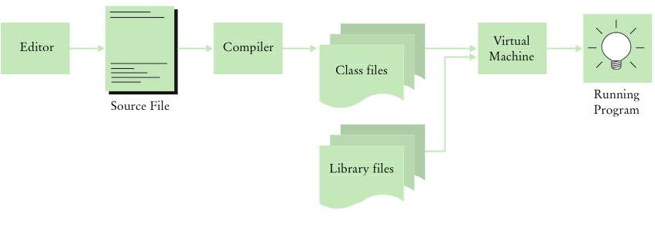
Becoming Familiar with Your Programming Environment
Java compiler translates source code into class files.
Class files contain instructions for the Java virtual machine.
From Source Code to Running Program

Slide 5
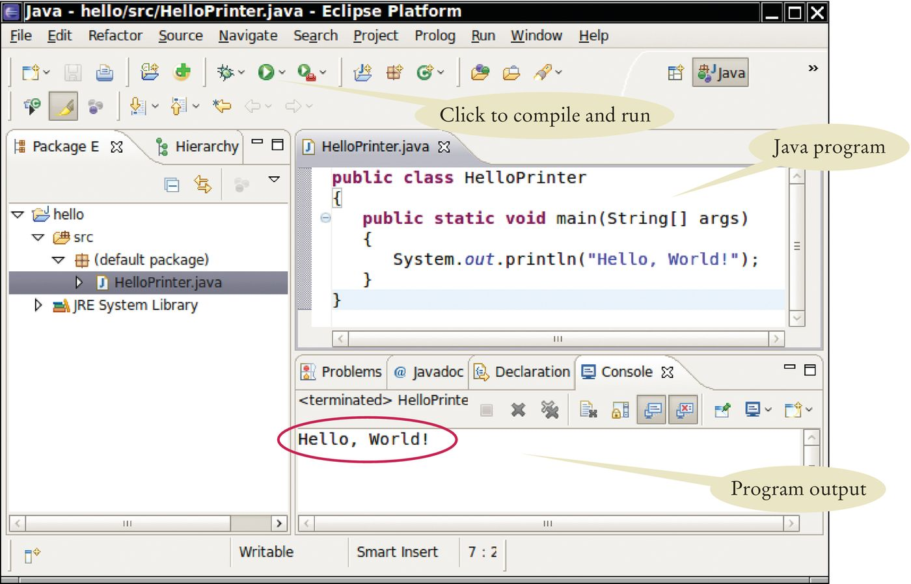
Becoming Familiar with Your Programming Environment
Figure 4 Running the HelloPrinter Program in an Integrated Development Environment

Slide 6
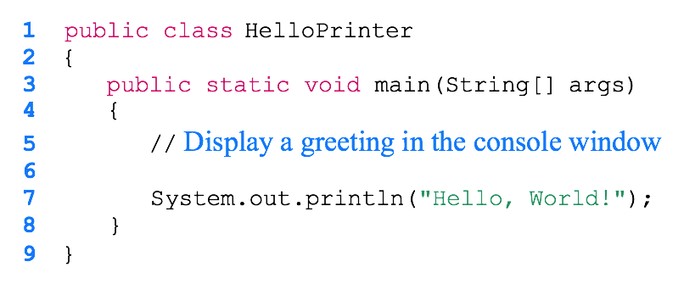
HelloPrinter.java
Java is CaSe sENsiTivE.

Slide 7
Analyzing Your First Program: Class Declaration
Classes are the fundamental building blocks of Java programs: Declaration of a class called HelloPrinter
public class HelloPrinter
In Java, every source file can contain, at most one public class.
The name of the public class must match the name of the file containing the class:
Class HelloPrinter must be contained in a file named HelloPrinter.java

Slide 8
Analyzing Your First Program: Methods
Each class contains declarations of methods. Each method contains a sequence of instructions.
A method contains a collection of programming instructions that describe how to carry out a particular task.
A method is called by specifying its name and its arguments.

Slide 9
Analyzing Your First Program: main Method
Every Java application contains a class with a main method
When the application starts, the instructions in the main method are executed

Slide 10
Analyzing Your First Program: Statements
The body of the main method contains statements. Our method has a single statement:
System.out.println("Hello, World!");
It prints a line of text:
Hello, World!

Slide 11
Analyzing Your First Program: Method Call
A method call:
System.out.println("Hello, World!");
A method call requires:
The method you want to use (in this case, System.out.println)
Any values the method needs to carry out its task enclosed in parentheses (in this case, "Hello, World!")
The technical term for such values is "Arguments"
Parameter
Argument

Slide 12
Analyzing Your First Program: Strings
String: a sequence of characters enclosed in double quotation marks:
"Hello, World!"

Slide 13
Analyzing Your First Program: Printing
You can print numerical values
System.out.println(3 + 4);
evaluates the expression 3 + 4 displays the number 7.
System.out.println method prints a string or a number and then starts a new line.
The sequence of statements
System.out.println("Hello");
System.out.println("World!");
Prints two lines
Hello
World!
There is a second method, System.out.print, that you can use to print an item without starting a new line

Slide 14
Errors
Compile-time error (syntax error)
is a violation of the programming language rules detected by the compiler.
System.ou.println("Hello, World!");
Run-time error (logic error)
causes a program to perform an action that the programmer did not intend.
System.out.println("Hello, Word!");
Exception: a type of Run-time error
Generates an error message from the Java virtual machine This statement
System.out.println(1 / 0)
Generates this run-time error message:
"Division by zero"

Slide 15
Self Check
Suppose you change println to printline in the HelloPrinter.java program. Is this a compile-time error or a run-time error?
Answer: This is a compile-time error. The compiler will complain that
System.out does not have a method called printline.

Slide 16
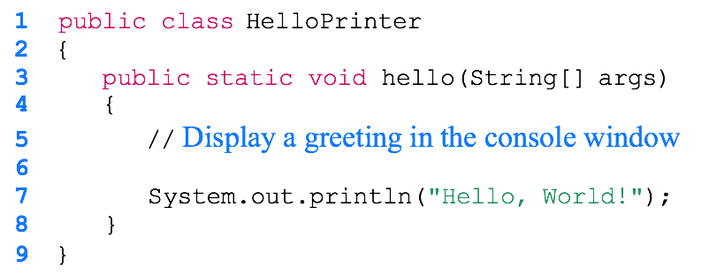
Self Check
Suppose you change main to hello in the HelloPrinter.java program. Is this a compile- time error or a run-time error?
Answer: This is a run-time error. It is perfectly legal to give the name hello to a method, so the compiler won't complain. But when the program runs, the virtual machine will look for a main method and won't find one.

Slide 17
The API Documentation
API: Application Programming Interface
API documentation: Lists classes and methods of the Java library
Application programmer: A programmer who uses the Java classes to put together a computer program (or application)
Systems Programmer: A programmer who designs and implements library classes such as PrintStream and Rectangle https://docs.oracle.com/en/java/javase/14/docs/api/index.html

Slide 18
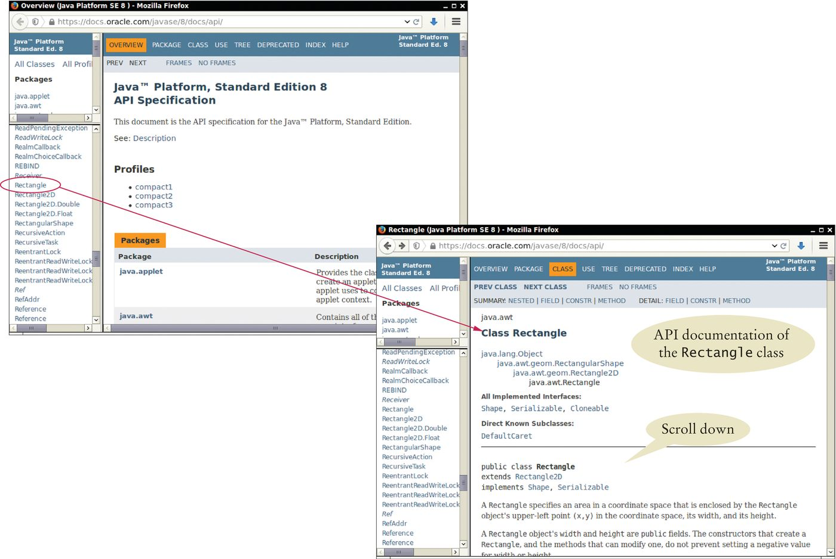
Browsing the API Documentation
Figure 13 The API Documentation of the Standard Java Library
Locate Rectangle link in the left pane Click on the link
The right pane shows all the features of the Rectangle class

Slide 19
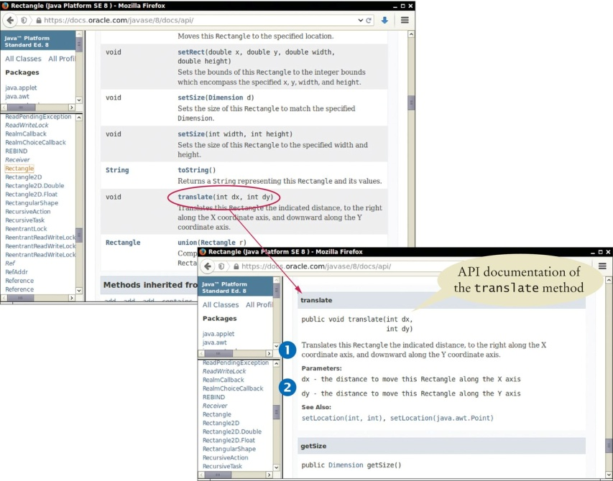
Browsing the API Documentation - Method Summary
Figure 14 The Method Summary for the Rectangle Class
The API documentation for each class has
A section that describes the purpose of the class Summary tables for the constructors and methods
Clicking on a method's link leads to a detailed description of the method

Slide 20
Browsing the API Documentation
The detailed description of a method shows:
The action that the method carries out
The types and names of the parameter variables that receive the arguments when the method is called
The value that it returns (or the reserved word void if the method doesn't return any value).

