Slide 1
60-141 Lecture 1: Functions
Process
C Library predefined, User defined functions
Dr. Robert Kent

Slide 2

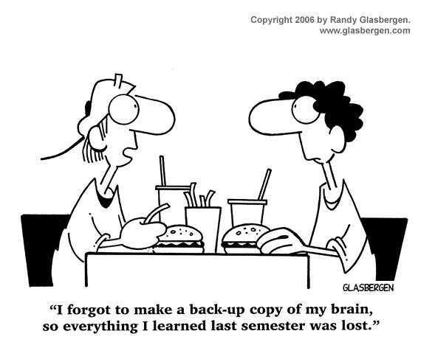
Review 60-140 (and 60-100 or 62-140)

Slide 3
Lecture 1: Outline
The function concept
C Library Functions
User Defined Functions
Storage Classes and Scope Rules
Summary

Slide 4
The function concept
F(x,y)
Process
The word function has different grammatical usages, all of which convey the notion of action, or performing something useful
The word is embedded in common (natural) language
The mosquito has a function in the ecosystem.
This car is functioning well.
The square root function applied to a number X obtains a number Y which, when multiplied by itself, reobtains X.
What are the functions of an operating system?

Slide 5
The function concept
F(x,y)
Process
From mathematics, we develop an appreciation of functions as formal objects, having
Names (descriptives)
square root cube logarithm integral
Well-defined by strict algebraic properties and algorithms, including limitations on applicability
Eg. The cube function applied to X is found by multiplying X by itself three times.
Eg. The set of all real square roots is determined over application of the square root function to the non-negative real numbers only.
Associated values whenever specific numeric values are applied
Eg. Applying the square root function to 4 returns the value 2.

Slide 6
The function concept
F(x,y)
Process
In computer science, programming languages have evolved to incorporate the concept of functions
As in mathematics, programming functions have
Names
Well defined logic that determines the actions to be performed
Limitations on applicability
Associated values when specific input parameters are applied
float Radius_of_circle_squared ( float X, float Y ) {
return X*X + Y*Y ;
}
F(x,y) = R ² = x ² + y ² for all (x,y) real
F(2,3) = 2 ² + 3 ² = 13

Slide 7
The function concept
F(x,y)
Process
Again, following mathematics, we inherit some functions with predefined names and definitions
Re-usable expertise
.... Standing on the shoulders of giants ....
But we may discover new functions that must be defined and named by user programmers
These also comprise the body of developing expertise
In this lecture we explore many facets of both predefined functions from the C library system, and also user defined functions that must be defined.

Slide 8
C Library Functions
Predefined Functions
Predefined process

Slide 9
C Library Functions
C libraries
C Compiler and Pre-processor
Operating Systems, Loaders and Linkers
Standard Input-Output Library <stdio.h>
Math Library <math.h>
Standard Utilities Library <stdlib.h>

Slide 10
C libraries
The C library system is designed to support special purpose programming needs, depending on the conceptual nature of the need.
The system is subdivided into specific libraries, each devoted to a particular topic (set of functions)
Each has its own name (eg. stdio.h)
Programs that refer to any function in a library must include all the functions in that library.
This strategy is based on the premise that most programming work that requires one function, most likely will also use the other functions
Since all function codes must be included in the fully compiled program, it is best to avoid unnecessary codes from other (non-included) libraries

Slide 11
C Compiler and Pre-processor
It is important to understand the role of the C compiler and pre-processor in how functions are handled
We have already seen in basic programs that in order to perform simple input (scanf) and output (printf) we must write the line of code:
#include <stdio.h>
This code provides a stated link to a file (called a header file - .h) that the compiler must know in order to properly translate references to functions defined within the library
stdio.h contains the definitions of some parts (stubs) of the functions defined within the standard input/output library
The actual executable files (already compiled) corresponding to each function (or the entire library) are known to the O/S.

Slide 12
C Compiler and Pre-processor
#include <stdio.h>
int main ( ) {
int V = 7 ;
.....
printf ( “Value = %d\n”, V ) ;
.....
return 0 ;
}
C program with function reference from standard I/O library
The actual machine code is filed elsewhere for location by the O/S
Compiled file for stdiolibrary
010000111101010101....
(printf machine code)
01110101010111111010....
.......
(scanf machine code)
1010101010111101011.....
File: stdio.h
.....
int printf ( char *S, void *V ) ;
.....
The C preprocessor looks for function definitions within stdio.h file

Slide 13
C Compiler and Pre-processor
#include <stdio.h>
int main ( ) {
int V = 7 ;
.....
printf ( “Value = %d\n”, V ) ;
.....
return 0 ;
}
C program with function reference from standard I/O library
The actual machine code is filed elsewhere for location by the O/S
Compiled file a.out
HEADER CODE:
Resources required, including machine codes for I/O.
PROGRAM MACHINE CODE:
11010010001011010.....
....
00010101001010101
Compiled file for stdiolibrary
010000111101010101....
(printf machine code)
01110101010111111010....
.......
(scanf machine code)
1010101010111101011.....
File: stdio.h
.....
int printf ( char *S, void *V ) ;
.....
The compiled program, a.out, contains translated machine codes for references to functions in the library, but the actual function machine codes are referenced in a part of a.out called the file header. They are not integrated with a.out until the program is loaded for execution.
The C preprocessor looks for function definitions within stdio.h file

Slide 14
Operating Systems, Loaders and Linkers
Operating Systems programs are responsible for managing the computer’s resources and how they are allocated, scheduled and used by user-programs
The request to load a program (a.out) for execution is done by entering the executable filename at the system prompt
%a.out
The O/S responds to this user request by looking at the file a.out in the user’s filesystem (what you are looking at when you log on) and verifying that it is an executable program
Otherwise, a system error message is outputted

Slide 15
Operating Systems, Loaders and Linkers
The O/S contains many programs that handle specific tasks:
The Resource Allocator reads and interprets the header part of the a.out file to determine which resources will be needed and how much RAM to allocate to the program
The Loader is responsible for finding all parts of the machine code files needed to complete the full user-program and place those files into RAM locations allocated for this purpose
The Linker is responsible for resolving all machine RAM addresses between the different files

Slide 16
Operating Systems, Loaders and Linkers
Res Alloc
Compiler
Loader
Final loaded, resolved executable process
User C program
a.out
Linker
stdio.h
stdio.h
C library system
DLL library system
math.h
math.h
stdlib.h
stdlib.h

Slide 17
Three Libraries
We will now turn our discussion to three of the C libraries
C libraries:
Standard Input/Output Library - stdio.h
Math Library – math.h
Standard Library – stdlib.h

Slide 18
Standard Input-Output Library <stdio.h>
As the name suggests, the Standard Input-Output Library header file <stdio.h> contains definitions (stubs) of several useful, predefined functions to perform input and output of characters
and constants such as EOF

Slide 19
Standard Input-Output Library <stdio.h>
The functions can be divided into categories based on whether
I/O involves a single character
I/O involves a string of characters that are not converted
I/O involves a string of character data that must be converted from character to internal machine representation (or vice versa)
Memory based conversions involving a string of character data that must be converted from character to internal machine representation (or vice versa)

Slide 20
Standard Input-Output Library <stdio.h>
Single character I/O is provided with two functions
putchar
char Ch ; .... Ch = ‘W’ ; .... putchar( Ch ) ; /* can output any valid character, including control */
getchar
char Ch ; .... Ch = getchar( ) ; /* can input any valid character, including control */
Both of these functions are used to do I/O with only one character, but this is the beginning of string processing where groups of characters are manipulated.

Slide 21
Standard Input-Output Library <stdio.h>
<stdio.h> provides definition of a special constant, called the end-of-file marker, EOF.
The actual value of EOF may vary on different systems, but is typically the value -1.
The getchar() and scanf() functions return a value which can be assigned to a variable (int or char)
This variable can then be compared with EOF to “detect” the end-of-file condition
while ( ( Ch = getchar() ) != EOF ) { ..... }
/* Alternatively: */
Ch = getchar() ;
while ( Ch != EOF ) {
.....
Ch = getchar() ;
}
/* Once the input is obtained, even the EOF value, it can be stored and referenced later */

Slide 22
Standard Input-Output Library <stdio.h>
There are also two functions that are used to perform I/O on strings of characters
The notion of a string will be discussed thoroughly in 60-141 (Chapters 6, 8)
A string in C is an array collection of char values, delimited by a special character ‘\0’ (backslash-zero)
Literal strings are expressed as a sequence of valid characters, including controls, contained within quotation marks
puts
..... puts ( “This is an output string 1 2 3 \n” ) ;
gets
To be discussed at a later time.

Slide 23
Standard Input-Output Library <stdio.h>
Previously, we introduced and discussed the printf and scanf functions and mention them here again as a reminder
printf ( FormatString [, opt. Parms or Exprs ] ) ;
.... printf ( “I am a string\n” ) ;
.... printf ( “Value = %d”, intVal ) ;
.... printf ( “Value = %f”, 0.5 * (X+Y) ) ;
scanf ( FormatString [, opt. DestParms using & ] ) ;
.... scanf ( “%d%f”, &intVal, &floatVal ) ;

Slide 24
Standard Input-Output Library <stdio.h>
There are two functions provided that handle strings of characters and are very similar to printf/scanf, but which do not actually perform I/O.
sprintf
sscanf
These functions process string and numeric data but all operations take place in RAM.
We will not discuss these at this time

Slide 25
Math Library <math.h>
As the name suggests, the Math Library header file <math.h> contains definitions (stubs) for several often used mathematical functions
Some of these are straightforward but used often enough to warrant inclusion to save programmer time
These are divided into several categories, including basic math, trigonometric and exponentiation/logarithm functions

Slide 26
Math Library <math.h>
The math functions are all based on well-known operations, but it is useful to review them in the programming context
Math Library <math.h>
sqrt
pow
fabs
ceil floor
fmod
sin cos tan atan
exp log log10

Slide 27
Math Library <math.h>
Math Library <math.h>
sqrt
double X, Y ; .... Y = sqrt ( X ) ; /* X >= 0 */
pow
double X, Y, Z ; .... Z = pow ( X, Y ) ; /* X to power Y */ /* Use with care ! Must be computable. */
fabs
double X, Y ; .... Y = fabs ( X ) ; /* absolute value */
Elmo has a 10 meter long ladder. He needs to lean it against the house so that the top of the ladder is exactly 6 meters above the ground.
How far away from the house must Elmo set the base of the ladder?
Distance = sqrt ( 10 * 10 - 6 * 6 ) = sqrt ( 64 ) = 8.0
Pythagorus Theorem:
Hypotenus*Hypotenus = Base*Base+Height*Height
6 m
10 m
?

Slide 28
Math Library <math.h>
Math Library <math.h>
ceil
int N ; float X ; .... N = ceil ( X ) ; /* ceil( 4.0) = 4 ceil( 4.001 ) = 5 */
floor
int N ; float X ; .... N = floor ( X ) ; /* floor( 4.0) = 4 floor( 4.9999 ) = 4 */
fmod (the “real” remainder)
float X, Y, Z ; .... Z = fmod ( X, Y ) ; /* divide 4.5 by 2.1 to get fmod( 4.5, 2.1) = 0.3 (out of 2.1) */
Consider the real division of X by Y :
X realRemainder
------ = intQuotient + ---------------------
Y Y
From this we denote:
fmod ( X, Y ) = realRemainder
In mathematical, algebraic notation these are represented as :
ceil(x) = x floor(x) = x

Slide 29
Math Library <math.h>
exp ( x ) = e ^{x} log ( x ) = ln ( x )
Math ☺ ln ( e ^{x} ) == x Identity !
Comp ☹ log ( exp ( x ) ) != x
Equality not guaranteed due to limitations of machine precision.
pow ( 10, x ) = 10 ^{x} log10 ( x ) = log₁₀ (x)
C
Math Library <math.h>
Trigonometry : sin cos tan atan
double X, Y, RadianAngle ..... X = sin ( Y ) ; .... Y = cos ( RadianAngle ) ; .... RadianAngle = atan ( X / Y ) ; ....
Exponential/Logarithm : exp log log10
double X, Y ; .... Y = exp ( X ) ; ..... X = log ( Y ) ; /* natural logarithm */ .... X = log10 ( Y ) ; /* base-10 logarithm */
A
a
B
sin (a) = A / C cos(a) = B / C
tan(a) = A / B atan(A/B) = a

Slide 30
Math Library <math.h>
Since any calculation must be completed in a finite time period it is necessary to truncate the series after a certain number of terms T(K).
This implies that any numeric calculation is only an approximation and not an exact algorithm.
It is good practice to try to develop some of the function algorithms you will encounter
Consider the trigonometric function sin(x)
How to calculate it?
Use Taylor’s Theorem on continuous functions
sin(x) = x - x³ / 3! + x⁵ / 5! - ... + (-1) ^{K} x^{2K+1} / (2K+1)! ...
= T(0) + T(1) + T(2) ...... + T(K) ....
This is called iteration, where we add successive terms to an accumulator. The value in the accumulator must converge to a specific value to be well defined.

Slide 31
Math Library <math.h>
In general, the (K+1)’th term is expressed
T(K+1) = (-1) ^{K+1} x^{2K+3} / (2K+3)!
Note that this requires (2K+3) multiplications of x and evaluation of (2K+3) factorial (recall how factorial overflows for small values of K).
We use a “trick” (a useful strategy)
T(K+1) = (-1) ^{K+1} x^{2K+3} / (2K+3)!
= - (-1) ^{K} x^{2K+1} / (2K+1)! x² / ((2K+3)(2K+2))
= - T(K) * x² / ((2K+3)(2K+2))
This needs only 4 multiplies, 1 division, and no overflow typically
Now one can develop a loop that computes each successive term and adds it to the sin accumulator until it converges to a satisfactory limit.

Slide 32
Math Library <math.h>
The following codes illustrate such an algorithm
#include <math.h>
float X, Sold, Snew, T, Slim = 0.00001 ;
Snew = T = X ;
do { Sold = Snew ; T = - T * X * X / (K+K+3) / (K+K+2) ; Snew = Snew + T ; } while( 2.0*fabs(Snew-Sold)/(Snew+Sold) >= Slim);
printf ( “sin(%f) = %f \n”, X, Snew ) ;
½ * (Snew + Sold ) is the average
(Snew-Sold) is the difference
We are demanding that the ratio of the difference and the average be less than the lower limit, Slim

Slide 33
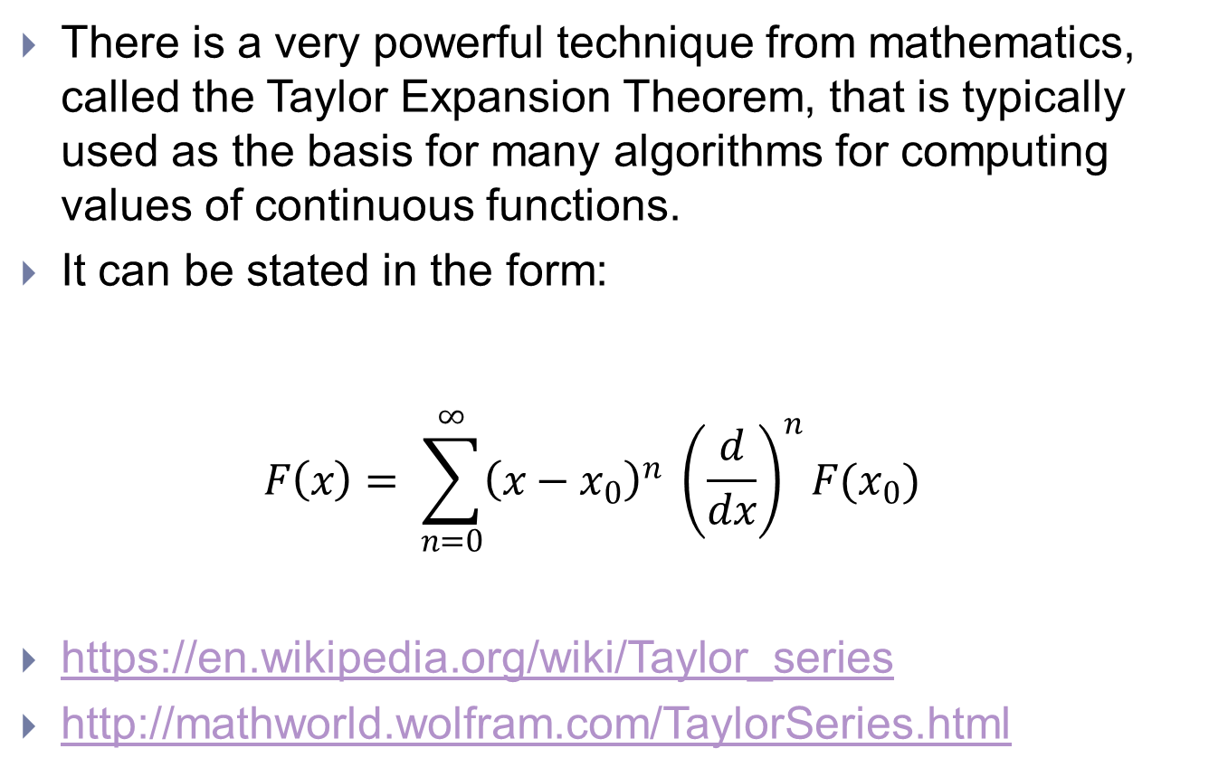
Math Library <math.h>
There is a very powerful technique from mathematics, called the Taylor Expansion Theorem, that is typically used as the basis for many algorithms for computing values of continuous functions.
It can be stated in the form: $F\left(x\right)= \sum_{n=0}^{∞}{{\left(x−x_{0}\right)}^{n} {\left(\frac{d}{dx}\right)}^{n}F(x_{0})}$
https://en.wikipedia.org/wiki/Taylor_series
http://mathworld.wolfram.com/TaylorSeries.html

Slide 34
Standard Utilities Library <stdlib.h>
The Standard Utilities Library <stdlib.h> contains definitions for a number of general purpose functions
Some of these will be discussed later, such as those below that are used to convert data from one machine representation to another, or request memory allocation
atoi atof atol
strtod strtol strtoul
malloc calloc
We will discuss one very useful function involving the concept and use of pseudo-random numbers

Slide 35
Standard Utilities Library <stdlib.h>
Randomness is a property of nature that refers to the unpredictability of events
Radioactive decay of fissile materials cannot be predicted
Random numbers are any sets of numbers whose pattern cannot be predicted
Unfortunately, computer algorithms are deterministic, hence they cannot (in principle) produce randomness
Pseudo-random numbers refer to a set of numbers whose apparent behaviour resembles a set of truly random numbers
Values are distributed evenly within an interval [A..B]
Order of production “appears” to be random, even though it is not random

Slide 36
Standard Utilities Library <stdlib.h>
Pre-defined pseudo-random functions
rand
int N ; .... N = rand ( ) ;
Produces an integer value in the range from 0 to RAND_MAX (defined within stdlib.h)
Each time rand() is called (used) it outputs a different value
But, it must be noted that the values repeat themselves if rand() is called a large number of times
Values generated are evenly distributed within the range

Slide 37
Standard Utilities Library <stdlib.h>
Pre-defined pseudo-random functions
rand
int N ; .... N = rand ( ) ;
This can be adapted to produce values within a range [0..L) by scaling with L using the modulus
N = rand() % L ;
Unfortunately, rand() always produces the same sequence of values, starting at the same value. Eventually the sequence repeats itself.

Slide 38
Standard Utilities Library <stdlib.h>
Example: Rolling the dice – is it a gamble?
Example Code:
int playgame, T1, T2 ;
do {
printf ( “Quit (0) or Roll again (1) > “ ) ; scanf ( “%d”, &playgame ) ;
if ( playgame ) {
T1 = rand() % 6 + 1 ; T2 = rand() % 6 + 1 ;
printf ( “You threw a %d and a %d\n”, T1, T2 );
}
} while ( playgame ) ;

Slide 39
Standard Utilities Library <stdlib.h>
We can partially overcome the limitations of rand() by seeding the pseudo-random number generator algorithm used in C.
srand
unsigned int Seed ; .... scanf ( “%d”, &Seed ) ; srand ( Seed ) ;
If a value of Seed is supplied (say, by inputting it) and it is chosen “randomly”, then the pseudo-random sequence generated thereafter by rand() begins at a different point
But the sequence is still not random

Slide 40
Standard Utilities Library <stdlib.h>
There is another library, <time.h>, which is useful for seeding the pseudo-random sequence using the current time (supplied by the system)
#include <time.h> #include <stdlib.h>
srand ( time( NULL) ) ;
When used in programming, this avoids the need to enter a seed value and the program uses a different time each time it is run.

Slide 41
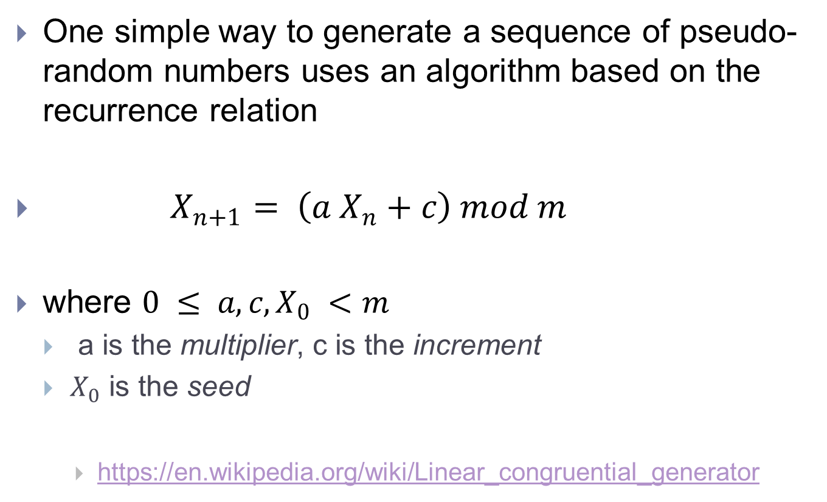
Linear Congruential Generator
One simple way to generate a sequence of pseudo-random numbers uses an algorithm based on the recurrence relation
$X_{n+1}= \left(a X_{n}+c\right) mod m$
where $0 ≤ a, c, X_{0} <m$
a is the multiplier, c is the increment
$X_{0}$ is the seed
https://en.wikipedia.org/wiki/Linear_congruential_generator

Slide 42
Other Libraries
Many other libraries do exist in the C programming system.
assert.h errno.h float.h limits.h signal.h time.h stddef.h stdarg.h setjmp.h locale.h
Some of these libraries will be discussed in 60-141
Especially the string handling library – string.h
and the character handling library – ctype.h
We now turn attention to user-defined functions
.... where the student learns to write their own functions
C99 :
There is a newer dialect of the C language called C99.
This version provides additional libraries, such as complex numbers and functions and some networking and communications functions.

Slide 43
User Defined Functions
Modular programming

Slide 44
User Defined Functions
Modular design and programming
Basic function template
Function prototypes and definitions
Functions and stacks
Call by value
Introduction to pointers
Call by (address) reference
Recursion

Slide 45
Modular design and programming
When we began the course, we discussed the difficulties associated with designing large, complex programs
Modular design refers to the breakdown of large problems into smaller units, or modules, each of which is easier to solve
Design approaches:
Top-Down Bottom-Up Stepwise refinement
Workflow
Structured programming
Identification of reusable modules
C provides capabilities for user programmers to define their own modules in the form of functions.

Slide 46
Basic function template
Each function defined in a C program follows a basic function template (structure)
functype FuncName ( [opt. parmtype ParmName] ) { /* data declarations */ /* function body – executable statements */ return [functype value] ; }

Slide 47
Basic function template
Examples: /* Assume int A,B; float U,V; */
int isquare ( int X ) { return X * X ; } /* Usage: B = isquare(A) ; */
FuncType FuncName ParmType ParmName ReturnVal
float fsquare ( float X ) { return X * X ; } /* Usage: U = fsquare(V) ; */

Slide 48
Basic function template
Examples:
double mysin ( double X ) {
double T = 0.0, Sold, Snew, Slim = 0.00001 ;
int K = 0 ;
Snew = T = X ;
do { Sold = Snew ; T = - T * X * X / (K+K+3) / (K+K+2) ; K++ ; Snew = Snew + T ; } while( 2.0*fabs(Snew-Sold)/(Snew+Sold) >= Slim);
return Snew ;
}

Slide 49
Function Prototypes and Definitions
Most design work begins using a Top-Down approach. During this phase one is not concerned with details, necessarily, rather high-level concepts.
It is usually straightforward to identify need for functions that will accomplish a task, together with the input data and the required output (if any). Typically, the designer is concerned with the general function concept, but not with the specific algorithm that defines the function.
This leads to the problem that in C programming it is required that all symbolic references, including function references, demand prior definition of the function.
Otherwise, compilers cannot correct resolve references

Slide 50
Function Prototypes and Definitions
To support rapid application development (RAD), programmers usually define functions in two stages
A prototype of the function is provided before the main function definition. The form of the prototype statement permits the compiler to translate function references.
This is sometimes referred to as a stub.
The actual full definition of the function is then placed after main and at a later stage of program development.

Slide 51
Function Prototypes and Definitions
Prototypes
Formal statements that describe the structural attributes of a function. Under some circumstances a prototype is not required and a full function definition is supplied.
Definitions
Formal, rigorous definitions of the structure and the internal logic of a function. The definition may be placed before main – in such cases a prototype statement may be eliminated as unnecessary.

Slide 52
Function Prototypes and Definitions
#include <stdio.h>
double mysin ( double ) ;
int main ( ) {
double Angle = 1.57 ;
printf ( “The sine of %lf = %lf\n”, Angle, mysin( Angle ) ) ;
return 0 ;
}
double mysin ( double X ) {
double T = 0.0, Sold, Snew, Slim = 0.00001 ;
int K = 0 ; Snew = T = X ;
do { Sold = Snew ; T = - T * X * X / (K+K+3) / (K+K+2) ; K++ ; Snew = Snew + T ; } while( 2.0*fabs(Snew-Sold)/(Snew+Sold) >= Slim);
return Snew ;
}
NOTE: In prototype statements, it is not necessary to provide names of parameter variables – only their data types are required.
HOWEVER: In function definitions it is required that all parameter names be specified, since they will be referenced within the function body.

Slide 53
Functions and stacks
Operating System
When programs are compiled, the file created (a.out) is composed as a set of machine coded modules, each corresponding to a particular need
A module for executable instructions (code)
A module for certain kinds of data (data)
In general, programs require additional modular structures within RAM, when loaded for execution
Buffer modules for I/O
Heap space for dynamic memory allocations requested by the program during execution
Stack space for storing and retrieving function data dynamically during execution
Code
(Static) Data
Heap
I/O Buffers
Stack

Slide 54
Functions and stacks
The role of the stack is an important detail in understanding how functions operate during execution
Each function has an associated data structure that groups all the function variables, including the function value itself (the return value), plus additional information, into a single data module (stack data frame, also called an activation record).
Every time a function is called, an allocation of stack memory is made – just enough for the data frame.

Slide 55
Functions and stacks
The life-cycle of a function call is detailed below
Stack space is allocated for the function frame
The frame is initialized with data supplied
Within the function definition
Through the calling interface using the values supplied
The address of the return point (where the function was called from)
As the function code is executed, all variable references are made to the frame locations assigned (by the compiler and linker)
The final result is stored in the frame
The return statement obtains the return point address from the frame, then returns to that instruction
The stack de-allocates the frame space and re-uses it for other functions
There are more details, and intricacies, to follow later.
As part of the 60-141 course, students will learn about a subject (and techniques) called dynamic memory allocation.
These techniques will teach how to construct a stack and function frame data structures, as well as how to process the data stored in the frame.

Slide 56
Function Interface – data passing
The function interface refers to the design and mechanisms implemented for passing data into and out from a function based on how the function is referenced (called)
We will discuss two methods of passing data
Call by Value (copy)
Call by Reference (address)
We will also need to introduce the concept of address pointers and operators
Input
F(a,b,c)
Output
(a,b,c)
F

Slide 57
Call by value
Y
4
Consider the function definition:
int cube ( int A ) { return A * A * A ; }
and the calling statement:
X = cube ( Y ) ;
When the cube function is called, its function data frame is allocated RAM space on the stack
The function variable A refers to an int storage at a stack specific RAM address.
The variable Y refers to a different RAM address where an int value has been stored.
After the function data frame allocation is completed, the frame is initialized by fetching the integer value stored at Y and copying it to the location A in the frame.
A
4
frame

Slide 58
Call by value
The Call by Value approach is sometimes described as a direct approach because of the way that a copy of original data (whose location is provided directly in the calling statement interface) is created and stored at a well-defined stack location.
The technique also provides for process and data isolation. Isolation refers to the fact that any changes made to variables within a function are not reflected in other (external to function) variables.
Clearly, there can be a severe efficiency problem if the amount of data passed in to a function is too large
It may take more time to move data than to process it and return a result
It is best to keep the CPU busy and not the data bus !

Slide 59
Introduction to pointers
The Call by Value method permits return of a value using storage allocated on a stack – this storage is limited by the data type attributed to the function (functype).
What if we want to pass many values into a function, but also obtain many values back from a function as the results of processing.
Matrix inversion or transposition
Sort all the values in a list and return the sorted list
Find all values in a list and return all their locations in the list
We can solve this problem by providing the actual RAM address locations (where data is stored in the calling routine) where we want data taken from, or placed as final results.

Slide 60
Introduction to pointers
The technique of treating a Ram address as data and passing the address data to a function is called Call by Reference (or Call by Address).
We defer further discussion until after we have discussed the concept of pointer in C.
We begin by introducing two operators
Address_Of :: &
Dereferencing :: *

Slide 61
Introduction to pointers
Address_Of :: & (ampersand)
Assume: int W = 0, N = 5 ; int * addrN ;
Now the expression addrN = &N ; causes the RAM address of the variable N (where the value 5 is stored, but not the value itself) to be stored (assigned) in the variable addrN.
Dereferencing :: * (asterisk)
The expression W = * addrN ; causes the value stored at the address stored in addrN (ie. the address of variable N) to be copied (assigned) to the variable W. Since addrN is a reference to variable N, it is called a pointer (more specifically an int pointer) to N. The expression * addrN dereferences addrN by fetching the value 5 stored at N. This is called indirect addressing.
NOTE:
In order to declare a pointer variable capable of storing the address of a variable (symbolic reference) it is necessary to supply the data type of the variable and then the * operator to indicate that the variable being defined is an address pointer variable.

Slide 62
Introduction to pointers
It is very important to appreciate the relationship between how a pointer is declared and how it may be used.
C is called a strongly typed language because it enforces type compatibility, even using pointers.
It does so by ensuring that the data used by dereferencing matches the typing requirements of logical expressions.
For instance, there is a difference between a pointer variable of type int* as opposed to another pointer variable of type double*.

Slide 63
Call by (address) Reference
Assume the declaration ...... and the function definition
int X = 4 ; void cube ( int * N ) { *N = *N * *N * *N ; return ; } /* be careful with asterisks !! */
Now consider the calling statement
cube ( &X ) ;
Note that we pass into the function the Address_Of variable X (ie. &X).
Inside the cube function, the variable N contains &X. In order to calculate the cube of 4 (the value of X) it is necessary to dereference N (ie. *N).
The final result is assigned indirectly back in the variable X, again using *N to refer to the storage location of the variable X.

Slide 64
Call by (address) Reference
Assume the declaration ... and the function definition
int X = 4 ; void cube ( int * N ) { *N = *N * *N * *N ; return ; } /* be careful with asterisks !! */
When a dereferencing operator is applied, as in *N, the data stored in N (the address of X) is fetched to the CPU. Then the data stored at this stored address is used to fetch the required data at the location X (ie. the value 4).
Thus, two memory references (fetches) are made in order to acquire the needed data for calculations.
As we shall see later, the main power of Call by Reference using pointers lies in how it supports access to large sets of data.

Slide 65
Recursion
Recursion is a strategy for solving problems in one (large) domain by using solutions based on the same strategy obtained from application to smaller domains.
Consider the factorial problem, F(N) = N !
Limitations: F(N) not defined for N < 0
Base case 0 : 0 ! = 1
Base case 1 : 1 ! = 1
Recursive case: F(N) = N * F(N-1)
C supports programming where a function calls itself. This is called recursion in programming.

Slide 66
Recursion
Consider the factorial problem, F(N) = N !
Limitations: F(N) not defined for N < 0
Base case 0 : 0 ! = 1
Base case 1 : 1 ! = 1
Recursive case: F(N) = N * F(N-1)
int Factorial ( int N ) {
if ( N < 0 ) return -1 ; /* indicate negative input */
if ( N == 0 || N == 1 ) return 1 ; /* base cases */
return N * Factorial ( N-1 ) ; /* recursive step */
}

Slide 67
Recursion – Example 2
Find the sum of integers from 1 to N
Iterative approach:
int Sum_iter ( int N ) { int accum = 0 ; for( k=N; k>0; k-- ) accum += k ; return accum ; }
Recursive approach:
int Sum_recur ( int N ) { if( N <= 0 ) return 0 ; return N + Sum_recur( N-1 ) ; // N+(N-1)+(N-2)+….+0 }

Slide 68
Recursion
Recursion is an alternative to Iteration.
Both involve repetition
Recursion repeatedly calls a function and therefore uses the call stack to store data – this takes time
Recursion is based on selection
Must be able to terminate the recursive algorithm by selecting a base case
However, iteration involves a control structure that must still make a decision to loop again, or exit the loop.
Recursion is elegant
Iteration has higher performance, typically
Both have advantages and disadvantages – learn both !!

Slide 69
Storage Classes & Scope Rules
The fine art of referencing ...

Slide 70
3C : Storage Classes & Scope Rules
Symbolic Referencing Issues
Storage Classes
Scope Rules

Slide 71
Symbolic Referencing Issues
We use symbolic names as a vital part of C programming in order to declare names of variables, functions and other items.
We have already encountered one important rule concerning referencing of symbol names – we must declare all names before they may be referenced.
It is necessary to understand all the rules concerning how we may reference symbol names
And whether we may even be prohibited from referencing names under certain conditions

Slide 72
Storage Classes
In C programs, symbolic names (identifiers) that refer to data storage (variables, functions) fall into two categories of storage class depending on their duration (lifetime)
Some identifiers exist in memory for only a brief period
Others exist for the entire time the program itself exists in RAM
Automatic storage duration (short lifetime)
auto
register
Static storage duration (long lifetime)
static
extern

Slide 73
Storage Classes
Automatic storage duration is used for identifiers that exist only briefly. There are two subclasses
Auto storage is the default storage class. It refers to all variables that are defined inside of any function (unless explicitly defined otherwise)
auto int N ; is the same as int N ;
Auto variables are allocated space in RAM when functions are called (ie. space on the stack). These storage spaces are de-allocated when leaving the function.

Slide 74
Storage Classes
NOTE:
Not every system and C compiler will support the register storage class option – in such systems the register declaration defaults to auto storage class.
Register storage is a special class and refers to data that is stored in CPU hardware registers
register int N ;
In this example, N does not refer to a RAM location, rather a CPU register location. Data is moved to the register and subsequently manipulated at that location
This avoids the need to move data back and forth between RAM and CPU
Both auto and register storages are sometimes called local identifiers.

Slide 75
Storage Classes
Static storage duration refers to identifiers whose lifetime is as long as the program’s lifetime. There are two sub-classes
Static variables are allocated permanent storage in RAM when programs are first loaded into memory.
static int N = 5 ;
Once a value is assigned to a static storage (N), the value stays even if the function is exited and then re-entered. Any changes in N are also kept until the next reference or modification.
Static variables are destroyed (deallocated) only when the program terminates.

Slide 76
Storage Classes
Example of static storage allocation:
#include <stdio.h> int add2 ( void ) ; int main ( ) { int N ; N = add2() ; printf( “%d\n”, N ) ; /* outputs value of N as 2 */ N = add2() ; printf( “%d\n”, N ) ; /* outputs value of N as 4 ! */ return 0 ; } int add2 ( void ) { static int A = 0 ; /* A is initialized to 0 only the first time */ A += 2 ; /* that the function add2 is called. */ return A ; /* Thereafter, 2 is added each time. */ }

Slide 77
Storage Classes
Extern storage refers to a symbol which, like static, is permanent for the lifetime of the program.
Such identifiers permit compilers and linkers to reference identifiers that may be declared inside of other compiled program modules
extern int N ;
Both static and extern identifiers are sometimes called global identifiers (see next section on Scope)

Slide 78
Scope Rules
Since symbol names may be referenced only after they have been declared, it follows that there are limits on how and where symbol names may be referenced
The Scope of a symbol name refers to the part(s) of a program where the name may be referenced.
Scope is sometimes referred to as a name space
There are four aspects of symbolic name scope
Function scope
File scope
Block scope
Function-Prototype scope

Slide 79
Scope Rules – Function scope
Variable names that are declared within functions have function scope
Such variables may be referenced only within the function in which they are declared
References from outside the function generate compiler errors, as if the variable name had never been declared
int FuncName ( ...... ) { int A, B ; /* function scope */ float X ; /* function scope */ printf ( “&d &d &f”, A, B, X ) ; }
All references to A, B or X must stay “within the box” of the function definition.

Slide 80
Scope Rules – Function scope
Example:
int F1 ( void ) { int X = 5 ; return X ; }
int main ( ) { printf ( “%d”, X ) ; /* Does NOT compile! */ return 0 ; }

Slide 81
Scope Rules – Function scope
Example:
int F1 ( void ) { int X = 5 ; return X ; }
int main ( ) { int X = 2 ; printf ( “%d”, X ) ; /* Output: 2 */ return 0 ; }
In effect, two different versions of X exist – each with its own allocated RAM storage location.
This can be clarified by thinking of one variable being the
“X that exists only inside of F1”
while the other is the
“X that exists only inside of main”.

Slide 82
Scope Rules – File scope
Symbol names can be declared outside of any function
The typical practice is to declare variables within functions, particularly the main function, in order to enforce localization.
Variable names that are declared before function definitions may be referenced directly from within those functions
They are often referred to as Global variables because they can be “globally” recognized by the compiler
Global variables have static storage class
They are allocated RAM storage locations when the program is loaded and the data stored is persistent for the lifetime of the program itself.

Slide 83
Scope Rules – File scope
Example:
#include <stdio.h> int A = 4 ; /* file scope */ float X = 6.5 ; char C ;
int Func1 ( ) { return A + 1 ; }
float Func2 ( int Z ) { X = X – Z ; return 3.0 * X ; }
char Func3 ( ) { return ( C = ‘w’ ); }
int main ( ) { int B ; int Y ;
B = Func1( );
Func3( );
Y = Func2( X – 0.5 );
printf( “%d %d\n”, A, B ); printf( “%f %f\n”, X, Y ); printf( “%c\n”, C ); }
OUTPUT: 4 5 0.5 1.5 w

Slide 84
Scope Rules – File scope
When to use Global variables
There are times when it is most convenient to declare and use global variables for “system” related data
Inter-process communication for control
Data that is mandated to be treated with utmost care and diligence
When to not use global variables
Some argue that global variables should never be used
This follows the principle of strong localization enforcement
Most of the time, use function scoping to control the data flow through the function calling interface
This promotes greater clarity and understanding of the logical intent of the programmer and of the algorithm

Slide 85
Scope Rules – Block scope
Block scope provides a specific programming mechanism for strongly enforcing the principle of localization of variable referencing and algorithmic logic
C provides for execution of statements, whether simple or compound.
C also provides for separation of compiled code space and static data space in the RAM allocations when the program is loaded.
Thus, it is possible to locate variable declaration statements within and amongst executable statements !
This is not necessarily recommended as it can lead to “spaghetti code” that is very difficult to understand

Slide 86
Scope Rules – Block scope
Example:
int main ( ) { int X = 3, K = 10 ; printf( “%d %d\n”, K, X );
{ register int K ; for( K = 0 ; K < 4 ; K++ ) { X = X + K ; printf( “%d %d\n”, K, X ) ; } }
printf( “%d %d\n”, K, X ); return 0 ; }
OUTPUT:
10 3
0 3
1 4
2 6
3 9
10 9

Slide 87
Scope Rules – Function-Prototype scope
Function-Prototype scope states, simply, that any symbol name declared within the prototype of a function may only be referenced within the prototype
This is not the same as a function reference where a symbolic variable name identified in the function interface of the definition is referenced within the function body
This may seem a trifle useless at first, but it is a necessary condition of a formal computing language that this case be properly identified and accounted for
Otherwise, compilers might not be able to handle certain codes
Example: int Func ( float X ) ; /* X is not required! */
int main ( ) { .... } int Func ( float Y ) { .... } /* Y is required */

Slide 88
Lecture 1 : Summary
Functions

Slide 89
Lecture 1: Summary
C Library Functions
User Defined Functions
Storage Classes and Scope Rules
Reading and Review: Chapters 1-5, 9, 13, 14.
Assigned Reading:
Chapter 5 – C Functions
Chapter 6 – C Arrays

