Slide 1
Files as Containers and File Processing
Files, I/O Streams, Sequential and Direct Access File Processing Techniques

Slide 2
Outline
Storage Devices
Concept of File
File Streams and Buffers
Sequential Access Techniques
Direct Access Techniques

Slide 3


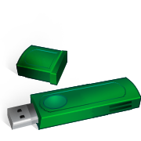
Storage Devices
John von Neumann first expressed the architecture of the stored program digital computer.
Computer System
Computer
Input Device
Data
CPU
Main Memory
Bus
Bus
Control
Output Device
Five Main Components:
1. CPU
2. Main Memory (RAM)
3. I/O Devices
4. Mass Storage
5. Interconnection network (Bus)
Bus
Secondary Storage Device

Slide 4
Storage Devices
Most of our previous discussions have been centred on how the C language supports dealing with data in memory (RAM).
How to declare and reference variables in a program (and the actual data at run time)
Expression of data in character string format (human centred) versus internal machine representations (machine centred)
Data types
Variables
Aggregate data structures (eg. arrays, structs, unions, bit strings)
Concepts and techniques of memory addressing
Using pointers
Direct access versus indirect access (dereferencing of a pointer)
Now we turn our attention to concepts and techniques of files and file processing on mass storage devices
We begin with the concept of a file.

Slide 5
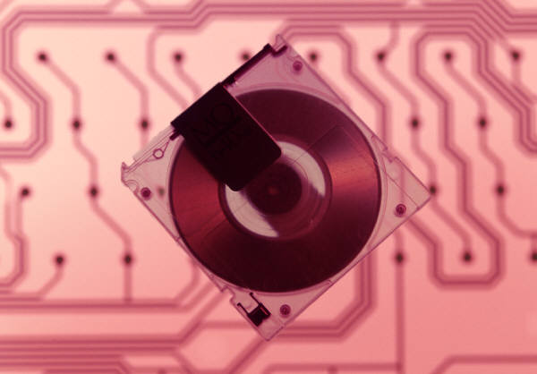
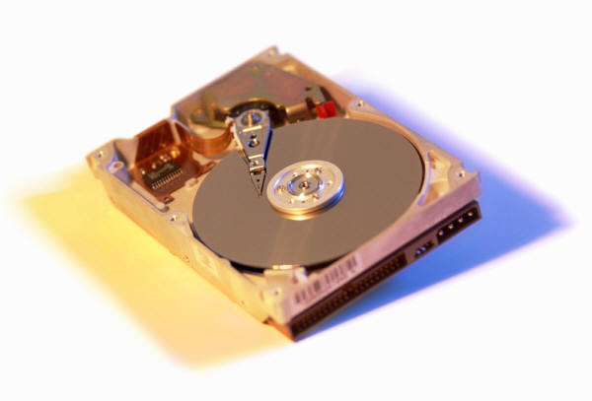

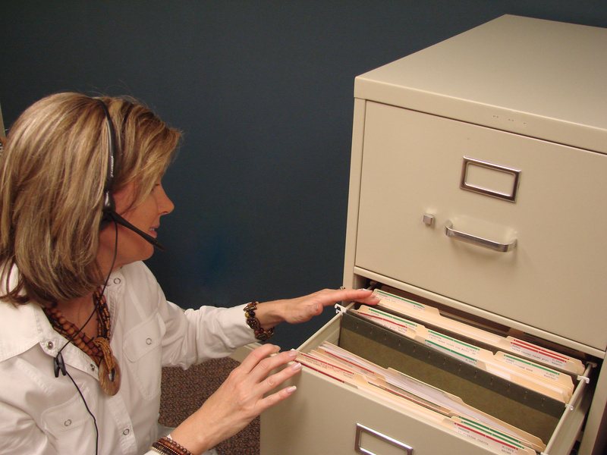

Concept of File
The concept of a file derives from its use in business, government and other areas
A folder containing multiple pieces of paper (or tape, film, etc), called records, containing information presented in differing ways
A digital file retains the same conceptual characteristics
Aggregates of data of differing data types and representations
Requires standardized structures for packaging and communicating data
File devices are any suitable hardware that supports file processing techniques
stdin and stdout utilize default devices, as does stderr
Each of stdin/stdout/stderr is actually a pointer to a struct
File processing is implemented through the operating system (O/S) as an intermediator
Processing functions include opening, closing, seeking, reading, writing …
Access techniques to files fall into two general categories
Sequential access – usually variable length records
Direct access – must be fixed length records

Slide 6
Concept of File
We will adopt a logical perspective of a file.
This is a simplified model based on assumptions
It permits us to ignore many low-level details
Variable length records
Sequential Access File:
BEGIN
File offset (Unpredictable)
Fixed length records
Direct Access File:
BEGIN
File offset (Predictable) = RecNum * RecLength

Slide 7


File Streams and Buffers
The cost of I/O:
Typical input or output operations on most devices require 1/1000’s of seconds to complete. This is thousands, to millions, of times slower than memory or cpu based operations. Complicated file access schemes (organizations and algorithms) are always being developed to speed up programs and reduce access times to data.
File Streams and Buffers – Brief !!
Program – send YourFile data transaction message to O/S
O/S – point to device API, allocate I/O buffer
O/S – send protocol wrapped message to device
Device – respond with message directed to proper I/O buffer
O/S – move message to Program buffer(s)
Program – process message data
O/S
3
2
API’s
I/O Buffers
5
6
User Program
1
YourFile
Executable logic
Variables, Structures
4

Slide 8
Making and Breaking File Connections
When a program is loaded into RAM, the O/S is provided with information about the default file system (stdin and stdout) to be used and also whether additional files on storage devices will be needed
Note that stdin normally points at the keyboard, while stdout points at the monitor
These can be modified to refer to specific files, using file redirection
cmdline% a.out < Infile.dat > Outfile.dat
In order to communicate with a file it is necessary, first, to open a channel to the device where the file is located (or will be located, once created). When the program is finished with the file, it is necessary to close the channel. All required functions are defined in <stdio.h>
All required information concerning the file attributes (characteristics) is contained in a C-defined data structure called FILE.
FILE * filePtr ; // pointer to struct that will hold file attributes
There can be many files opened at the same time, each using its own FILE structure and file pointer.
Study Figure 11.4 in the textbook.
It discusses the relationship between FILE pointers, FILE structures and File Control Blocks (FCB), and the Operating System.
Note that stdin and stdout are just FILE* pointers.
File Control Block (FCB)
File Name String
File Offset (Bytes)
Access Mode (R,W,B,+)
….

Slide 9
Making and Breaking File Connections
In order to communicate with a file it is necessary, first, to open a channel to the device where the file is located (or will be located, once created). When the program is finished with the file, it is necessary to close the channel.
Channels may be re-opened and closed, multiple times
A FILE pointer may be re-assigned to different files
Assuming the declaration: FILE * cfPtr1, * cfPtr2 ; // declare two C file pointers
To open a file channel cfPtr1 = fopen( “MyNewFileName.dat”, “w” ) ; // open for writing cfPtr2 = fopen( “MyOldFileName.dat”, “r” ) ; // open for reading
To close a file channel fclose( cfPtr1 ) ; fclose( cfPtr2 ) ;
Every file contains an end-of-file indicator that the O/S can detect and report. This is shown with an example
while( ! feof( cfPtr1 ) ) printf( “More data to deal with\n” ) ;
End-of-File
Different O/S’s use different codes to indicate the EOF.
Linux/Unix - <Ctrl> d
Windows - <Ctrl> z

Slide 10
Making and Breaking File Connections
In the previous slide we saw the statements cfPtr1 = fopen( “MyNewFileName.dat”, “w” ) ; // open for writing cfPtr2 = fopen( “MyOldFileName.dat”, “r” ) ; // open for reading
File access attributes are used to tell the operating system (and the background file handling system) what kind of file processing is intended by the program
C supports three types of sequential file transactions, called modes
Read (with fscanf)
Write (with fprintf)
Append
There are combinations of these as well, using ‘+’
r+ w+ a+
Later we will discuss one more mode – binary (b)

Slide 11
Making and Breaking File Connections
Mode | Description
r | Open an existing file for reading only
w | Create a file for writing only. If the file currently exists, destroy its contents before writing to it.
a | Open an existing file or create a file for writing at the end of the file.
r+ | Open an existing file for update, including both reading and writing.
w+ | Create a file for update use (reading and writing). If the file already exists, destroy its current contents before writing.
a+ | Append: Open or create a file for update – writing is done at the end of the file.

Slide 12
Sequential Access Techniques
Writing to a sequential file
fprintf( cfPtr, FormatString [, Parameter list] ) ;
Example: fprintf( cfPtr, “%d %lf\n”, intSum, floatAve ) ; fprintf( cfPtr, “This a message string, no values\n” ) ;
Reading from a sequential file
fscanf( cfPtr, FormatString [, Parameter list] ) ;
Example: fscanf( cfPtr, “%d%lf”, &intSum, &floatAve ) ; fscanf( cfPtr, “%s”, stringVar ) ;
Interpreting return values
fopen – NULL means “no file exists”
fprintf – returns number of parameters outputted, or failure of operation
fscanf – returns number of parameters inputted, or failure of operation
feof – returns 0 if EOF found, otherwise non-zero.

Slide 13
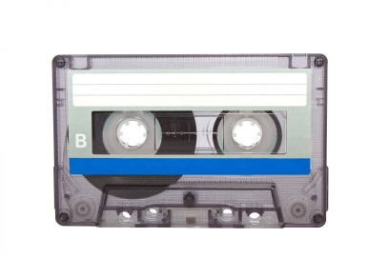
Sequential Access Techniques
There are two ways of re-reading a sequential file
Close the file and then re-open it
considered quite inefficient
Rewind the file to the beginning (reset the file offset value in the FCB) while leaving it open
rewind( cfPtr ) ;
Before moving on it should be noted that most files that contain character based data alone have variable record length, hence sequential access is the only kind of access that makes sense
However, any file (including those with fixed length records) can be accessed sequentially.

Slide 14
Direct Access Techniques
Direct Access Techniques are also called Random Access techniques
Random just means that a read or write operation can be performed directly at the position (within the file) desired
As with the case of array data structures, direct access can be performed at constant cost (almost!)
By contrast, sequential access implies that we may need to move through multiple records before we finally arrive at the file position desired.

Slide 15
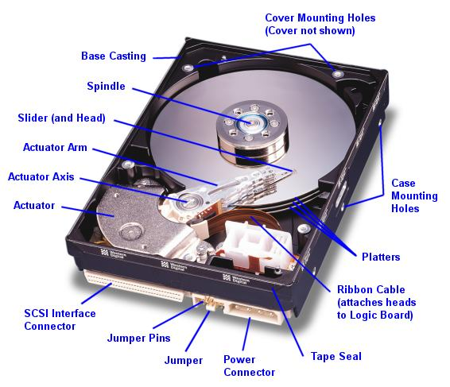
Direct Access Techniques
Two kinds of movement for the Read/Write Head:
Linear
Across the disk along a radius
Rotary
Around the disk, within a circular track
Each kind requires different timing and control, but both contribute to access time.

Slide 16
Making and Breaking File Connections
We now consider the statements cfPtr1 = fopen( “MyNewFileName.dat”, “wb” ) ; // open for writing cfPtr2 = fopen( “MyOldFileName.dat”, “rb” ) ; // open for reading
C supports three types of fixed length file transactions, called binary modes
Read binary
Write binary
Append binary
There are combinations of these as well, using ‘+’
rb+ wb+ ab+
The term binary refers to a bit-level machine representation of data (ie. not characters, necessarily – recall signed binary)
Ex. unsigned and signed binary, IEEE float and double, etc.

Slide 17
Making and Breaking File Connections
Mode | Description (all files are binary)
rb | Open an existing file for reading only
wb | Create a file for writing only. If the file currently exists, destroy its contents before writing to it.
ab | Open an existing file or create a file for writing at the end of the file.
rb+ | Open an existing file for update, including both reading and writing.
wb+ | Create a file for update use. If the file already exists, destroy its current contents before writing.
ab+ | Append: Open or create a file for update – writing is done at the end of the file.
… x | C11 has recently introduced the write exclusive mode as well. We will not discuss or examine this but students should read about it.

Slide 18
Direct Access Techniques
Writing to a direct access file
fwrite( &DataStruct, sizeof( DS_t ), NumRecs, cfPtr ) ;
Reading from a direct access file
fread( &DataStruct, sizeof( DS_t ), NumRecs, cfPtr ) ;
Seeking a record in a direct access file
int fseek( FILE * cfPtr, long int Offset, int Whence ) ;
Offset just refers to sizeof( DS_t )
Whence is one of three standard values (defined in <stdio.h>)
SEEK_SET - seek based on offset from beginning of file
SEEK_CUR – seek based on relative offset from current file position
SEEK_END - seek based on offset from end of file

Slide 19
Direct Access Techniques
#include <stdio.h>
struct rec_t {
int ID ; // Assume 1 <= ID <= 100
char Name[50] ;
double Score ;
}
int main( ) {
FILE * cfPtr ;
struct rec_t Rec ;
cfPtr = fopen( “Score.dat”, “w” ) ;
while( scanf( “%d”, &Rec.ID) != EOF ) {
scanf( “%s%lf”, Rec.Name, &Rec.Score ) ;
fseek( cfPtr, (Rec.ID – 1)*sizeof( struct rec_t ), SEEK_SET ) ;
fwrite( &Rec, sizeof( struct rec_t ), 1, cfPtr ) ;
}
fclose( cfPtr ) ;
return 0 ;
}
Example: Writing to a direct access file

Slide 20
Concept of Direct Access File
Absolute Record Offset Number
Direct Access File with Fixed length records:
Current position
Begin File
N-1 N-2 . . . . 3 2 1 0
From BEGIN : RecNum * RecLength
End File
SEEK_SET
From END : (N - 1 - RecNum) * RecLength
SEEK_END
NumRecs * RecLength
+
-
Relative offset
SEEK_CUR

Slide 21
Direct Access Techniques
Checking for errors
fwrite
Returns the number of items outputted. If this number is less than the 3d argument, then an error has occurred fwrite( &DataStruct, sizeof( DS_t ), NumRecs, cfPtr ) ;
fread
Returns the number of data items successfully inputted, or EOF
fseek
Returns a non-zero value if the seek cannot be performed correctly

Slide 22
Direct Access Techniques
Some additional problems to consider:
Sort a file by a special value (called a key)
Merge two files into a single file, maintaining sorted order
Store blocks of memory (RAM) to a file, then recover it later into memory (concept of virtual memory management)
Develop a hierarchical technique for accessing files based on organizational patterns.
Example: Indexed Sequential Access techniques
Develop your own (simple) database system involving multiple files, all linked through index (ie. key) values.
Many of these problems and techniques will be discussed more deeply in future Computer Science courses.

Slide 23
Summary
C File Processing, Files, I/O Streams, Sequential and Direct Access File Processing Techniques

Slide 24
Topic Summary
Storage Devices
Concept of File
File Streams and Buffers
Sequential Access Techniques
Direct Access Techniques
Study – Chapter 11: File Processing
Moving beyond RAM to include data on persistent storage in the file system.
Reading – Chapter 12: Data Structures
Abstract data structures, dynamic memory allocation, using pointers and self-referential data structures, linked lists.
Review – Begin reviewing and preparing for Final Exam !
Study examples – Adapt them to your own uses !

