Slide 1
Chapter 4 C Program Control
C How to Program, 8/e

Slide 2
Iteration Essentials
A loop is a group of instructions the computer executes repeatedly while some loop-continuation condition remains true.
Two means of iteration:
Counter-controlled iteration
Sentinel-controlled iteration
Counter-controlled iteration is sometimes called definite iteration because we know in advance exactly how many times the loop will be executed.
Sentinel-controlled iteration is sometimes called indefinite iteration because it’s not known in advance how many times the loop will be executed.

Slide 3
Iteration Essentials (Cont.)
In counter-controlled iteration, a control variable is used to count the number of iterations.
The control variable is incremented (usually by 1) each time the group of instructions is performed.
When the value of the control variable indicates that the correct number of iterations has been performed, the loop terminates and execution continues with the statement after the iteration statement.

Slide 4
Iteration Essentials (Cont.)
Sentinel values are used to control iteration when:
The precise number of iterations isn’t known in advance, and
The loop includes statements that obtain data each time the loop is performed.
The sentinel value indicates “end of data.”
The sentinel is entered after all regular data items have been supplied to the program.
Sentinels must be distinct from regular data items.

Slide 5
Counter-Controlled Iteration
Counter-controlled iteration requires:
The name of a control variable (or loop counter).
The initial value of the control variable.
The increment (or decrement) by which the control variable is modified each time through the loop.
The condition that tests for the final value of the control variable (i.e., whether looping should continue).

Slide 6
The while Iteration Statement
An iteration statement allows you to specify that an action is to be repeated while some condition remains true.
The pseudocode statement
While there are more items on my shopping list Purchase next item and cross it off my list
describes the iteration that occurs during a shopping trip.
The condition, “there are more items on my shopping list” may be true or false.
If it’s true, then the action, “Purchase next item and cross it off my list” is performed.
This action will be performed repeatedly while the condition remains true.

Slide 7
The while Iteration Statement (Cont.)
The statement(s) contained in the while iteration statement constitute the body of the while.
The while statement body may be a single statement or a compound statement.
Eventually, the condition will become false (when the last item on the shopping list has been purchased and crossed off the list).
At this point, the iteration terminates, and the first code statement after the iteration structure is executed.

Slide 8
The while Iteration Statement (Cont.)
As an example of a while statement, consider a program segment designed to find the first power of 3 larger than 100.
Suppose the integer variable product has been initialized to 3.
When the following while iteration statement finishes executing, product will contain the desired answer:
product = 3;
while ( product <= 100 ) { product = 3 * product; } // end while
The flowchart of Fig. 3.4 illustrates the flow of control in the while iteration statement.

Slide 9
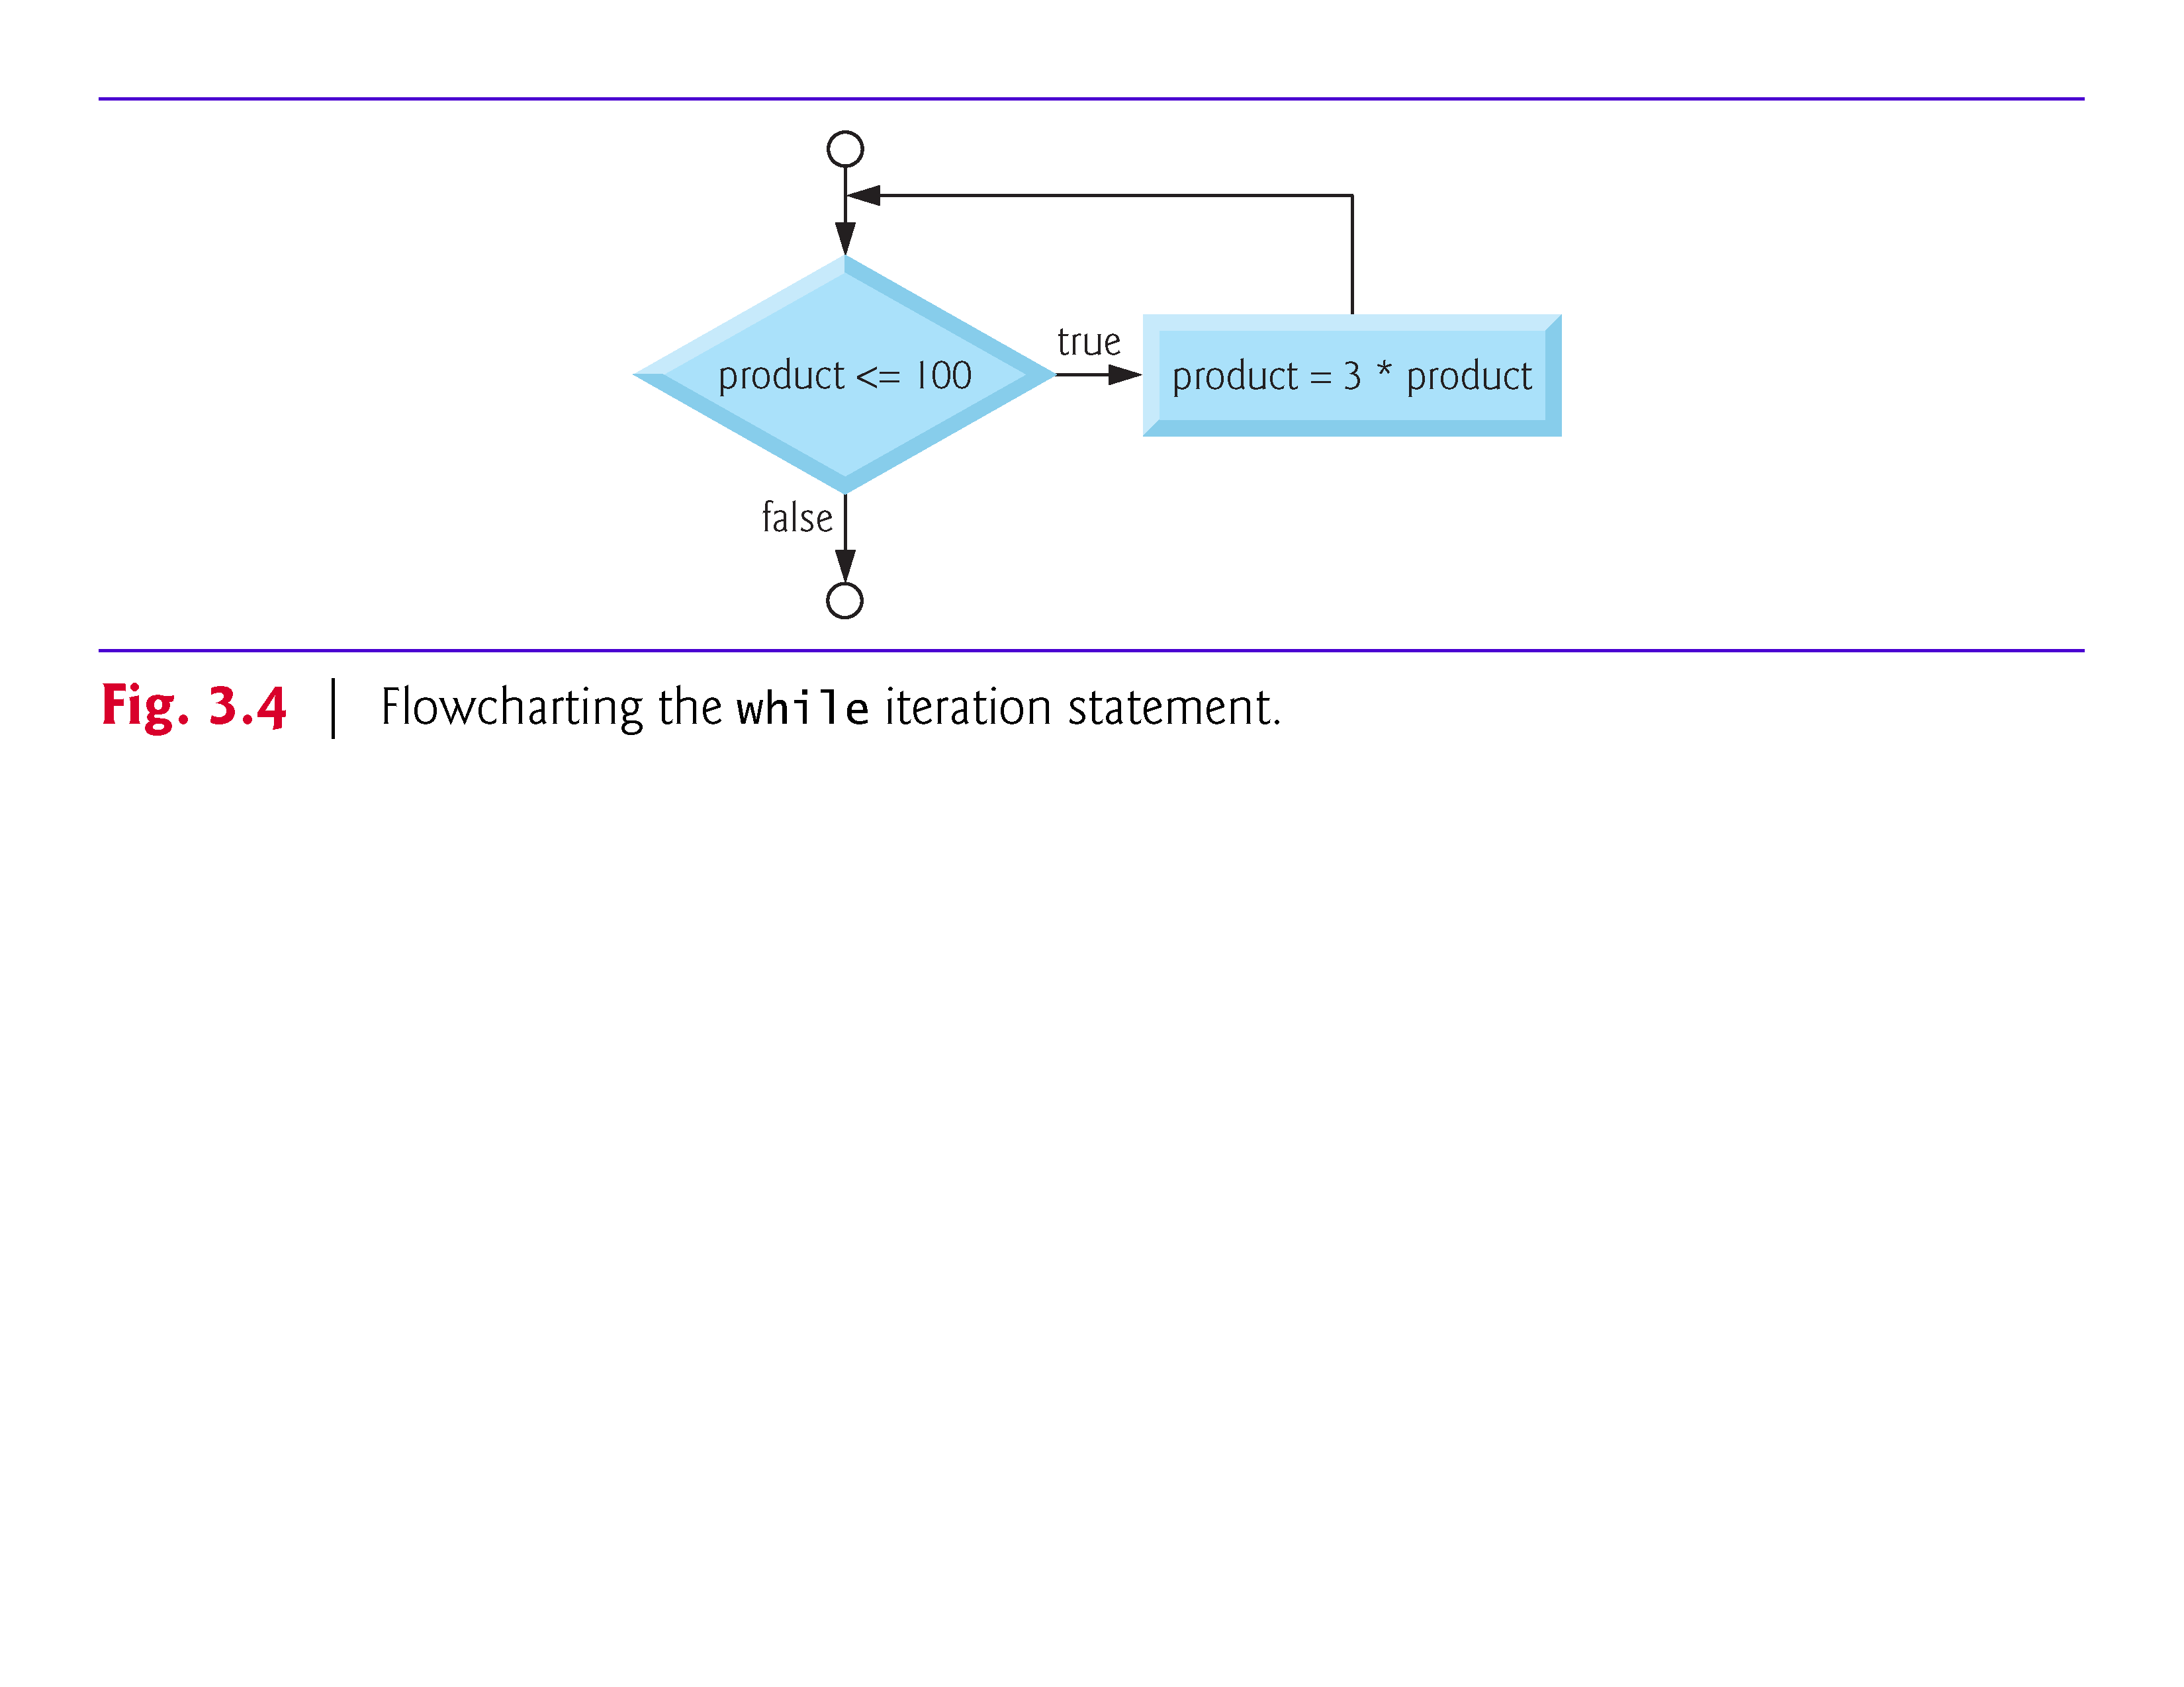

Slide 10
Counter-Controlled Iteration
To illustrate how algorithms are developed, we solve several variations of a class-average problem.
Consider the following problem statement:
A class of ten students took a quiz. The grades (integers in the range 0 to 100) for this quiz are available to you. Determine the class average on the quiz.
The class average is equal to the sum of the grades divided by the number of students.
The algorithm for solving this problem on a computer must input each of the grades, perform the average calculation, and print the result.

Slide 11
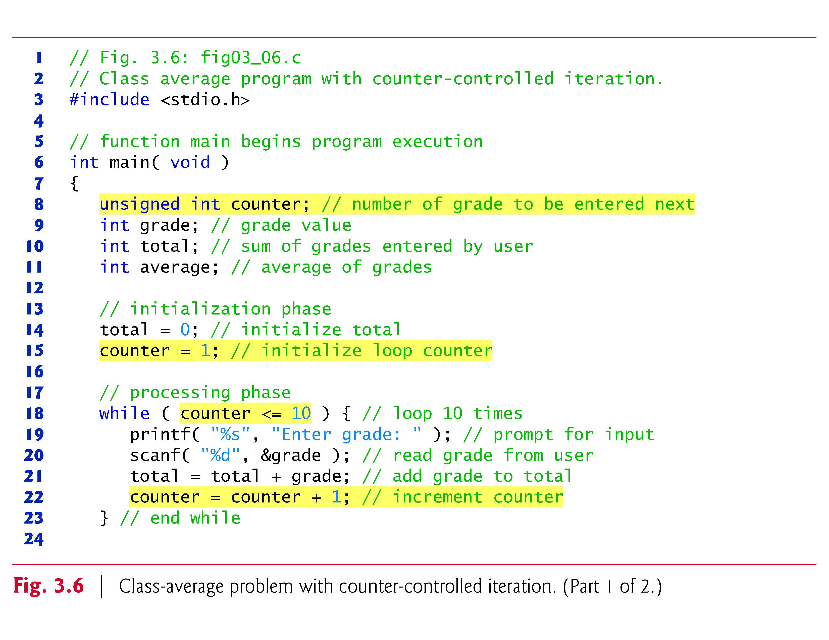

Slide 12
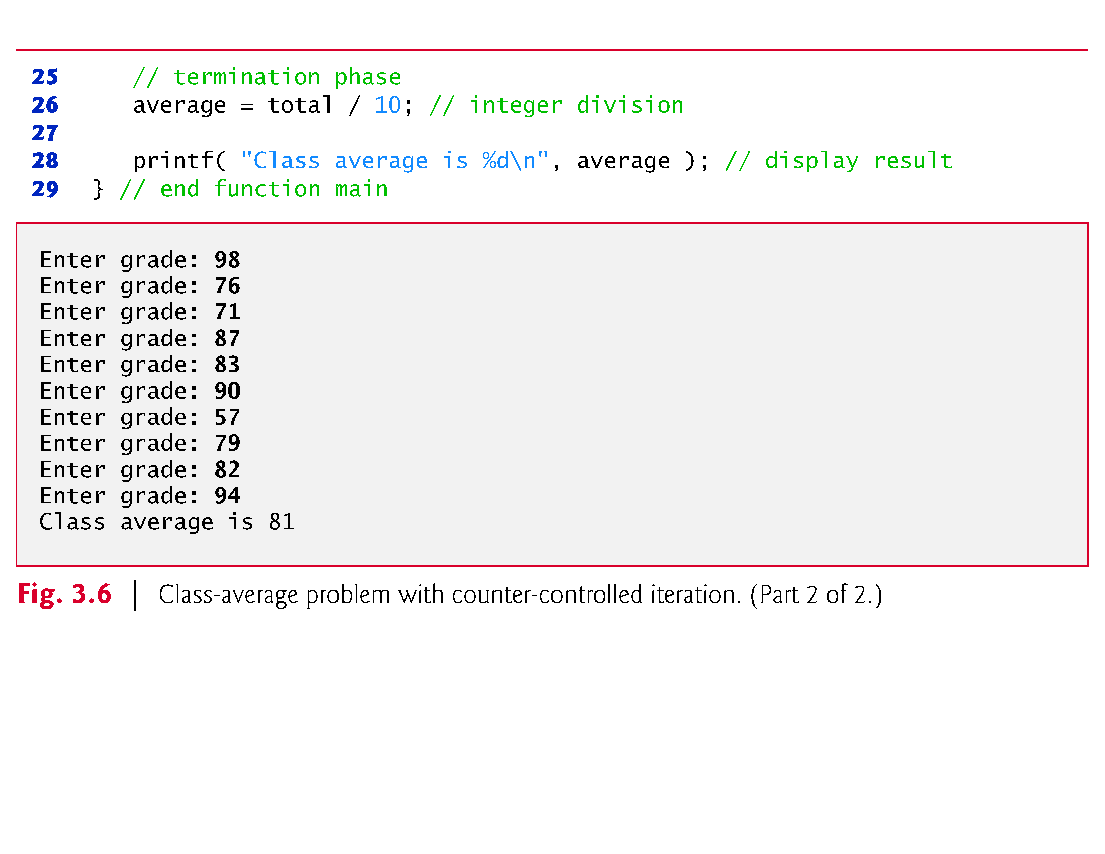

Slide 13
Counter-Controlled Iteration (Cont.)
Variables used to store totals should normally be initialized to zero before being used in a program; otherwise the sum would include the previous value stored in the total’s memory location.
Counter variables are normally initialized to zero or one, depending on their use (we’ll present examples of each).
An uninitialized variable contains a “garbage” value—the value last stored in the memory location reserved for that variable.

Slide 14
Sentinel-Controlled Iteration
Let’s generalize the class-average problem.
Consider the following problem:
Develop a class-average program that will process an arbitrary number of grades each time the program is run.
In the first class-average example, the number of grades (10) was known in advance.
In this example, the program must process an arbitrary number of grades.
How can the program determine when to stop the input of grades? How will it know when to calculate and print the class average?

Slide 15
Sentinel-Controlled Iteration (Cont.)
One way to solve this problem is to use a special value called a sentinel value (also called a signal value, a dummy value, or a flag value) to indicate “end of data entry.”
The user types in grades until all legitimate grades have been entered.
The user then types the sentinel value to indicate “the last grade has been entered.”
Sentinel-controlled iteration is often called indefinite iteration because the number of iterations isn’t known before the loop begins executing.

Slide 16
Sentinel-Controlled Iteration (Cont.)
Clearly, the sentinel value must be chosen so that it cannot be confused with an acceptable input value.
Because grades on a quiz are normally nonnegative integers, –1 is an acceptable sentinel value for this problem.
Thus, a run of the class-average program might process a stream of inputs such as 95, 96, 75, 74, 89 and –1.
The program would then compute and print the class average for the grades 95, 96, 75, 74, and 89 (–1 is the sentinel value, so it should not enter into the average calculation).

Slide 17
Sentinel-Controlled Iteration (Cont.)
The C program and a sample execution are shown in Fig. 3.8.
Although only integer grades are entered, the average calculation is likely to produce a number with a decimal point.
The type int cannot represent such a number.
The program introduces the data type float to handle numbers with decimal points (called floating-point numbers) and introduces a special operator called a cast operator to handle the average calculation.
These features are explained after the program is presented.

Slide 18
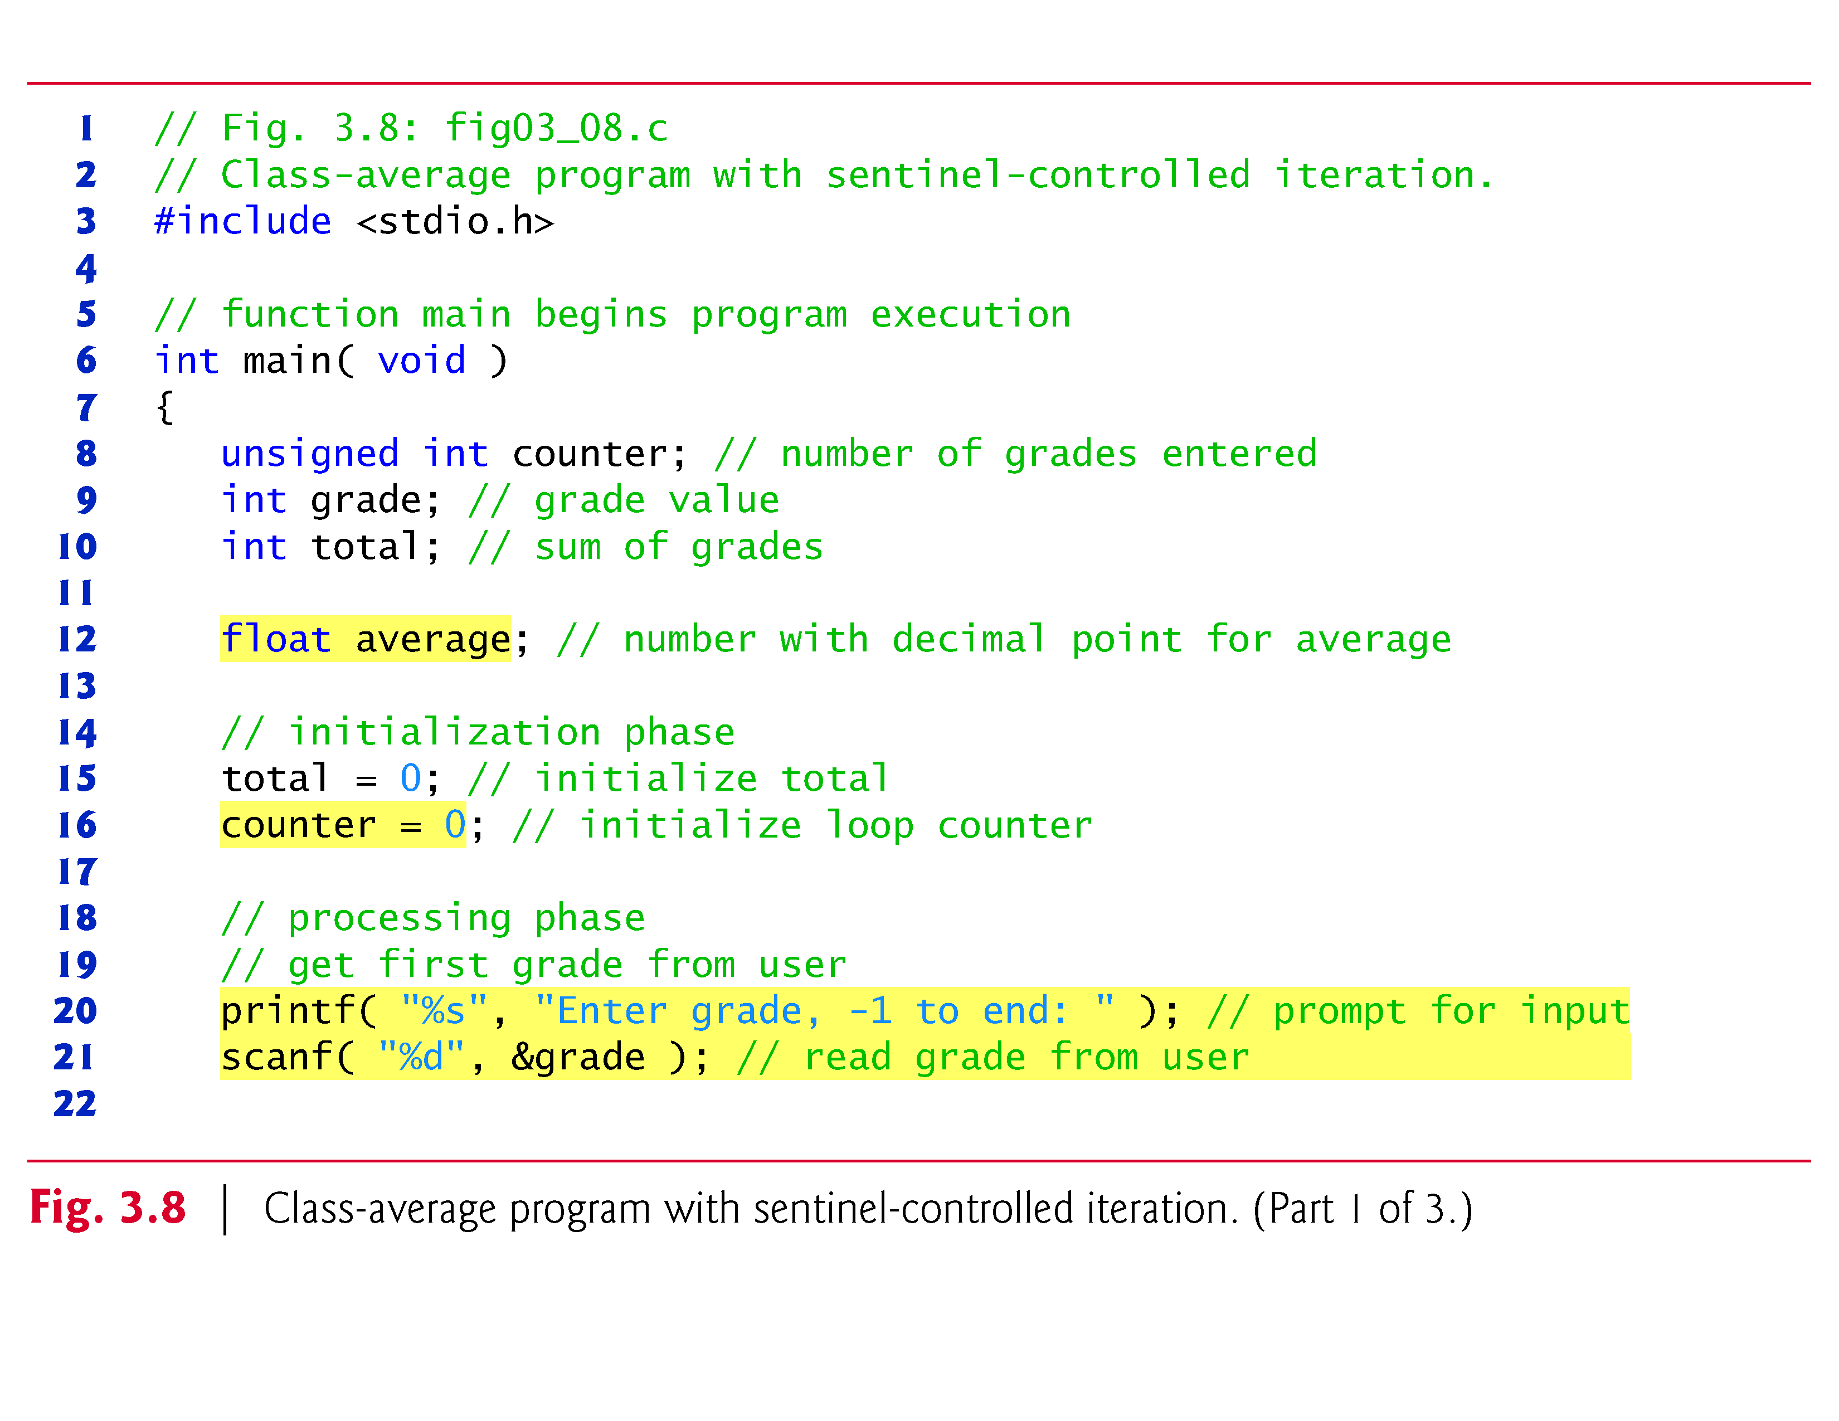

Slide 19
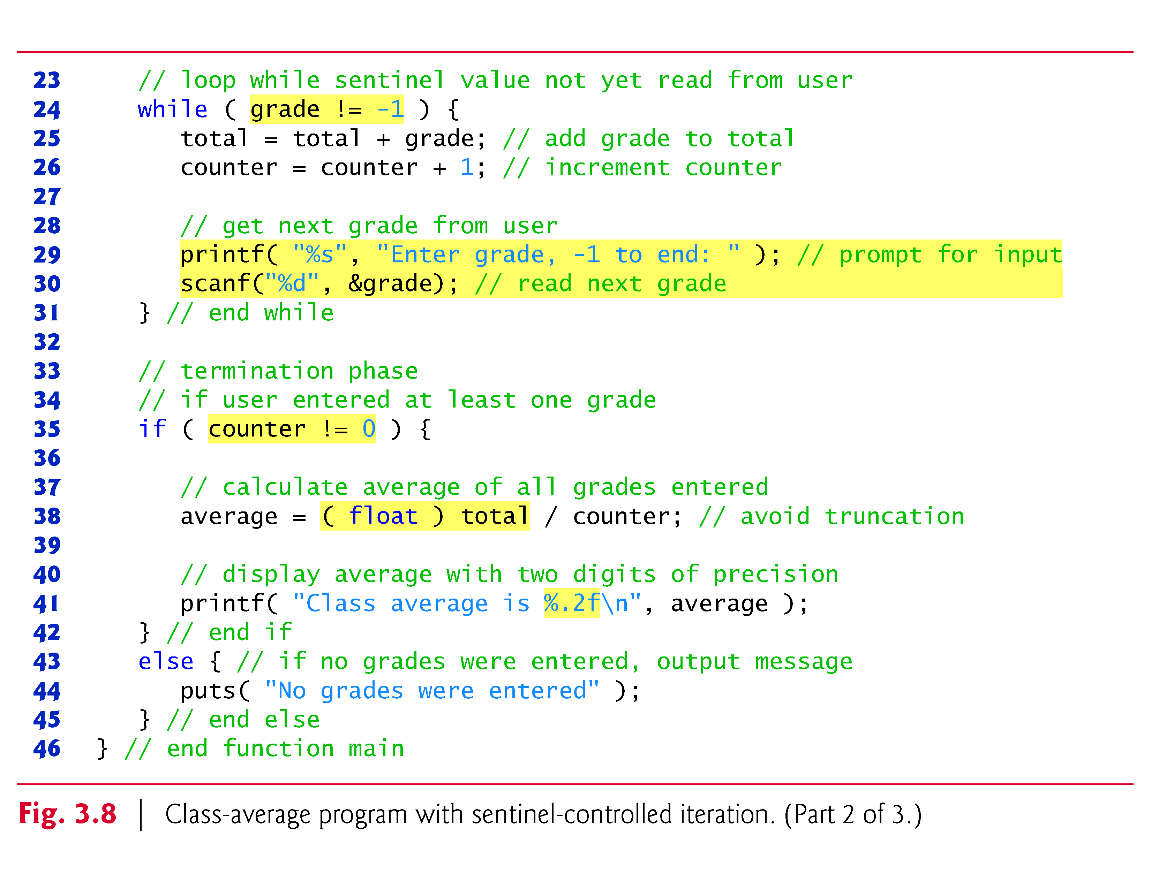

Slide 20
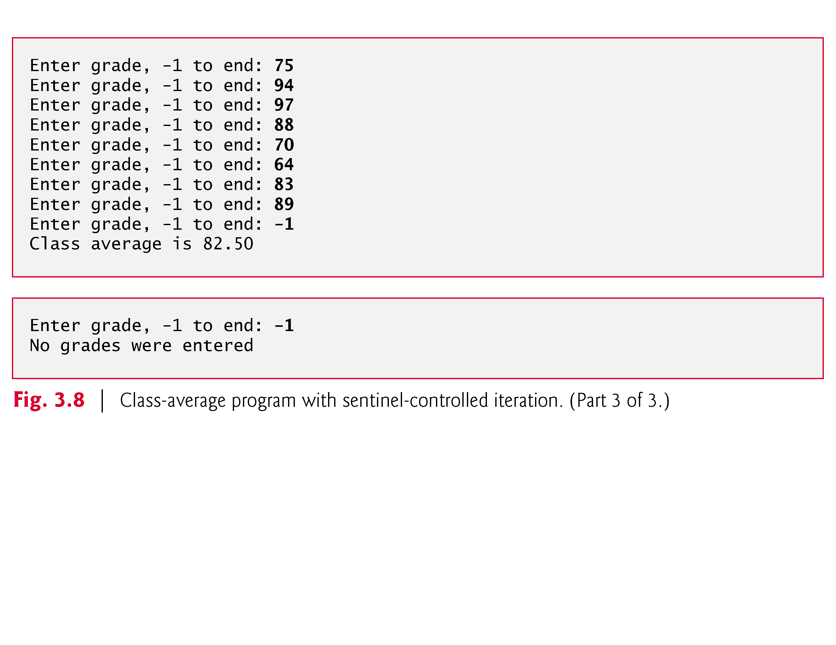

Slide 21
Sentinel-Controlled Iteration (Cont.)
In the while loop in Fig. 3.8, the braces are necessary to ensure that all four statements execute within the loop.
Without the braces, the last three statements in the body of the loop would fall outside the loop, causing the computer to interpret this code incorrectly as follows.
while ( grade != -1 ) total = total + grade; // add grade to total counter = counter + 1; // increment counter printf( "Enter grade, -1 to end: " ); // prompt for input scanf( "%d", &grade ); // read next grade
This would cause an infinite loop if -1 is not input as the first grade.

Slide 22
Converting Between Types Explicitly and Implicitly
Averages do not always evaluate to integer values.
Often, an average is a value such as 7.2 or –93.5 that contains a fractional part.
These values are referred to as floating-point numbers and can be represented by the data type float.
The variable average is defined to be of type float to capture the fractional result of our calculation.
However, the result of the calculation total / counter is an integer because total and counter are both integer variables.

Slide 23
Converting Between Types Explicitly and Implicitly (Cont.)
Dividing two integers results in integer division in which any fractional part of the calculation is truncated (i.e., lost).
Because the calculation is performed first, the fractional part is lost before the result is assigned to average.
To produce a floating-point calculation with integer values, we must create temporary values that are floating-point numbers.
C provides the unary cast operator to accomplish this task.

Slide 24
Converting Between Types Explicitly and Implicitly (Cont.)
Line 38
average = ( float ) total / counter;
includes the cast operator (float) , which creates a temporary floating-point copy of its operand, total.
The value stored in total is still an integer.
Using a cast operator in this manner is called explicit conversion.
The calculation now consists of a floating-point value (the temporary float version of total) divided by the unsigned int value stored in counter.

Slide 25
Converting Between Types Explicitly and Implicitly (Cont.)
C evaluates arithmetic expressions only in which the data types of the operands are identical.
To ensure that the operands are of the same type, the compiler performs an operation called implicit conversion on selected operands.
For example, in an expression containing the data types unsigned int and float, copies of unsigned int operands are made and converted to float.
In our example, after a copy of counter is made and converted to float, the calculation is performed and the result of the floating-point division is assigned to average.

Slide 26
Converting Between Types Explicitly and Implicitly (Cont.)
Cast operators are available for most data types—they’re formed by placing parentheses around a type name.
Each cast operator is a unary operator, i.e., an operator that takes only one operand.
C also supports unary versions of the plus (+) and minus (-) operators, so you can write expressions such as -7 or +5.
Cast operators associate from right to left and have the same precedence as other unary operators such as unary + and unary -.
This precedence is one level higher than that of the multiplicative operators *, / and %.

Slide 27
Formatting Floating-Point Numbers
Figure 3.8 uses the printf conversion specifier %.2f to print the value of average.
The f specifies that a floating-point value will be printed.
The .2 is the precision with which the value will be displayed—with 2 digits to the right of the decimal point.

Slide 28
Formatting Floating-Point Numbers (Cont.)
If the %f conversion specifier is used (without specifying the precision), the default precision of 6 is used—exactly as if the conversion specifier %.6f had been used.
When floating-point values are printed with precision, the printed value is rounded to the indicated number of decimal positions.
The value in memory is unaltered.
When the following statements are executed, the values 3.45 and 3.4 are printed.
printf( "%.2f\n", 3.446 ); // prints 3.45 printf( "%.1f\n", 3.446 ); // prints 3.4

Slide 29
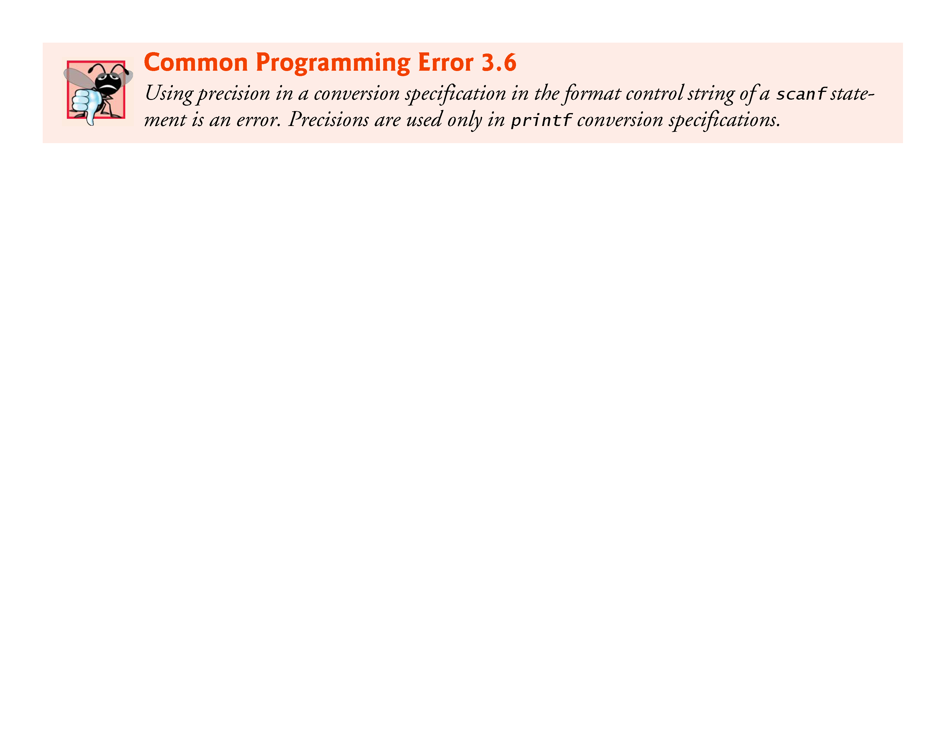
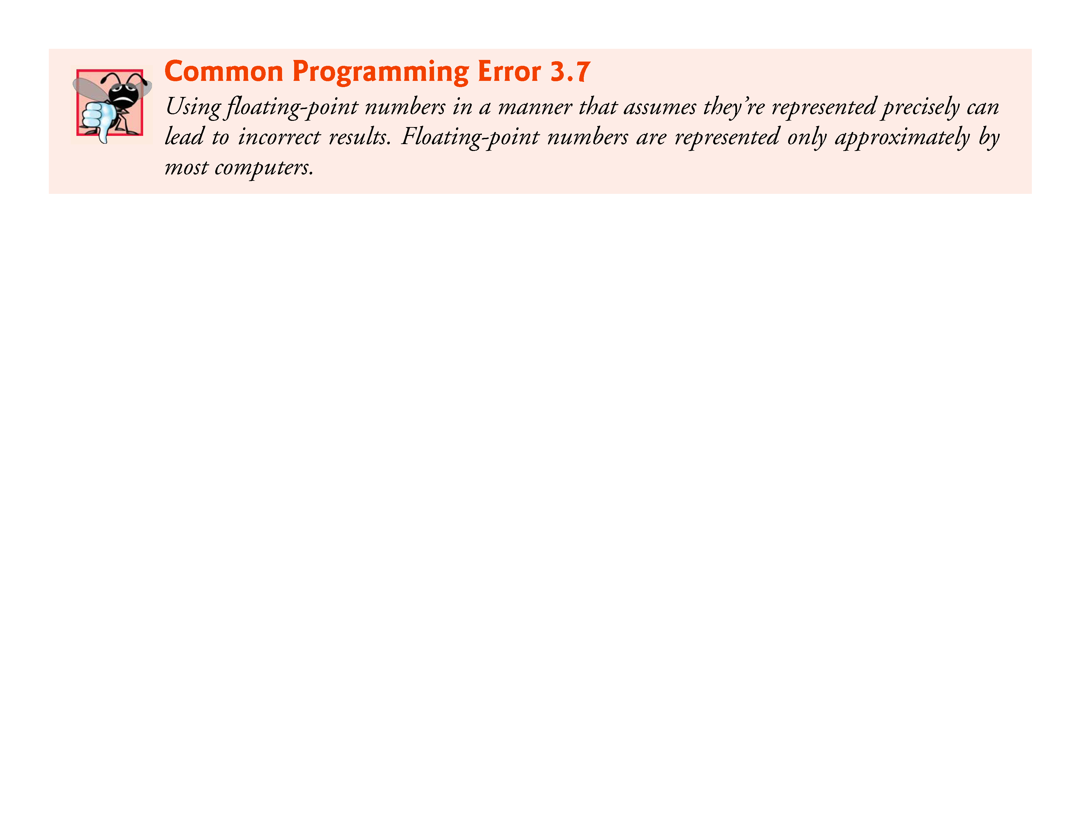
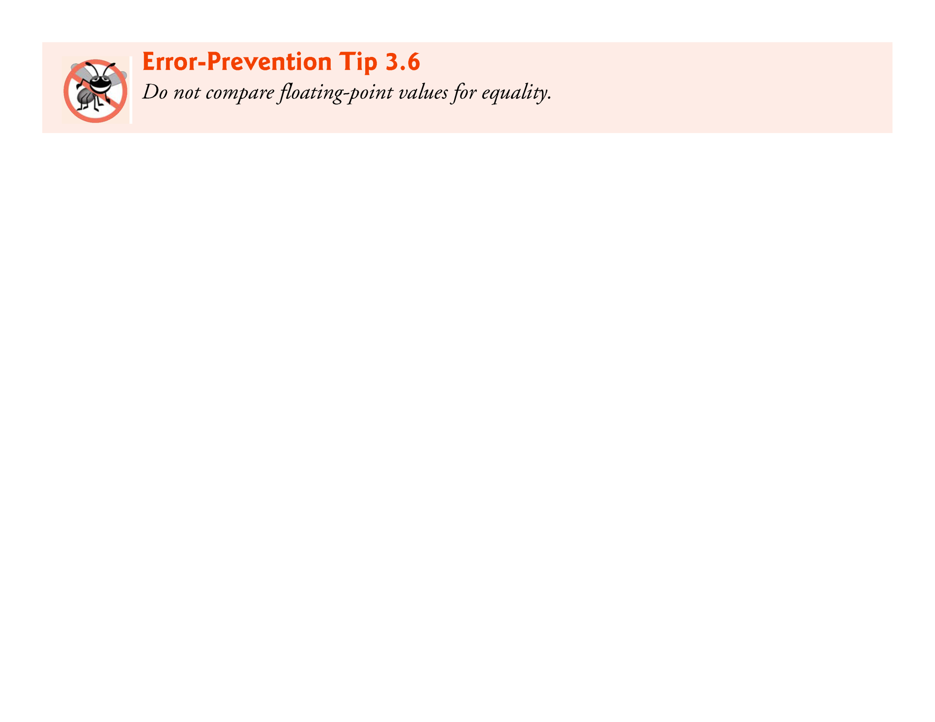

Slide 30
Nested Control Statements
Let’s work another complete problem.
We’ve seen that control statements may be stacked on top of one another (in sequence) just as a child stacks building blocks.
In this case study we’ll see the only other structured way control statements may be connected in C, namely through nesting of one control statement within another.

Slide 31
Nested Control Statements (Cont.)
Consider the following problem statement:
A college offers a course that prepares students for the state licensing exam for real estate brokers. Last year, 10 of the students who completed this course took the licensing examination. Naturally, the college wants to know how well its students did on the exam. You’ve been asked to write a program to summarize the results. You’ve been given a list of these 10 students. Next to each name a 1 is written if the student passed the exam and a 2 if the student failed.

Slide 32
Nested Control Statements (Cont.)
Your program should analyze the results of the exam as follows:
Input each test result (i.e., a 1 or a 2). Display the prompting message “Enter result” each time the program requests another test result.
Count the number of test results of each type.
Display a summary of the test results indicating the number of students who passed and the number who failed.
If more than eight students passed the exam, print the message “Bonus to instructor!”

Slide 33
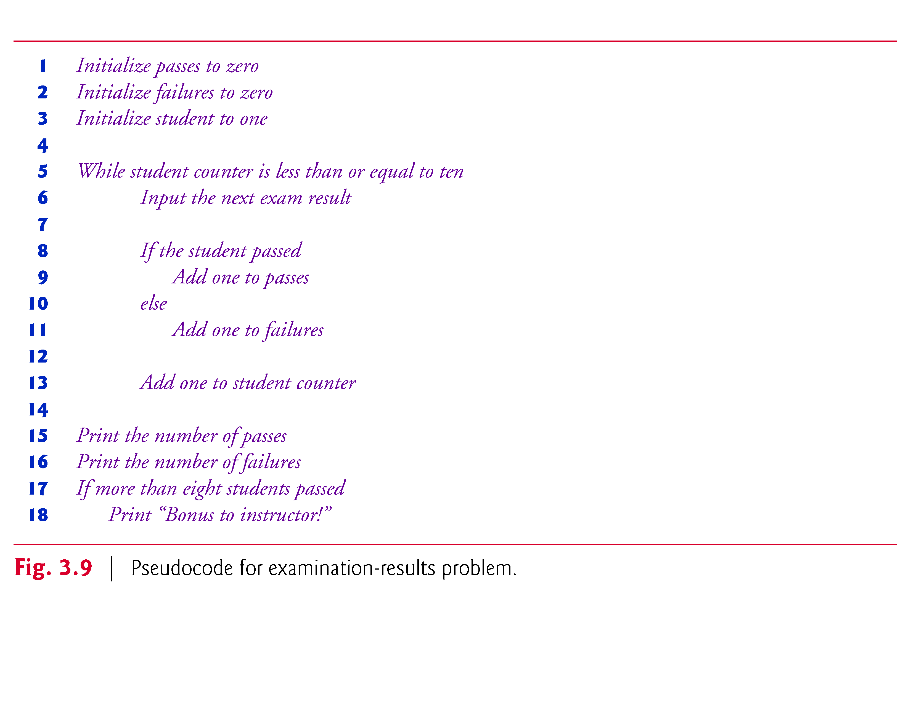

Slide 34
Nested Control Statements (Cont.)
This pseudocode is sufficiently refined for conversion to C.
The C program and two sample executions are shown in Fig. 3.10.
We’ve taken advantage of a feature of C that allows initialization to be incorporated into definitions.
Such initialization occurs at compile time.
Also, notice that when you output an unsigned int you use the %u conversion specifier.

Slide 35
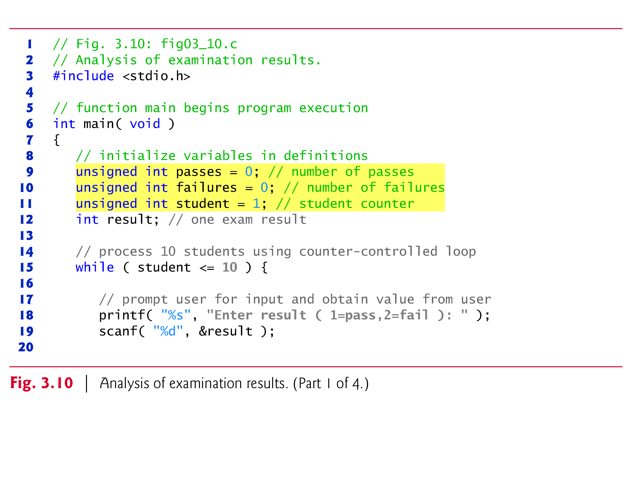

Slide 36
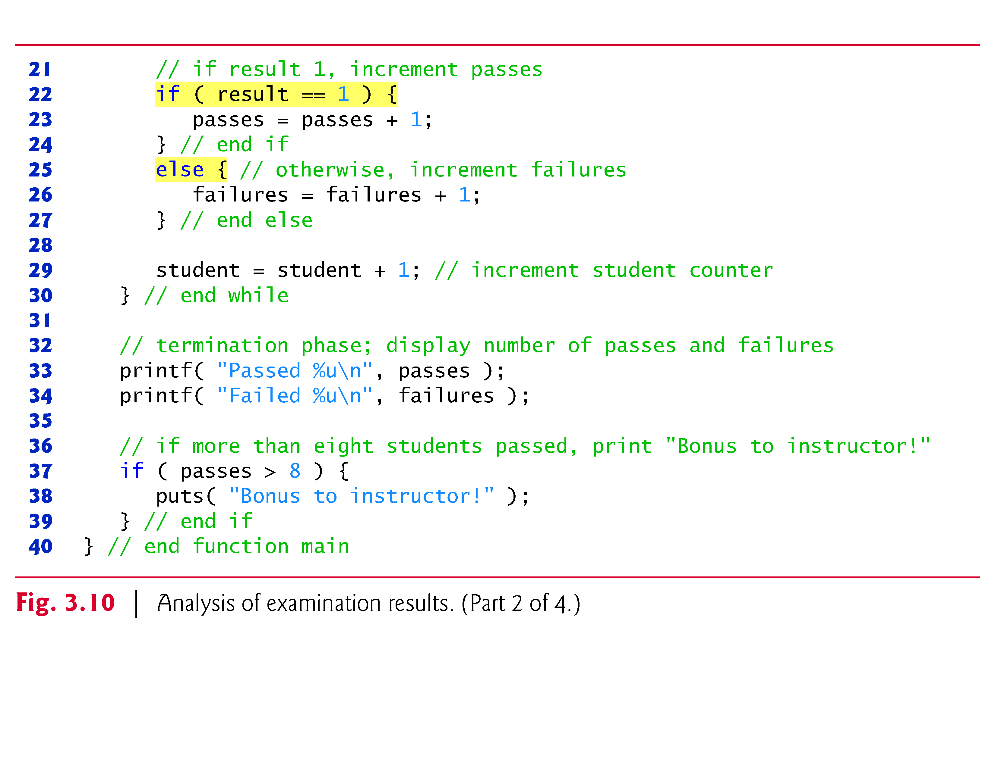

Slide 37
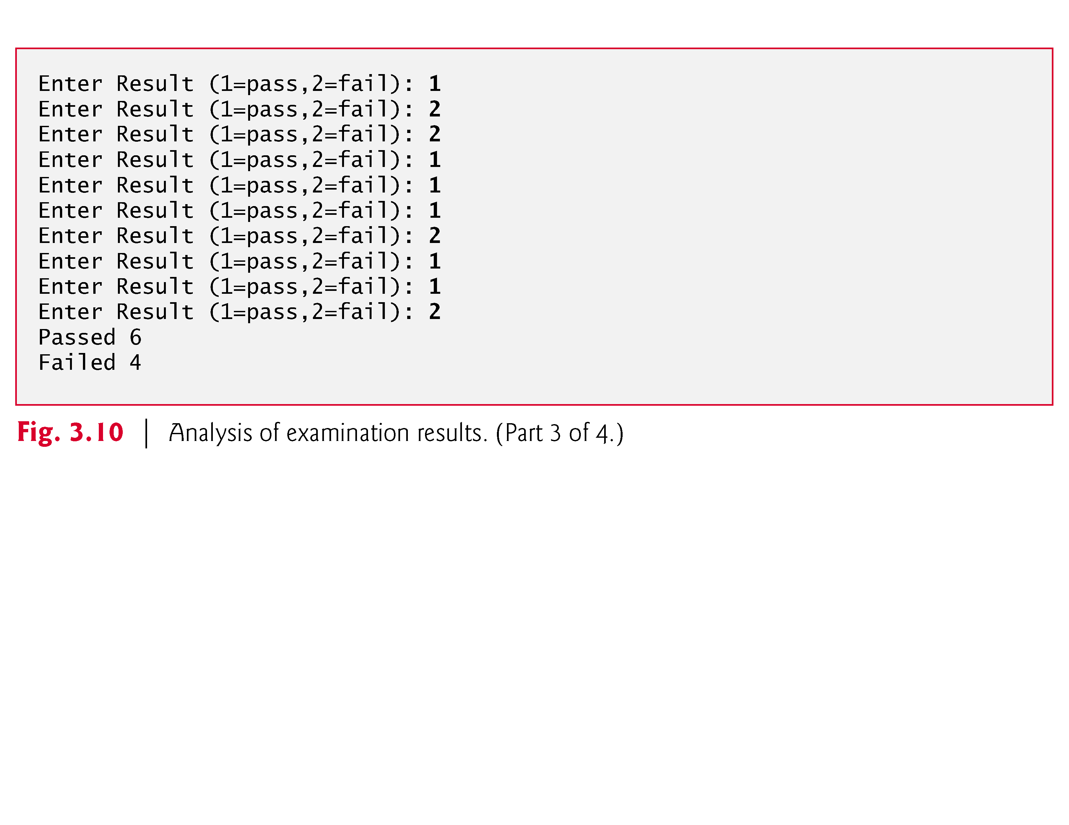

Slide 38
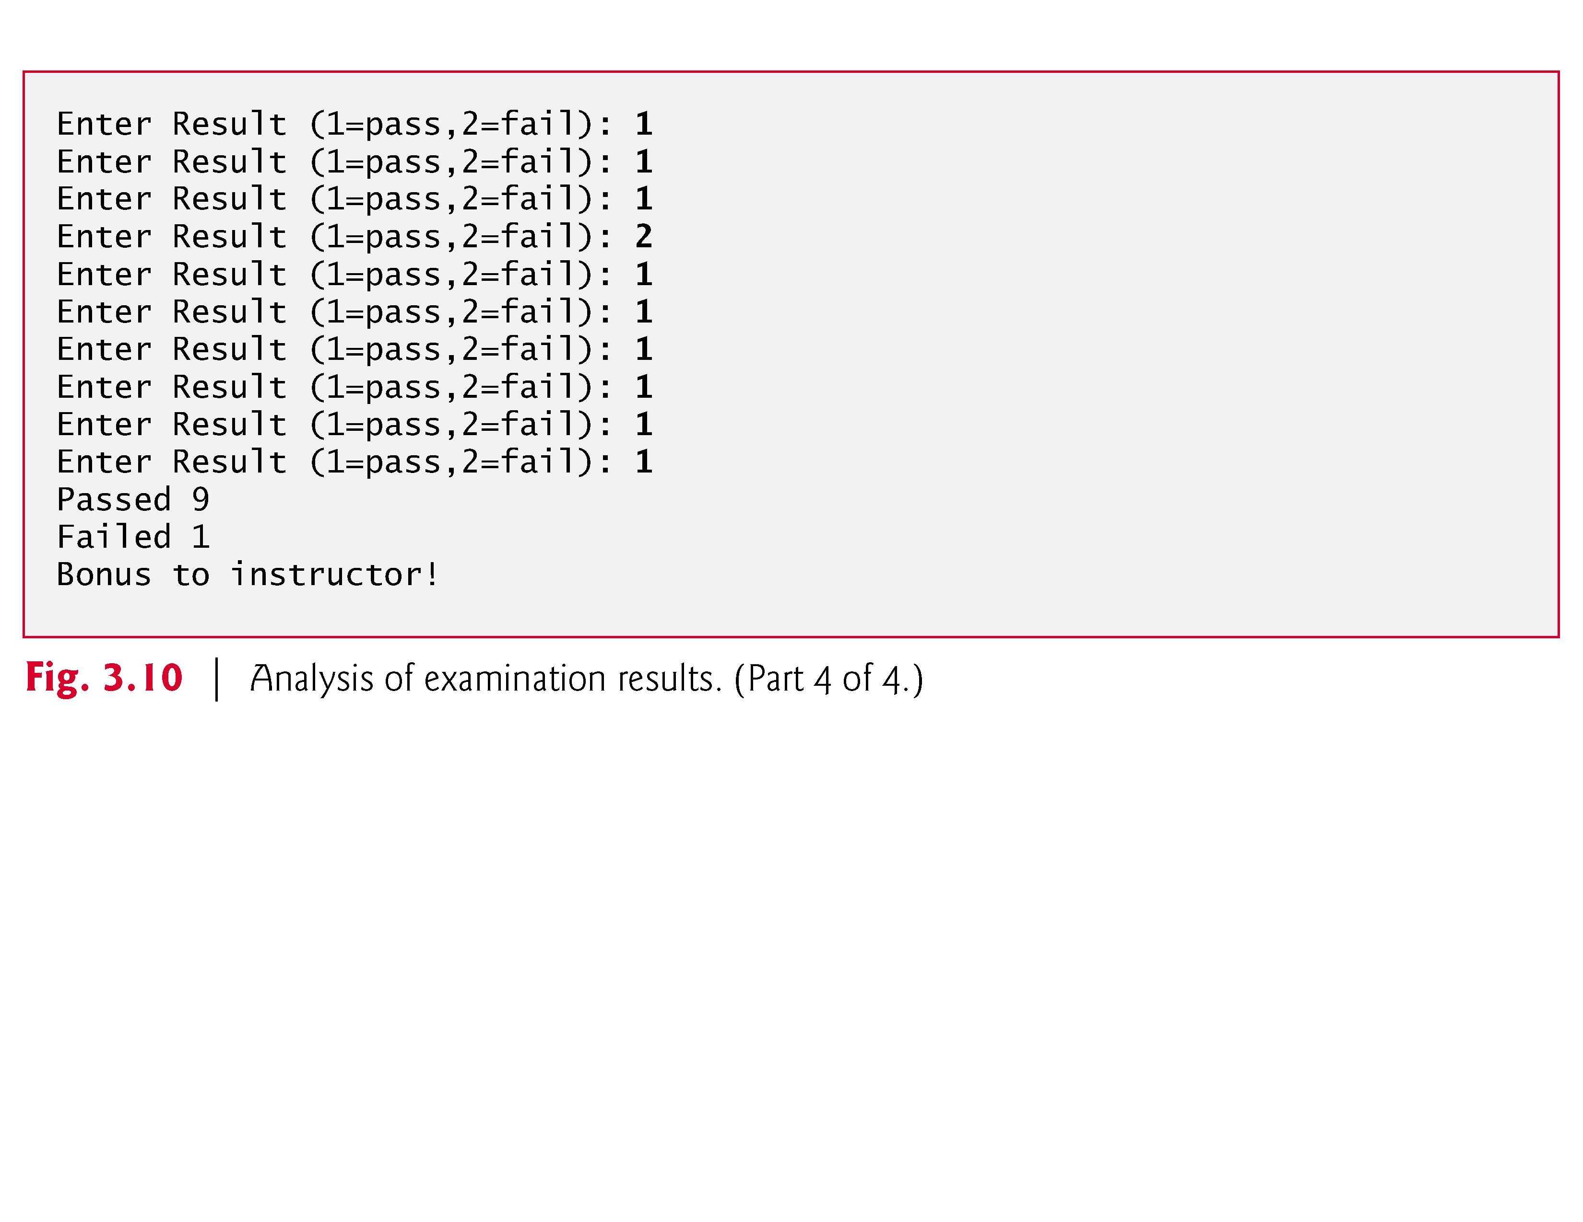

Slide 39
for Iteration Statement
The for iteration statement handles all the details of counter-controlled iteration.
To illustrate its power, let’s rewrite the program of Fig. 4.1.
The result is shown in Fig. 4.2.

Slide 40
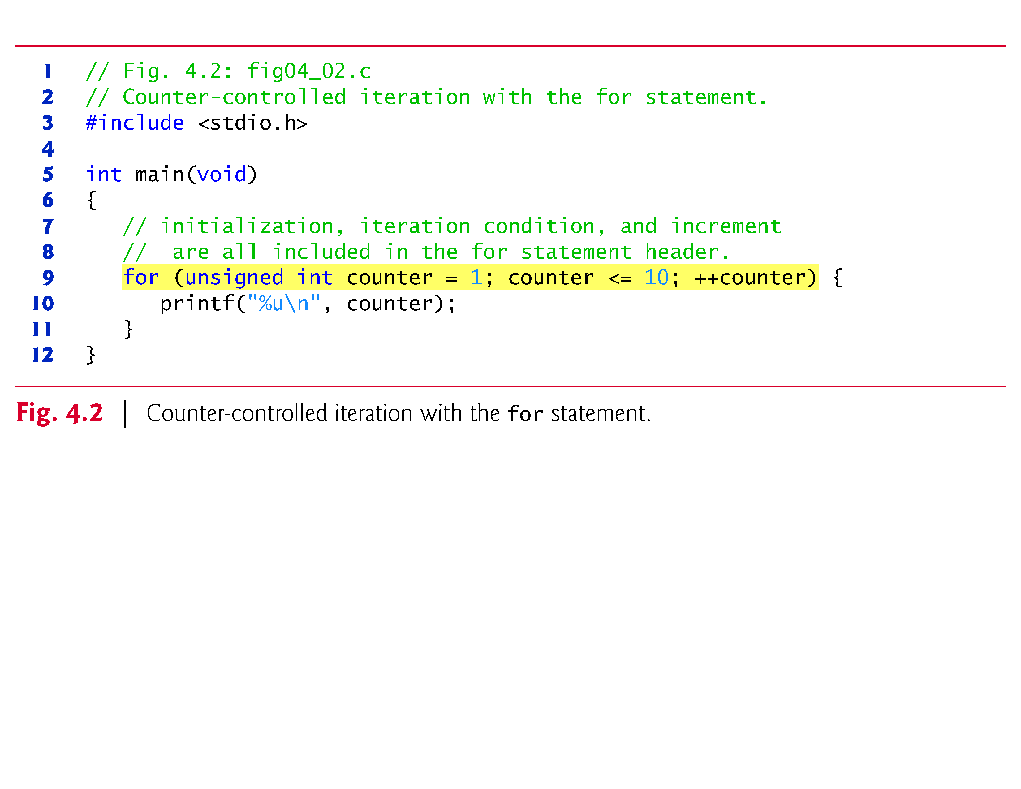
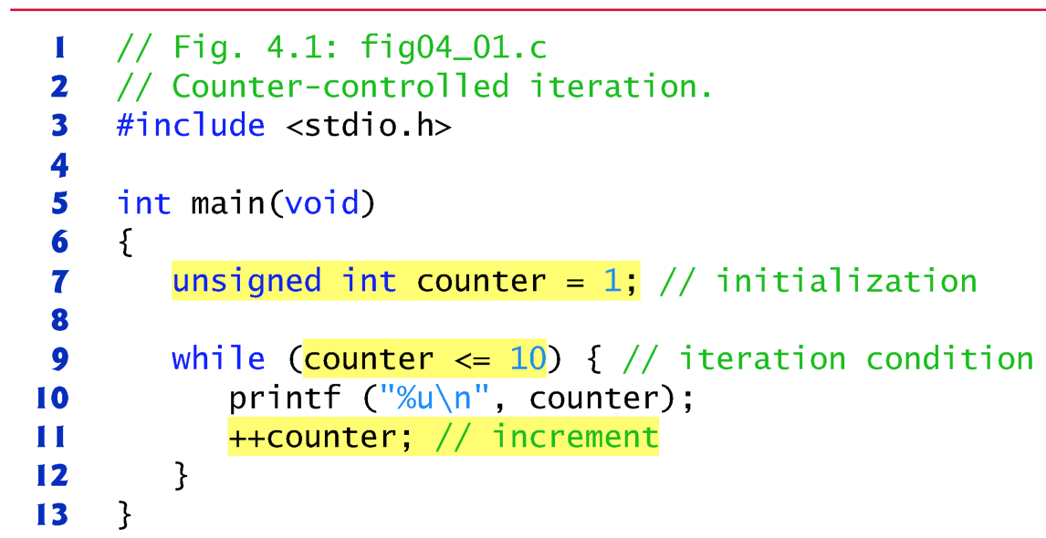

Slide 41
for Iteration Statement (Cont.)
When the for statement begins executing, the control variable counter is initialized to 1.
Then, the loop-continuation condition counter <= 10 is checked.
Because the initial value of counter is 1, the condition is satisfied, so the printf statement (line 13) prints the value of counter, namely 1.
The control variable counter is then incremented by the expression ++counter, and the loop begins again with the loop-continuation test.

Slide 42
for Iteration Statement (Cont.)
Because the control variable is now equal to 2, the final value is not exceeded, so the program performs the printf statement again.
This process continues until the control variable counter is incremented to its final value of 11—this causes the loop-continuation test to fail, and iteration terminates.
The program continues by performing the first statement after the for statement (in this case, the end of the program).

Slide 43
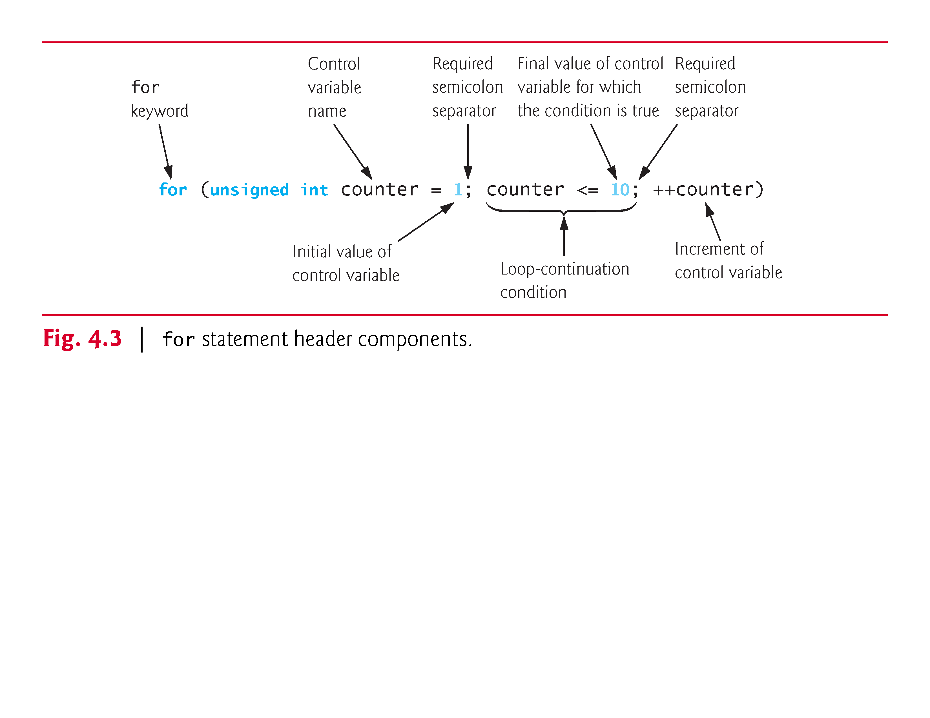
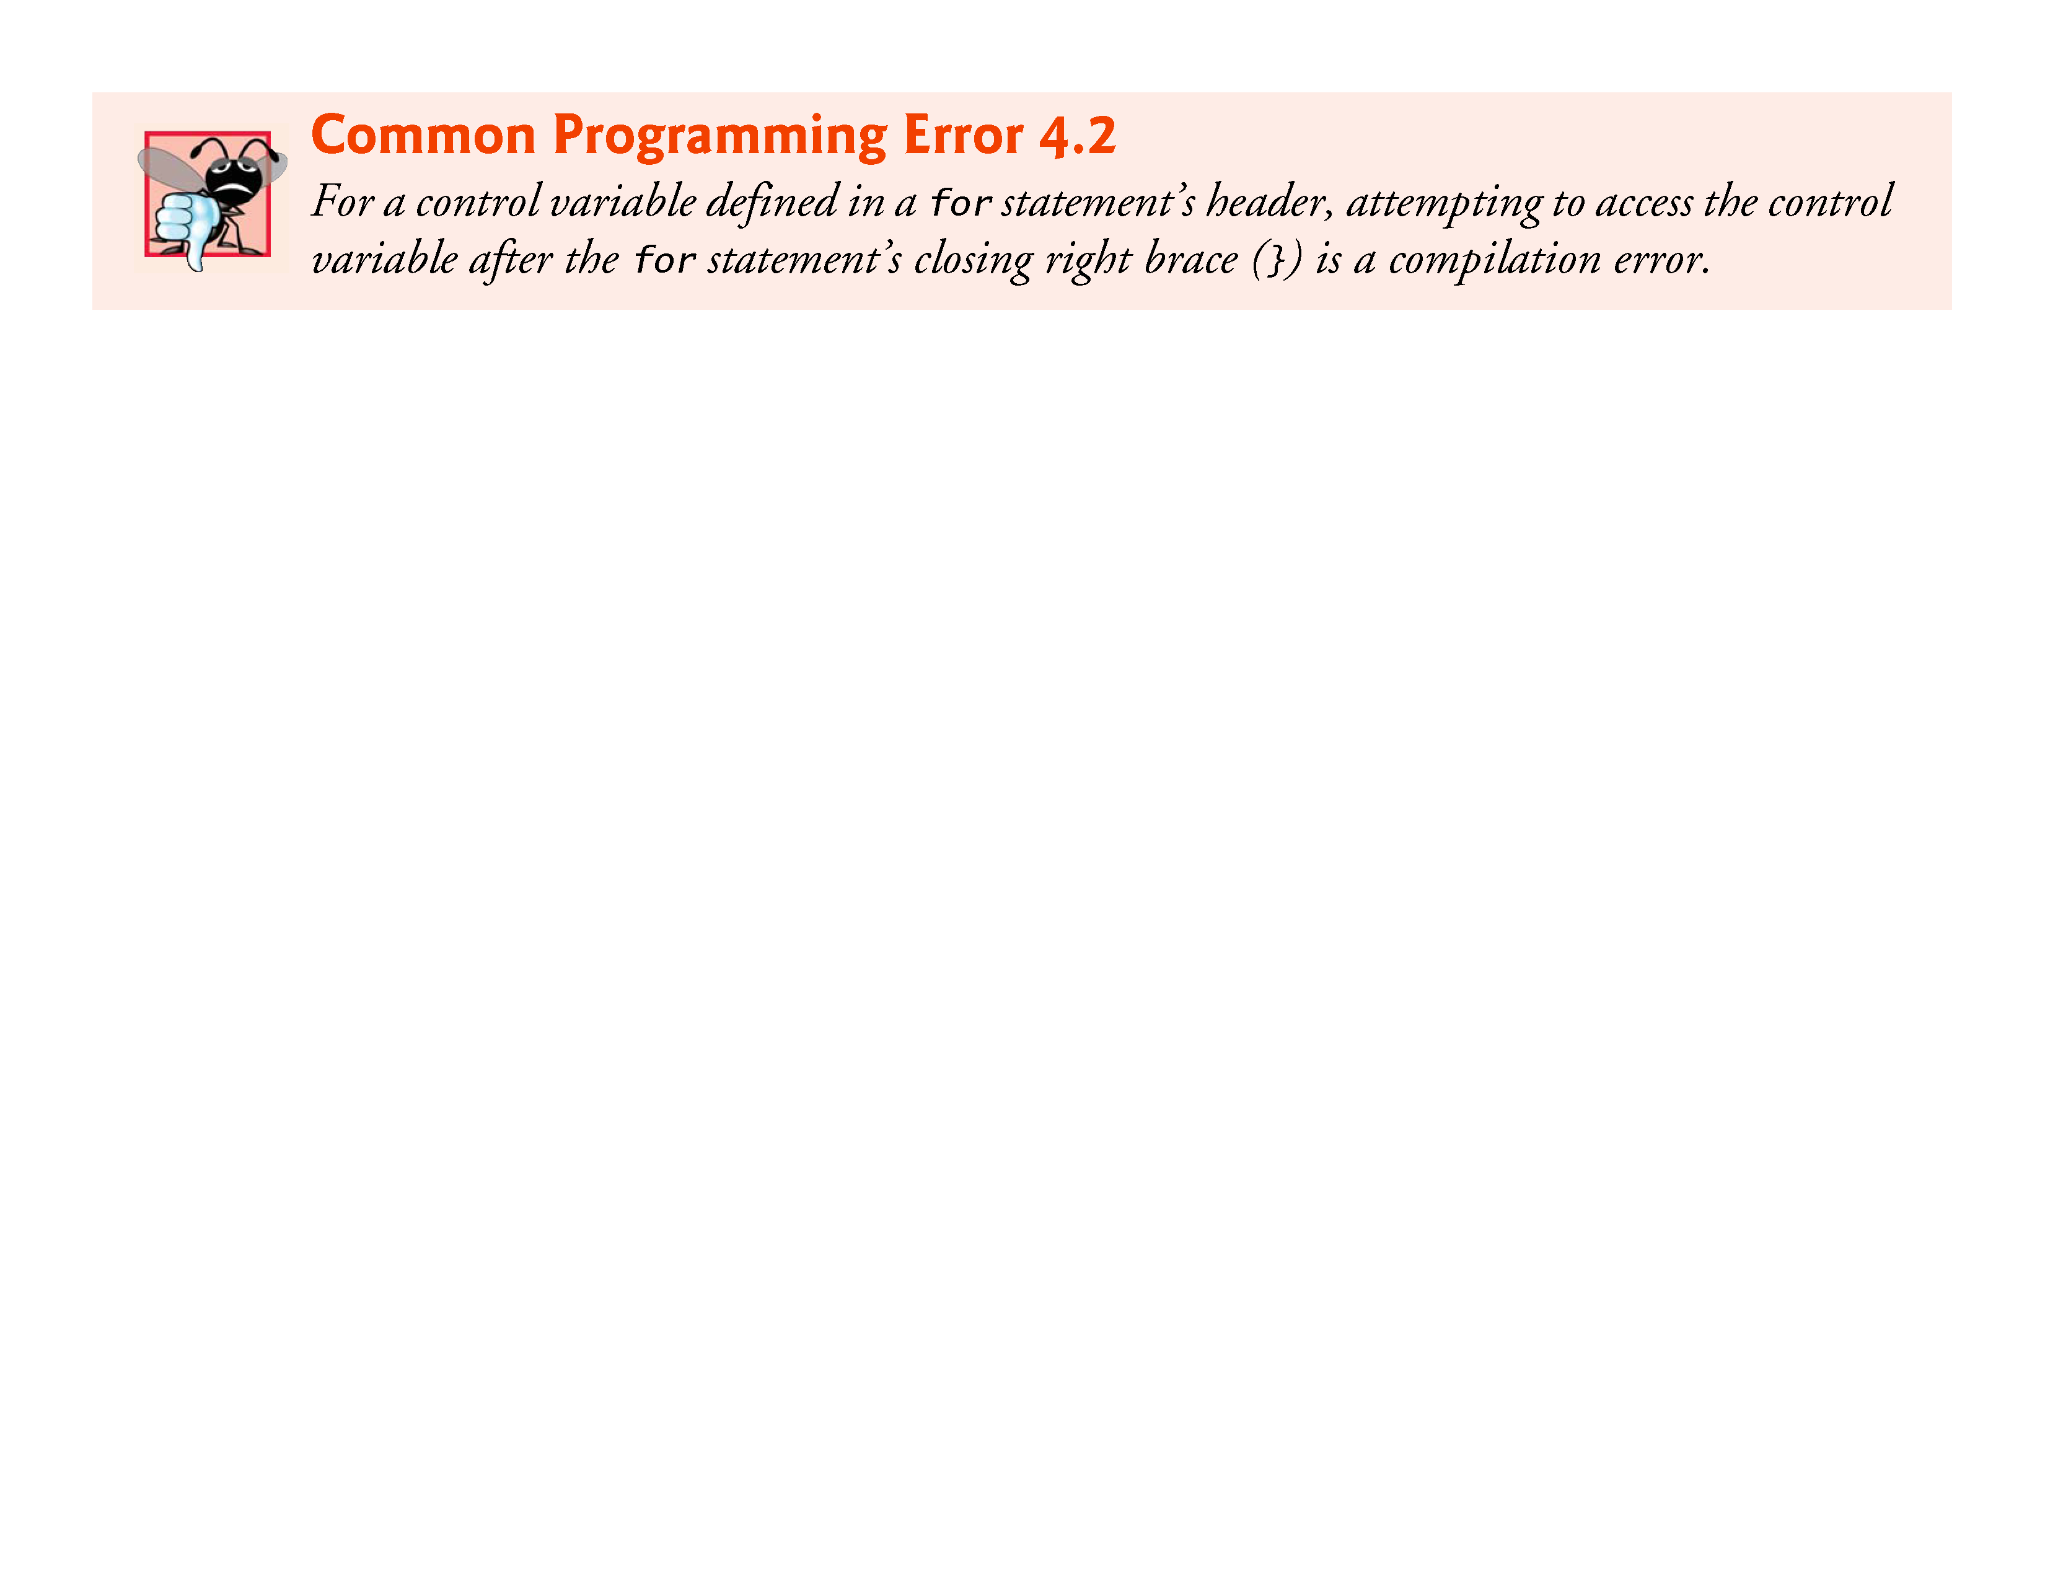

Slide 44
for Iteration Statement (Cont.)
Off-By-One Errors
Notice that Fig. 4.2 uses the loop-continuation condition counter <= 10.
If you incorrectly wrote counter < 10, then the loop would be executed only 9 times.
This is a common logic error called an off-by-one error.

Slide 45
for Iteration Statement (Cont.)
Expressions in the for Statement’s Header Are Optional
The three expressions in the for statement are optional.
If the condition expression is omitted, C assumes that the condition is true, thus creating an infinite loop.
You may omit the initialization expression if the control variable is initialized elsewhere in the program.
The increment may be omitted if it’s calculated by statements in the body of the for statement or if no increment is needed.

Slide 46
for Iteration Statement (Cont.)
Increment Expression Acts Like a Standalone Statement
The increment expression in the for statement acts like a stand-alone C statement at the end of the body of the for.
Therefore, the expressions
counter = counter + 1 counter += 1 ++counter counter++
are all equivalent in the increment part of the for statement.
Because the variable being preincremented or postincremented here does not appear in a larger expression, both forms of incrementing have the same effect.
The two semicolons in the for statement are required.

Slide 47
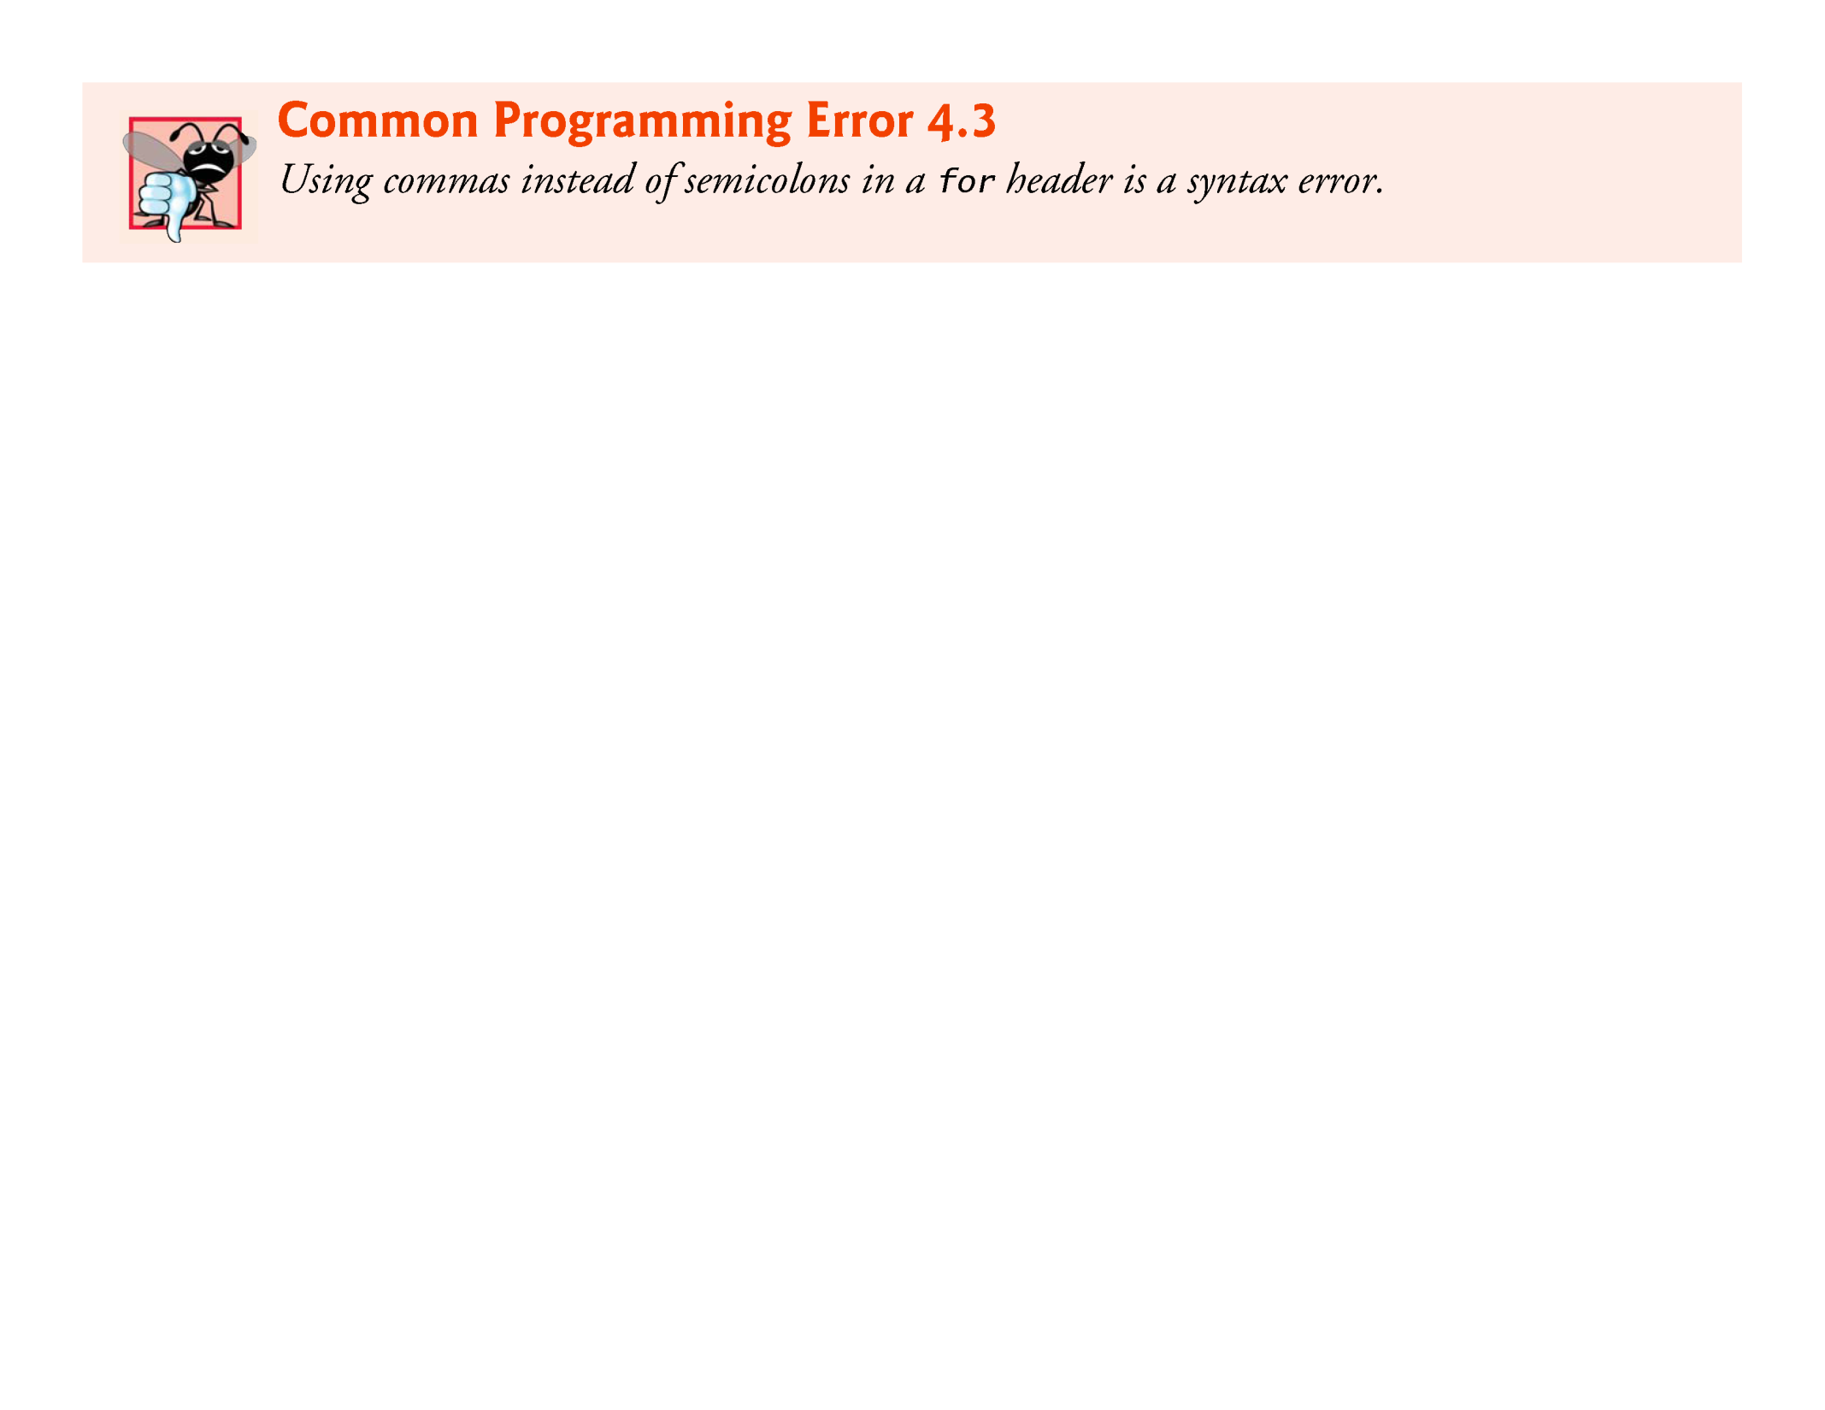
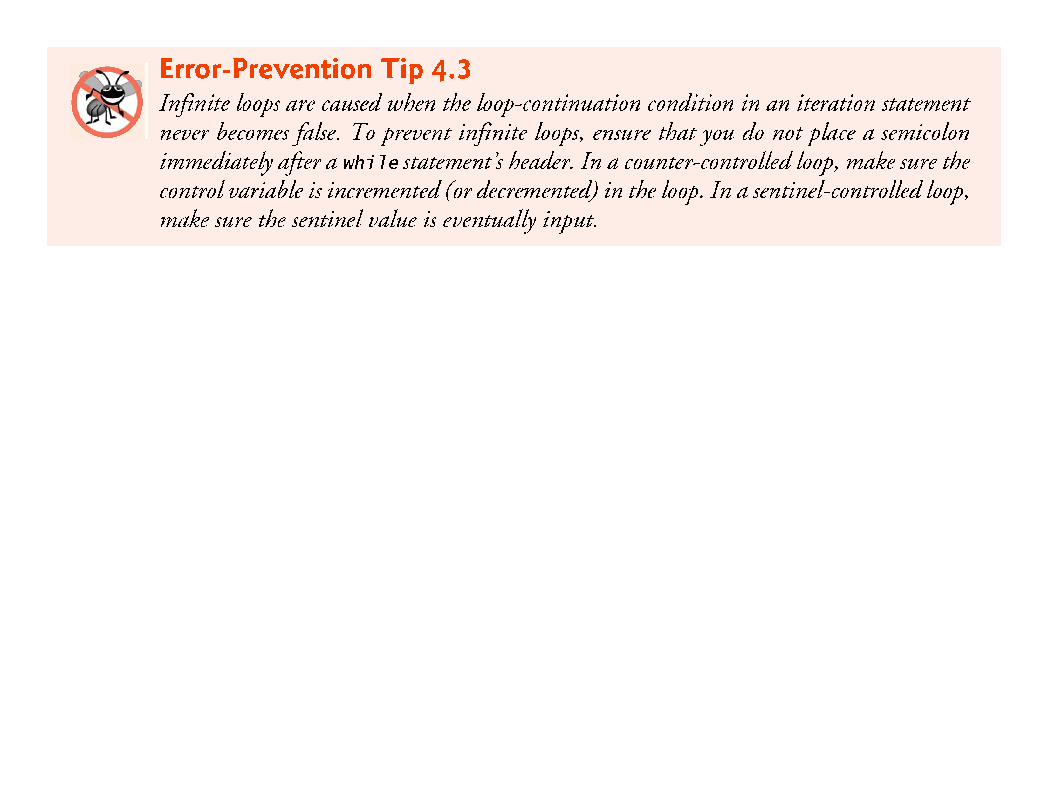

Slide 48
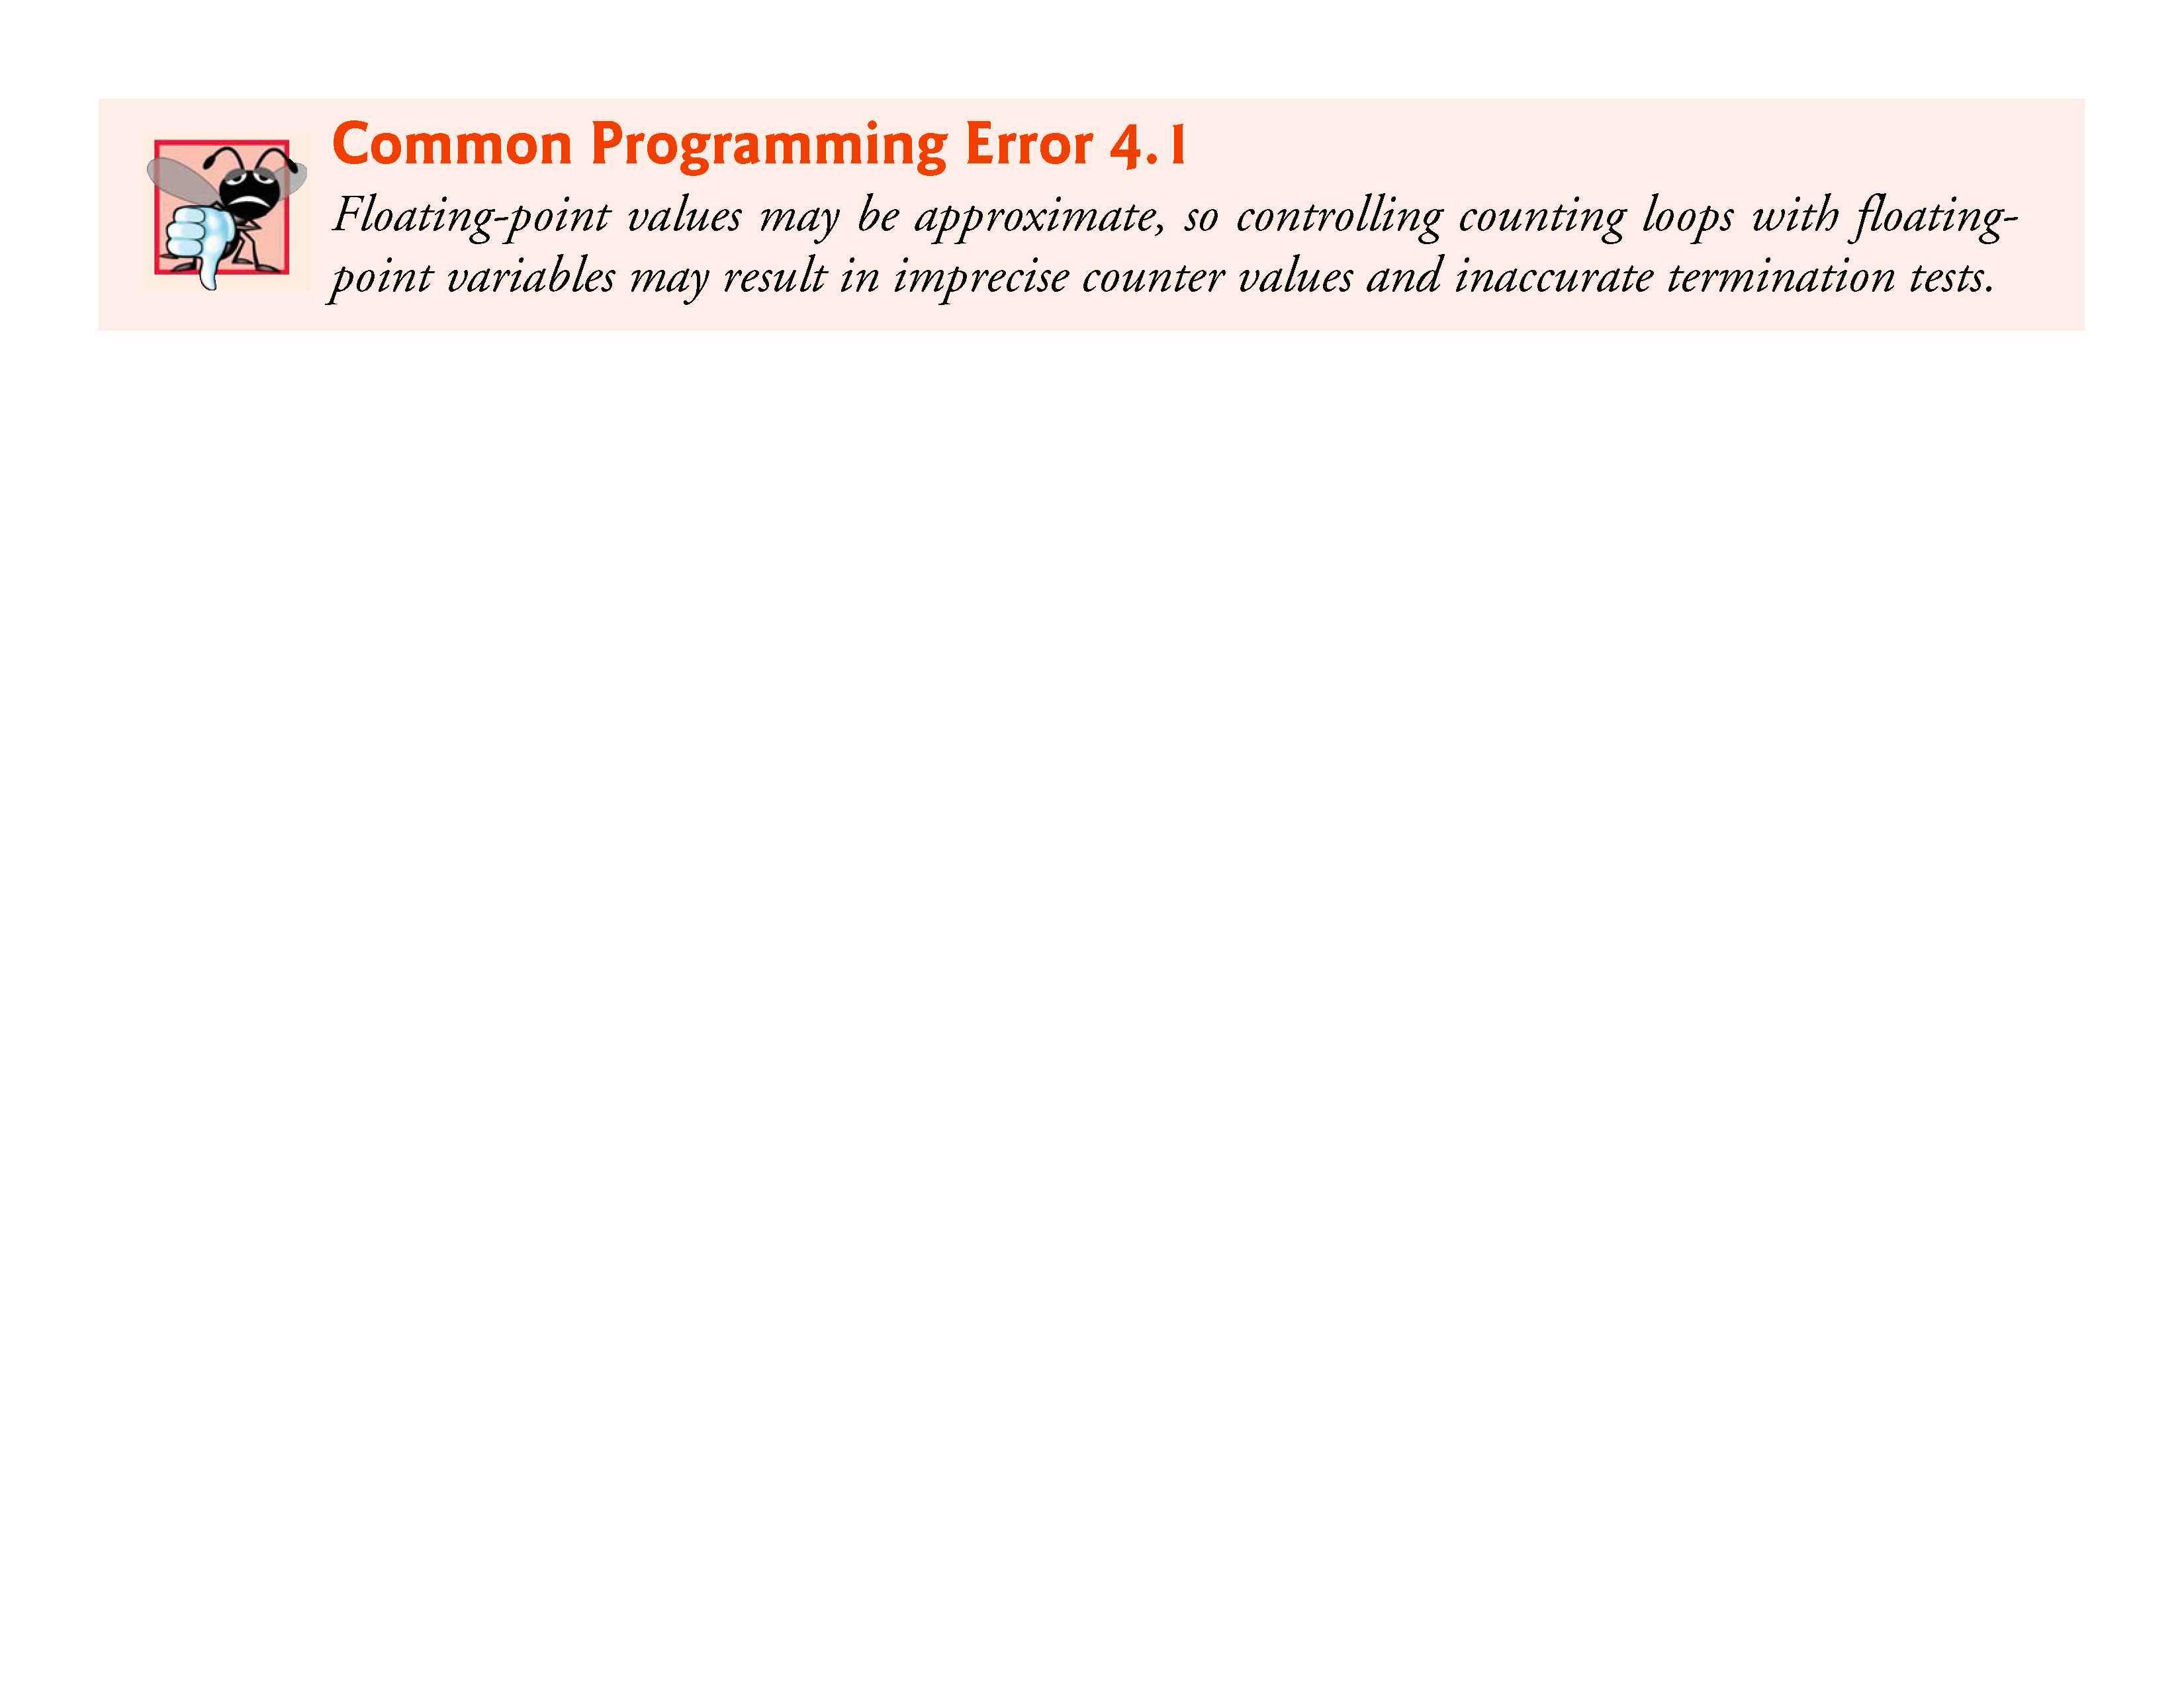
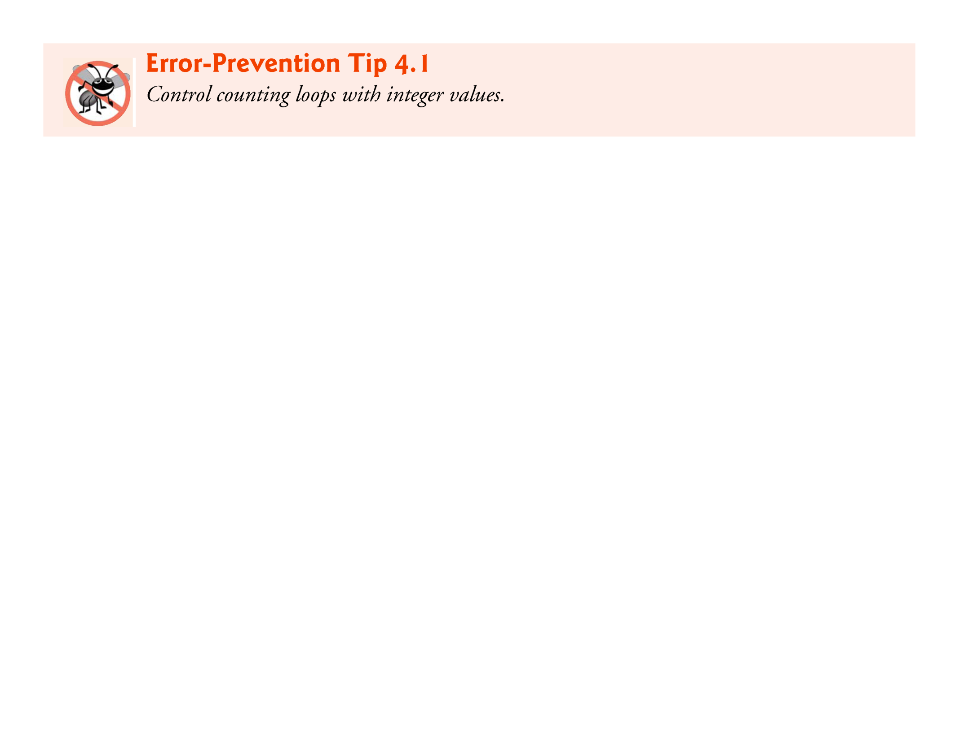

Slide 49
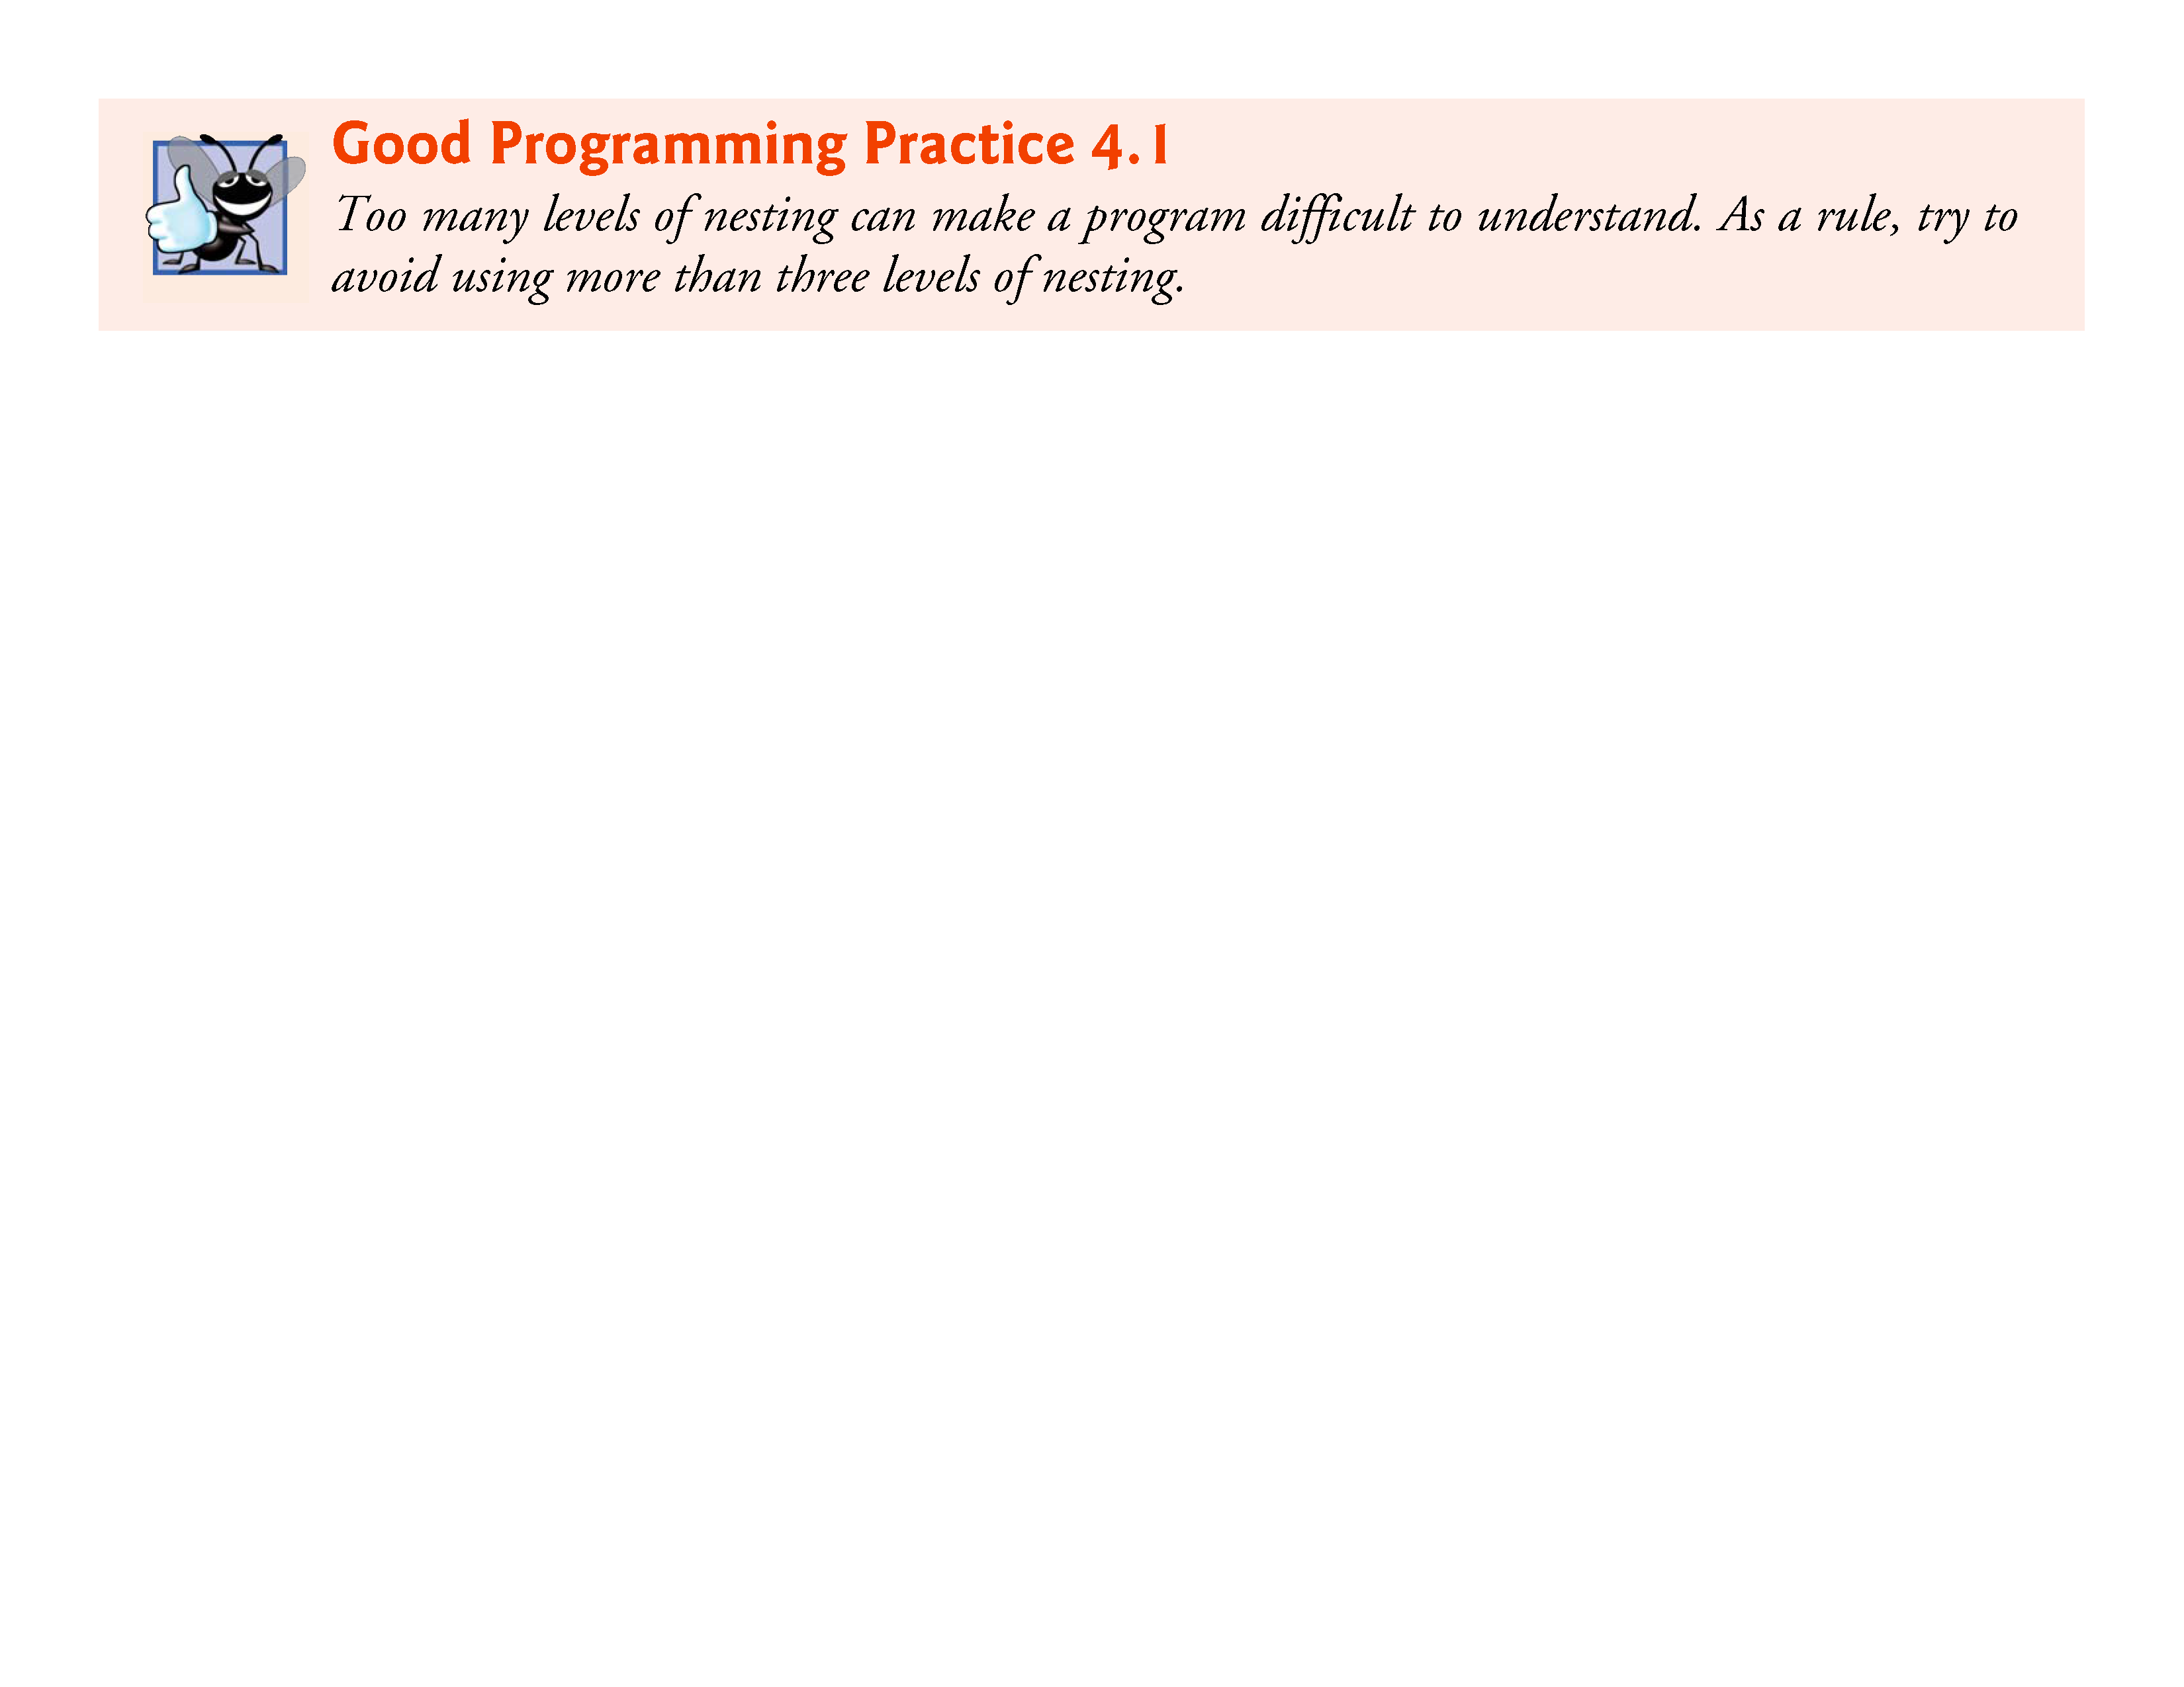
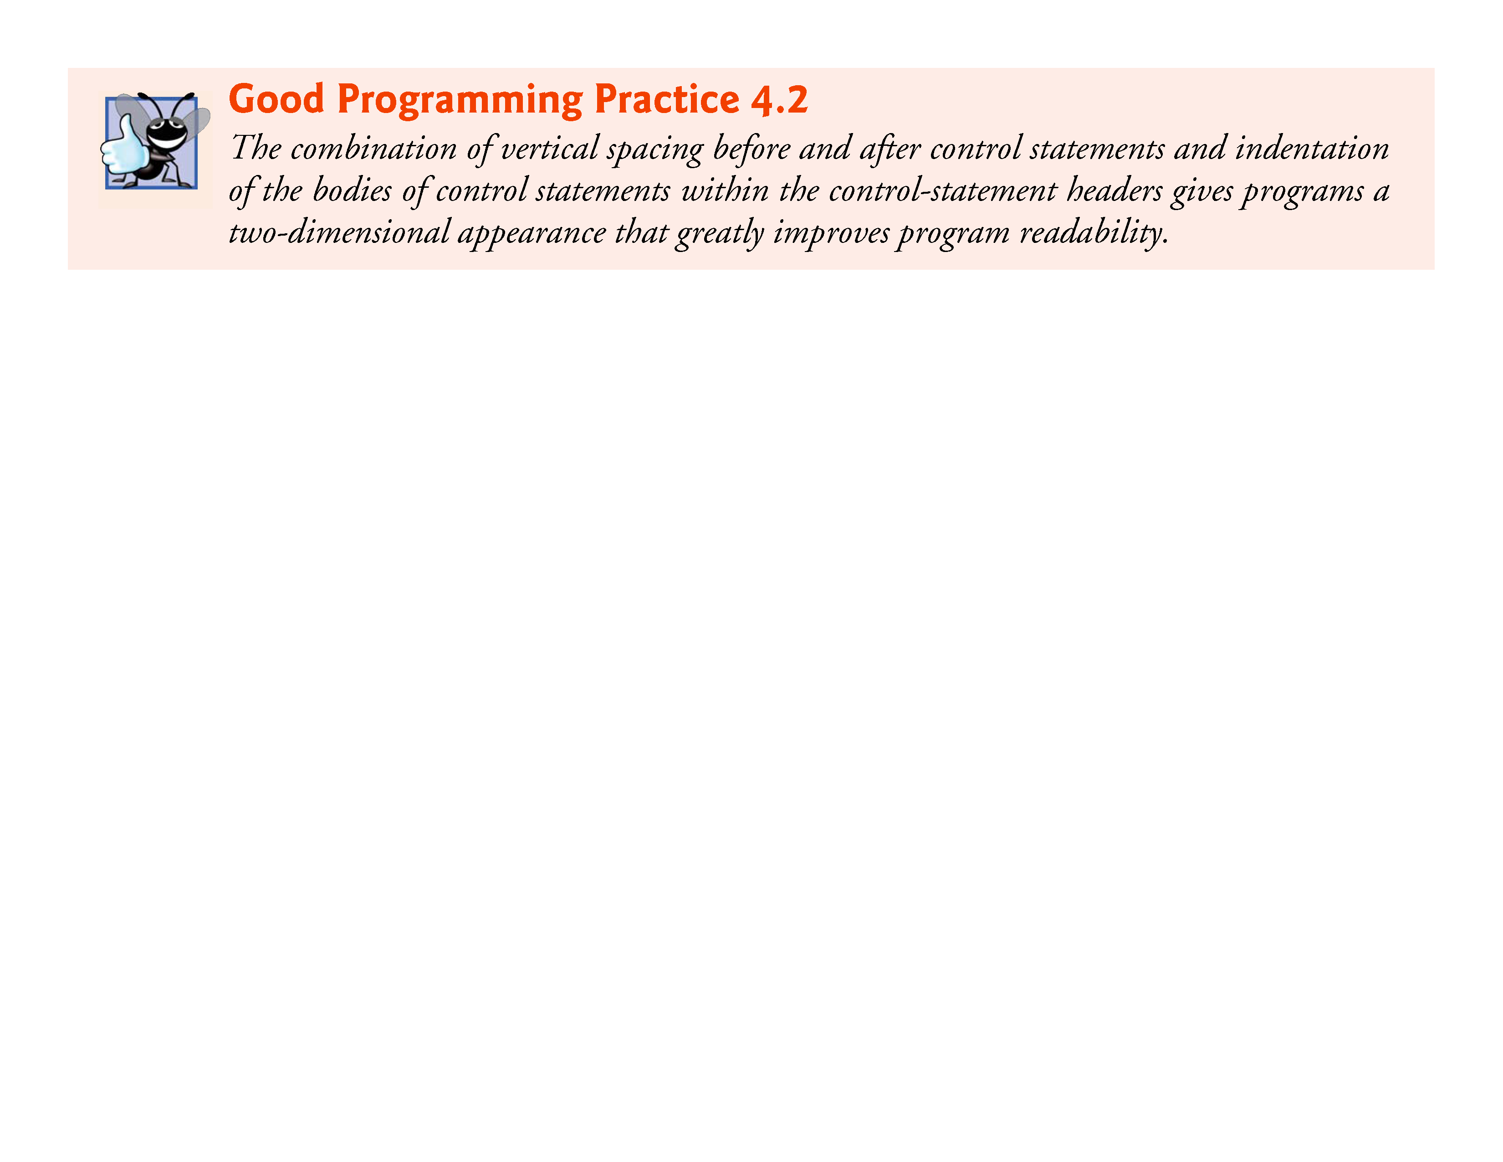

Slide 50
for Statement: Notes and Observations
The initialization, loop-continuation condition and increment can contain arithmetic expressions. For example, if x = 2 and y = 10, the statement
for (j = x; j <= 4 * x * y; j += y / x)
is equivalent to the statement
for (j = 2; j <= 80; j += 5)
The “increment” may be negative (in which case it’s really a decrement and the loop actually counts downward).
If the loop-continuation condition is initially false, the loop body does not execute. Instead, execution proceeds with the statement following the for statement.

Slide 51
for Statement: Notes and Observations (cont.)
The control variable is frequently printed or used in calculations in the body of a loop, but it need not be. It’s common to use the control variable for controlling iteration while never mentioning it in the body of the loop.
The for statement is flowcharted much like the while statement. For example, Fig. 4.4 shows the flowchart of the for statement
for (counter = 1; counter <= 10; ++counter) printf("%u", counter);
This flowchart makes it clear that the initialization occurs only once and that incrementing occurs after the body statement is performed.

Slide 52
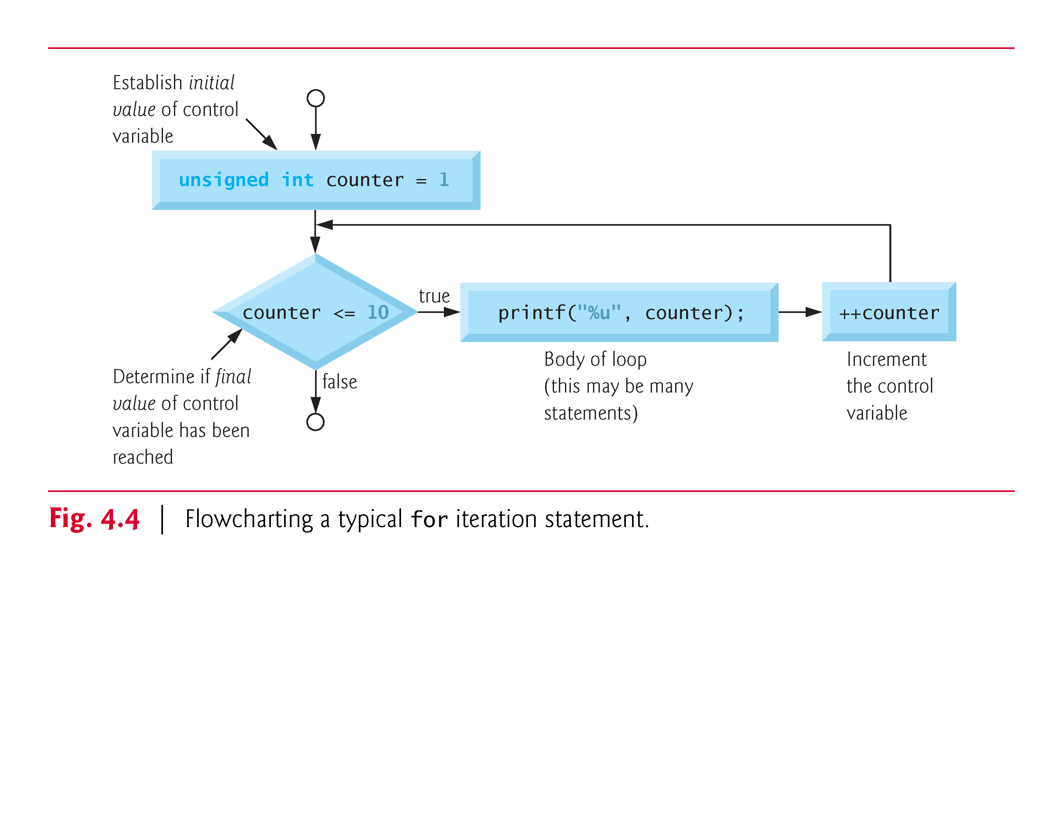
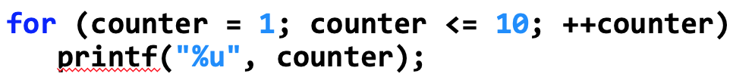
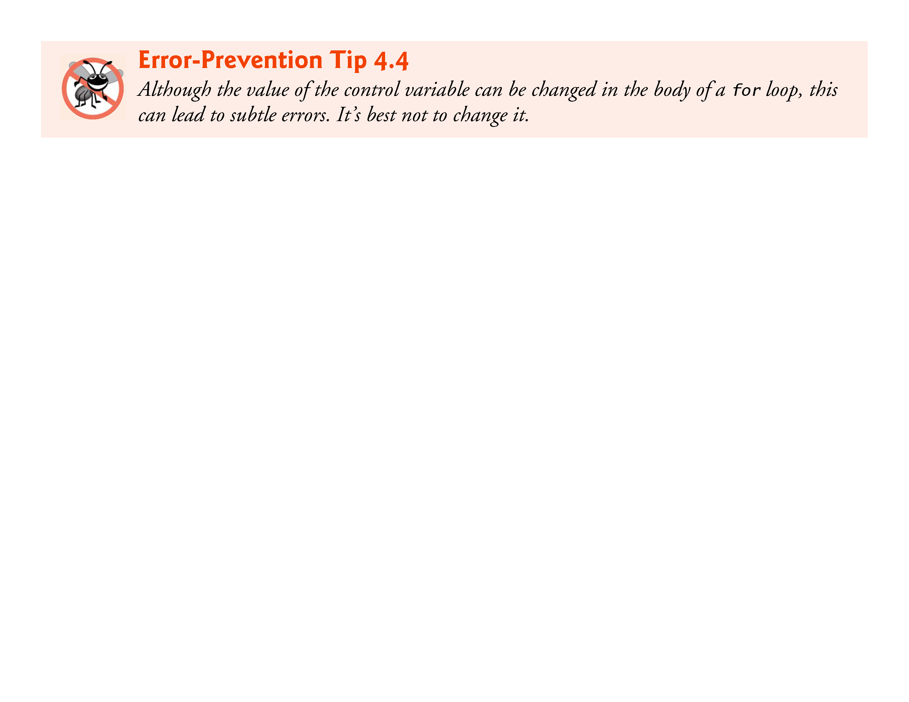

Slide 53
Examples Using the for Statement
The following examples show methods of varying the control variable in a for statement.
Vary the control variable from 1 to 100 in increments of 1.
for (i = 1; i <= 100; ++ i)
Vary the control variable from 100 to 1 in increments of -1 (decrements of 1).
for (i = 100; i >= 1; --i)
Vary the control variable from 7 to 77 in steps of 7.
for (i = 7; i <= 77; i += 7)
Vary the control variable from 20 to 2 in steps of -2.
for (i = 20; i >= 2; i -= 2)
Vary the control variable over the following sequence of values: 2, 5, 8, 11, 14, 17.
for (j = 2; j <= 17; j += 3)
Vary the control variable over the following sequence of values: 44, 33, 22, 11, 0.
for (j = 44; j >= 0; j -= 11)

Slide 54
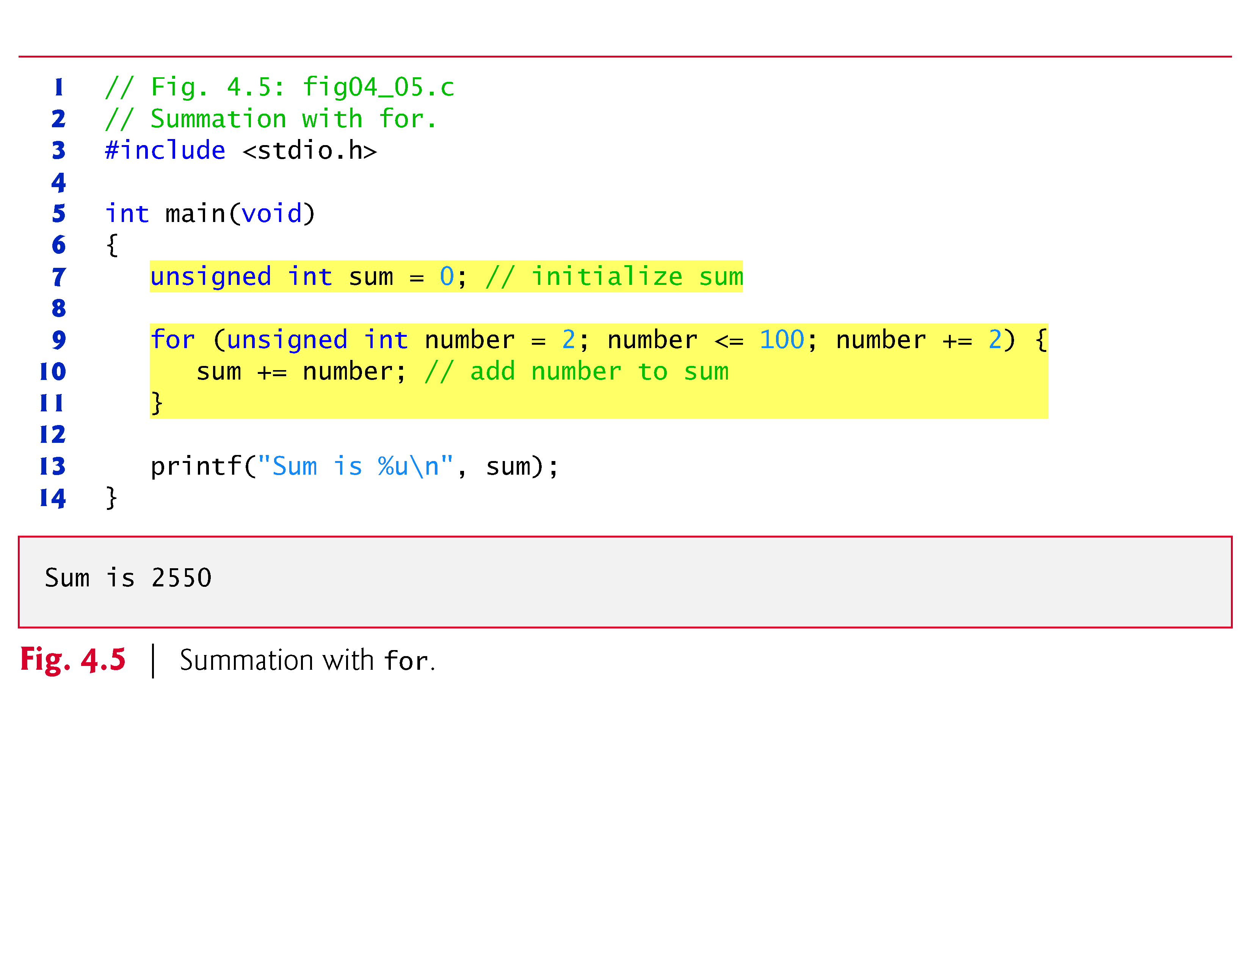
Examples Using the for Statement (Cont.)
Application: Summing the Even Integers from 2 to 100
Figure 4.5 uses the for statement to sum all the even integers from 2 to 100.

Slide 55
Introduction to Array
Arrays are data structures consisting of related data items of the same type.
Arrays are “static” entities in that they remain the same size throughout program execution.
An array is a group of contiguous memory locations that all have the same type.
To refer to a particular location or element in the array, we specify the array’s name and the position number of the particular element in the array.

Slide 56
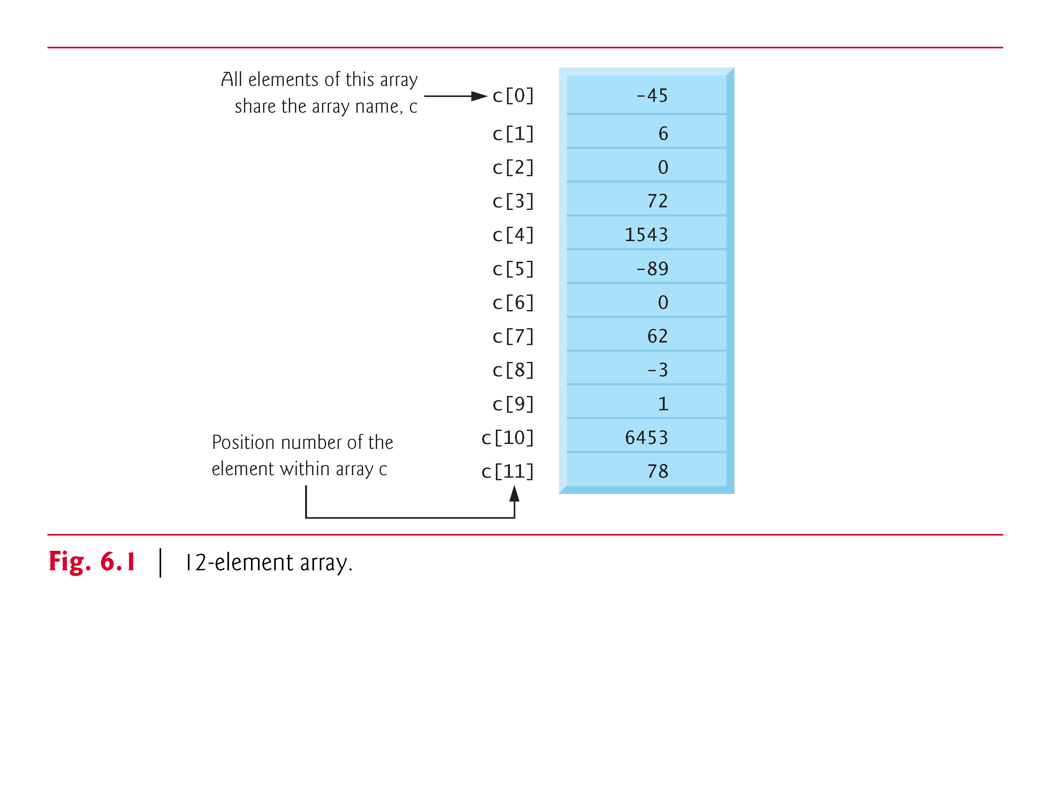
Figure 6.1 shows an integer array called c, containing 12 elements.
Any one of these elements may be referred to by giving the array’s name followed by the position number of the particular element in square brackets ([]).

Slide 57
Arrays (Cont.)
The first element in every array is the zero^{th} element.
An array name, like other identifiers, can contain only letters, digits and underscores and cannot begin with a digit.
The position number within square brackets is called an index or subscript.
An index must be an integer or an integer expression.
For example, if a = 5 and b = 6, then the statement
c[a + b] += 2;
adds 2 to array element c[11].

Slide 58
Defining Arrays
You specify the type of each element and the number of elements each array requires so that the computer may reserve the appropriate amount of memory.
The following definition reserves 12 elements for integer array c, which has indices in the range 0 - 11.
int c[12];

Slide 59
Defining Arrays (Cont.)
The definition
int b[100], x[27];
reserves 100 elements for integer array b and 27 elements for integer array x.
These arrays have indices in the ranges 0 – 99 and 0 – 26, respectively.
Arrays may contain other data types.
Like any other variables, uninitialized array elements contain garbage values.

Slide 60
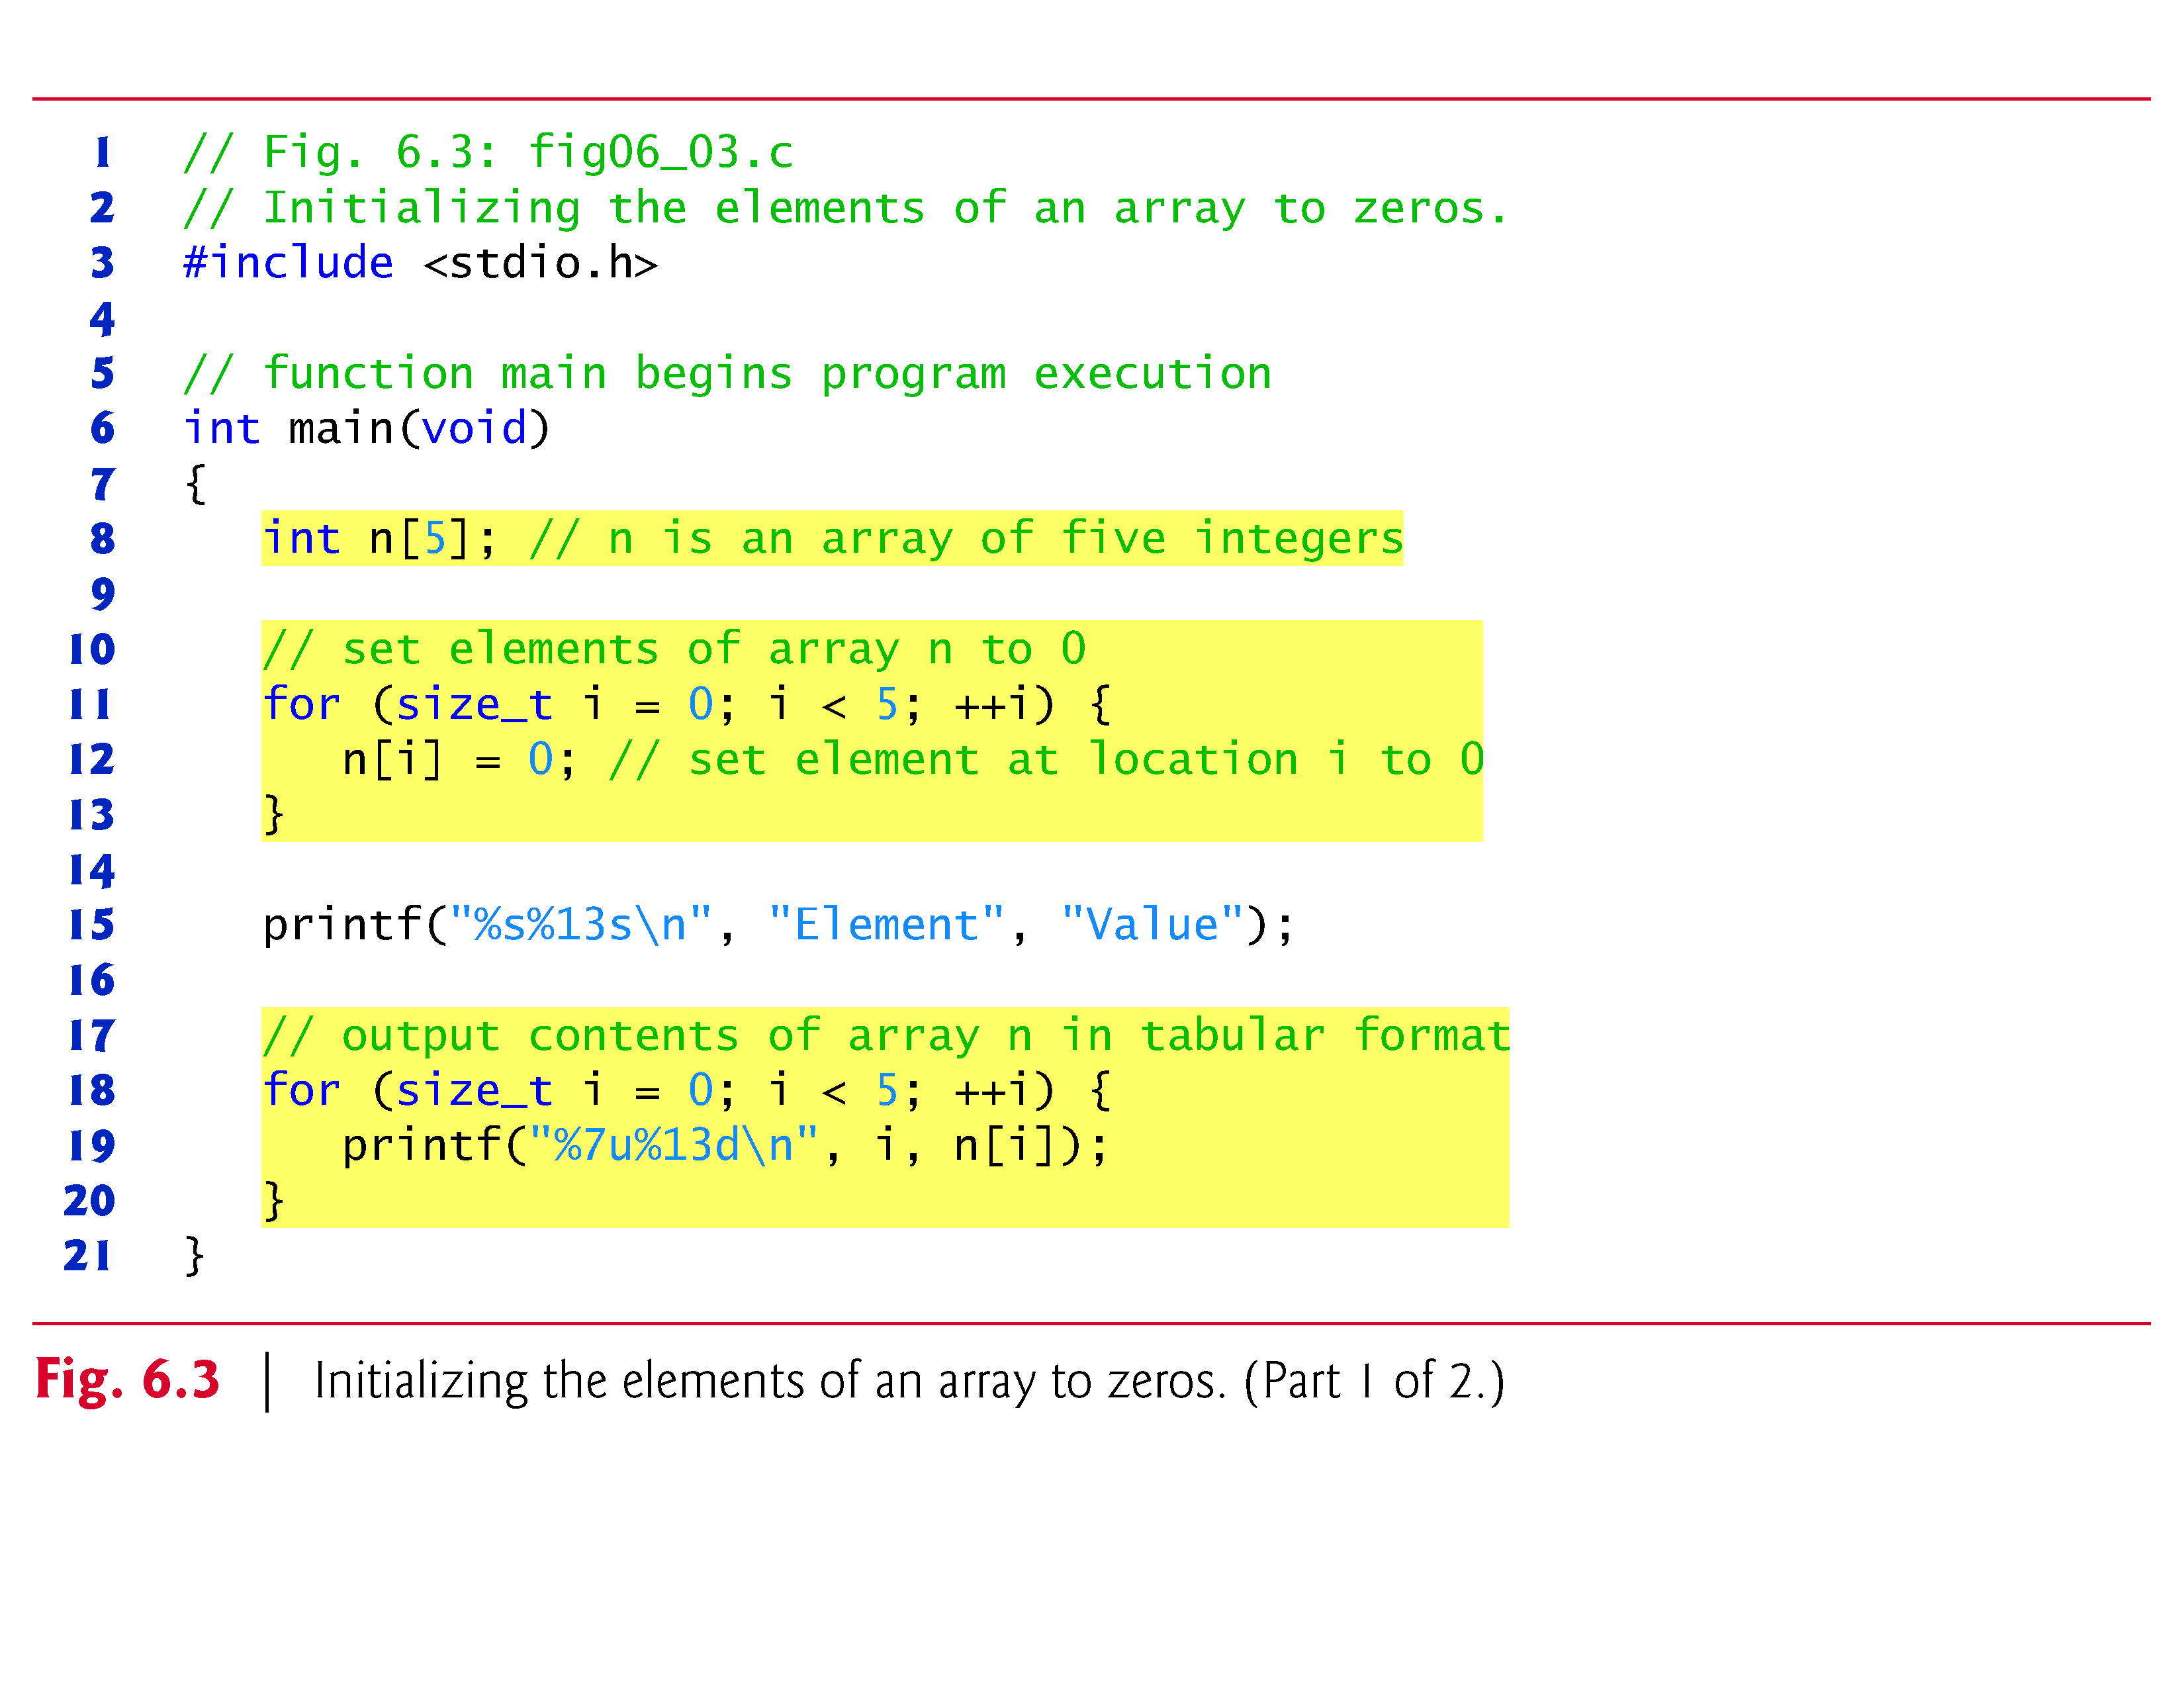

Slide 61
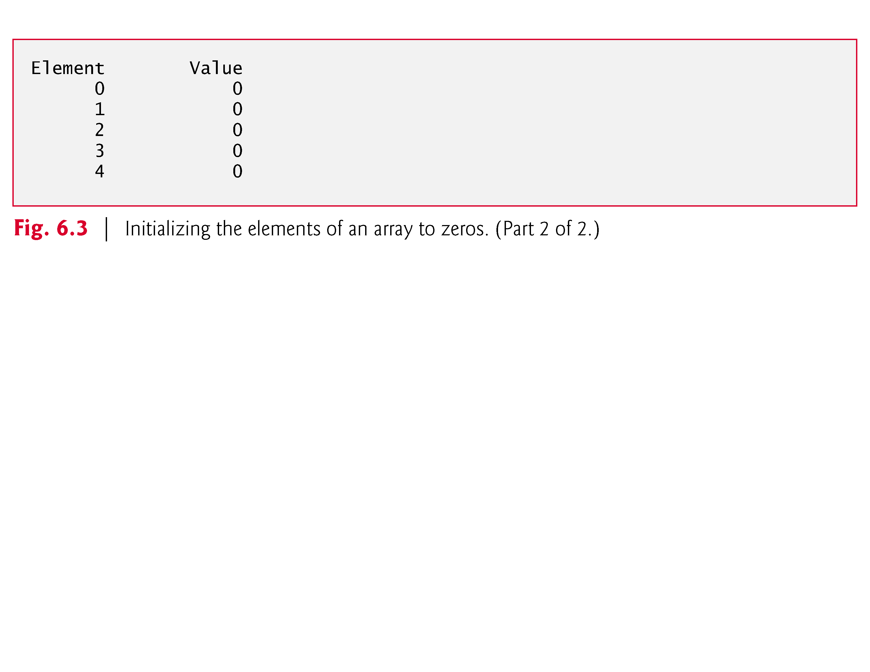

Slide 62
Array Examples (Cont.)
Notice that the variable i is declared to be of type size_t, which according to the C standard represents an unsigned integral type.
This type is recommended for any variable that represents an array’s size or an array’s indices.
Type size_t is defined in header <stddef.h>, which is often included by other headers (such as <stdio.h>).
[Note: If you attempt to compile Fig. 6.3 and receive errors, simply include <stddef.h> in your program.]

Slide 63
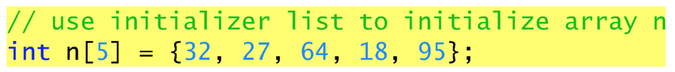
Array Examples (Cont.)
Initializing an Array in a Definition with an Initializer List
The elements of an array can also be initialized when the array is defined by following the definition with an equals sign and braces, {}, containing a comma-separated list of array initializers.
Figure 6.4 initializes an integer array with five values and prints the array in tabular format.

Slide 64
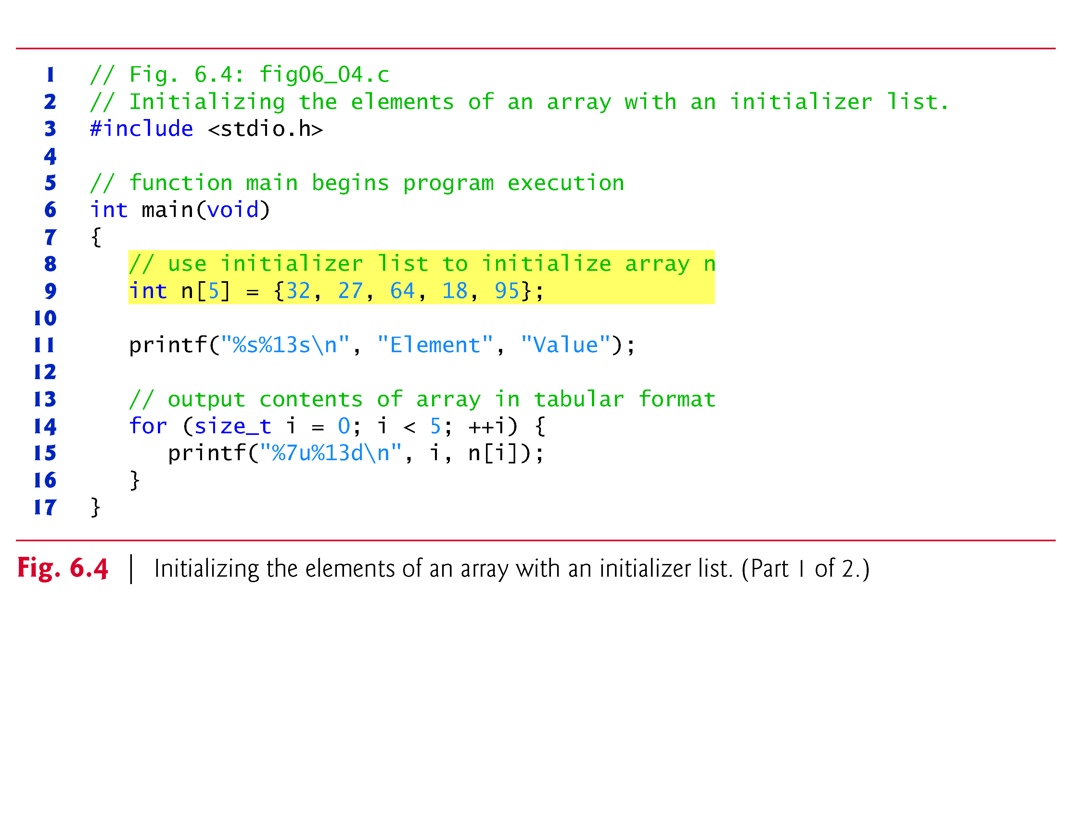
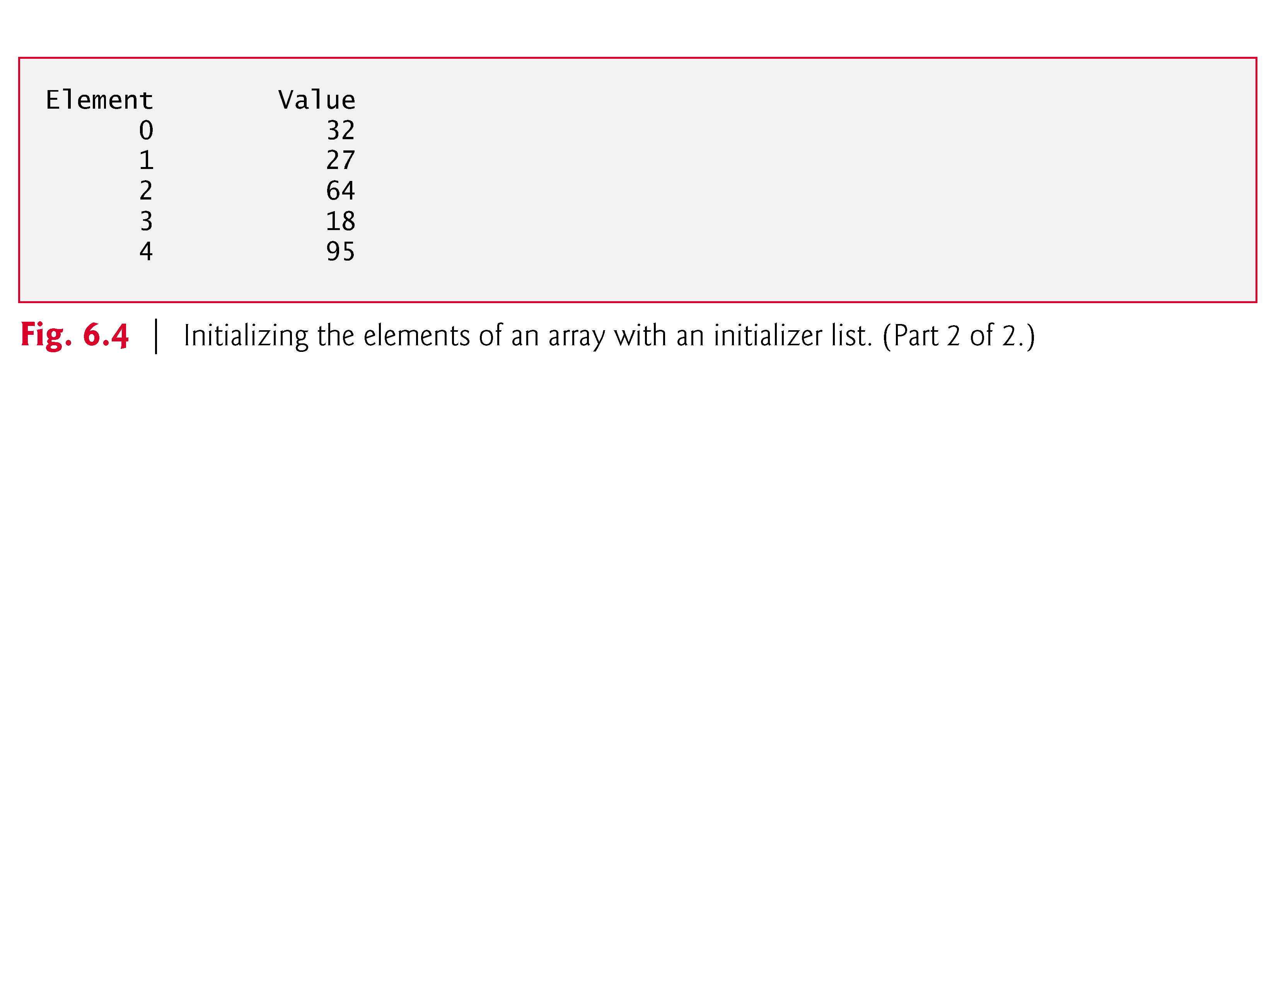

Slide 65
Array Examples (Cont.)
If there are fewer initializers than elements in the array, the remaining elements are initialized to zero.
For example, the elements of the array n in Fig. 6.3 could have been initialized to zero as follows:
// initializes entire array to zeros
int n[10] = {0};
This explicitly initializes the first element to zero and initializes the remaining nine elements to zero because there are fewer initializers than there are elements in the array.

Slide 66
Array Examples (Cont.)
It’s important to remember that arrays are not automatically initialized to zero.
You must at least initialize the first element to zero for the remaining elements to be automatically zeroed.

Slide 67
Array Examples (Cont.)
The array definition
int n[5] = {32, 27, 64, 18, 95, 14};
causes a syntax error because there are six initializers and only five array elements.
If the array size is omitted from a definition with an initializer list, the number of elements in the array will be the number of elements in the initializer list.
For example,
int n[] = {1, 2, 3, 4, 5};
would create a five-element array initialized with the indicated values.

Slide 68
for Iteration Statement (Cont.)
Comma-Separated Lists of Expressions
Often, the initialization and increment expressions are comma-separated lists of expressions.
The commas as used here are actually comma operators that guarantee that lists of expressions evaluate from left to right.
The value and type of a comma-separated list of expressions are the value and type of the rightmost expression in the list.

Slide 69
for Iteration Statement (Cont.)
The comma operator is most often used in the for statement.
Its primary use is to enable you to use multiple initialization and/or multiple increment expressions.
For example, there may be two control variables in a single for statement that must be initialized and incremented.

Slide 70
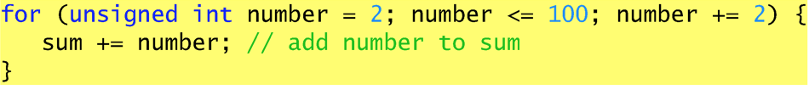
Examples Using the for Statement (Cont.)
The body of the for statement in Fig. 4.5 could actually be merged into the rightmost portion of the for header by using the comma operator as follows:
for (number = 2; number <= 100; sum += number, number += 2) ; // empty statement
The initialization sum = 0 could also be merged into the initialization section of the for.

Slide 71
Examples Using the for Statement (Cont.)
Application: Compound-Interest Calculations
Consider the following problem statement:
A person invests $1000.00 in a savings account yielding 5% interest. Assuming that all interest is left on deposit in the account, calculate and print the amount of money in the account at the end of each year for 10 years. Use the following formula for determining these amounts:
a = p(1 + r)^{n}
where
p is the original amount invested (i.e., the principal) r is the annual interest rate n is the number of years a is the amount on deposit at the end of the n^{th} year.
This problem involves a loop that performs the indicated calculation for each of the 10 years the money remains on deposit.
The solution is shown in Fig. 4.6.

Slide 72
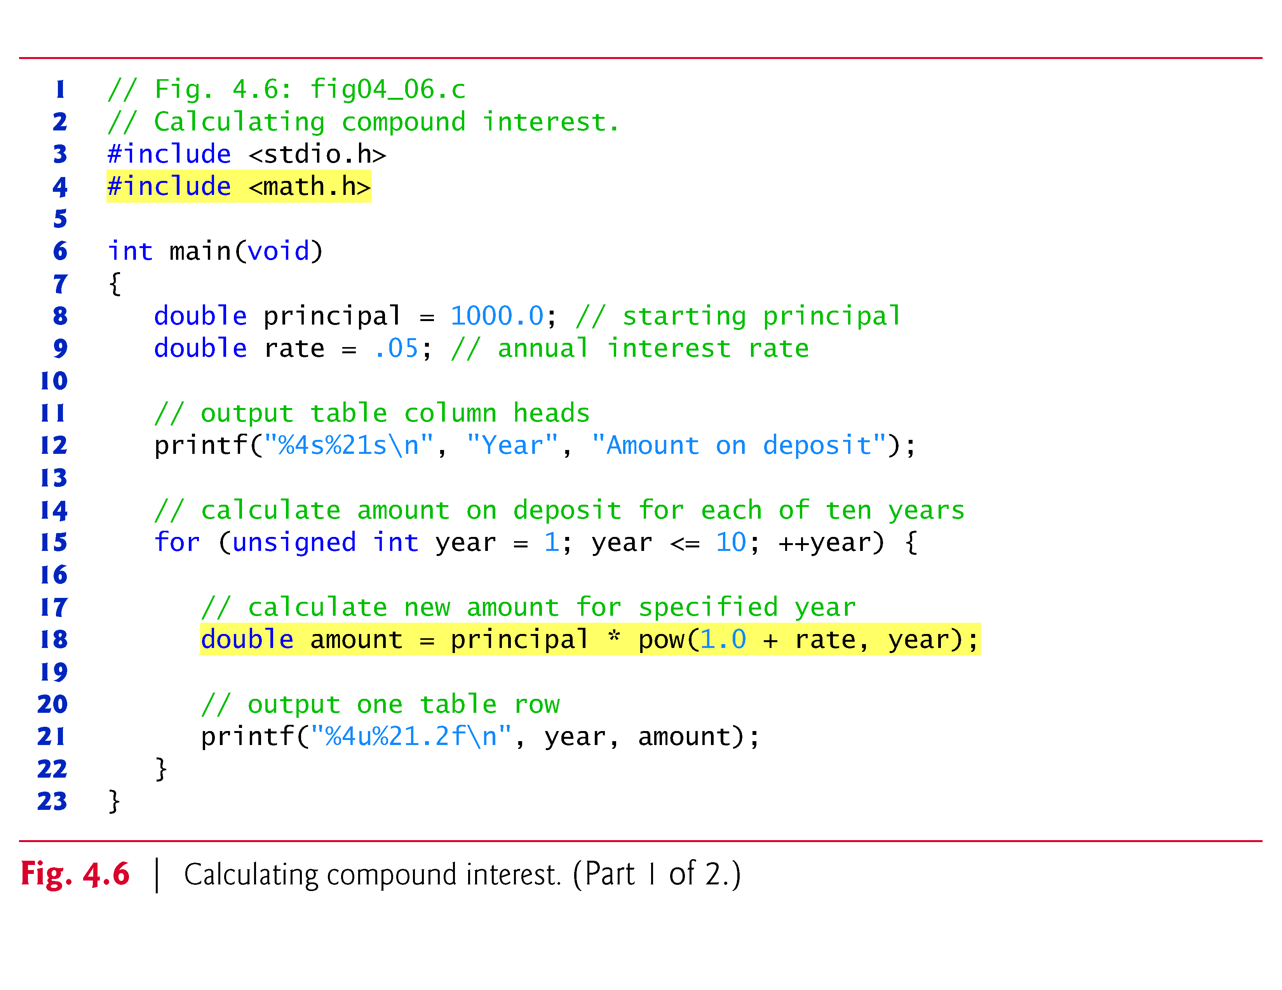

Slide 73
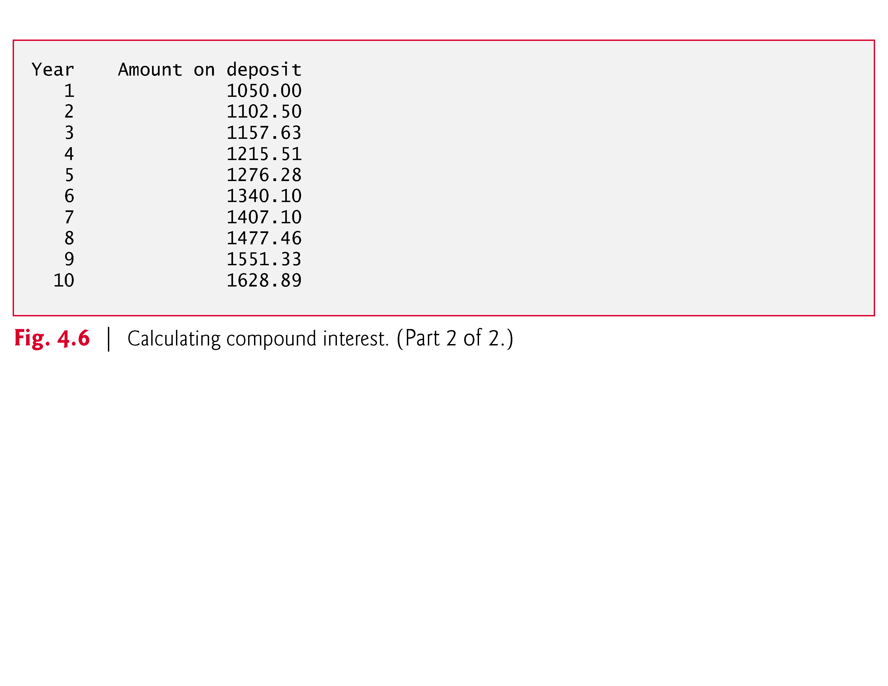

Slide 74
Examples Using the for Statement (Cont.)
The header <math.h> (line 4) should be included whenever a math function such as pow is used.
Actually, this program would malfunction without the inclusion of math.h, as the linker would be unable to find the pow function.
Function pow requires two double arguments, but variable year is an integer.
The math.h file includes information that tells the compiler to convert the value of year to a temporary double representation before calling the function.

Slide 75
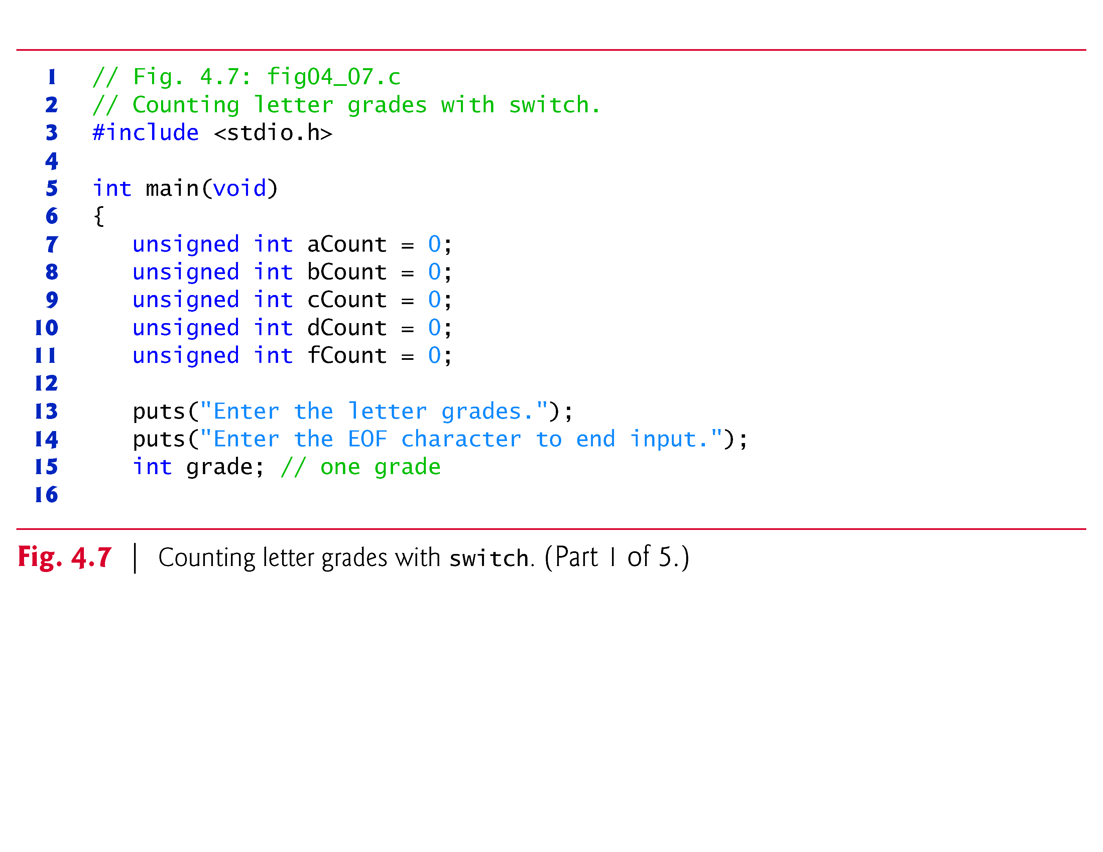
getchar() function and EOF

Slide 76
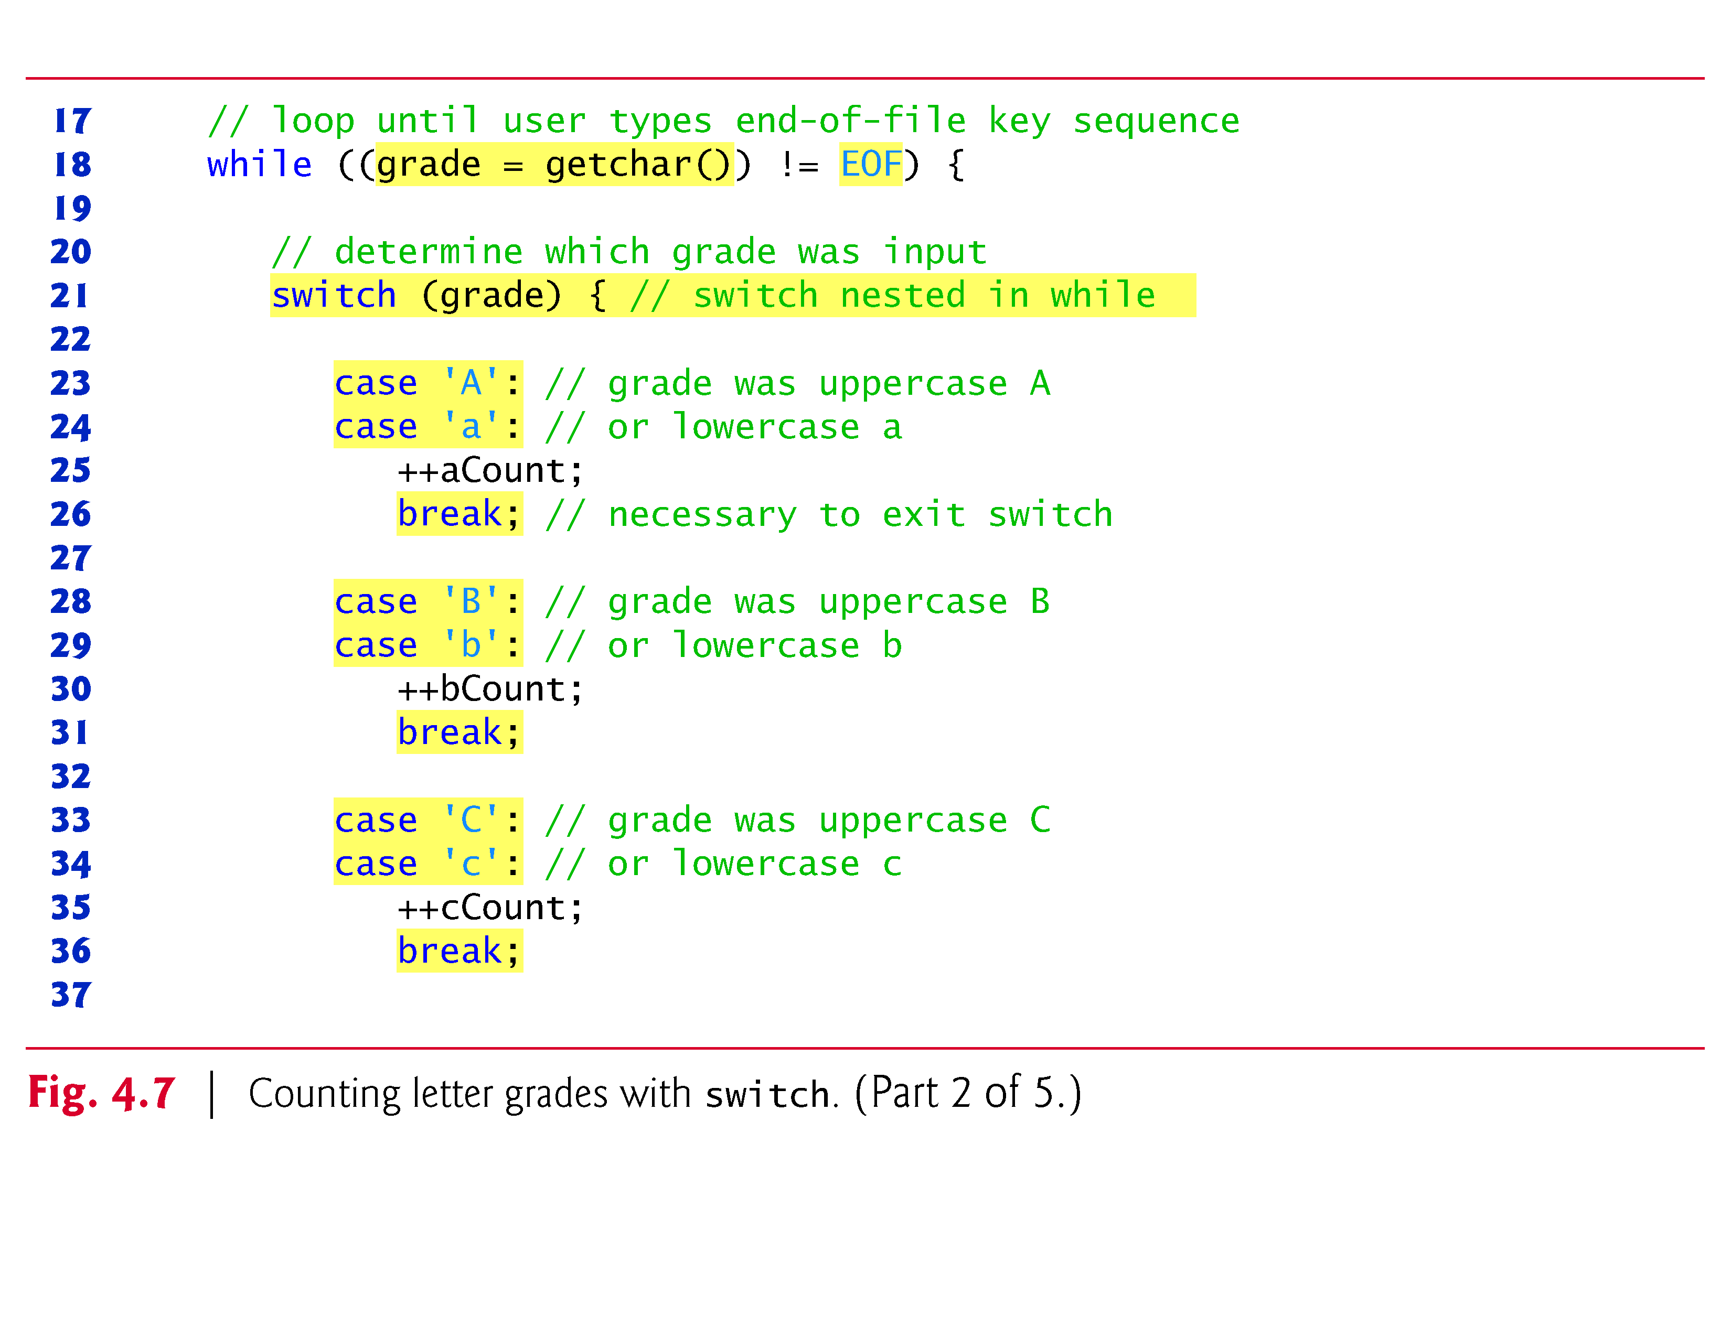

Slide 77
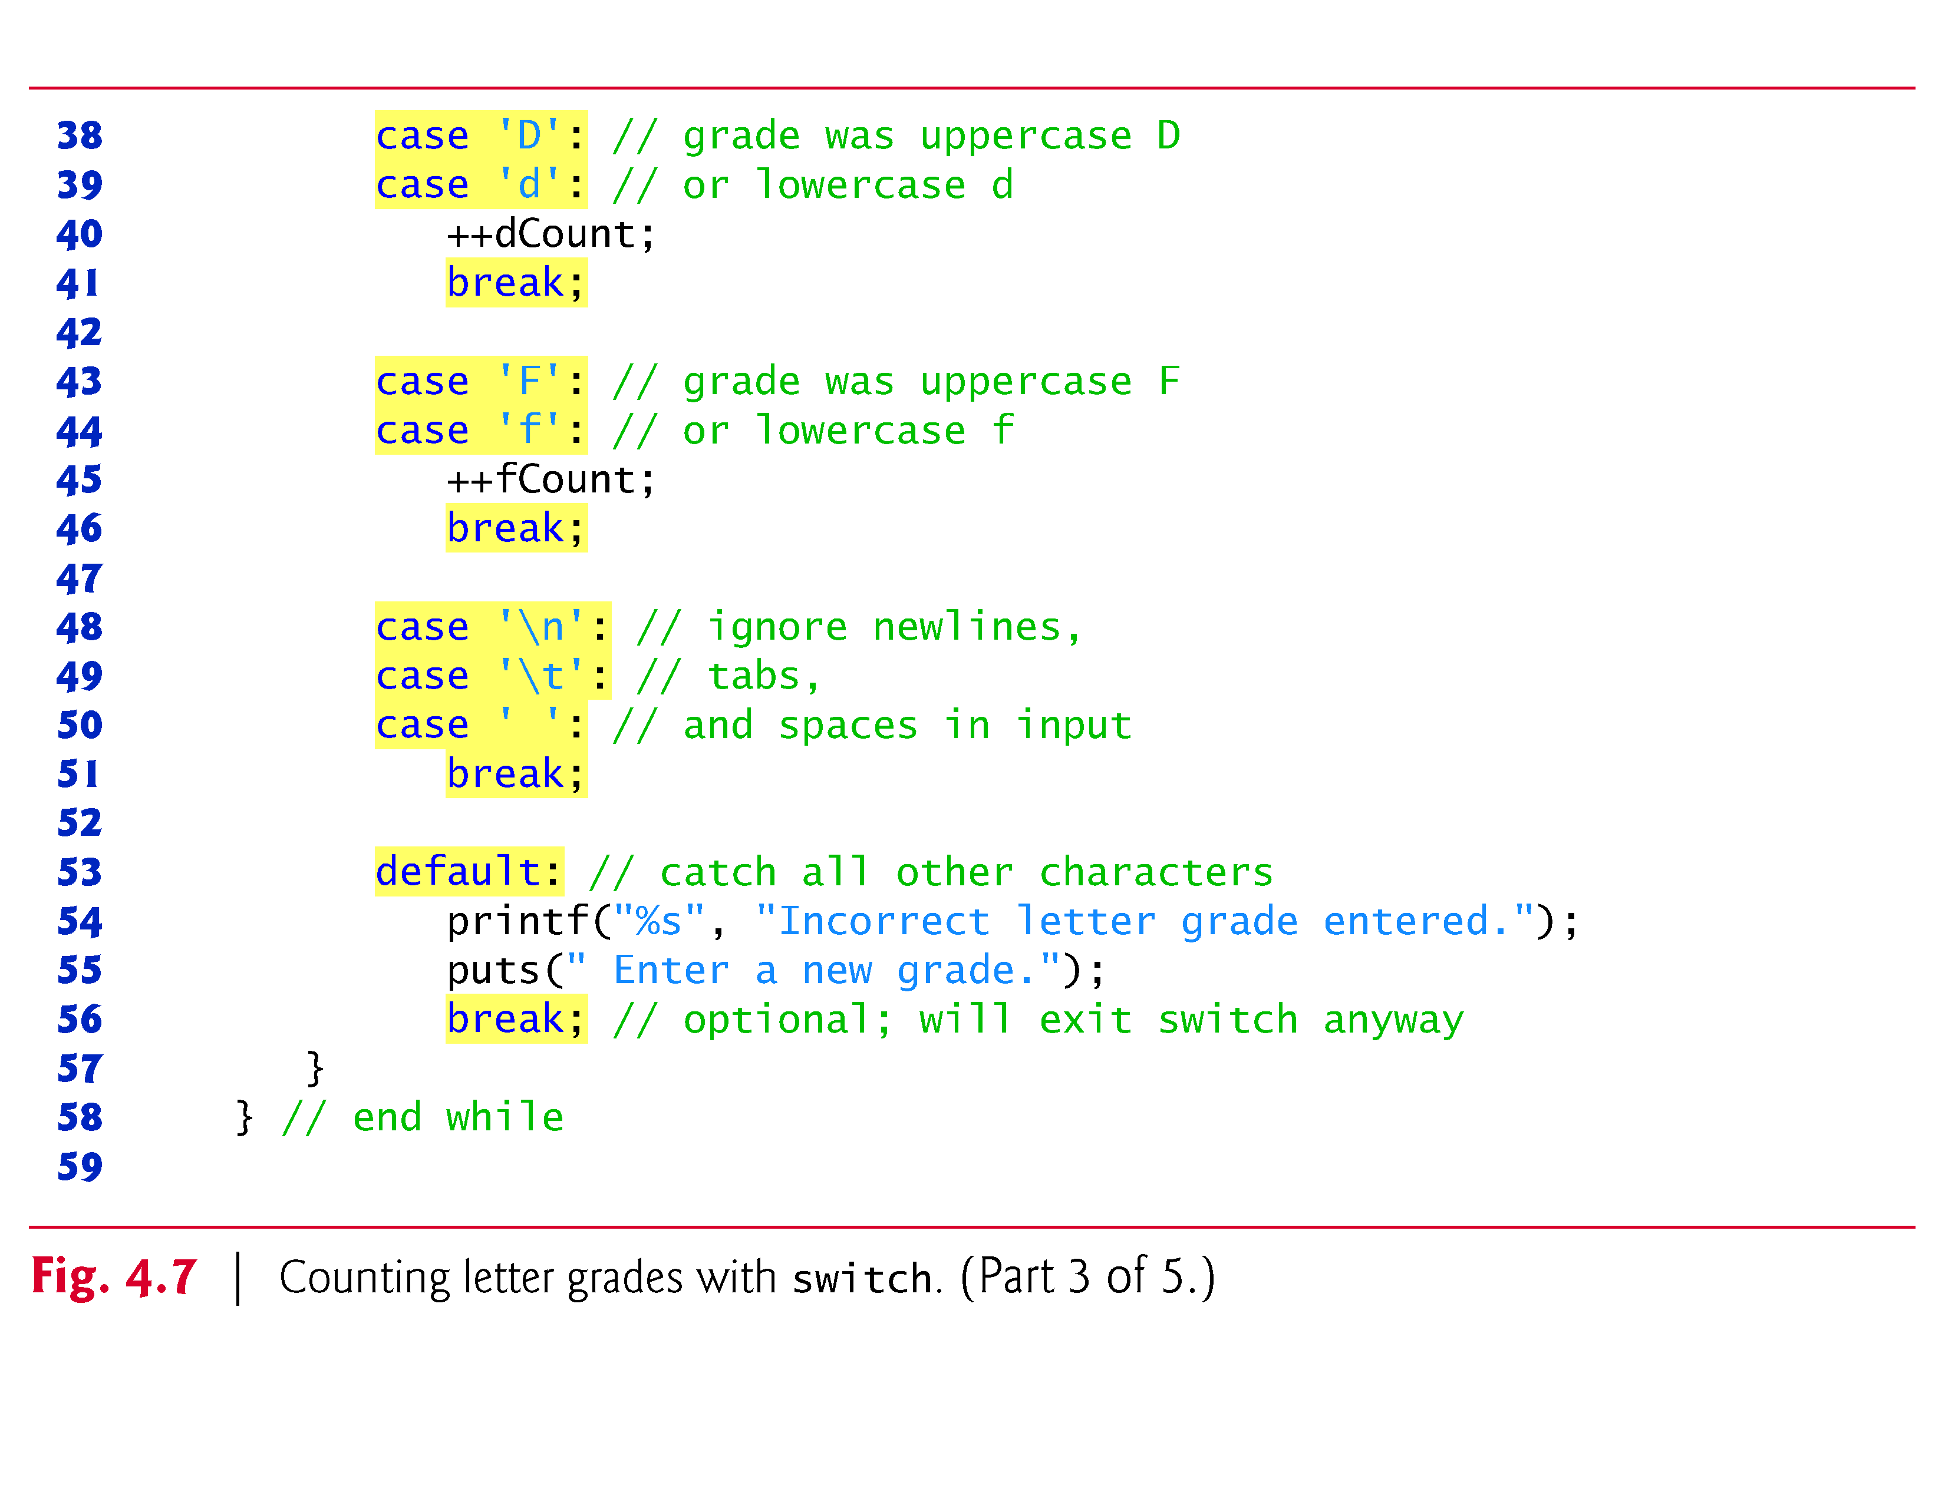

Slide 78
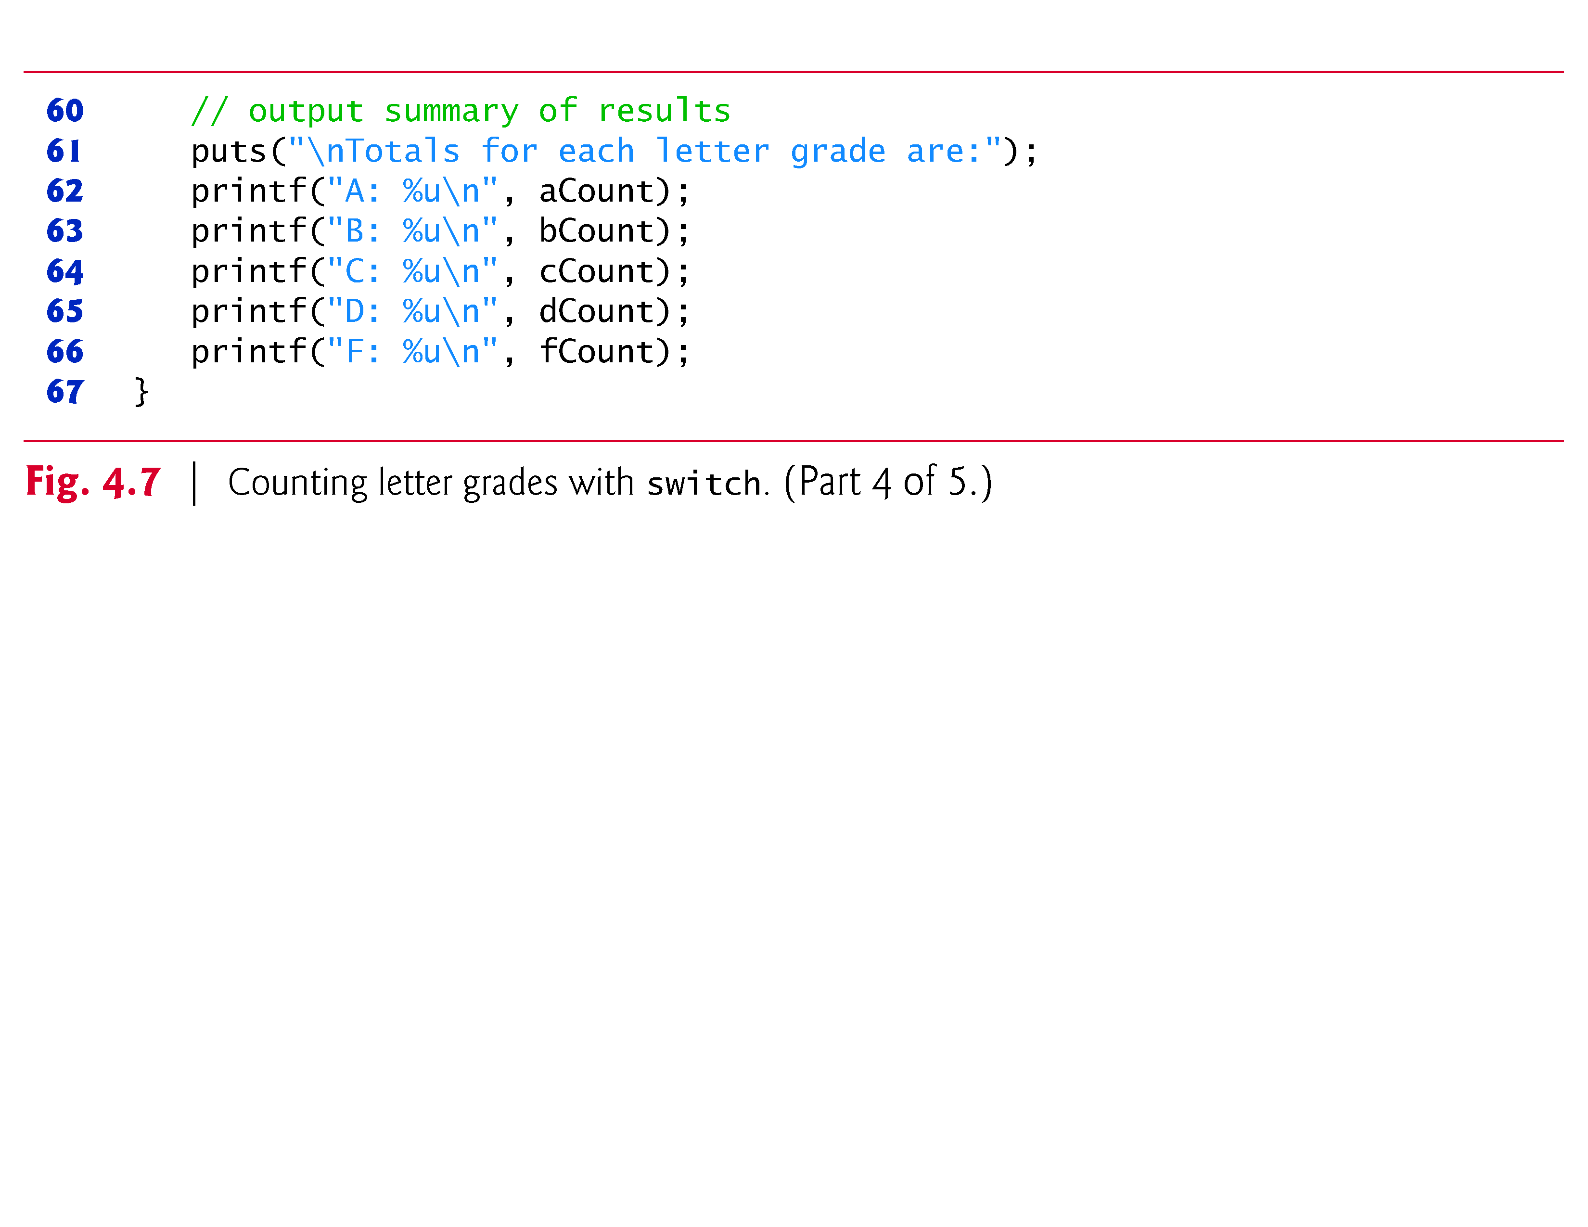

Slide 79
getchar() function and EOF
Reading Character Input
In the program, the user enters letter grades for a class.
In the while header (line 18),
while ((grade = getchar()) != EOF)
the parenthesized assignment (grade = getchar()) executes first.
The getchar function (from <stdio.h>) reads one character from the keyboard and returns as an int the character that the user entered.
Characters are normally stored in variables of type char.
However, an important feature of C is that characters can be stored in any integer data type because they’re usually represented as one-byte integers in the computer.

Slide 80
EOF
Entering the EOF Indicator
On Linux/UNIX/Mac OS X systems, the EOF indicator is entered by typing
<Ctrl> d
on a line by itself.
This notation <Ctrl> d means to press the Enter key then simultaneously press both Ctrl and d.
On other systems, such as Microsoft Windows, the EOF indicator can be entered by typing
<Ctrl> z
You may also need to press Enter on Windows.

Slide 81
do…while Iteration Statement
The do…while iteration statement is similar to the while statement.
In the while statement, the loop-continuation condition is tested at the beginning of the loop before the body of the loop is performed.
The do…while statement tests the loop-continuation condition after the loop body is performed.
Therefore, the loop body will be executed at least once.
When a do…while terminates, execution continues with the statement after the while clause.

Slide 82
do…while Iteration Statement (Cont.)
It’s not necessary to use braces in the do…while statement if there’s only one statement in the body.
However, the braces are usually included to avoid confusion between the while and do…while statements.

Slide 83
do…while Iteration Statement (Cont.)
A do…while with no braces around the single-statement body appears as
do statement while (condition);
which can be confusing.
The last line—while(condition);—may be misinterpreted as a while statement containing an empty statement.
Thus, to avoid confusion, the do…while with one statement is often written as follows:
do { statement } while (condition);

Slide 84
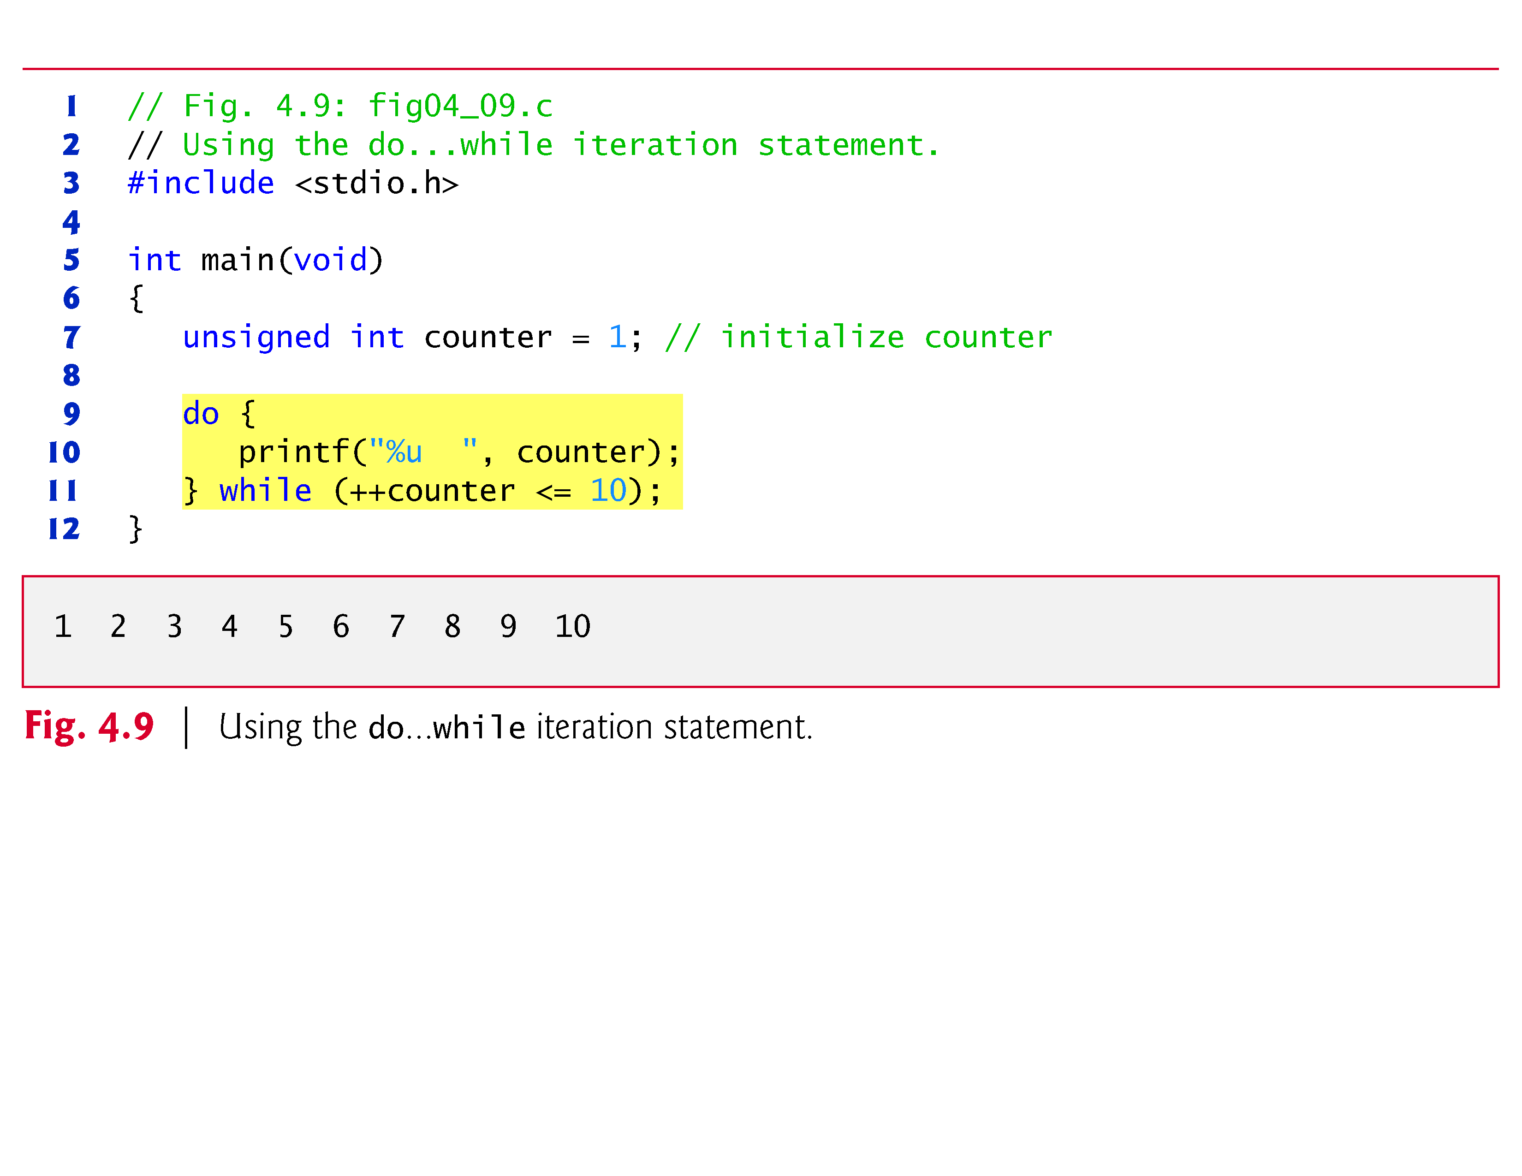

Slide 85
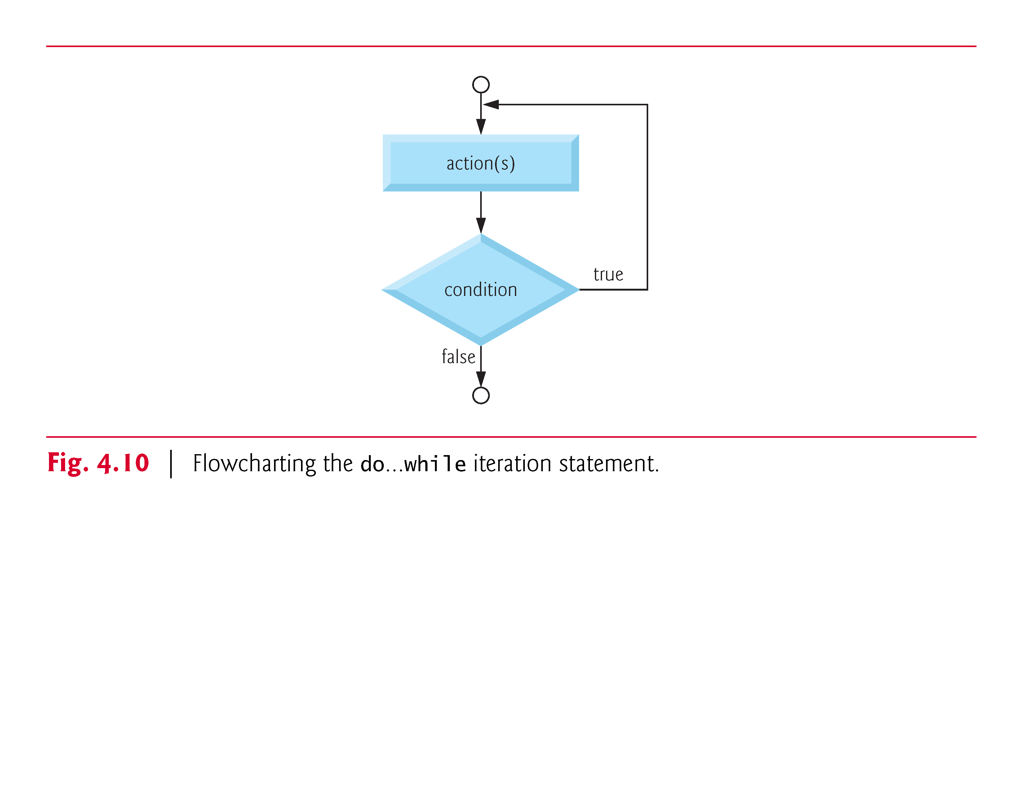

Slide 86
break and continue Statements
The break and continue statements are used to alter the flow of control.
The break statement, when executed in a while, for, do…while or switch statement, causes an immediate exit from that statement.
Program execution continues with the next statement.
Common uses of the break statement are to escape early from a loop or to skip the remainder of a switch statement

Slide 87
break and continue Statements (Cont.)
Figure 4.11 demonstrates the break statement in a for iteration statement.
When the if statement detects that x has become 5, break is executed.
This terminates the for statement, and the program continues with the printf after the for.
The loop fully executes only four times.

Slide 88
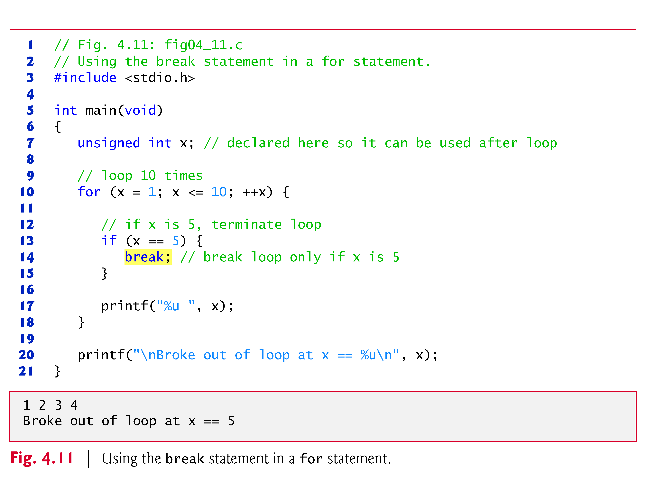

Slide 89
break and continue Statements (Cont.)
The continue statement, when executed in a while, for or do…while statement, skips the remaining statements in the body of that control statement and performs the next iteration of the loop.
In while and do…while statements, the loop-continuation test is evaluated immediately after the continue statement is executed.
In the for statement, the increment expression is executed, then the loop-continuation test is evaluated.
Figure 4.12 uses the continue statement in a for statement to skip the printf statement and begin the next iteration of the loop.

Slide 90
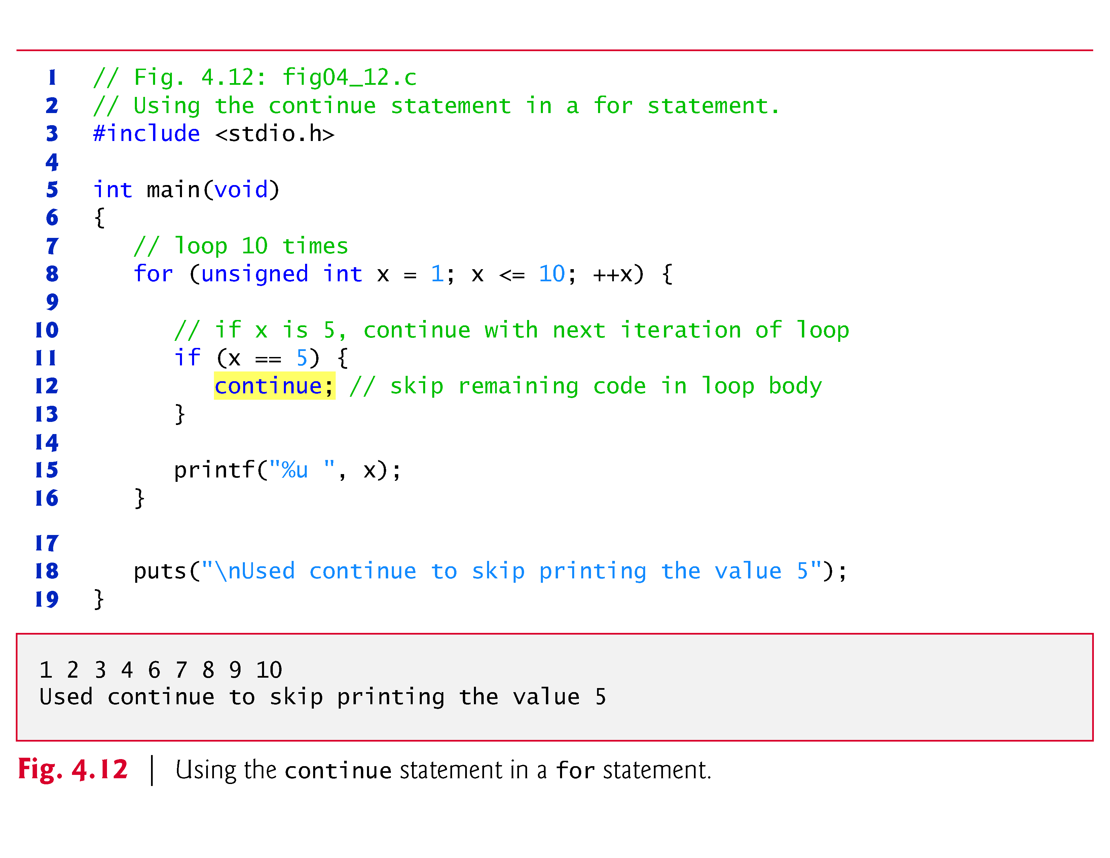

Slide 91
Logical Operators
C provides logical operators that can be used to form more complex conditions by combining simple conditions.
The logical operators are
&& (logical AND)
|| (logical OR)
! (logical NOT also called logical negation)

Slide 92
Logical Operators (Cont.)
Logical AND (&&) Operator
Suppose we wish to ensure that two conditions are both true before we choose a certain path of execution.
In this case, we can use the logical operator && as follows:
if (gender == 1 && age >= 65) ++seniorFemales;
This if statement contains two simple conditions.
The condition gender == 1 might be evaluated, for example, to determine if a person is a female.
The condition age >= 65 is evaluated to determine whether a person is a senior citizen.
The two simple conditions are evaluated first because the precedencies of == and >= are both higher than the precedence of &&.

Slide 93
Logical Operators (Cont.)
The if statement then considers the combined condition
gender == 1 && age >= 65
Which is true if and only if both of the simple conditions are true.
Finally, if this combined condition is true, then the count of seniorFemales is incremented by 1.
If either or both of the simple conditions are false, then the program skips the incrementing and proceeds to the statement following the if.
Figure 4.13 summarizes the && operator.

Slide 94
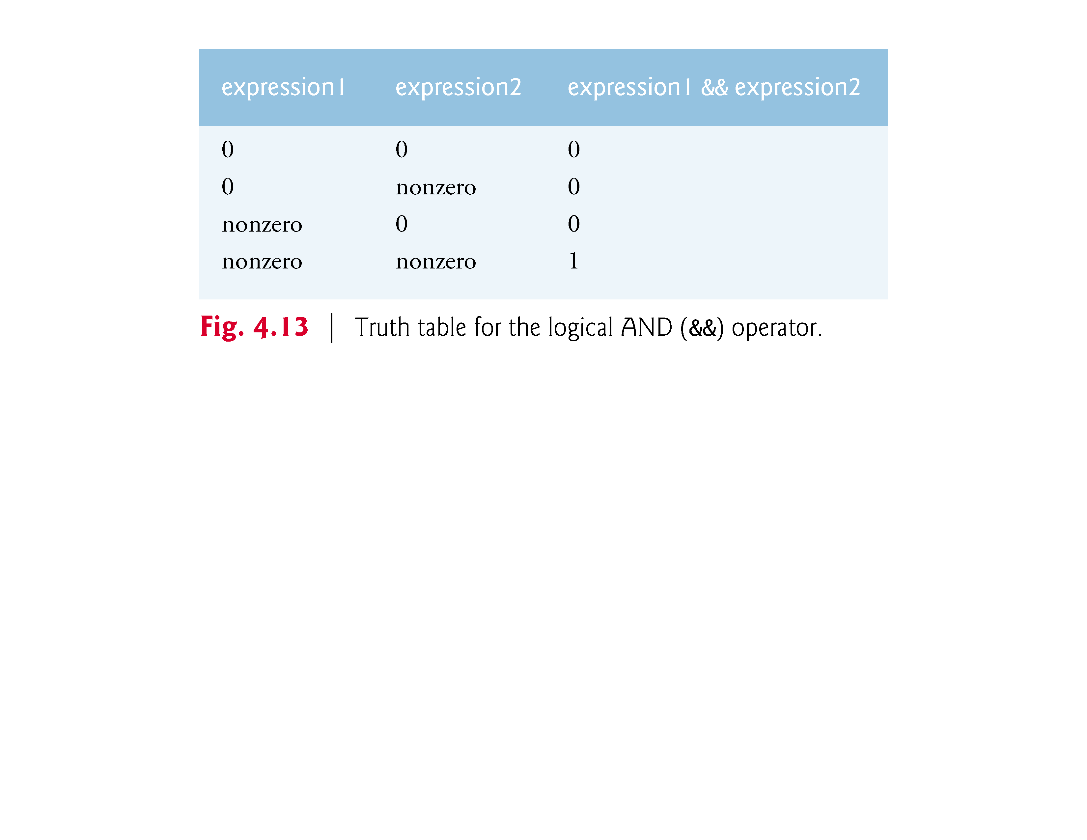

Slide 95
Logical Operators (Cont.)
Logical OR (||) Operator
Now let’s consider the || (logical OR) operator.
Suppose we wish to ensure at some point in a program that either or both of two conditions are true before we choose a certain path of execution.
In this case, we use the || operator as in the following program segment
if (semesterAverage >= 90 || finalExam >= 90) printf("Student grade is A");:
This statement also contains two simple conditions.
The condition semesterAverage >= 90 is evaluated to determine whether the student deserves an “A” in the course because of a solid performance throughout the semester.

Slide 96
Logical Operators (Cont.)
The condition finalExam >= 90 is evaluated to determine whether the student deserves an “A” in the course because of an outstanding performance on the final exam.
The if statement then considers the combined condition
semesterAverage >= 90 || finalExam >= 90
and awards the student an “A” if either or both of the simple conditions are true.
The message “Student grade is A” is not printed only when both of the simple conditions are false (zero).
Figure 4.14 is a truth table for the logical OR operator (||).

Slide 97
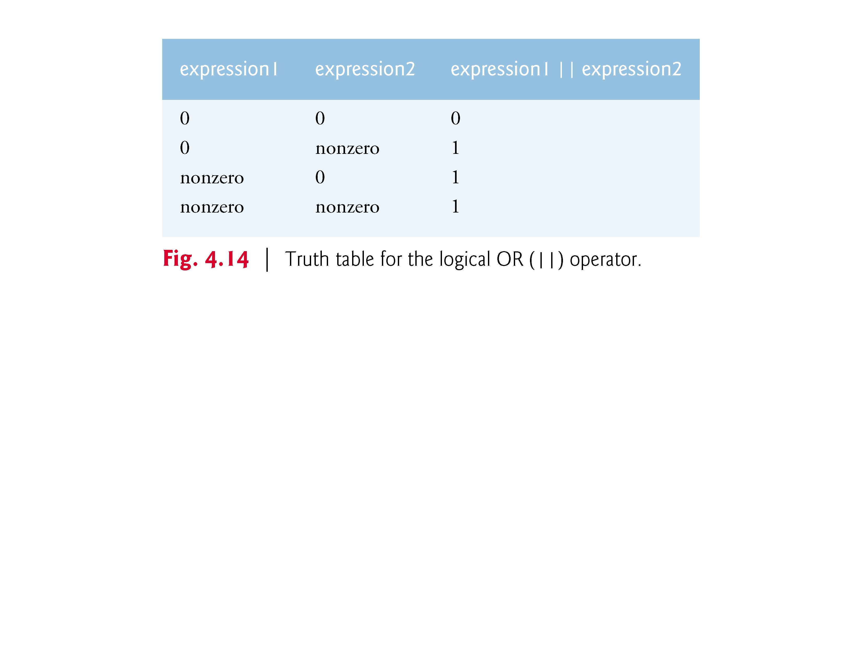

Slide 98
Logical Operators (Cont.)
The && operator has a higher precedence than ||.
Both operators associate from left to right.
Thus, evaluation of the condition
gender == 1 && age >= 65
will stop if gender is not equal to 1 (i.e., the entire expression is false), and continue if gender is equal to 1 (i.e., the entire expression could still be true if age >= 65).
This performance feature for the evaluation of logical AND and logical OR expressions is called short-circuit evaluation.

Slide 99
Logical Operators (Cont.)
Logical Negation (!) Operator
C provides ! (logical negation) to enable you to “reverse” the meaning of a condition.
The logical negation operator has only a single condition as an operand (and is therefore a unary operator).
Placed before a condition when we’re interested in choosing a path of execution if the original condition (without the logical negation operator) is false, such as in the following program segment:
if (!(grade == sentinelValue)) printf("The next grade is %f\n", grade);
The parentheses around the condition grade == sentinelValue are needed because the logical negation operator has a higher precedence than the equality operator.
Figure 4.15 is a truth table for the logical negation operator.

Slide 100
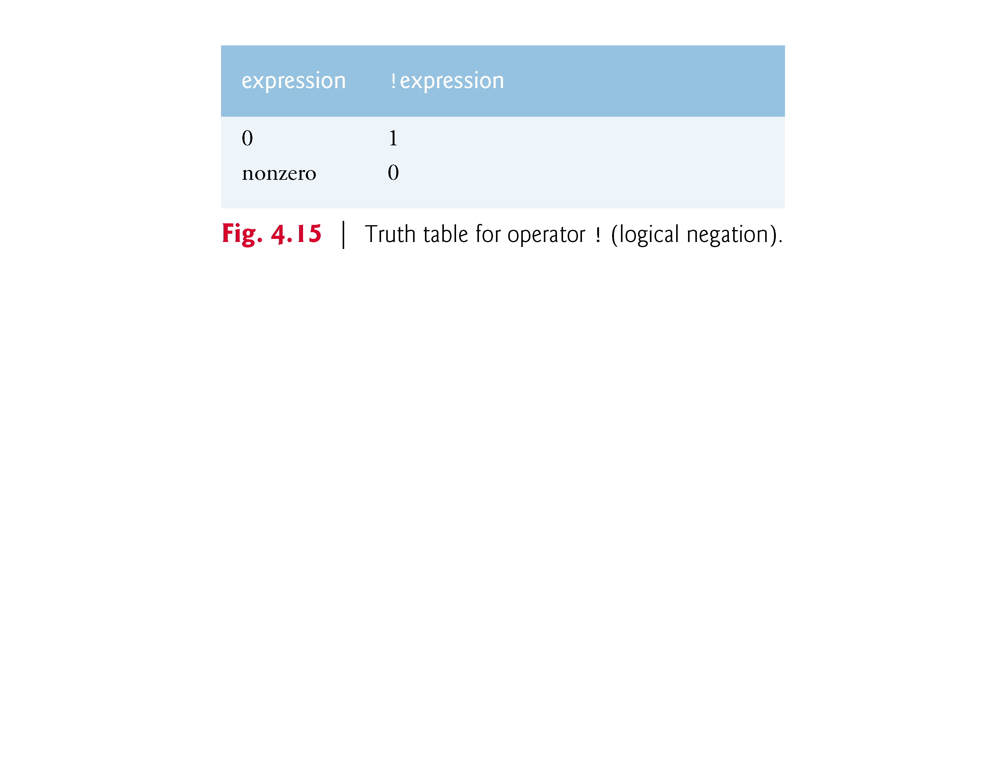

Slide 101
Logical Operators (Cont.)
In most cases, you can avoid using logical negation by expressing the condition differently with an appropriate relational operator.
For example, the preceding statement may also be written as follows:
if (grade != sentinelValue) printf("The next grade is %f\n", grade);

Slide 102
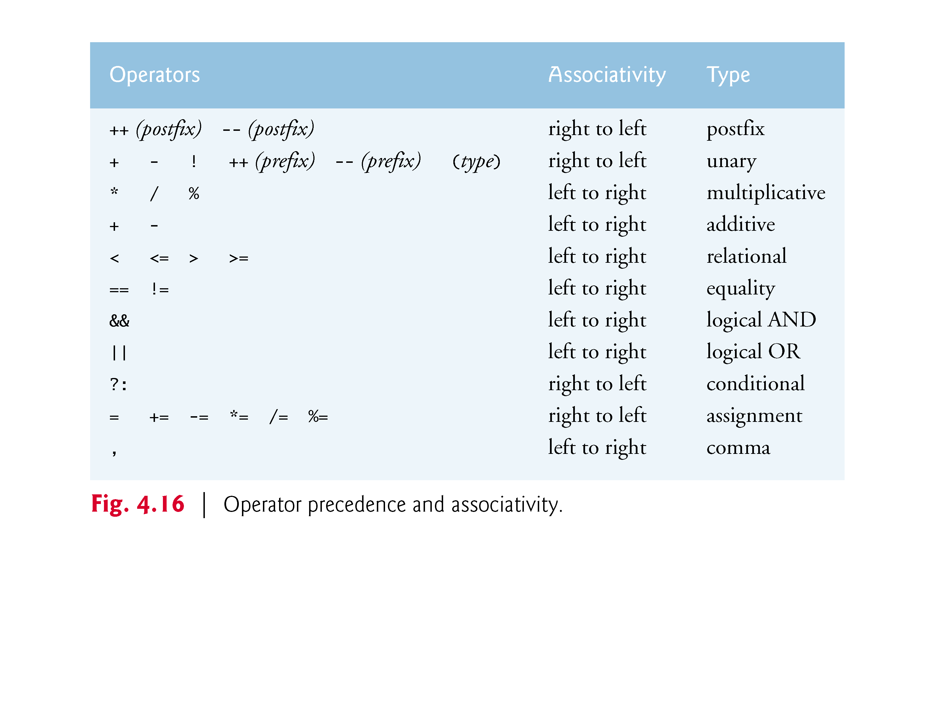

Slide 103
Logical Operators (Cont.)
The _Bool Data Type
The C standard includes a boolean type—represented by the keyword _Bool—which can hold only the values 0 or 1.
Recall C’s convention of using zero and nonzero values to represent false and true—the value 0 in a condition evaluates to false, while any nonzero value evaluates to true.
Assigning any non-zero value to a _Bool sets it to 1.
The standard also includes the <stdbool.h> header, which defines bool as a shorthand for the type _Bool, and true and false as named representations of 1 and 0, respectively.

Slide 104
Secure C Programming
Many functions return values indicating whether they executed successfully.
For example, function scanf returns an int indicating whether the input operation was successful.
If an input failure occurs, scanf returns the value EOF (defined in <stdio.h>); otherwise, it returns the number of items that were read.
If this value does not match the number you intended to read, then scanf was unable to complete the input operation.

Slide 105
Secure C Programming (Cont.)
Consider the following statement
scanf("%d", &grade); // read grade from user
which expects to read one int value.
If the user enters an integer, scanf returns 1 indicating that one value was indeed read.
If the user enters a string, such as "hello", scanf returns 0 indicating that it was unable to read the input as an integer.
In this case, the variable grade does not receive a value.

Slide 106
Secure C Programming (Cont.)
Function scanf can read multiple inputs, as in
scanf("%d%d", &number1, &number2); // read two integers
If the input is successful, scanf will return 2 indicating that two values were read.
If the user enters a string for the first value, scanf will return 0 and neither number1 nor number2 will receive values.
If the user enters an integer followed by a string, scanf will return 1 and only number1 will receive a value.

Slide 107
Secure C Programming (Cont.)
To make your input processing more robust, check scanf’s return value to ensure that the number of inputs read matches the number of inputs expected.
Otherwise, your program will use the values of the variables as if scanf completed successfully.
This could lead to logic errors, program crashes or even attacks.

Slide 108
Secure C Programming (Cont.)
Range Checking
Even if a scanf operates successfully, the values read might still be invalid.
For example, grades are typically integers in the range 0–100. In a program that inputs such grades, you should validate the grades by using range checking to ensure that they are values from 0 to 100.
You can then ask the user to reenter any value that’s out of range.

