Slide 1


Hercules – A Scalable Fault Tolerant Parallel FS
Faraz Shaikh

Slide 2
Agenda
Hercules Design & Operations:
Layout, Basic Operations ,Scalability Fault Tolerance
Health Monitor:
Overview, Working, Features, Screen Shots
Conclusions:
Scalability metrics, Feature Comparison …..
Q & A
Notes:
© 2003-2004 Microsoft Corporation. All rights reserved.
This presentation is for informational purposes only. Microsoft makes no warranties, express or implied, in this summary.

Slide 3





Super Quick Introduction
Data Servers
Meta Data Servers
1. Lookup Inode Info /myfile.txt
3. Parallel Data Access
2. Data Striped On –Srv{1,2,3}
Client
Notes:
© 2003-2004 Microsoft Corporation. All rights reserved.
This presentation is for informational purposes only. Microsoft makes no warranties, express or implied, in this summary.

Slide 4




File Layout
EXTENT R
EXTENT G
EXTENT B
LOOKS SIMILAR TO STRIPED RAID 0 !!
File: file1.txt
INODE_ID: 0x23450999 MDS_SRV_ID=0
Standard UNIX style attribute Information
HFS Data Layout
Access Time
DS Server ID 1
Extent Handle 1
MDS
DS
Change Time
Modification Time
Extent Handle 2
DS Server ID 2
Owner root
Access mask rwx------
DS Server ID 3
Extent Handle 3
Filesize 8MB
DS Server ID 4
Extent Handle 4
Client
Client File Byte 0 ------------------------------------------------------------------------------------------------→ N
Stripe Unit 1
Stripe Unit 2
Stripe Unit 3
Strip e Unit 4
Stripe Unit 5
Stripe Unit 6
Notes:
© 2003-2004 Microsoft Corporation. All rights reserved.
This presentation is for informational purposes only. Microsoft makes no warranties, express or implied, in this summary.

Slide 5
File data Mirroring
EXTENT R
EXTENT G
EXTENT B
LOOKS SIMILAR TO STRIPED RAID 1 !!
File: file1.txt
INODE_ID: 0x23450999 MDS_SRV_ID=0
Standard UNIX style attribute Information
HFS Data Layout
Access Time
DS Server ID 1
Extent Handle 1
MDS
Backup EXTENT R
DS
Change Time
Modification Time
Extent Handle 2
DS Server ID 2
Backup EXTENT G
Owner root
Access mask rwx------
DS Server ID 3
Extent Handle 3
Backup EXTENT B
Filesize 8MB
DS Server ID 4
Extent Handle 4
Client
Stripe Unit 1
Stripe Unit 1
Notes:
© 2003-2004 Microsoft Corporation. All rights reserved.
This presentation is for informational purposes only. Microsoft makes no warranties, express or implied, in this summary.

Slide 6

Basic File system Operations
Create.
  Allocate Data Handles from DS
  Allocate Inode – Meta-Data handle from MDS
  Make Name space entry.(Ahead)
Read
  Get Inode from Metadata server
  Gather stripe units from MDS. Service write.
  On failure read from Backup (server-id + 1)
Write.
  Not in terms of stripe Units. Done at the server. To avoid RMW cycle
  Active replication to back up data-handle

Slide 7
HFS namespace.
$ ls /
.
..
F1.txt
Otherservdir
|> 0f1.txt
|> newdir
1
0
2
Parent Inode | Self Server Id | Self Inode Number | name | mode
16 | 0 | 16 | . | dir
16 | 0 | 16 | .. | dir
16 | 0 | 17 | F1.txt | File
16 | 1 | 17 | otherservedir | File
Parent Inode | Self Server Id | Self Inode Number | name | mode
17 | 1 | 18 | 0F1.txt | File
17 | 2 | 19 | newdir | File
Notes:
© 2003-2004 Microsoft Corporation. All rights reserved.
This presentation is for informational purposes only. Microsoft makes no warranties, express or implied, in this summary.

Slide 8

HFS MDS replication.
$ ls /
.
..
F1.txt
Otherservdir
|> 0f1.txt
|> newdir
1
1
0
0
2
2
MYSQL MASTER SLAVE REPLICATION
Parent Inode
Self
Server
Id
Self
Inode
Number
name
mode
Parent Inode
Self
Server
Id
Self
Inode
Number
name
mode
16
0
16
.
dir
16
0
16
..
dir
16
0
17
F1.txt
File
17
1
18
0F1.txt
File
16
1
17
otherservedir
File
17
2
19
newdir
File
Notes:
© 2003-2004 Microsoft Corporation. All rights reserved.
This presentation is for informational purposes only. Microsoft makes no warranties, express or implied, in this summary.

Slide 9


Supporting POSIX calls (FUSE).
Hfs_lookup()
HFS Client Deamon
open(/mnt/hfsmntpt/foo.txt);
hfs_getIAttr/Inode()
user
Kernel
HFS
VFS
  Once opened the file inode is cached at the client i.e data mapping.
  Size is not stored in the inode. Write optimization
Fuse
Notes:
© 2003-2004 Microsoft Corporation. All rights reserved.
This presentation is for informational purposes only. Microsoft makes no warranties, express or implied, in this summary.

Slide 10
Scalability
Add machine to the HFS cluster
Root MDS holds the maps of all the machines in the cluster.
Client Queries root server for current file system configuration (server list).
TASK !!!!!!!
  Notify the client about newly available resources MDS/DS
  Client Code transparently accomodates new resources
Notes:
© 2003-2004 Microsoft Corporation. All rights reserved.
This presentation is for informational purposes only. Microsoft makes no warranties, express or implied, in this summary.

Slide 11
Client FS Configuration Update
Connected to all servers
HFS Client Deamon
FS Config Changed Notification
HFS
  Transaction Begin
  Freeze Client
  Wait for In-flight
  Update Mapping
  Close old Connection
  Transaction End
Add DS update Root MDS
Notes:
© 2003-2004 Microsoft Corporation. All rights reserved.
This presentation is for informational purposes only. Microsoft makes no warranties, express or implied, in this summary.

Slide 12
Health Monitor.
Overview, Operations, Screenshots
Chaiyong Ragkhitwetsagul (Andy)

Slide 13
Health Monitor
GUI tool to monitor all the machines in real time
Can display the activities happening on all the servers (read, write, read & write)
Email notification when a machine is dead, and becomes alive
Direct SSH terminal inside the application

Slide 14
Health Monitor Operations
Connect to the root MDS server to retrieve all the machine configurations
Create ping packet to send to each machine (check-alive)
Also create another packet to check the latest activities on each server
Display all the information on the application main panel

Slide 15
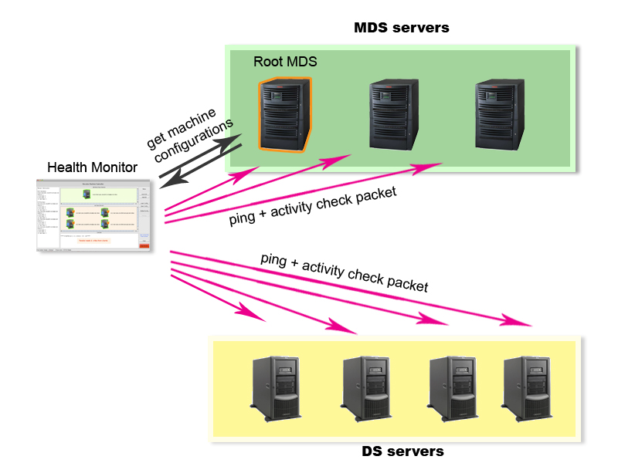
Health Monitor Operations

Slide 16
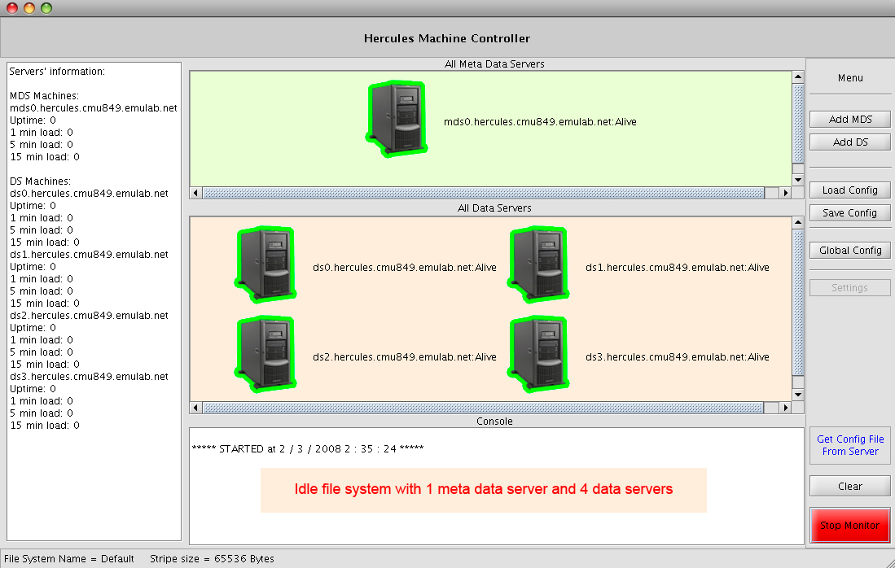
Screenshots

Slide 17
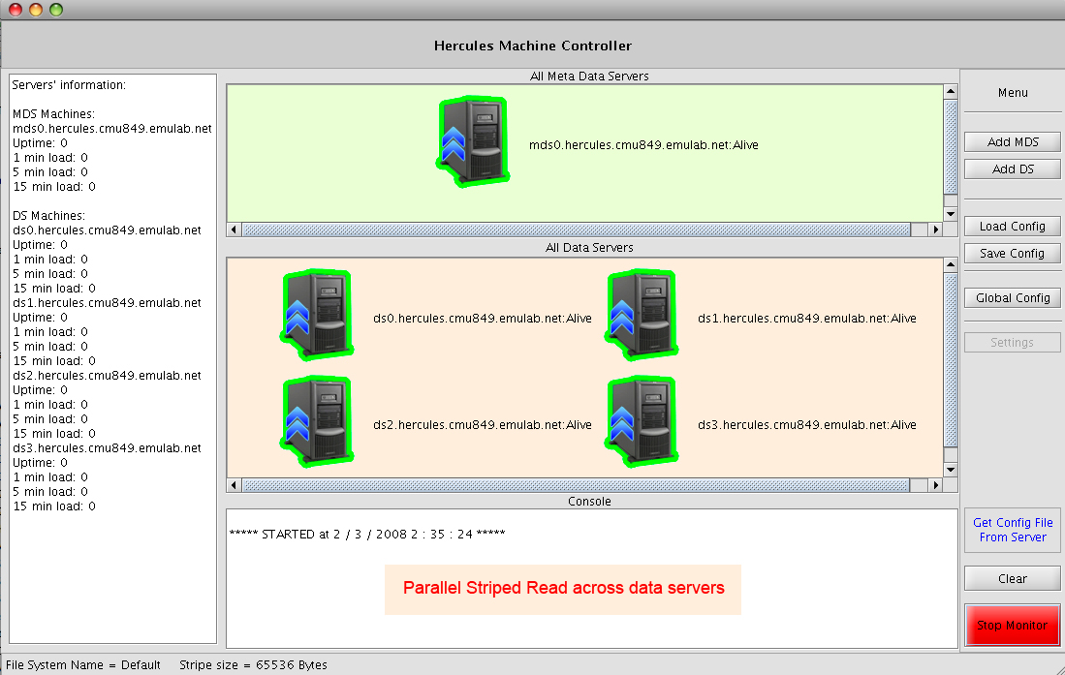
Screenshots

Slide 18
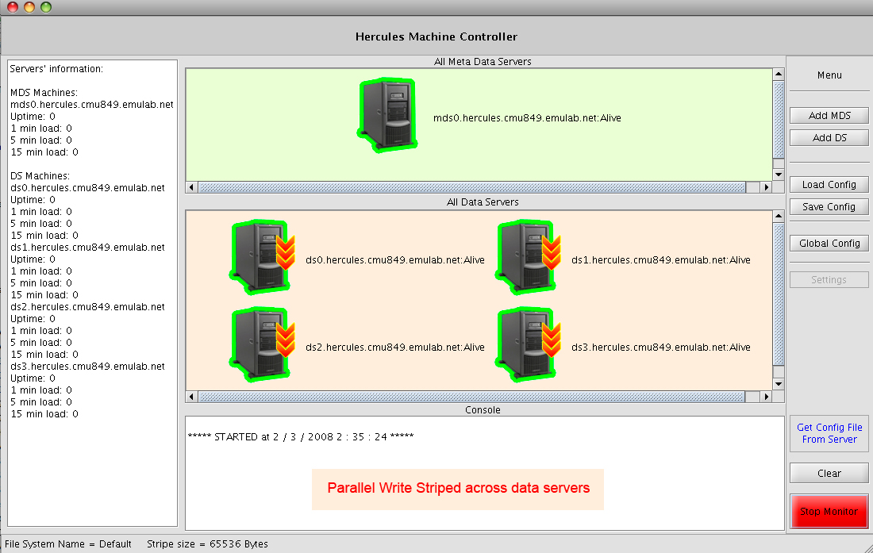
Screenshots

Slide 19
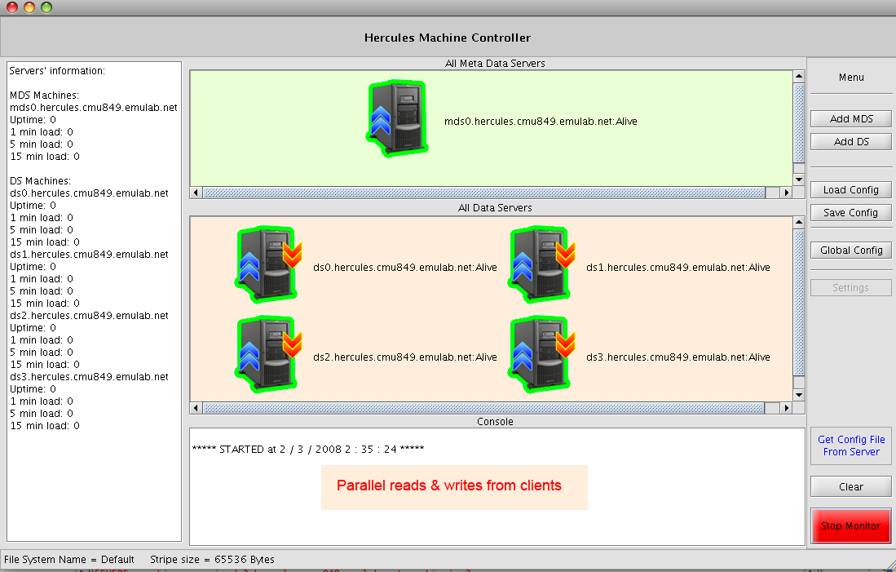
Screenshots

Slide 20
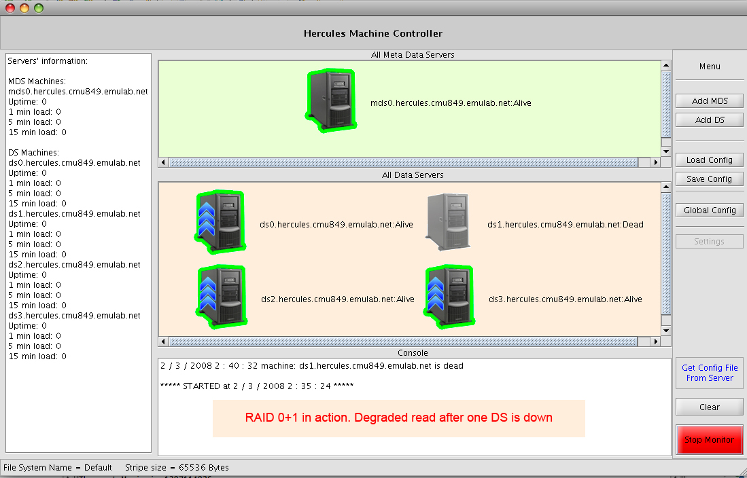
Screenshots

Slide 21
Initial Performance Measure, Feature comparison, Conclusion

Slide 22
Initial performance Metrics & Results
Tools Used
  Postmark (by Network Appliance Inc.)
  IOZone
Setup on EMULab (Research Network Test Bed in Utah)
Results
  IO Operations per second (Read/ Write)
  Creation of files per second

Slide 23




Slide 24
HFS vs PVFS Feature Comparison
Parameter | HerculesFS | PVFS2
MDS Scalability | Yes | No
DS Scalability | Yes | No
Fault Tolerance | Yes | No
Real-Time Monitoring | Yes | No
Distributed NS | Yes | Yes
POSIX Call | Using Fuse | Using proprietary approach
Performance | Very low: Around 80kB/s | 225 MB/s (fast ethernet)

Slide 25
Demo Sequence
Application Compatibility (POSIX Calls supported)
Scalability (Upward)
  MDS
  DS
Failover
  MDS
  DS
Intermittent Failure Handling (without affecting the client)

Slide 26
Responsibilities
Faraz
  File system Server (MDS & DS)
  Client
  Protocol RPC and Database Integration
  Scalability and Fault Tolerance
  Security (CHAP)
Chaiyong
  Health Monitor
  Protocol Conversion from JAVA to C
  MDS & DS “PING” commands
Abdur Rehman
  MySQL Server Replication
  FS Config mappings (retrieval from MDS)
  Integration of Health Monitor with the FS
  Performance Measures (PostMark, IOZone)
  EMU Lab Setup and Testing

Slide 27
Future Work
File System Operations
  Remove (rm, rmdir)
  Rename
  Symbolic Links (create, delete)
Data Server Coherency
  In case of Intermittent Failures
Performance Improvement

Slide 28
Conclusion
A Working Distributed Parallel File System
Real – Time Visualization of Operations.
Miscellaneous
  High Availability (MDS, DS Fault Tolerant)
  Scalability (both MDS & DS)
  Security (CHAP)
Additional Features
  Attribute Caching on client Side
  Run-Time monitoring of File System Operations

Slide 29
References
PVFS Documentation: www.pvfs.org/documentation
PVFS Guide: A Parallel File System For Linux Clusters - http://www.pvfs.org/cvs/pvfs-2-7-branch-docs/doc//pvfs2-guide.pdf
PVFS Performance Enhancement: http://www.clustermonkey.net//content/view/42/28/

Slide 30
Thank You!!!
Questions?????

