Slide 1



WebChaff
EVE: ???
Chaff generation for Confidentiality of Instant Messenger conversation.
Faraz Shaikh
Privacy Policy Law and Technology.
fshaikh@cs.cmu.edu

Slide 2
Winnowing and Chaffing
Proposed by R. Rivest.
Response Cryptography export regulations.
No Cryptography !
No Transformation on original Message.
Based on Authentication.
More or less a not a serious suggestion by Rivest.

Slide 3






Winnowing and Chaffing (Process)
Alice
Bob
Lets Plan to Meet Tomorrow !
Lets Plan to Meet Tomorrow !
EVE: ???
Lets have a resolution. Congress dropped the Plan. To be or not to be. Intersecting lines meet at 0 degrees. Fore cast for tomorrow.
0x234 0x134 0x234 0x2342 0x235
0x234 0x134 0x234 0x2342 0x235
Session Key 0xDEADBEEF
Session Key 0xDEADBEEF
ADD MAC + CHAFF
MAC + Winnow Chaff

Slide 4

WAC (Options)
Message breakup
  Fine grained break up gives you stronger guarantees of privacy. Higher Overhead
  Privacy Vs Overhead.
Selection of Chaff.
Indistinguishable from original message.
  Indistinguishable ???
  Similar Context
  Similar Language
  Similar dialect ....
  Similar .. Similar .. Similar ..

Slide 5
WebChaff Project.
To Use Winnowing and Chaffing for Instant messaging conversations.
Challenges
  Using existing IM infrastructure.
  Generate good quality chaff for messages.
    Esp. evaluate generating chaff from www.
  List down the Ideal requirements from a chaff generation algorithm.
  Evaluate strength of privacy provided.

Slide 6


Need Chaff for IM messages !
Problem Definition.
IM Message X
Generate Chaff
IM Message X’ for Xmit
Constraints on Transformation X’
Constraints on Chaff Generation Method
P1. X subset of X’. (Strongly required)
P2. X indiscernible for X’ (Strongly required)
P3. Words in X should appear in X’ in the same order as they as they appear in X. (Can be relaxed)
P4. Support P2 under all languages (Strongly required)
P5. X’ should be as small as possible. (Strongly required)
PS1. It should generate distinct X’ for the same input X
for different of the invocations of the algorithm.
PS2. Should not compromise or leak the contents of X in the process of generating X’

Slide 7

Basic WebChaff (for Chaff generation)
X
WebChaff
X’
Random(page,Link)
“Lets”
“Lets have a resolution”
Random(page,Link)
“Plan”
“Congress dropped plan”
Random(page,Link)
“to”
“To be or not be”
Random(page,Link)
“meet”
“Intersecting lines meet”
Random(page,Link)
“tomorrow”
“Forecast for tomorrow”
X
X’
PROBLEMS ! Solution Voilates constraint ”PS2”
EVE = happy

Slide 8
Securing the Web Search Channel.
P2 is violated by the basic Web Chaff solution.
Chaff the Web Search Stream itself.
Chicken and Egg ? Egg and Chicken ?
Entire problem moved from one point to the other ?
Solution have a Initial entropy pool.
Populate the entropy pool overtime. (Random + But Converge towards context)

Slide 9
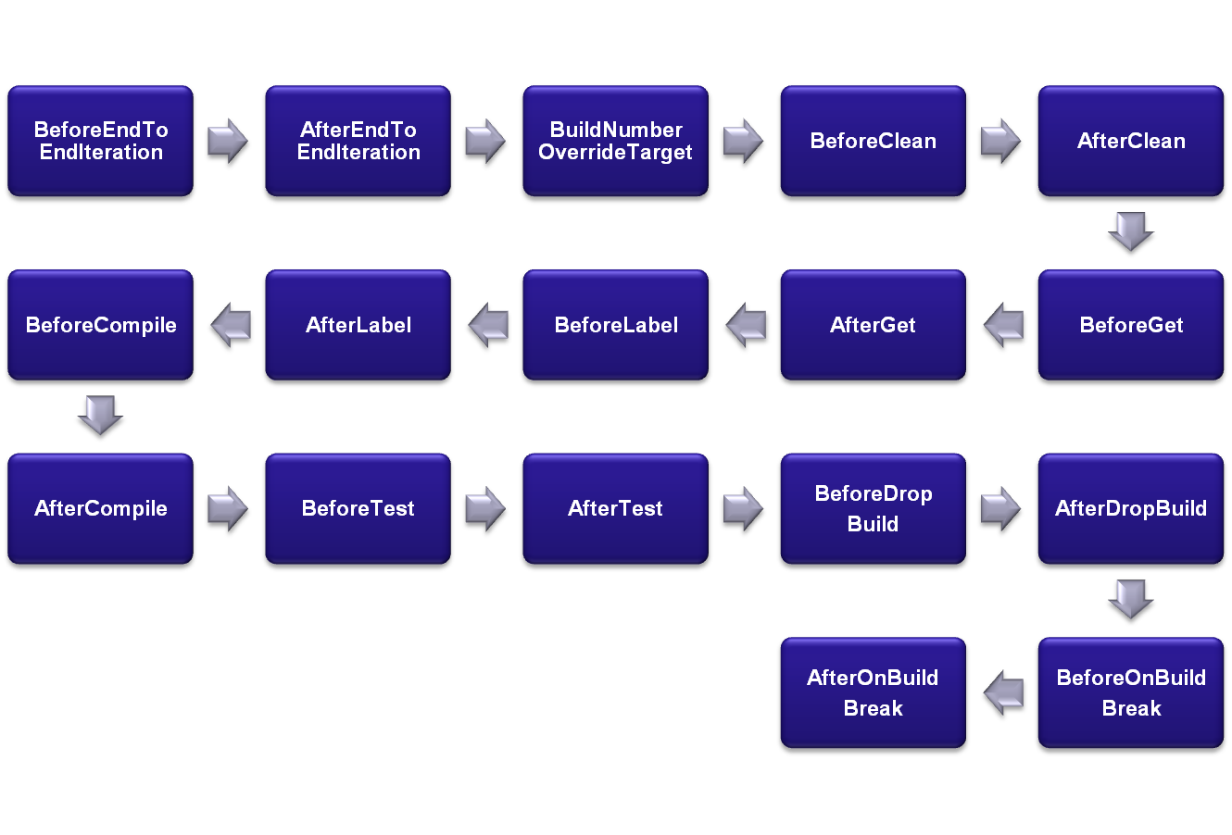
Chaffed - WebChaff (for Chaff generation)
X
WebChaff
X’
“Lets”
“Lets have a resolution”
“go”
“Go Steelers”
“bad”
“Bad Joke !! Coke !!”
“Plan”
“Congress dropped plan”
“to”
“To be or not be”
“fun”
“Walt Disney fun”
“meet”
“Intersecting lines meet”
“net”
“Microsoft .net 3.1”
Input
Feedback
X
X’
E Pool
EVE !=happy

Slide 10

Trusting IM Provider ?
Thoughts about protection against IM providers.
Trust IM provider ?
What if end user account compromised ??
Well not very important !! not Mission Critical !!
But good to have answers.
  Possible solutions.
  Take up the responsibility of Authentication. Before Session Key exchange !
  Transmit session key encrypted using Ends Public key.

Slide 11
Criticism !!
Why not use encryption ?
  Rules and Policies may not allow.
  WAC as an alternative approach to be studied.
  How slow ? Complexity ?
  For transmitting a message with N words.
  ~(N + k) * 2 Messages exchanged as opposed to 1 message.
  (K configurable for confidentiality).

Slide 12
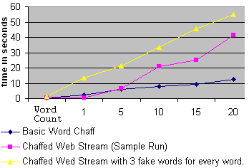
Timing results

Slide 13
Free Thank you E-Card for your Family
YouTube Broadcast yourself !!
EVE: ???

