Slide 1
Use after frees in Cyber Warfare
WACTF Exploitation 5

Slide 2

Who am I?
Cyber Security Undergraduate at Curtin University.
Browser Security Research Intern at InfoSect Canberra.
Love finding and exploiting vulnerabilities in low level software.
Love playing CTFs.

Slide 3
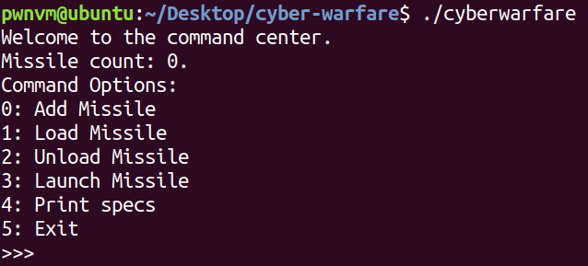
The challenge binary

Slide 4
The challenge binary
Full RELRO – Full Relocations Read Only
Stack canaries enabled
NX disabled
PIE – Position Independent Executable
ASLR – Address Space Layout Randomization

Slide 5
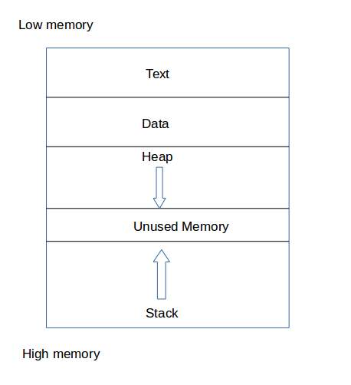
Linux memory mappings

Slide 6
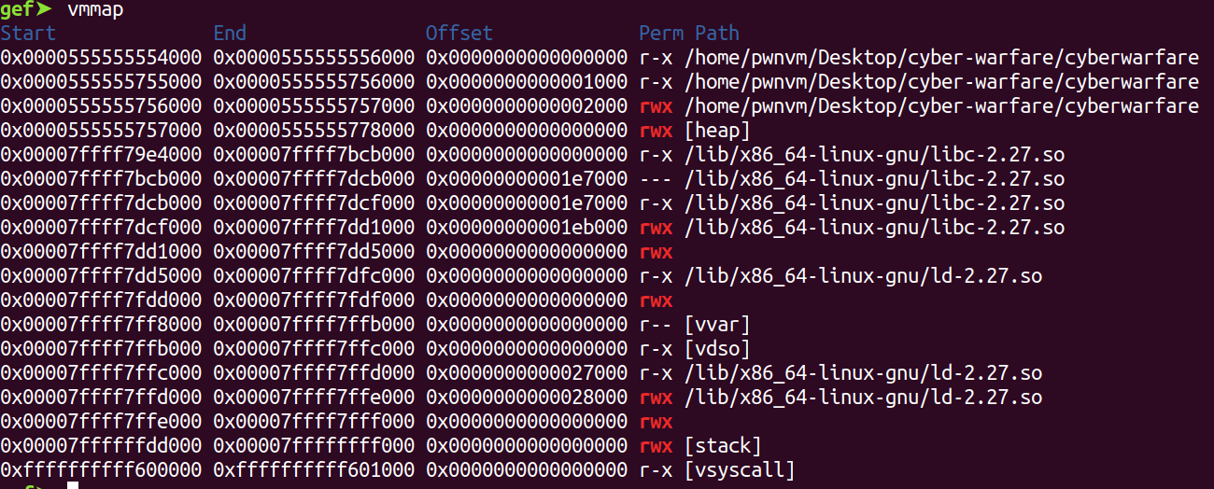
Memory mapping

Slide 7
Where are the two vulnerabilities?

Slide 8
Where are the two vulnerabilities?
The Add Missile function – Format string vulnerability
printf(missiles[missile_count]->name)
The Launch Missile function – Use after free vulnerability
Never unloads the missile

Slide 9
What is a format string vulnerability?
Essentially a very easily avoidable programming error.
Attacker controlled data being passed into the first argument of printf
Recall that the definition of printf is as follows: int printf(const char *format, …)
printf(missiles[missile_count]->name)
printf(“%p %p %p”)

Slide 10
Leaking addresses from the stack
When passing in “%p” to printf without any other arguments, printf actually starts looking for values on the stack to print out.
The stack can contain addresses to the code section, libc, and the heap.
This lets us bypass two mitigations
Address Space Layout Randomization (ASLR)
Position Independent Executable (PIE)

Slide 11
What is a use after free vulnerability?
Being able to use a pointer after it’s been freed
Much harder to exploit
In the context of this challenge the use after free allows us to either:
Print out the name and description of the missile
Free it again, causing a double free.

Slide 12
Malloc internals
Every allocated chunk has a “chunk header” just above it.
“Malloc doesn’t always return the exact number of bytes you ask for”
This chunk header contains some important metadata information that the allocator uses.

Slide 13
Bins
Bins are essentially free-lists
Multiple bins for multiple types of chunks
Freed chunks are stored in a LIFO linked list
Chunks are inserted at the head
fwd pointers are stored in the first 8 bytes of the chunk’s user data

Slide 14
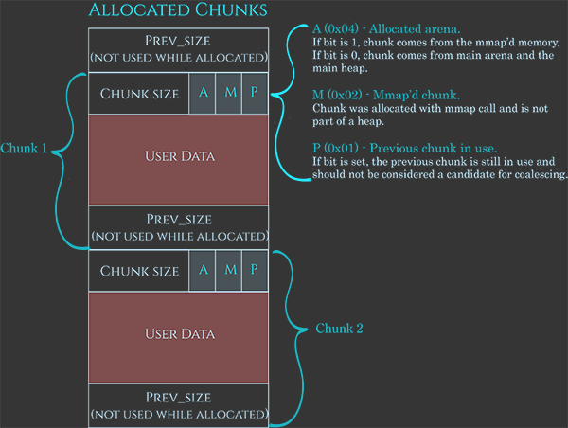
Allocated chunks

Slide 15
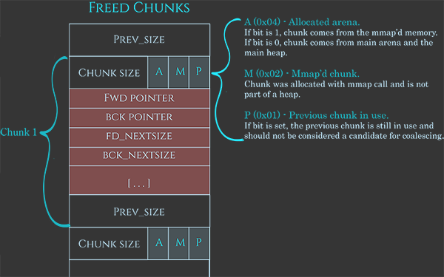
Freed chunks

Slide 16
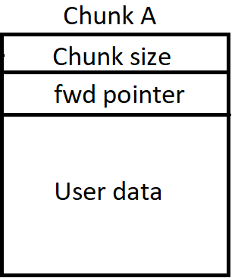
FWD pointers
→ NULL

Slide 17
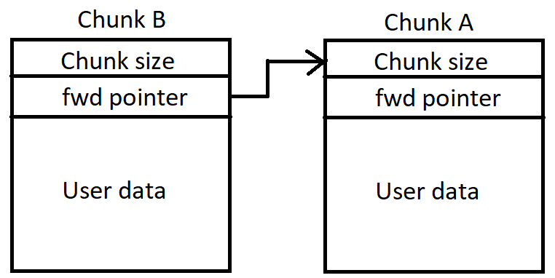
FWD pointers
→ NULL

Slide 18
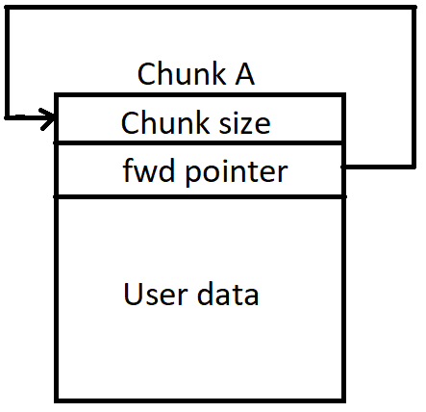
Double free

Slide 19
Double free – one allocation
<- Also user data!

Slide 20
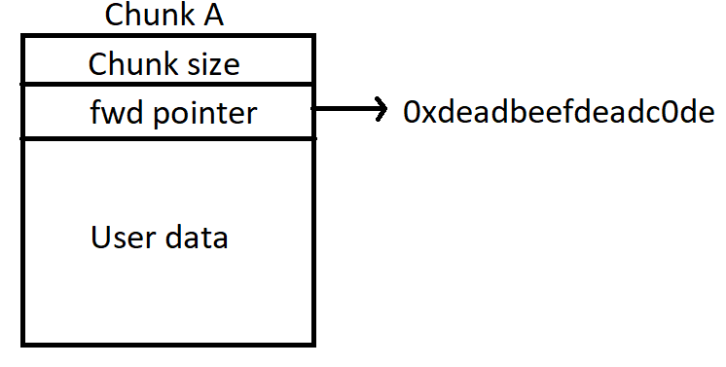
Double free – one allocation

Slide 21
Plan of attack
Use the format string vulnerability to find the binary’s base address
Subsequently find the address of print_secret_codes
Use the double free to leak an address on the heap
Overwrite one of the menu function pointers on the heap with the secret function’s address using the double free

Slide 22
pwntools
Python library built for binary exploitation
Has built in capabilities for socket programming, interaction with a program’s stdin and stdout, and etc
Allows us to automate a lot of the exploit

Slide 23
Time for a demo!

Slide 24
The ending
Questions?
Twitter: @farazsth98

