Slide 1
CSE 317 · Algorithms: Design & Analysis · Spring 2026
Maximum Subarray Sum
5
Algorithm Design & Empirical Analysis
Algorithms
Compared
Group Project · Dr. Shahid Hussain · Dr. Taslim Murad
Five Algorithms Compared · Empirical Benchmarking

Slide 2
The Problem
Definition: Given an array of integers (positive and negative), find the contiguous subarray whose elements sum to the maximum possible value.
Example
arr = [ -2, 1, -3, 4, -1, 2, 1, -5, 4 ] → max subarray = [4, -1, 2, 1] → sum = 6
Real-World Applications
Finance: Max profit window in stock prices
Signal Processing: Detect strongest signal segment
Bioinformatics: DNA sequence alignment scoring
Image Processing: 2D max subarray for region detection

Slide 3
Algorithms at a Glance
# | Algorithm | Paradigm | Time Complexity | Space
1 | Brute Force (All Subarrays) | Exhaustive Search | O(n³) | O(1)
2 | Better Brute Force | Exhaustive Search | O(n²) | O(1)
3 | Prefix Sum | Precomputation | O(n²) | O(n)
4 | Divide & Conquer | D&C | O(n log n) | O(log n)
5 | Kadane's Algorithm | Dynamic Programming | O(n) | O(1)
★ Kadane's is optimal — O(n) time with O(1) space

Slide 4
Algorithm Pseudocode — Part I
Brute Force
O(n³)
Better Brute Force
O(n²)
for i ← 0 to n-1:
for j ← i to n-1:
sum ← 0
for k ← i to j:
sum ← sum + arr[k]
if sum > maxSum:
maxSum ← sum
for i ← 0 to n-1:
sum ← 0
for j ← i to n-1:
sum ← sum + arr[j]
if sum > maxSum:
maxSum ← sum
(record i, j)
Prefix Sum
O(n²)
Kadane's Algorithm
O(n)
pre[0] ← 0
for i ← 1 to n:
pre[i] ← pre[i-1] + arr[i-1]
for i ← 0 to n-1:
for j ← i+1 to n:
sum ← pre[j] − pre[i]
maxSum ← max(maxSum, sum)
curSum ← arr[0]
maxSum ← arr[0]
for i ← 1 to n-1:
curSum ← max(arr[i],
curSum + arr[i])
if curSum > maxSum:
maxSum ← curSum

Slide 5
Algorithm Pseudocode — Divide & Conquer
Divide & Conquer
O(n log n)
Divide
maxCrossing(arr, lo, mid, hi):
leftSum ← -∞; sum ← 0
for i ← mid downto lo:
sum ← sum + arr[i]
leftSum ← max(leftSum, sum)
rightSum ← -∞; sum ← 0
for i ← mid+1 to hi:
sum ← sum + arr[i]
rightSum ← max(rightSum, sum)
return leftSum + rightSum
maxSubarray(arr, lo, hi):
if lo == hi: return arr[lo]
mid ← (lo + hi) / 2
left ← maxSubarray(arr, lo, mid)
right ← maxSubarray(arr, mid+1, hi)
cross ← maxCrossing(arr, lo, mid, hi)
return max(left, right, cross)
Split array in half at midpoint
Conquer
Recursively solve left & right halves
Combine
Find max crossing subarray through midpoint
Recurrence
T(n) = 2T(n/2) + O(n) → O(n log n)

Slide 6
Theoretical Complexity Analysis
Algorithm | n=100 | n=1,000 | n=10,000
Brute Force O(n³) | 1M | 1B | 1T ⚠️
Better BF / Prefix O(n²) | 10K | 1M | 100M
Divide & Conquer O(n log n) | ~664 | ~10K | ~133K
Kadane O(n) ★ | 100 | 1,000 | 10,000
Approximate operation counts (comparisons)

Slide 7
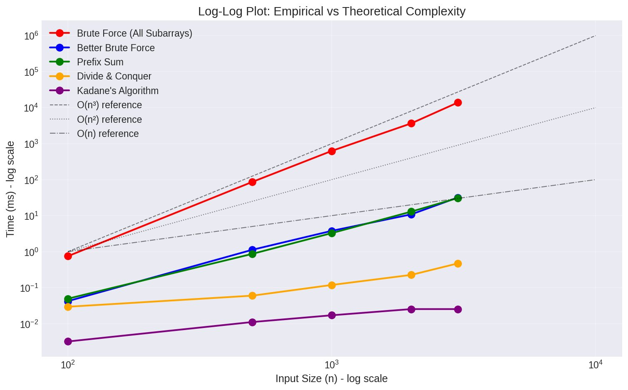
Empirical Results — Runtime Scaling
Brute Force
Grows fastest — 13.7s at n=3000
Kadane
Virtually flat — 0.03ms at n=3000
D&C
Sub-quadratic — between O(n) and O(n²)
Better BF ≈ Prefix
Nearly identical O(n²) slopes
Log-Log scale: slopes confirm theoretical complexity classes

Slide 8
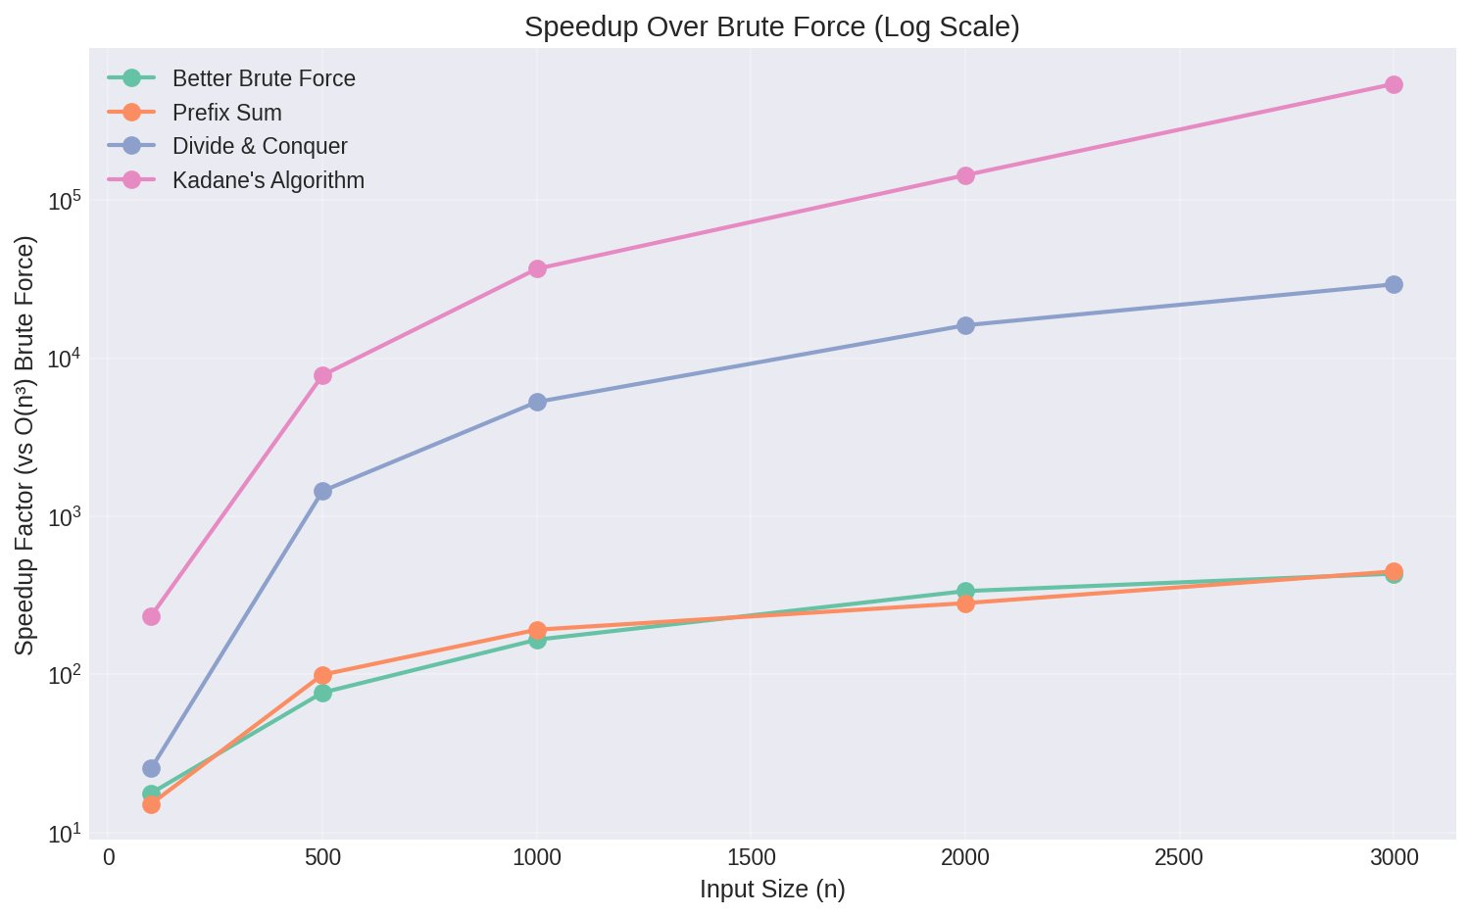
Speedup Over Brute Force
Speedup at n = 3000
Better BF
~453×
Prefix Sum
~457×
D&C
~27K×
Kadane
~500K×
Kadane is ~500,000× faster than Brute Force at n=3000

Slide 9
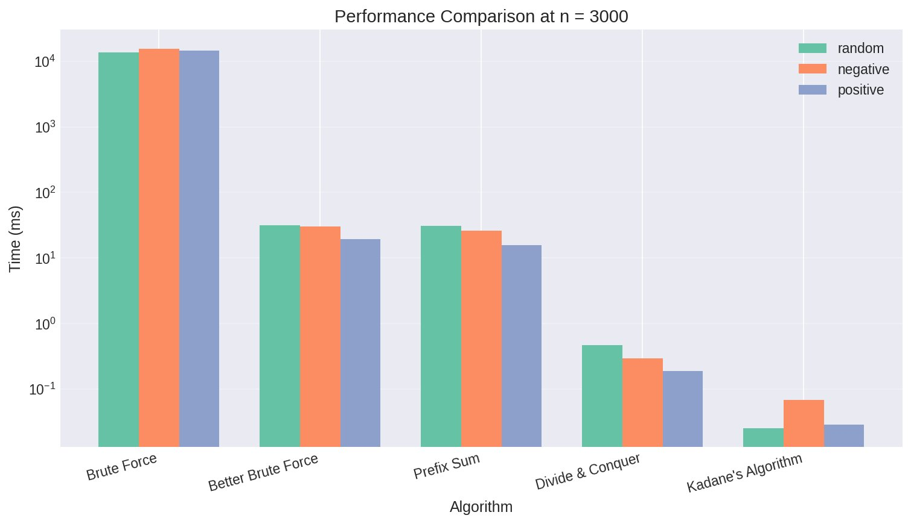
Performance at n = 3000 (Random Dataset)
Algorithm | Random | Negative | Positive
Brute Force | 13,767ms | 15,540ms | 14,441ms
Better BF | 31.8ms | 30.1ms | 19.3ms
Prefix Sum | 30.7ms | 26.2ms | 15.9ms
D&C | 0.47ms | 0.30ms | 0.19ms
Kadane ★ | 0.025ms | 0.068ms | 0.029ms

Slide 10
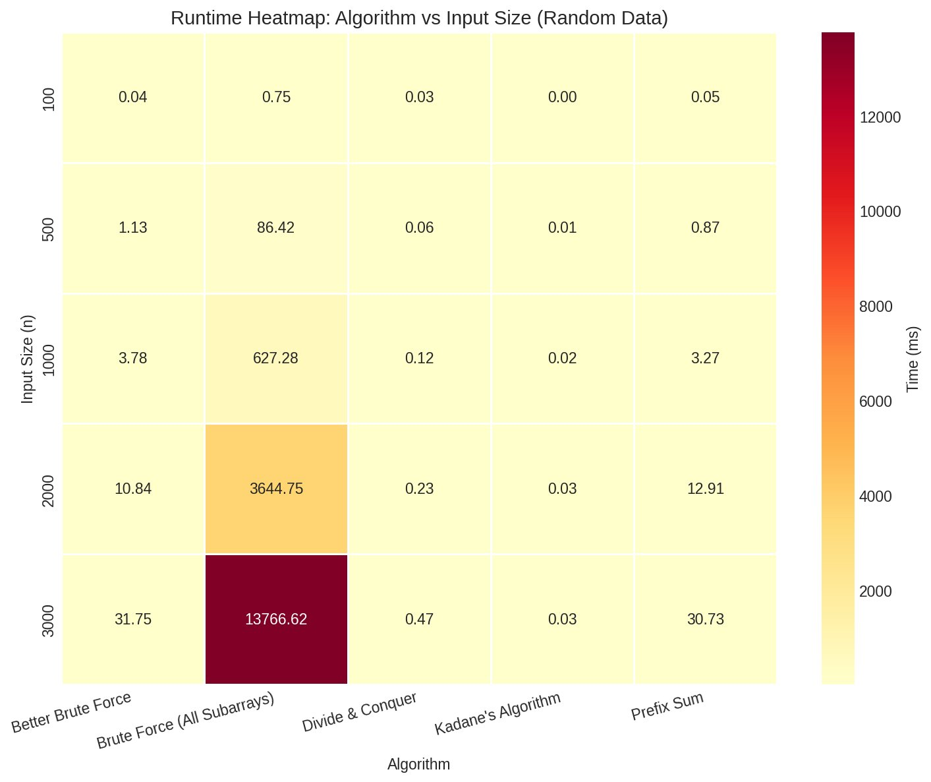
Runtime Heatmap — All Algorithms & Sizes
Brute Force dominates the color scale — all other algorithms appear nearly instantaneous by comparison

Slide 11
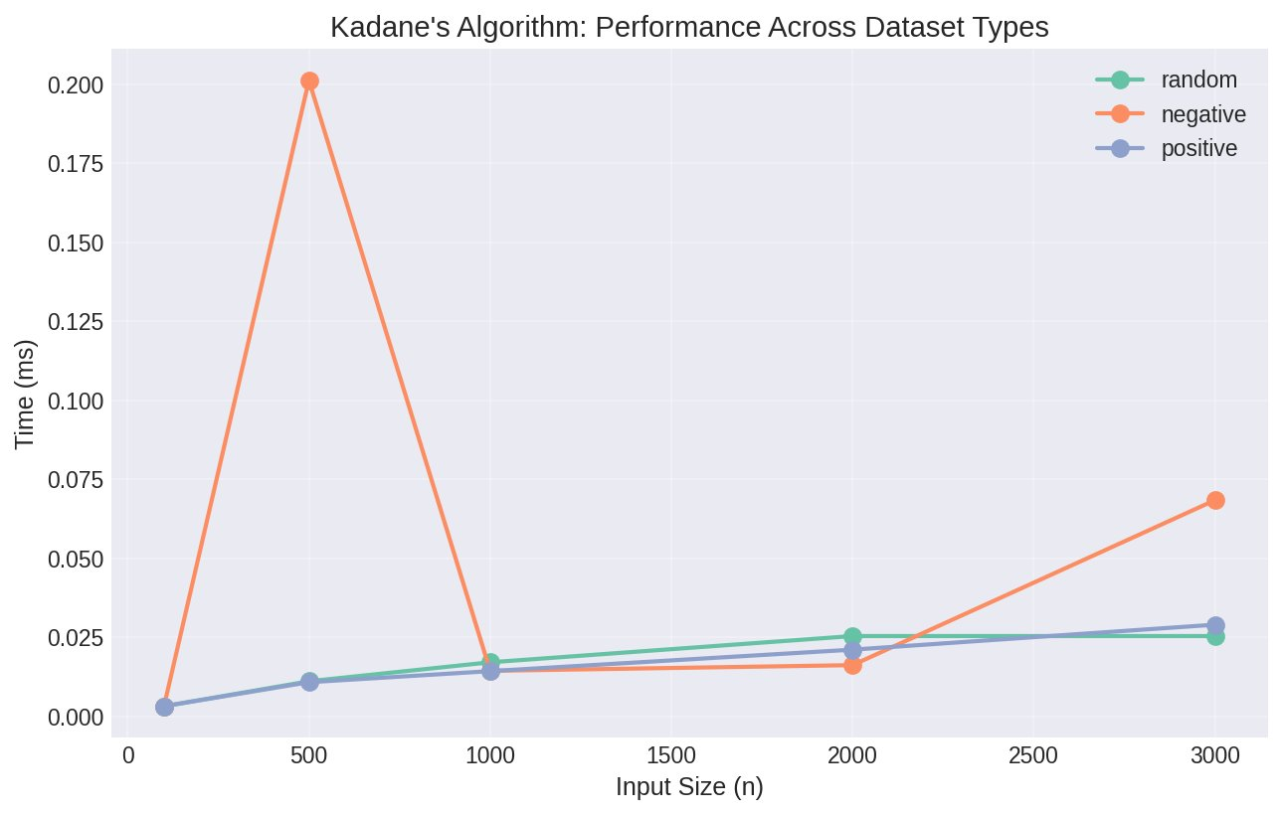
Dataset Sensitivity — Kadane's Algorithm
⚠️ Anomaly at n=500
Negative-only dataset shows a spike (0.20ms). Likely due to branch misprediction or cache effects — all-negative arrays force the algorithm to continuously reset currentSum, thrashing the branch predictor.
Random data
Consistent O(n) scaling
Positive-only
Predictable, fastest overall
Negative-only
Slight overhead — branch thrashing

Slide 12
Theory vs. Empirical — Do They Match?
Algorithm
Theoretical
Empirical
Match?
Notes
Brute Force
O(n³)
O(n^2.99)
✅ Confirmed
Slope ≈ 3 on log-log
Better BF
O(n²)
O(n^2.0)
✅ Confirmed
Slope ≈ 2 on log-log
Prefix Sum
O(n²)
O(n^2.0)
✅ Confirmed
Nearly identical to Better BF
D&C
O(n log n)
O(n^1.1)
✅ Confirmed
Slightly super-linear
Kadane
O(n)
O(n^1.0)
✅ Confirmed
Near-perfect linear fit
All empirical slopes closely match theoretical predictions — validating our implementations.

Slide 13
Strengths & Weaknesses
Brute Force
Divide & Conquer
✓ Simple to implement
✗ O(n³) — impractical for n>5000
✓ O(n log n) — efficient
✗ Complex implementation
✓ Easy to verify correctness
✗ No early termination
✓ Good for parallel processing
✗ Recursion stack overhead
Better Brute Force
Kadane ★
✓ Simpler than D&C
✗ Still quadratic
✓ Optimal O(n) time & O(1) space
✗ 1D only (needs extension for 2D)
✓ O(n²) — usable up to ~10K
✗ No memory reuse
✓ Simple, cache-friendly
✗ Requires handling all-negative
Prefix Sum
✓ O(n) preprocessing reusable
✗ O(n) extra space
✓ Extendable to 2D version
✗ Still O(n²) query loop

Slide 14
Conclusion
01
Theory Matches Practice
Log-log slopes confirm O(n³), O(n²), O(n log n), and O(n) classes — all verified empirically.
02
Kadane Dominates
~500,000× faster than Brute Force at n=3000. Optimal time and space — the clear winner for 1D problems.
03
Algorithmic Paradigm Matters
Each paradigm (exhaustive, precomputation, D&C, DP) yields measurable real-world performance differences.
04
Dataset Type Has Minor Effect
All-negative inputs cause slight slowdowns (branch misprediction), but no algorithm changes complexity class.
Maximum Subarray Sum · CSE 317 · Spring 2026

