Slide 1
The Advanced Engineering Course
Zynq 7000: AXI Lite peripherals
Low Level Driver for polled and interrupt mode
Aleksei Rostov, PhD,
Senior R&D Engineer,
FPGA/Embedded Linux Developer,
aleksei.rostov@protonmail.com

Slide 2
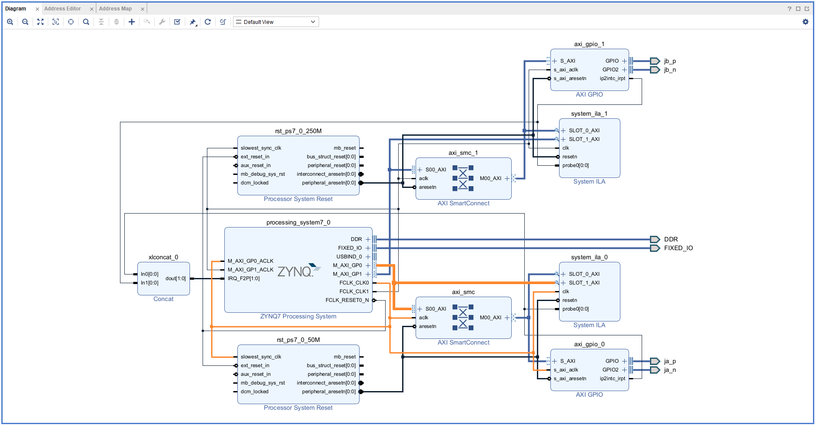
250 MHz
650 MHz
50 MHz
aleksei.rostov@protonmail.com
aleksei.rostov@protonmail.com

Slide 3
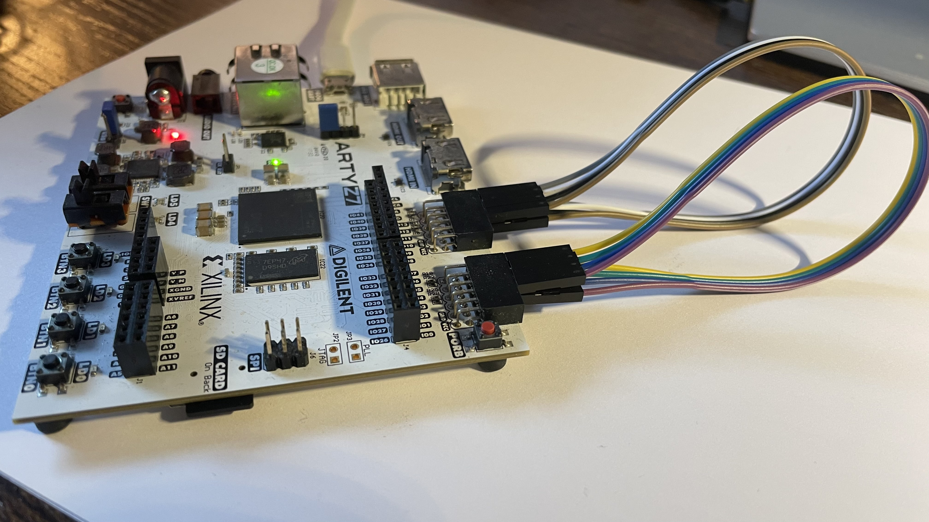
aleksei.rostov@protonmail.com
aleksei.rostov@protonmail.com
aleksei.rostov@protonmail.com

Slide 4
Test Procedure
aleksei.rostov@protonmail.com
aleksei.rostov@protonmail.com
aleksei.rostov@protonmail.com

