Slide 1
August 2010
Salesforce.com
User Orientation Guide

Slide 2
Contents
Salesforce Overview (logging in, navigation, search)
Account (Client) Management
Contact (at the Client) Management
Opportunity (Lead) Management
Activity (Task) Management
Reports and Dashboards
Security
Getting Help

Slide 3

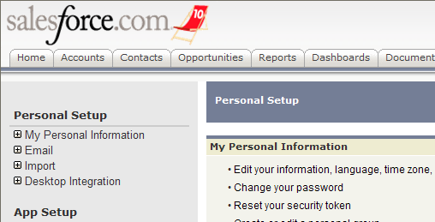
Reviewing Your Personal Settings (Optional)
Use the Setup link found at the top of every page to adjust your personal Salesforce.com settings
Setup > My Personal Information > Personal Information
Adjust time zone, display settings, language

Slide 4
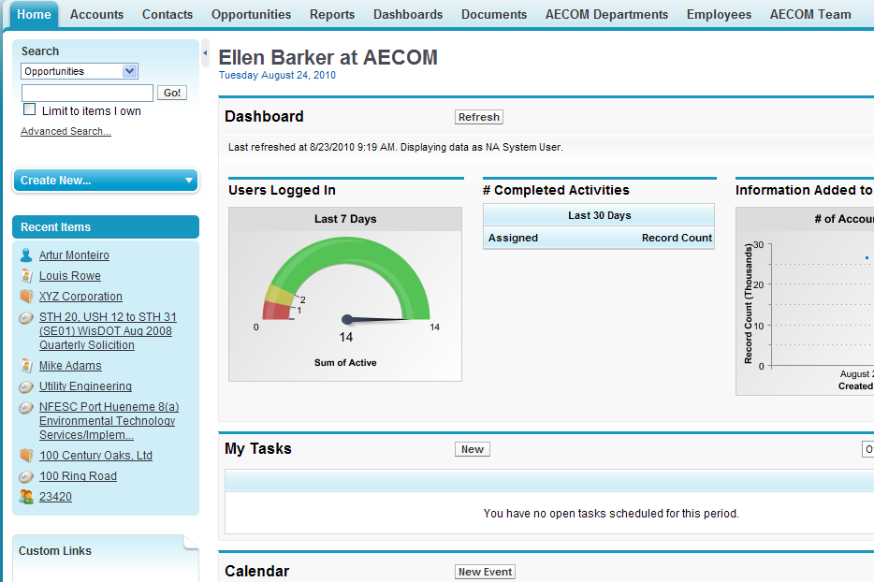
Navigating the System
You can navigate the system using Tabs, Views, Detail Pages, Editing & more

Slide 5
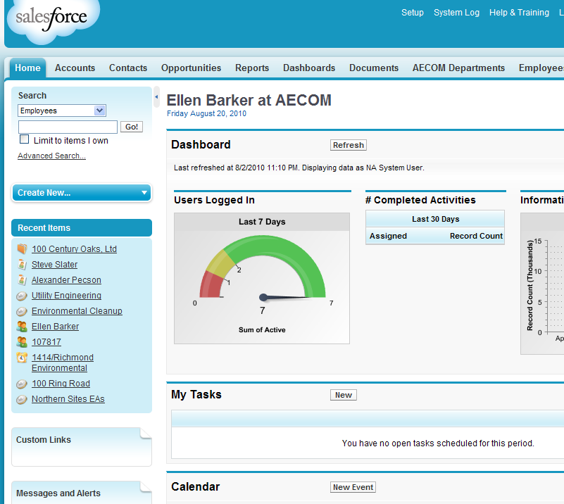
Home Page Basics
Tabs allow you to access various type of records from any page
The sidebar area gives you the ability to search for records using a simple Search or a more Advanced Search
A list of recently accessed records will always be displayed in the sidebar

Slide 6
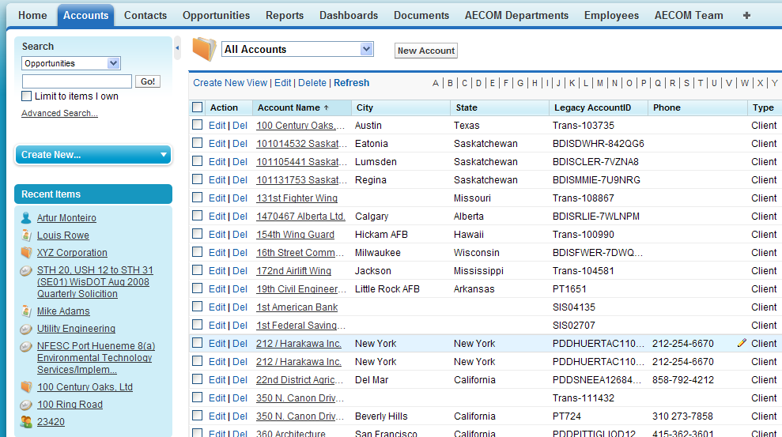








Navigating the System
You can navigate the system using Tabs, Views, Detail Pages, Editing & more
View Name
View Menu
Result list of the View
Account Record link

Slide 7
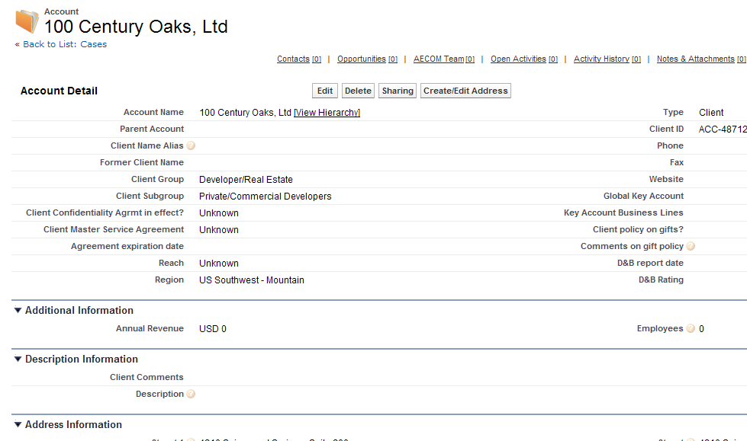





Navigating the System (continued)
Edit button
Account Record Detail

Slide 8
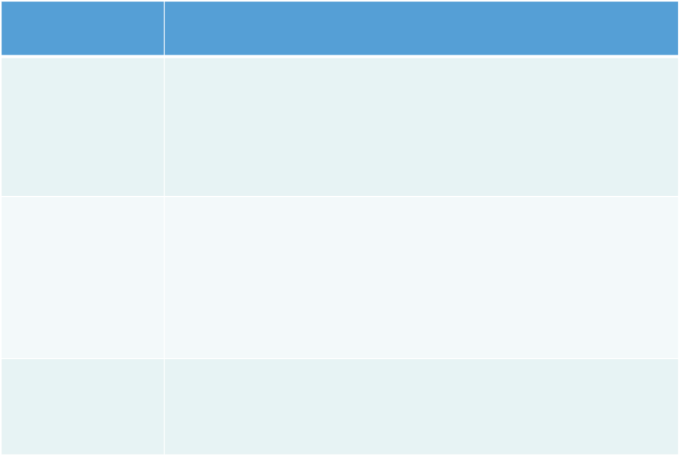
Searching for Records
Type of Search
Options & Benefits
Sidebar Search
Searches all objects
Searches are treated as a phrase search
Searches on many of the key fields of records
Wildcard (*) option – must add * to the end of a search term to find all items that start with that term
Use Boolean operators
Advanced Search Options
Searches additional fields: custom fields of type text, long text, email etc.
Search terms are treated as separate words
Choose OPERATORS, FIELDS, PHRASES, WILD-CARD etc
Choose to limit to only items you own
Limit the scope of the objects to search
Choose fields that you would like to display
Filter your records by specific criteria e.g., Award Date > 10/15/2010
Save in order to pull up the View of records any time
Creating Your Own Views

Slide 9

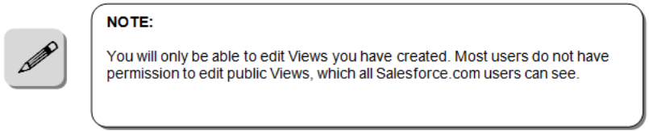
Creating a New View
Go to Leads Tab
Click on Create New View
Enter View Details
Specify Criteria
Fields to display
Save
Note: look for the edit, delete, refresh links related to the view

Slide 10
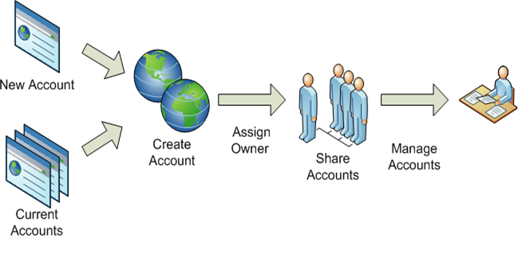
Account Management
Managing customers, competitors and partners

Slide 11
Accounts
What is an Account?
Accounts store company information for AECOM customers, partners, and competitors
Each account stores information such as name, address, and phone numbers
For each account, you can store related information such as opportunities, activities, cases, partners, contracts, and notes
Who creates Accounts?
All users
Who provides quality control on Accounts?
Content Management group
How will you use Accounts?
To track all company information on the Account (name, address etc.)

Slide 12
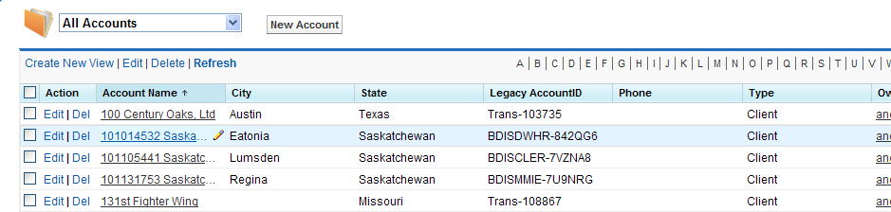
Creating Accounts
Always check first to see if the account already exists
Click the New Account button
Note: If the account is in the system but at a different location, you should create a new account.

Slide 13
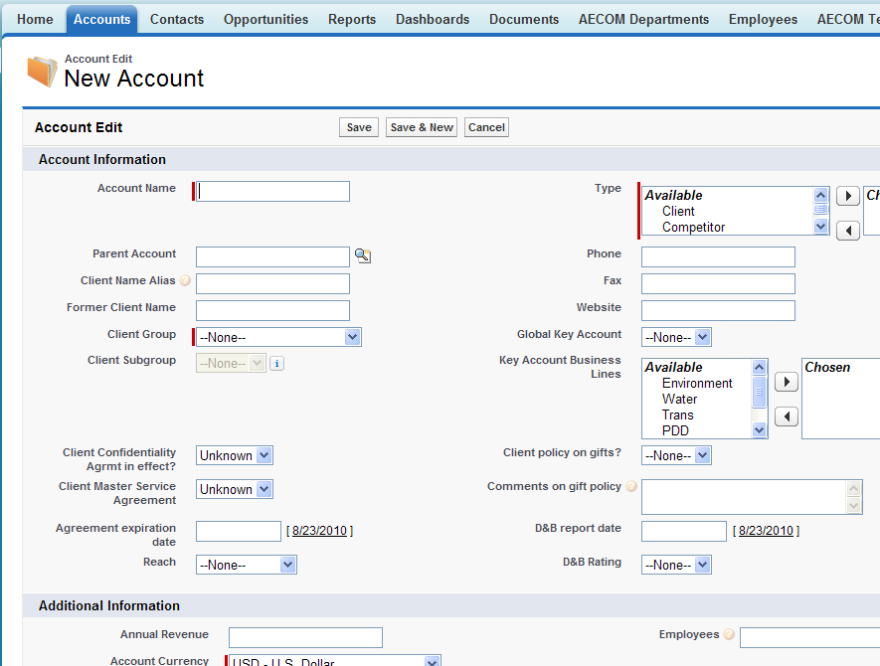
Creating Accounts (Continued)
Complete required fields
Enter all other information you have
Click Save

Slide 14


Parent Account
What is a Parent Account?
The account hierarchy shows you the accounts that are associated via the Parent Account field, giving you a global view of a company and its subsidiaries. In the hierarchy, accounts are indented to show that they are subsidiaries of the parent account above them.
To view the account hierarchy, click View Hierarchy next to the account name on the account detail page.

Slide 15
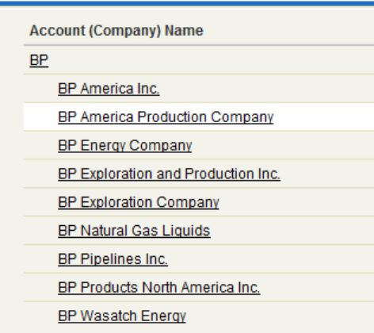
Account Hierarchy
The hierarchy is created by associating accounts (companies) with parent accounts (companies).

Slide 16
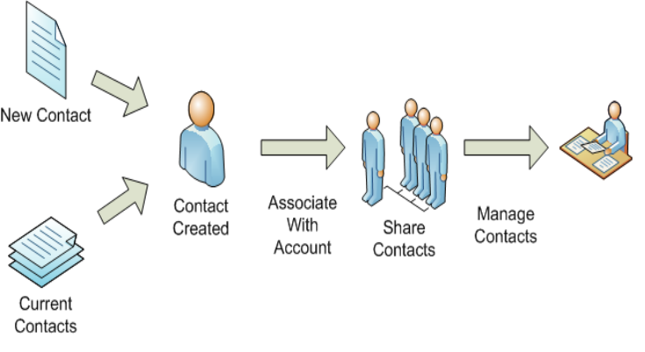
Contact Management
Managing your customers associated with your business accounts.

Slide 17
Contacts
What is a Contact?
Contacts are your individuals associated with your business accounts (companies) that you need to track in Salesforce.
You can store various information for a contact, such as phone numbers, addresses, titles, and roles in a deal.
Who uses and creates Contacts?
All users
Can my Outlook Contacts by synced with my Salesforce contacts?
Yes

Slide 18
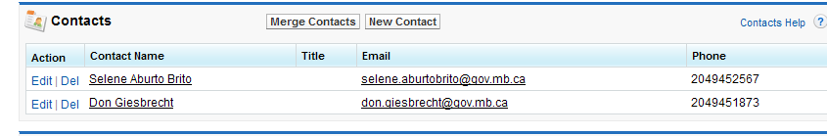

Create a Contact
Search for the Account you want to associate the contact to
Click on that Account
Scroll down to Contacts related list
Click New Contact button
Note: If you do not find the Account, search several ways to be certain it does not exist before you create a new account.

Slide 19
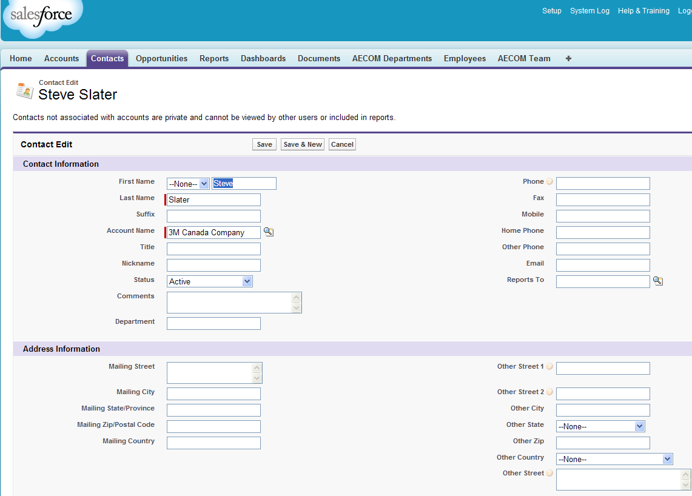

Create a Contact (continued)
Enter all relevant customer information and Save
Last Name is a required field
Although First Name is not technically required, it should always be entered

Slide 20
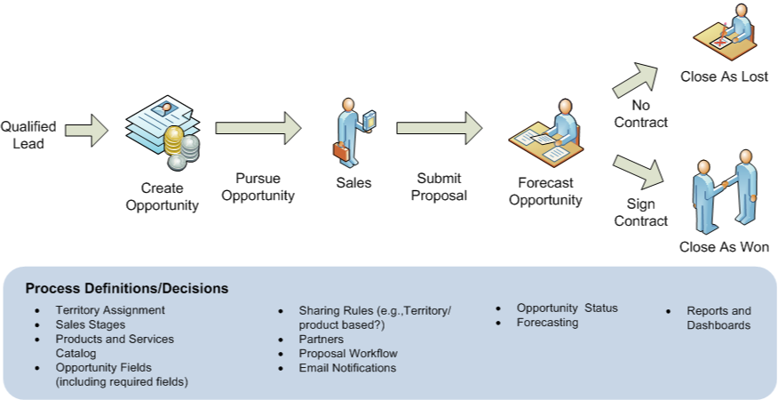
Opportunity Management
Managing leads and opportunities (pipeline)

Slide 21
Opportunities
What is an Opportunity?
Opportunities are pursuits that you want to track for a client or potential client
What kinds of Opportunities are there?
Projects: standalone pursuits - the most common type of opportunity
Programs: Master Service Agreements, ID/IQs, and similar contracts
Task Orders: Task orders, delivery orders, and other types of projects under a program
How will you use Opportunities?
Enter required data
Enter data in important fields customized for AECOM
Enter data required by your business line or group
Generate reports for your own use
Generate reports for your department, region, or business line

Slide 22

Create an Opportunity
Make sure the Opportunity has not already been entered
Search for the Account (company) with which you want to associate the opportunity
Click on that Account
Scroll down to “Opportunities” related list
Click New Opportunity button
Note:
Choose the ultimate account, not another AECOM division and not the prime if we are a subcontractor

Slide 23
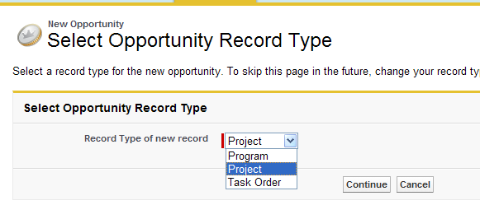

Create an Opportunity (continued)
Choose one:
Program (e.g., Master Service Agreement or IDIQ)
Project (standard type of stand-alone opportunity)
Click Continue
Notes:
Project is the most common opportunity type and is the default
Task Orders (TO or similar opportunity under an MSA or IDIQ) must be entered from the Program record

Slide 24
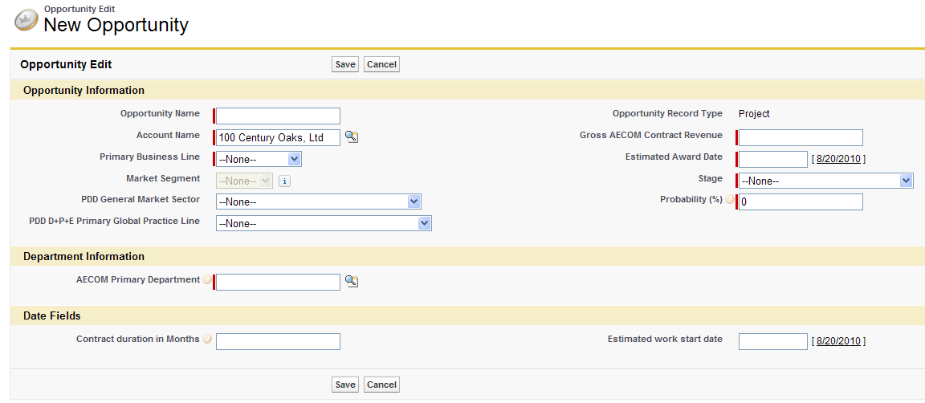
Task Order Opportunities
Open the Program that the task order falls under
Click the New Opportunity button
Enter all required and relevant opportunity information including Opportunity Name (don’t include information in other fields, such as Account name or project location)
Click Save

Slide 25
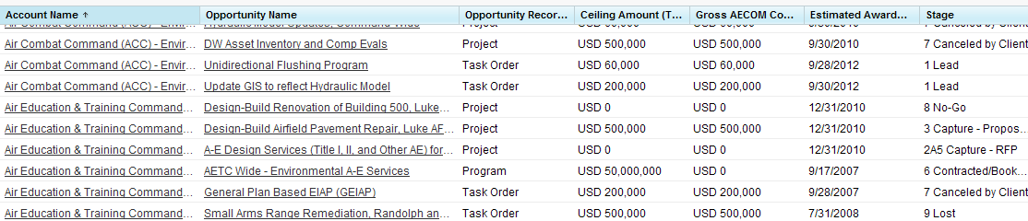
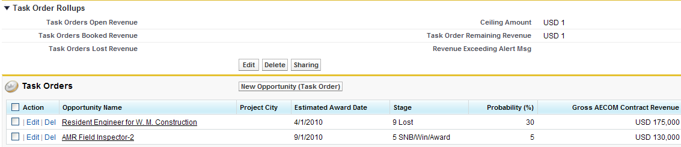
Task Order Tracking Features
Task orders appear in the Opportunities views along with Project and Program type opportunities
Task orders and summary rollups are displayed on the Program record with which they are associated
USD 130,000
USD 3,000,000
USD 2,870,000
USD 175,000

Slide 26
History Tracking
Salesforce can track history on standard and custom fields that are edited
History displays who changed the field and the before and after values
History tracking is turned on for key fields such as Opportunity stage, Contract $, and award date

Slide 27
Campaigns
What is a campaign?
A campaign is an outbound marketing project that you want to track within Salesforce
It can be a direct mail program, seminar, print advertisement, email, or other type of marketing initiative. You can organize campaigns into hierarchies for easy analysis of related marketing tactics
Who will use Campaigns?
Special permissions and training are required to use Campaigns
Functionality will be rolled out on request and with approval
Reminder: Campaigns are planned and managed in coordination with Corporate Communications

Slide 28

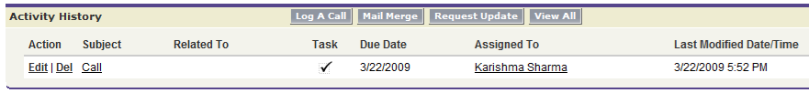
Activities
Activities can be associated with Accounts, Contacts, and Opportunities
Activities including Tasks, Events, and Logged Calls are viewable through the Open Activities and the Activity History related lists.

Slide 29
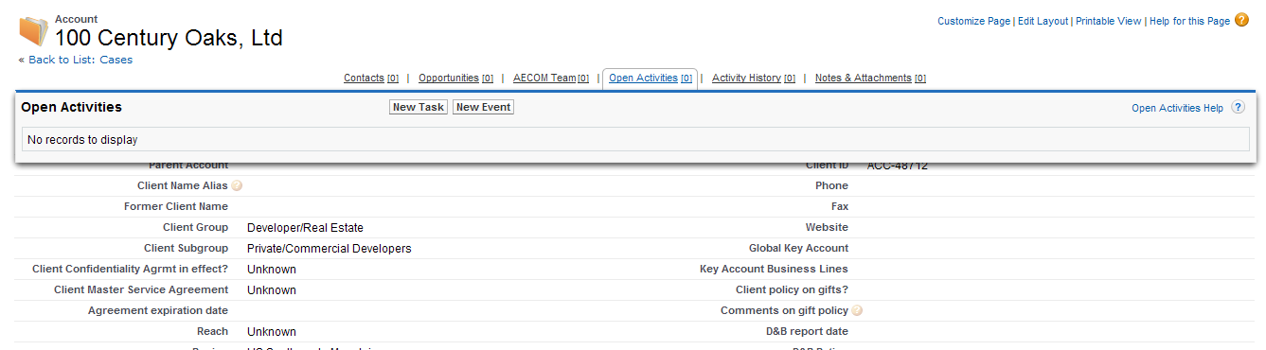

Activities - Tasks
Open an Account, Contact, or Opportunity
Hover over Open Activities to view open activities
Click New Task to add an activity

Slide 30
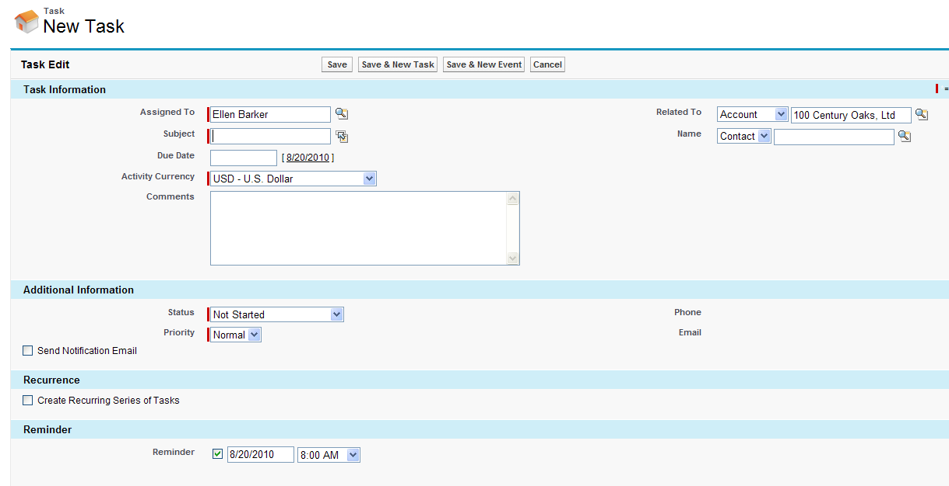
Activities – Tasks (Continued)
Complete required fields (with red left borders)
Click Save
Notes:
Default “Assigned to” is the user who creates it – but it can be changed
Task inherits the Account, Contact, or Opportunity from which it was created

Slide 31
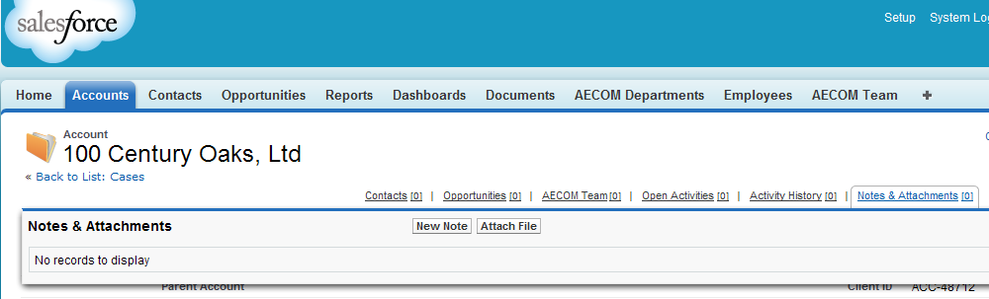
Notes & Attachments
Open an Account, Contact, or Opportunity
Hover over Notes & Attachments to view open activities
Click New Note to add an activity (or Attach File to attach a document)

Slide 32
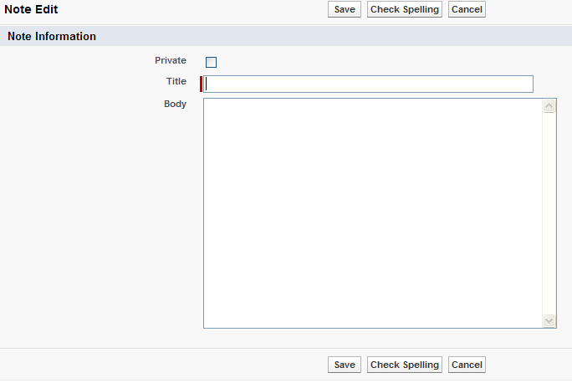
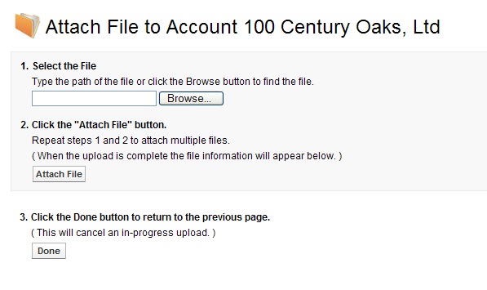
Notes & Attachments (Continued)
Enter note information and click Save
or
Follow the three steps to attach a file

Slide 33
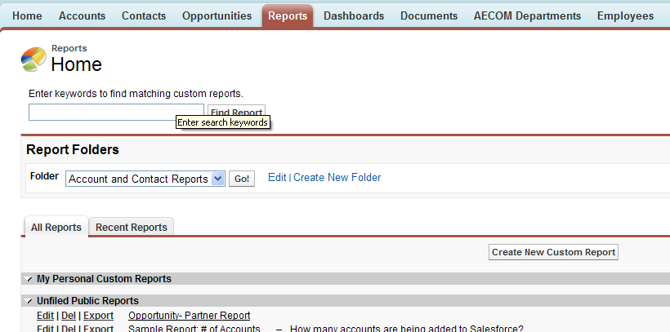
Reports
The Reports feature allows you to view and analyze your data and to get a summary of the records you are interested in, in a preferred format
The Folder drop-down list includes all Report folders you can view.
Use a canned report as a starting point to create your own custom reports

Slide 34
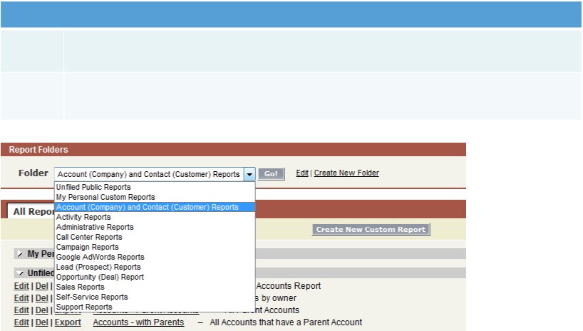

Running a Report (continued)
First Steps for Running a Report
Step 1
Select the Report Folder you are interested in and select “Go”. A list of all of the Reports you are able to see within this folder will be displayed.
Step 2
Click a Report Name. Most reports will be run automatically by clicking the name; some may require you to select additional information.

Slide 35
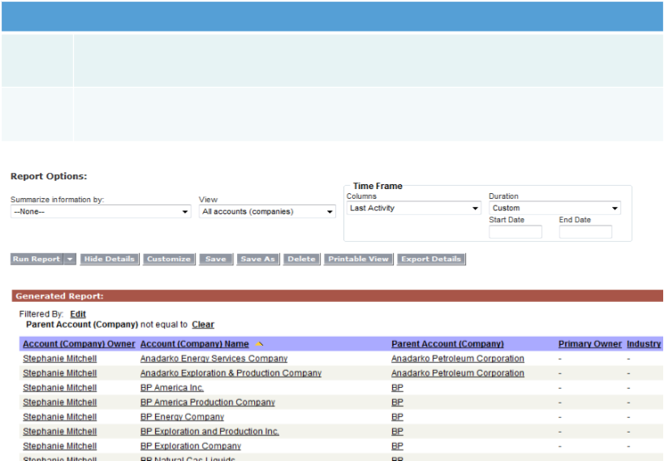


Running a Report (continued)
Next Steps for Running a Report
Step 3
After the Report runs, you can view the initial results. You can also modify it from the list of available options.
Step 4
Choose the “Customize” button to customize an existing report that has just been run. This will be described in the next section.

Slide 36
Creating Your Own Reports
There are two ways to create your own reports, which are saved to the “My Personal Custom Reports” folder:
Customize one of the already-existing “Reports”:
Click the “Customize” button and update the Report Summary Fields, Column Information and Filters - then Save it
This option can be limiting, as the original settings cannot always be seen again once you’ve begun editing it
Create your own report from scratch (e.g., “All My documents Sorted by date”)
Recommendation: Complete the on-line Salesforce course Reports Fundamentals

Slide 37
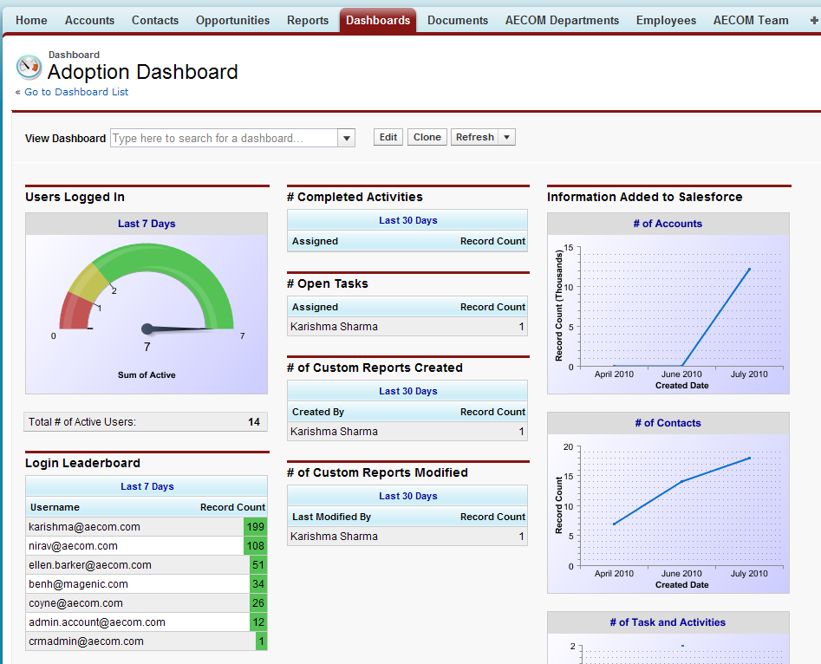
The Dashboard
Dashboards and Dashboard Components
A Salesforce.com Dashboard consists of a set of dashboard components, each of which is a Report, displayed in summary in graphical format
Dashboards are created by managers or system administrators
There is no such concept as a personal set of “My Dashboards”—all Dashboards are potentially shared across the user base
The Dashboard feature will be more fully developed for AECOM users in the coming months as requirements are defined

Slide 38
Security
Geography Defaults
All users in Americas, Asia, Europe, and Middle East can see each other’s data
Users can edit opportunities only within their own geography
Global data is available through a global data platform that consolidates Salesforce data with data from ANZ’s B&O system
Special Permissions
Deletion of records is by request to the geography administrators
Employee data (People pick lists) are not editable in Salesforce, they are managed through HRIS data feed

Slide 39
Getting Help
Type of Help | Description
Internal Support | Provided by Superusers (BLs and Geographies) Geography links are at the bottom of the left panel in Salesforce
Online Searchable Help from Salesforce.com | Help & Training link found at the top of every page Searches return HELP documentation and SOLUTIONS written by Salesforce.com support Click the “Help for this Page” link in upper right-hand corner of any page
Online Training from Salesforce.com | A list of Self-paced Training Courses can be found under the “Help & Training” link
Field-level help | Hold cursor over the symbol for guidance related to that field
?

Slide 40
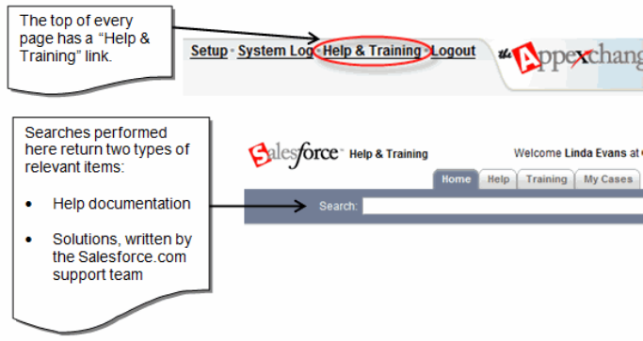
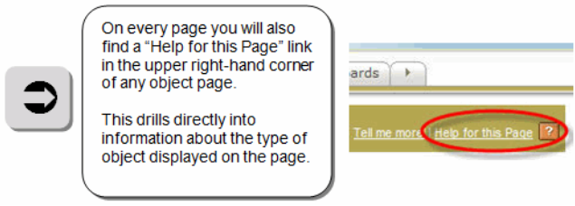
Online Help from Salesforce.com

Slide 41
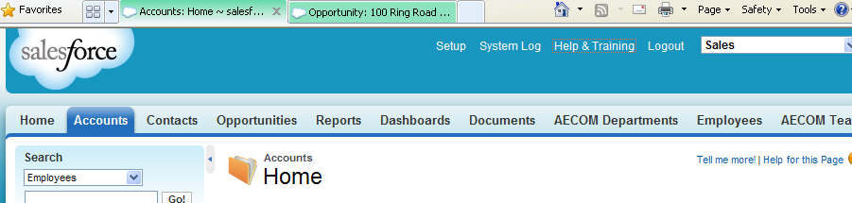
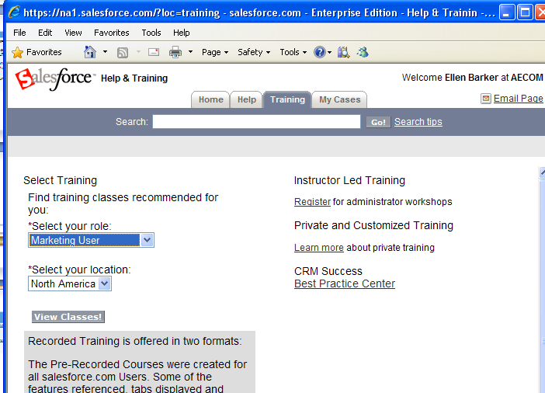
Online Training from Salesforce.com
Select Help & Training
Click the Training Tab
Select any Role
Click View Classes

Slide 42
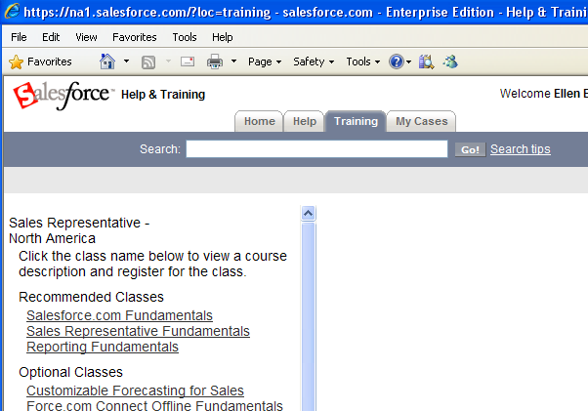
Online Training from Salesforce.com (Continued)
Select and complete Salesforce.com Fundamentals
Select and complete Reporting Fundamentals
Note:
Skip the “Lead” sections of the training (AECOM is not implementing this functionality).

