Slide 1
Salesforce Department Split Redesign Overview Presentation: PDD
February 2012

Slide 2
Introductory Remarks
Salesforce is a licensed program; do not share your login/password with anyone
Reports are being generated at all levels throughout AECOM, so accurate and updated records are extremely important
Business decisions are being made with this information
If you are not sure, please ask:
PDD Systems Team
Kimberly Cowern
Diane Fencl
Holly Penrose
Joy Woo
Exciting news to share today…

Slide 3
Enhanced Reporting
Salesforce AECOM Departments have been reconfigured to enhance reporting and eliminate the practice of entering multiple opportunities for a single pursuit
This presentation illustrates the major changes:
New opportunity entry
Department updates
Reporting

Slide 4
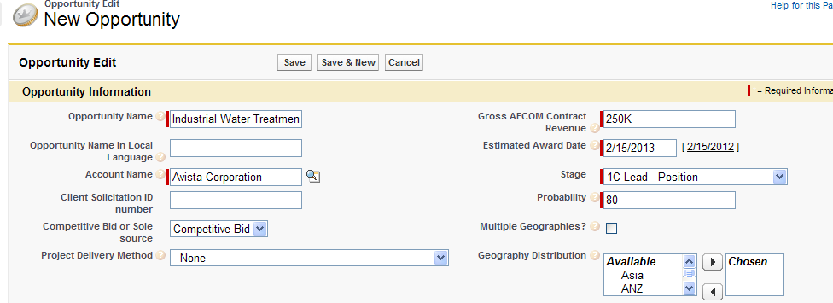
New Opportunity Input Step 1
Enter most information as before
Note: you no longer enter Department or Primary Business line in this step
Click “Save”

Slide 5
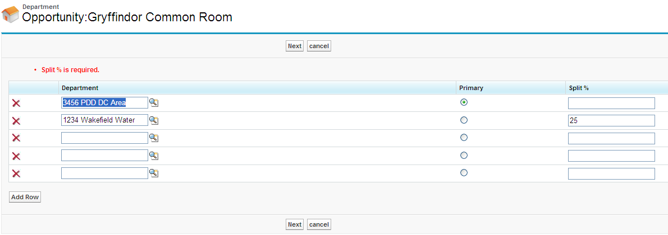
New Opportunity Input Step 2
Once you have successfully saved your record, you will be taken to the Department entry screen
Enter one or more departments and their % share of net revenue (must equal 100%)
Select the Primary button next to the department that is primary (this is the department that will hold the contract with the client; it does not need to have the largest % of the net revenue)
Click “Next”

Slide 6
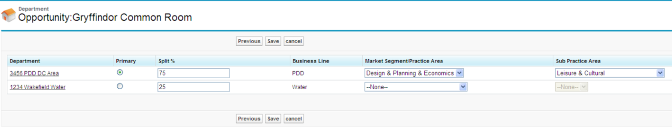
New Opportunity Input Step 3
Business Lines are now pre-populated based upon the Departments you selected
Next, select Market Segment/Practice Area and Sub Practice Area from the picklists; the available list is dependent upon the Business Line
You will be required at a minimum to specify the Market Segment/Practice Area for the Primary Department.
Note for PDD, the Sub Practice Area is the same as the PDD General Market Sector and should match what you entered in that field in Step 1. Consider required for PDD.
Click “Save”

Slide 7
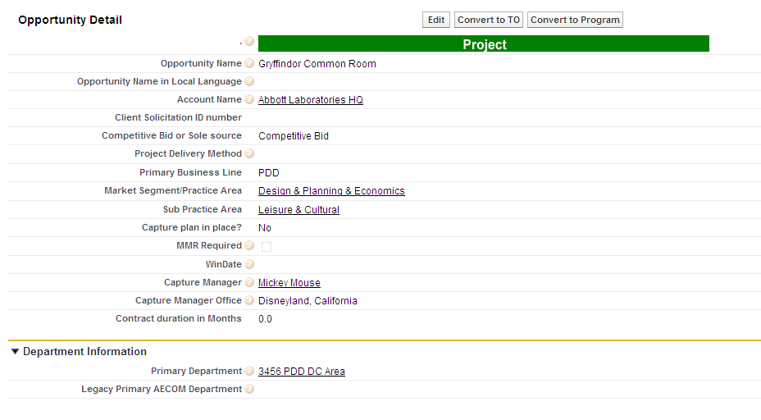
New Opportunity Input Step 4
Once you have successfully saved the record, note that Primary Business Line, Market Segment/Practice Area, Sub Practice Area, and AECOM Primary Department for the Primary Department are displayed on the main record

Slide 8
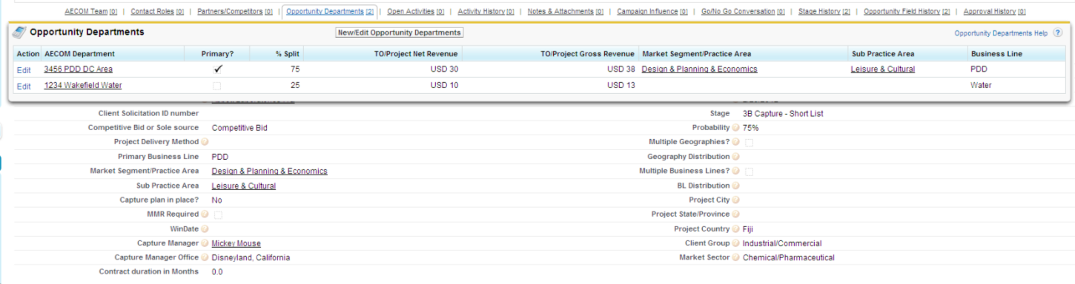
Department Edit Step 1
Find and open an existing opportunity record as before (do not click Edit)
Hover over the “Opportunity Departments” link at the top of the opportunity
Click New/Edit Opportunity Departments

Slide 9
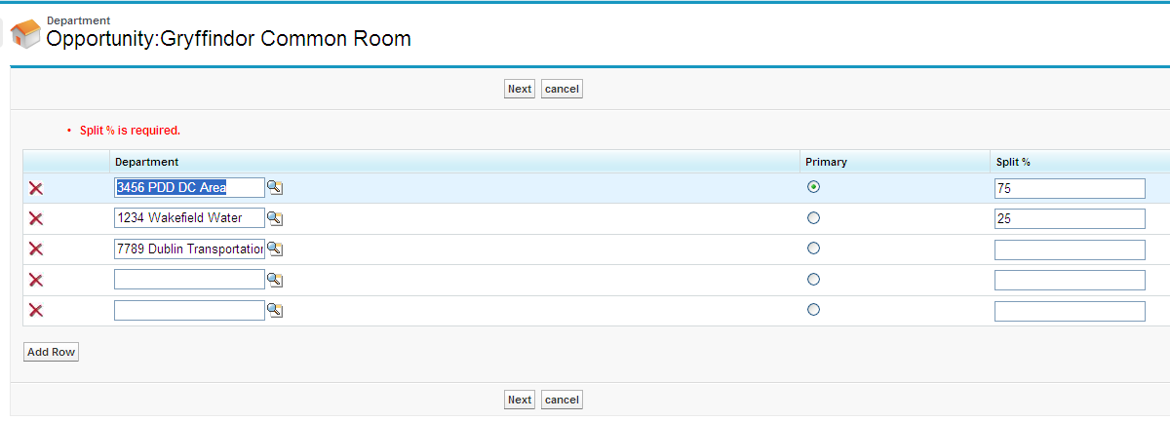
Department Edit Step 2
You will be taken to the Department entry screen
Revise one or more departments and their % share of revenue (must equal 100%)
Enter additional departments and splits
Select Primary next to your Primary Department (this is the department that will hold the contract; it does not need to have the largest % of the net revenue)
Click “Next”

Slide 10
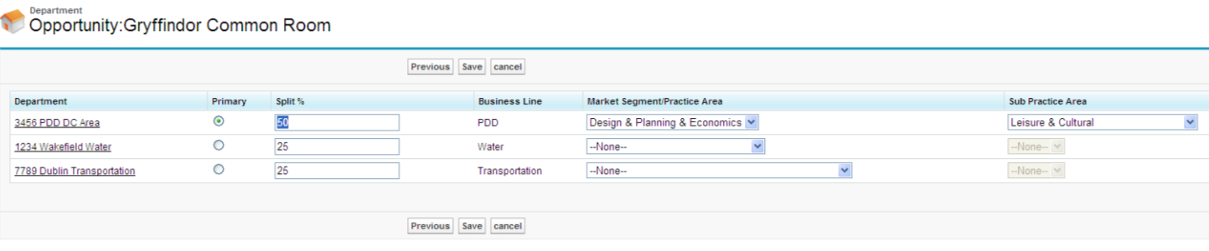
Department Edit Step 3
Business Lines are pre-populated based upon the Departments select in Step 2
Add or adjust Market Segment/Practice Areas and Sub Practice Areas
Click “Save”

Slide 11
Architecture and Building Engineering Splits
FY12 Guidance for A/BE Opportunities and Projects/Financial Reporting:
Projects will be owned/assigned to the practice line (A or BE dept) expected to earn a significant majority of NSR (>=70%). shared management department.
Otherwise, projects are owned by shared management department.
 | Scenario 1: | Scenario 2: | Scenario 3:
Salesforce Data Protocol | Scenario 1: A + BE; Arch is majority (>=70%) | Scenario 2: A + BE; BE is majority (>=70%) | Scenario 3: A + BE; No Practice line is majority (<70%)
Primary Dept | NCO Arch (451) | NCO BE (449) | NCO Shared (402)
Market Segment/Practice Area | Architecture | Building Engineering | Architecture
Revenue Split:
NCO Arch (451) | 80% | 20% | 59%
NCO BE (449) | 20% | 80% | 40%
NCO Shared Mgmt (402) | 0% | 0% | 1%
 | 100% | 100% | 100%
Booking/Oracle project | NCO Arch (451) | NCO BE (449) | NCO Shared (402)

Slide 12
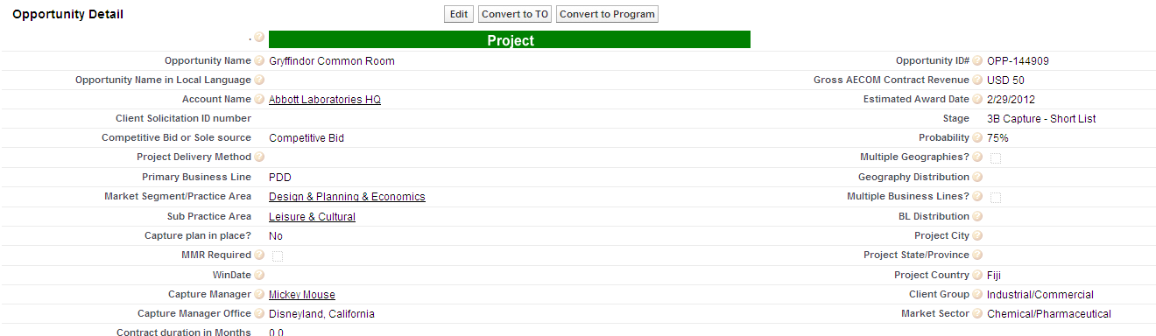
Multiple Geographies + Business Lines
Even though you have entered various departments in the Opportunity Departments table, you will still need to populate these fields on the main screen:
Multiple Geographies?
Geography Distribution
Multiple Business Lines?
BL Distribution
Project City, State/Province, and Country are also critical to Reporting

Slide 13
Request/Reminders
Record Cleanup
Please review your records and update the information accordingly. Ensure the department splits are accurate.
The Primary Department is the department that will receive full credit for the win while the Department splits are used for forecasting.
After your opportunity reaches Stage 5, SNB, please do not change the Primary Department.
Stage 5, SNB, to Stage 6, Contracted/Booked
Design + Planning + Economics: Kimberly Cowern updates opportunity records
A and BE: Holly Penrose update opportunity records
They reconcile with APIC entries
Communication/Coordination
Each lead/opportunity is entered once.
Requires clear communication and coordination with other business lines and geographies.
As courtesy, do not change another’s record. Consult them first.

Slide 14
Reporting Changes: Department Splits
Note that you will need to change any existing reports.
For example, fields that have changed will have “_old” in the field name and need to be changed to the new field name:
• Primary BL
• Marketing Segment / Practice Area
• Sub practice area
• Geography
• Lead District
• Lead Region

Slide 15
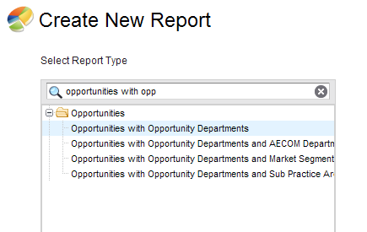
Reporting Changes – Filtering Step 1
To filter for all opportunities in which Department 0449 is involved, choose report type “Opportunities with Opportunity Departments”

Slide 16
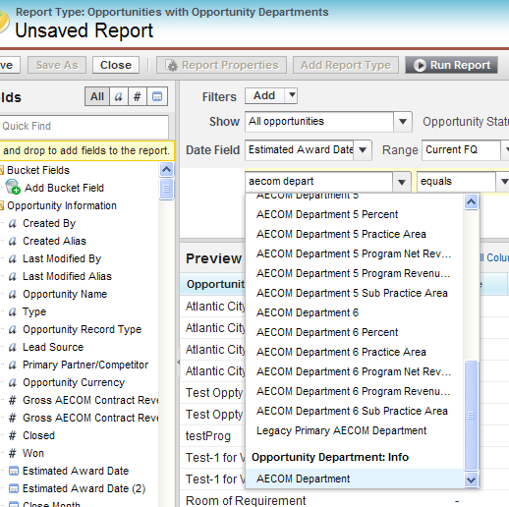
Reporting Changes – Filtering Step 2
Add field filter
Select “AECOM Department” under Opportunity Department: Info
Select Contains
Enter “0449”
Click OK
This filter will find opportunities with 0449 in any row in the Department entry screen

Slide 17
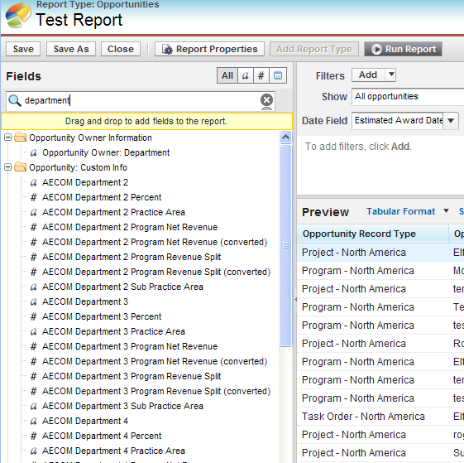
Reporting Changes – Field Columns Available
Departments 2, 3, 4, 5, and 6 are now available to select as report columns
Department-specific information is also available as shown in this screenshot

Slide 18
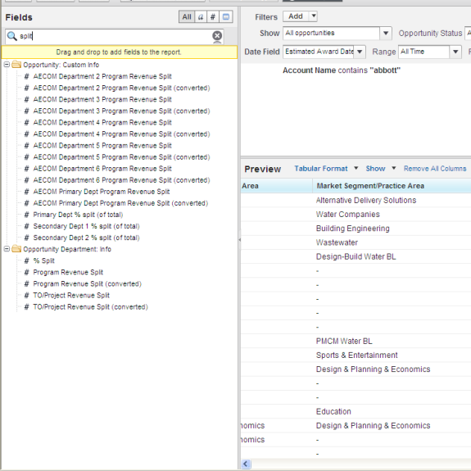
Reporting – % Split Field Column
Select % Split under Opportunity Department: Info to include in your report
If you filtered on one department as in “0449”, then this shows % split allocated to department 0449
Thus, you do not need to know which department number (primary to #6) your selected department is

Slide 19
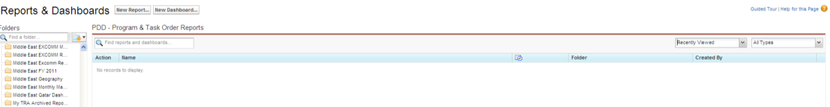
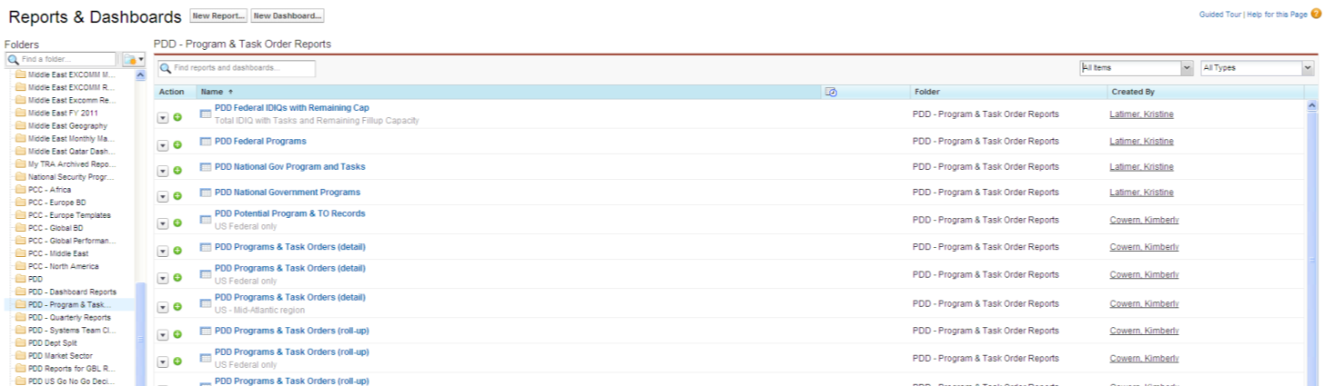
Reporting Changes: Updates
New fields that may be of interest:
Stage Group
Win-Loss Report Date
Report lists: All Items vs. Recently Viewed as the default

Slide 20
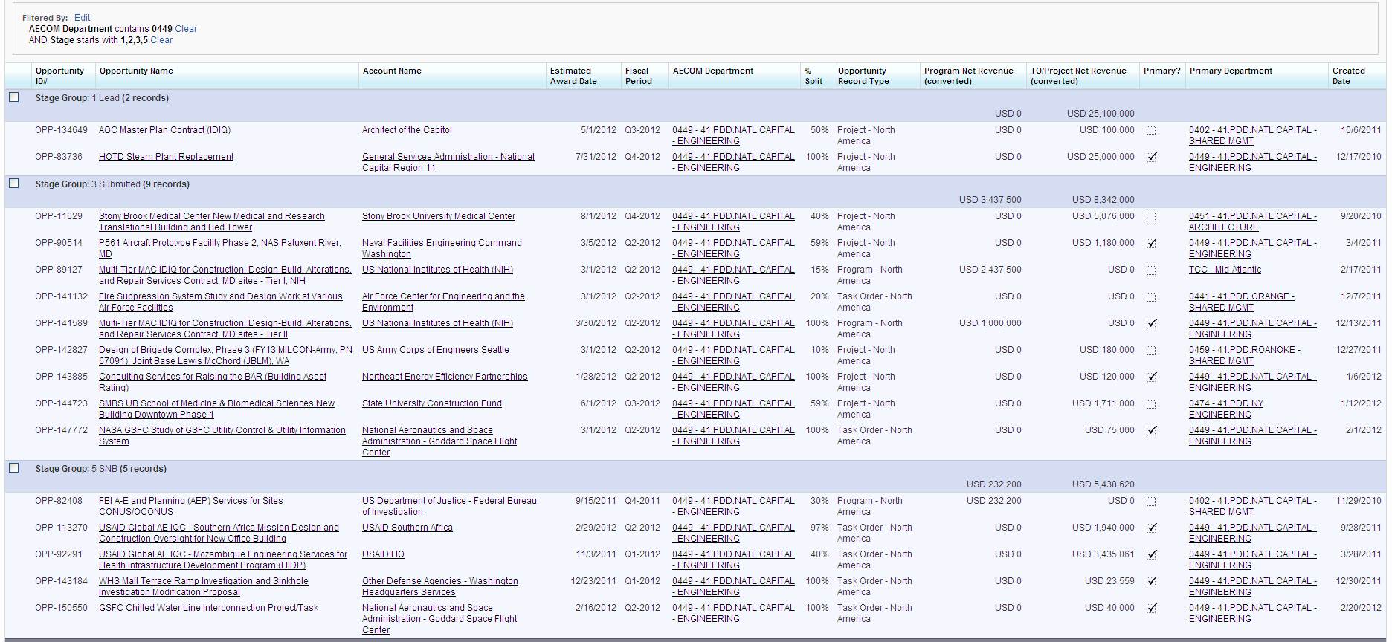
Reporting – Template 1: Pipeline
Go to Reports
Go to PDD Dept Split folder
Select this report: one dept w/its revenue split

Slide 21
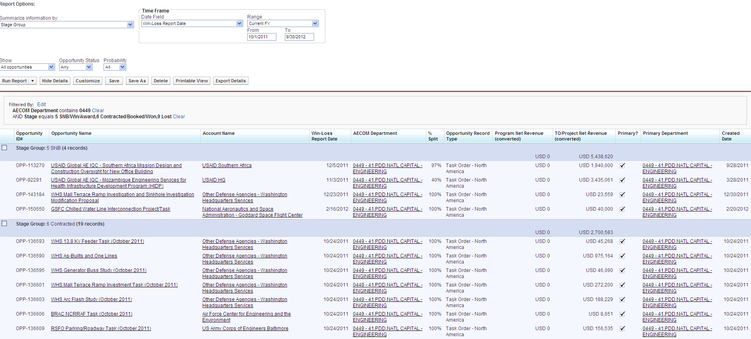
Reporting – Template 2: Current FY Wins/Losses
Go to Reports
Go to PDD Dept Split folder
Select this report: one dept win loss current fy

Slide 22
Thank you.

