Slide 1
AECOM Technology Corporation Third Party Screening Tool
Office of Ethics and Compliance
January, 2011 Edition

Slide 2
Table of Contents
Why Screen
Who to Screen
Who Screens
MK Denial – What it is and Why Use It
Using MK Denial to Screen
MK Denial Country Reports
Using MK Denial - Frequency of Screening
Subscription Access Control
Contact Information
Appendix A – Lists Screened by MK Denial Screening Tool

Slide 3
Why Screen
AECOM must know certain facts about the parties with whom it does business in order to comply with government regulations
Thirty two countries, the UN, World Bank and Interpol all publish lists of controlled entities and individuals involved in criminal activities, human rights violations, money-laundering, narco-trafficking, terrorism, or weapons tracking and proliferation.
“Screening” is the process of comparing individuals or organizations with these lists, including
Agents, banks, clients, consultants, customers, joint ventures, service-providers, sub-contractors, suppliers, teaming partners, ultimate end users or owners, and vendors
To make screening easier, AECOM has purchased enterprise-wide access to MK Denial, an online database that consolidates and updates these lists
All AECOM owned or controlled entities must incorporate screening using the MK Denial database into business processes

Slide 4
Who to Screen
Agents, Clients, Customers, Joint Ventures, Project Owners and Ultimate End Users / Owners
Regulations and prudent business practices require AECOM to conduct due diligence on the parties with whom it does business
AECOM’s due diligence obligations apply whether or not AECOM has a direct contract with the ultimate client or end user
AECOM must determine and screen anyone funding or getting the benefit of the contract or transaction
Banks
The physical location, owners or the types of business transactions conducted by a bank may impact AECOM’s ability to receive funds from or use a bank
Consultants, Service-Providers, Subcontractors, Suppliers, Teaming Partners, Vendors
Due diligence obligations also apply to those we pay, not just those who pay us

Slide 5
Who Screens
AECOM Department | Why?
Accounting & Finance | Receive and process funds received from domestic and foreign banks; certain foreign banks are subject to sanctions
Business Development | Potential clients, consultants, customers, joint ventures, project owners, service-providers, subcontractors, suppliers, teaming partners or vendors may be subject to controls that impact the proposed transaction
Contracts & Subcontracts
Operations / Program Management
Procurement / Purchasing
Recruiting & Human Resources | Potential agents, consultants, independent contractors or employees (if current hiring practices do not conduct background checking) may be subject to controls that impact the proposed work to be performed

Slide 6
MK Denial – What It Is, Why Use It: a fast, accurate and means of checking lists
The following slides cover these key topics:
Why use MK Denial
Which lists MK Denial checks
Links and instructions on how to access MK Denial
MK Denial screening tools you’ll use most frequently
Step by step instructions on how to conduct a screen
Including what to do if a name matches!
How frequently screening should be done
What screening records to keep and retain

Slide 7
MK Denial – What It Is, Why Use it Continued
Why Use MK
One-Stop Shopping – MK Denial provides one comprehensive, constantly updated source.
Speed – MK Denial produces search results within seconds.
Due Diligence – MK Denial screening reports automatically create due diligence records
Universal Access – The enterprise-wide license purchased by Ethics and Compliance allows AECOM employees to check immediately, efficiently and economically
Which Lists
Appendix A indentifies these lists

Slide 8
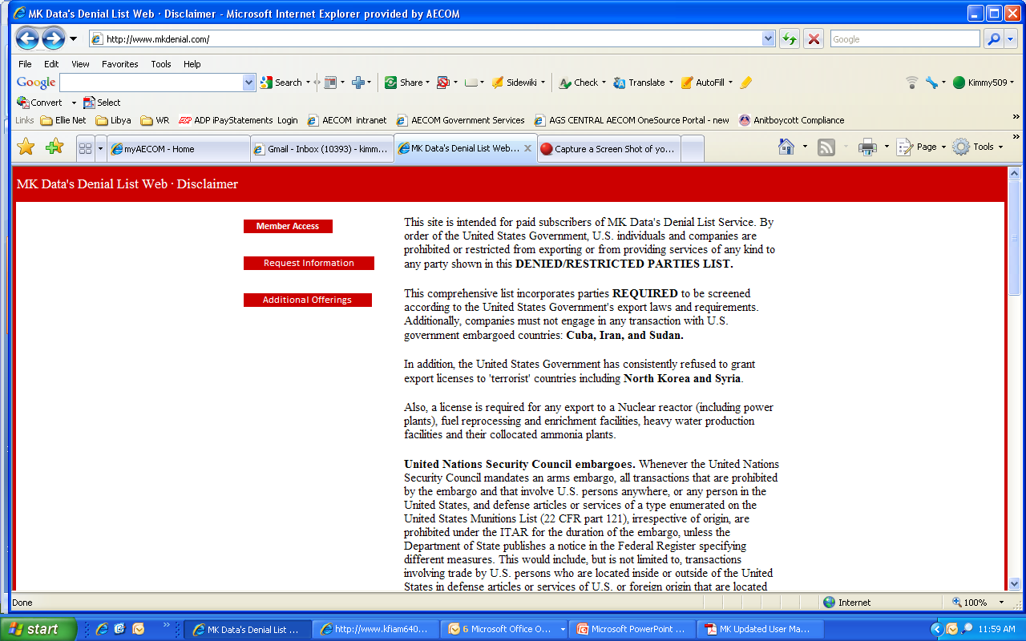
Using MK Denial to Screen: How to Log In Via the Internet
From outside AECOM’s network, go to www.mkdenial.com
Select “Member Access” (the top red box)
To log into MK Denial via AECOM’s intranet, follow the links at http://my.aecomnet.com/Intranet/AECOM+Corporate/Ethics+and+Compliance

Slide 9
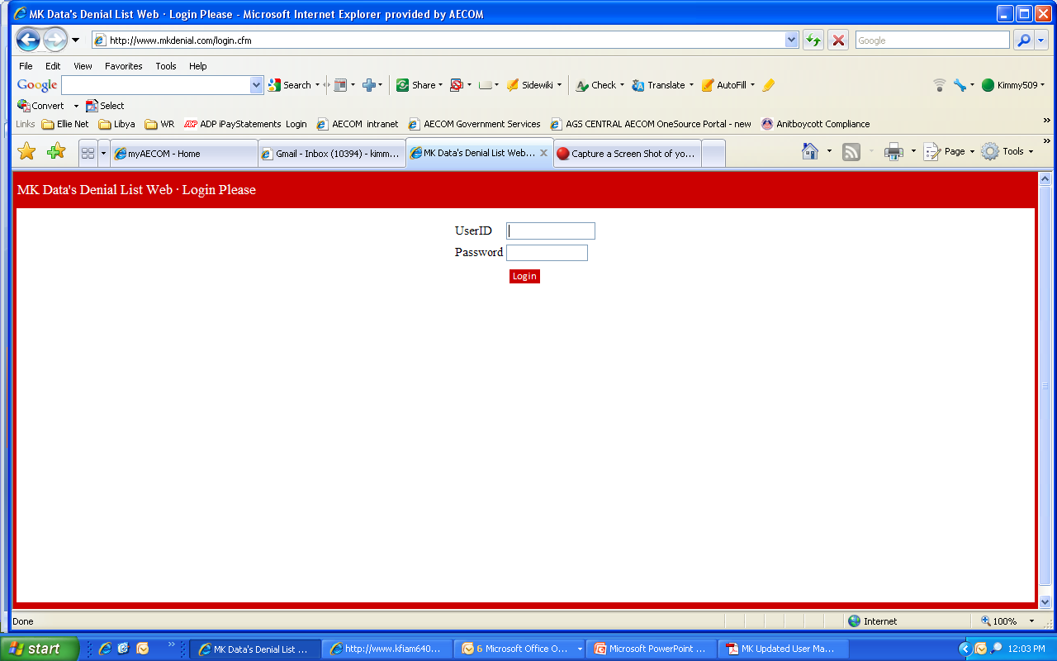
Using MK Denial to Screen: How to Log In Via the Internet
Log In Page
User ID: 7969
Password: aecom

Slide 10
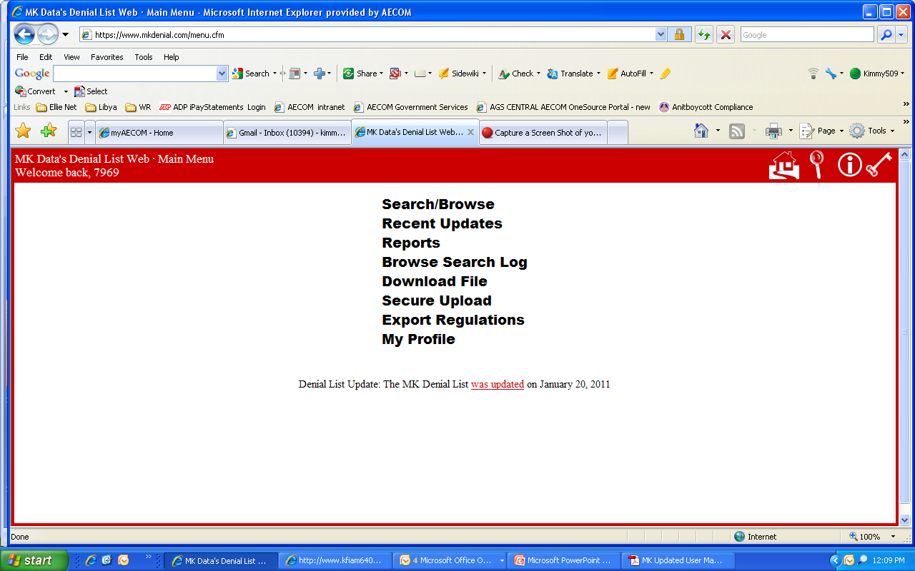
Using MK Denial to Screen: How to Log In Via the Internet
Log In Completion
What You’ll See
You have successfully logged in when you are here

Slide 11
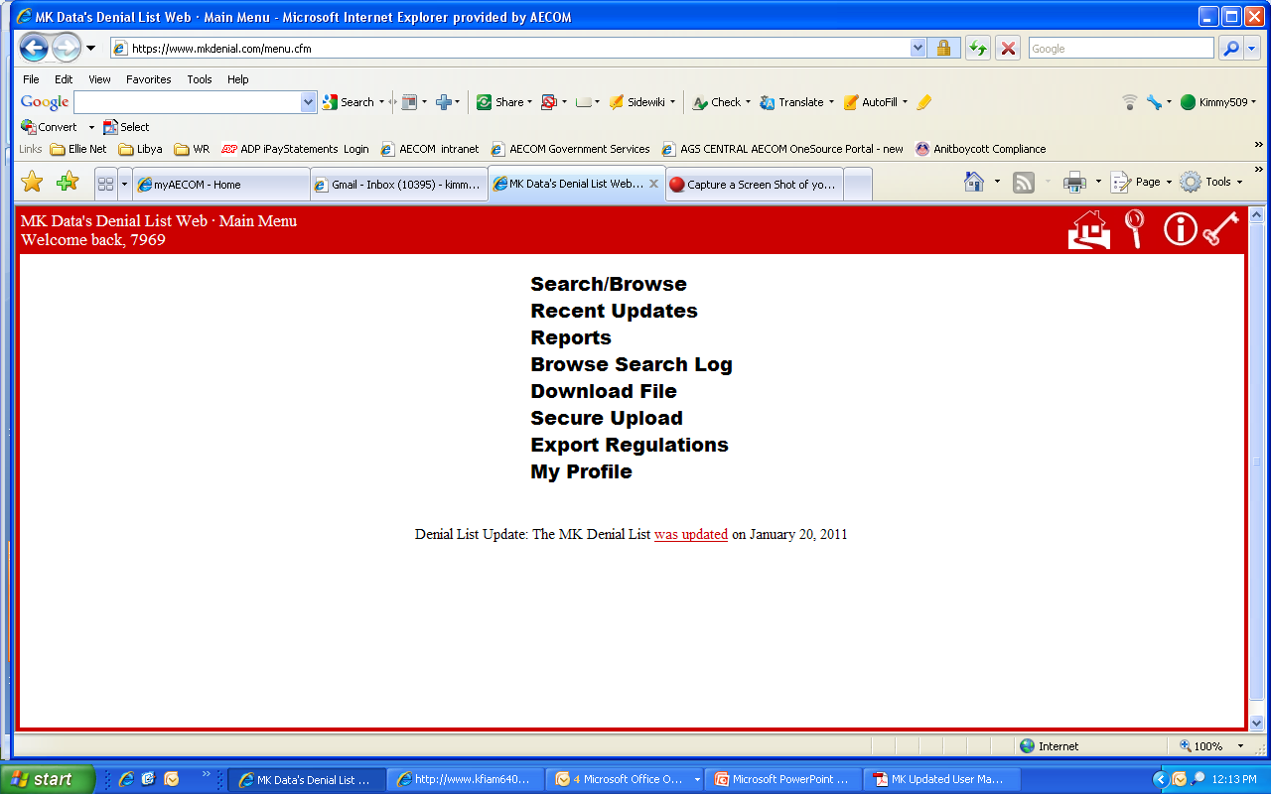
Using MK Denial to Screen: Screening Tools
Most Commonly Used Tools
“Search / Browse”
Use for single name screening
Use for screening multiple names (“batch screening”)
Reports
Use to print out restricted parties for a specific country
What You’ll See

Slide 12
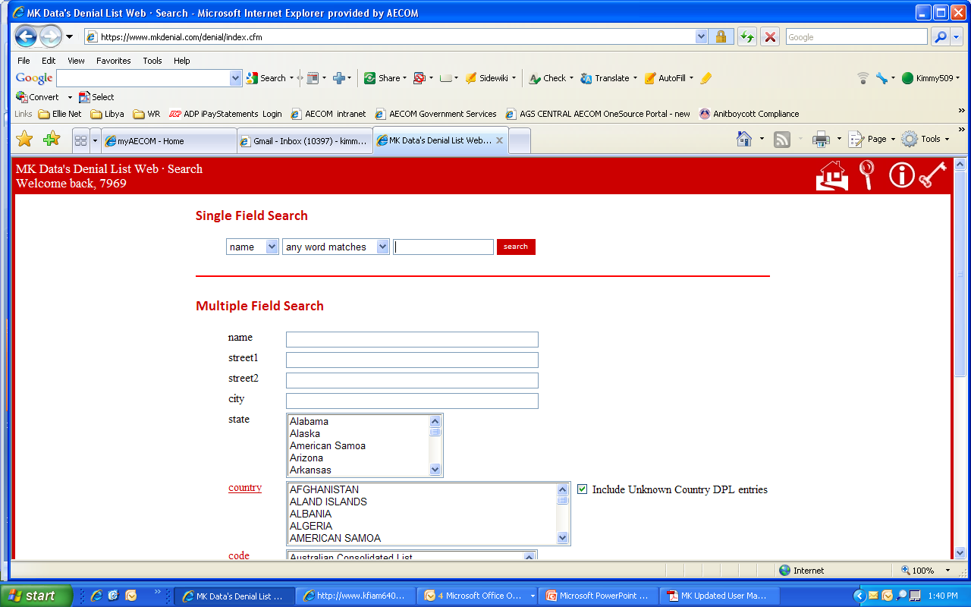
Using MK Denial to Screen: Individual Screening
To search on a name (person or organization), type it in here and click on “search”
Search

Slide 13
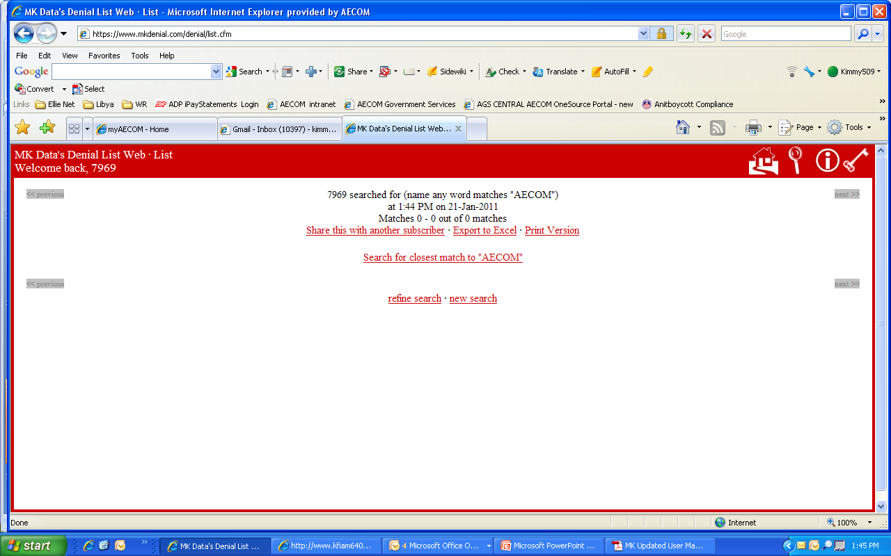
Using MK Denial to Screen: Individual Screening
Here is an example of the results (the name “AECOM” is used as an example):
A search on “AECOM” shows no matches

Slide 14
Using MK Denial to Screen: Screen More Than One Name at a Time (“Batch Screen”)
Go to:
What You’ll See
“Search / Browse”
Use for screening multiple names (“batch screening”)

Slide 15
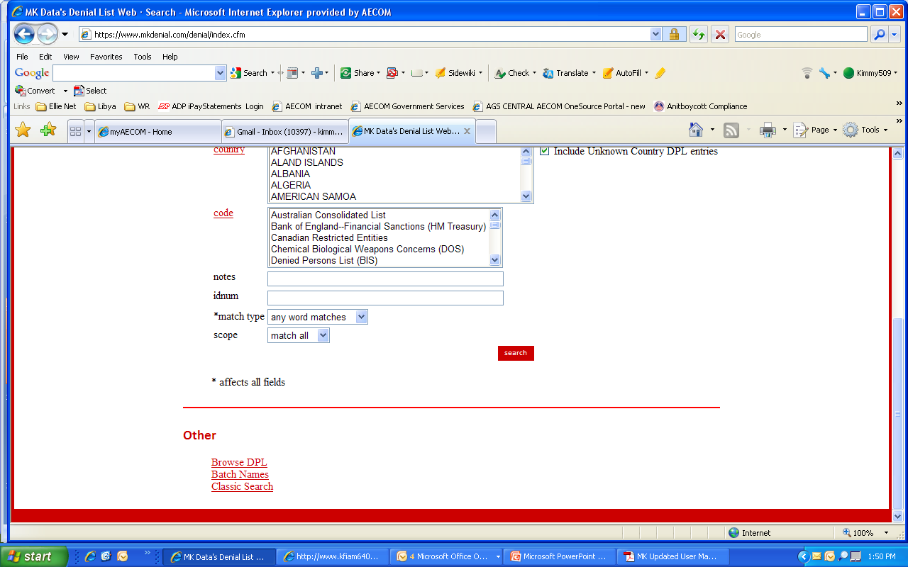
Using MK Denial to Screen: Screen More Than One Name at a Time (“Batch Screen”)
Scroll down to the bottom of the page…
The individual screen option
is at the top of this page
Click on “Batch Names”

Slide 16
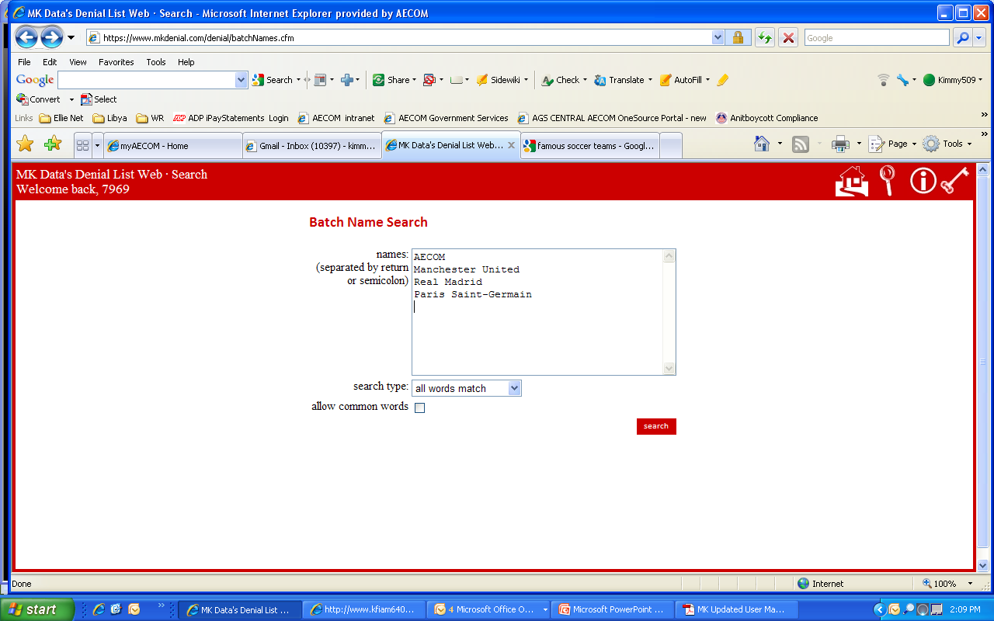
Using MK Denial to Screen: Screen More Than One Name at a Time (“Batch Screen”)
Type up to 20 names in the box below
First – type in names.
Separate each name by using the “return” key
Select “all words match.” Using “all words match” avoids “false positive” hits on very common words, like “real.”
Then click on search

Slide 17
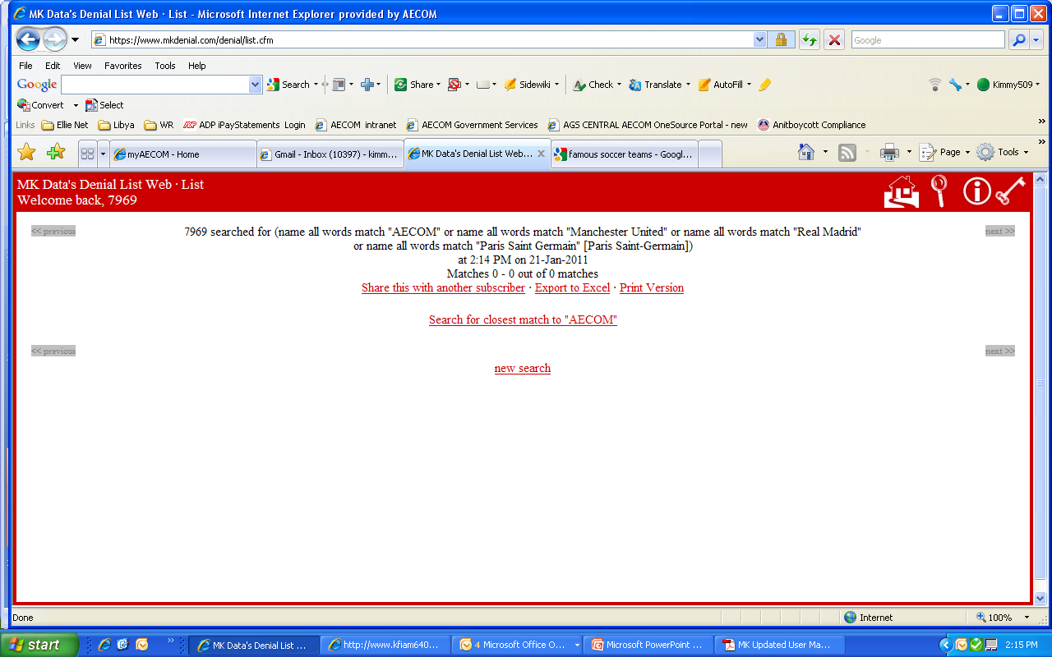
Using MK Denial to Screen: Results
This is an example of search results:

Slide 18
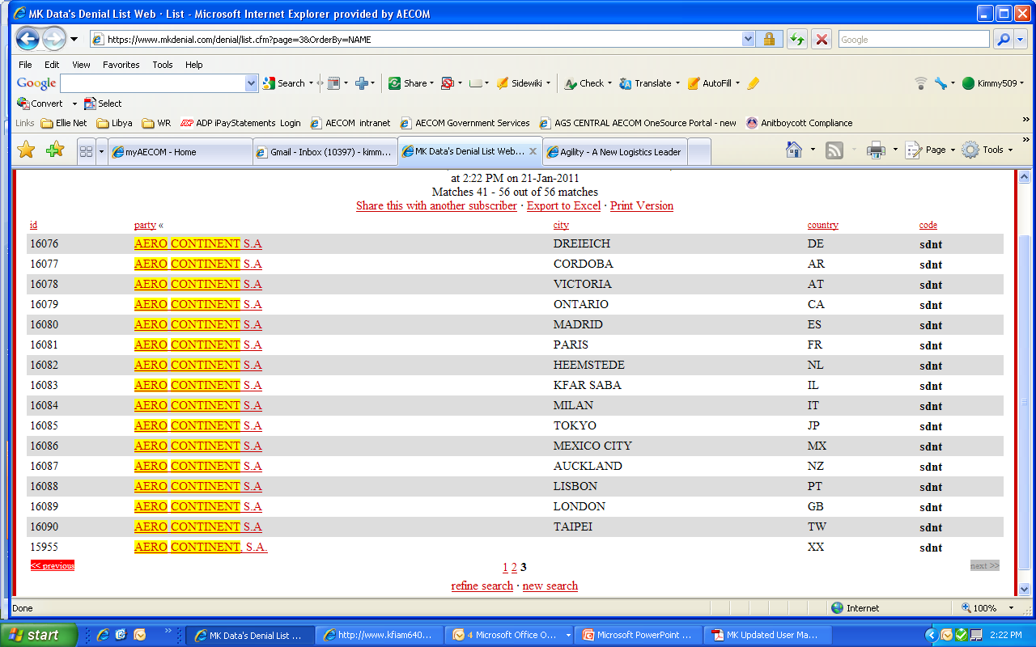
Using MK Denial to Screen: Results
This is an example of search results with listed names:
This entity, “Aero Continent,” is restricted by many different countries for “narco-trafficking”

Slide 19
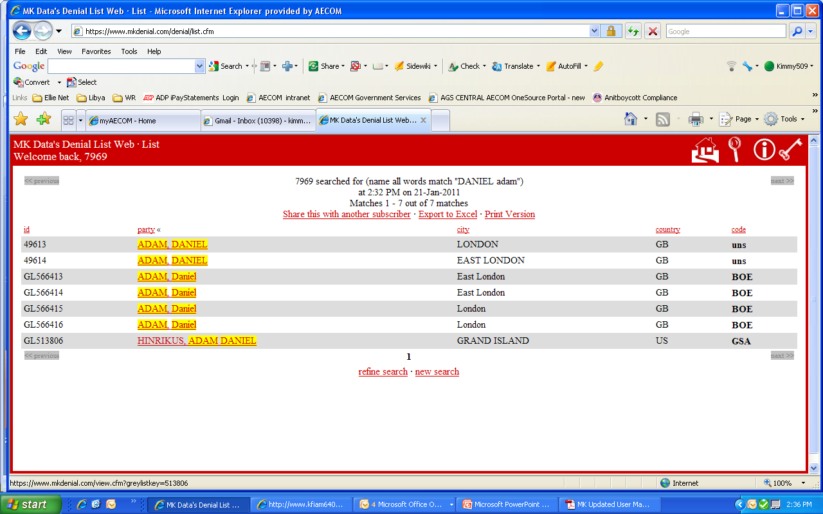
Using MK Denial to Screen: Results – Is It a Match??
What to do when…
Suppose you have a match. If you cannot distinguish the name you are screening with the information provided by MK Denial, contact AECOM’s Director of Corporate Export Administration or your AECOM in-house legal counsel
Example: Daniel Adam
Daniel Adam is a British citizen, born in Damascus, Syria and is sanctioned by the United Nations for terrorism. He has links to Al-Qaida and the Taliban.

Slide 20
Using MK Denial to Screen: Results – When You Know It Isn’t a Match
What to do when…
Suppose you have a match.
If you are able to determine that the name you are screening is not the same as the name on the search results, no further screening is required.
If you have any questions, or are uncertain, contact the Director of Corporate Export Administration or your AECOM in-house legal counsel.
Example: Daniel Adam

Slide 21
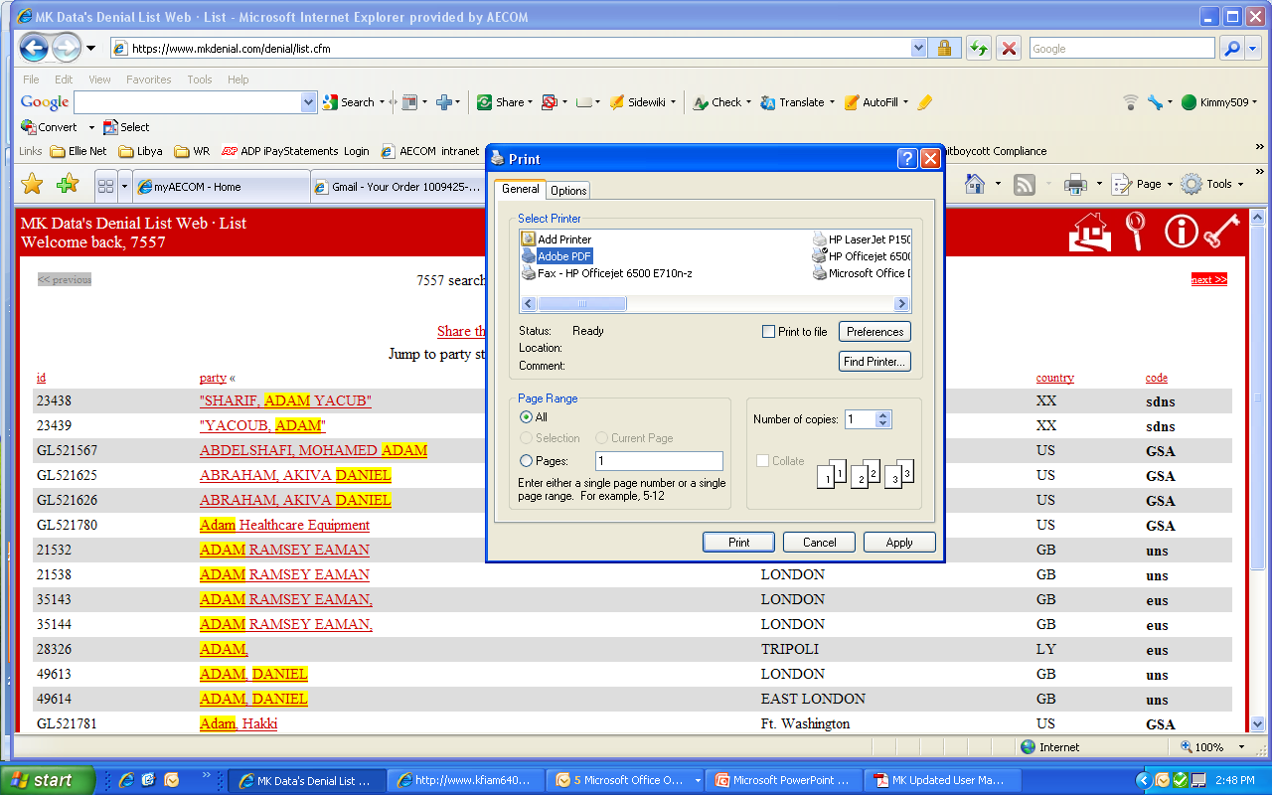
Using MK Denial to Screen: Results – Keep a Copy
Save the Results!
For recordkeeping, save a copy for no less than five (5) years from the time business is completed.
EX: In January, 2011 the name is screened. On December 31, 2013 the project is completed. Retain a copy of the MK Denial results until December 31, 2018.
Records can be retained in electronic form so long as:
They can be provided upon request
They cannot be changed after they are created
Print to Adobe PDF

Slide 22
MK Denial Country Reports Screening Tools – Country Reports
Most Commonly Used Tools
“Search / Browse”
Use for single name screening
Use for screening multiple names (“batch screening”)
Reports
Use to print out restricted parties for a specific country
Back to the Main Menu

Slide 23
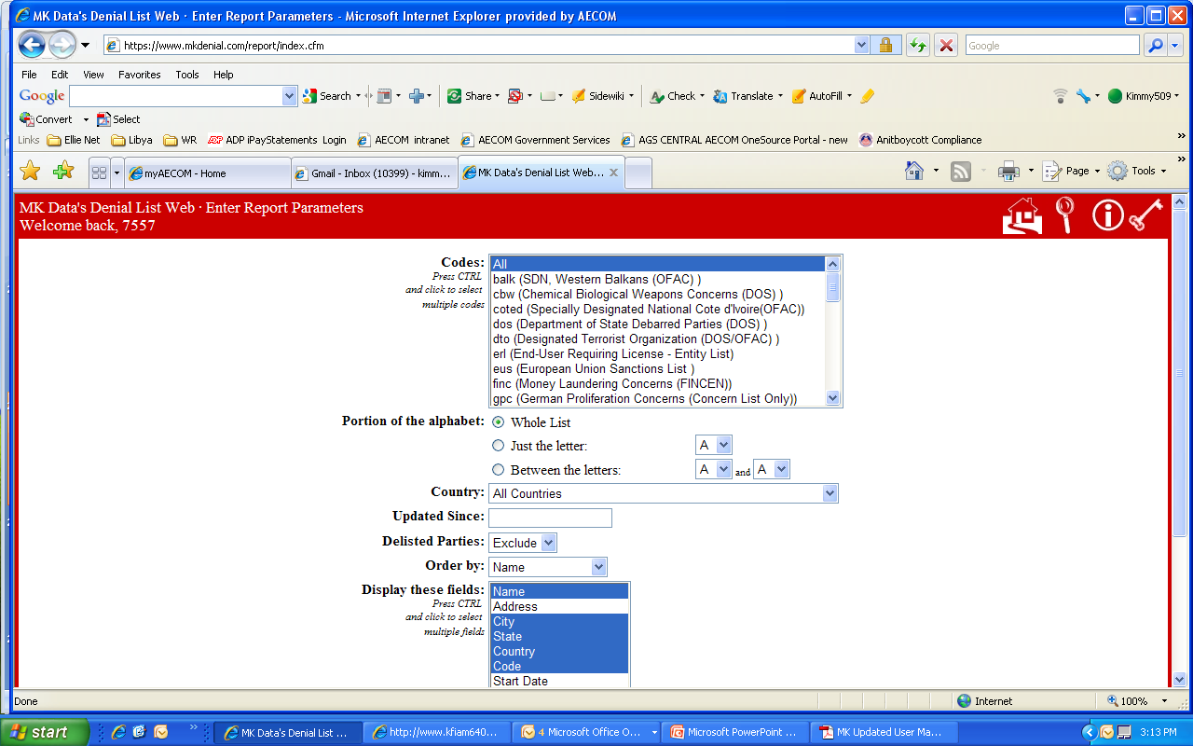
MK Denial Country Reports How to Create a Report
To create a country report
Always use “ALL”
Always use “Whole List
Scroll down the page

Slide 24
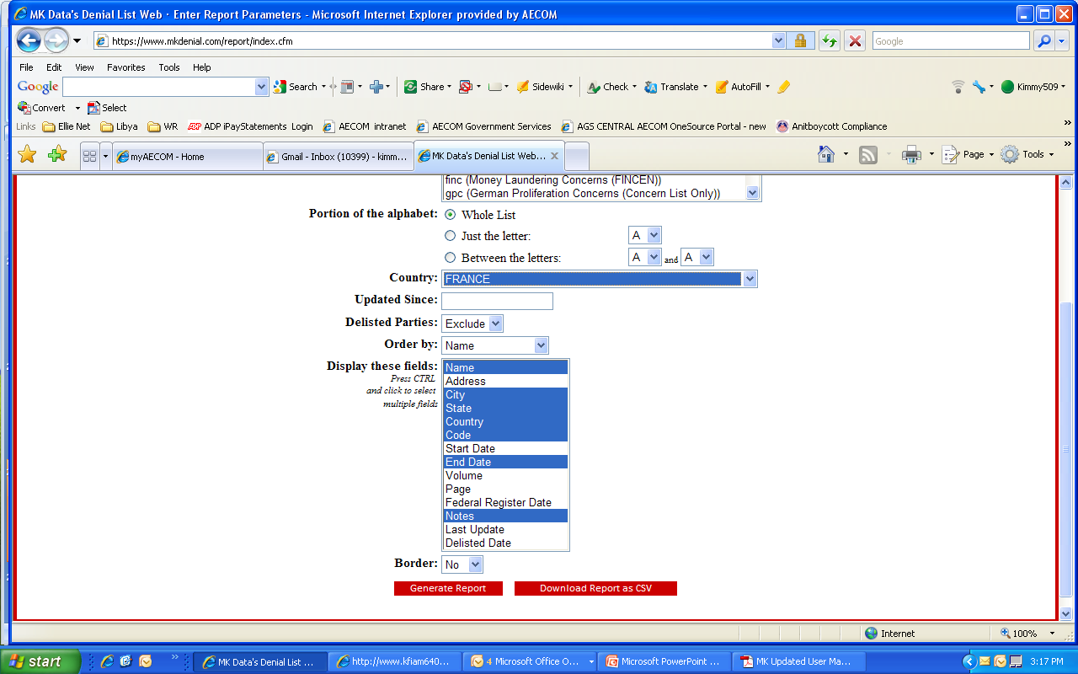
MK Denial Country Reports How to Create a Report
To create a country report
Select the country you want. This example uses France.
MK automatically uses these default settings. The default settings will provide the data needed to produce a good report.
Click here create a standard formatted report
Downloading a CSV file will create a file that can be saved in Excel

Slide 25
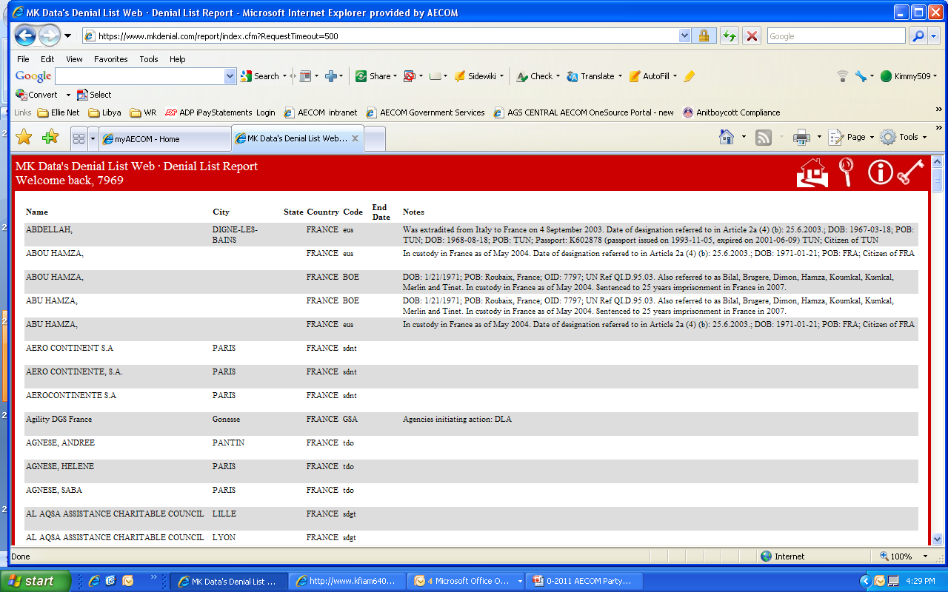
MK Denial Country Reports How to Create a Report
Sample Report
Onscreen, scroll to see the rest of this report

Slide 26
Using MK Denial - Frequency of Screening
Minimum or Maximum?
Regulations do not specify the frequency of screening
Instead, we must reasonably screen so as to know the parties with whom we do business – use common sense
Screening AECOM Entities?
AECOM’s legal entities, subsidiaries and joint ventures do not have to be screened
Screening Customers and/or Customers’ Clients or End Users?
Screen at the beginning of the transaction
Document to the file an electronic copy of the “About Us” section entity’s website where its products, services and locations are described
Screen the entity itself, its parent organization if one exists
Screen the principals of the organization (i.e. Board of Directors, Chief Executives)
Re-screen once every six months during the project

Slide 27
Using MK Denial - Frequency of Screening Continued
Screening Subcontractors, Suppliers, Teaming Partners, Vendors
Same as Customers and/or Customers’ Clients or End Users
Exception – For US Government contracts, screen more frequently in accordance with the Federal Acquisition Regulations
Screening Individuals
If not one of the above-referenced types of organizations, screen individuals just as you would an entity

Slide 28
Subscription Access Control
The MK Denial subscription is an enterprise-wide license for AECOM’s use only
Parties unrelated to AECOM are not covered by this license and thus may not be granted to unrelated third parties
Individuals that are hired by AECOM either on a temporary or contract basis may only use the MK Denial screening tool while actually conducting work for AECOM

Slide 29
Contact Information
For questions concerning the use of the MK Denial tool, contact:
Kim Canales-Yarborough
Director, Corporate Export Administration
AECOM Technology Corporation
Kim.canales-yarborough@aecom.com

Slide 30
Appendix A - Lists
MK Database Uses:
Australian Consolidated List
Bank of England Financial Sanctions List
Canadian Restricted Entities List
European Union Sanctions List
German Proliferation Concerns List
Japanese Proliferation Concerns List
Swiss Restricted List
UK Proliferation Concerns List
United Nations Security Counsel Sanctions List
US Government Lists (multiple agencies, including OFAC and Debarred Parties)
World Bank List of Debarred / Ineligible Firms

Slide 31
Thank You
January, 2011

