Slide 1
Projects!
New functionality in Salesforce

Slide 2
Salesforce Projects – The Basics
What is it?
Projects is a new database developed in Salesforce for project descriptions and project-related information to be used in proposals
What is included?
Projects were migrated from North America legacy systems (Vision and BDIS)
Projects from other legacy systems will be entered as needed
New projects in North America, Europe, Middle East, and Asia projects will be entered as they are booked in Oracle
How are new projects added?
Opportunities that are booked in the Salesforce Opportunities system are “pushed” to the Projects database, or they can be entered manually.
Who has access?
All Salesforce CRM license holders and ChatterPlus license holders have read access. Until enterprise licensing is available, everyone else at AECOM can access all the projects in Salesforce through the global project profiles page.

Slide 3
Salesforce Projects – The Basics part 2
How are projects updated?
User updates: Use the Chatter at the top of the project to submit an update, e.g. “Please add this paragraph on public participation: . . .”
Post a file containing a revised project description in Chatter
Automatic updates: Certain Oracle information will be updated automatically, and project updates will become part of AECOM’s project review and closeout procedures
Email project updates to ProjectSystem@aecom.com

Slide 4
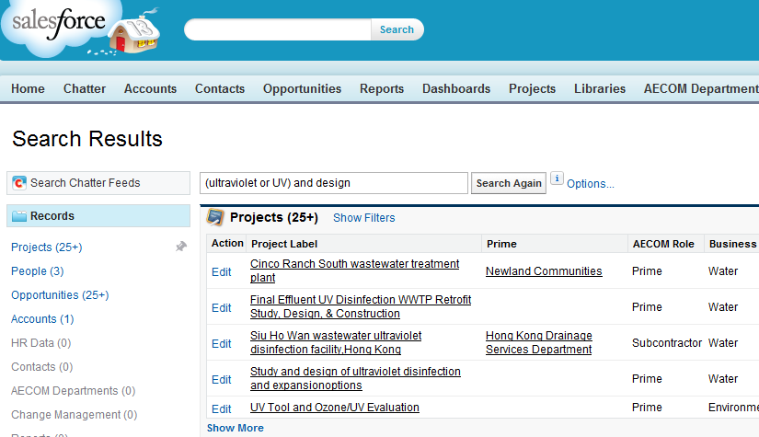
Salesforce Projects – Search using Full-text
There are three ways to search.
Full-text search – the simplest method:
Enter the words you are looking for in the Search box at the top of the screen.
You can do Boolean searches using AND, OR, AND NOT, and parentheses, and you can use * and ? as wildcards.
Click the Search button.
When results appear, click Projects in the left panel.
Tip: you can ‘Pin’ Projects to the top of the list if that is the object you use most often.

Slide 5
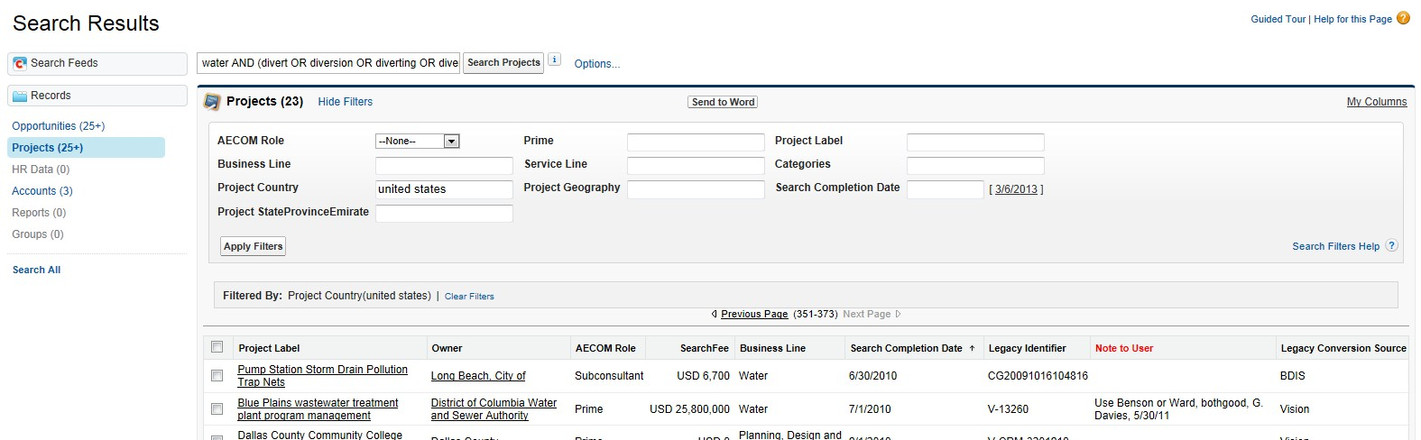
Salesforce Projects – Search using Full-text (continued)
You can further refine the search results using the filters that appear at the top of the results list.
For fields without a drop-down arrow, you need to enter a single value.
For date fields, type in operators such as LAST 3 YEARS or NEXT 6 MONTHS.
If you would like to see different columns in the results, click the My Columns button and choose the columns you want to see in the results.
Click the Apply Filters button.
Tips on filtering date fields:
Always use a number: LAST 3 YEARS, not LAST three YEARS
Choosing a single date will return only results with that exact date in the field
Use cannot use < or > in this filter

Slide 6
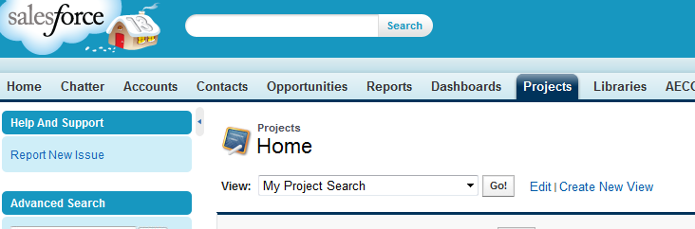
Salesforce Projects – Search using Views
The second way to search – use this method for more structured searching.
2. Search in a View
Click on the Projects tab
Click Create New View (or select My Project Search if you have already created it)
In Step 1, enter a name such as My Project Search
In Step 2:
Leave All Projects checked
Enter additional filter criteria, such as Primary 330 Code contains S04,W03
Add filter logic, if necessary, by clicking on Add Filter Logic, to use OR operators instead of the default AND
In Step 3, select the fields you want to see in the search results
Click Save

Slide 7
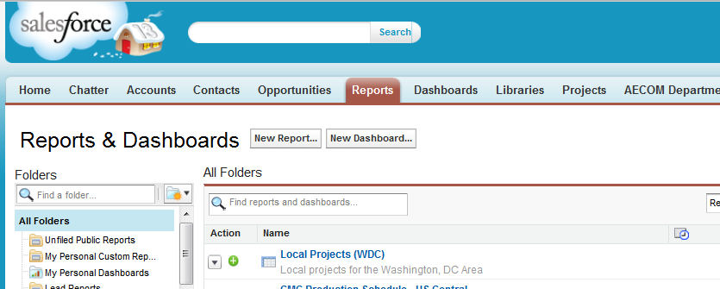
Salesforce Projects – Search using Reports
The most robust way to search and easily export the results.
3. Create or Edit a Report
Click on the Reports tab
Click New Report or select a personal report you previously created
Click Create at the bottom and far right of the screen
For new reports, choose Report Type “Projects”
Extensive help in customizing reports can be found here: https://help.salesforce.com/HTViewHelpDoc?id=reports_builder_editing.htm&language=en_US

Slide 8
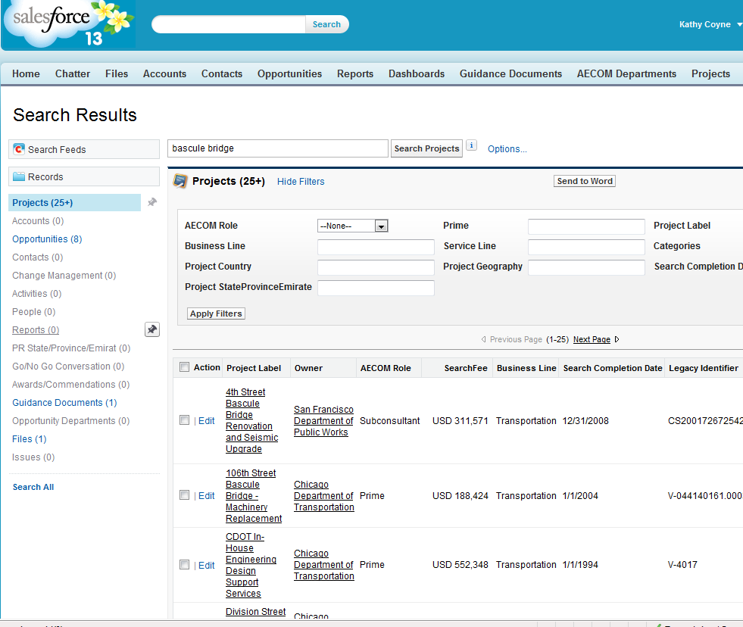
Salesforce Projects – Exporting formatted projects to Word
Method 1. Merging multiple projects into a single Word document
From search results or a view, check the projects you want to export
Click the Send to Word button.

Slide 9
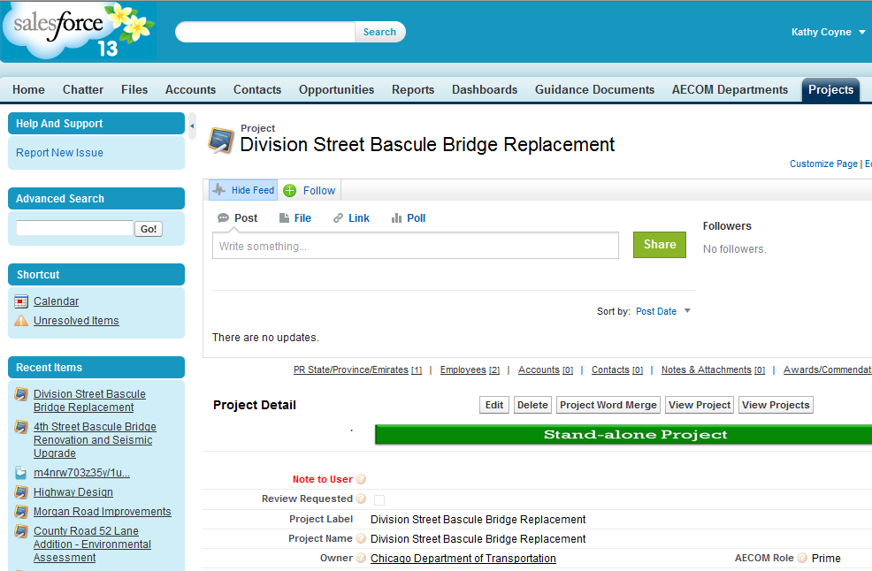
Salesforce Projects – Exporting formatted projects to Word
Method 2. Merging a single project into a single new Word document
Open the project you want to export
Click the Project Word Merge button.

Slide 10
Salesforce Projects – Exporting formatted projects to Word
Method 3. Grabbing a single project to paste into an existing Word document
Open the project you want to export
Click the View Project button
Copy and paste the project description into your Word doc

