Slide 1
DOOZ GAME

Slide 2
represetationBoard
mainBoard
1,1 1,2 1,3
2,1 2,2 2,3
3,1 3,2 3,3
000000000

Slide 3
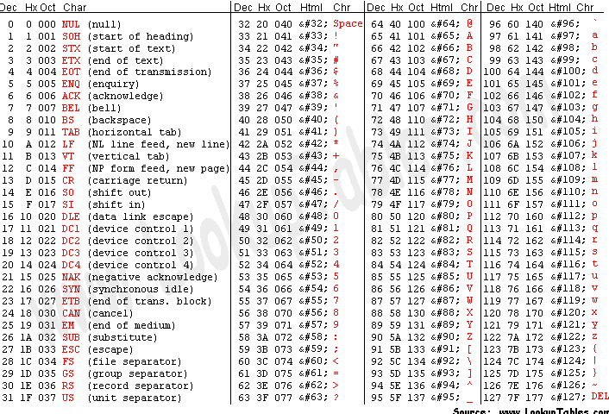

Slide 4
Ah =9 / INT 21 h :
Print DS:DX on console
Note : string must terminated by ‘$’

Slide 5
Ah =1 / INT 21 h :
read character from standard input and store the result in AL

Slide 6
AH AL
quotient
reminder
=
AL
and
AH
CL

Slide 7
1
2
AH AL
1
2
=
AL
and
AH
CL
10

Slide 8
LocationCheck
input
1
,
1
1
,
2

Slide 9
LocationCheck
input
BP
1
,
1
1
,
2
BX

Slide 10
LocationCheck
input
1
,
1
1
,
2
BP
BX

Slide 11
LocationCheck
input
1
,
2
1
,
2

Slide 12
LocationCheck
input
BP
1
,
2
1
,
2
BX

Slide 13
LocationCheck
input
1
,
2
1
,
2
BP
BX

Slide 14
AL
*
CL
=
AH
and
AL

Slide 15
represetationBoard
mainBoard
1 , 1 1 , 2 1 , 3
2 , 1 2 , 2 2 , 3
3 , 1 3 , 2 3 , 3
1
2
3
4
5
6
7
8
9
10
11
12
13
14
15
0 0 0 0 0 0 0 0 0
1
2
3
4
5
6
7
8
9
16
17
18
19
20
21
22
23
24
25
26
27
28
29
30
31
32
33
34
35
36
37
38
39
40
41
42
43
44
45

Slide 16
represetationBoard
mainBoard
* 1,2 1,3
2,1 * 2,3
3,1 3,2 *
* 0 0 0 * 0 0 0 *
0 0 * 0 * 0 * 0 0

Slide 17
represetationBoard
mainBoard
* * * 0 0 0 0 0 0
0 0 0 * * * 0 0 0
0 0 0 0 0 0 * * *
* * *
2,1 2,2 2,3
3,1 3,2 3,3

Slide 18
represetationBoard
mainBoard
1,1 * 1,3
2,1 * 2,3
3,1 * 3,3
0 * 0 0 * 0 0 * 0
* 0 0 * 0 0 * 0 0
0 0 * 0 0 * 0 0 *

Slide 19
represetationBoard
mainBoard
* * &
& & *
* * &
* * & & & * * * &

