Slide 1
A Node
next ptr
data
prev ptr
A Queue
Head
Current
Tail
Size
4

Slide 2
next
A Node
prev
data
Head
Current
Tail
Size
4

Slide 3
Head
Current
Tail
Size
4

Slide 4
next
A Node
prev
data
Head
Current
Tail
Size
4

Slide 5
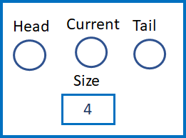
prev
A Node
next
data

Slide 6
prev
A Node
next
data

Slide 7
prev
A Node
next
data

Slide 8
prev
A Node
next
data

Slide 9
prev
A Node
next
data

Slide 10
prev
A Node
next
data

Slide 11
prev
A Node
next
data

Slide 12
forward_list
A Node
next
data
Current
Size
Head
4

Slide 13
prev
A Node
next
data
Size
Currnet
4

