Slide 1


NORTHWIND DATA ANALYSIS
Name :Fardeen b
Roll no:BCA232675

Slide 2
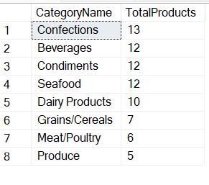
1. Categories, and the total products in each category
select c.CategoryName, count(p.ProductID) as TotalProducts
from[dbo].[Categories] c join [dbo].[Products] p on c.CategoryID=p.CategoryID
group by c.CategoryName
order by TotalProducts desc

Slide 3
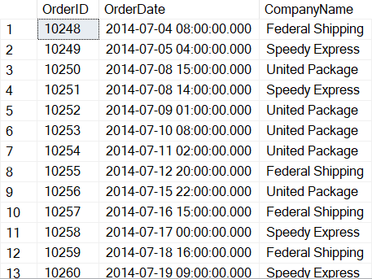
2. Orders and the Shipper that was used
select o.OrderID, o.OrderDate, s.CompanyName
from[dbo].[Orders] o inner join [dbo].[Shippers] s on o.ShipVia=s.ShipperID
where OrderID<10300;

Slide 4
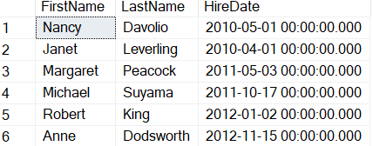
3. Sales Representatives
select FirstName, LastName, HireDate
from [dbo].[Employees] where Title='Sales Representative';

Slide 5
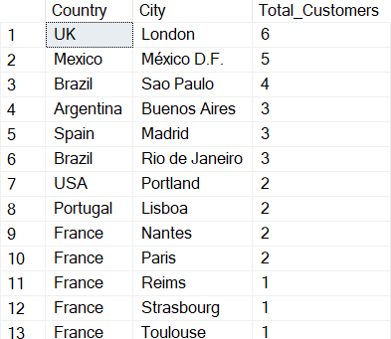
4. Total customers per country/city
select Country, City, count(*) as Total_Customers
from [dbo].[Customers] group by City, Country order by Total_Customers desc

Slide 6
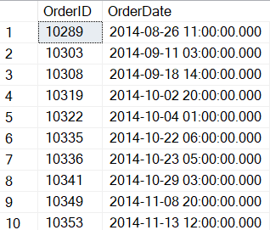
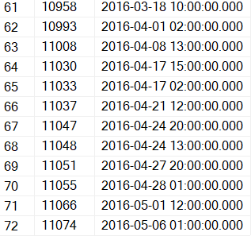
5. Orders placed by specific EmployeeID
select OrderID, OrderDate
from[dbo].[Orders] where EmployeeID=7;

Slide 7
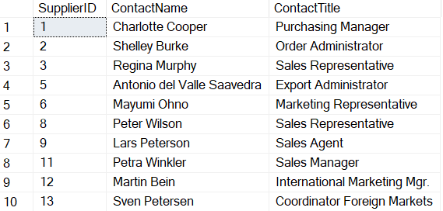
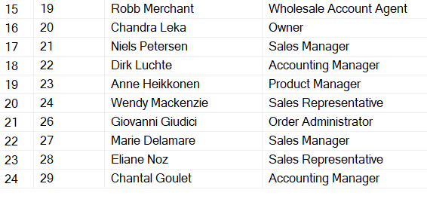
6. Suppliers and ContactTitles
select SupplierID,ContactName,ContactTitle
from[dbo].[Suppliers] where not ContactTitle='Marketing Manager';

Slide 8

7. Products with “queso” in ProductName
select ProductID,ProductName
from[dbo].[Products] where ProductName like '%queso%';

Slide 9
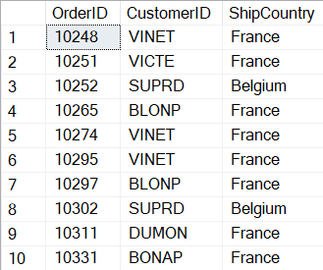
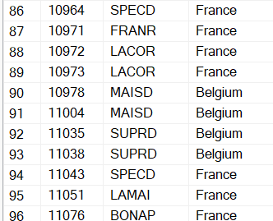
8. Orders shipping to France or Belgium
select OrderID,CustomerID, ShipCountry
from[dbo].[Orders] where ShipCountry='France' or ShipCountry='Belgium';

Slide 10
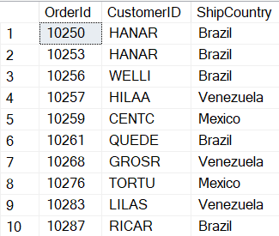
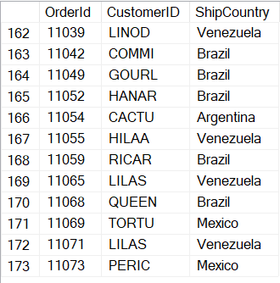
9. Orders shipping to any country in Latin America
select OrderId, CustomerID, ShipCountry
from[dbo].[Orders] where ShipCountry in ('Brazil','Mexico','Argentina','Venezuela');

Slide 11
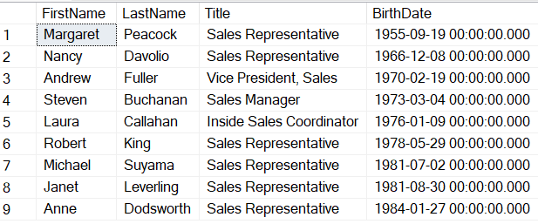
10. Employees, in order of age
select FirstName,LastName, Title, BirthDate
from[dbo].[Employees] order by BirthDate asc;

Slide 12
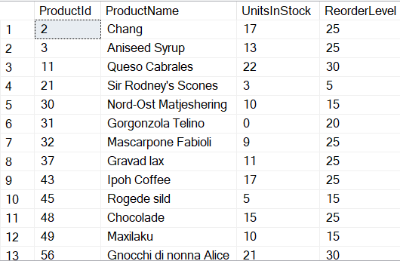
11. Products that need reordering
select ProductId, ProductName, UnitsInStock, ReorderLevel
from[dbo].[Products] where UnitsInStock<ReorderLevel

Slide 13

12. Products that need reordering, continued
select ProductID, ProductName, UnitsInStock, UnitsOnOrder, ReorderLevel, Discontinued
from[dbo].[Products] where (UnitsInStock+UnitsOnOrder) <= ReorderLevel and Discontinued=0

Slide 14
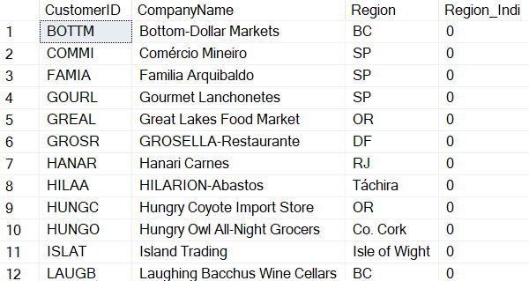
13. Customer list by region
WITH CTE AS(
select CustomerID, CompanyName, Region,
case
when Region is null then 1
else 0
end
as Region_Indi
from[dbo].[Customers])
SELECT * FROM CTE
WHERE Region_Indi != 1

Slide 15
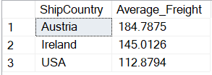
14. High freight charges
select top 3 ShipCountry, avg(Freight) as Average_Freight
from[dbo].[Orders] group by ShipCountry order by Average_Freight desc

Slide 16
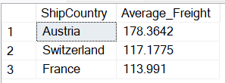
15. High Freight charges
select top 3 ShipCountry, avg(Freight) as Average_Freight
from[dbo].[Orders] where OrderDate like '%2015%' group by ShipCountry order by Average_Freight desc

Slide 17
Thank You

