Slide 1


Social Buzz
Content Popularity
Analysis

Slide 2


Today's agenda
Project recap
Problem
The Analytics team
Process
Insights
Summary

Slide 3

Project Recap
3-month Initial project focused on:
- Big data audit
- IPO recommendation
- Top content category analysis

Slide 4

Problem
Around a hundred ton of contents per day, huge numbers of users interactions!
What does it mean for the business of Social Buzz?
Analysis to find out the top 5 most popular content categories!

Slide 5
Andrew Fleming
Chief Technical Architect
Marcus Rompton
Senior Principle
Fardin Islam Mahin
Data Analyst
The Analytics team

Slide 6
Process
1
Understading the problem and Data Collection
2
Data cleaning
3
Data modeling
4
Data Analysis and Vizualization
5
The information!

Slide 7
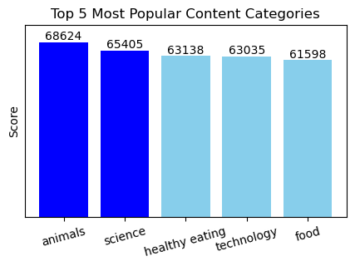

Insights
Here animals category tops the list with an aggregate score of 68624
Second most popular category is science followed by healthy eating, technology, and food.

Slide 8
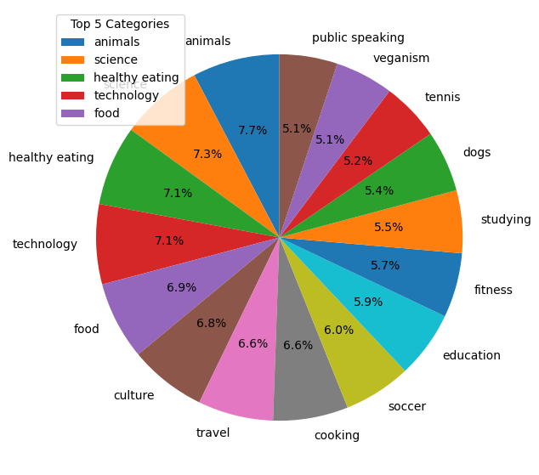
Showing the distribution of scores across all 16 content categories.
Compared to the percentages of the top five most popular categories, the other categories are not significantly less popular.

Slide 9

Users are highly drawn to animals and science, making them popular categories of interest.
Furthermore, food, as well as healthy eating, ranks within the top five. Capitalizing on these interests can significantly boost engagement with your brand. Consider launching public activities centered around food.
Summary

Slide 10
Thank you!
ANY QUESTIONS?

