Slide 1

DIGITAL CIRCUITS COURSE PROJECT
TEAM MEMBERS Bhuvan A.K Fardin Khan Sinchana Maskeri Vaishnavi Bhat
Guide :Prof. Vijay HM

Slide 2
Problem Statement
Design a 2-bit ALU with a Status Register , each flag indicating the status of each ALU operation
i. Carry flag
ii. Negative flag
iii. Parity flag
iv. Zero flag
Note: the ALU is supposed to perform following operations.
A*B,2A+B,!(A&B),A|B

Slide 3
INTRODUCTION
An Arithmetic Logic Unit (ALU) is a multi operation ,combinational logic digital function. It can perform a set of basic arithmetic operations and set of logic operation. Our designed ALU has number of Switches which decides particular operation to be performed And we DIP switch to give the input .Our ALU unit has 4 subsystems which performs four different operations, based on the switch only one operation can be performed at a time . Thus, Giving only one output. We have four flags namely . Carry flag , Negative flag, Parity flag , Zero flag.

Slide 4
DESCRIPTION:-
PARITY FLAG : If the number of set bits is odd in the binary representation
of the result of the last operation.
NEGATIVE FLAG :Is a single bit in a system status (flag) register used to
indicate whether the result of the last mathematical operation produced a value in which the most significant bit (the left most bit) was set.
CARRY FLAG : A single bit in a system status register/flag register used to indicate when an arithmetic carry or borrow has been generated out of the most significant arithmetic logic unit (ALU) bit position
ZERO FLAG: If an operand is subtracted from another of equal value, the Zero flag is set.
COMMON ANODE: In the common anode display, all the anode connections of the LED segments are joined together to logic “1”.

Slide 5
List Of Components
COMPONENTS | NOTATION | QUANTITY | PIN NUMBER
AND GATE | A*B | 6 | 7408
OR GATE | A+B | 2 | 7432
NAND GATE | (A*B)’ | 2 | 7400
XOR GATE | A XOR B | 2 | 7486
7 SEGMENT DISPLAY | - | 4 | -
4 WAY DIP SWITCH | - | 5 | -
COMMON ANODE | - | 4 | 7447
WIRES | - | - | -
BREADBOARD | - | 2 OR 3 | -
LED’S | - | 16 | -

Slide 6
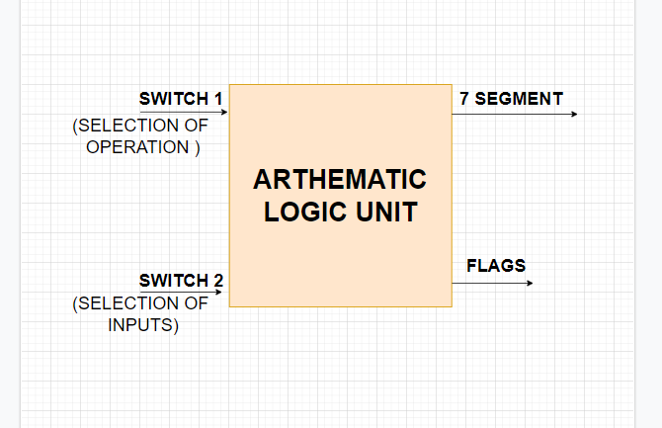
BLOCK DIAGRAM

Slide 7
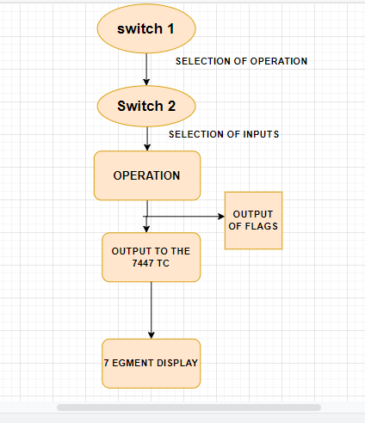
FLOW CHART

Slide 8
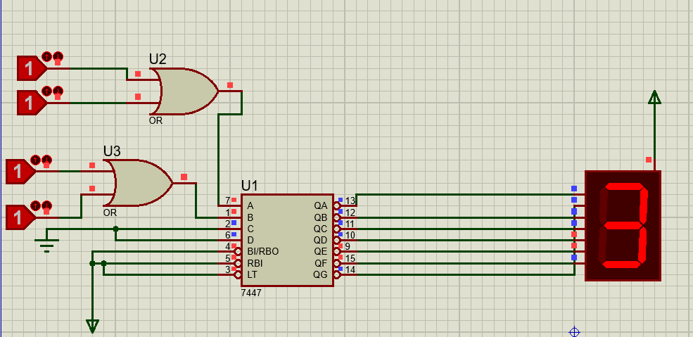
Design: A|B OPERATION

Slide 9
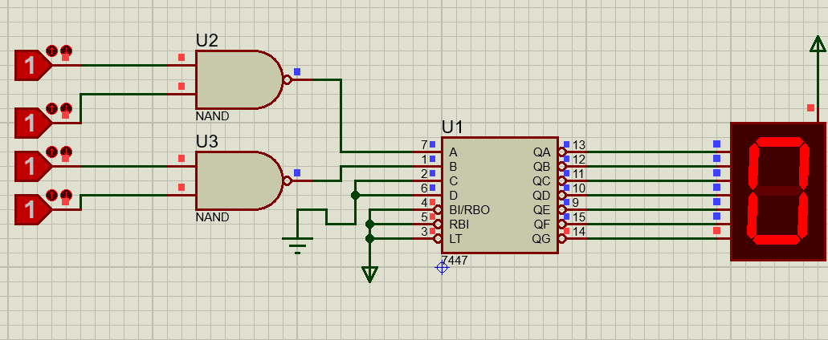
!(A&B) OPERATION

Slide 10
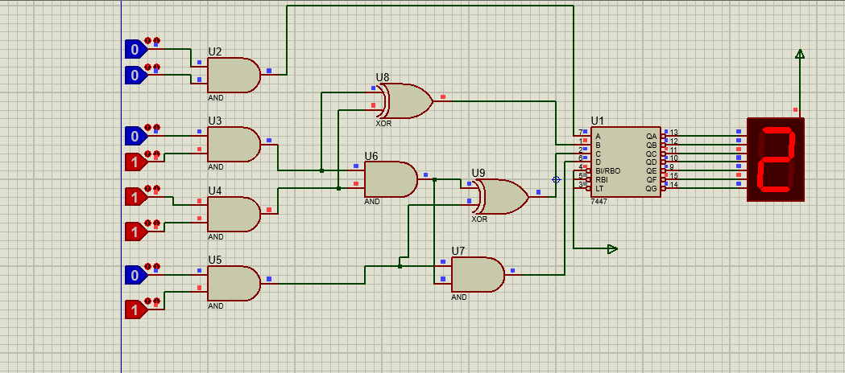
A*B OPERATION

Slide 11
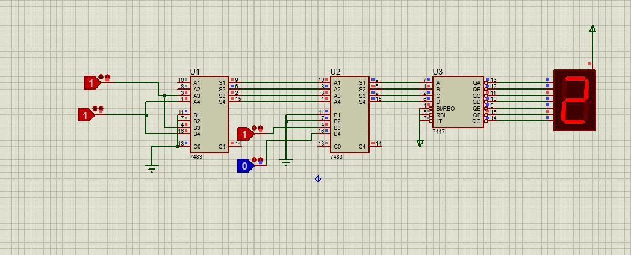
2A+B OPERATION

Slide 12
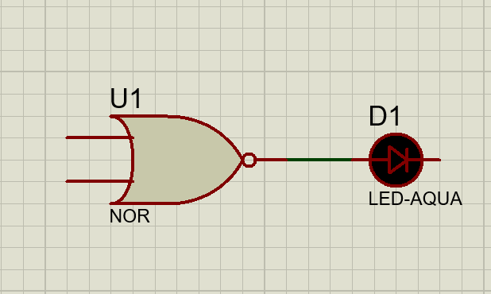
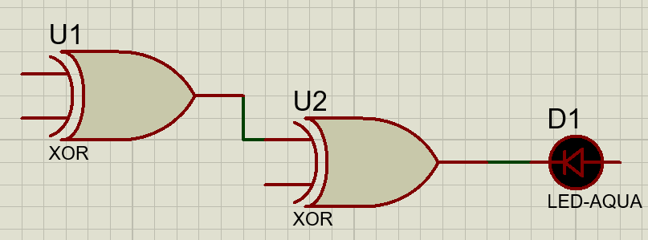
FLAGS
ZERO FLAG PARITY FLAG

Slide 13
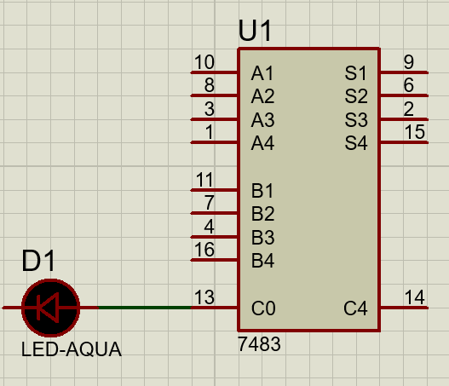
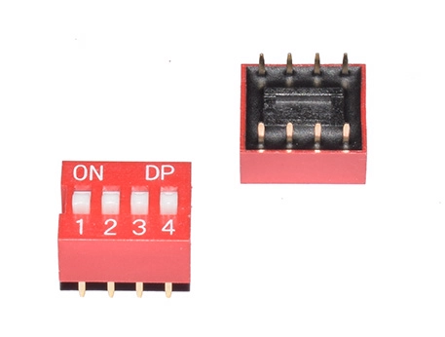
CARRY FLAG 4 WAY DIP SWITCH

Slide 14
Thank You

