Slide 1

Digital Voting System
A Project using Data Structures
Presentation by:
Jannatul Fardous
ID: 242-35-156

Slide 2



Introduction
1.
Voting is an important part of life.
2.
Traditional voting is slow and sometimes unfair.
3.
Our project shows a simple digital voting system using
Data Structures.

Slide 3

Objectives
Store candidates and their votes.
Manage voters in a queue.
Keep history of votes (undo option).
Find and declare the winner.

Slide 4

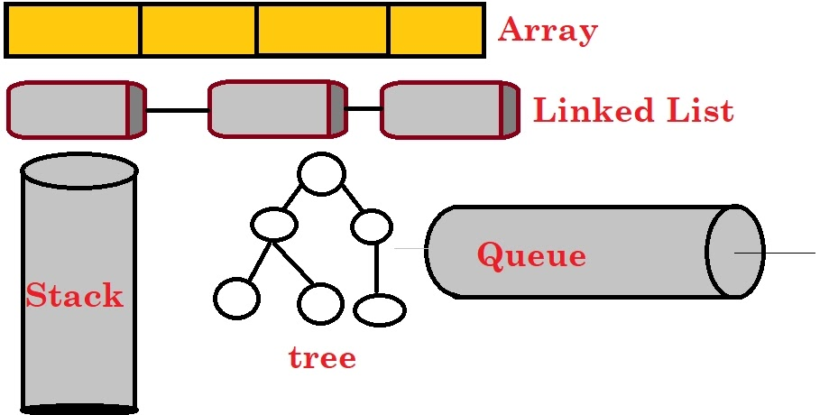

Data Structures Used
Array → Candidate list and votes
Queue → Voter line
Stack → Vote history / Undo
Linked List → Winner list

Slide 5
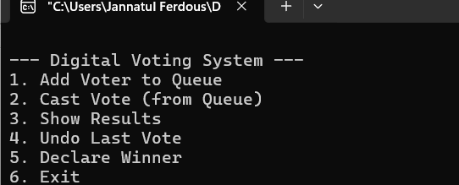
Functionalities
This is the Main Menu. The user can choose any option (1–6).

Slide 6


Functionalities
This adds a voter into the Queue.
We can see that voter 1002 is added First. If more voters come, they stand in line (FIFO order).
The first voter in the queue casts a vote.
Candidate ID = 0 → A-Group
After voting, that voter is removed from the queue.

Slide 7
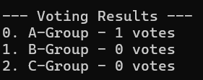

Functionalities
Displays the current number of votes for each candidate.
If a mistake happens, the system can undo the last vote. Then repeat it.
The program checks all candidates’ vote counts. The candidate(s) with the highest votes are stored in a Linked List. That’s how Digital Voting System work actually.

Slide 8


Impact in Real Life
1. Makes voting fast and easy
2. Reduces human error
3. Ensures fair and transparent results
4. Useful in schools, colleges, and small organizations

Slide 9

Conclusion
1.
This project shows how Data Structures solve real problems.
2.
Simple system, but expandable for real elections.
3.
Digital voting is the future.

Slide 10
Thank you

