Slide 1
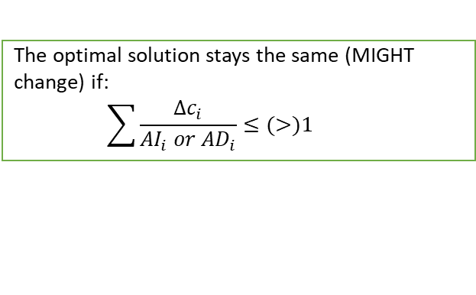
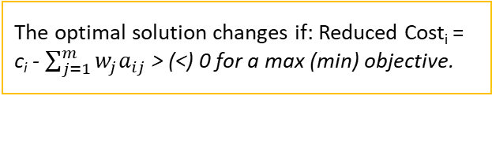
Changing RHS of one constraint
(Constraints Table)
Alternate optimal solutions: 0s in the allowable increase/decrease in Variables Table
Changing one objective function coefficient
(Variables Table)
If ΔRHS_{j} is within allowable increase/decrease
If Δc_{i} is within allowable increase/decrease
The optimal objective function changes by ΔRHS_{j}*w_{j}.
The optimal solution changes (stays the same) for binding (nonbinding) constraints.
The optimal solution stays the same.
The objective function value changes by Δc_{i} * x*.
If Δc_{i} is outside allowable increase/decrease
If ΔRHS_{j} is outside allowable increase/decrease
Sensitivity Analysis
The optimal solution and the objective function value changes.
w_{j} is invalid.
Optimal solution changes for binding/nonbinding constraints.
Changing more than one objective function coefficient
(Variables Table)
Add a new variable or change at least one constraint coefficient
(Both Tables)
If variables with changes have nonzero reduced costs.
The optimal solution changes if: Reduced Cost_{i} = c_{i} - $\sum_{j=1}^{m}{w_{j}a_{ij}}$ > (<) 0 for a max (min) objective.
Degeneracy: 0s in the allowable increase/decrease in Constraints Table
The optimal solution stays the same (MIGHT change) if Δc_{i} within (outside) allowable increase/decrease.
If at least one variables with changes have 0 reduced cost.
The optimal solution stays the same (MIGHT change) if:
$$\sum{\frac{∆c_{i}}{{AI}_{i} or {AD}_{i}}}≤(>)1$$
Notes:
c_{i} = The objective function coefficient for variable i
$∆c_{i}$= New objective function coefficient for i – old objective function coefficient for i
ΔRHS_{j} = New RHS for constraint j – old RHS for constraint j
$w_{j}$= Shadow price for constraint j
$a_{ij}$ = Constraint coefficient for variable i and constraint j

