Slide 1
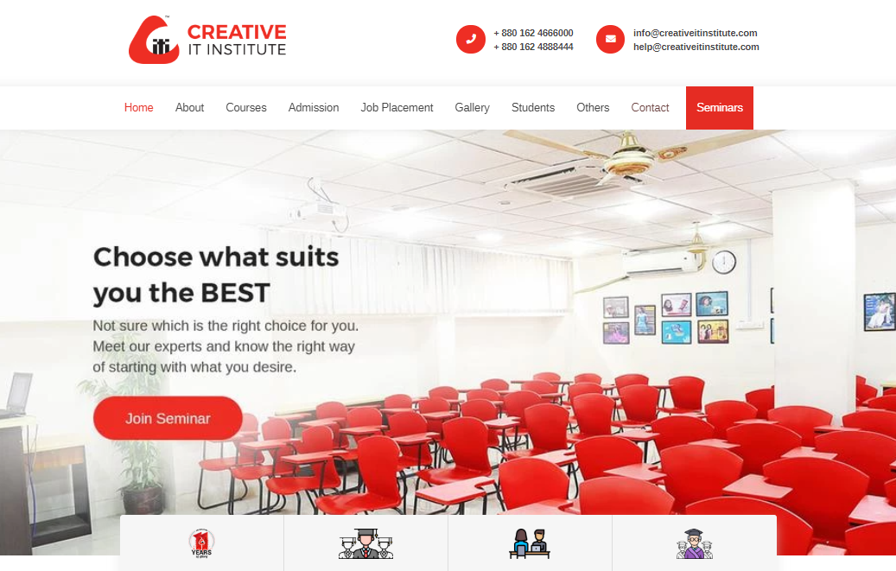
Website User Interface

Slide 2
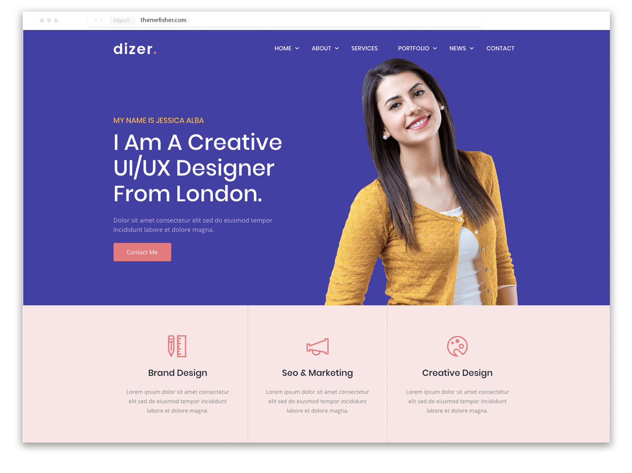
What does Website Template mean?
A website template is a predesigned resource that shows the structure for the comprehensive layout and display features of any website.
It is provided by various suppliers to help make Web design a lot easier for designers.

Slide 3
Important of Web Template

Slide 4
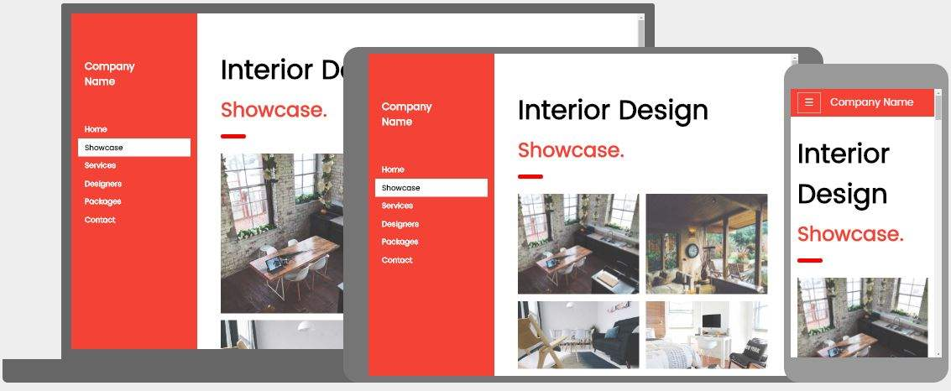
What is responsive web design?
Responsive web design is a term that describes the concept of building a website design in a way that allows the layout to change depending on what screen resolution the viewer has.

Slide 5
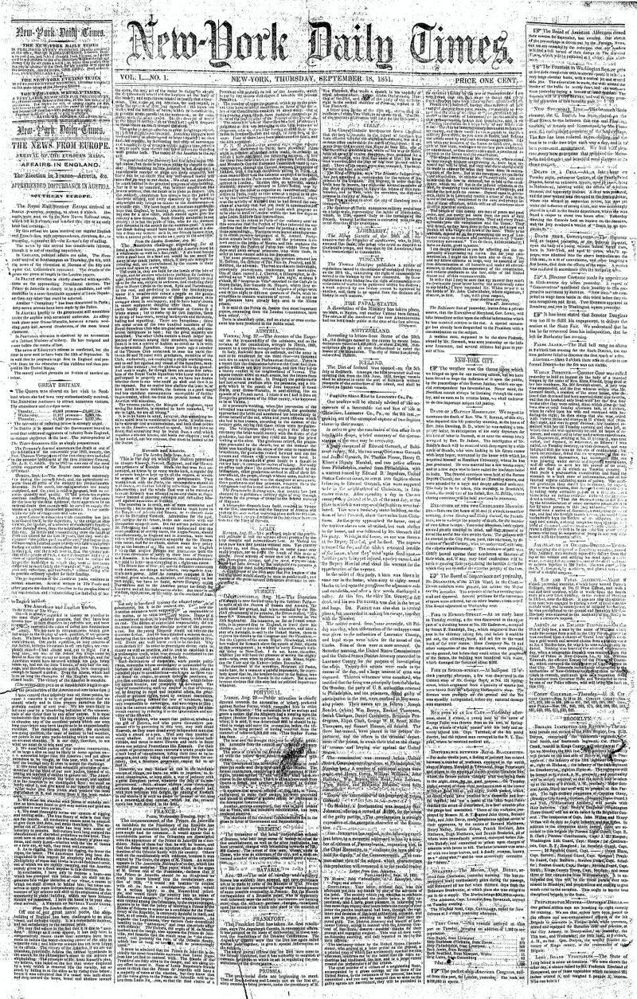
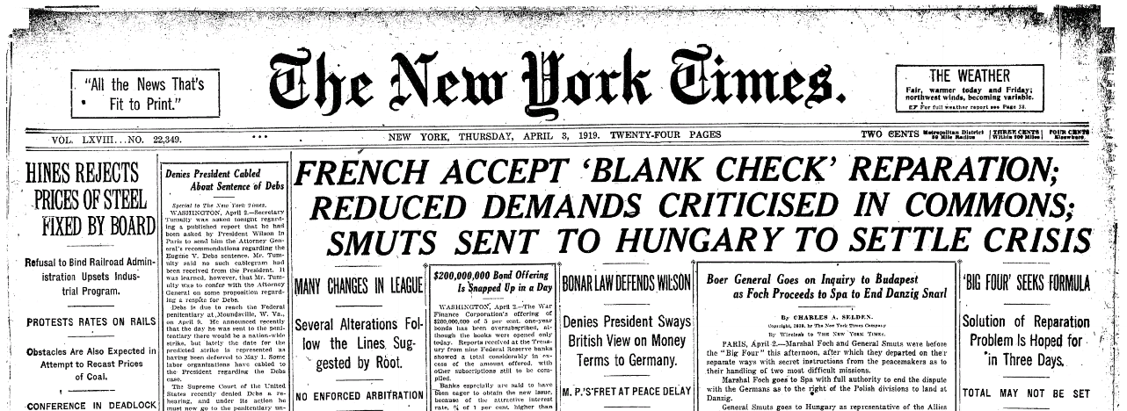
1851
Visual Hierarchy
Visual hierarchy refers to the arrangement or presentation of elements in a way that implies importance. In other words, visual hierarchy influences the order in which the human eye perceives what it sees.
1919

Slide 6
8 PRINCIPLES OF VISUAL HIERARCHY FOR DESIGNERS
Size: The larger the element, the more attention it will attract.
Color: Bright colors are more likely to draw attention over muted ones.
Contrast: Dramatically contrasted colors will catch the eye easily
Alignment: An element that breaks away from the alignment of others will attract more attention.
Repetition: Repeating styles can give the impression that content is related
Proximity: Closely placed elements will also appear related.
Whitespace: More space around elements will attract the eye toward them.
Texture and style: Richer textures will attract more attention than flat ones.
Resource: https://visme.co/blog/color-combinations/

Slide 7
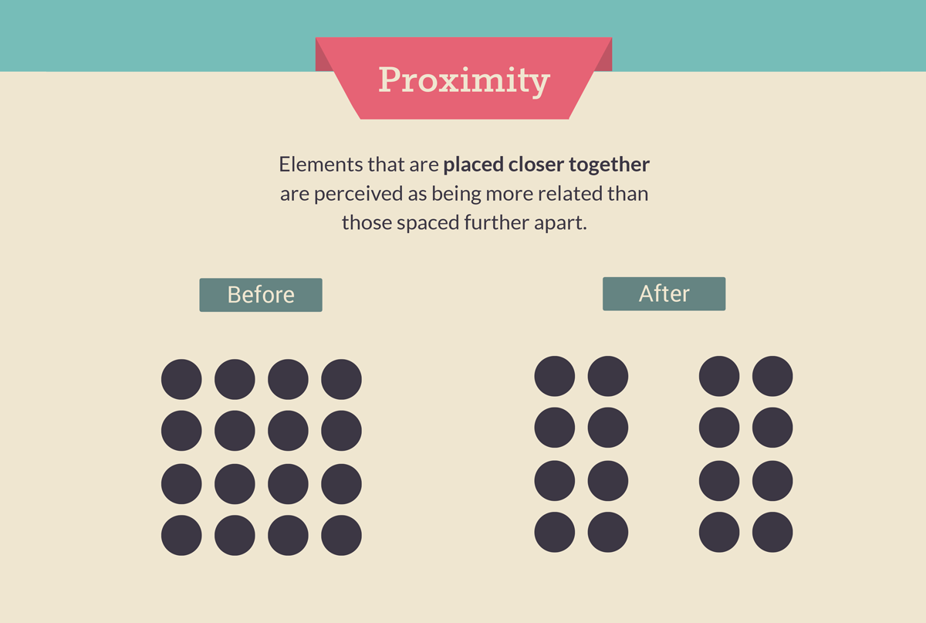

Slide 8
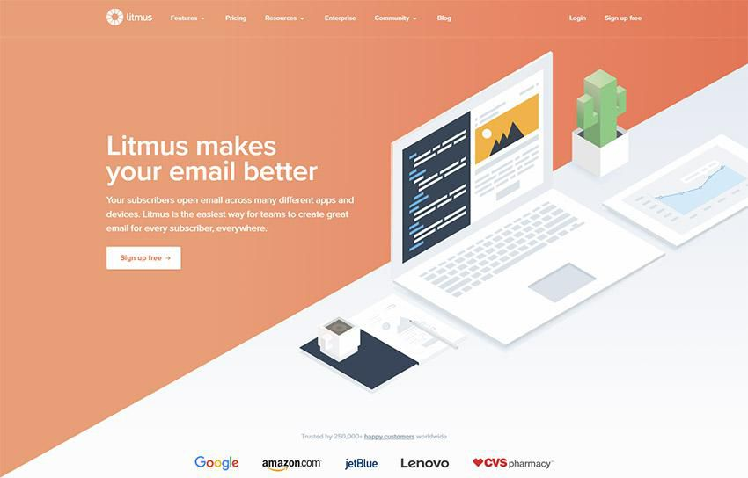
EXAMPLE OF VISUAL HIERARCHY IN WEBSITE

Slide 9
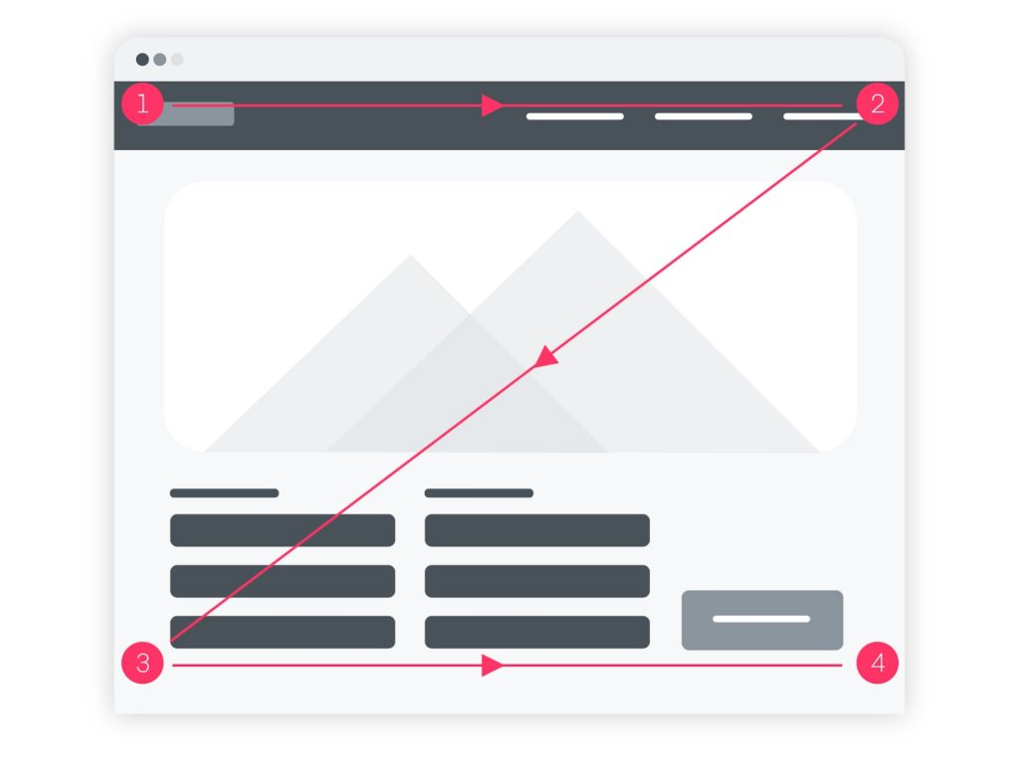
The Z Pattern — In designs without much text, our eye starts scanning from top left to top right, then diagonally down to bottom left, stopping at the bottom right.

Slide 10
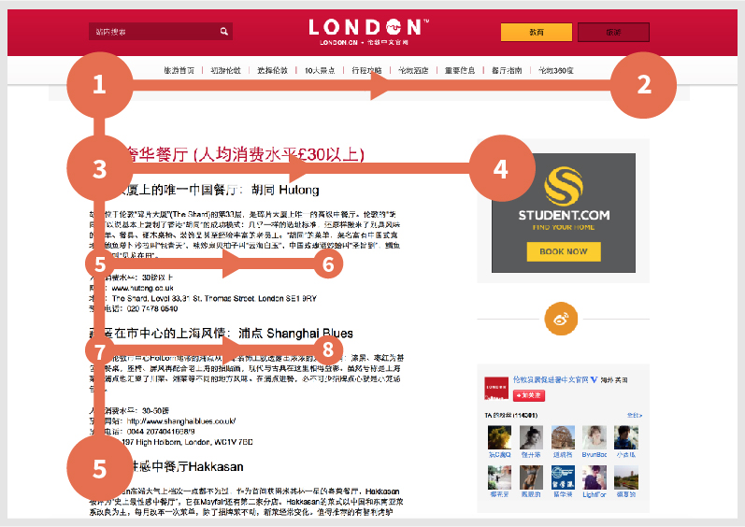
The F Pattern — In designs with more text, we scan across the top, from left to right, then down the left, searching for clues to what we want to know. On finding one, we’ll scan across to the right.

Slide 11
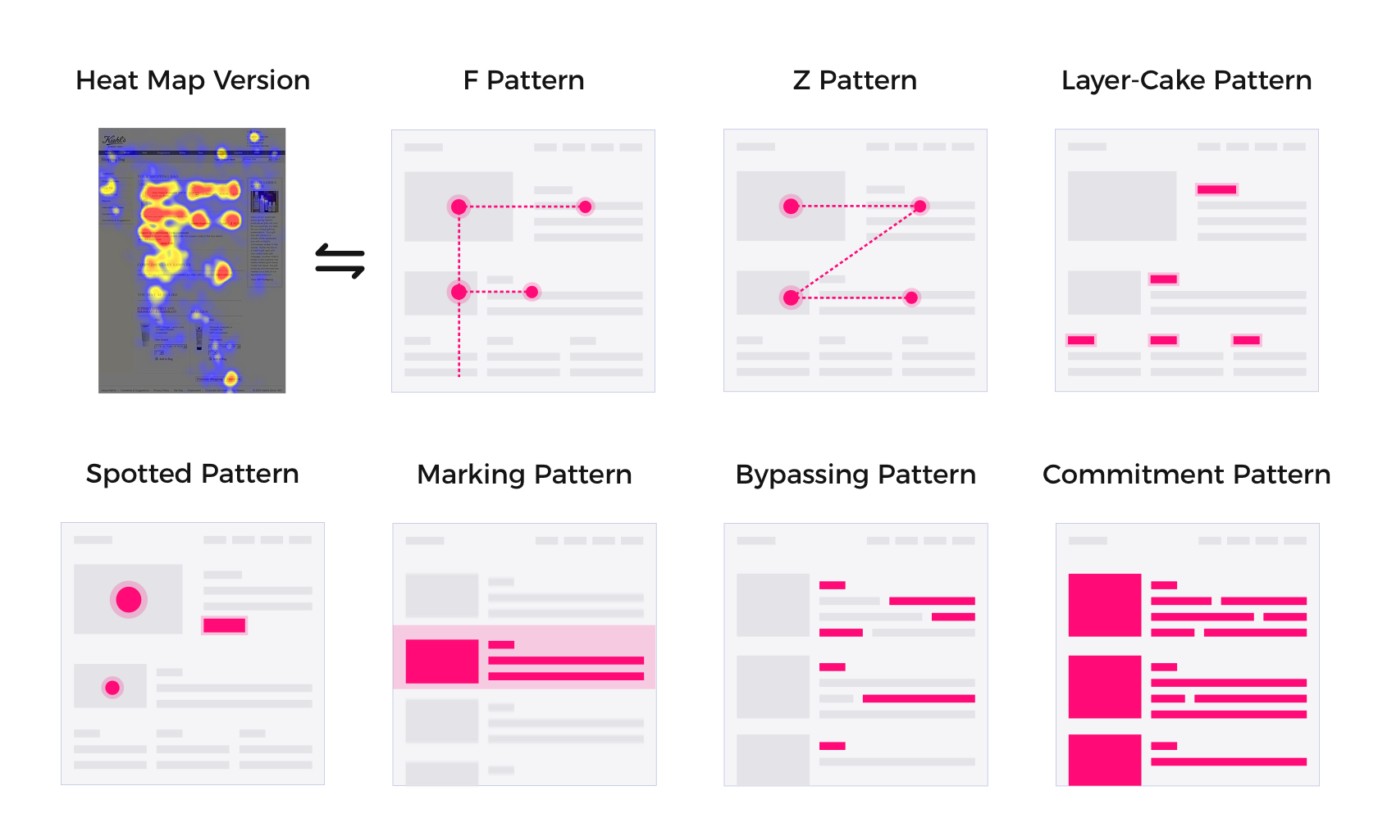

Slide 12
Typography Rules in Web Template
1. Fonts Used At a Minimum
Using more than 3 different fonts makes a website look unstructured and unprofessional.
2. Try To Use Standard Fonts
Users are more familiar with standard fonts and can thus read them faster. Download from Google Web Fonts or Typekit. Some slandered font like Roboto, Open Sans, Avenir next, San Francisco, Helvetica Neue, Proxima Nova, Museo Sans, Lato, Raleway, Montserrat.
3. Limit Line Length
You should have around 60 characters per line if you want a good reading experience. Having the right amount of characters on each line is key to the readability of your text.
4. Avoid All Caps
5. Spacing Between Lines
As a rule, leading should be about 30% more than the character height for good readability. For example If you are using body text 16pt the leading should be 24 pt.
Resource: https://fontpair.co/

Slide 13
Font sizes
Menu text: 16- 20pt (For uppercase 16 fixed)
Slider text/Banner Text: 60-120pt
Supplement text: 20pt
Button text: 20pt
Section title: 32pt
Description /Body text: 16 pt
Description /Body text title: 20-24 pt
Remember In all cases it will be the same size

Slide 14
Space & Alignment
1. Banner Height 600px is called standard size but with Nap bar/Menu bar 700px.
2. For every section gap 80 - 120px is called standard.
3. Section title to Section Content gap should be Half of the section space.
4. Subtitle to Descriptions should be Half of the Section title to Section Content Space.
“For example if you are using 100px gap for section to section
Than Section title to Section Content will be 50px gap
Again for Subtitle to Descriptions gap will be 25px”

Slide 15
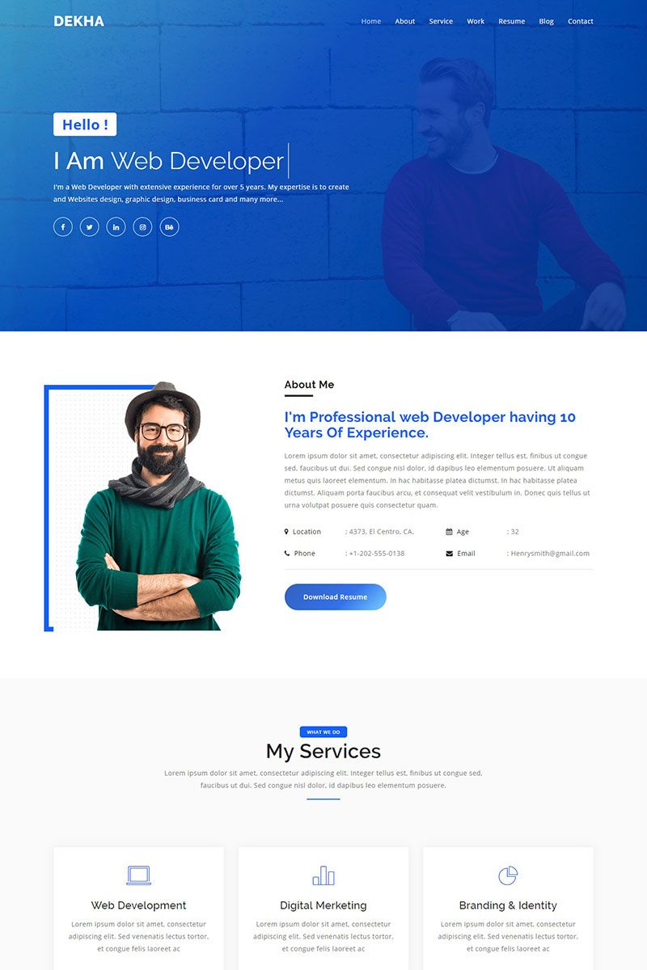
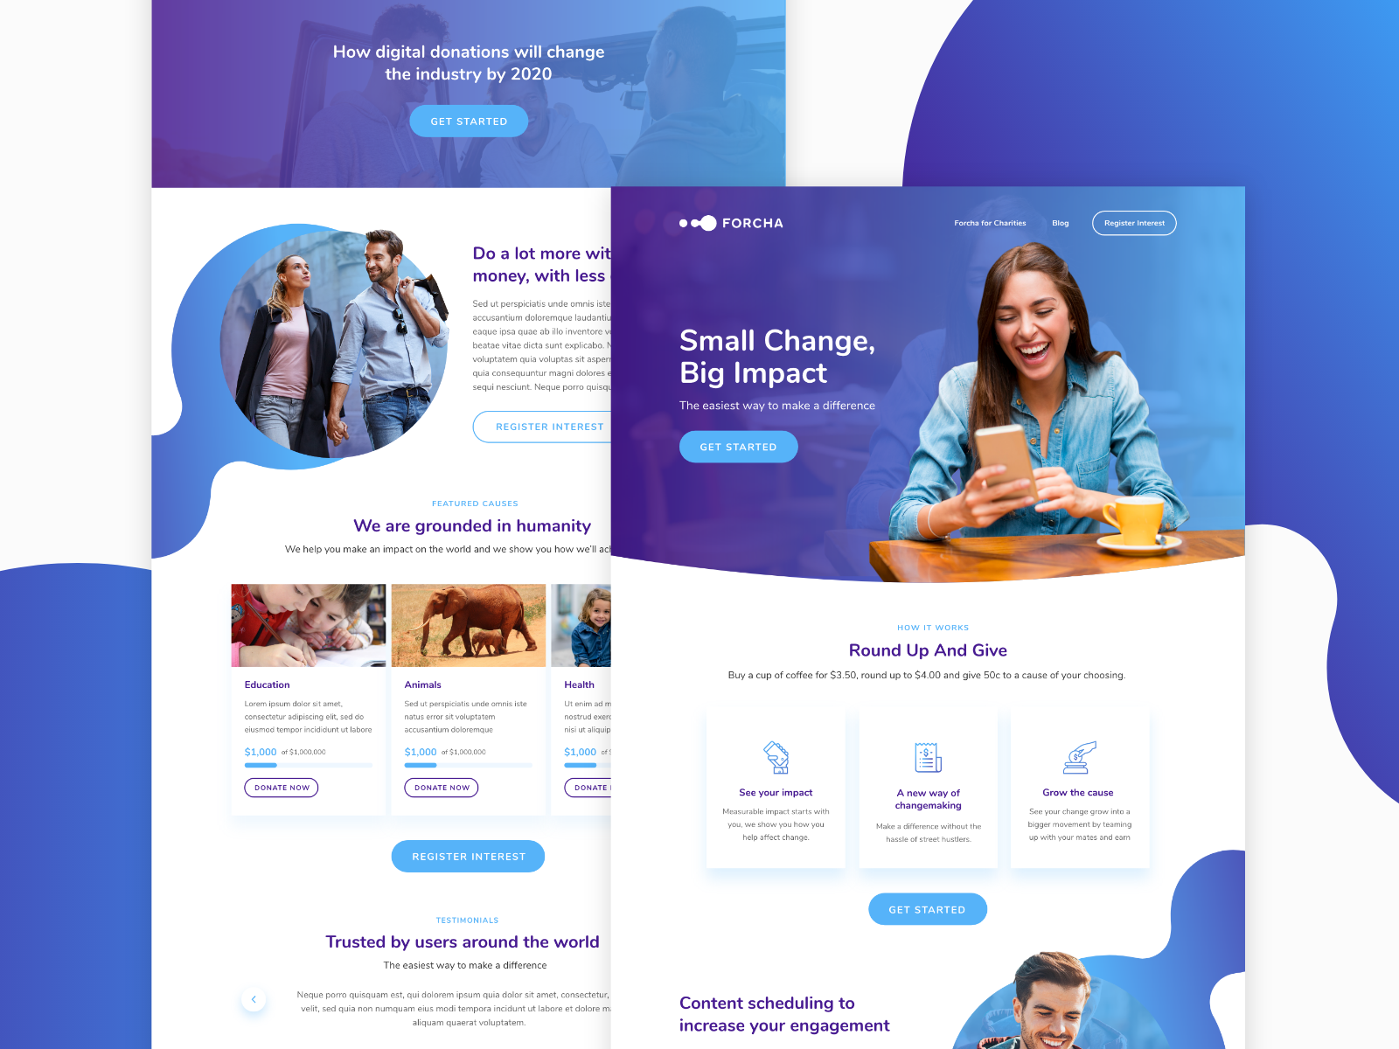

Slide 16
THANK YOU

