Slide 1
₹ COMPUTER SCIENCE & ENGINEERING • CAPSTONE PROJECT
Expenso: High-Speed Personal Finance Engine
A Privacy-First, Zero-Latency Expense Tracker Built with Clean Architecture
₹
₹ FINAL VIVA DEFENSE
🎯 Project Vision & Core Problem
Engineered to record daily expenses in under 5 seconds (< 5s benchmark).
Eliminates 6-step tedious friction found in commercial mobile trackers.
Zero Data Leakage: 100% self-hosted, user-isolated, and private.
Clean Monorepo Turborepo architecture strictly enforcing < 500 LOC per file.
🛠️ Technology Stack Breakdown
Backend: Python 3.10+, FastAPI (Asynchronous ASGI), Pydantic v2
Database: SQLite / RDBMS with SQLAlchemy ORM & Foreign Key Cascades
Security: Stateless JWT (HS256) & Passlib salted bcrypt password hashing
Frontend: Modular Vanilla JS (IIFE Services/Views), Semantic CSS Tokens, Chart.js
Expenso • Smart Indian Finance • Slide 1 of 16 • ₹ ₹ ₹

Slide 2
₹ INDUSTRY CONTEXT & MOTIVATION
Problem Statement: Why Modern Finance Apps Fail
Analysis of existing commercial solutions and the friction users face daily
₹
₹ GAP ANALYSIS
1. Multi-Screen Friction
Logging a single cup of tea takes 5 to 6 screens and multiple dropdown clicks.
Users experience cognitive fatigue and abandon habit tracking within 14 days.
No intelligent auto-categorization based on contextual keywords.
2. Invasive Data Harvesting
Free apps read user SMS inboxes and sell spending patterns to ad brokers.
Financial data is monetized without transparent user consent.
Lack of self-hosted, confidential finance management alternatives.
3. Excessive Framework Bloat
Heavy 15MB+ Single Page Application (SPA) bundles cause high memory pressure.
Slow startup latency on budget mobile devices and spotty network connections.
Complex compilation toolchains make maintenance difficult.
Expenso • Smart Indian Finance • Slide 2 of 16 • ₹ ₹ ₹

Slide 3
₹ SOLUTION ARCHITECTURE
Expenso: Minimum Clicks, Maximum Clarity
Key engineering innovations designed to make expense tracking effortless
₹
₹ CORE INNOVATIONS
⚡ Smart Keyword Recognition
User types 'Pizza 250' -> Auto-detects & selects 'Food & Dining'.
User types 'Uber 180' -> Auto-detects & selects 'Transport'.
Zero manual searching through exhaustive category dropdowns.
🛡️ Isolated Transaction Engine
Complete state separation between Expense and Income modes.
Optional Description for expenses; simplified Amount+Category for income.
Default UPI payment mode with automatic zero-click fallback.
⌨️ Power-User Navigation
Ctrl+K: Instant Command Palette for rapid keyboard logging.
E: Quick Expense Modal | I: Quick Income Modal | /: Ledger Search.
Esc: Dismiss active overlays with zero mouse interaction.
Expenso • Smart Indian Finance • Slide 3 of 16 • ₹ ₹ ₹

Slide 4
₹ MONOREPO & SOFTWARE DESIGN
Clean Monorepo Architecture & Standards
Strict domain isolation, maintainability, and clean code enforcement
₹
₹ ENTERPRISE PATTERNS
📁 Monorepo Layout (Turborepo)
apps/api: Asynchronous FastAPI service divided into clean domain modules.
apps/api/core: Cross-cutting database engines, security, and middleware.
apps/api/domain: Feature slices (auth, transactions, budgets, analytics, recurring).
apps/web: Zero-framework client with layered services, components, and views.
📏 Strict < 500 LOC Engineering Rule
Core Project Constraint: No file in the codebase may exceed 500 lines of code.
Forces high modularity, atomic responsibilities, and easy unit testability.
Proactive decomposition whenever a file approaches 350 lines.
Expenso • Smart Indian Finance • Slide 4 of 16 • ₹ ₹ ₹

Slide 5
₹ RELATIONAL DATA MODELING
Database Schema & Entity Relationships
Normalized relational design with foreign keys and cascading integrity
₹
₹ RDBMS SCHEMA
🗄️ Core Relational Entities
users: (id, name, email, password_hash, currency, created_at)
transactions: (id, user_id, amount, type, description, category_id, date, notes)
categories: (id, user_id, name, type, icon, color, is_default)
payment_methods: (id, user_id, name, type)
budgets: (id, user_id, category_id, amount, month, year)
recurring_expenses: (id, user_id, name, amount, frequency, next_date)
🛡️ Referential Integrity & Indexing
Foreign Keys with ON DELETE CASCADE: Clean deletion without orphaned records.
Indexed Queries: B-tree indexes on (user_id, transaction_date) for fast ranges.
SQLAlchemy Eager Loading: joinedload eliminates N+1 query bottlenecks.
Expenso • Smart Indian Finance • Slide 5 of 16 • ₹ ₹ ₹

Slide 6
₹ BACKEND SERVICES & API SECURITY
FastAPI Implementation & Defense-in-Depth
Asynchronous REST endpoints, cryptographic security, and token verification
₹
₹ REST API & AUTH
🔐 Cryptographic Authentication
Passlib bcrypt: Passwords hashed with unique random salt rounds before storage.
Stateless JWT Tokens: Signed with HS256 algorithm, payload contains user ID.
FastAPI Dependency Injection: Depends(get_current_user_id) guards private routes.
Profile Management: Direct endpoints for name, currency, and password updates.
🛡️ API Defense & Validation
SQL Injection Immunity: Parameterized queries generated via SQLAlchemy ORM.
Pydantic Validation: Enforces strict data types, positive amounts, and email formats.
Cross-User Isolation: Every database query enforces WHERE user_id == current_user.
Expenso • Smart Indian Finance • Slide 6 of 16 • ₹ ₹ ₹

Slide 7
₹ CLIENT-SIDE ENGINEERING
Semantic CSS & Layered JavaScript Architecture
High-aesthetic glassmorphism and instant performance without virtual DOM overhead
₹
₹ NATIVE WEB STACK
🎨 Semantic CSS Layering
tokens.css: HSL design tokens, elevation shadows, border radii, and accent colors.
base.css: Grid layouts, sticky topbar with blur filter, and sidebar navigation.
components.css: Glassmorphic cards, responsive tables, badge pills, metric items.
Dynamic Theme Engine: Instant Dark/Light mode toggle persisted in localStorage.
📦 Modular JavaScript Layers
services/api.js: Centralized HTTP client with automatic Authorization header.
services/state.js: Single source of truth for user state, currency, and timezone.
views/: Decoupled controllers for Home, Dashboard, Ledger, Calendar, and Settings.
components/profile.js: Interactive floating account dropdown with edit modal.
Expenso • Smart Indian Finance • Slide 7 of 16 • ₹ ₹ ₹

Slide 8
₹ CORE ENGINE SPOTLIGHT
Smart Transaction Engine & Keyword Detection
Real-time client-side keyword parsing for zero-friction transaction entry
₹
₹ INTELLIGENT UX
🧠 Contextual Keyword Mapping
Food Keywords: 'pizza', 'burger', 'chai', 'lunch', 'zomato' -> Food & Dining 🍔
Transport Keywords: 'uber', 'ola', 'auto', 'petrol', 'metro' -> Transport 🚕
Shopping Keywords: 'amazon', 'blinkit', 'clothes', 'grocery' -> Shopping 🛒
Bills Keywords: 'bijli', 'wifi', 'electricity', 'recharge' -> Bills & Utilities 💡
⚡ Streamlined Entry Rules
Optional Description: Expense logs with just Amount + Category if user is in a hurry.
Add Income Isolation: Description field hidden to prevent carryover of expense text.
Default UPI: Modal opens with UPI pre-selected, auto-fallback on submission.
Instant Undo Toast: Deleted transactions can be restored within a 5-second window.
Expenso • Smart Indian Finance • Slide 8 of 16 • ₹ ₹ ₹

Slide 9
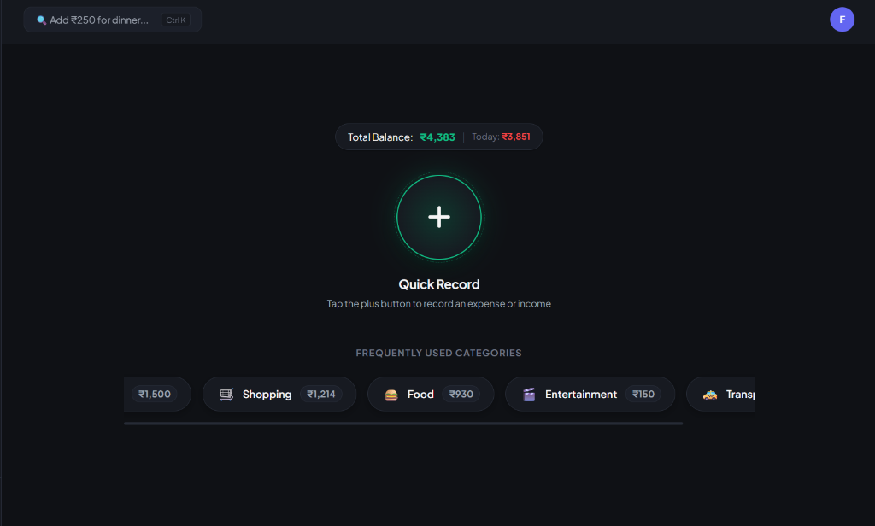
₹ LIVE DEMO • ZERO-FRICTION LOGGING
Home Screen: 1-Tap Quick Record
Record everyday expenses in under 2 seconds right from the home screen
₹
₹ 1-TAP LOGGING
💡 What You See Here (Beginner Guide)
Designed for zero-effort habit tracking. Anyone can record daily expenses in under 2 seconds without navigating through complex sub-menus.
🟢 Big Green (+) Action: Centered for instant thumb reach; opens the entry popup in one single tap.
💰 Live Balance Ticker: See your available balance (₹4,383) and today's total spending (₹3,851) at all times.
⚡ Quick-Category Chips: One tap on Food (₹930) or Shopping (₹1,214) pre-fills your most frequent expenses.
⌨️ Smart Natural Input (Ctrl+K): Type 'Add ₹250 for dinner' and AI detects the category automatically.
✨ Beginner Benefit: No accounting knowledge needed. It works just like sending a quick chat message.
Expenso • Smart Indian Finance • Slide 9 of 16 • ₹ ₹ ₹

Slide 10
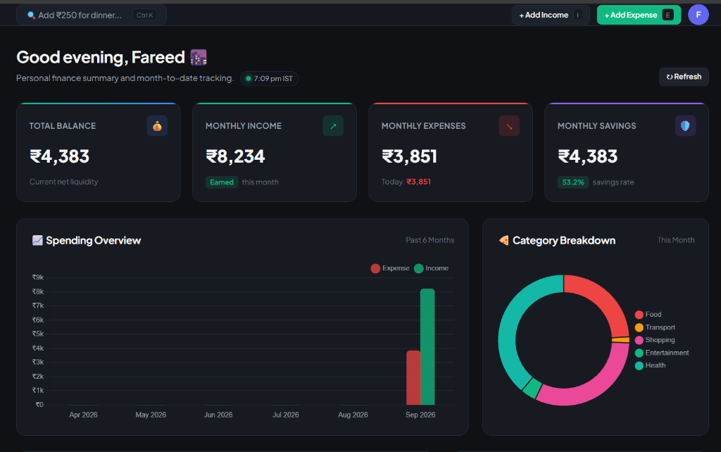
₹ LIVE DEMO • REAL-TIME CASHFLOW
Interactive Dashboard & Visual Analytics
Clear charts and essential metrics translating numbers into visual health
₹
₹ CASHFLOW ANALYTICS
💡 What You See Here (Beginner Guide)
Translates complex numbers into simple, colorful charts so beginners instantly know where their money went and how much they saved.
📊 4 Core Summary Cards: Clear numbers for Total Balance, Monthly Income, Monthly Expenses, and Savings.
📈 Savings Rate (53.2%): Tells you in green if you are saving enough money this month.
📉 Spending Overview Bar Chart: Compares cash coming in vs going out across months.
🍩 Category Donut Chart: Shows exact percentage spent on Food, Transport, Shopping, and Health.
✨ Beginner Benefit: You understand your complete monthly financial health in just 5 seconds.
Expenso • Smart Indian Finance • Slide 10 of 16 • ₹ ₹ ₹

Slide 11
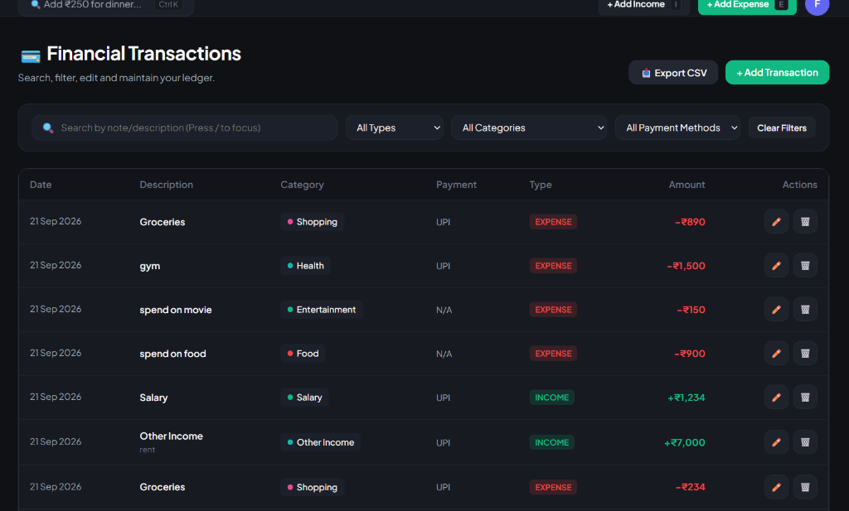
₹ LIVE DEMO • SEARCHABLE LEDGER
Smart Ledger: Filterable Money Diary
An organized digital passbook with color badges, instant search, and CSV export
₹
₹ LEDGER & FILTERS
💡 What You See Here (Beginner Guide)
An organized digital passbook where every rupee is tracked with clear color codes, instant search, and export capabilities.
🏷️ Color-Coded Badges: Green (+₹7,000) for Income and Red (-₹890) for Expenses — impossible to confuse.
🔍 Instant Keyword Search: Find past spends like 'gym', 'movie', or 'groceries' in milliseconds.
⚡ Category & Mode Filters: Filter by Payment Method (UPI, Cash) or Category with 1 click.
📥 One-Click CSV Export: Download your full transaction history to Excel for personal records or taxes.
✨ Beginner Benefit: Never wonder where your cash disappeared at the end of the month.
Expenso • Smart Indian Finance • Slide 11 of 16 • ₹ ₹ ₹

Slide 12
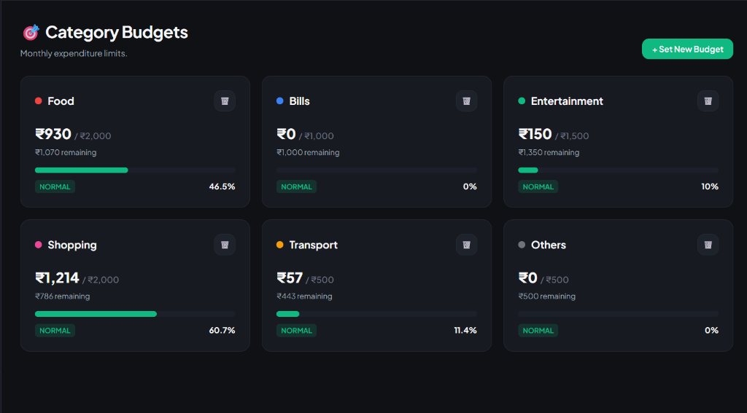
₹ LIVE DEMO • ACTIVE SPENDING CAPS
Budget Guardrails: Avoid Month-End Deficit
Visual progress bars and live remaining balances to prevent overspending
₹
₹ BUDGET GUARDRAILS
💡 What You See Here (Beginner Guide)
Set monthly spending limits for categories like Food and Shopping. Visual progress meters guide you before you overspend.
📊 Visual Progress Meters: Colored bars show percentage consumed (e.g., Shopping: 60.7%, Food: 46.5%).
💵 Live Remaining Balances: Exact cash left displayed upfront (e.g. '₹1,070 remaining' for food).
🛡️ Safe vs Danger Status: Clear 'NORMAL' green badge alerts you before a category limit is exceeded.
⚙️ Flexible Custom Limits: Tap '+ Set New Budget' anytime to adjust limits as your lifestyle changes.
✨ Beginner Benefit: Acts like a financial guardian, preventing impulse overspending before it happens.
Expenso • Smart Indian Finance • Slide 12 of 16 • ₹ ₹ ₹

Slide 13
₹ DATA VISUALIZATION & TIMEZONE SYNC
Visual Intelligence & Live IST Clock
Translating raw ledger data into actionable personal financial insights
₹
₹ CHART.JS ENGINE
📊 Interactive Chart.js Dashboards
Monthly Trend Line Chart: 6-month historical cashflow comparing Inflow vs Outflow.
Category Breakdown Doughnut: Visual percentage distribution of monthly expenses.
Live Metric Cards: Net Balance, Monthly Income, Monthly Burn, and Savings Rate.
Formula: Savings Rate = ((Monthly Income - Monthly Expense) / Monthly Income) * 100.
🕒 Live IST Timezone Synchronization
Indian Standard Time (IST) Clock: Live ticker on dashboard updated every 10 seconds.
Contextual Greetings: Good morning (🌅), afternoon (☀️), evening (🌆), or night (🌙).
Timezone-Safe Date Utility: Uses Intl.DateTimeFormat with Asia/Kolkata timezone.
Expenso • Smart Indian Finance • Slide 13 of 16 • ₹ ₹ ₹

Slide 14
₹ FINANCIAL PLANNING & AUTOMATION
Budgets, Recurring Bills & Interactive Calendar
Active spending guardrails, automated renewals, and date-wise ledger
₹
₹ ACTIVE CONTROLS
🎯 Category Spend Caps
Set monthly spending limits for high-burn categories (e.g. Dining ₹5,000).
Progress bar visual status: Normal (Green) -> Warning (Amber) -> Exceeded (Red).
Live percentage calculation prevents surprise month-end overspending.
🔄 Automated Recurring Subscriptions
Tracks recurring liabilities (Netflix, Gym, Rent, Internet).
Automated endpoint /api/recurring/process-due posts due bills on cycle dates.
Maintains active subscriptions list with next due dates.
📅 Day-by-Day Interactive Calendar
Monthly calendar grid aggregating daily expenditure totals on each date cell.
Click any calendar cell to filter and review that specific day's financial activity.
Expenso • Smart Indian Finance • Slide 14 of 16 • ₹ ₹ ₹

Slide 15
₹ SYSTEM VALIDATION & BENCHMARKS
Performance Metrics & Testing Standards
Rigorous performance profiling and test coverage across the full stack
₹
₹ QA & BENCHMARKS
🚀 Performance Profiling
Sub-50ms API Latency: FastAPI ASGI server handles high concurrent throughput.
Client Load Time: < 60ms initial page load due to zero framework bundle overhead.
Server-Side Pagination: Transactions endpoint limits payloads (50 items/page).
Database Queries: EXPLAIN QUERY PLAN confirms index utilization on transaction queries.
🧪 Test Coverage & Verification
Authentication Edge Cases: Verified rejection of expired and tampered JWT tokens.
Data Boundary Tests: Verified handling of zero amounts, empty notes, and long strings.
Cross-Browser Compatibility: Validated in Chromium, Firefox, and Safari rendering engines.
Expenso • Smart Indian Finance • Slide 15 of 16 • ₹ ₹ ₹

Slide 16
₹ SUMMARY & FUTURE SCOPE
Conclusion, Learnings & Commercial Roadmap
Reflection on engineering achievements and commercial expansion vision
₹
₹ PROJECT DEFENSE
🎓 Academic & Engineering Learnings
Full-Stack Mastery: Seamless coordination between FastAPI, SQLAlchemy, and DOM APIs.
Security Best Practices: Implemented real-world token-based auth, hashing, and defense.
Clean Code Discipline: Successfully kept entire monorepo compliant with < 500 LOC rule.
🔮 Future Scope & Commercial Expansion
AI Receipt OCR: Camera bill scanning with automatic optical character recognition.
Android Background SMS Sync: Auto-capturing banking transaction SMS alerts.
Splitwise Group Splitting: Automated shared expense calculation with roommates.
Expenso • Smart Indian Finance • Slide 16 of 16 • ₹ ₹ ₹

