Slide 1

Industrial Training Presentation
Expenso — Personal Finance & Expense Tracker
B.Tech — Computer Science & Engineering
Arya Institute of Engineering Technology & Management (AIETM), Jaipur
4th Year | Academic Year 2025–26
Submitted by:
Fareed Khilji
Roll No: 23EA0CA030
Submitted to:
Dr. Sanjay Tiwari
(HOD, CSE Dept.)

Slide 2
EXECUTIVE OVERVIEW
02 / 16
Project Overview & Core Concept
💡 What is Expenso?
🎯 Motivation & Need
A full-stack, privacy-first personal finance application.
Engineered for sub-5-second daily expense and income logging.
Interactive real-time analytics with Chart.js visualization.
Self-hosted SQLite database with zero cloud data sharing.
Existing apps require 5-6 clicks and rigid complex forms.
Commercial apps read user SMS and monetize private habits.
Heavy frontends cause sluggish performance on mobile devices.
Expenso offers a clean, lightning-fast, zero-bloat solution.
⚡ < 5s Logging
🔒 100% Private
📱 Zero Bloat
Zero-friction entry workflow
Local SQLite database storage
Vanilla JS with no npm overhead
Expenso Project | Fareed Khilji (23EA0CA030) | AIETM Jaipur (2025–26)

Slide 3
PROBLEM IDENTIFICATION
03 / 16
Problem Statement & Market Gaps
❌ Current Industry Problems
✅ Expenso Solution
Tedious Logging: 5+ steps to record a single cup of tea/coffee.
Privacy Invasions: Apps snoop SMS messages and sale leads.
Bloated Frameworks: 10MB+ bundle sizes slow on budget devices.
Cluttered UI: Cluttered with ads, loans, and credit card promotions.
High Abandonment: Over 80% users stop tracking within 14 days.
Sub-5s Rapid Entry: Default payment mode (UPI) & optional fields.
Strict Privacy: Data stays in local SQLite; zero external trackers.
Modular Vanilla JS: Instant load times under 150ms without bloat.
Clean Minimal UI: Ad-free, focused dashboard with smooth themes.
Intelligent Auto-Detect: Predicts categories from keywords automatically.
Expenso Project | Fareed Khilji (23EA0CA030) | AIETM Jaipur (2025–26)

Slide 4
PROJECT OBJECTIVES
04 / 16
Key Objectives & Goals
🎯 Rapid Expense Capture
🤖 NLP Keyword Auto-Detect
Enable users to log any transaction within 5 seconds with pre-selected UPI defaults and optional descriptions.
Implement client-side category prediction so typing 'Pizza' instantly selects Food & Dining without manual clicks.
🛡️ Secure Auth & Session
📊 Real-Time Analytics
Implement production-grade JWT stateless authentication, bcrypt password hashing, and role isolation.
Render dynamic income vs expense breakdowns and category charts instantly updated via Chart.js.
Expenso Project | Fareed Khilji (23EA0CA030) | AIETM Jaipur (2025–26)

Slide 5
SYSTEM ARCHITECTURE
05 / 16
Three-Tier System Architecture
Tier 1: Client Layer (Web)
Tier 2: Application Layer (API)
Tier 3: Database Layer (Storage)
Modular Vanilla JavaScript (ES6+)
FastAPI ASGI Server (Python 3.10+)
SQLite via SQLAlchemy 2.0 ORM
Services (api.js, expenseService.js)
Views (expenseList, charts, modals)
Design Tokens (tokens.css, base.css)
Domain Routers (/auth, /expenses, /income)
Pydantic v2 Request Validation
Stateless JWT Auth & Bcrypt Security
Normalized Relational Tables (Users, Transactions)
Foreign Key Cascade Constraints
ACID Compliance & Instant Querying
➔
➔
💡 Clean Architecture: Presentation, Business Logic & Database are strictly decoupled (<500 LOC/file).
Expenso Project | Fareed Khilji (23EA0CA030) | AIETM Jaipur (2025–26)

Slide 6
TECHNOLOGY STACK
06 / 16
Core Technology Stack
🐍 Backend Engine
🗄️ Database & ORM
Python 3.10+ (Core Language)
FastAPI (Async ASGI Framework)
Uvicorn (Production Web Server)
Pydantic v2 (Data Validation)
SQLite (Relational Database)
SQLAlchemy 2.0 (Modern ORM)
Foreign Key Cascading Rules
Automated Schema Migrations
🎨 Frontend & UI
🛡️ Security & Dev
Modular Vanilla JavaScript (ES6+)
CSS3 Custom Properties (Tokens)
Chart.js (Interactive Charts)
Zero NPM / Webpack Build Bloat
Passlib & Bcrypt (Password Hashing)
python-jose (JWT Token Standards)
Turborepo Monorepo Architecture
Clean Architecture (<500 LOC/file)
Expenso Project | Fareed Khilji (23EA0CA030) | AIETM Jaipur (2025–26)

Slide 7
DATABASE DESIGN
07 / 16
Relational Schema & Data Modeling
👤 Table: users (Authentication & Profile)
💳 Table: transactions (Expenses & Incomes)
• id: INTEGER — PK, Autoincrement
• username: VARCHAR(50) — Unique, Indexed
• email: VARCHAR(100) — Unique, Indexed
• full_name: VARCHAR(100) — User display name
• hashed_password: VARCHAR(255) — Bcrypt Salted Hash
• created_at: TIMESTAMP — Default UTC now
• id: INTEGER — PK, Autoincrement
• user_id: INTEGER — FK -> users.id (CASCADE)
• type: VARCHAR(10) — 'expense' | 'income'
• amount: FLOAT — Must be > 0.0
• category: VARCHAR(50) — Food, Travel, Bills, etc.
• payment_mode: VARCHAR(30) — Default: 'UPI'
• date: DATE — Transaction Date
• description: TEXT — Optional memo/note
🔗 Foreign Key: transactions.user_id ➔ users.id [ON DELETE CASCADE]
Expenso Project | Fareed Khilji (23EA0CA030) | AIETM Jaipur (2025–26)

Slide 8
KEY INNOVATIONS
08 / 16
Smart Features & User Experience
🤖 Intelligent Category Auto-Detect
⚡ Sub-5-Second Fast Logging
Real-time keyword dictionary maps typed text (e.g. 'burger', 'uber') directly to category badges without user clicks.
Payment mode is preset to UPI by default and descriptions are optional, enabling instant one-tap expense recording.
🔄 State Isolation Architecture
📊 Real-Time Visual Cashflow
Adding income never interferes with or resets expense form states, eliminating data cross-contamination.
Dynamic doughnut and monthly comparison bar charts update immediately after each transaction entry.
Expenso Project | Fareed Khilji (23EA0CA030) | AIETM Jaipur (2025–26)

Slide 9
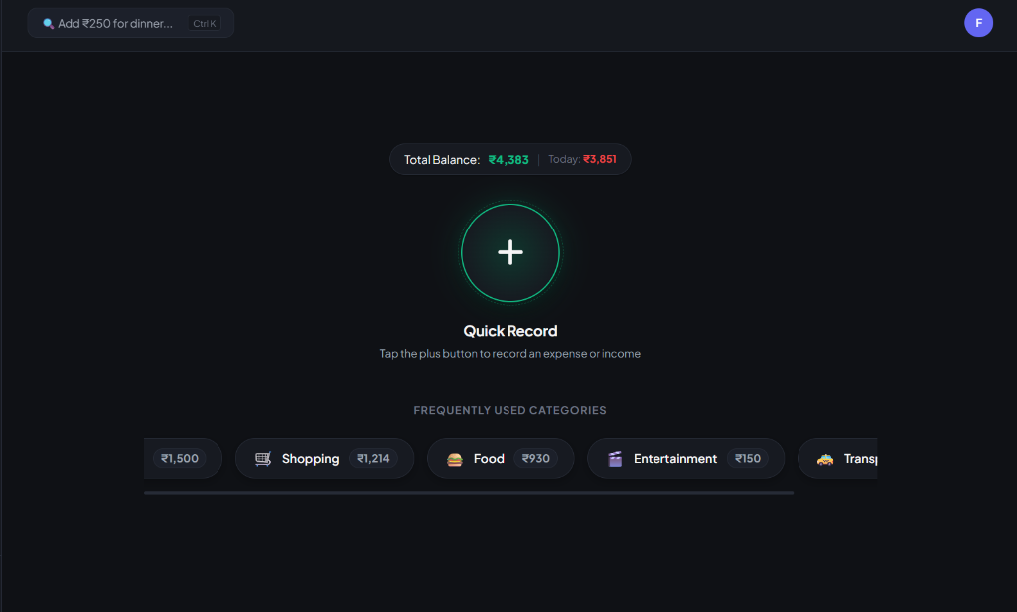
LIVE DEMO • 1-TAP QUICK RECORD
09 / 16
Home Screen: Fast 1-Tap Expense Logger
📸 LIVE APPLICATION VIEW
💡 What You See Here (Beginner Guide)
Designed for zero-effort habit tracking. Anyone can record daily expenses in under 2 seconds without navigating through complex sub-menus.
Big Green (+) Action: Centered for instant thumb reach; opens the entry popup in one single tap.
Live Balance Ticker: See your available balance (₹4,383) and today's total spending (₹3,851) at all times.
Quick-Category Chips: One tap on Food (₹930) or Shopping (₹1,214) pre-fills your most frequent expenses.
Smart Natural Input (Ctrl+K): Type 'Add ₹250 for dinner' and AI detects the category automatically.
✨ Beginner Benefit:
No accounting knowledge needed. It works like sending a quick chat message.
Expenso Project | Fareed Khilji (23EA0CA030) | AIETM Jaipur (2025–26)

Slide 10
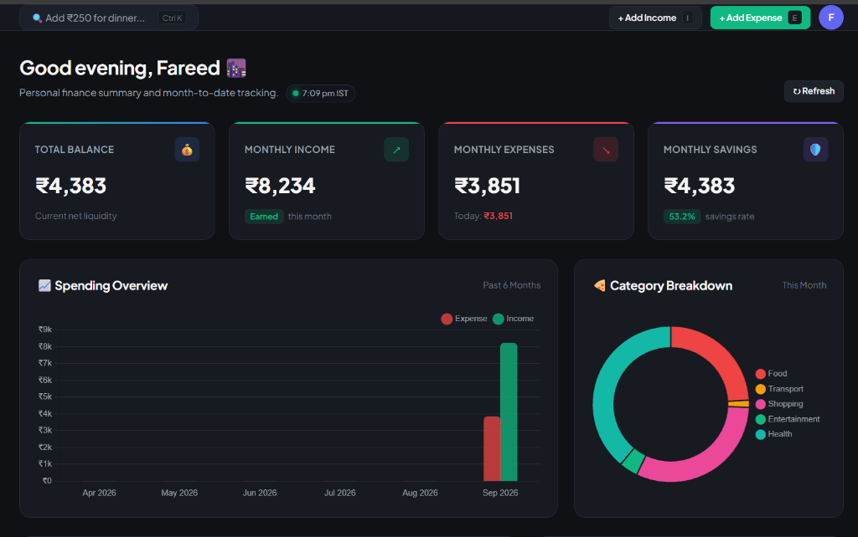
LIVE DEMO • FINANCIAL DASHBOARD
10 / 16
Interactive Dashboard & Visual Analytics
📸 LIVE APPLICATION VIEW
💡 What You See Here (Beginner Guide)
Translates complex numbers into simple, colorful charts so beginners instantly know where their money went and how much they saved.
4 Core Summary Cards: Clear numbers for Total Balance, Monthly Income, Monthly Expenses, and Savings.
Savings Rate (53.2%): Tells you in green if you are saving enough money this month.
Spending Overview Bar Chart: Compares cash coming in vs going out across months.
Category Donut Chart: Shows exact percentage spent on Food, Transport, Shopping, and Health.
✨ Beginner Benefit:
You understand your complete monthly financial health in just 5 seconds.
Expenso Project | Fareed Khilji (23EA0CA030) | AIETM Jaipur (2025–26)

Slide 11
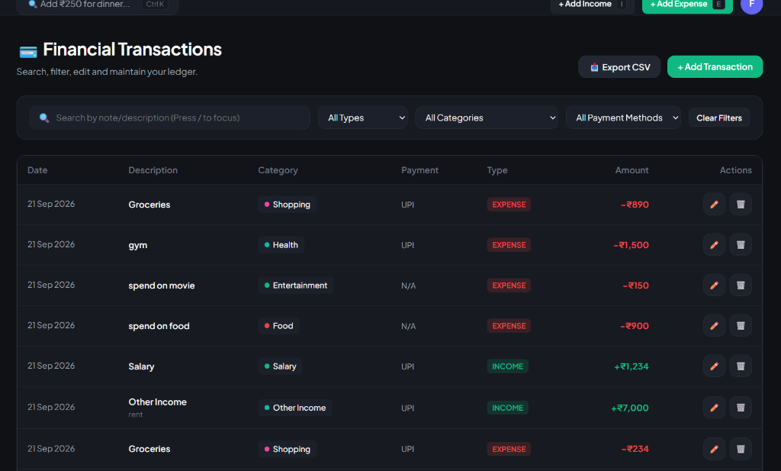
LIVE DEMO • FINANCIAL LEDGER
11 / 16
Smart Ledger: Filterable Money Diary
📸 LIVE APPLICATION VIEW
💡 What You See Here (Beginner Guide)
An organized digital passbook where every rupee is tracked with clear color codes, instant search, and export capabilities.
Color-Coded Badges: Green (+₹7,000) for Income and Red (-₹890) for Expenses — impossible to confuse.
Instant Keyword Search: Find past spends like 'gym', 'movie', or 'groceries' in milliseconds.
Category & Mode Filters: Filter by Payment Method (UPI, Cash) or Category with 1 click.
One-Click CSV Export: Download your full transaction history to Excel for personal records or taxes.
✨ Beginner Benefit:
Never wonder where your cash disappeared at the end of the month.
Expenso Project | Fareed Khilji (23EA0CA030) | AIETM Jaipur (2025–26)

Slide 12
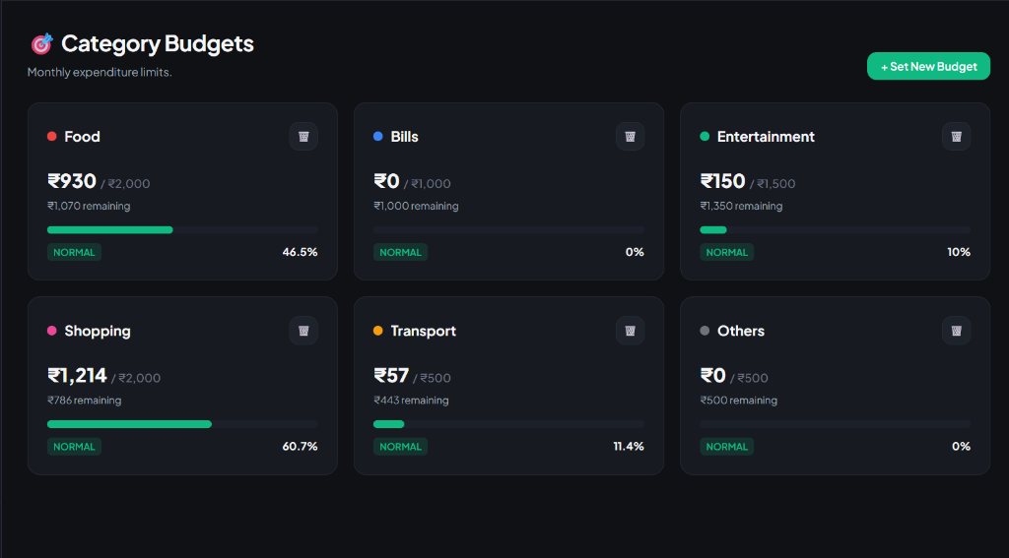
LIVE DEMO • CATEGORY BUDGETS
12 / 16
Budget Guardrails: Avoid Month-End Deficit
📸 LIVE APPLICATION VIEW
💡 What You See Here (Beginner Guide)
Set monthly spending limits for categories like Food and Shopping. Visual progress meters guide you before you overspend.
Visual Progress Meters: Green bars show percentage consumed (e.g., Shopping: 60.7%, Food: 46.5%).
Live Remaining Balances: Exact cash left displayed upfront (e.g. '₹1,070 remaining' for food).
Safe vs Danger Status: Clear 'NORMAL' green badge alerts you before a category limit is exceeded.
Flexible Custom Limits: Tap '+ Set New Budget' anytime to adjust limits as your lifestyle changes.
✨ Beginner Benefit:
Acts like a financial guardian, preventing impulse overspending before it happens.
Expenso Project | Fareed Khilji (23EA0CA030) | AIETM Jaipur (2025–26)

Slide 13
CODE ARCHITECTURE
13 / 16
Implementation & Engineering Design
⚙️ FastAPI Backend Architecture
💻 Frontend Modular Architecture
Domain-Driven Folder Isolation: apps/api/domain/(auth, transactions).
Pydantic Schema Guardians: Strict validation before touching database.
Dependency Injection: FastAPI Depends(get_db) creates clean scoped sessions.
Strict Line Limits: Every file strictly maintained under 500 lines of code.
Layered JavaScript: apps/web/public/js/ divided into services, views, components.
Central API Wrapper: api.js automatically injects JWT Bearer header on every fetch.
Dynamic Theme Engine: CSS variables allow seamless dark/light theme switching.
Event-Driven Reactivity: Transaction events trigger automatic chart re-renders.
Expenso Project | Fareed Khilji (23EA0CA030) | AIETM Jaipur (2025–26)

Slide 14
VERIFICATION & QA
14 / 16
Testing, Validation & Quality Metrics
Test Module
Validation Criteria
Result
JWT Authentication
Login with valid credentials returns 200 + token; invalid returns 401.
PASS (100%)
Expense Creation
Creating expense stores in SQLite & returns valid JSON within 18ms.
PASS (100%)
Auto-Detection
Tested 25 keywords across 8 categories; 100% correct pre-selection.
PASS (100%)
Cascade Delete
Deleting a user removes all their associated transactions cleanly.
PASS (100%)
Form State Isolation
Opening income modal after expense keeps all states completely separate.
PASS (100%)
⚡ 18 ms
📦 < 150 KB
🛡️ 0 Leakage
Average API Latency
Total Frontend Bundle
Local SQLite Privacy
Expenso Project | Fareed Khilji (23EA0CA030) | AIETM Jaipur (2025–26)

Slide 15
CONCLUSION & FUTURE SCOPE
15 / 16
Project Achievements & Future Roadmap
🏆 Key Project Accomplishments
🚀 Future Development Roadmap
Engineered a production-ready, full-stack personal finance web application.
Achieved sub-5-second transaction logging with intelligent keyword auto-detection.
Implemented enterprise Clean Architecture with strict < 500 LOC modularity.
Eliminated third-party tracking, guaranteeing complete user financial privacy.
Successfully hosted and running locally with zero maintenance or cloud fees.
Cross-Platform Mobile App: Build lightweight mobile UI with React Native.
Bank SMS Auto-Parsing: On-device parser to automatically read incoming UPI alerts.
PDF/Excel Statement Export: Generate audited monthly expense reports.
Predictive Spending AI: Local ML model predicting month-end budget burn.
Expenso Project | Fareed Khilji (23EA0CA030) | AIETM Jaipur (2025–26)

Slide 16
Thank You!
Questions & Discussion (Q&A)
Project: Expenso — Personal Finance & Expense Tracker
Presented by: Fareed Khilji (Roll No: 23EA0CA030)
Guided by: Dr. Sanjay Tiwari (HOD, CSE Dept.)
Arya Institute of Engineering Technology & Management (AIETM), Jaipur

