Slide 1



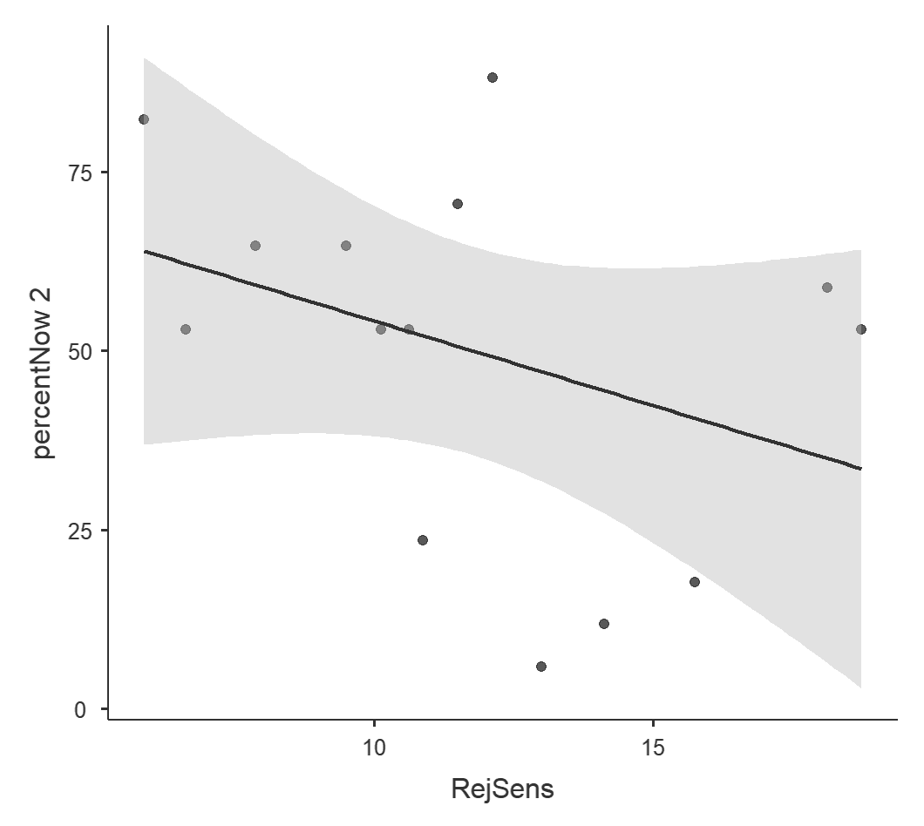
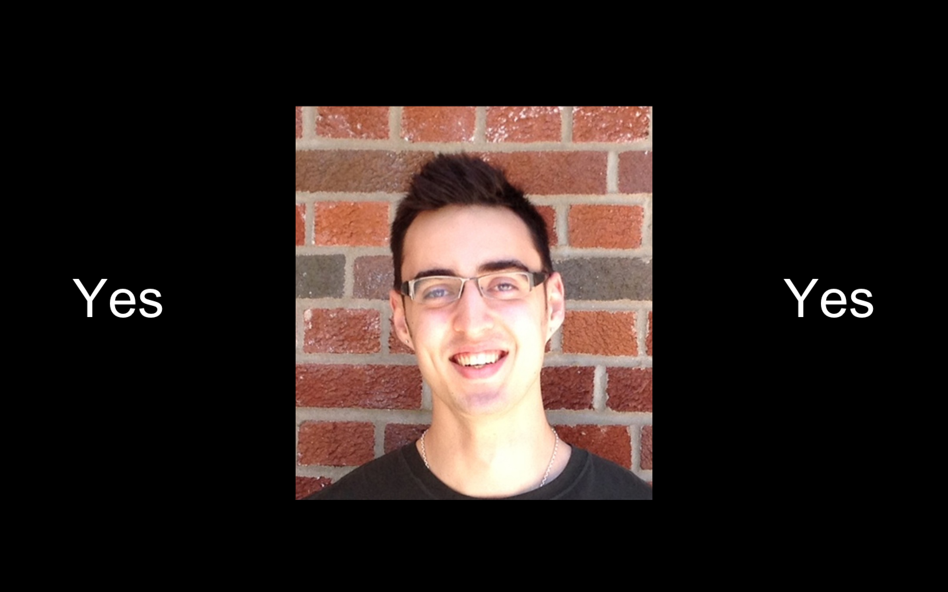
Effects of Social Rejection on Intertemporal Choice
Elizabeth L. Plaut & Dominic S. Fareri
Gordon F. Derner School of Psychology, Adelphi University
Introduction
Goals & Hypothesis
Results
People often make decisions by considering the various payoffs (i.e., reward value) associated with different choice options. One factor that is often important in our choices is time.
In general, when making intertemporal choices, people tend to exhibit a preference for smaller, immediately available rewards, compared to rewards that may be larger, but available in the future. This is a phenomenon known as delay discounting.
Importantly, intertemporal choices are context dependent: such choices could be influenced by experience of negative mood¹ or stress^{2.} These findings have implications for substance abuse, as those with substance use disorders (SUD) exhibit altered delay discounting processes (i.e., increased preference for immediate vs. delayed rewards), which may be related to altered function of neural reward systems ^{3, 4} .
Interestingly, previous research demonstrates that social isolation and exclusion is a risk factor for the onset of SUD^{5,6}. However, the link between the experience of social rejection and an individual’s tendency to discount delayed rewards in favor of smaller immediate rewards remains under-investigated.
The implications of the current study could lead to a better understanding of risk and reward seeking behavior which is seen in individuals who suffer from SUD’s.
Hypothesis: We hypothesize that an individual’s experience of social rejection will be associated with an increased discounting of delayed rewards, resulting in a preferred choice of immediate rewards.
On average, participants rated being accepted more positively (M = 2.2857, SD = 1.8985) than being disliked (M = -1.14286, SD=1.9945) (paired samples t-test: t₍₁₃₎ = 5.551, p=.001, d = 1.48)
On average, participants demonstrated no differences in delay discounting before (M=51.6807, SD=22.7447) and after (M=50, SD=25.77) the rejection induction (paired samples t-test: t₍₁₃₎ = 0.653, p=0.525, d = 0.17)
A Pearson’s correlation between participants’ choice of immediate reward post rejection and their general sensitivity to rejection revealed a negative association: greater sensitivity to rejection was associated with lower proportions of choices for immediate rewards.
Methods: Design
75
Participants
N = 14 (11 F, 3 M), Ages 18-30, Mean Age = 21.5
Experiment Structure
Day 1:
Self-report questionnaires of sociality, self-esteem, rejection sensitivity and social support.
Intertemporal Choice Task⁷
Photo of participant taken; told that others at different study sites will be rating them on likeability based on their photo^{8.}
Day 2:
Rejection Induction Task
Intertemporal Choice Task
50
r = -0.359
p = 0.208
Percent Immediate Chosen (Post Rejection)
25
0
10
15
Rejection Sensitivity
Discussion
Our results show that individuals are sensitive to social rejection, yet this did not seem to influence their tendency to discount future rewards as hypothesized.
On average participants rated being liked more positively than being disliked showing that individuals are more sensitive to being socially accepted than to being rejected.
Individuals with increased rejection sensitivity are more susceptible to preferring the immediate rather than the delayed reward after experiencing rejection, suggesting greater sensitivity to considering future outcomes.
Future work probing the relationship between negative social experiences and decision-making can focus on more salient manipulations and increased sample sizes.
Intertemporal Choice Task
Participants completed an adapted version of an intertemporal choice task⁷ in which they indicated there preference for an immediate or a delayed monetary reward.
17 choices
immediate reward range ($11-$32)
delayed reward range ($25-$35)
Delay range (3-171 days)
Rejection Induction Task
Participants are told they will be shown photos of the participants who rated them and are expected to predict whether they were liked or not, prior to seeing actual feedback^{8.}
Participants saw images of 80 distinct individuals.
Task was to first indicate whether they thought a target individual liked them or not, and then were presented with feedback indicating the person’s purported actual response.
Participants received negative feedback on approximately 60% of trials
References
Lerner et al., Psychological Science (2013)
2. Pennebaker, Unintended Thought (1989)
3. Kalivas & Volkow, American Journal of Psychiatry (2005)
4. Volkow et al., Nature (1997)
5. Heilig et al., Nature Reviews Neuroscience (2016)
6. Sinha, et al., Psychopharmacology (2011)
7. Yu et al., Psychiatry Research (2017)
8. Somerville et al., Nature Neuroscience (2006)
This work was supported by an Adelphi University
Faculty Development Grant (7-7225) to DF

