Slide 1
+

Slide 2


Slide 3
+

Slide 4
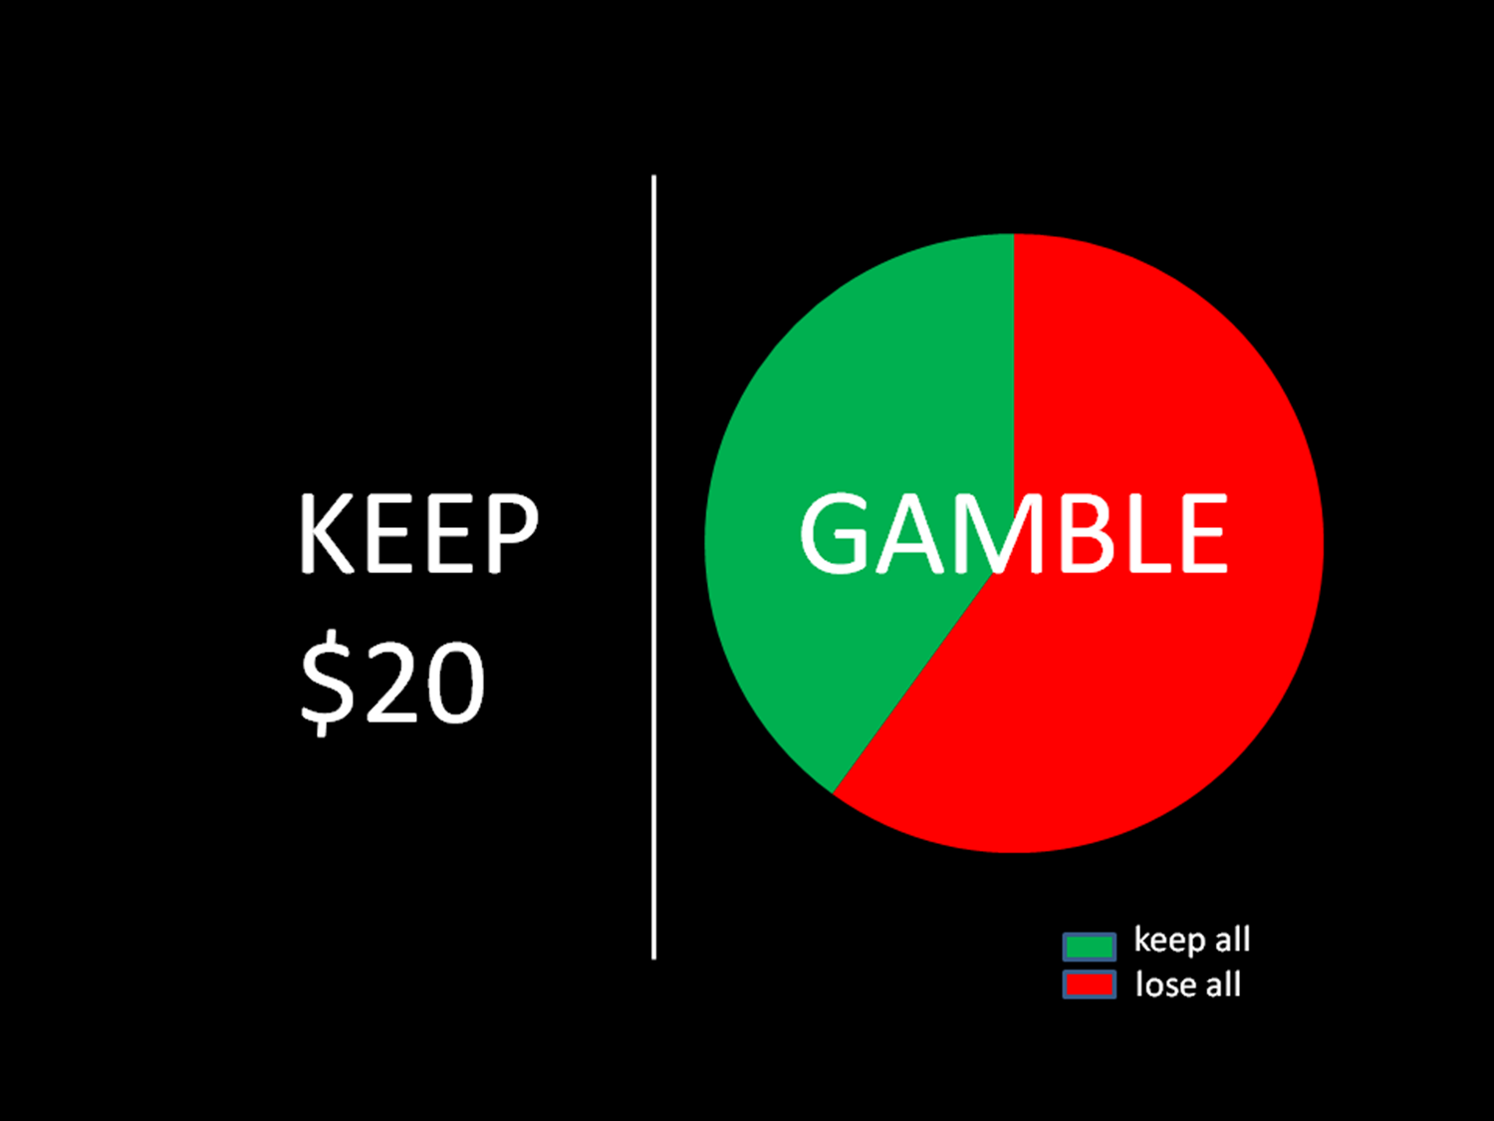

Slide 5
Would you like to hear advice from your financial advisor?
1=Y 2=N

Slide 7


Slide 8
+

