Slide 1
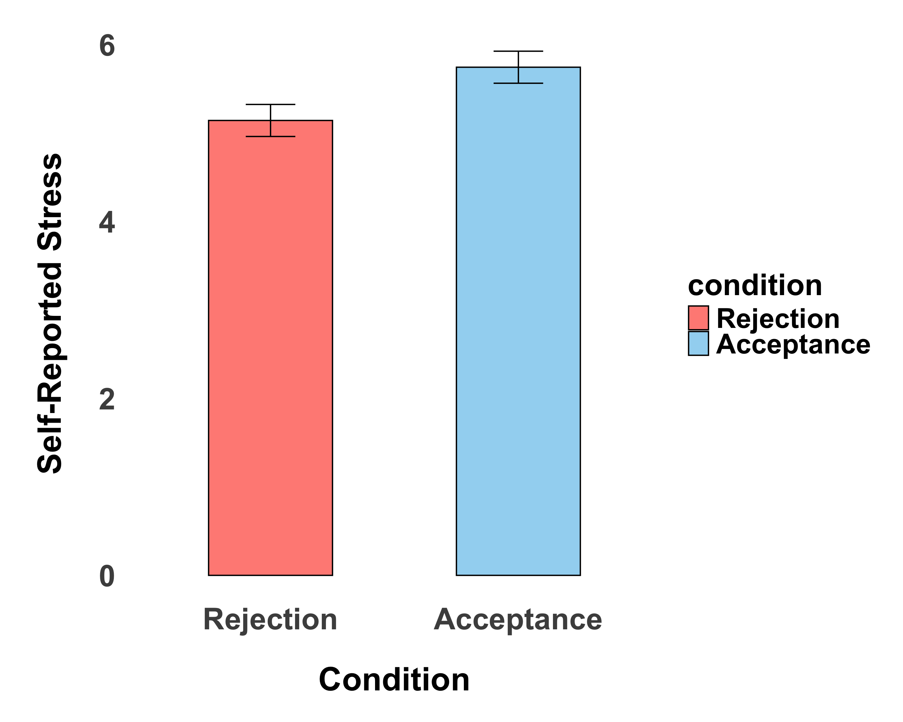
Less Stress
Self-Reported Stress
More Stress

Slide 2
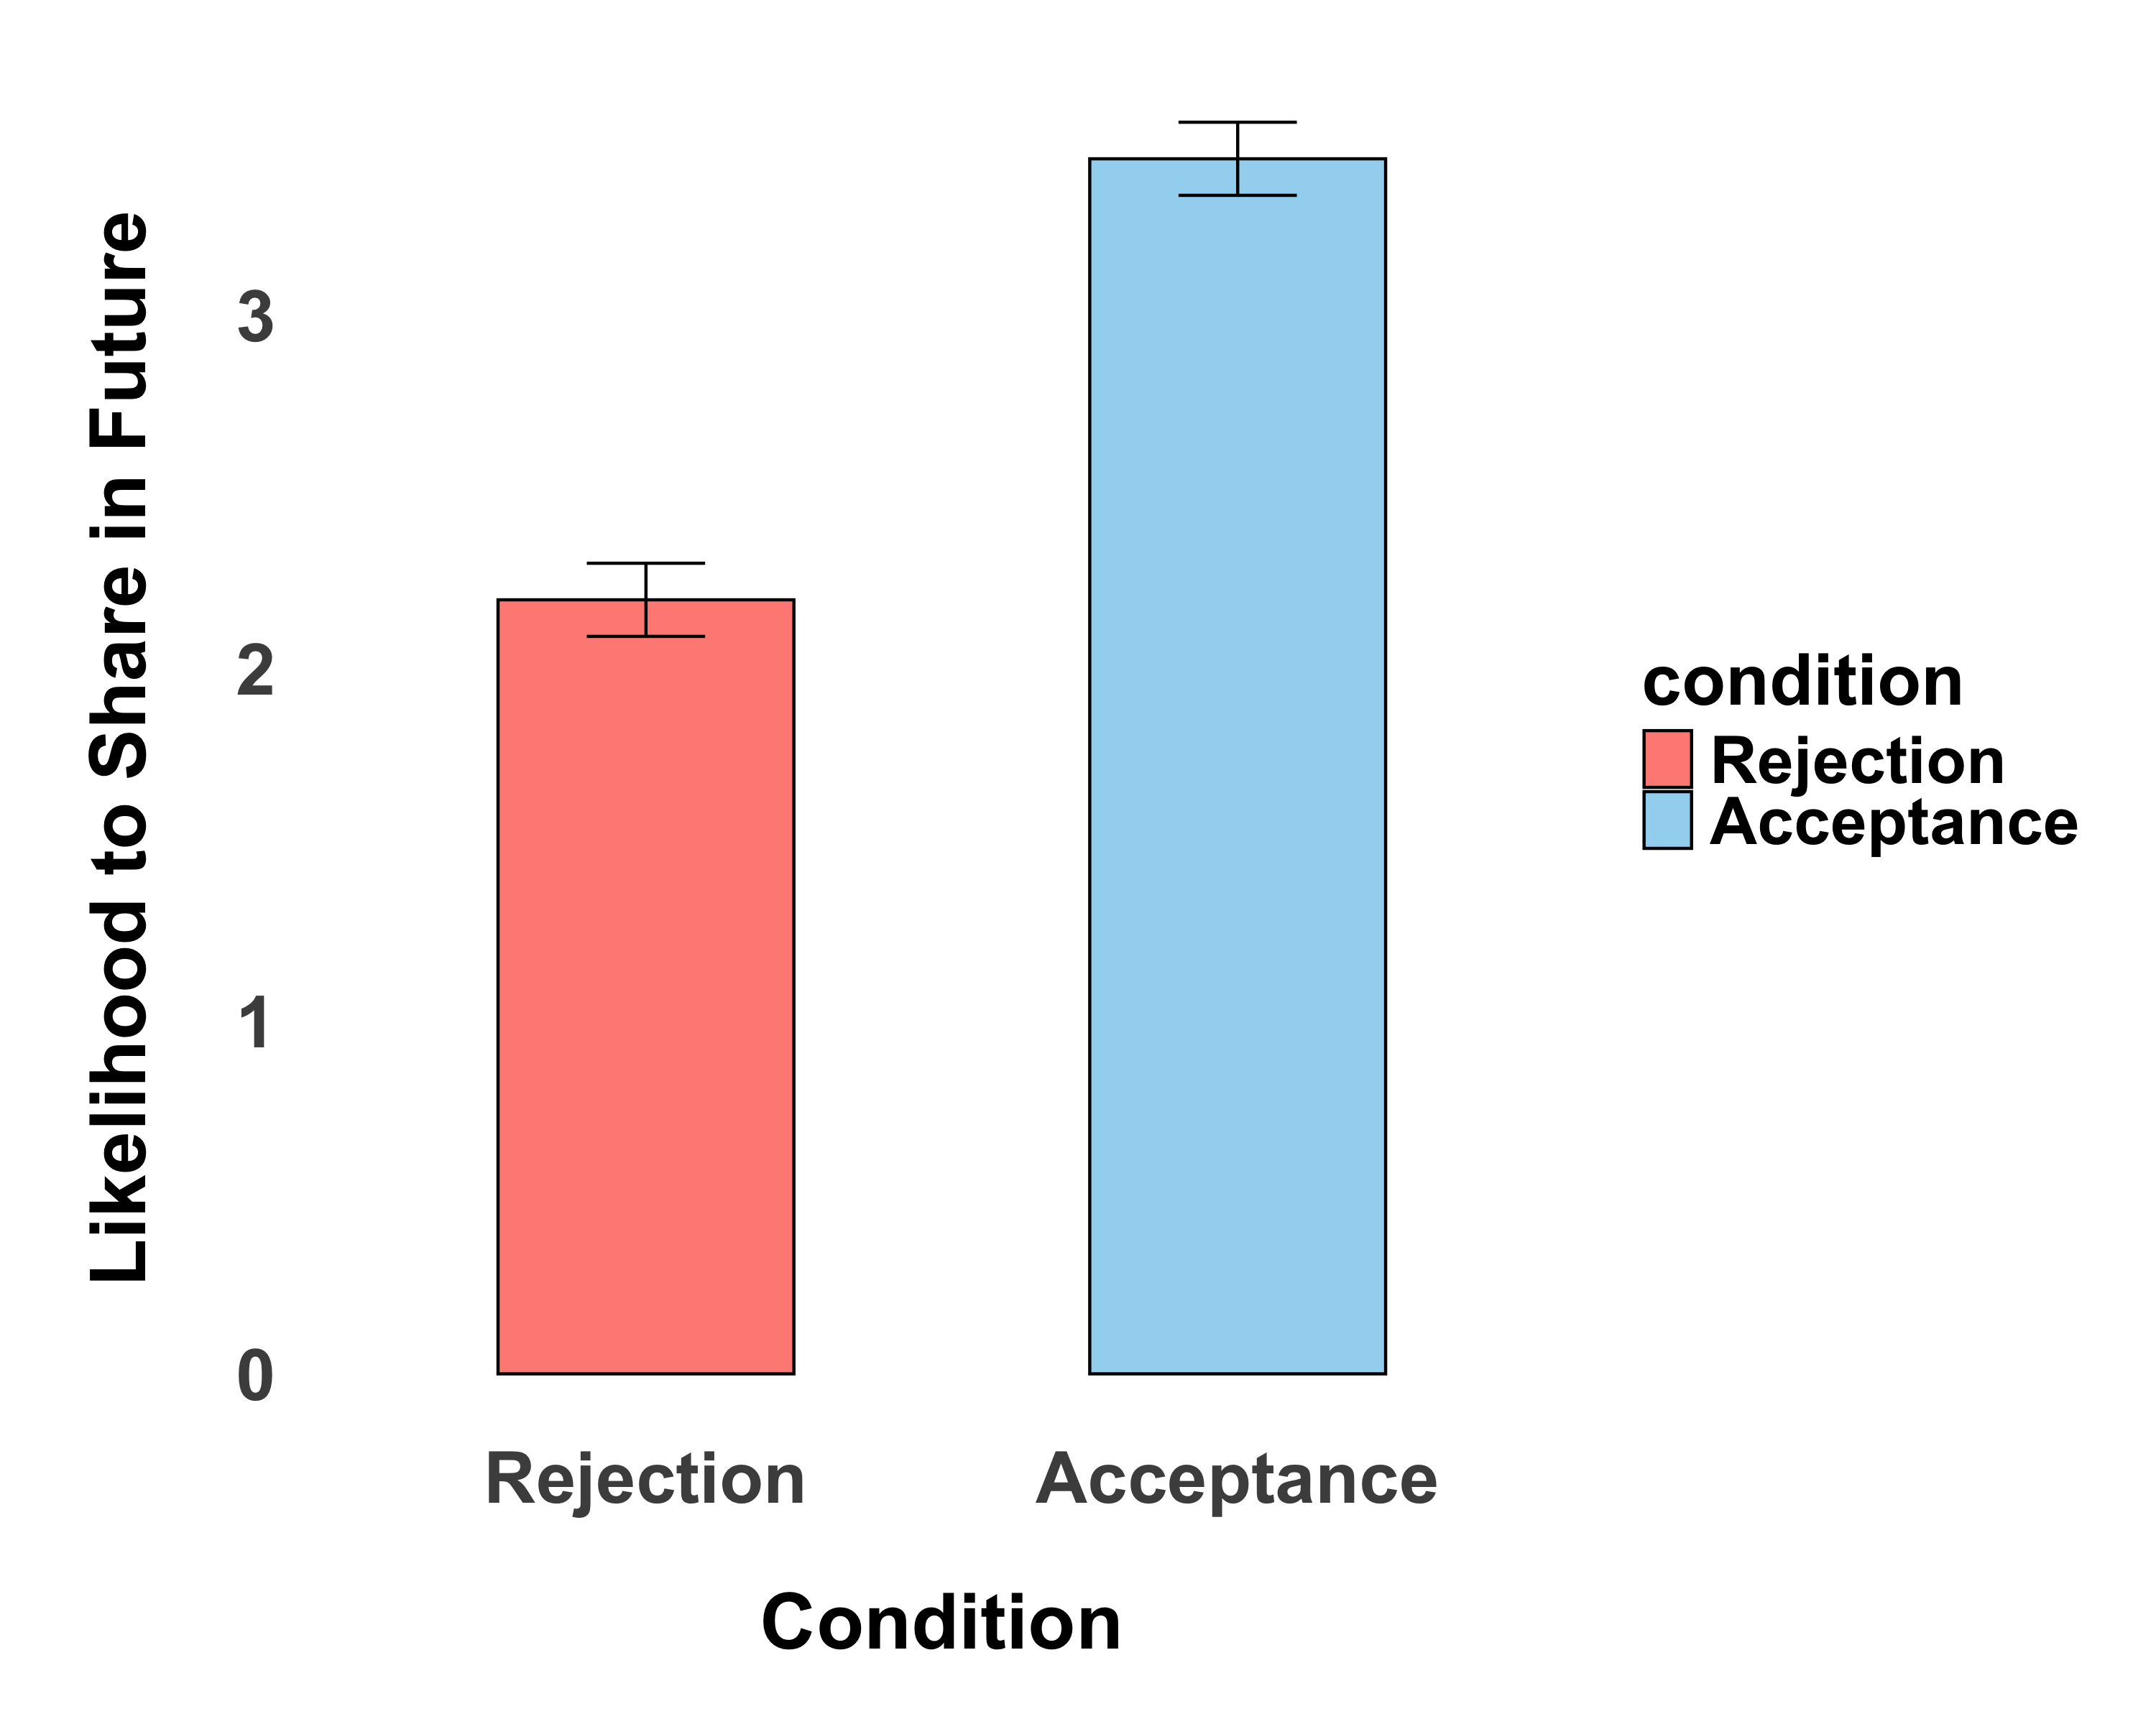

Slide 3
