Slide 1
SS
StudyStrike
Compete. Excel. Succeed.
What if studying felt like a game
you couldn't afford to lose?
Verified focus. Real grade rewards. A productivity platform UAE students actually stick with.
Mohamed Fares
Product & Vision
Ayman Hanoun
Front-end & UX
Faisal Ahmed
Market Research
Ahmed Nabil
Backend & Data
Omar Mahmoud
Customer Development
Mohamed Ali
Business Model
FWS310 — Fundamentals of Innovation & Entrepreneurship | Spring 2025–2026 | Instructor: Abdelrahman El Adly

Slide 2
THE PROBLEM
Students don't lack intent — they lack a system
that turns knowing into doing
73%
5+ hrs
2 in 3
$1.4B
lost weekly to poor prioritisation & procrastination
say their tools don't fit their real-life schedule
global edtech-productivity market, growing 9.1%/yr
of students miss at least one deadline every semester
Four root causes we kept hearing
Procrastination
Emotional barriers
Broken tools
One size fits none
Students delay starting even when the deadline is known.
Anxiety & guilt block action — not a lack of knowledge.
Planners need constant manual upkeep, so they get abandoned.
Commuters, workers, ESL learners — generic tools fail them all.
Sources: UAE student time-management survey (n=120, 2025); Statista EdTech productivity market, 2023.

Slide 3
WHY CURRENT TOOLS FAIL
Plenty of tools exist — none convert academic intent into action
Existing solution
Its drawback
Who it fails
Planner & list apps (Todoist, Notion)
High manual upkeep — abandoned within days
Busy commuters & working students
Focus apps (Forest, Pomodoro timers)
Track time, but no link to grades or deadlines
Students who need real stakes
LMS portals (Blackboard, MyADU)
Show deadlines, offer zero motivation or guidance
Chronic procrastinators
Gamified habit apps (Habitica, Duolingo)
Fun, but disconnected from real academic work
Course-focused students
Reminder / notification apps
Notify — but never prompt the next action
Anxiety-driven avoiders
Every competitor fails on one of three fronts: maintenance, stakes, or motivation. StudyStrike fixes all three.

Slide 4
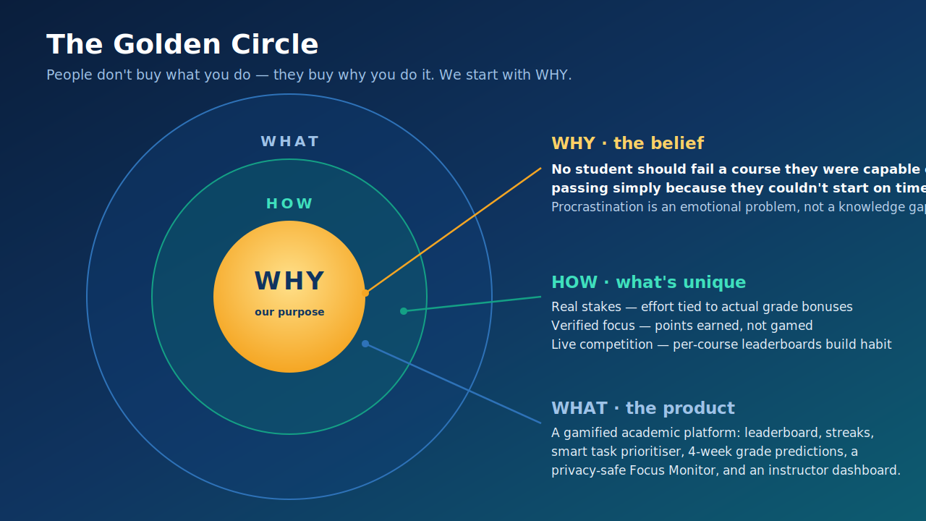
OUR WHY
We start with why students don't act

Slide 5
OUR MVP
A working web platform — built, running, and pilot-tested
What's in the MVP
StudyStrike is a functional web app today —
not a mock-up. Students log in, study under verified focus, earn points, and climb a live per-course leaderboard.
🔒
Verified Focus Monitor — webcam + screen presence confirm real focus
🏆
Grade-linked Leaderboard — live weekly rankings, up to +2% grade bonus
📋
Smart Task Prioritiser — auto-sorted by urgency, with progress bars
🧑‍🏫
Instructor Dashboard — progress, focus %, and at-risk flags
✓ Validated with a 5-student, 1-week pilot
Intentionally out of scope (next phases):
native mobile app · full LMS API · AI task-duration model

Slide 6
USER JOURNEY
From sign-up to habit in six steps
1
Register & link LMS
2
Tasks auto-imported
3
Verified study session
→
→
Connect Blackboard / MyADU
Deadlines pulled in & prioritised
Focus Monitor on · points per minute
4
Points & streak update
5
Review predictions
6
Earn grade bonus
→
→
Streak +1 · leaderboard refreshes
4-week projected rank & grade
Top finish → instructor applies bonus
Step 3 is the magic moment — verified focus is what makes every point trustworthy.

Slide 7
CORE FEATURES
Built around one moat: verified effort that earns real rewards
MOAT
MOAT
MOAT
🔒 Verified Focus Monitor
🏆 Grade-linked Leaderboard
🔥 Streak System
Webcam + screen presence confirm real focus — points are earned, not gamed.
Live weekly rankings per course. Top performers earn up to +2% on their grade.
A daily study streak builds momentum and habit through visual consistency.
📋 Smart Task Prioritiser
📈 Predictions & Stats
🧑‍🏫 Instructor Dashboard
Auto-sorted task list with urgency labels, progress bars and time estimates.
Grade and rank projection over the next four weeks to keep students ahead.
Teachers see progress, focus % and at-risk students — and apply the bonuses.

Slide 8
PROTOTYPE — LIVE BUILD
This isn't a mock-up. The product runs today.
Focus Dashboard — home view
Leaderboard — weekly rankings
🥇
Alex Chen
🔥 28d
4,520
+2.0%
🔥 19
⭐ 3,850
🥈
Jordan Smith
🔥 24d
4,180
+1.5%
day streak
total points
Current semester rewards
🥉
You (You)
🔥 19d
3,850
+1.0%
1st
2nd
3rd
Top 10
#4
Morgan Lee
🔥 15d
3,620
+0.5%
+2%
+1.5%
+1%
+0.5%
grade
grade
grade
grade
#5
Casey Brown
🔥 12d
3,210
+0.5%
Live demo available: the verified Focus Monitor flips green → red the moment a student looks away or opens off-task content.

Slide 9
PROTOTYPE — ANALYTICS & TASKS
Predictions keep students ahead; the task view tells them what to do next
Predictions & stats
Task progress — prioritised
3,850
19d
Advanced Calculus – Problem Set 5
Due soon
Total Points
Streak
MATH 401 · 85% · Today 11:59 PM · 100 pts
110%
92%
Weekly Goal
On-Time
Organic Chemistry Midterm
Urgent
CHEM 301 · 30% · Tomorrow 2 PM · 250 pts
Predicted performance (next 4 weeks)
W1
W2
W3
W4
Physics Pop Quiz
Upcoming
~550
~605
~680
~745
PHYS 200 · 0% · In 2 days · 50 pts
3rd
3rd
2nd
1st

Slide 10
VALUE PROPOSITION
We connect every pain to a feature — and a feeling
Student pain (their words)
StudyStrike feature
The benefit they feel
“I know the deadline, I just don't start.”
Smart prioritiser + daily start-points
Anxiety becomes one obvious next action
“Planners are work on top of work.”
LMS auto-import
Zero maintenance — deadlines just appear
“Nothing makes studying feel worth it.”
Grade-linked leaderboard & streaks
Effort becomes a grade investment
“I get distracted / cheat my own timer.”
Verified Focus Monitor
Points you — and your instructor — can trust
The only student tool where verified daily effort converts into real grade bonuses — a trust loop no leaderboard can fake.

Slide 11
VALIDATION
Our 5-student pilot proved the hook — and showed us what to build next
5 students · 1 week · Google Form + WhatsApp leaderboard simulation
5/5
3/5
1
2/5
found tasks easier to complete vs. the prior week
named leaderboard competition as their main motivator
did extra revision purely to protect a streak
used prioritisation to choose what to tackle first
Every issue raised, we've since acted on
Issue raised
Proposed / built fix
Manual Google-Form entry was clunky
Native in-app task logging + LMS auto-sync
No way to stop point-cheating
✓ BUILT: verified Focus Monitor (webcam + screen)
Streak lost if internet dropped
Offline mode + streak-freeze (roadmap)

Slide 12
MARKET OPPORTUNITY
A growing market, a focused beachhead
TAM
$1.4B
Global edtech-productivity market (2023) → $2.7B by 2031 @ 9.1% CAGR
SAM
$85M
UAE + GCC higher-ed productivity tools (2025 estimate)
SOM
$4–8M
5–10% UAE share targeted within 3 years of launch
Revenue model: Free tier · Premium AED 29/mo · Institutional licence AED 15/student/yr

Slide 13
CUSTOMER DEVELOPMENT
We didn't guess — we interviewed, then built what they asked for
Ahmed, 20
Sara, 22
Bilal, 21
2nd-yr Engineering · part-time tutor
3rd-yr Business · group-project lead
2nd-yr IT · international (ESL)
NEED
NEED
NEED
Balance tutoring shifts with heavy lab reports.
Group deadlines scattered across WhatsApp & email.
Underestimates task time due to English reading load.
WILLING TO PAY
WILLING TO PAY
WILLING TO PAY
AED 25–35/mo
AED 20–30/mo
AED 30/mo
SUGGESTED → WE BUILT
SUGGESTED → WE BUILT
SUGGESTED → WE BUILT
Asked for a 'work-shift blocker' → added to roadmap. Joined beta.
Asked for 'group sprint mode' → added. Volunteered for beta.
Asked for a 'language difficulty multiplier' → in Predictions roadmap.

Slide 14
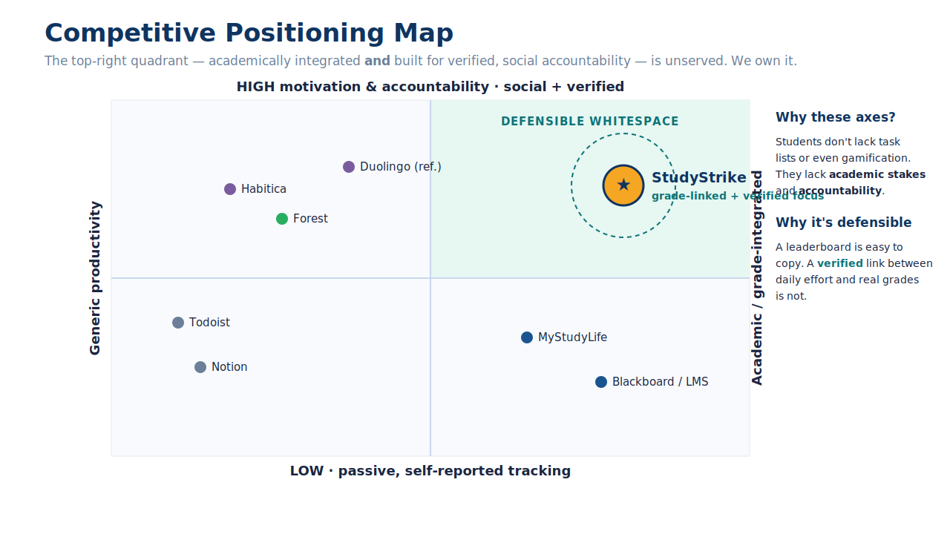
COMPETITIVE POSITIONING
We own the empty corner of the market
Positioning statement
For UAE students who struggle to meet deadlines, StudyStrike turns assignments into competitive, motivating challenges — unlike generic tools that ignore grades and schedules.
Why we win
A leaderboard can be copied. A verified link between daily effort and real grades cannot.

Slide 15
BUSINESS MODEL
How we create and capture value
Revenue streams
Who we serve
Free
Core tasks + streaks
AED 0
B2C — UAE university students
Freemium app; premium upgrade for power users
Premium
Predictions, focus mode, sync
AED 29 / mo
B2B — Universities
Institutional licence per enrolled student
Institutional
Full platform per university
AED 15 / student / yr
How we reach them
• University partnerships & pilots
• Web platform (self-serve sign-up)
• Social — TikTok / Instagram student communities
Unit economics: low marginal cost per user (cloud-hosted SaaS) → freemium funnel converts to premium & institutional revenue.

Slide 16
BUSINESS MODEL CANVAS
The full picture on one page
KEY PARTNERS
KEY ACTIVITIES
VALUE PROPOSITIONS
CUSTOMER RELATIONSHIPS
CUSTOMER SEGMENTS
• Universities (ADU etc.)
• LMS providers (Blackboard)
• Cloud / IT infrastructure
• Platform dev & maintenance
• LMS integration
• Student onboarding
• Verified effort → real grade bonuses
• One zero-maintenance deadline view
• Competition that builds study habit
• Self-serve app
• In-app support
• Community leaderboards
• UAE university students (B2C)
• Universities (B2B licensing)
• Procrastination-prone learners
KEY RESOURCES
CHANNELS
• Engineering team
• Verified-focus technology
• Student community & data
• University partnerships
• Web platform
• Social (TikTok / IG)
COST STRUCTURE
REVENUE STREAMS
• Development & hosting
• Marketing & user acquisition
• Customer support
• Premium subscription — AED 29/mo
• Institutional licence — AED 15/student/yr
• Free tier (top of funnel)

Slide 17
LEARN & ADAPT
We validated the core — and changed course where the evidence said so
✓ Validated assumptions
⟳ Adaptations made
• Gamification (streaks + leaderboard) lifts daily engagement
Manual Google-Form entry → LMS auto-import (Blackboard .ics)
• Grade-linked rewards beat generic badges by a wide margin
No anti-cheat mechanism → Verified Focus Monitor — now built
• A single consolidated task view reduces missed deadlines
Web-only prototype → Mobile-first redesign next sprint
• Direct interviews surfaced features we'd never have designed
Individual-only tasks → Group sprint / team-challenge mode

Slide 18
ROADMAP
Shipped the MVP — here's how we scale
◀ YOU ARE HERE
Phase 1 — NOW
Phase 2 — Short term
Phase 3 — Medium term
Q3 2026
Q4 2026
Q1–Q2 2027
• Functional web MVP (built ✓)
• Full Blackboard API integration
• AI adaptive task-duration model
• Verified Focus Monitor (built ✓)
• Native mobile app (iOS + Android)
• Group sprints / team challenges
• Blackboard .ics import
• Streak-freeze feature
• University B2B licensing
• Pomodoro focus timer
• Instructor approval dashboard
• Instructor analytics dashboard

Slide 19
SS
Every deadline met is a student who proved they could.
We just give them the reason to start.
Thank you · Questions & Answers welcome
6
4
5
100%
Interviews
Key Insights
Pilot Users
Positive Feedback
StudyStrike — Compete. Excel. Succeed. | FWS310, Spring 2025–2026 | Instructor: Abdelrahman El Adly

