Slide 1


National Engineering School of Tunis
University of Tunis El Manar
Civil Engineering Department
Presentation of the Synthesis Project
Année universitaire 2020-2021
Realized by :
Fares Frikha
Supervised by :
Mrs Emna Gargouri
Mr Khlifa Maalel
3 Year Civil Engineering 2

Slide 2
LAYOUT
Introduction
EPANET tutorial
EPASWMM tutorial
Sanitation project
Conclusion

Slide 3
INTRODUCTION

Slide 4
INTRODUCTION
As civil engineering students in the national engineering school of Tunis, we have the opportunity to do an hydraulic synthesis project that consist of three phases :
EPANET tutorial
EPASWMM tutorial
Study case of a sanitation project

Slide 5
EPANET tutorial

Slide 6
EPANET tutorial
EPANET is a software application used throughout the world to model water distribution systems.
Throw this tutorial, I have analyzed the hydraulic and water quality behavior of a piping network.

Slide 7
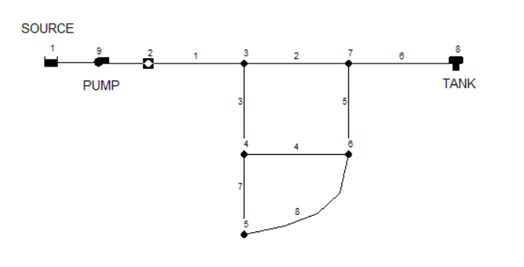
Construction of the network model

Slide 8
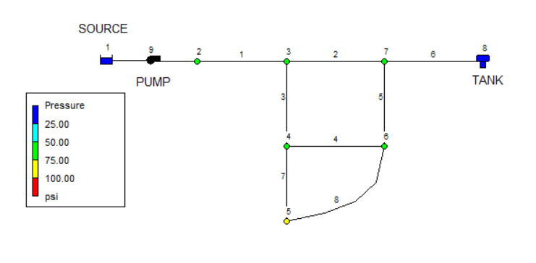
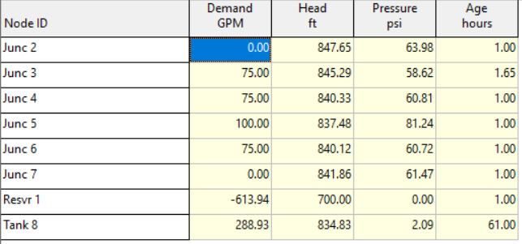
Running the program

Slide 9
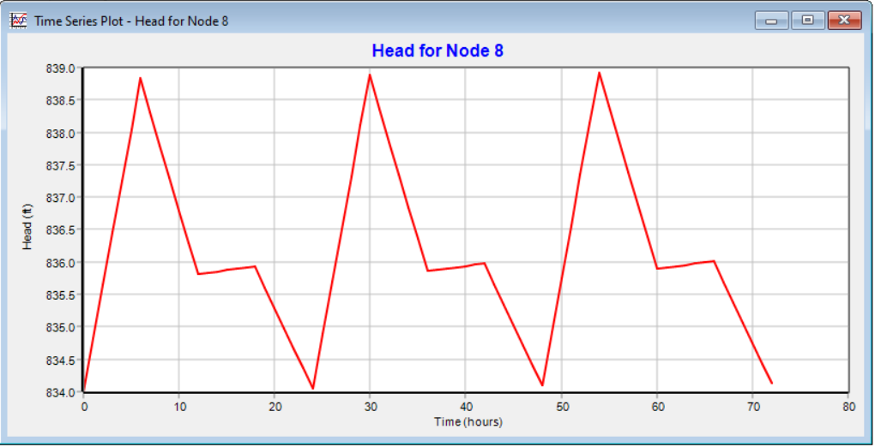
Running the program

Slide 10
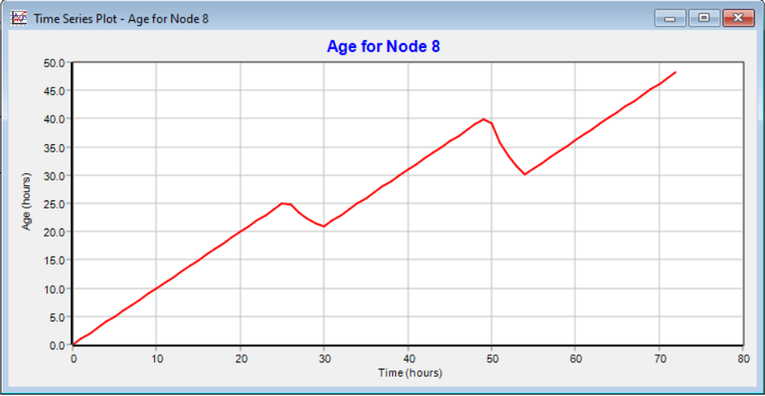
Running the program

Slide 11
EPASWMM tutorial

Slide 12
EPASWMM tutorial
EPANET is a software application used throughout the world for planning, analysis, and design related to stormwater runoff, combined and sanitary sewers, and other drainage systems.
Throw this tutorial, I have modeled the quantity and quality of stormwater runoff produced from urban areas.

Slide 13
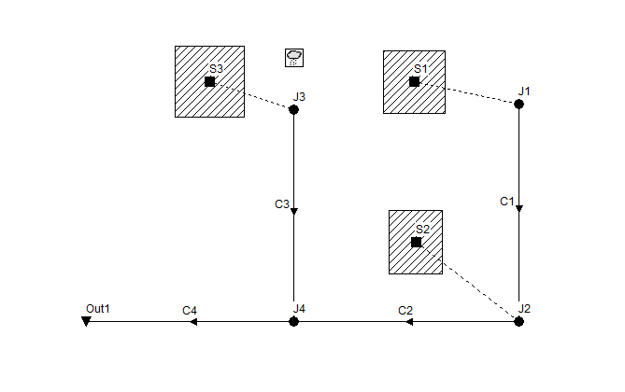
Construction of the SWMM model

Slide 14
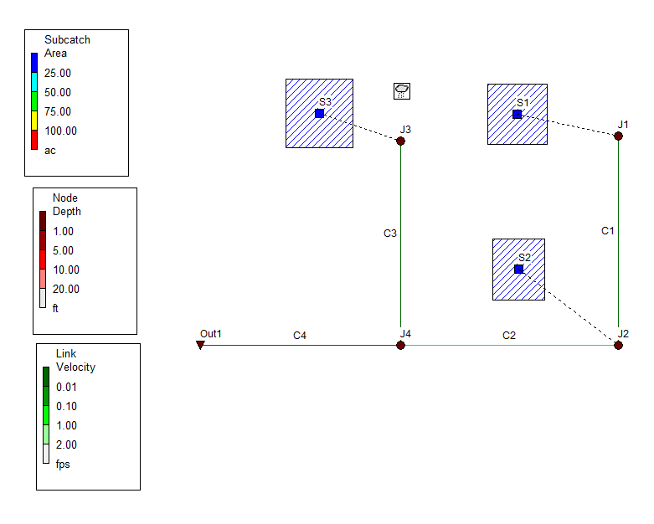
Running the program

Slide 15
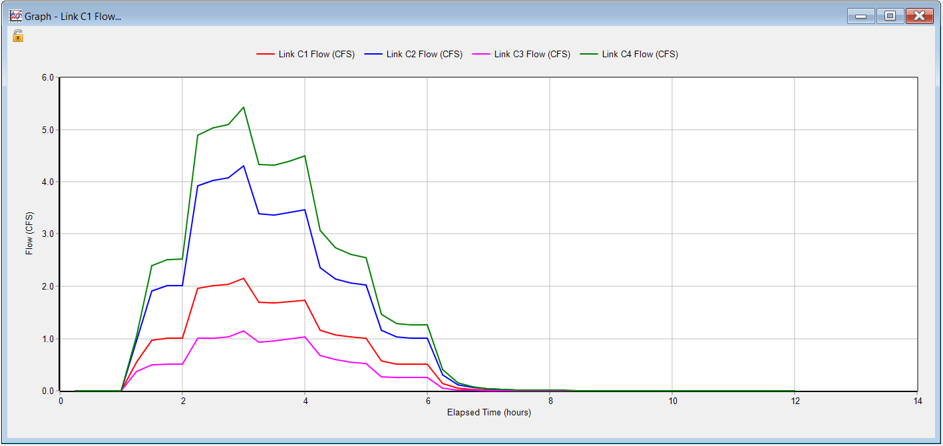
Running the program

Slide 16
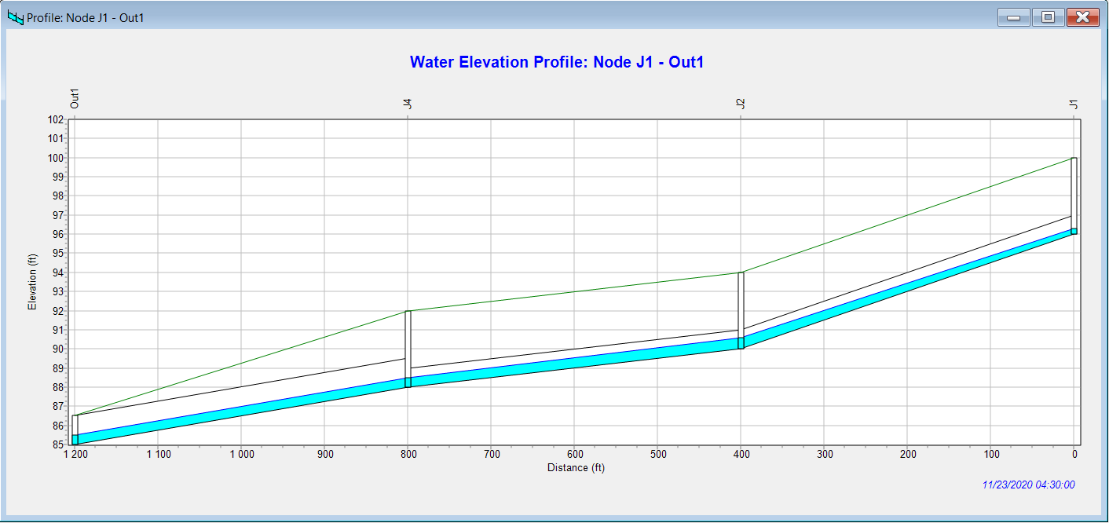
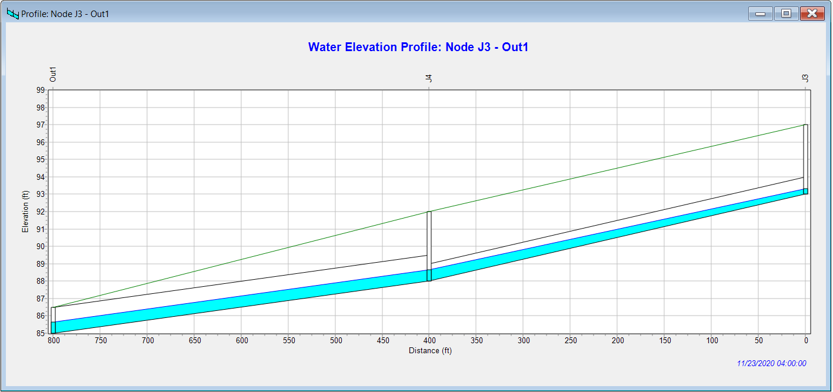

Slide 17
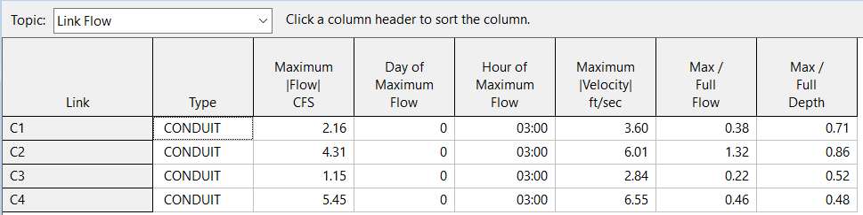
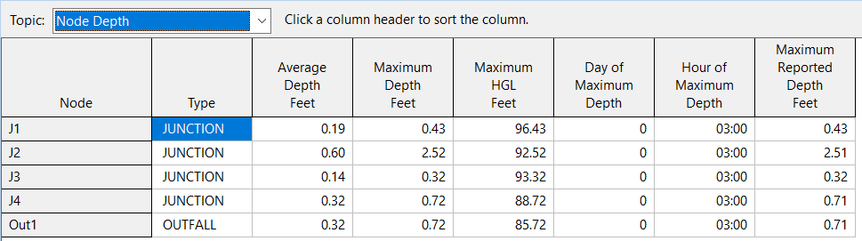
Running the program

Slide 18
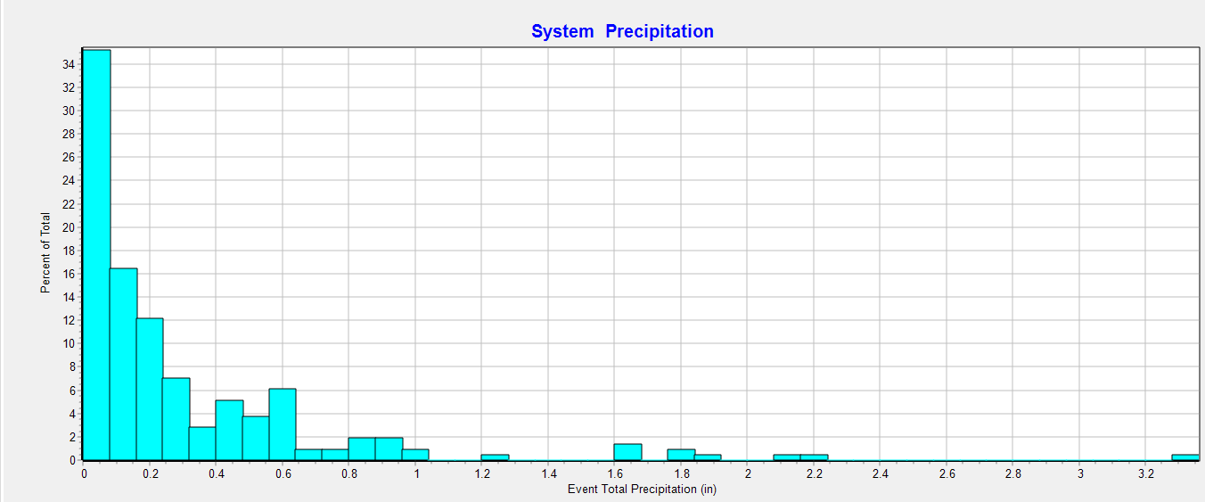
Running the example

Slide 19
Sanitation project

Slide 20
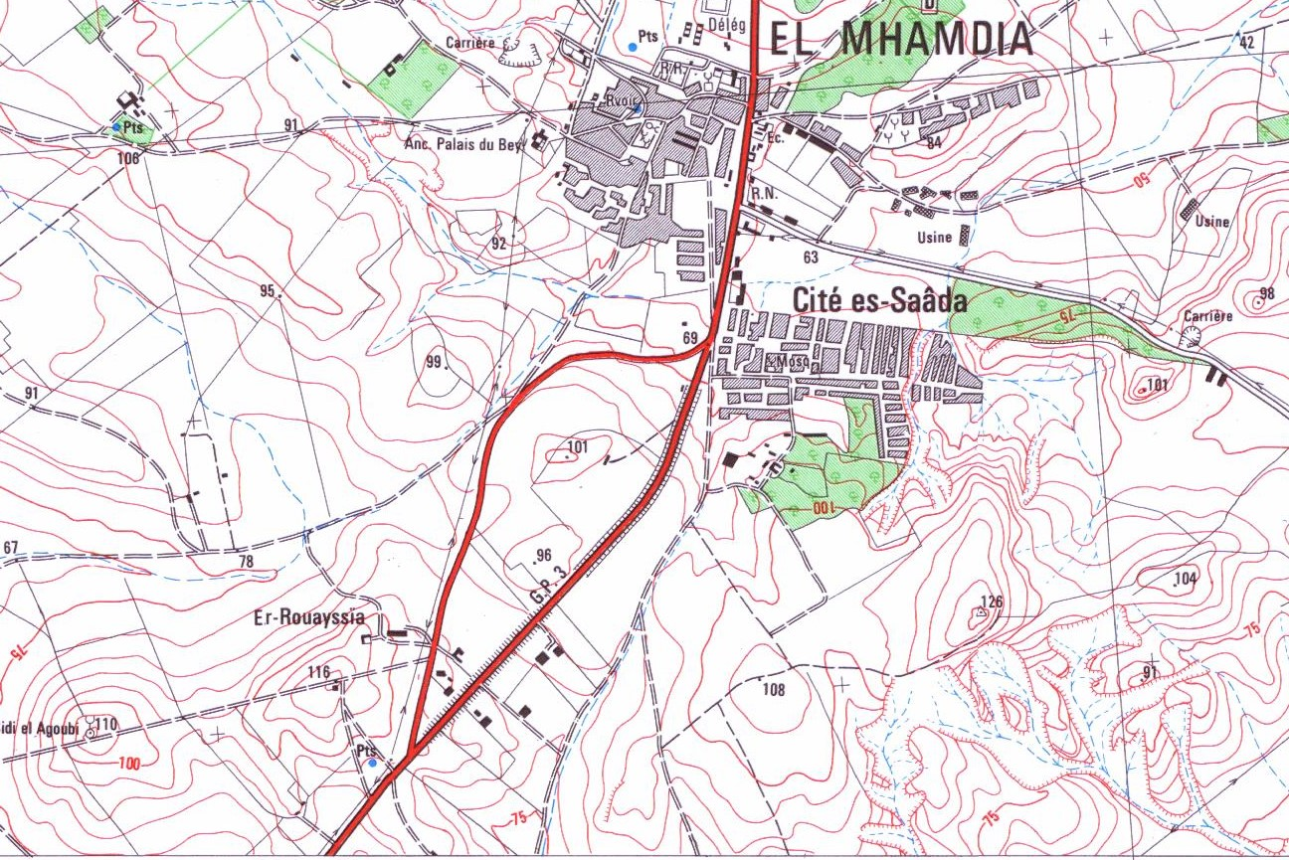
Project presentation
This study case is about the calculation of the sanitation network of an urban agglomeration in Mhammedia in Tunisia.
The objective of this project is to study the runoff system in this area and to attribute the stormwater drainage network in the site.
Software used : EPASWMM

Slide 21
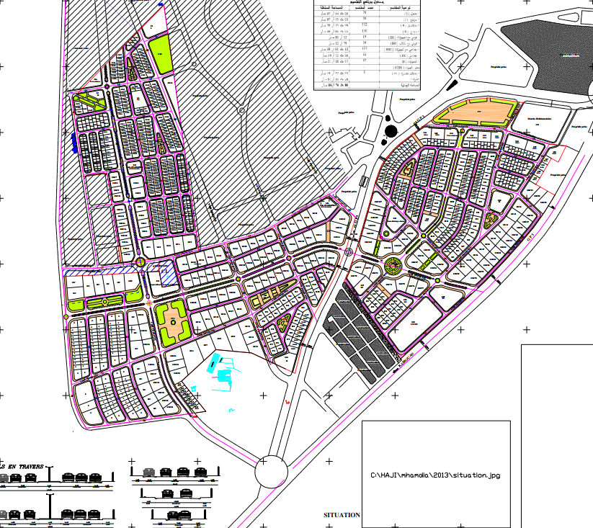
The following figure represent the subdivision plan of the studied area.

Slide 22
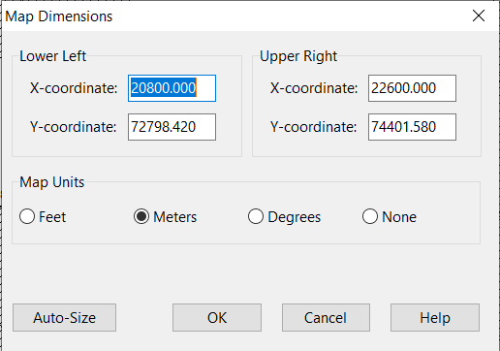
Georeferencing
The first step is to fix our dimensions in the software.

Slide 23
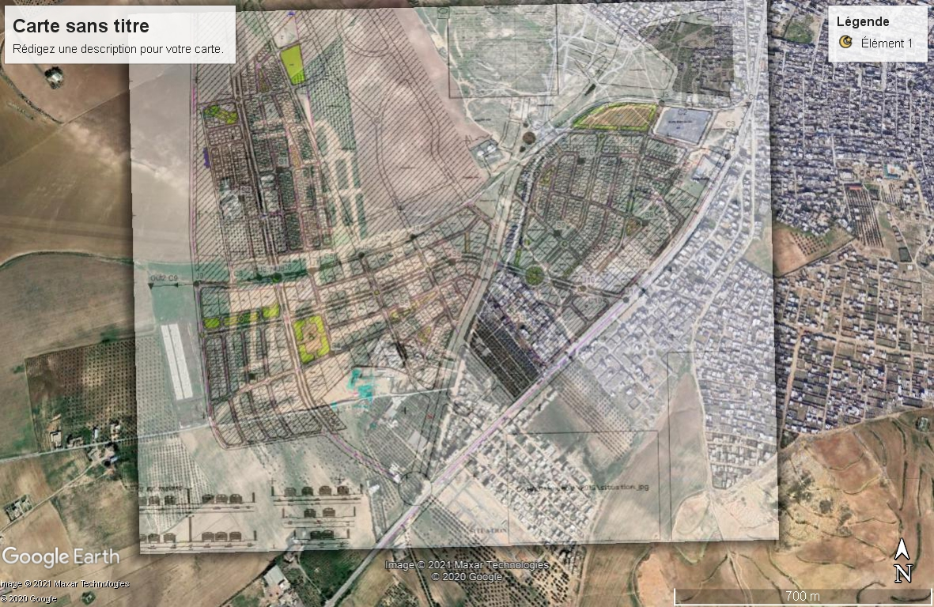
Outfalls and flow directions
Identifying the gravitational flow.
Positioning the outfalls places.

Slide 24
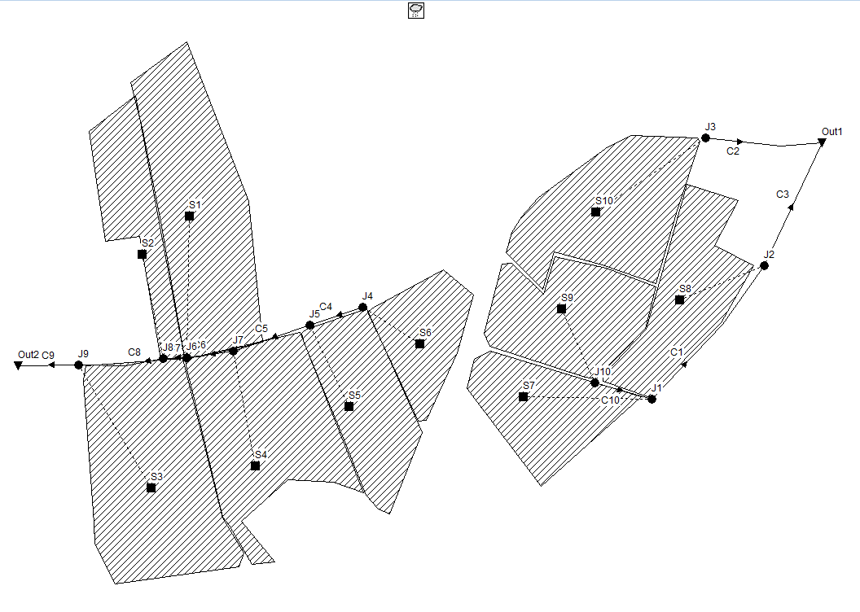
Designing the network
10 Subcatchments
10 Junctions
10 Links
2 Outfalls

Slide 25
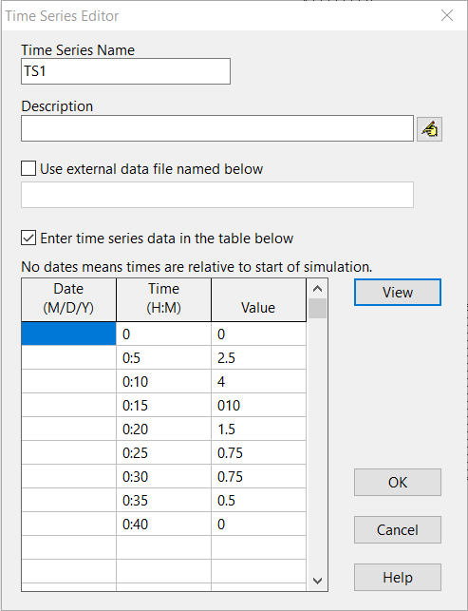
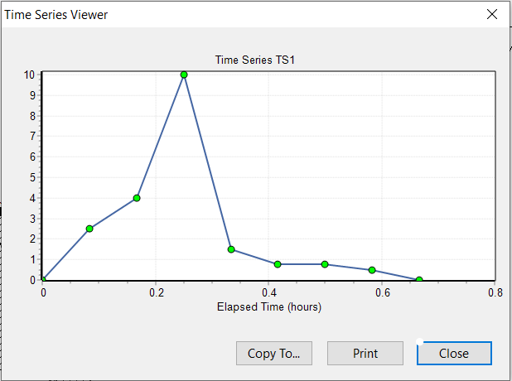
Time series for the rain gage

Slide 26
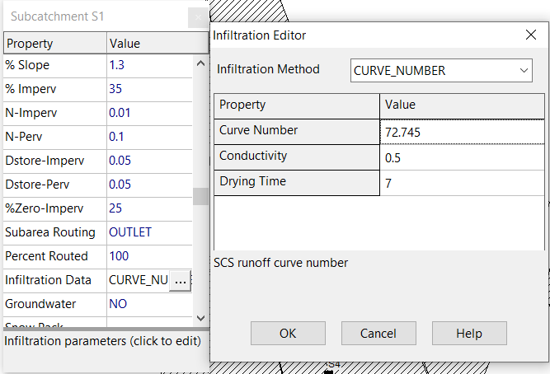
Calculation of the curve number
Calculate the curve number to each subcatchment using the surface of each type of subdivision containing in every subcatchment.

Slide 27
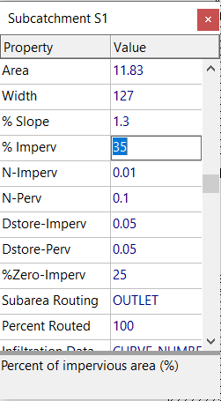
Calculation of the impervious surface
The impervious surface percentage is calculated by dividing the surface of roads by the total surface =35%

Slide 28
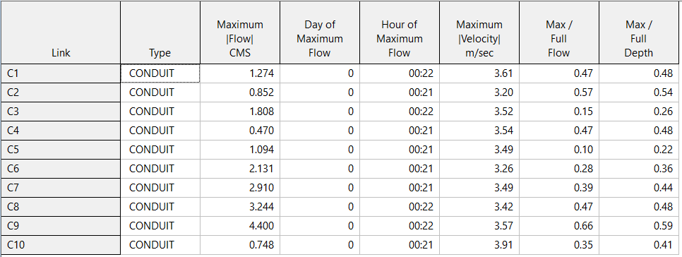
Running the program
After successfully running the program, we have to check the velocity condition:
0.3 m/s < Velocity < 4m/s

Slide 29
Conclusion

Slide 30
Conclusion
During this module, I had the opportunity to use some software like “EPANET” et “EPASWMM”.
I had the chance to manipulate these software in order to study a real sanitation project in Tunisia.

Slide 31
Thank you for your attention

