Slide 1


Urbistic Project Local materials
Amira Chouikh,Syrine Romdhane,Fares Frikha 3AGC
supervised by M.Neji JAMEL
2020-2021

Slide 2
Plan
2
1 Introducing local materials
2 Proving the efficiency of its use
3 Approximate Cost
4 Analysis
5 Conclusion and recommendation

Slide 3
Introducing local materials
3
video

Slide 4

Proving the efficiency of its use
1. Cases
2. INFORMATIONS ABOUT THE STUDIED CASE
3. Resistance and stability

Slide 5

Cases
4
Masonry carrying geo-concrete
sol2
Vaulted roof
Mixed masonry
sol5
Resistance
stability
Masonry carrying geo-concrete
sol3
Wood frame roof
Masonry in classic agglos
COST
sol1
Mixed masonry
sol4

Slide 6
INFORMATIONS ABOUT THE STUDIED CASE
5
1
Project made by SNHLM in Sénégal
DTU(6) for the Geo-concrete and mixed masonry
2
Calculation rules
BAEL for dimensionning the frame that contains iron steel
Calculation of the needed quantity of materials
Structural analysis
Determination of the structure’s dimensions
Cost estimation

Slide 7
Resistance and stability
6
Lateral compression (4)(3): σ = 0.53MPa,C=9.43
Resistance and stability
Shear stress(4)(3) : σ = 0.26MPa,C=2.53²
Geo-concrete structure
Longitudinal compression(4)(3) : σ = 0.13,C=38
Shape that allows the elements to selflock
Both structures are dimensionned in the ELS case to hold the calculated loads and to perform a similar stability and resistance to armed concrete.
Wood and containing steel structures
σ : load stress of 12cm(4) thickness ; C : stability factor in longitudianl,lateral compression = 5/ σ (5 : bricks average resistance(5)) while for shear stress = shear strength in mortar/σ

Slide 8

Approximate Cost
Cost
Project cost in FCFA

Slide 9
Cost(3)
7
Construction methods | Possible economy
 | in%
Vaulted roof on masonry carrying geo-concrete | 34,67
Vaulted roof on mixed masonry | 16,82
Wood frame roof on masonry carrying geo-concrete | 8,86
Vaulted roof on mixed masonry | 29,63
Solution 1 : Wood frame on classic agglos maçonnerie is the best construction method
Generally required in tender documents and for
consumers.

Slide 10
Project cost in FCFA(2)
8
materials | quantity | prix unitaire FCFA | Prix total FGFA
cement (sac de 50 kg) | 180 | 1760 | 316 800
sea sand (m^3) | 9 | 2125 | 19 125
laoteric sand (m^3) | 11 | 1440 | 15 840
large aggregate (m^3) | 9 | 11250 | 101 250
hollow bricks | 2346 | 130 | 304 980
solid bricks | 681 | 115 | 78 315
water (m^3) | 10 | 200 | 2 044
x bars of 10 | 106 | 1500 | 159 000
y bars of 8 | 68 | 1000 | 68 000
wood (m^3) | 2,239 | 120000 | 268 680
n Fiber cement | 126 | 2432 | 306 432
m false ceiling (m^2) | 77,20 | 750 | 57 900
nails (kg) | 20 | 600 | 12 000
wire (kg) | 4 | 700 | 2 800
 |  |  | 1 713 166
 |  | main d'œuvre | 0
 |  | total | 1 713 166
1m² of Slab made with :
Cement,sea sand,water hollow and solid bricks costs 20897,16 FCFA while a normal slab made purely with armed concrete can cost 59462,67 FCFA (2).

Slide 11

analysis
1. Satisfaction degree of the use of local materials
2. Identification of the risk factor
3. Implementation of the derogation

Slide 12



9

Slide 13
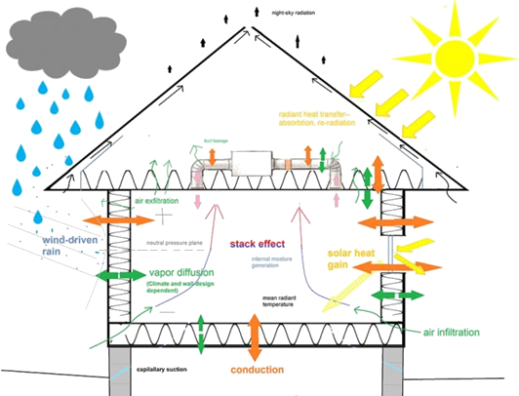



Satisfaction degree of the use of local materials
10
Resistance
Cost
Comfort

Slide 14



Identification of the risk factor
11
A research of the properties of a material composition. Requires :
a good knowledge of the characteristics of the product;
a laboratory study of the properties characterizing the composite material
a test site to observe the behavior of the composite material on site

Slide 15
Implementation of the derogation
12
The approach followed must make it possible to examine the consequences of the defectiveness the material or the behavior of the structure.
At the end of the process, it should be clearly formulated:
The production conditions and the associated quality approach to ensure the conformity of the materials to those studied;
The nature and extent of the derogation, with all other characteristics of the aggregate remaining in conformity with the specifications;
The possible field of use in the technique under consideration;
Possible adjustments to the composition of the mixture, production, compaction.

Slide 16

Conclusion and recommendation
13
- Types of local materials
- An economic study
The use of local materials reduces construction costs

Slide 17

Thank you for YOUR attention

Slide 18
Bibliography
14
1- Surfaces-Reporter “Local-Materials”. [on line]
2- 2-Laiterie Tahoua, [on line] https://www.enabel.be/sites/default/files/tenders/dqe_infrastructures_appui_dev_elevage_vf_1.pdf
3- AHISSOU, Joseph. utilisation des matériaux locaux dans la construction de
l'habitat économique. Sénegal : s.n., 1993.
4- Timber design manual Laminated Timber Institute of CANADA, Metric Edition.
5- Batirama,liste des DTU, [on line] https://www.batirama.com/article/1964-la-liste-
des-dtu-documents-techniques-unifies-a-jour.html

