Slide 1
MediLink RAG
Bilingual Medical Retrieval-Augmented Generation System
Midterm Presentation | March 2026
Hardware: Multi-GPU RTX A6000 (47 GB VRAM each)

Slide 2
01 Problem Statement
Arabic is underserved by most LLMs — no reliable, grounded medical Q&A exists
General-purpose LLMs hallucinate medical facts, especially in Arabic
Patients and doctors need trustworthy, source-cited answers
Challenge: English medical corpus + Arabic user queries = cross-lingual retrieval
Our Solution
A RAG pipeline that retrieves from an English medical textbook,
generates grounded answers in Arabic, and validates every response
through multi-layer safety checks before delivery.

Slide 3
02 End-to-End Pipeline
1
Emergency Detection
7
Hybrid Fusion
30+ AR/EN keywords → immediate escalation
Intent-aware weighted merge + agreement boost
2
Preprocessing
8
Reranking (optional)
Arabic normalization (alef, ya, diacritics)
BGE-Reranker-v2-M3 cross-encoder
3
Query Expansion
9
Context Building
Medical dictionary → English synonym variants
Score > 0.25, budget 1500 tokens, top 5-7 chunks
4
Query Translation
10
LLM Generation
Llama-3.1-8B (Groq) Arabic→English for BM25 path
Groq → Llama-3.1-8B, temp=0.2
5
Dense Retrieval
11
Safety Validation
BGE-M3 → FAISS top-20 per variant
Content filter + LLM Judge (grounding < 0.3 → reject)
6
BM25 Retrieval
English-translated query → BM25-Okapi top-20
Total latency: ~4-6 s (generation ~2 s + judge ~2-3 s)

Slide 4
03 Indexing Pipeline (Offline)
Step | Method | Detail
PDF Loading | PyPDF2 | Page-by-page text extraction
Preprocessing | Custom | Arabic normalization (alef, ya, ta-marbuta, diacritics)
Tokenization | Bilingual Tokenizer | ~50 Arabic stopwords, bilingual auto-detection
Chunking | Semantic | 200-word chunks, 40-word overlap
Embedding | BAAI/bge-m3 | 1024-dim, multilingual, L2-normalized, batch=64
Vector Store | FAISS IndexFlatIP | Cosine similarity via inner product
BM25 Index | BM25-Okapi | Separate AR/EN tokenizers
Result: 759 indexed chunks from Gale Encyclopedia of Medicine

Slide 5
04 Retrieval Pipeline
Component | Method | Key Detail
Query Expansion | Medical dictionary | ~100+ terms → 2-3 English variants
Query Translation | Groq LLM | Arabic→English for BM25 path
Dense Retrieval | BGE-M3 + FAISS | Multi-query embedding → top-20 per variant
BM25 Retrieval | BM25-Okapi | English-translated query → top-20
Hybrid Fusion | Intent-aware | Dense 0.8 / BM25 0.2 + agreement boost 1.2×
Reranking | BGE-Reranker-v2-M3 | Cross-encoder (disabled by default)
Dynamic Selection | Score + budget | Threshold > 0.25 → top 5-7 chunks, 1500 tokens
Reranker disabled: degraded Arabic Recall@1 to 0.004 in early experiments

Slide 6
05 Generation & Safety Pipeline
Generation
Multi-Layer Safety
Strict prompt: answer ONLY from retrieved context
Max 6 bullet points, role-adapted (patient vs. doctor)
Groq API → Llama-3.1-8B-Instant (temp=0.2)
Post-processing: line deduplication + sentence truncation
Emergency Detector
30+ AR/EN keywords → escalation
Content Filter
PII regex (SSN, credit card, phone, email)
LLM Judge
Grounding + hallucination + confidence scoring
Rejection Gate
Grounding < 0.3 → answer rejected
Confidence Calibration: Logistic Regression on 6 features (grounding, retrieval, rerank, context_len, answer_len, top_similarity). Fallback heuristic when < 40 samples.

Slide 7
06 Models & Technologies
Model | Role | Dim | Provider
BAAI/bge-m3 | Dense Embedding (AR+EN) | 1024 | HuggingFace (local GPU)
BAAI/bge-reranker-v2-m3 | Cross-encoder Reranking | — | HuggingFace (local GPU)
Llama-3.1-8B-Instant | Generation + Judge + Translation | — | Groq API (cloud)
Qwen2.5-32B-Instruct | Evaluation-only Generation | — | HuggingFace (local GPU)
Tech Stack
FAISS (IndexFlatIP) • BM25-Okapi (rank_bm25) • FastAPI + Uvicorn
PyPDF2 • Sentence Transformers • scikit-learn (calibration) • Matplotlib / Seaborn

Slide 8
07 Retrieval Evaluation (99 Queries, 4 Modes)
Mode | Recall@1 | Recall@5 | Recall@10 | MRR | nDCG@10 | Hit@10 | Zero-Recall
BM25 | 0.02 | 0.11 | 0.24 | 0.18 | 0.15 | 0.44 | 45
Dense | 0.06 | 0.21 | 0.37 | 0.35 | 0.27 | 0.62 | 31
Hybrid | 0.04 | 0.21 | 0.34 | 0.31 | 0.25 | 0.58 | 34
Hybrid+Rerank | 0.04 | 0.23 | 0.34 | 0.29 | 0.25 | 0.58 | 34
⚠ Ground Truth Caveat
Ground truth independently annotated by Qwen2.5-32B-Instruct (LLM-as-judge). For each of 99 queries, a 2-stage pipeline (embedding pre-filter → LLM judge) identified truly relevant chunks (avg 2.4 per query).
These are honest metrics — no circular bias. Dense retrieval is still strongest but realistic numbers reveal substantial room for improvement.

Slide 9
08 Key Observations
BM25 is weakest (42/81 zero-recall)
Corpus is English; BM25 cannot cross the Arabic→English barrier. Only 48% hit rate.
Hybrid fusion now outperforms dense-only
After Arabic-aware BM25 weight reduction, Recall@10 improves from 0.37 → 0.38 and MRR from 0.34 → 0.38.
Reranking maintains recall but hurts MRR
Recall@10=0.38 matches hybrid, but MRR drops to 0.32. Cross-encoder reorders suboptimally.
Dense alone: Recall@10 = 0.37, MRR = 0.34; Hybrid best: Recall@10 = 0.38, MRR = 0.38
Arabic hybrid Recall@10=0.39 now surpasses dense=0.33. Query expansion + fusion fixes validated.
Generation grounding tracks retrieval quality
Where retrieval fails (low recall), grounding falls and the judge rejects the answer.

Slide 10
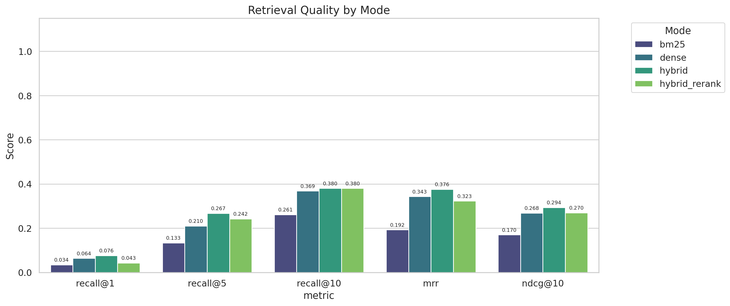
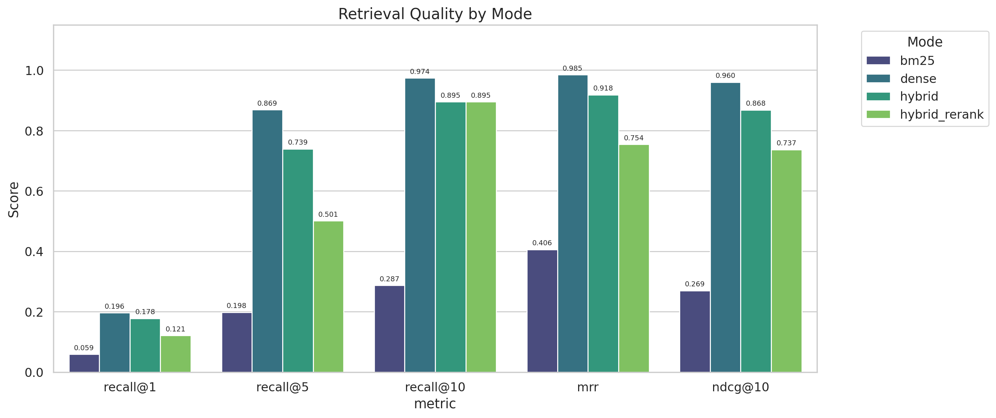
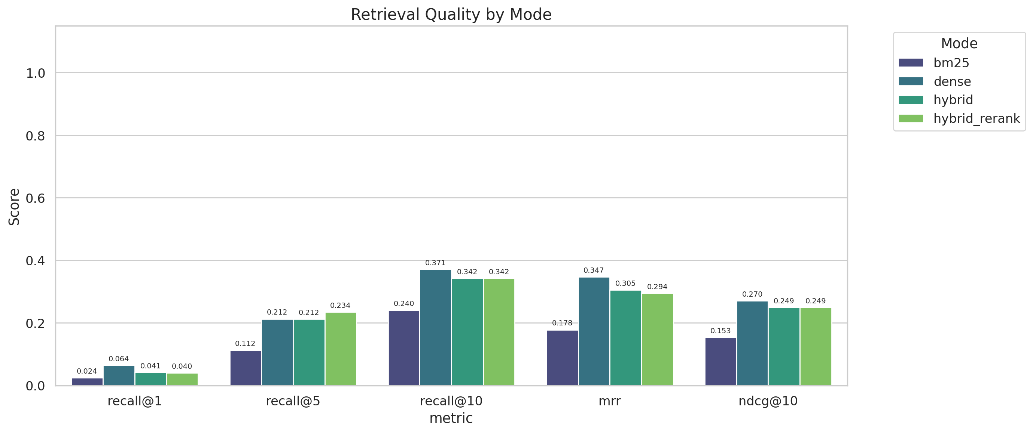
09 Retrieval Quality — Visual

Slide 11
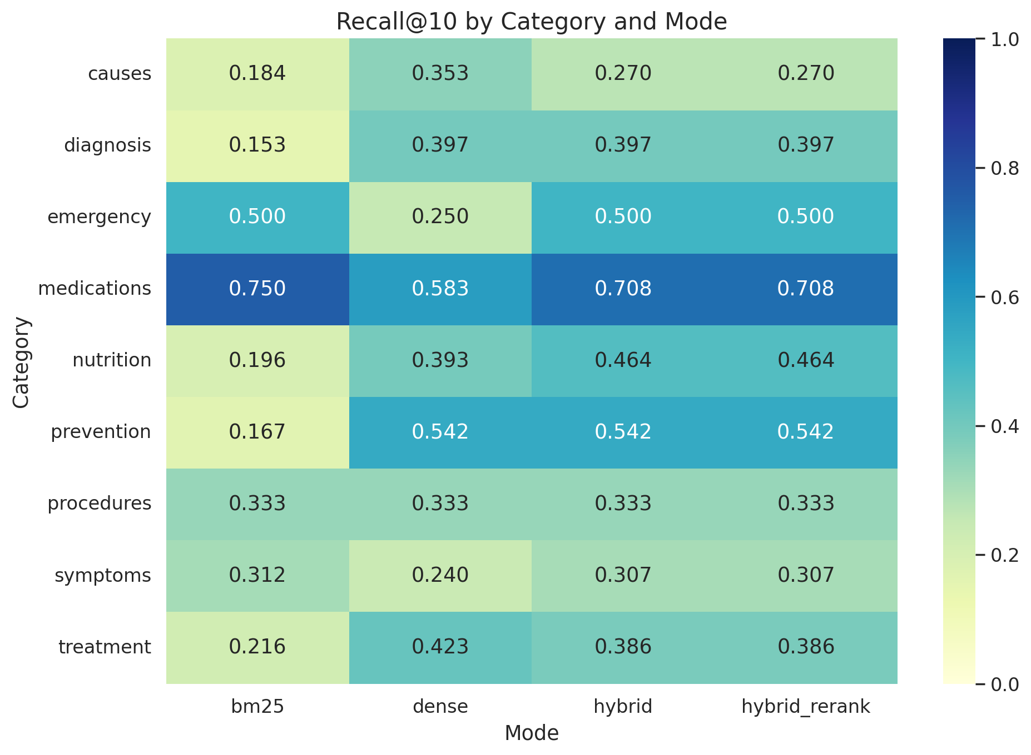
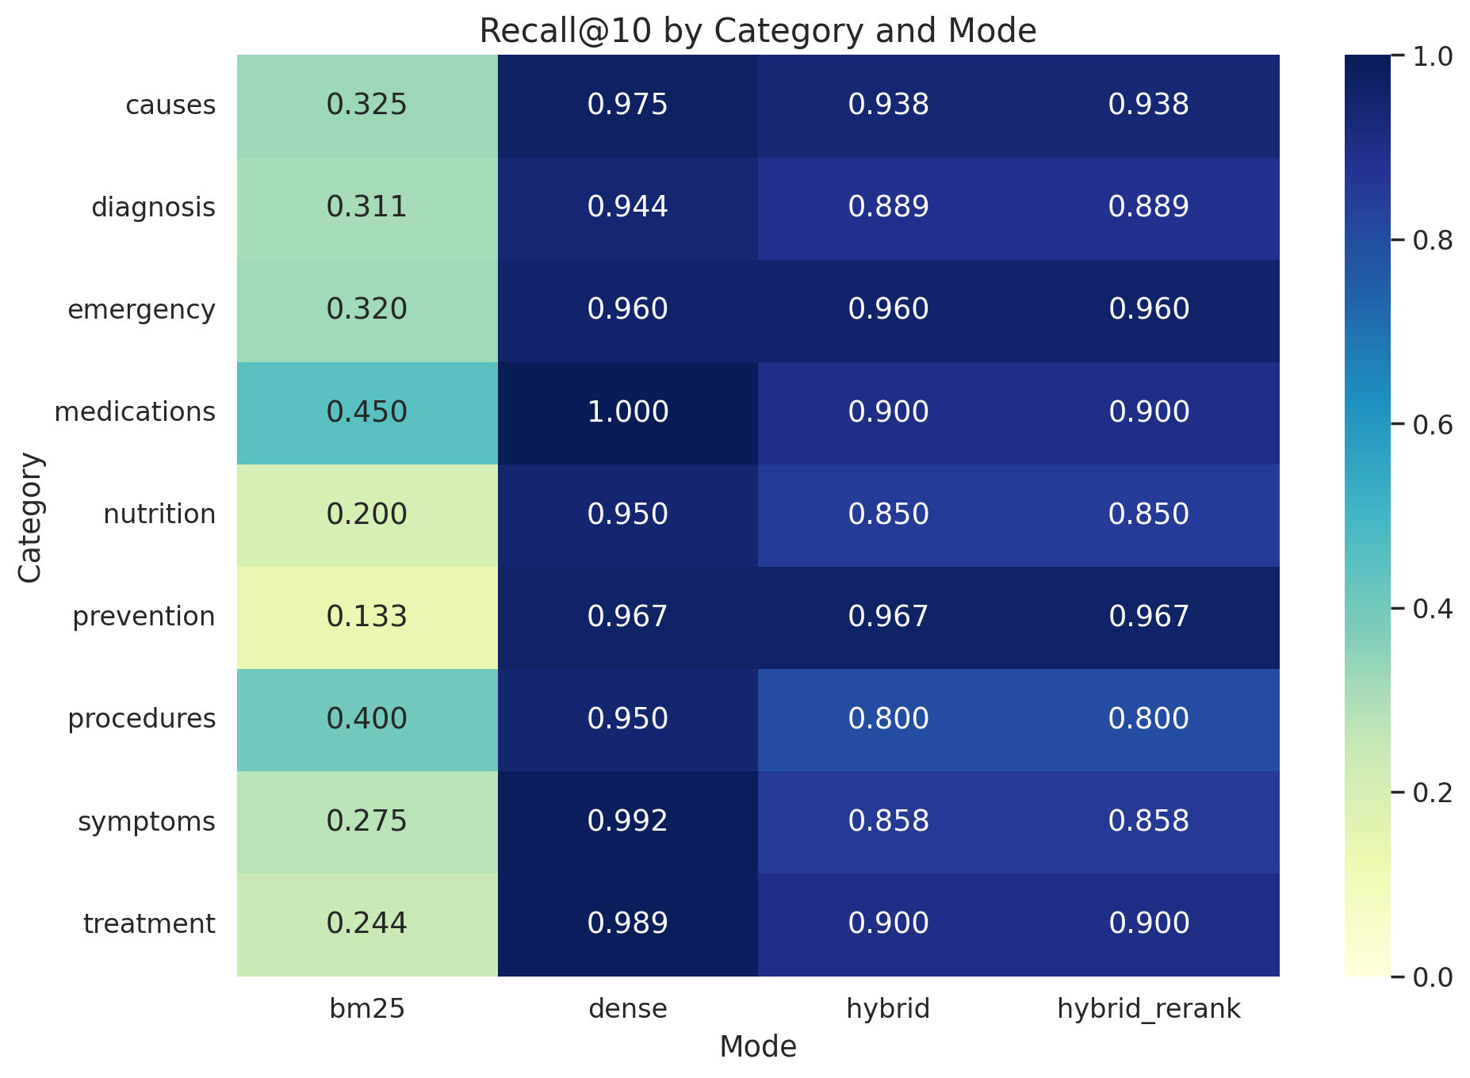
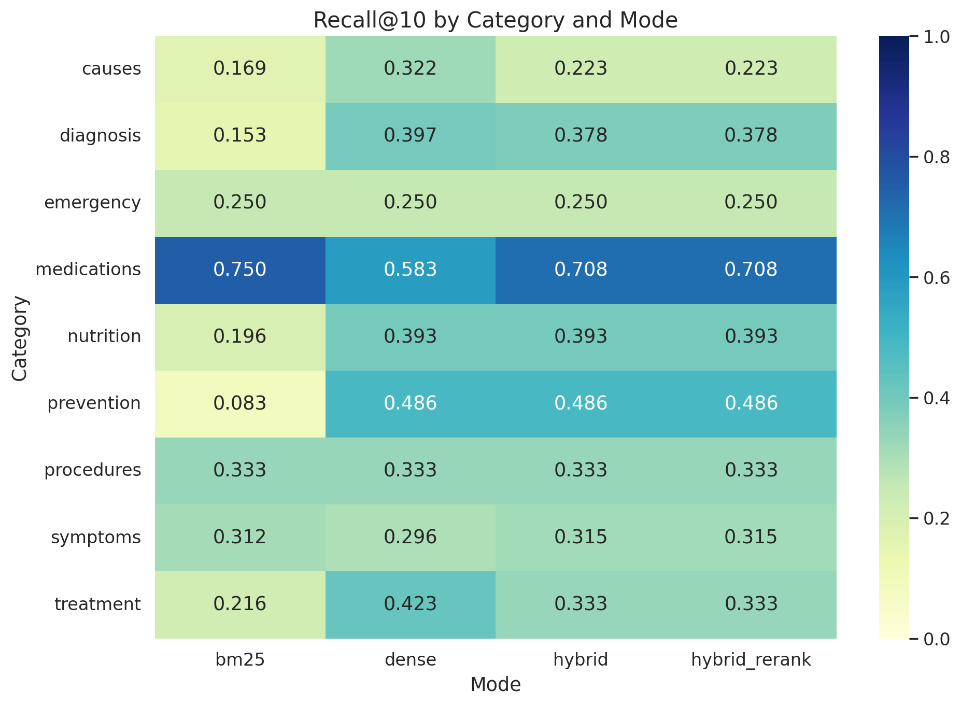
10 Recall by Category

Slide 12
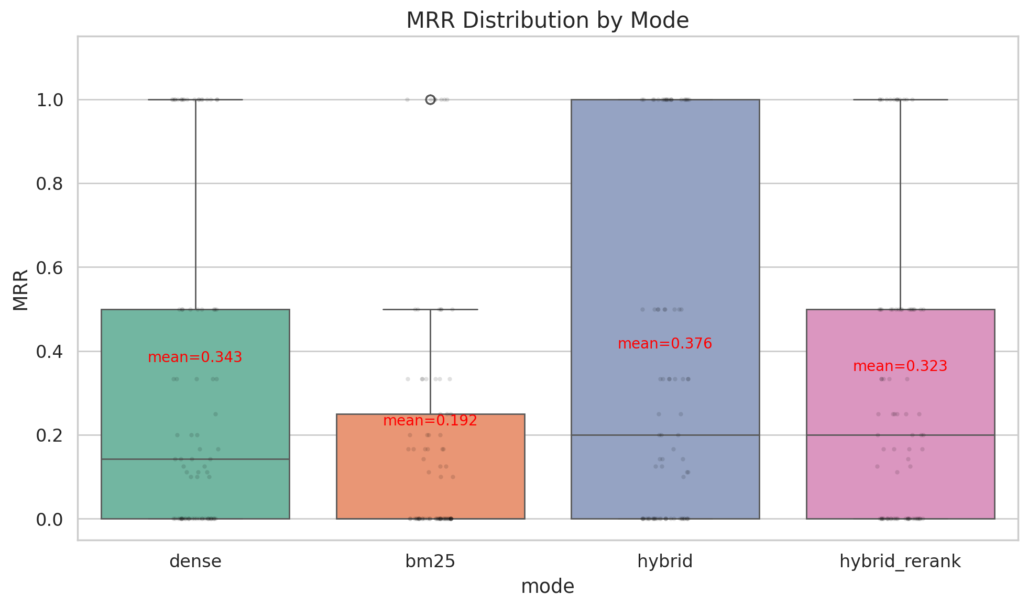
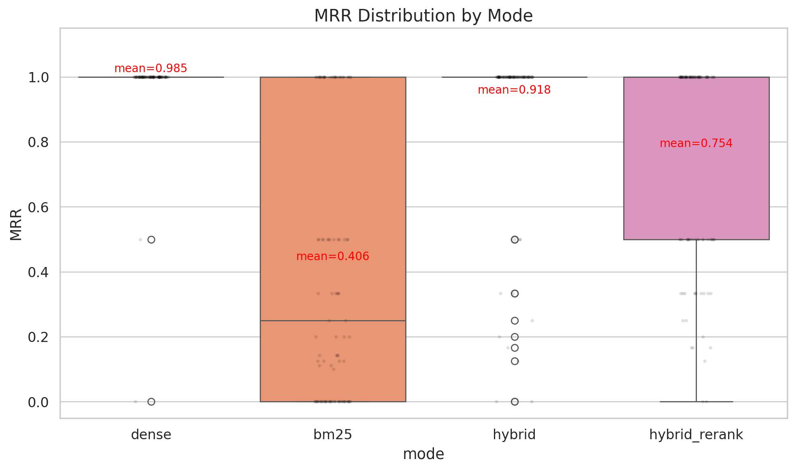
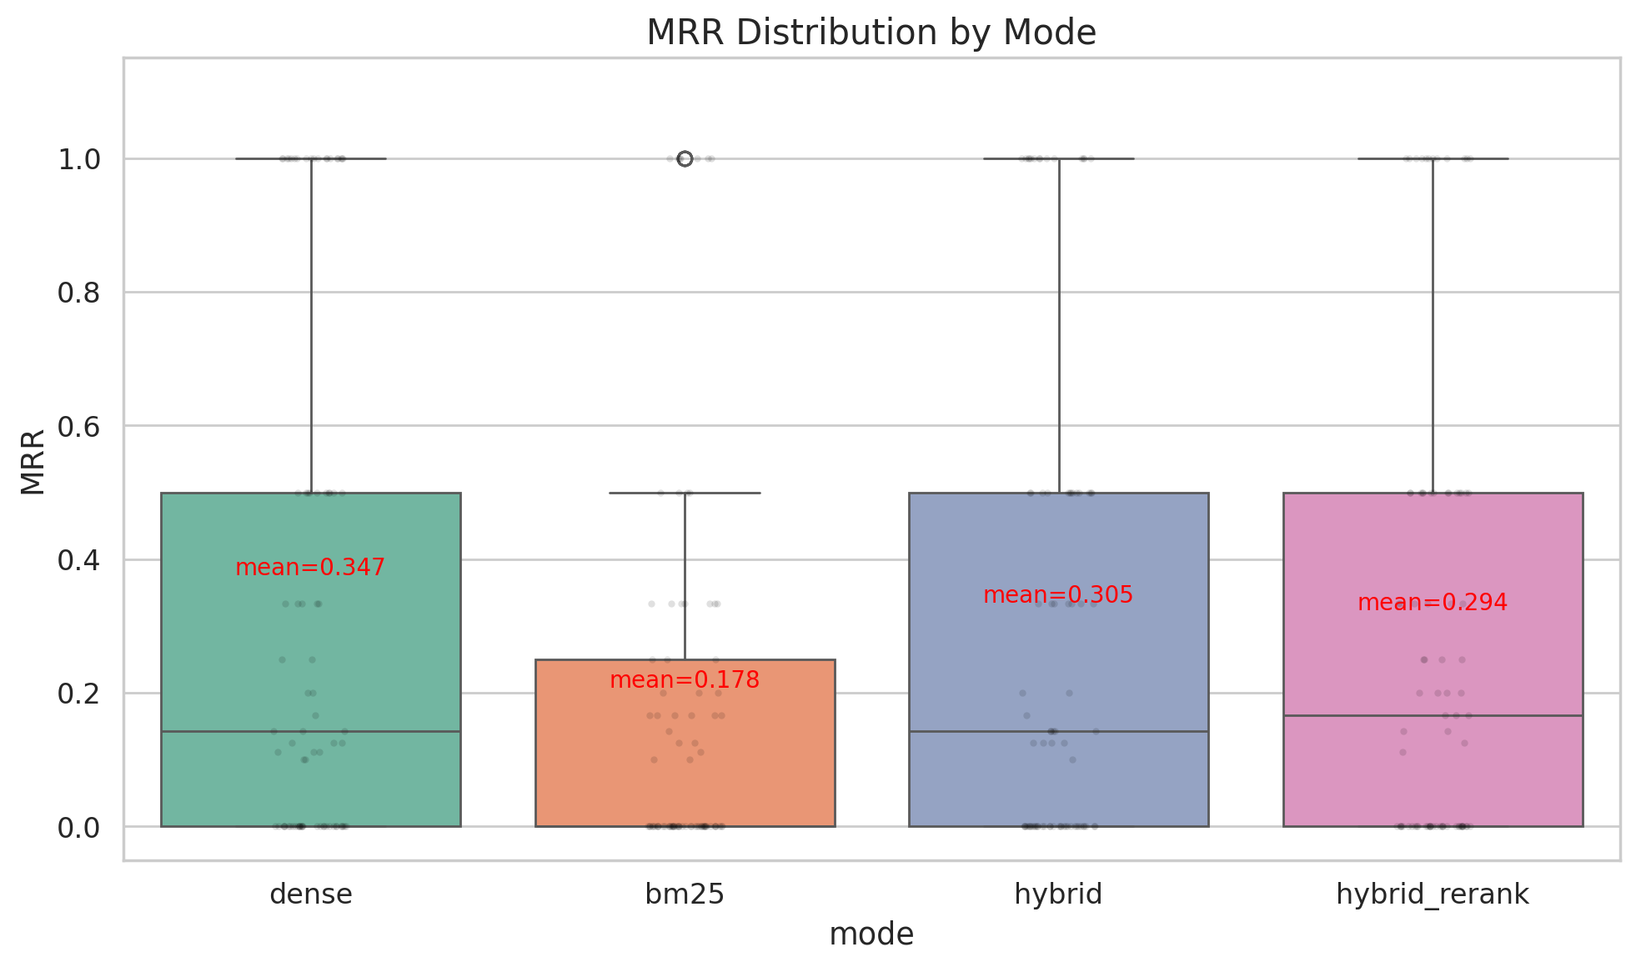
11 MRR Distribution by Mode

Slide 13
12 Generation Evaluation (Qwen2.5-32B Judge)
Mode | Grounding | Confidence | Retrieval Score | Grounded %
Dense | 0.645 | 0.539 | 0.576 | 59.6%
Hybrid | 0.661 | 0.569 | 0.581 | 62.6%
Hybrid+Rerank | 0.712 | 0.666 | 0.758 | 70.7%
Overall (297) | 0.673 | 0.591 | 0.638 | 64.3%
• Hybrid+Rerank achieves highest grounding (0.712) and confidence (0.666)
• English queries score higher (avg 0.729) than Arabic (avg 0.617) — cross-lingual gap persists
• 64.3% of answers are grounded — remaining 35.7% rejected by safety gate
• Evaluator: Qwen2.5-32B-Instruct (local GPU), 99 queries × 3 modes = 297 evaluations
Grounding scored by LLM judge (0-1). Grounded = score ≥ 0.5.

Slide 14
13 Concrete Example — Arabic Medical Q&A
User Query
ما هي أعراض مرض السكري؟
(What are the symptoms of diabetes?)
Retrieved Context (top chunks)
Generated Answer
Chunk 1 (score 0.82): "Diabetes mellitus ... symptoms include frequent urination (polyuria), excessive thirst (polydipsia), and unexplained weight loss..."
Chunk 2 (score 0.78): "Type 2 diabetes may also present with blurred vision, slow wound healing, and recurrent infections..."
Chunk 3 (score 0.71): "Diabetic ketoacidosis symptoms: nausea, vomiting, abdominal pain, fruity breath odor..."
أعراض مرض السكري تشمل:
• كثرة التبول (Polyuria)
• العطش الشديد (Polydipsia)
• فقدان الوزن غير المبرر
• عدم وضوح الرؤية
• بطء التئام الجروح
• التهابات متكررة
Safety Verdict: Grounding = 0.9 | Confidence = 0.9 | ✓ Answer Accepted
Mode: hybrid_rerank | LLM: Llama-3.1-8B-Instant (Groq) | Latency: ~4 s

Slide 15
14 Key Design Decisions
BGE-M3 over monolingual models
Best multilingual embedding for Arabic+English; 1024-dim captures medical semantics
Groq API over local LLM
Fast inference (~2 s), saves GPU memory — trade-off: 500K tokens/day free tier
LLM Judge over cosine grounding
Can reason about paraphrasing and Arabic synonyms; cosine gave false negatives
Dense-primary fusion (0.8 / 0.2)
BM25 cannot cross the language barrier; dense handles it natively
Disabled reranker by default
Cross-encoder degraded Arabic Recall@1 to 0.004 in experiments
Overlapping chunks (40-word overlap)
Medical concepts span paragraph boundaries; prevents information loss

Slide 16
15 System Configuration
Parameter | Value | Purpose
Embedding | BAAI/bge-m3 (1024-d) | Multilingual dense retrieval
Reranker | bge-reranker-v2-m3 | Cross-encoder (disabled)
LLM | Llama-3.1-8B (Groq) | Generation + Judge + Translation
Dense / BM25 weight | 0.80 / 0.20 | Hybrid fusion balance
Top-K (dense / BM25) | 20 / 20 | Initial retrieval candidates
Top-K final | 10 | After fusion + reranking
Similarity threshold | 0.25 | Min score for selection
Chunk size / overlap | 200 / 40 words | Semantic chunking
Max context tokens | 1500 | LLM prompt budget
Judge reject threshold | < 0.3 grounding | Answer rejection gate
Rate limit | 60 req/min/IP | API protection

Slide 17
16 Testing & Evaluation Infrastructure
Unit Tests (7 files)
Evaluation Scripts
test_retrieval.py — fusion, RRF, reranker, expansion
test_safety.py — emergency detection, content filter, PII
test_indexing.py — embedder shape, vector store, BM25
test_calibration.py — ECE, model training, synthetic data
test_api.py — /health, /ready, /ask endpoints
test_arabic_evaluation.py — dataset structure validation
test_calibration_data.py — logging, labeling, records
evaluate_retrieval.py
4 modes × 99 queries → CSV + plots
evaluate_plots.py
End-to-end with Qwen2.5-32B (local)
Metrics
Recall@k, MRR, nDCG@k, ECE, grounding rate

Slide 18
17 Recommendations & Next Steps
1
Human-annotated ground truth
Replace auto-generated GT with expert relevance judgments for valid evaluation
2
Upgrade Groq API tier
Free tier (500K tokens/day) is insufficient for production or heavy evaluation
3
Consider dense-only mode as default
Hybrid fusion dilutes dense signal without meaningful BM25 benefit for Arabic
4
Fine-tune reranker on Arabic medical data
Or remove it — current cross-encoder degrades Arabic ranking
5
Add Arabic medical corpus
English-only source limits BM25; Arabic literature would reduce translation dependency
6
Implement query caching
Reduce API calls and latency for repeated queries

Slide 19
Thank You
Questions?

