Slide 1
Bookworm
Developed By:
Farha Jawed
Srashti Badjatya
CS5200 Fall 2017

Slide 2
Introduction
In this video, we will go through the following points:
Problem statement
Solution statement
Architecture and technology stack
Class Diagram
Demo of the application

Slide 3
Problem statement
There are many people who are fond of reading books, but due to time constraints, not many are able to visit traditional old book markets. Even if they do, it’s a hassle to find the books of their interest, which we believe the modern urban population would like to avoid.
Since e-commerce is fast growing field, where more and more businesses are implementing web sites for performing commercial transactions over the web.
And hence, we tried to explore that option for easy online buying, searching and selling of books.

Slide 4
Solution statement
Bookworm is one such portal where any book can be bought, searched or sold from the comfort of home through the Internet.
On the portal, all customers can search for books of their interest but only the registered customers can add/update books to their cart or wish-list, sell books, update their profile information and view their sales and order history.
The portal also provides direct interaction between the buyer and seller, via messaging.
The registered customer can also write reviews for any book available.

Slide 5
Architecture and technology stack
The project follows the three-tier architecture.
Presentation Tier: This has been developed using JSP and JavaScript.
Application Tier: This has been developed using Spring MVC and Hibernate.
Data Tier: This has been developed using MySQL.

Slide 6
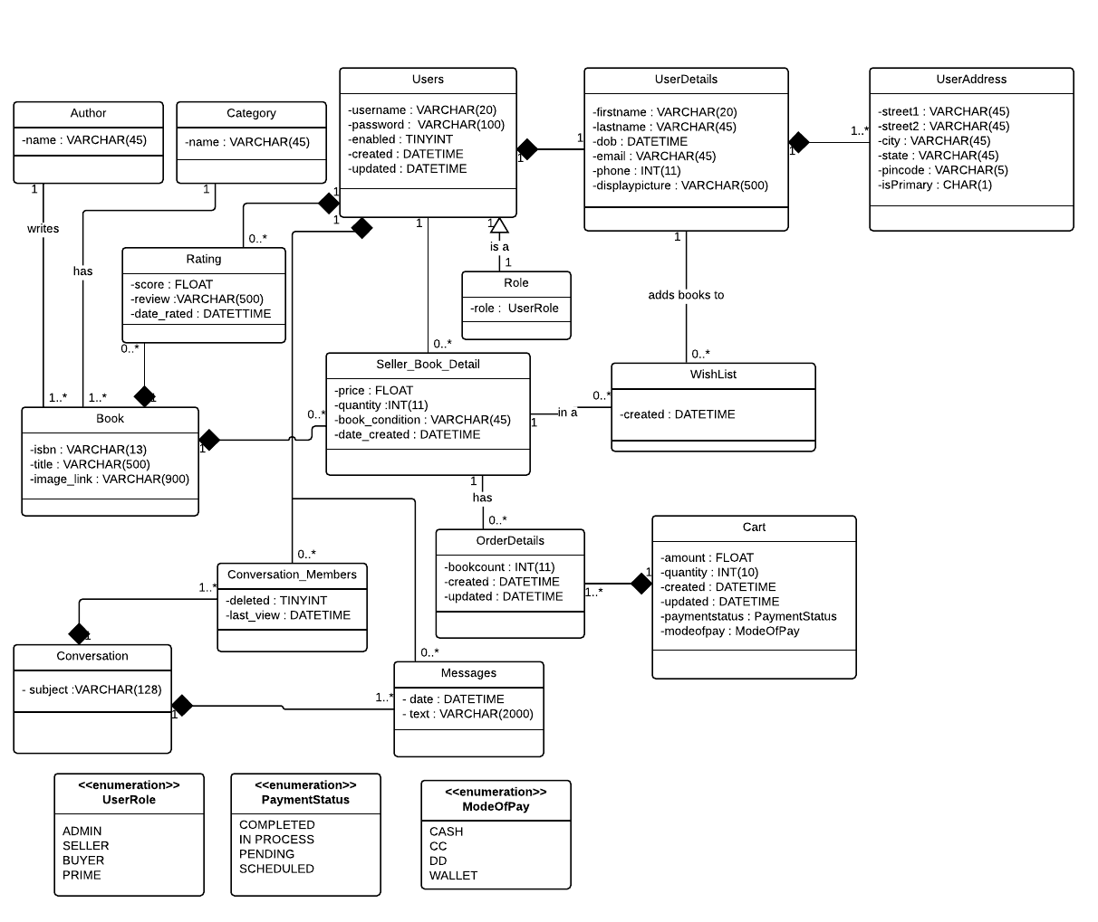
Class Diagram
Link to class diagram description

Slide 7
Application Demo
Please click on the link :
Demo

Slide 8
Thank You.

