Slide 1
Microprocessors and Assembly Language Lecture 10 Hamed Farbeh farbeh@aut.ac.ir Fall 2022

Slide 2
Copyright Notice
Parts (text & figures) of this lecture are adopted from:
Arm Assembly Language Programming and Architecture, Volume 1, 1st edition, Muhammad Ali Mazidi, Sarmad Naimi, and Sepehr Naimi, MicroDigitalEd, 2013
Design of Microprocessor-Based Systems (aka Embedded Systems Design and Implementation), Prabal Dutta, University of Michigan
CortexTM-M3 Revision r2p1 Technical Reference Manual
ARMv7-M Architecture Reference Manual

Slide 3
Universal Synchronous Asynchronous Receiver/Transmitter (USART)

Slide 4
Introduction to USART
A universal synchronous and asynchronous receiver-transmitter (USART) is a type of a serial interface device that can be programmed to communicate asynchronously or synchronously.
Like a UART(Universal Asynchronous Receiver/Transmitter), a USART provides the computer with the interface necessary for communication with modems and other serial devices.

Slide 5
Introduction to USART
However unlike a UART, a USART offers the option of synchronous mode.
In program-to-program communication, the synchronous mode requires that each end of an exchange respond in turn without initiating a new communication.
Asynchronous operation means that a process operates independently of other processes.

Slide 6
Differences between synchronous and asynchronous mode
The synchronous mode requires both data and a clock. The asynchronous mode requires only data.
In synchronous mode, the data is transmitted at a fixed rate. In asynchronous mode, the data does not have to be transmitted at a fixed rate.
Synchronous data is normally transmitted in the form of blocks, while asynchronous data is normally transmitted one byte at a time.
Synchronous mode allows for a higher DTR(data transfer rate) than asynchronous mode does if all other factors are held constant.

Slide 7
USART Characteristics
5- to 9-bit Full-duplex Synchronous or Asynchronous Communications
1, 1.5 or 2 Stop Bits in Asynchronous Mode
1 or 2 Stop Bits in Synchronous Mode
Configurable MSB- or LSB-first
By 8 or by 16 Over-sampling Receiver Frequency

Slide 8

USART Characteristics
Optional Hardware Handshaking RTS-CTS
RS485 with Driver Control Signal
SPI Mode
LIN Mode (USART0 only)

Slide 9
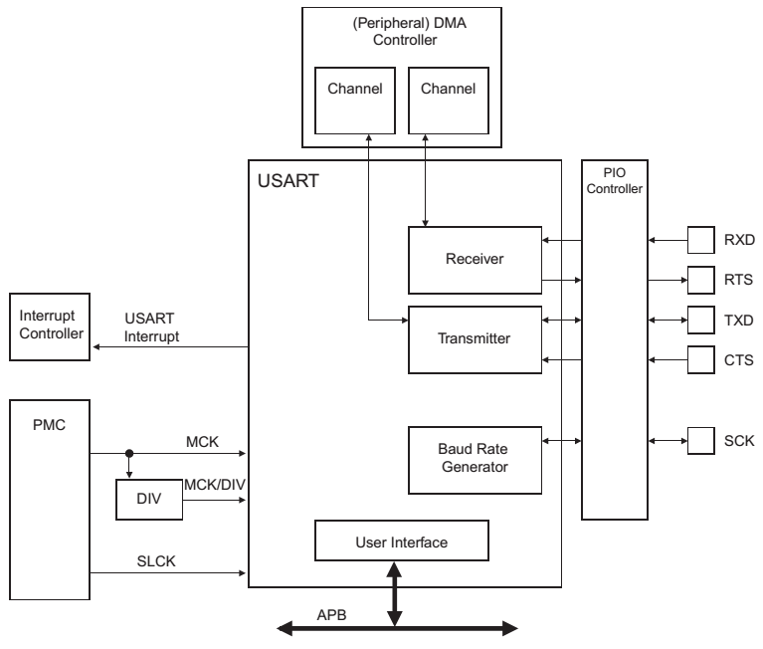
USART Block Diagram

Slide 10
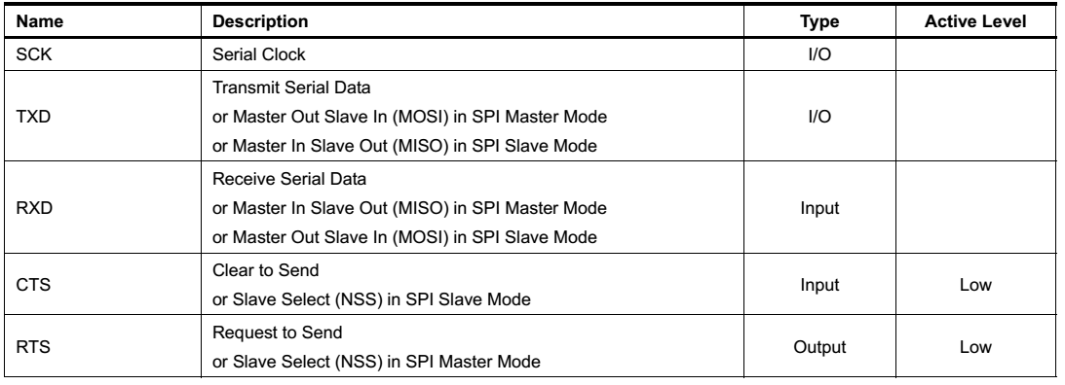
I/O Lines Description

Slide 11
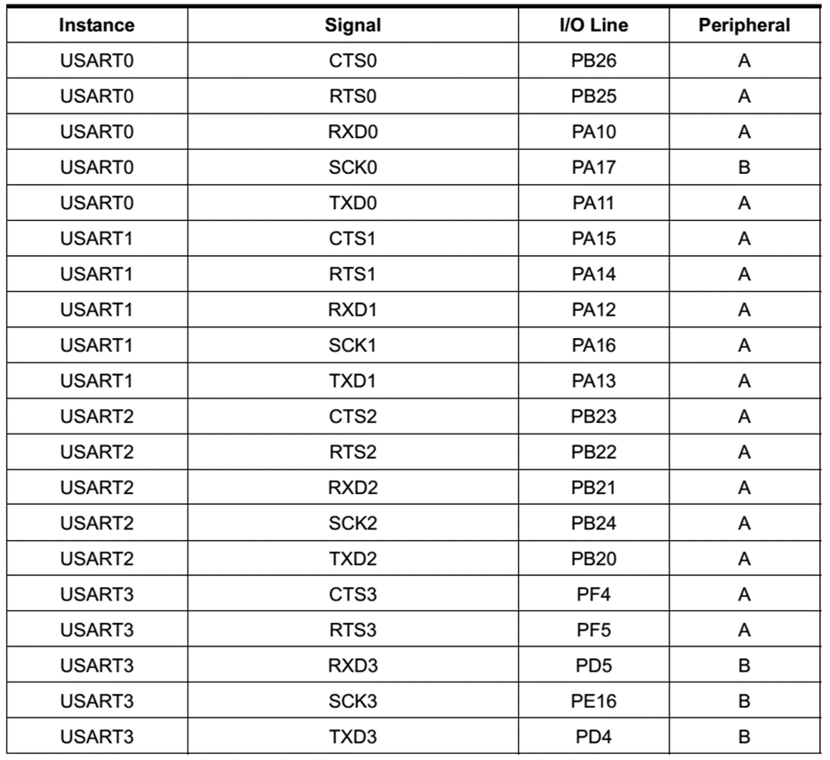
I/O Lines Description

Slide 12
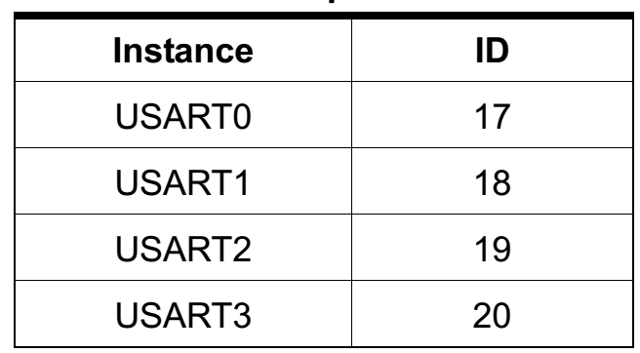
Interrupt Peripheral IDs

Slide 13
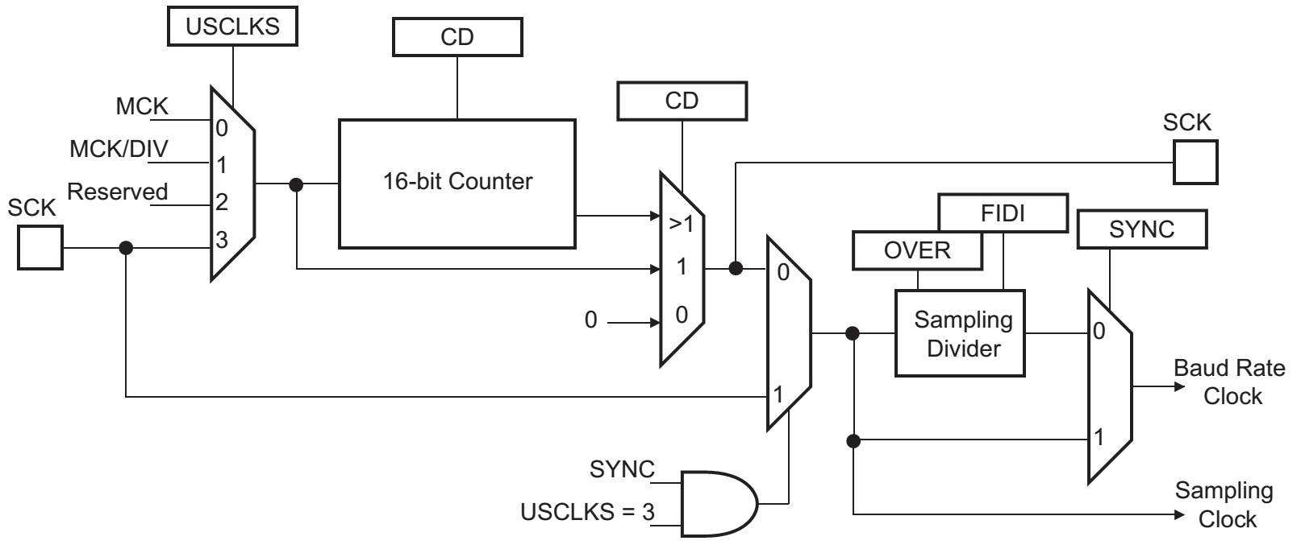
Baud Rate Generator
If selected, the frequency of the signal provided on SCK must be at least 3 times lower than MCK in USART mode, or 6 in SPI mode

Slide 14
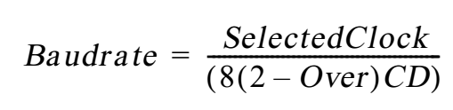
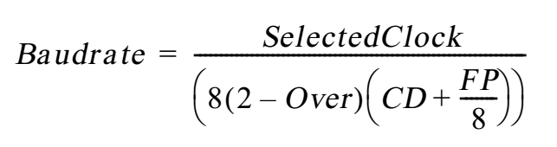
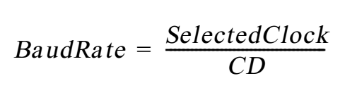
Baud Rate
Asynchronous Mode
Fractional Baud Rate: Program the FP field in the US_BRGR
Synchronous Mode

Slide 15
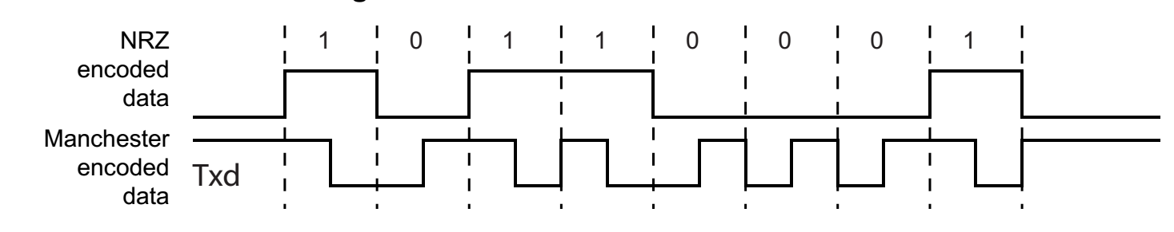
Data Transmission
The transmitter performs the same in synchronous and asynchronous modes
One start bit, up to 9 data bits, one optional parity bit and up to two stop bits are successively shifted out on the TXD pin at each falling edge of the programmed serial clock
Manchester mode
To enable this mode, MAN=1 field in the US_MR

Slide 16
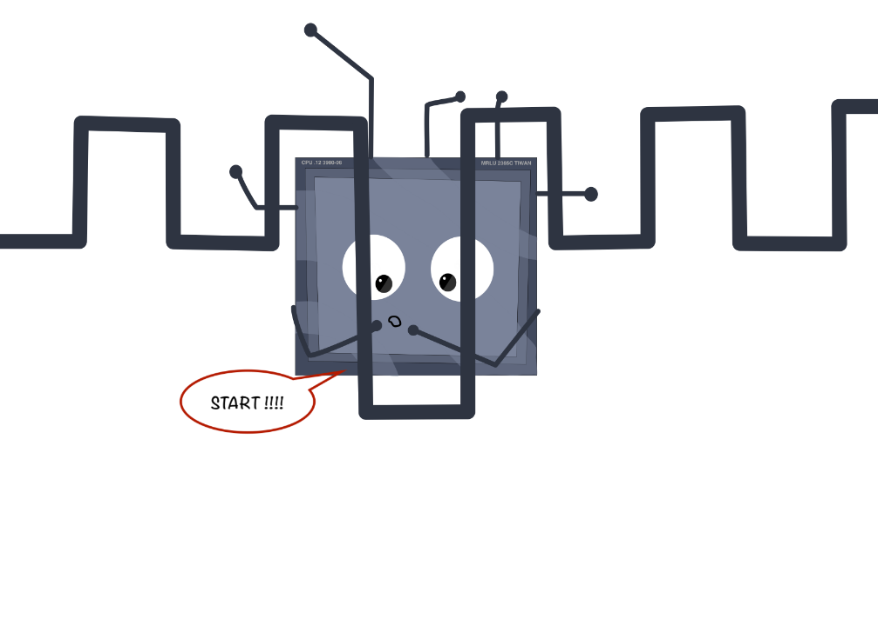
Data Transmission
Asynchronous Receiver
Oversampling either 16 or 8 times the Baud Rate clock
Depending on the OVER bit in the US_MR
Synchronous Receiver
The receiver samples on each rising edge of the Baud Rate Clock
If a low level is detected, it is considered as a start
Synchronous mode operations provide a high speed transfer capability

Slide 17
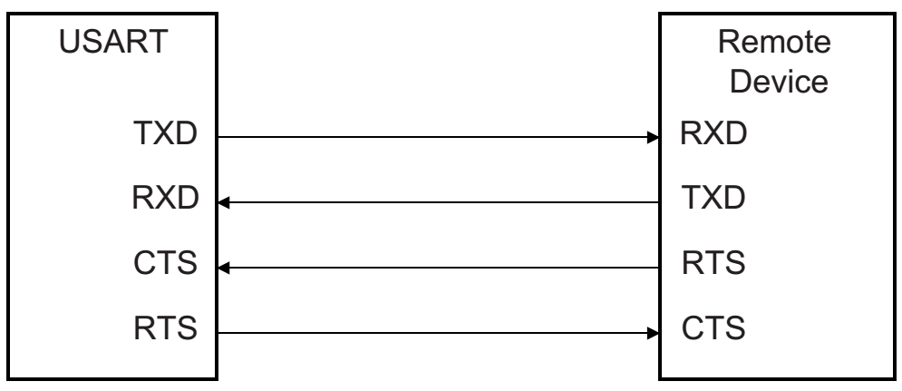
Hardware Handshaking
Receiver operation
The RTS (Request To Send) pin is driven high if
The receiver is disabled
The status RXBUFF (Receive Buffer Full) is high
The remote device does not start transmitting while its CTS pin (driven by RTS) is high
When the receiver is enabled, the RTS falls
Indicating to the remote device that it can start transmitting

Slide 18
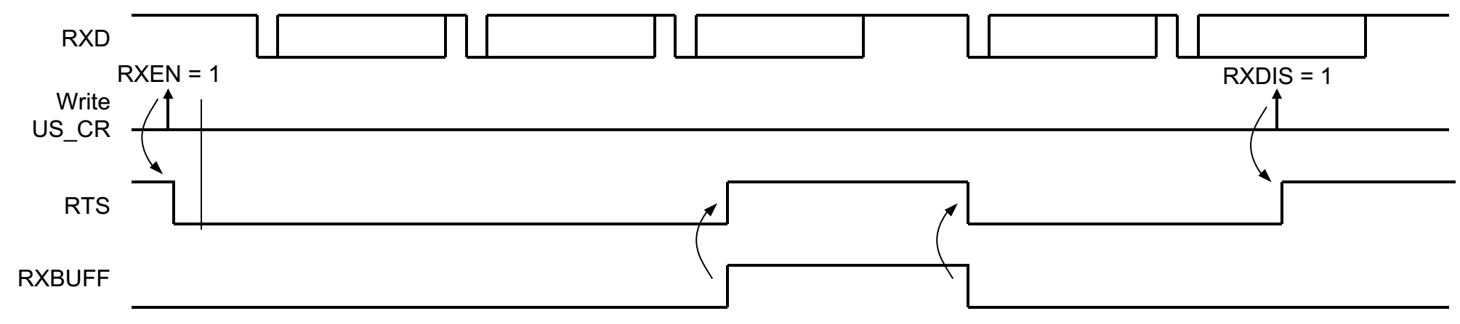
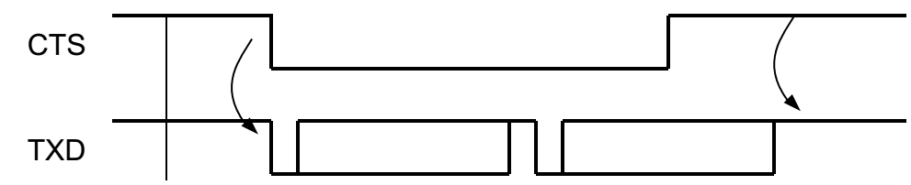
Hardware Handshaking

Slide 19
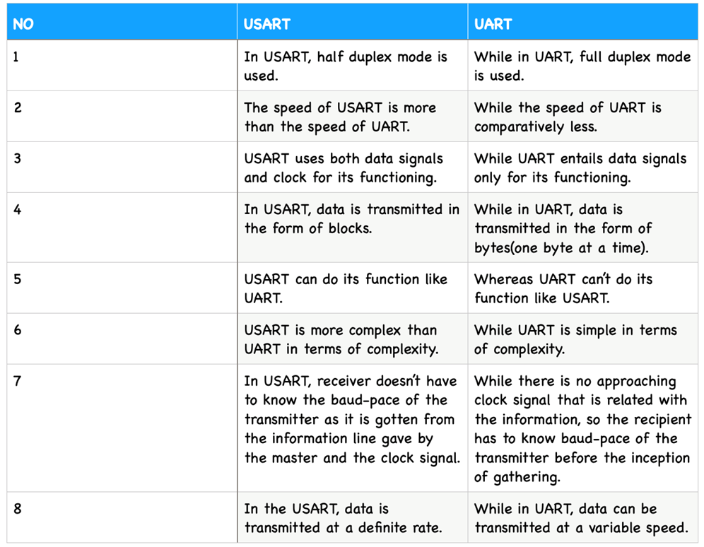
Difference between USART and UART

Slide 20
The End (for now)!

