Slide 1
Microprocessors and Assembly Language Lecture 13 Hamed Farbeh farbeh@aut.ac.ir Fall 2022

Slide 2
Copyright Notice
Parts (text & figures) of this lecture are adopted from:
Arm Assembly Language Programming and Architecture, Volume 1, 1st edition, Muhammad Ali Mazidi, Sarmad Naimi, and Sepehr Naimi, MicroDigitalEd, 2013
Design of Microprocessor-Based Systems (aka Embedded Systems Design and Implementation), Prabal Dutta, University of Michigan
CortexTM-M3 Revision r2p1 Technical Reference Manual
ARMv7-M Architecture Reference Manual

Slide 3
ARM Architecture and Assembly Language Programming

Slide 4
ARM Architecture and Assembly Language Programming
Python
Assembly
Math.sqrt(num)
mov r3,r0
loop
mov r14,r0,lsr#1
mov r0,r3
mov r1,r14
udiv r0,r0,r1
add r0,r0,r14
cmp r14,r0,lsr#1
bne loop

Slide 5
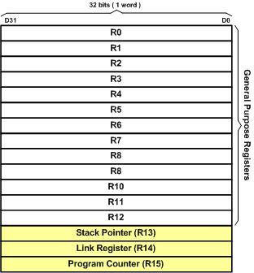
ARM Registers
13 GPRs
R0-R12 (32-bit)
Can be used by all arithmetic/logic instructions

Slide 6
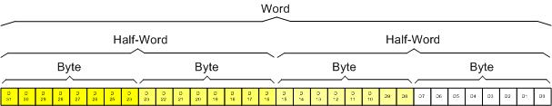
Registers Data Size
MSB: D31
LSB: D0

Slide 7
ARM Instruction Format
A common format
Instruction destination, source1, source2
Source2 can be
A register
Immediate (constant)
Memory
Destination is often
A register
Memory

Slide 8
MOV Instruction
Copies data into register or from register to register
MOV Rn, Op2
load Rn register with Op2 (Operand2)
Op2 can be immediate (an 8-bit value)
Op2 can be a register Rm
Rn or Rm can be any of the registers R0 to R15
It can be a GPR, Stack pointer, Link pointer or Program counter

Slide 9
MOV Instruction: Examples
Load R2 with 0x25 (R2 = 0x25)
MOV R2,#0x25; 25 in hex
Notice the # before immediate values
Use “;” for comment (same as “//” in C)
For numbers in hex, put “0x” in front of the value
Put nothing for decimal
MOV R1,#50; 50 in decimal
Copy contents of R7 into R5 (R5 = R7)
MOV R5,R7

Slide 10
MOV Instruction: Examples
On moving a constant,
What happens to the rest of the register’s bits?
EX: MOV R1, #84 ; R1 = 0000 0000 0000 0000 0000 0000 1000 0100
What about moving an immediate larger than 255?
MOV R1,#505
Will cause an error! Why?

Slide 11
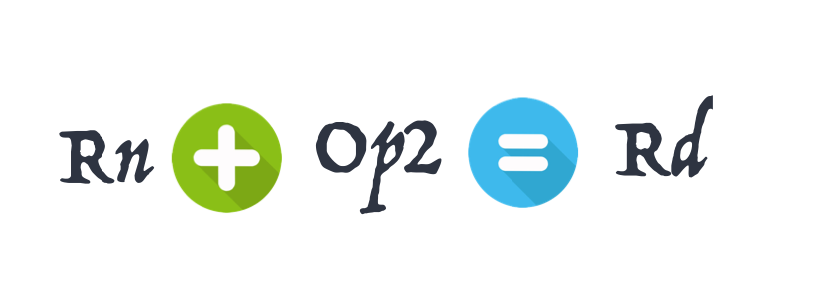
ADD Instruction
ADD Rd,Rn,Op2
Add Rn to Op2 and store the result in Rd
Op2 can be immediate (an 8-bit value)
Op2 can be a register Rm

Slide 12
A Simple Program
Add 0x25 and 0x34
MOV R1,#0x25
MOV R7,#0x34
ADD R5,R1,R7
OR
MOV R1,#0x25
ADD R5,R1,#0x34

Slide 13
WHY To Learn Assembly?!!!

