Slide 1
Microprocessors and Assembly Language Lecture 15 Hamed Farbeh farbeh@aut.ac.ir Fall 2022

Slide 2
Copyright Notice
Parts (text & figures) of this lecture are adopted from:
Arm Assembly Language Programming and Architecture, Volume 1, 1st edition, Muhammad Ali Mazidi, Sarmad Naimi, and Sepehr Naimi, MicroDigitalEd, 2013.

Slide 3
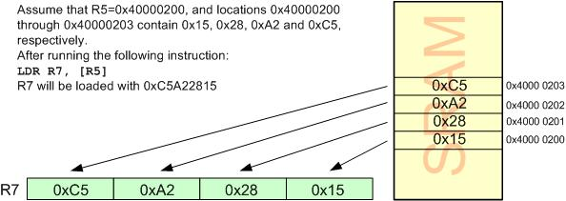
Load and Store Instructions
Load Rd with the contents of location pointed to by Rx register
LDR Rd,[Rx]; Rx contains an address between 0x00000000 to 0xFFFFFFFF
LDR reads one word (32-bit or 4-byte) of data
from 4 consecutive memory locations
The locations can be in the SRAM, a Flash memory or I/O registers

Slide 4
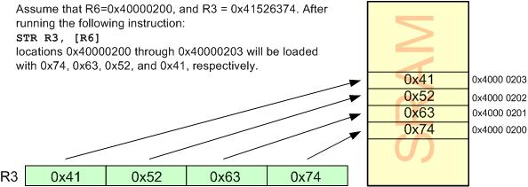
Load and Store Instructions
Store register Rd into locations pointed to by Rx
STR Rd,[Rx]

Slide 5
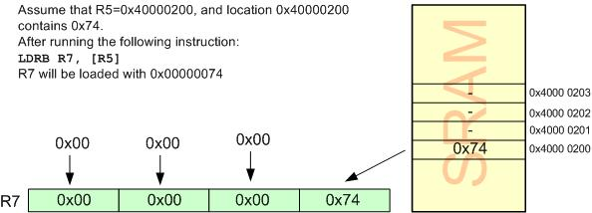
Load and Store Variations
Load a byte
LDRB Rd, [Rx]

Slide 6
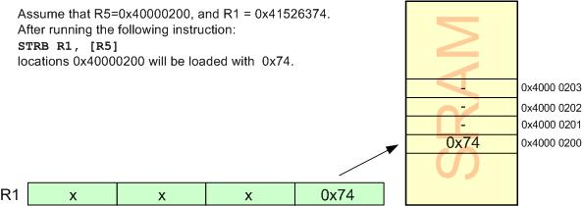
Load and Store Variations
Store a byte
STRB Rd, [Rx]

Slide 7
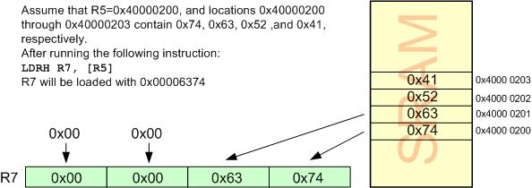
Load and Store Variations
Load half-word (2-byte)
LDRH Rd, [Rx]

Slide 8
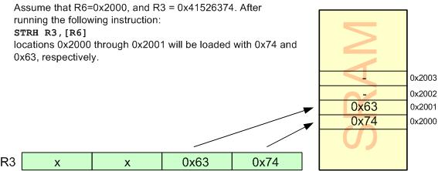
Load and Store Variations
Store half-word (2-byte)
STRH Rd, [Rx]

Slide 9
LDR, STR and MOV comparison
LDR: moves data from memory to processor. loads data to a specified register.
STR: moves data out of the processor to a memory location from a specified register.
Note: Both of the instructions above can use various addressing modes allowed by ARM, while specifying address of the memory location (indirect addressing, PC-relative, displacement etc.)
MOV: copies from register to register, or loads a constant into a register.

Slide 10

Current Program Status Register
CPSR: Flag register
N: Negative
Z: Zero
C: Carry
V: Overflow
T: Thumb
I and F: Enable or disable the interrupt

Slide 11

S suffix and the status register
By executing data processing instructions
By default, the status flags of CPSR are not updated
To update the flags
put the ‘S’ suffix at the end of the opcode
ADD => ADDS

Slide 12
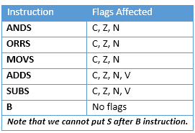
S Suffix and the Status Register

Slide 13
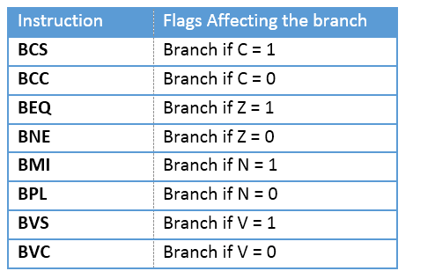
Flag Bits and Decision Making
Conditional branch instructions

Slide 14
Question
Write a program to see if a given number (in this example 0x80000001) is palindrome.

Slide 15
Answer
Ex: 1001 is a 4-bit palindrome
Mov R0, 0x80000001
Mov R1, R0
Mov R2, #0
Mov R3, #32 ; loop counter
Mov R4, #0 ; output
Loop
AND R5,R1,#1
LSL R2,R2,#1
ADD R2,R2,R5
LSR R1,R1,#1
SUBS R3,R3,#1
BNE Loop
CMP R0,R2
BNE Here
MOV R4,#1
Here B Here

