Slide 1
Microprocessors and Assembly Language Lecture 18 Hamed Farbeh farbeh@aut.ac.ir Fall 2022

Slide 2
Copyright Notice
Parts (text & figures) of this lecture are adopted from:
Arm Assembly Language Programming and Architecture, Volume 1, 1st edition, Muhammad Ali Mazidi, Sarmad Naimi, and Sepehr Naimi, MicroDigitalEd, 2013.

Slide 3
Instruction Formation of the ARM

Slide 4
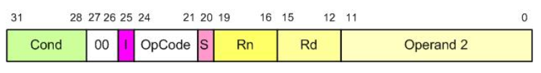
Instruction Formation
General formation of data processing instructions
Cond [31:28]: Condition field (will be discussed in Ch. 4)
[27:26]: Always “00”
I [25]: Defines the type of second operand
I = 1: Op2 is an immediate value
[24:21]: Opcode
S [20]: Update CPSR

Slide 5



Instruction Formation
ADD instruction format
SUB instruction format
Branch (B) instruction format

Slide 6
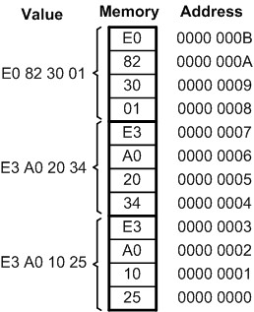
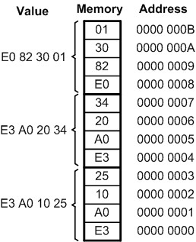
Little Endian vs. Big Endian War
Little endian
Low byte goes to the low memory location
High byte goes to the high memory address
All Intel processors
Big endian
Low byte goes to the high memory location
High byte goes to the low memory address
Freescale (formerly Motorola and now NXP)
ARM allows the software designer to choose!
A hardware switch that is controlled by software

Slide 7
More Example for Little endian & Big Endian
4F52 in little endian:
52 is stored at storage address 1000
and 4F is stored at 1001
4F52 in big endian:
4F is stored at storage address 1000
and 52 is stored at 1001
Value | Address
4F | 1001
52 | 1000
Value | Address
52 | 1001
4F | 1000

Slide 8
Some ARM Addressing Modes

Slide 9

Addressing Modes
Addressing Mode
The various ways operands are specified in the instruction
Is the way CPU generates address from instruction to read/write the operands
Three basic modes
Register
Immediate
Register indirect (indexed addressing mode)

Slide 10
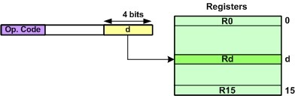

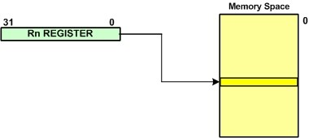
Addressing Modes
Register Addressing Mode
Immediate addressing mode
Register Indirect addressing mode (Indexed)

Slide 11
Addressing Modes
Register Indirect addressing mode (Indexed)
Can be used for pointer implementation
char *ourPointer; ourPointer = (char*) 0x12456; //Point to location 12456 *ourPointer = 25; //store 25 in location 0x12456 ourPointer ++; //point to next location
LDR R2, =0x12456 ; point to location 0x12456 MOV R0, #25 ; R0 = 25 STRB R0, [R2] ; store R0 in location 0x12456 ADD R2, R2, #1 ; increment R2 to point to next location

Slide 12

Example
MyString DCB “Hello world!”, 0
AREA MyCode, CODE, READONLY
ENTRY
LDR R0, =MyString
mov R1, #0
LoopCount
LDRB R2, [R0], #1
CBZ R2, Here
ADD R0,#1
ADD R1,#1
B LoopCount
Here B Here
END

Slide 13
End of Chapter 2!

