Slide 1
Microprocessors and Assembly Language Lecture 22 Hamed Farbeh farbeh@aut.ac.ir Fall 2022

Slide 2
Copyright Notice
Parts (text & figures) of this lecture are adopted from:
Arm Assembly Language Programming and Architecture, Volume 1, 1st edition, Muhammad Ali Mazidi, Sarmad Naimi, and Sepehr Naimi, MicroDigitalEd, 2013

Slide 3
ARM Memory Map, Memory Access and Stack

Slide 4
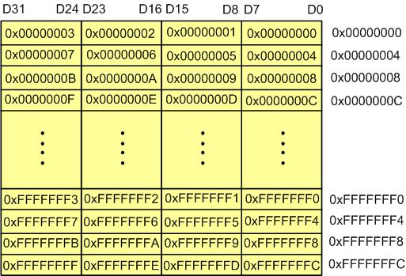
Memory Addressing
Memory Byte Addressing in ARM

Slide 5
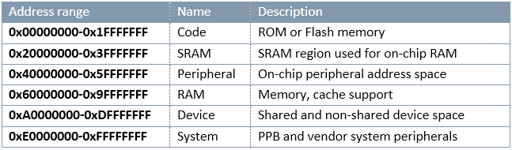
Memory Addressing
Sample Memory Space Allocation in ARM

Slide 6
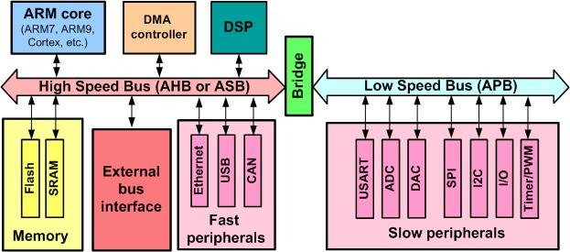
AHB and APB buses
AHB: advanced high-performance bus
Connects CPU to RAM, ROM, …
APB: advanced peripherals bus
Dedicated for communication with the on-chip peripherals
timers, ADC, UART, SPI, I2C, …

Slide 7
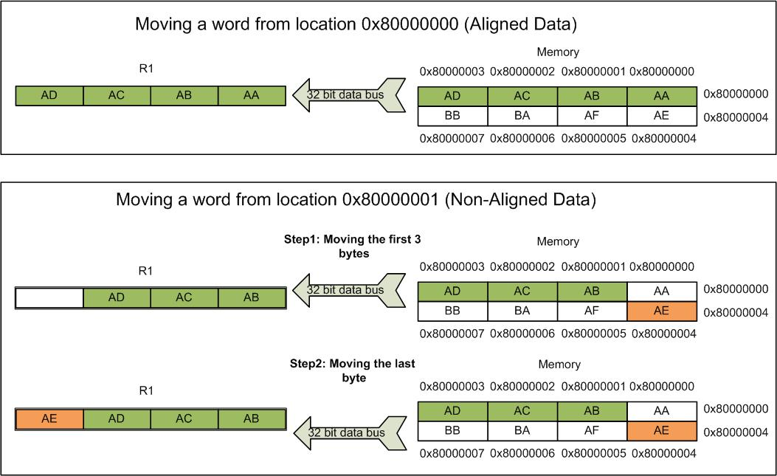
Data Misalignment in SRAM
Compilers make sure that instructions are always aligned
Placement of data in SRAM can be nonaligned
Memory access penalty

Slide 8
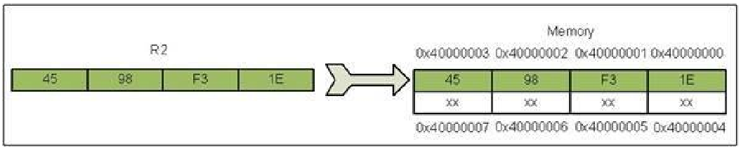
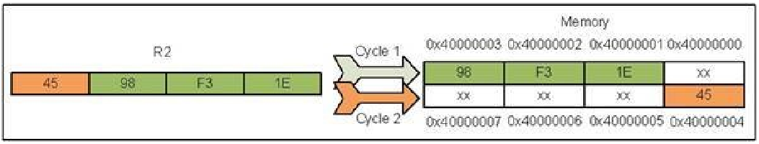
Data Misalignment in SRAM
LDR R1, =0x40000000 ; R1=0x40000000
LDR R2, =0x4598F31E ; R2=0x4598F31E
STR R2, [R1] ; Store R2 to location 0x40000000
ADD R1, R1, #1 ; R1 = R1 + 1 = 0x40000001
STR R2, [R1] ; Store R2 to location 0x40000001

Slide 9
Advanced Indexed Addressing Mode
Base plus offset addressing modes
Pre-indexed addressing mode with fixed offset
LDR R5, =0x55667788
LDR R1, =0x10000000 ; load the address of first location
STR R5, [R1] ; store R5 to location 0x10000000
STR R5, [R1, #4] ; store R5 to location 0x10000000 + 4 (0x10000004)
STR R5, [R1, #8] ; store R5 to location 0x10000000 + 8 (0x10000008)
STR R5, [R1, #0x0C] ; store R5 to location 0x10000000 + 0x0C (0x1000000C)

Slide 10
Advanced Indexed Addressing Mode
Base plus offset addressing modes
Pre-indexed addressing mode with write back and fixed offset
The calculated pointer is written back to the pointing register
LDR R1, =0x10000000 ; load the address of first location
STR R5, [R1] ; store R5 to location 0x10000000
STR R5, [R1, #4]! ; store R5 to location 0x10000000 + 4 (0x10000004)
; write back makes R1 = 0x10000004
STR R5, [R1, #4]! ; store R5 to location 0x10000004 + 4 (0x10000008)
; write back makes R1 = 0x10000008
STR R5, [R1, #4]! ; store R5 to location 0x10000008 + 4 (0x1000000C)
; write back makes R1 = 0x1000000C

Slide 11
Advanced Indexed Addressing Mode
Base plus offset addressing modes
Post-indexed addressing mode with fixed offset
Update pointer after the load/store operation
STR R1, [R2], #4 ; store R1 into memory pointed to by R2 and then write back R2 + 4 to R2
LDRB R5, [R3], #1 ; load a byte from memory pointed to by R3 and then write back R3 + 1 to R3

Slide 12
Advanced Indexed Addressing Mode
Pre-indexed address mode with offset of a shifted register
Simple format
LDR Rd, [Rm, Rn] ; Rd is loaded from location Rm + Rn of memory
STR Rs, [Rm, Rn] ; Rs is stored to location Rm + Rn of memory
General format
LDR Rd, [Rm, Rn, <shift>] ; (Shifted Rn) + Rm is used as the address
STR Rd, [Rm, Rn, <shift>] ; (Shifted Rn) + Rm is used as the address
LDR R1, [R2, R3, LSL #2] ; R2 + (R3 × 4) is used as the address
STR R1, [R2, R3, LSL #1] ; R2 + (R3 × 2) is used as the address
STRB R1, [R2, R3, LSL #2] ; R2 + (R3 × 4) is used as the address
; least significant byte of R1 is stored at location R2 + (R3 × 4)
LDR R1, [R2, R3, LSR #2] ; R2 + (R3 / 4) is used as the address

Slide 13
Advanced Indexed Addressing Mode
Write back sign ! in pre-indexed load/store with scaled register
LDR R1, [R2, R3, LSL #2]! ; R2 + (R3 × 4) is used as the address,
; content of location R2 + (R3 × 4) is loaded to R1
; R2 = R2 + (R3 × 4) (R2 is updated.)
STR R1, [R2, R3, LSL #1]! ; R2 + (R3 × 2) is used as the address
; R1 is stored to location R2 + (R3 × 2)
; R2 = R2 + (R3 × 2) (R2 is updated)
Scaled register post-indexed
STR R1, [R2], R3, LSL #2 ; store R1 at location R2 of memory and write back R2 + (R3 × 4) to R2 LDR R1, [R2], R3, LSL #2 ; load location R2 of memory to R1 and write back R2 + (R3 × 4) to R2

Slide 14
Question
There are ‘n’ 32-bit unsigned numbers starting from the memory address 0x80000. Assuming ‘n’ is stored in R0, write a program to sort them with Bubble Sort.

Slide 15
To be Continued!

