Slide 1
Microprocessors and Assembly Language Lecture 4 Hamed Farbeh farbeh@aut.ac.ir Fall 2022

Slide 2
Copyright Notice
Parts (text & figures) of this lecture are adopted from:
Arm Assembly Language Programming and Architecture, Volume 1, 1st edition, Muhammad Ali Mazidi, Sarmad Naimi, and Sepehr Naimi, MicroDigitalEd, 2013
Design of Microprocessor-Based Systems (aka Embedded Systems Design and Implementation), Prabal Dutta, University of Michigan
Cortex™-M3 Revision r2p1 Technical Reference Manual
ARMv7-M Architecture Reference Manual

Slide 3
Interrupts In the course of computer architecture, you got to know interrupts in a general way. In this lecture, we are going to discuss interrupts detail.
3/26

Slide 4
Interrupts
Merriam-Webster
“to break the uniformity or continuity of a process”
Informs a program of some external events
Breaks execution flow
Key questions
Where do interrupts come from?
How do we save state for later continuation before handling the interrupt?
How can we ignore interrupts?
How can we prioritize interrupts?
How can we share interrupts? (Interrupts with the same service routine)

Slide 5
I/O Data Transfer
Computers communicate with the outside through interrupts
Two key questions to determine how data is transferred to/from a non-trivial I/O device
How does the CPU know when data is available?
Polling
Interrupts (more efficient)
How is data transferred into and out of the device?
Programmed I/O (poor method)
Direct Memory Access (DMA)

Slide 6
Interrupts
Interrupt (a.k.a. exception or trap):
An event that causes the CPU to stop executing the current program and begin executing a special piece of code called an interrupt handler or interrupt service routine (ISR). Typically, the ISR does some work and then resumes the interrupted program.
Interrupts are really glorified procedure calls, except that they:
can occur between any two instructions of program
are transparent to the running program (usually)
are not explicitly requested by the program (There is no request from the program) (typically)
call a procedure at an address determined by the type of interrupt, not the program (Different events have different interrupts and services)

Slide 7
Two basic types of interrupts
Interrupts are of two types:
Those caused by an instruction (software interrupts) (Trap, exception)
TLB miss
Illegal/unimplemented instruction
div by 0
Those caused by the external world (hardware interrupts) (interrupt, external interrupt)
External device
Reset button
Timer expires
Power failure
System error

Slide 8

Interrupts: How it works
Something tells the processor core there is an interrupt
Core transfers control to code that needs to be executed (Interrupts Service Routine)
Said code “returns” to old program
Much harder than it looks
Why?

Slide 9
Interrupts: How it works
How do you figure out where to branch to?
How do you ensure that you can get back to where you started?
Don’t we have a pipeline? What about partially executed instructions? (If it has a pipeline, it gets complicated)
What if we get an interrupt while we are processing our interrupt?
What if we are in a critical section? (Critical section means an area of code that shouldn’t execute over some thread or process simultaneously)

Slide 10
Interrupts: Where to branch
If you know what caused the interrupt then you want to jump to the code that handles that interrupt
There are two methods to handle it:
If you number the possible interrupt cases, and an interrupt comes in, you can just branch to a location, using that number as an offset (this is a branch table)
If you don’t have the number, you need to poll all possible sources of the interrupt to see who caused it
Then you branch to the right code

Slide 11
Interrupts: Snazzy architectures
A modern processor has many (often 50+) instructions in-flight at once
What do we do with them?
Drain the pipeline?
What if one of them causes an exception? (like divide by 0)
It is not time efficient
Punt all that work
Slows us down
It disrupts the logic of the program that was running
What if the instruction that caused the exception was executed before some other instruction?
What if the order of the instructions is important?
What if that other instruction caused an interrupt?

Slide 12

Nested interrupts
If we get one interrupt while handling another what to do?
There are three methods to handle it:
Just handle it
What if I’m doing something that can’t be stopped?
Ignore it
But what if it is important?
Prioritize
Take those interrupts you care about and ignore the rest

Slide 13
Interrupt (Exception) Processing Sequence
Other code (background) is running
Interrupt trigger occurs
Processor does some hard-wired processing
Processor executes ISR (foreground), including return-from-interrupt instruction at end
Processor resumes other code
Main Code (Background)
Hardwired CPU response activities
ISR (Foreground)

Slide 14
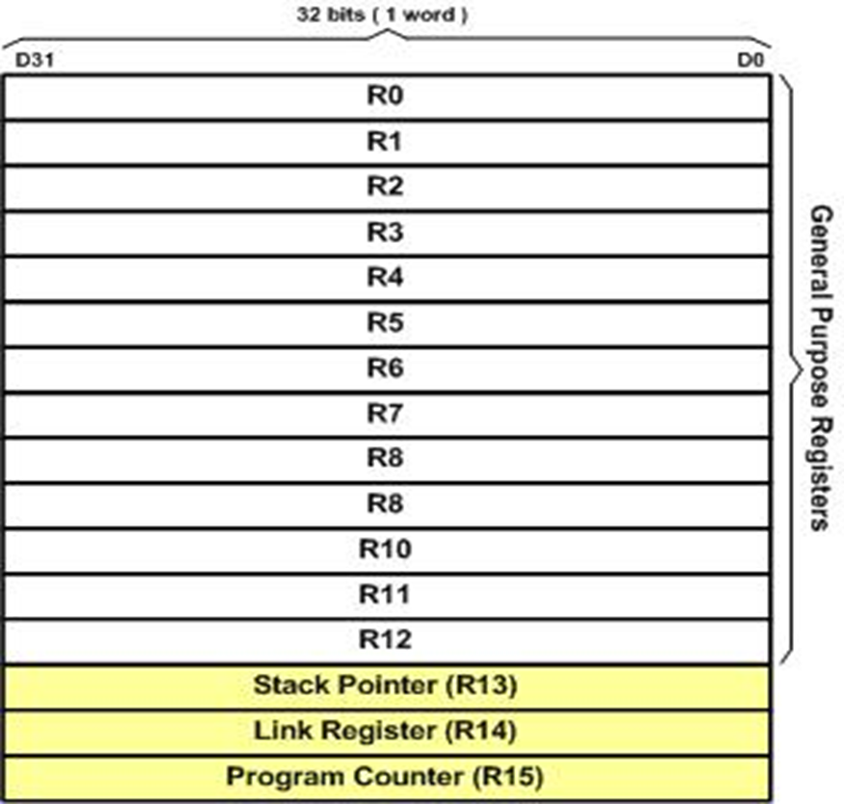
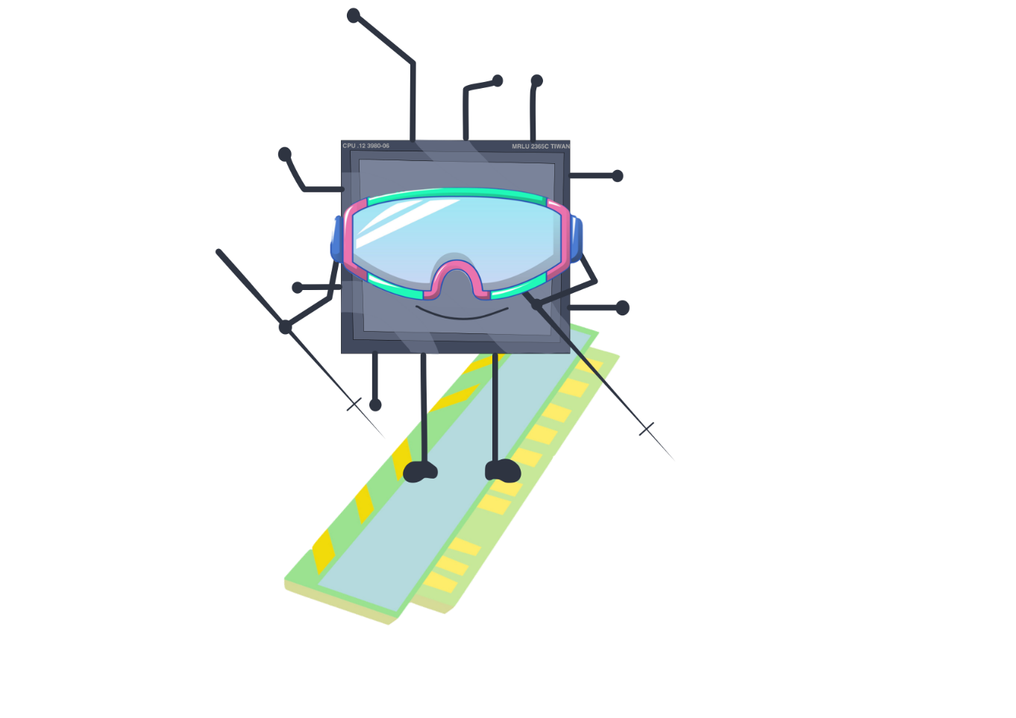
ARM Registers
13 GPRs
R0-R12 (32-bit)
Can be used by all arithmetic/logic instructions

Slide 15
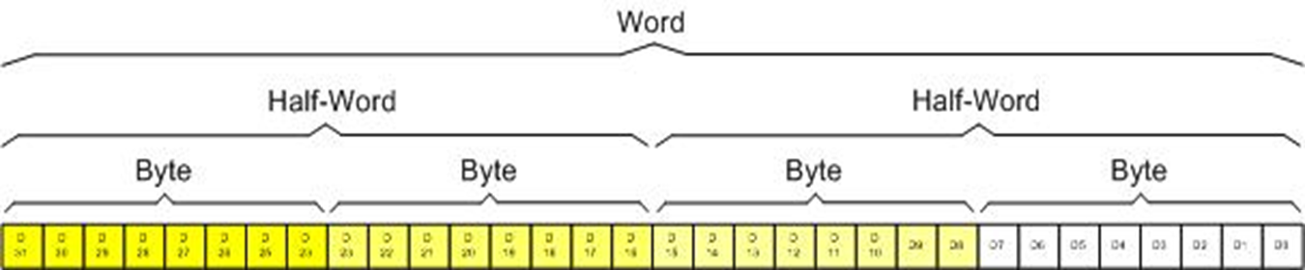
ARM Registers Data Size
MSB: D31
LSB: D0

Slide 16
Interrupt (Exception) Processing Sequence
Finish current instruction (except for lengthy instructions, “complex instructions”)
Push context (8 32-bit words) onto current stack (MSP or PSP) (hardwired)
xPSR, PC, LR (R14), R12, R3, R2, R1, R0
Switch to handler/privileged mode, use MSP
Load PC with address of exception handler
Load LR with EXC_RETURN code (Current value of PC)
Load IPSR with exception number
Start executing code of exception handler
Usually 16 cycles from exception request to execution of first instruction in handler

Slide 17
1. Finish Current Instruction
Most instructions are short and finish quickly
Some instructions may take many cycles to execute
Load Multiple (LDM), Store Multiple (STM), Push, Pop, MULS (32 cycles for some CPU core implementations)
This will delay interrupt response significantly
If one of these is executing when the interrupt is requested, the processor:
abandons the instruction
responds to the interrupt
executes the ISR
returns from interrupt
restarts the abandoned instruction (continue or restart instruction)
Notes:
Such a crowd slide! ☺

Slide 18
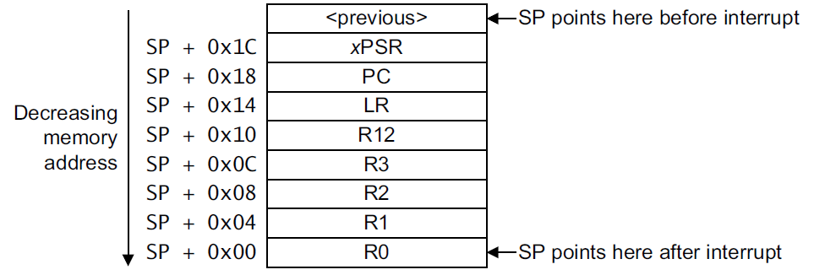
2. Push Context onto Current Stack
Two SPs: Main (MSP), process (PSP)
Which is active depends on operating mode, CONTROL register bit 1
Stack grows toward smaller addresses

Slide 19
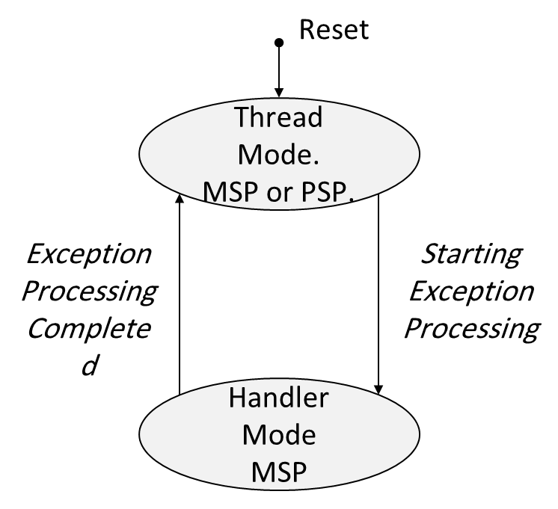
3. Switch to Handler/Privileged Mode
Handler mode always uses Main SP

Slide 20

Exiting an Exception Handler
Execute instruction triggering exception return processing
Select return stack, restore context from that stack
Resume execution of code at restored address

Slide 21
Nested Vectored Interrupt Controller (NVIC)
NVIC manages and prioritizes external interrupts
Exception states: Inactive, Pending, Active, A&P (Active & Pending)
Processor state is automatically stored to the stack on an exception
and automatically restored from the stack at the end of ISR
The processor supports tail-chaining
enables back-to-back interrupts without the overhead of state saving and restoration
Never more than one interrupt can be in active state

Slide 22
Nested Vectored Interrupt Controller (cont’d)
Late-arriving mechanism: to speed up pre-emption
Dynamic reprioritization of interrupts
Configurable number of interrupts: from 1 to 240
Configurable number of interrupt priorities: from 3 to 8 bits (8 to 256 levels)
Priority masking to support critical regions (with software)
Level and pulse detection of interrupt signals

Slide 23
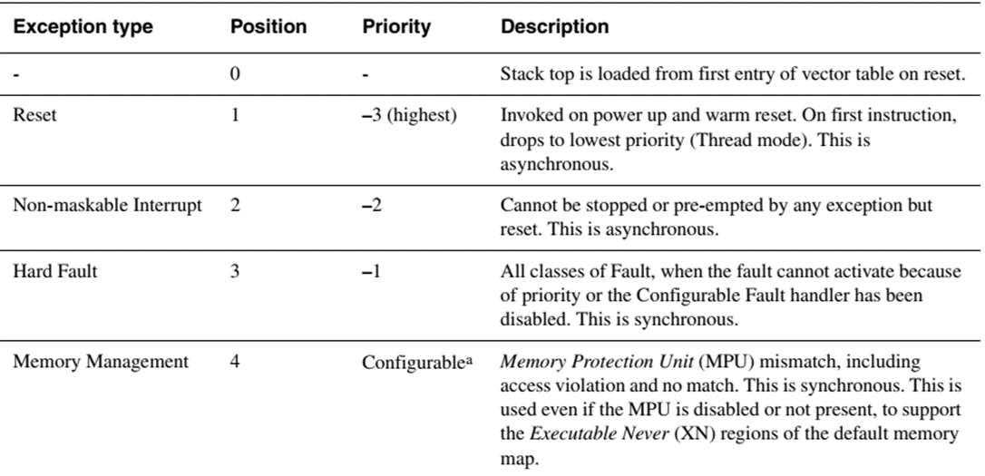
Nested Vectored Interrupt Controller
Exception types
A lower number has a higher priority
The first three interrupts are hardware interrupts
Notes:
[Cortex-M3 Technical Reference Manual: Table 5-1]

Slide 24
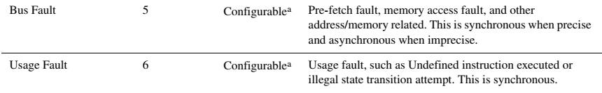
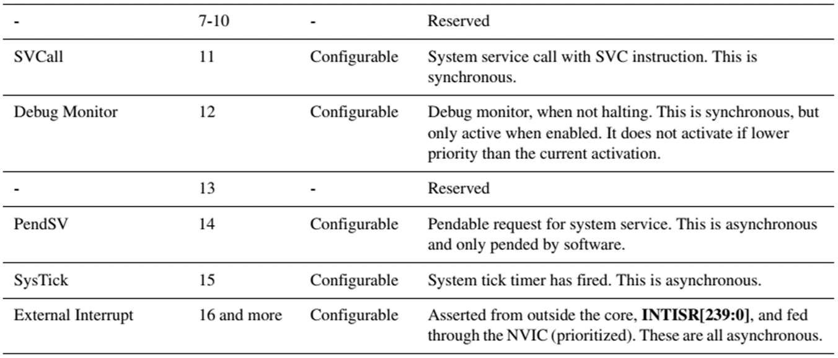
Nested Vectored Interrupt Controller
Exception types

Slide 25
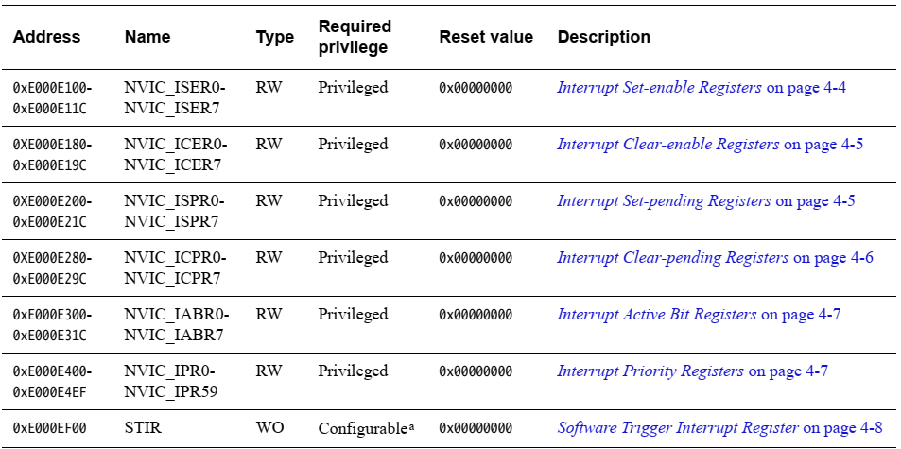
Nested Vectored Interrupt Controller
NVIC register summary
Notes:
This table is taken from Cortex-M3 Devices Generic User Guide

Slide 26
The end (for now)!

