Slide 1
Microprocessors and Assembly Language Lecture 8 Hamed Farbeh farbeh@aut.ac.ir Fall 2022

Slide 2
Copyright Notice
Parts (text & figures) of this lecture are adopted from:
Arm Assembly Language Programming and Architecture, Volume 1, 1st edition, Muhammad Ali Mazidi, Sarmad Naimi, and Sepehr Naimi, MicroDigitalEd, 2013
Design of Microprocessor-Based Systems (aka Embedded Systems Design and Implementation), Prabal Dutta, University of Michigan
CortexTM-M3 Revision r2p1 Technical Reference Manual
ARMv7-M Architecture Reference Manual

Slide 3
I²C-bus specification

Slide 4
I²C Description
Synchronous serial data link
Multi-master, multi-slave (Unlike SPI which is single-master, multi-slave)
Invented in 1982 by Philips Semiconductor (now NXP Semiconductors)
Widely used for attaching lower-speed peripheral ICs to processors and microcontrollers in short-distance (Somewhat similar to SPI)
Appropriate for peripherals where simplicity and low manufacturing cost are more important than speed (Somewhat similar to SPI)
https://en.wikipedia.org/wiki/I%C2%B2C

Slide 5
I²C Design
Two bidirectional open collector or open drain lines (SPI has four communication lines)
open collector (or open drain): behaves like a switch that is either connected to ground or disconnected
Serial Data Line (SDA) and Serial Clock Line (SCL)
pulled up with resistors (They always have a value of one when there is no data)
7-bit address space (rarely-used 10-bit extension) (Through Serial Data Line)
Each device has an address
The master is responsible for managing the communication and specifies the beginning and the end of the communication
https://en.wikipedia.org/wiki/I%C2%B2C

Slide 6
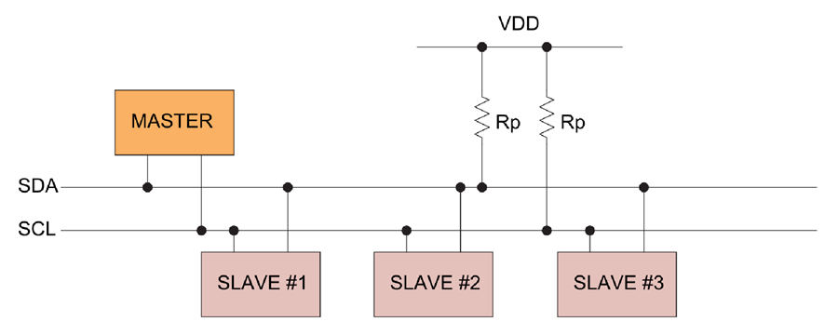
I²C Design
Bus speeds
100 kbit/s: standard mode
400 kbit/s: Fast mode
10 kbit/s: low-speed mode
1 Mbit/s: Fast mode plus
3.4 Mbit/s: High Speed mode
5 Mbit/s Ultra Fast-mode
https://en.wikipedia.org/wiki/I%C2%B2C

Slide 7
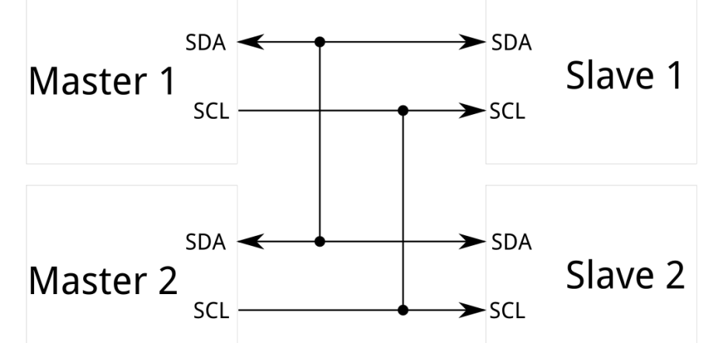
I²C Design
Operating roles
Master: generates the clock and initiates communication with slaves
Slave: receives the clock and responds when addressed by the master
Multi-master bus: any number of master nodes can be present but it can only have one master at the moment
Master and slave roles may be changed between messages (Communication is always between a master and a slave)
https://en.wikipedia.org/wiki/I%C2%B2C

Slide 8
I²C Design (Different modes of a node)
Each node is either a transmitter or a receiver at the moment
Potential modes of operation for a given bus device
Master transmit – master node is sending data to a slave
Master receive – master node is receiving data from a slave
Slave transmit – slave node is sending data to the master
Slave receive – slave node is receiving data from the master
https://en.wikipedia.org/wiki/I%C2%B2C

Slide 9
I²C Data Transfer
Message delimiters
START and STOP signals (Master generates)
Are distinct from the data bits (0 and 1)
The master is initially in master transmit mode by sending a START (Write a zero on the data line) followed by the 7-bit address of the slave
followed by a single bit representing whether it wishes to write (0) to or read (1) from the slave
The slave will respond with an ACK bit (active low (why?) for acknowledged)
If slave exists and is ready to communicate
The address and the data bytes are sent most significant bit first
https://en.wikipedia.org/wiki/I%C2%B2C

Slide 10
I²C Data Transfer
The start bit is indicated by a high-to-low transition of SDA
with SCL high
The stop bit is indicated by a low-to-high transition of SDA
with SCL high
All other transitions of SDA take place with SCL low
To write to the slave
The Master repeatedly sends a byte with the slave sending an ACK bit
To read from slave
Master repeatedly receives a byte from the slave, and send an ACK bit after every byte except the last one
https://en.wikipedia.org/wiki/I%C2%B2C

Slide 11
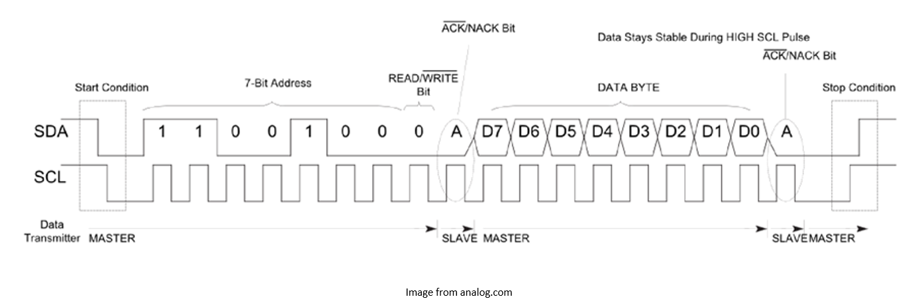
I²C Data Transfer

Slide 12
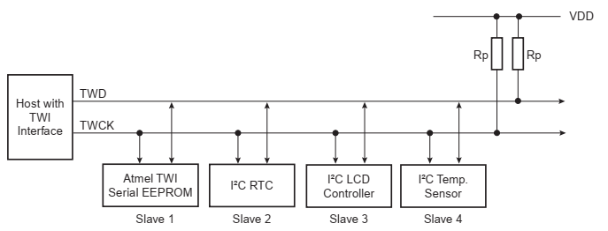
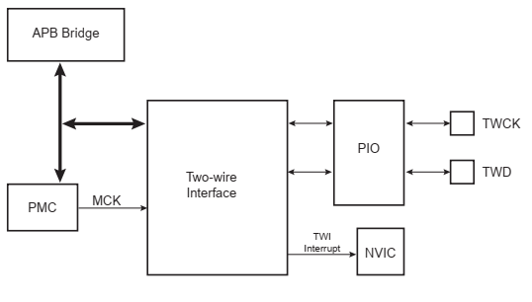

Two-wire Interface (TWI)
I2C-Compatible interface of ATMEL microcontroller
Two GPIO pins should be configured
speeds of up to 400 Kbits/s
It can have 128 devices ($2^{7}$)
Chapter 33: Atmel | SMART ARM-based MCU DATASHEET, SAM3X / SAM3A Series, Atmel-11057C-ATARM-SAM3X-SAM3A-Datasheet_23-Mar-15

Slide 13

Clock Stretching
In an I2C communication, the master device determines the clock speed.
There are situations where an I2C slave is not able to co-operate with the clock speed given by the master and needs to slow down a little.
This is done by a mechanism referred to as “clock stretching” which allows it to work with these different clocks.
But HOW?!
https://www.i2c-bus.org/clock-stretching/

Slide 14
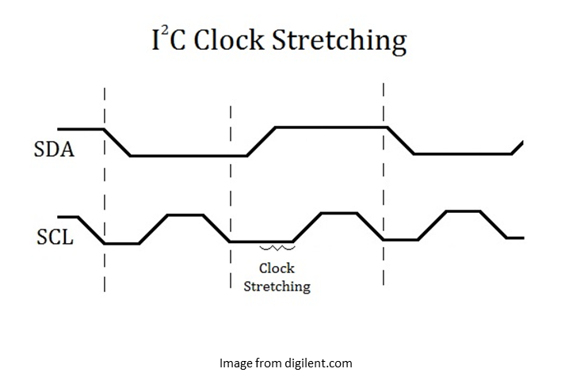
Clock Stretching
It is possible for a slave device to hold the SCL signal low (0), which “stretches” the clock and can halt the master device from transmitting data or commands.
The master, on the other hand, is required to read back the clock signal after releasing it to the high state and wait until the line has actually gone high.
As a result, this method solves the problem of different clocks

Slide 15
The End (for now)!

