Slide 1
Microprocessors and Assembly Language Lecture 2 Hamed Farbeh farbeh@aut.ac.ir Fall 2022

Slide 2
Copyright Notice
Parts (text & figures) of this lecture are adopted from:
Arm Assembly Language Programming and Architecture, Volume 1, 1st edition, Muhammad Ali Mazidi, Sarmad Naimi, and Sepehr Naimi, MicroDigitalEd, 2013
Design of Microprocessor-Based Systems (aka Embedded Systems Design and Implementation), Prabal Dutta, University of Michigan
CortexTM-M3 Revision r2p1 Technical Reference Manual
ARMv7-M Architecture Reference Manual

Slide 3
Microcontrollers

Slide 4
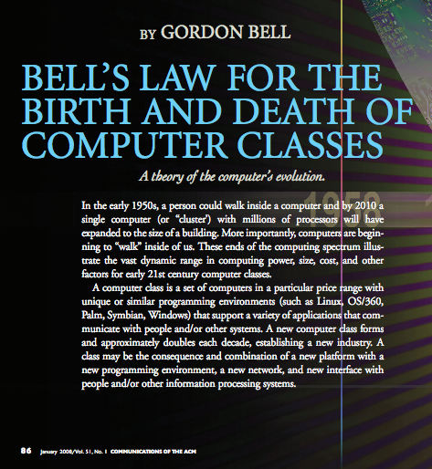
Microcontrollers
Bell’s Law: A new computer class every decade
“Roughly every decade a new, lower priced computer class forms based on a new programming platform, network, and interface resulting in new usage and the establishment of a new industry.”
- Gordon Bell [1972,2008]

Slide 5

Microcontrollers: A Brief History
1980s and 1990s
Intel: x86 (8088/86, 80286, 80386, 80486, and Pentium)
Motorola (Freescale=>NXP): 68xxx (68000, 68010, 68020)
High-end embedded systems (Cisco routers)
Intel’s 32-bit x86
Motorola’s 32-bit 68xxx
Low-end embedded systems
Intel’s 8-bit 8051
Motorola’s 8-bit 68HC1

Slide 6
Microcontrollers: A Brief History
Major players in the 8-bit market
PIC from Microchip: 1976
AVR from Atmel (Acquired by Microchip 2016): 1996
Leaders in terms of volume (2013): PIC and AVR
2019: Microchip and Renesas
Late 1990s
ARM challenged Intel and Motorola in 32-bit market

Slide 7
Microcontrollers: A Brief History
RISC features to enhance the performance, BUT
Intel & Motorola: compatibility with legacy software
Could not start over
Massive amounts of gates to keep up the performance
Increased power consumption of the x86
Unacceptable for battery-powered embedded products
ARM: A clean RISC architecture
Leading microcontroller in the 32-bit market

Slide 8
Currently Available Microcontrollers
32-bit
ARM, AVR32 (Atmel), ColdFire (Freescale), MIPS32, PIC32 (Microchip), PowerPC, TriCore (Infineon), SuperH
16-bit
MSP430 (TI), HCS12 (Freescale), PIC24 (Microchip), dsPIC (Microchip)
8-bit
8051, AVR, HCS08 (Freescale), PIC16, PIC18

Slide 9


Why study the ARM architecture?

Slide 10
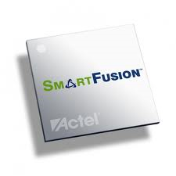
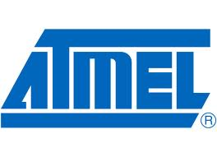

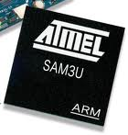

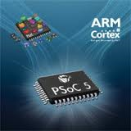
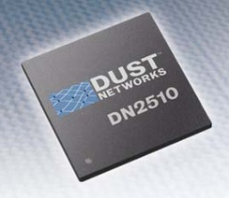

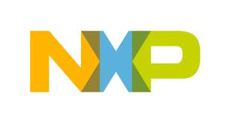
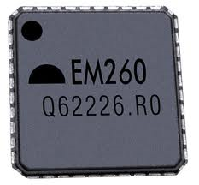

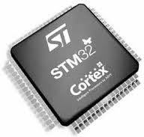
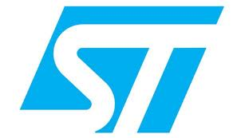

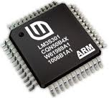
Lots of manufacturers ship ARM products

Slide 11

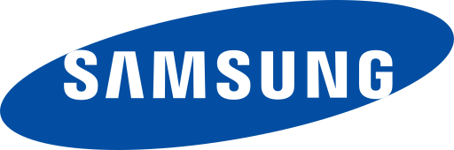
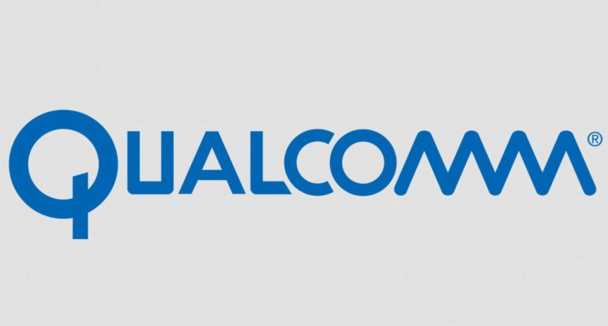
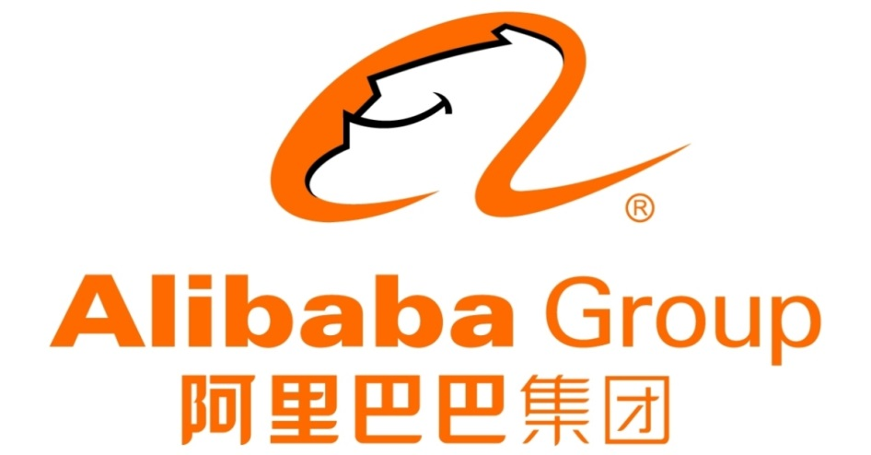
Giant Partners

Slide 12
ARM is the Big Player
ARM has a huge market share
2011: ARM has chips in 90% of the world’s mobile handsets
2010: ARM has chips in 95% of the smartphone market
And, 10% of the notebook market
Expected to hit 40% of the notebook market in 2015 (?)
Heavy use in general embedded systems
Cheap to use
Flexible

Slide 13
A Brief History of the ARM
Came out of a company called Acorn Computers
In United Kingdom in the 1980s
Prof. Steve Furber of Manchester Univ. and Sophie Wilson
Define the ARM architecture and instructions
First ARM chip: 1985
Acorn RISC Machine (ARM)
Produced by VLSI Technology Corp.
World’s First commercial RISC processor
Unable to compete with x86 (8088, 80286, 80386, …) PCs from IBM and other personal computer makers

Slide 14

A Brief History of the ARM
Acorn was forced to push ARM into emb. market
Apple Corp.
Using the ARM chip for the PDA (personal digital assistants) products
ARM as a new company
ARM (Advanced RISC Machine)
A big gamble
Selling the rights to this new CPU to other silicon
manufacturers and design houses

Slide 15
ARM Company Milestones
1982: Acorn produced a computer for BBC
1983: Acorn began designing its own uP
1985: ARMv1 developed (2500 trans., 4MHz)
1990: Advanced RISC Machines (ARM) spins out
1992: GEC Plessey and Sharp licensed ARM
1993: Texas Instrument licensed ARM
1995: ARM lunched Software Development Toolkit
1996: ARM and MS worked together: Windows CE on ARM
1997: Hyundai, Lucent, Philips, Rockwell, and Sony licensed ARM

Slide 16
ARM Company Milestones
1998: HP, IBM, Matsushita, Seiko Epson, and Qualcomm licensed ARM
1999: LSI Logic, STMicroelectronics, and Fujitsu licensed ARM
2000: Agilent, Altera, Micronas, Mitsubishi, Motorola, Sanyo, Triscend and ZTEIC licensed ARM
2001: Global UniChip, Samsung and Zeevo licensed ARM
Share of the 32-bit embedded RISC microprocessor market: 76.8%
2002: Seagate, Broadcom, Philips, Matsushita, Micrel, eSilicon, Chip Express and ITRI licensed ARM
2004: The ARM Cortex family of processors was announced (Cortex-M3)
2005: ARM acquired Keil Software
2009: ARM launches its smallest, lowest power, most energy efficient processor: Cortex-M0
….

Slide 17

Making money from selling IP (intellectual property)
has made ARM one of the most widely used
CPU architectures in the world

Slide 18
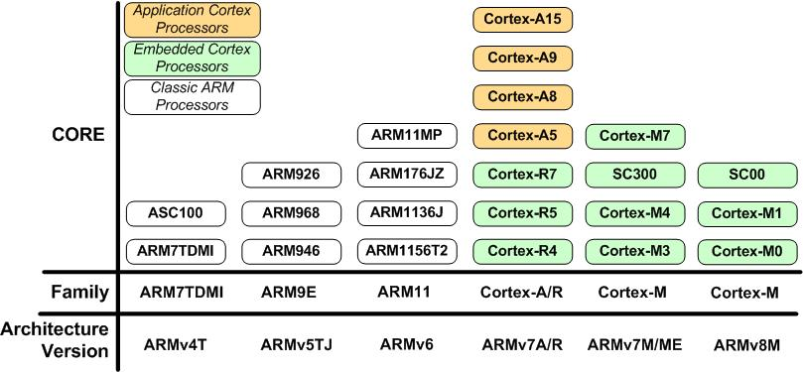
ARM Family Variations

Slide 19
ARM: One CPU, Many Peripherals
ARM Defines and holds the copyright to
Details of arch., reg., intr. set, memory map, and timing
For the ARM CPU
Design houses and semiconductor manufacturers
Add their own peripherals
I/O ports, serial port UART, timers, ADC, SPI, DAC, I2C, …
Same instructions and architecture, different peripherals
Incompatibility across vendors
Keil IDE: provides peripheral libraries for chips from various vendors

Slide 20
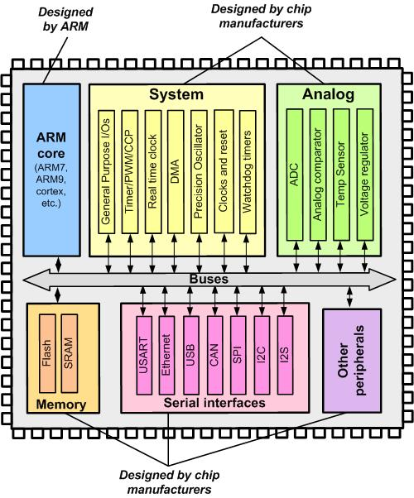
ARM Simplified Block Diagram

