Slide 1
Data

Slide 2
Data
Database: collection of data objects
record, point, vector, instance, event, case, sample, observation, entity
data objects are described by a number of attributes capture the basic characteristics of an object
variable, characteristic, field, feature, dimension

Slide 3
Data

Slide 4
Data
Attributes
Objects

Slide 5
Different Types of Attributes
Nominal
The values of a nominal attribute are just different Names
Examples: ID numbers, eye color

Slide 6
Different Types of Attributes
Nominal
The values of a nominal attribute are just different Names
Examples: ID numbers, eye color
Ordinal
The values of an ordinal attribute provide enough information to order objects.
Examples: rankings (e.g., taste of potato chips on a scale from 1-10), grades, height {tall, medium, short}

Slide 7
Different Types of Attributes
Nominal
The values of a nominal attribute are just different Names
Examples: ID numbers, eye color
Ordinal
The values of an ordinal attribute provide enough information to order objects.
Examples: grades, height {tall, medium, short}
Interval
For interval attributes, the differences between values are meaningful, i.e., a unit of measurement exists.
Examples: calendar dates

Slide 8
Different Types of Attributes
Nominal
The values of a nominal attribute are just different Names
Examples: ID numbers, eye color
Ordinal
The values of an ordinal attribute provide enough information to order objects.
Examples: rankings (e.g., taste of potato chips on a scale from 1-10), grades, height {tall, medium, short}
Interval
For interval attributes, the differences between values are meaningful, i.e., a unit of measurement exists.
Examples: calendar dates
Ratio
Both differences and ratios are meaningful.
Examples: length, counts

Slide 9
Different Types of Attributes
The type of an attribute depends on which of the following properties/operations it possesses:
Distinctness: = ≠
Order: < >
Differences are - meaningful :
Ratios are * / meaningful
Nominal attribute: distinctness
Ordinal attribute: distinctness & order
Interval attribute: distinctness, order & meaningful differences
Ratio attribute: all 4 properties/operations

Slide 10
Different Types of Attributes
Discrete Attribute
Has only a finite or countably infinite set of values
Examples: counts
Note: binary attributes are a special case of discrete attributes
Continuous Attribute
Has real numbers as attribute values
Examples: temperature, height, or weight.

Slide 11
Data
Asymmetric Attributes
only presence—a non-zero attribute value—is regarded as important
Students and courses
Words present in documents
Items present in customer transactions
Asymmetric attributes typically arise from objects that are sets

Slide 12
Types of Data Sets

Slide 13
Types of Data Sets
1. Record Data
2. Graph-Based Data
3. Ordered Data
Data that consists of a collection of records, each of which consists of a fixed set of attributes
1.1 Data Matrix
1.2 Document Data
1.3 Transaction or Market Basket Data

Slide 14
Types of Data Sets
1.1 Data Matrix
data objects have the same fixed set of numeric attributes
data objects are points in a multi-dimensional space
each dimension represents a distinct attribute
represented by an m by n matrix
Data matrix or pattern matrix

Slide 15
Types of Data Sets
1.2 Document Data
Each document becomes a ‘term’ vector
Each term is a component (attribute) of the vector
The value of each component is the number of times the corresponding term occurs in the document.

Slide 16
Types of Data Sets
1.3 Transaction or Market Basket Data
A special type of record data, where Each record (transaction) involves a set of items.

Slide 17
Types of Data Sets
2. Graph-Based Data
2.1 graph captures relationships among data objects
2.2 data objects themselves are represented as graphs.
2.1 Data with Relationships among Objects
relationships among objects frequently convey important information.
data objects are mapped to nodes
relationships among objects are captured by the links between objects

Slide 18
Types of Data Sets
2.2 Data with Objects That Are Graphs

Slide 19
Types of Data Sets
3. Ordered Data
the attributes have relationships that involve order
in time or space
3.1 Sequential (Temporal) Data
each record has a time
associated with it

Slide 20
Types of Data Sets
sequence of words or letters
no time stamps
Positions in an ordered sequence.
3.2 Sequence Data

Slide 21
Types of Data Sets
each record is a time series
a series of measurements taken over time
3.3 Time Series Data
temporal autocorrelation

Slide 22
Types of Data Sets
3.4 Spatial Data
spatial autocorrelation
spatio-temporal data

Slide 23
Data Quality

Slide 24
Data quality
Poor data quality negatively affects many data processing efforts
correction of data quality
use of algorithms that can tolerate poor data quality
data cleaning

Slide 25
Data quality
Poor data quality negatively affects many data processing efforts
correction of data quality
use of algorithms that can tolerate poor data quality
data cleaning
Examples of data quality problems:
Noise and outliers
Missing values
Duplicate data
Wrong data

Slide 26
Noise
Noise is the random component of a measurement error

Slide 27
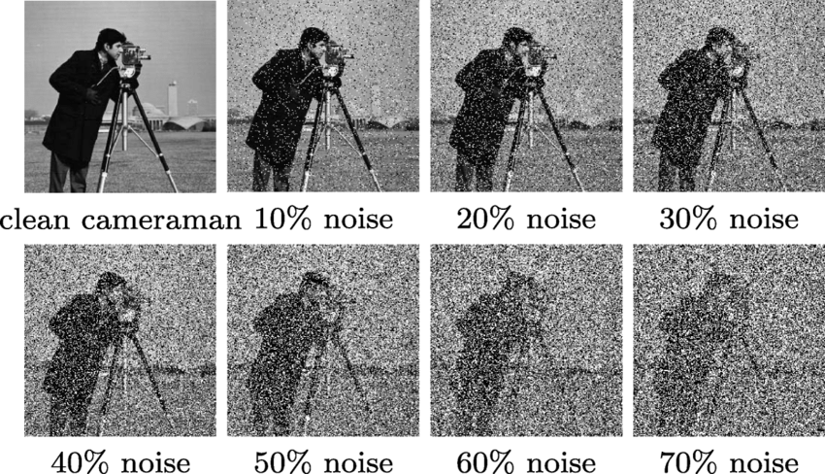
Noise
Noise is the random component of a measurement error
signal processing can frequently be used to reduce noise

Slide 28
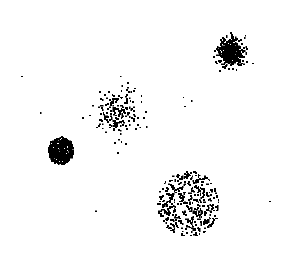
Outlier
(1) data objects that, in some sense, have characteristics that are different from most of the other data objects in the data set
(2) values of an attribute that are unusual with respect to the typical values
for that attribute.
anomalous objects or values

Slide 29
Missing Values
Reasons for missing values
Information is not collected (e.g., people decline to give their age and weight)
Attributes may not be applicable to all cases (e.g., annual income is not applicable to children)

Slide 30
Missing Values
Reasons for missing values
Information is not collected (e.g., people decline to give their age and weight)
Attributes may not be applicable to all cases (e.g., annual income is not applicable to children)
Handling missing values
Eliminate data objects or variables
Estimate missing values
Example: time series of temperature
Example: similar data points
Ignore the missing value during analysis

Slide 31
Data Preprocessing

Slide 32
Data Preprocessing
Aggregation
Sampling
Dimensionality Reduction
Feature subset selection
Feature extraction, creation
Discretization and Binarization
Attribute Transformation

Slide 33
Aggregation
Combining two or more attributes (or objects) into a single attribute (or object)
Data reduction
Reduce the number of attributes or objects
Change of scale
Cities aggregated into regions, states, countries, etc.
Days aggregated into weeks, months, or years
More “stable” data
Aggregated data tends to have less variability

Slide 34
Sampling
Sampling is a commonly used approach for selecting a subset of the data objects to be analyzed
Processing the entire set of data of interest is too expensive or time consuming.

Slide 35
Sampling
Sampling is a commonly used approach for selecting a subset of the data objects to be analyzed
Processing the entire set of data of interest is too expensive or time consuming.
Effective Sampling
Using a sample will work almost as well as using the entire data set, if the sample is representative
A sample is representative if it has approximately the same properties (of interest) as the original set of data
Sampling Method & size?

Slide 36
Sampling
Sampling is a commonly used approach for selecting a subset of the data objects to be analyzed
Processing the entire set of data of interest is too expensive or time consuming.
Effective Sampling
Using a sample will work almost as well as using the entire data set, if the sample is representative
A sample is representative if it has approximately the same properties (of interest) as the original set of data
Simple Random Sampling
There is an equal probability of selecting any particular item
Sampling Method & size?

Slide 37
Sampling
Sampling without replacement
As each item is selected, it is removed from the population
Sampling with replacement
Objects are not removed from the population as they are selected for the sample.
In sampling with replacement, the same object can be picked up more than once

Slide 38
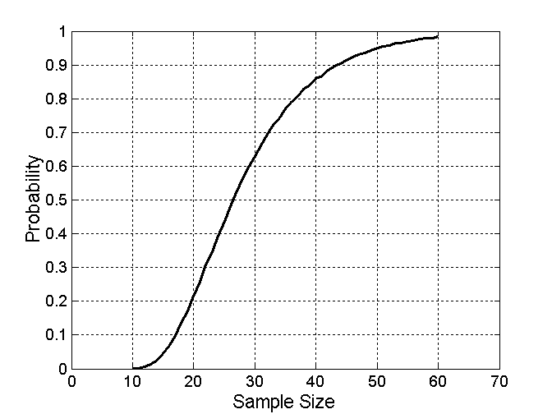
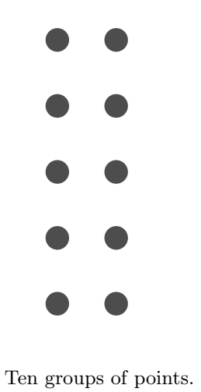
Sampling
What sample size is necessary to get at least one object from each of 10 equal-sized groups.

Slide 39
Sampling
What sample size is necessary to get at least one object from each of 10 equal-sized groups.
Stratified sampling
Split the data into several partitions; then draw random samples from each partition

Slide 40
Dimensionality Reduction
many data mining algorithms work better if the dimensionality is lower
eliminate irrelevant features
curse of dimensionality
more easily visualized
Reduce amount of time and memory required by data mining algorithms

Slide 41
Dimensionality Reduction
many data mining algorithms work better if the dimensionality is lower
eliminate irrelevant features
curse of dimensionality
Reduce amount of time and memory required by data mining algorithms
many types of data analysis become significantly harder as the dimensionality of the data increases
When dimensionality increases, data becomes increasingly sparse in the space that it occupies

Slide 42
Dimensionality Reduction
creating new features that are a combination of the old attributes
selecting features feature subset selection or feature selection

Slide 43
Dimensionality Reduction
creating new features that are a combination of the old attributes
selecting features feature subset selection or feature selection
x₂
Dimensionality Reduction: PCA
e
finds new features (principal components) that
capture the maximum amount of variation in the data
x₁

Slide 44
Feature Selection
Another way to reduce dimensionality of data
Redundant features
Duplicate much or all of the information contained in one or more other attributes
Example: purchase price of a product and the amount of sales tax paid
Irrelevant features
Contain no information that is useful for the data mining task at hand
Example: students' ID is often irrelevant to the task of predicting students' GPA
Embedded, filter, wrapper

Slide 45
Feature Creation
Create new attributes that can capture the important information in a data set much more efficiently than the original attributes
Feature extraction/construction
Mapping data to new space : different view of the data

Slide 46
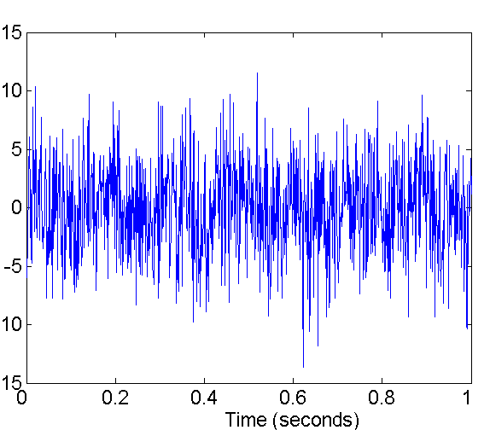
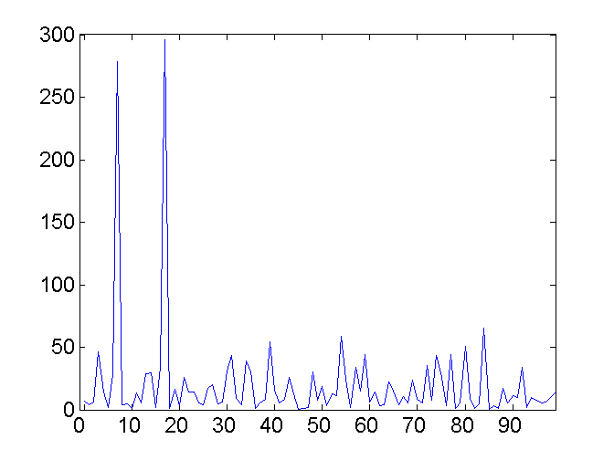
Fourier and wavelet transform
Two Sine Waves + Noise
Frequency

Slide 47
Discretization
Binarization

Slide 48
Discretization
Unsupervised discretization: find breaks in the data values
Supervised discretization: Use class labels to find breaks

Slide 49
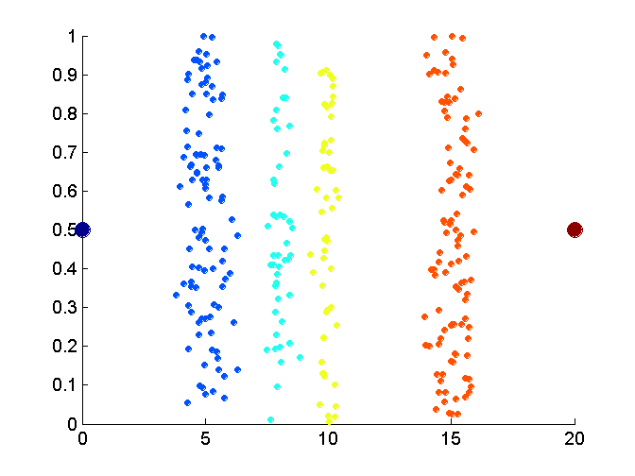
Discretization
Unsupervised discretization: find breaks in the data values
Supervised discretization: Use class labels to find breaks
Example: Discretization Without Using Class Labels
Data consists of four groups of points and two outliers. Data is one-dimensional, but a random y component is added to reduce overlap

Slide 50
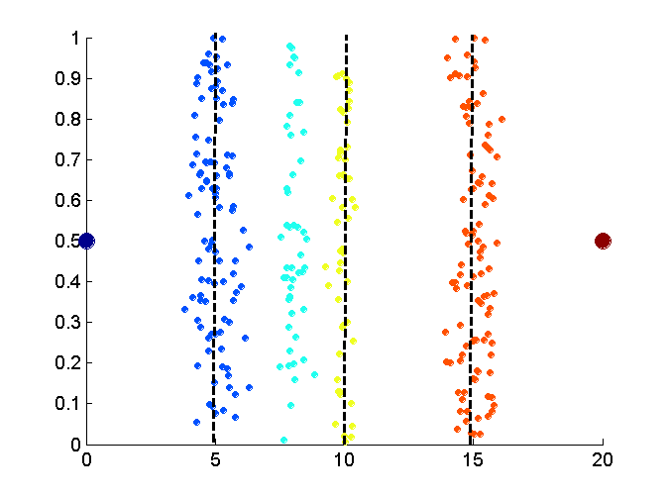
Discretization
Equal interval width approach used to obtain 4 values

Slide 51
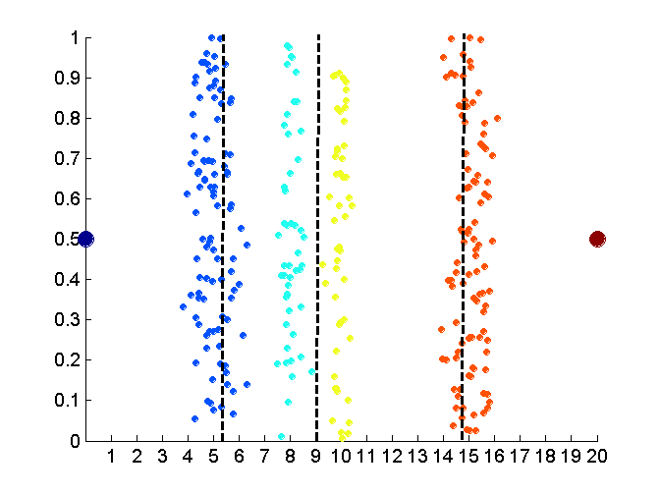
Discretization
Equal frequency approach used to obtain 4 values

Slide 52
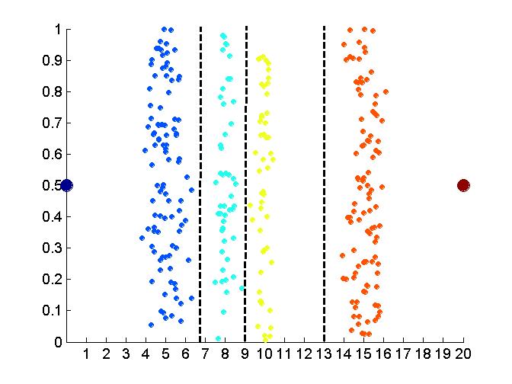
Discretization
K-means approach to obtain 4 values.

Slide 53
Attribute Transformation
An attribute transform is a function that maps the entire set of values of a given attribute to a new set of replacement values such that each old value can be identified with one of the new values
Simple functions: x^{k}, log(x), e^{x}, |x|
Normalization
Refers to various techniques to adjust to differences among attributes in terms of mean, variance, range
In statistics, standardization refers to subtracting off the means and dividing by the standard deviation

Slide 54
Similarity and Dissimilarity Measures

Slide 55
Similarity and Dissimilarity Measures
Similarity measure
Numerical measure of how alike two data objects are.
Is higher when objects are more alike.
Often falls in the range [0,1]

Slide 56
Similarity and Dissimilarity Measures
Similarity measure
Numerical measure of how alike two data objects are.
Is higher when objects are more alike.
Often falls in the range [0,1]
Dissimilarity measure
Numerical measure of how different two data objects are
Lower when objects are more alike
Minimum dissimilarity is often 0
Upper limit varies
Proximity refers to a similarity or dissimilarity

Slide 57
Similarity and Dissimilarity Measures
Similarity measure
Numerical measure of how alike two data objects are.
Is higher when objects are more alike.
Often falls in the range [0,1]
Dissimilarity measure
Numerical measure of how different two data objects are
Lower when objects are more alike
Minimum dissimilarity is often 0
Upper limit varies
Proximity refers to a similarity or dissimilarity
distance
objects having only one simple attribute
objects with multiple attributes

Slide 58
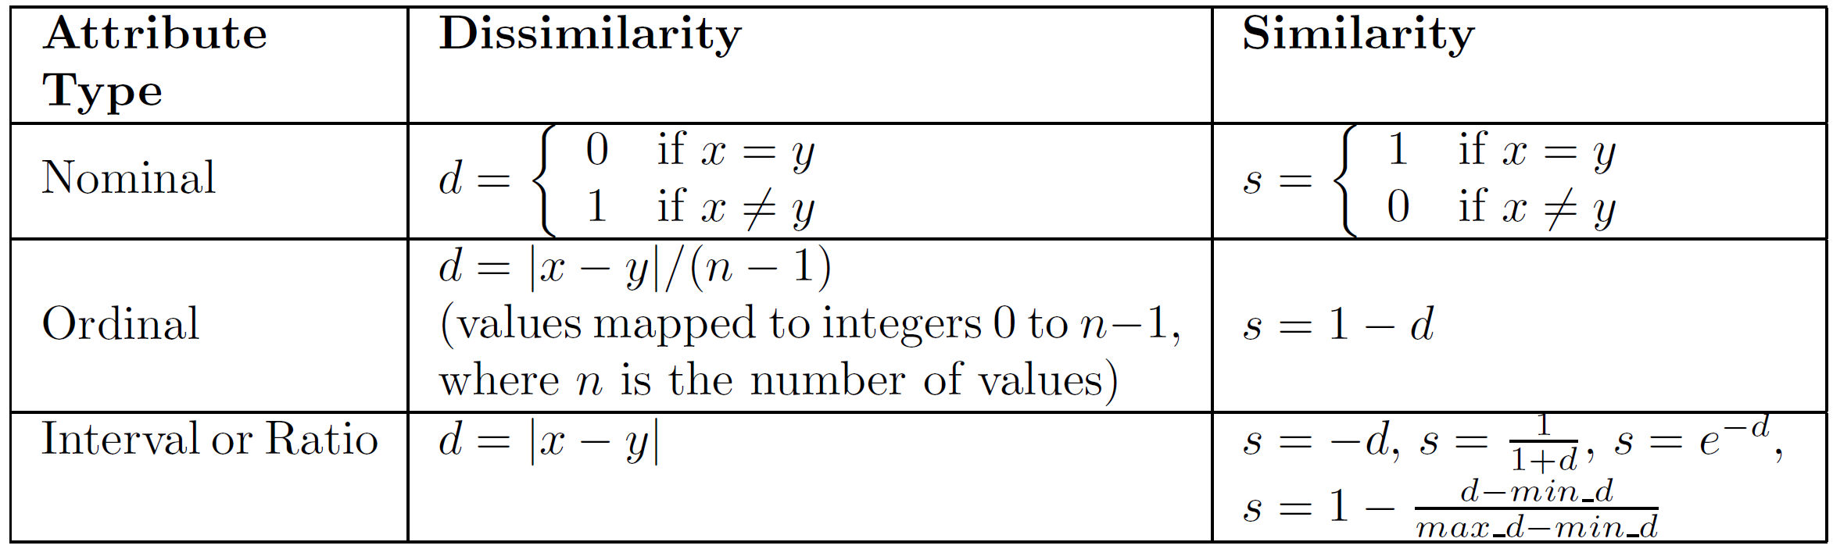
Similarity/Dissimilarity for Simple Attributes
The following table shows the similarity and dissimilarity between two objects, x and y, with respect to a single attribute.

Slide 59
Dissimilarities between Data Objects
various kinds of dissimilarities
distances, which are dissimilarities with certain properties
provide examples of more general kinds of dissimilarities

Slide 60
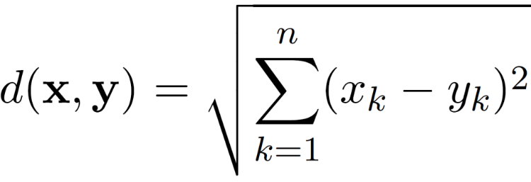
Dissimilarities between Data Objects
various kinds of dissimilarities
distances, which are dissimilarities with certain properties
provide examples of more general kinds of dissimilarities
Euclidean Distance
where n is the number of dimensions (attributes) and x_{k} and y_{k} are, respectively, the k^{th} attributes (components) or data objects x and y.

Slide 61
Distances:example
Distance Matrix

Slide 62
Distances:example
Distance Matrix

Slide 63
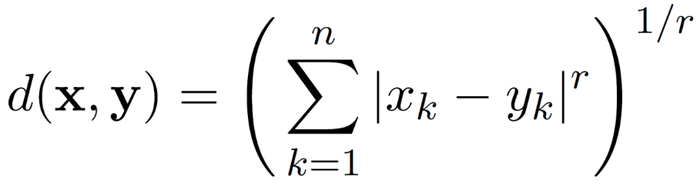
Distances
Minkowski Distance
is a generalization of Euclidean Distance
Where r is a parameter, n is the number of dimensions (attributes) and x_{k} and y_{k} are, respectively, the k^{th} attributes (components) or data objects x and y.

Slide 64
Distances
Minkowski Distance
r = 1
r = 2. Euclidean distance
r → ∞. “supremum” (L_{max} norm, L∞ norm) distance.
This is the maximum difference between any component of the vectors

Slide 65
Distances:Example
Distance Matrix

Slide 66
Distances
Distances, such as the Euclidean distance, have some well known properties.
d(x, y) ≥ 0 for all x and y
d(x, y) = 0 only if x = y
d(x, y) = d(y, x) for all x and y.
d(x, z) ≤ d(x, y) + d(y, z) for all points x, y, and z.
where d(x, y) is the distance (dissimilarity) between points (data objects), x and y.
Metric

Slide 67
Non-metric Dissimilarities
many dissimilarities do not satisfy one or more of the metric properties
Example: Non-metric Dissimilarities: Set Differences
Given two sets A and B, A − B is the set of elements of A that are not in B.

Slide 68
Non-metric Dissimilarities
many dissimilarities do not satisfy one or more of the metric properties
Example: Non-metric Dissimilarities: Set Differences
Given two sets A and B, A − B is the set of elements of A that are not in B.

Slide 69
Similarities between Data Objects
Similarities, have some typical properties.
s(x, y) = 1 (or maximum similarity) only if x = y.
s(x, y) = s(y, x) for all x and y. (Symmetry)
where s(x, y) is the similarity between points (data objects), x and y.

Slide 70
Similarities between Data Objects
Similarity Between Binary Vectors
p and q, have only binary attributes
Compute similarities using the following quantities
f₀₁ = the number of attributes where p was 0 and q was 1
f₁₀ = the number of attributes where p was 1 and q was 0
f₀₀ = the number of attributes where p was 0 and q was 0
f₁₁ = the number of attributes where p was 1 and q was 1

Slide 71
Similarities between Data Objects
Similarity Between Binary Vectors
p and q, have only binary attributes
Compute similarities using the following quantities
f₀₁ = the number of attributes where p was 0 and q was 1
f₁₀ = the number of attributes where p was 1 and q was 0
f₀₀ = the number of attributes where p was 0 and q was 0
f₁₁ = the number of attributes where p was 1 and q was 1
Simple Matching Coefficient
SMC = number of matches / number of attributes
= (f₁₁ + f₀₀) / (f₀₁ + f₁₀ + f₁₁ + f₀₀)

Slide 72
Similarities between Data Objects
Similarity Between Binary Vectors
p and q, have only binary attributes
Compute similarities using the following quantities
f₀₁ = the number of attributes where p was 0 and q was 1
f₁₀ = the number of attributes where p was 1 and q was 0
f₀₀ = the number of attributes where p was 0 and q was 0
f₁₁ = the number of attributes where p was 1 and q was 1
Simple Matching Coefficient
SMC = number of matches / number of attributes
= (f₁₁ + f₀₀) / (f₀₁ + f₁₀ + f₁₁ + f₀₀)
Jaccard Coefficient
J = number of 11 matches / number of non-zero attributes
= (f₁₁) / (f₀₁ + f₁₀ + f₁₁)

Slide 73
Similarities between Data Objects
Example: binary similarity
x = 1 0 0 0 0 0 0 0 0 0
y = 0 0 0 0 0 0 1 0 0 1

Slide 74
Similarities between Data Objects
Example: binary similarity
x = 1 0 0 0 0 0 0 0 0 0
y = 0 0 0 0 0 0 1 0 0 1
f₀₁ = 2 (the number of attributes where p was 0 and q was 1)
f₁₀ = 1 (the number of attributes where p was 1 and q was 0)
f₀₀ = 7 (the number of attributes where p was 0 and q was 0)
f₁₁ = 0 (the number of attributes where p was 1 and q was 1)
SMC = (f₁₁ + f₀₀) / (f₀₁ + f₁₀ + f₁₁ + f₀₀)
= (0+7) / (2+1+0+7) = 0.7
J = (f₁₁) / (f₀₁ + f₁₀ + f₁₁) = 0 / (2 + 1 + 0) = 0

Slide 75
Similarities between Data Objects
Cosine Similarity
If d₁ and d₂ are two document vectors, then
cos( d₁, d₂ ) = <d₁,d₂> / ||d₁|| ||d₂|| ,

Slide 76
Similarities between Data Objects
Cosine Similarity
If d₁ and d₂ are two document vectors, then
cos( d₁, d₂ ) = <d₁,d₂> / ||d₁|| ||d₂|| ,
d₁ = 3 2 0 5 0 0 0 2 0 0
d₂ = 1 0 0 0 0 0 0 1 0 2
Example:

Slide 77
Similarities between Data Objects
Cosine Similarity
If d₁ and d₂ are two document vectors, then
cos( d₁, d₂ ) = <d₁,d₂> / ||d₁|| ||d₂|| ,
d₁ = 3 2 0 5 0 0 0 2 0 0
d₂ = 1 0 0 0 0 0 0 1 0 2
<d₁, d2> = 3*1 + 2*0 + 0*0 + 5*0 + 0*0 + 0*0 + 0*0 + 2*1 + 0*0 + 0*2 = 5
| d₁ || = (3*3+2*2+0*0+5*5+0*0+0*0+0*0+2*2+0*0+0*0)^{0.5} = (42) ^{0.5} = 6.481
|| d₂ || = (1*1+0*0+0*0+0*0+0*0+0*0+0*0+1*1+0*0+2*2) ^{0.5} = (6) ^{0.5} = 2.449
cos(d₁, d₂ ) = 0.3150
Example:

Slide 78
Similarities between Data Objects
Correlation

Slide 79
Similarities between Data Objects
Correlation

Slide 80
Similarities between Data Objects
Correlation

Slide 81
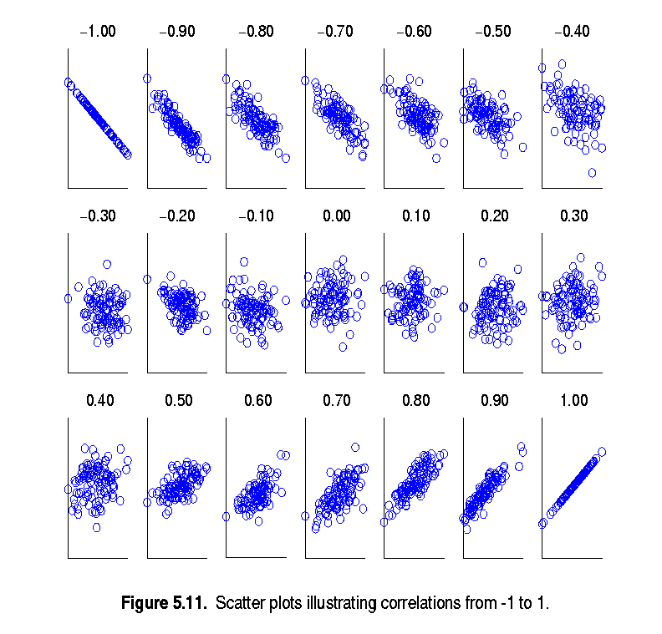
Similarities between Data Objects
Scatter plots showing the correlation from –1 to 1.

Slide 82
Similarities between Data Objects
Drawback of Correlation : Non-linear Relationships
correlation is 0, no linear relationship between the attributes of the two data objects
non-linear relationships may still exist.

Slide 83
Similarities between Data Objects
Drawback of Correlation : Non-linear Relationships
correlation is 0, no linear relationship between the attributes of the two data objects
non-linear relationships may still exist.
Example:
x = (-3, -2, -1, 0, 1, 2, 3)
y = (9, 4, 1, 0, 1, 4, 9)

Slide 84
Similarities between Data Objects
Drawback of Correlation : Non-linear Relationships
correlation is 0, no linear relationship between the attributes of the two data objects
non-linear relationships may still exist.
Example:
x = (-3, -2, -1, 0, 1, 2, 3)
y = (9, 4, 1, 0, 1, 4, 9)
y_{i} = x_{i}²
mean(x) = 0, mean(y) = 4
std(x) = 2.16, std(y) = 3.74
corr = (-3)(5)+(-2)(0)+(-1)(-3)+(0)(-4)+(1)(-3)+(2)(0)+3(5) / ( 6 * 2.16 * 3.74 ) = 0

Slide 85
Similarities between Data Objects

Slide 86
Standardization and Correlation for Distance Measures
A generalization of Euclidean distance, the Mahalanobis distance when attributes are correlated, have different ranges of values
$$mahalanobis\left(x,y\right)={ (x−y)}^{T}Ʃ^{−1}(x−y)$$
Σ is the covariance matrix
ijth entry is the covariance of the ith
and jth attributes

Slide 87
Similarities between Data Objects
Information Based Measures
Information theory
Some similarity measures are based on information theory
Mutual information
handle non-linear relationships
complicated and time intensive to compute

Slide 88
Similarities between Data Objects
Information Based Measures
Information theory
Some similarity measures are based on information theory
Mutual information
handle non-linear relationships
complicated and time intensive to compute
Information and Probability
Information relates to possible outcomes of an event
information is related the probability of an outcome
The smaller the probability of an outcome, the more information it provides
Entropy is the commonly used measure

Slide 89
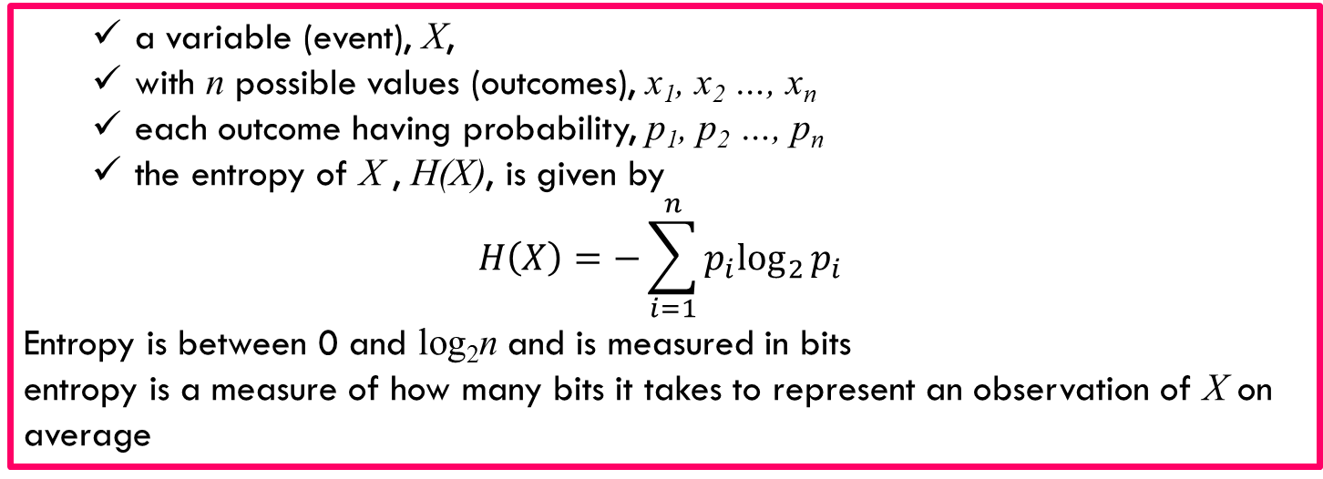
Similarities between Data Objects
a variable (event), X,
with n possible values (outcomes), x₁, x₂ …, x_{n}
each outcome having probability, p₁, p₂ …, p_{n}
the entropy of X , H(X), is given by
$$H\left(X\right)=−\sum_{i=1}^{n}{{p_{i}log}_{2}{p_{i}}}$$
Entropy is between 0 and log₂n and is measured in bits
entropy is a measure of how many bits it takes to represent an observation of X on average

Slide 90
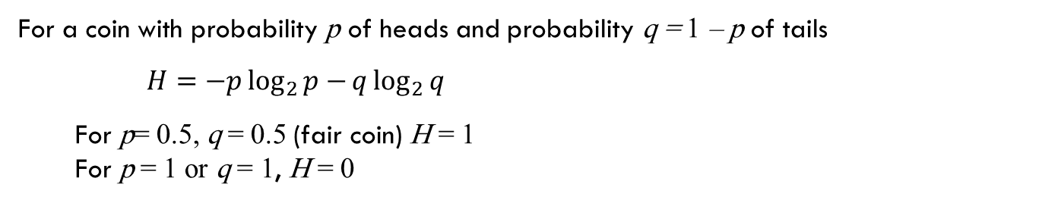

Similarities between Data Objects
a variable (event), X,
with n possible values (outcomes), x₁, x₂ …, x_{n}
each outcome having probability, p₁, p₂ …, p_{n}
the entropy of X , H(X), is given by
$$H\left(X\right)=−\sum_{i=1}^{n}{{p_{i}log}_{2}{p_{i}}}$$
Entropy is between 0 and log₂n and is measured in bits
entropy is a measure of how many bits it takes to represent an observation of X on average
Example:
For a coin with probability p of heads and probability q = 1 – p of tails
$$H=−p\log_{2}{p−}q\log_{2}{q}$$
For p= 0.5, q = 0.5 (fair coin) H = 1
For p = 1 or q = 1, H = 0

Slide 91
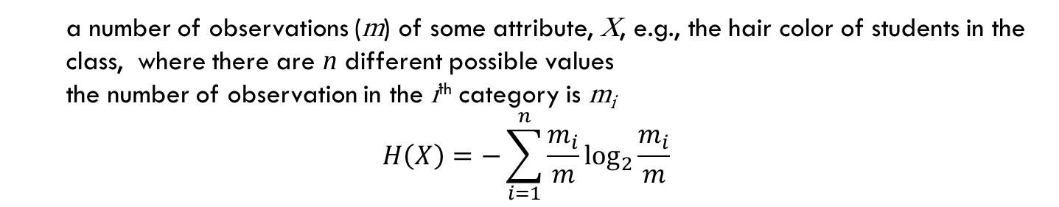
Similarities between Data Objects
a number of observations (m) of some attribute, X, e.g., the hair color of students in the class, where there are n different possible values
the number of observation in the i^{th} category is m_{i}
$$H\left(X\right)=−\sum_{i=1}^{n}{{\frac{m_{i}}{m}log}_{2}{\frac{m_{i}}{m}}}$$
Maximum entropy is log₂5 = 2.3219
Hair Color | Count | p | -plog₂p
Black | 75 | 0.75 | 0.3113
Brown | 15 | 0.15 | 0.4105
Blond | 5 | 0.05 | 0.2161
Red | 0 | 0.00 | 0
Other | 5 | 0.05 | 0.2161
Total | 100 | 1.0 | 1.1540

Slide 92
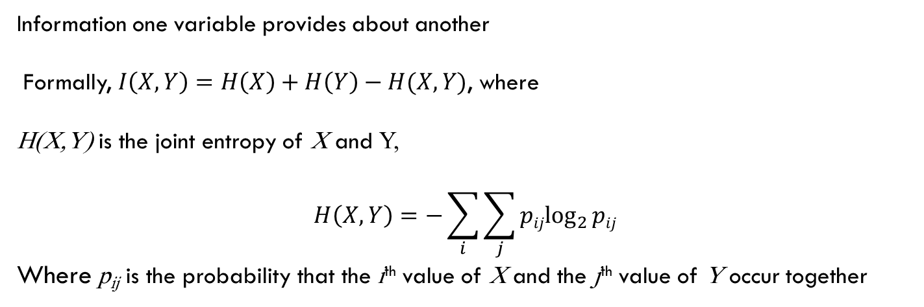
Mutual Information
Information one variable provides about another
Formally, $I\left(X,Y\right)=H\left(X\right)+H\left(Y\right)−H(X,Y)$, where
H(X,Y) is the joint entropy of X and Y,
$$H\left(X,Y\right)=−\sum_{i}{\sum_{j}{{pijlog}_{2}{pij}}}$$
Where p_{ij} is the probability that the i^{th} value of X and the j^{th} value of Y occur together

Slide 93
Mutual Information
Information one variable provides about another
Formally, $I\left(X,Y\right)=H\left(X\right)+H\left(Y\right)−H(X,Y)$, where
H(X,Y) is the joint entropy of X and Y,
$$H\left(X,Y\right)=−\sum_{i}{\sum_{j}{{pijlog}_{2}{pij}}}$$
Where p_{ij} is the probability that the i^{th} value of X and the j^{th} value of Y occur together
how similar the joint distribution p(X, Y ) is to the factored distribution p(X)p(Y ).
MI is zero iff the variables are independent
MI between X and Y as the reduction in uncertainty about X after observing Y

Slide 94
Mutual Information example
Student Status | Count | p | -plog₂p
Undergrad | 45 | 0.45 | 0.5184
Grad | 55 | 0.55 | 0.4744
Total | 100 | 1.00 | 0.9928
Student Status | Grade | Count | p | -plog₂p
Undergrad | A | 5 | 0.05 | 0.2161
Undergrad | B | 30 | 0.30 | 0.5211
Undergrad | C | 10 | 0.10 | 0.3322
Grad | A | 30 | 0.30 | 0.5211
Grad | B | 20 | 0.20 | 0.4644
Grad | C | 5 | 0.05 | 0.2161
Total |  | 100 | 1.00 | 2.2710
Grade | Count | p | -plog₂p
A | 35 | 0.35 | 0.5301
B | 50 | 0.50 | 0.5000
C | 15 | 0.15 | 0.4105
Total | 100 | 1.00 | 1.4406
Mutual information of Student Status and Grade = 0.9928 + 1.4406 - 2.2710 = 0.1624

