Slide 1
CS276
Information Retrieval and Web Search
Chris Manning and Pandu Nayak
Systems issues

Slide 2
Background
Score computation is a large (10s of %) fraction of the CPU work on a query
  Generally, we have a tight budget on latency (say, 250ms)
  CPU provisioning doesn’t permit exhaustively scoring every document on every query
Today we’ll look at ways of cutting CPU usage for scoring, without compromising the quality of results (much)
Basic idea: avoid scoring docs that won’t make it into the top K

Slide 3
Safe vs non-safe ranking
The terminology “safe ranking” is used for methods that guarantee that the K docs returned are the K absolute highest scoring documents
Is it ok to be non-safe?

Slide 4
Ranking function is only a proxy
Sec. 7.1.1
User has a task and a query formulation
Ranking function matches docs to query
Thus the ranking function is anyway a proxy for user happiness
If we get a list of K docs “close” to the top K by the ranking function measure, should be ok

Slide 5
Recap: Queries as vectors
Ch. 6
Key idea 1: Do the same for queries: represent them as vectors in the space
Key idea 2: Rank documents according to their proximity to the query in this space
proximity = similarity of vectors, measured by cosine similarity

Slide 6
Efficient cosine ranking
Sec. 7.1
Find the K docs in the collection “nearest” to the query ⇒ K largest query-doc cosines.
Efficient ranking:
  Computing a single cosine efficiently.
  Choosing the K largest cosine values efficiently.
    Can we do this without computing all N cosines?

Slide 7
Computing the K largest cosines: selection vs. sorting
Sec. 7.1
Typically we want to retrieve the top K docs (in the cosine ranking for the query)
  not to totally order all docs in the collection
Can we pick off docs with K highest cosines?
Let J = number of docs with nonzero cosines
  We seek the K best of these J

Slide 8
Use heap for selecting top K
Sec. 7.1
Binary tree in which each node’s value > the values of children
Takes 2J operations to construct, then each of K “winners” read off in 2log J steps.
For J=1M, K=100, this is about 10% of the cost of sorting.
1
.9
.3
.3
.8
.1
.1

Slide 9
Bottlenecks
Sec. 7.1.1
Primary computational bottleneck in scoring: cosine computation
Can we avoid all this computation?
Yes, but may sometimes get it wrong
  a doc not in the top K may creep into the list of K output docs
  As noted earlier, this may not be a bad thing

Slide 10
SPEEDING COSINE COMPUTATION BY PRUNING

Slide 11
Generic approach
Sec. 7.1.1
Find a set A of contenders, with K < |A| << N
  A does not necessarily contain the top K, but has many docs from among the top K
  Return the top K docs in A
Think of A as pruning non-contenders
The same approach is also used for other (non-cosine) scoring functions
Will look at several schemes following this approach

Slide 12
Index elimination
Sec. 7.1.2
Basic cosine computation algorithm only considers docs containing at least one query term
Take this further:
  Only consider high-idf query terms
  Only consider docs containing many query terms

Slide 13
High-idf query terms only
Sec. 7.1.2
For a query such as catcher in the rye
Only accumulate scores from catcher and rye
Intuition: in and the contribute little to the scores and so don’t alter rank-ordering much
Benefit:
  Postings of low-idf terms have many docs → these (many) docs get eliminated from set A of contenders

Slide 14
Docs containing many query terms
Sec. 7.1.2
Any doc with at least one query term is a candidate for the top K output list
For multi-term queries, only compute scores for docs containing several of the query terms
  Say, at least 3 out of 4
  Imposes a “soft conjunction” on queries seen on web search engines (early Google)
Easy to implement in postings traversal

Slide 15
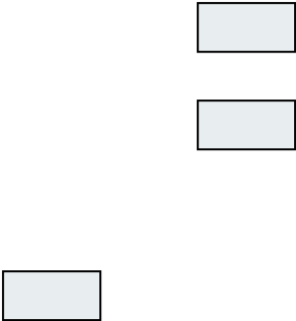
3 of 4 query terms
Sec. 7.1.2
Antony
3
4
8
16
32
64
128
Brutus
2
4
8
16
32
64
128
Caesar
1
2
3
5
8
13
21
34
Calpurnia
13
16
32
Scores only computed for docs 8, 16 and 32.

Slide 16
Champion lists
Sec. 7.1.3
Precompute for each dictionary term t, the r docs of highest weight in t’s postings
  Call this the champion list for t
  (aka fancy list or top docs for t)
Note that r has to be chosen at index build time
  Thus, it’s possible that r < K
At query time, only compute scores for docs in the champion list of some query term
  Pick the K top-scoring docs from amongst these

Slide 17
Exercises
Sec. 7.1.3
How can Champion Lists be implemented in an inverted index?

Slide 18
QUERY-INDEPENDENT DOCUMENT SCORES

Slide 19
Static quality scores
Sec. 7.1.4
We want top-ranking documents to be both relevant and authoritative
Relevance is being modeled by cosine scores
Authority is typically a query-independent property of a document
Examples of authority signals
  Wikipedia among websites
  Articles in certain newspapers
  A paper with many citations
  Many bitlys, likes, or bookmarks
  Pagerank
Quantitative

Slide 20
Modeling authority
Sec. 7.1.4
Assign to each document a query-independent quality score in [0,1] to each document d
  Denote this by g(d)
Thus, a quantity like the number of citations is scaled into [0,1]
  Exercise: suggest a formula for this.

Slide 21
Net score
Sec. 7.1.4
Consider a simple total score combining cosine relevance and authority
net-score(q,d) = g(d) + cosine(q,d)
  Can use some other linear combination
  Indeed, any function of the two “signals” of user happiness
Now we seek the top K docs by net score

Slide 22
Top K by net score – fast methods
Sec. 7.1.4
First idea: Order all postings by g(d)
Key: this is a common ordering for all postings
Thus, can concurrently traverse query terms’ postings for
  Postings intersection
  Cosine score computation
Exercise: write pseudocode for cosine score computation if postings are ordered by g(d)

Slide 23
Why order postings by g(d)?
Sec. 7.1.4
Under g(d)-ordering, top-scoring docs likely to appear early in postings traversal
In time-bound applications (say, we have to return whatever search results we can in 50 ms), this allows us to stop postings traversal early
  Short of computing scores for all docs in postings

Slide 24
Champion lists in g(d)-ordering
Sec. 7.1.4
Can combine champion lists with g(d)-ordering
Maintain for each term a champion list of the r docs with highest g(d) + tf-idf_{td}
Seek top-K results from only the docs in these champion lists

Slide 25
CLUSTER PRUNING

Slide 26
Cluster pruning: preprocessing
Sec. 7.1.6
Pick √N docs at random: call these leaders
For every other doc, pre-compute nearest leader
  Docs attached to a leader: its followers;
  Likely: each leader has ~ √N followers.

Slide 27
Cluster pruning: query processing
Sec. 7.1.6
Process a query as follows:
  Given query Q, find its nearest leader L.
  Seek K nearest docs from among L’s followers.

Slide 28
Visualization
Sec. 7.1.6
Query
Leader
Follower

Slide 29
Why use random sampling
Sec. 7.1.6
Fast
Leaders reflect data distribution

Slide 30
General variants
Sec. 7.1.6
Have each follower attached to b1=3 (say) nearest leaders.
From query, find b2=4 (say) nearest leaders and their followers.
Can recurse on leader/follower construction.

Slide 31
TIERED INDEXES

Slide 32
High and low lists
Sec. 7.1.4
For each term, we maintain two postings lists called high and low
  Think of high as the champion list
When traversing postings on a query, only traverse high lists first
  If we get more than K docs, select the top K and stop
  Else proceed to get docs from the low lists
Can be used even for simple cosine scores, without global quality g(d)
A means for segmenting index into two tiers

Slide 33
Tiered indexes
Sec. 7.2.1
Break postings up into a hierarchy of lists
  Most important
  …
  Least important
Can be done by g(d) or another measure
Inverted index thus broken up into tiers of decreasing importance
At query time use top tier unless it fails to yield K docs
  If so drop to lower tiers

Slide 34
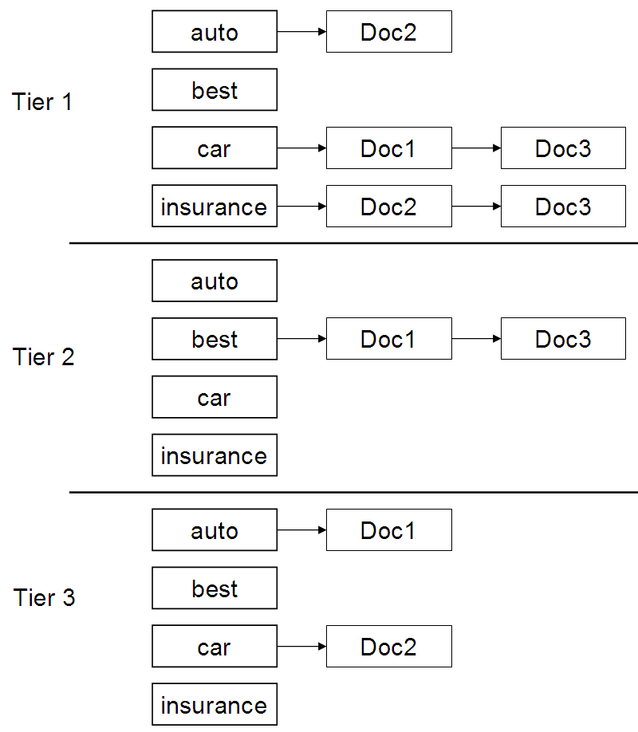
Example tiered index
Sec. 7.2.1

Slide 35
Impact-ordered postings
Sec. 7.1.5
We only want to compute scores for docs for which wf_{t,d} is high enough
We sort each postings list by wf_{t,d}
Now: not all postings in a common order!
How do we compute scores in order to pick off top K?
  Two ideas follow

Slide 36
1. Early termination
Sec. 7.1.5
When traversing t’s postings, stop early after either
  a fixed number of r docs
  wf_{t,d} drops below some threshold
Take the union of the resulting sets of docs
  One from the postings of each query term
Compute only the scores for docs in this union

Slide 37
2. idf-ordered terms
Sec. 7.1.5
When considering the postings of query terms
Look at them in order of decreasing idf
  High idf terms likely to contribute most to score
As we update score contribution from each query term
  Stop if doc scores relatively unchanged
Can apply to cosine or some other net scores

Slide 38
SAFE RANKING

Slide 39
Safe vs non-safe ranking
The terminology “safe ranking” is used for methods that guarantee that the K docs returned are the K absolute highest scoring documents
  (Not necessarily just under cosine similarity)

Slide 40
Safe ranking
When we output the top K docs, we have a proof that these are indeed the top K
Does this imply we always have to compute all N cosines?
  We’ll look at pruning methods
  So we only fully score some J documents

Slide 41
WAND scoring
An instance of DAAT scoring
Basic idea reminiscent of branch and bound
  We maintain a running threshold score – e.g., the K^{th} highest score computed so far
  We prune away all docs whose cosine scores are guaranteed to be below the threshold
  We compute exact cosine scores for only the un-pruned docs
Broder et al. Efﬁcient Query Evaluation using a Two-Level Retrieval Process.

Slide 42
Index structure for WAND
Postings ordered by docID
Assume a special iterator on the postings of the form “go to the first docID greater than or equal to X”
Typical state: we have a “finger” at some docID in the postings of each query term
  Each finger moves only to the right, to larger docIDs
Invariant – all docIDs lower than any finger have already been processed, meaning
  These docIDs are either pruned away or
  Their cosine scores have been computed

Slide 43
Upper bounds
At all times for each query term t, we maintain an upper bound UB_{t} on the score contribution of any doc to the right of the finger
  Max (over docs remaining in t’s postings) of w_{t}(doc)
finger
t
3
7
11
17
29
38
57
79
UB_{t} = w_{t}(38)
As finger moves right, UB drops

Slide 44
Pivoting
Query: catcher in the rye
Let’s say the current finger positions are as below
Threshold = 6.8
catcher
273
UB_{catcher}= 2.3
rye
304
UB_{rye} = 1.8
in
589
UB_{in} = 3.3
the
762
UB_{the} = 4.3
Pivot

Slide 45
Prune docs that have no hope
Terms sorted in order of finger positions
Move fingers to 589 or right
Threshold = 6.8
catcher
273
Hopeless docs
UB_{catcher}= 2.3
rye
304
Hopeless docs
UB_{rye} = 1.8
in
589
UB_{in} = 3.3
the
762
UB_{the} = 4.3
Update UB’s
Pivot

Slide 46
Compute 589’s score if need be
If 589 is present in enough postings, compute its full cosine score – else some fingers to right of 589
Pivot again …
catcher
589
rye
589
in
589
the
762

Slide 47
WAND summary
In tests, WAND leads to a 90+% reduction in score computation
  Better gains on longer queries
Nothing we did was specific to cosine ranking
  We need scoring to be additive by term
WAND and variants give us safe ranking
  Possible to devise “careless” variants that are a bit faster but not safe (see summary in Ding+Suel 2011)
  Ideas combine some of the non-safe scoring we considered

Slide 48
FINISHING TOUCHES FOR A COMPLETE SCORING SYSTEM

Slide 49
Query term proximity
Sec. 7.2.2
Free text queries: just a set of terms typed into the query box – common on the web
Users prefer docs in which query terms occur within close proximity of each other
Let w be the smallest window in a doc containing all query terms, e.g.,
For the query strained mercy the smallest window in the doc The quality of mercy is not strained is 4 (words)
Would like scoring function to take this into account – how?

Slide 50
Query parsers
Sec. 7.2.3
Free text query from user may in fact spawn one or more queries to the indexes, e.g., query rising interest rates
  Run the query as a phrase query
  If <K docs contain the phrase rising interest rates, run the two phrase queries rising interest and interest rates
  If we still have <K docs, run the vector space query rising interest rates
  Rank matching docs by vector space scoring
This sequence is issued by a query parser

Slide 51
Aggregate scores
Sec. 7.2.3
We’ve seen that score functions can combine cosine, static quality, proximity, etc.
How do we know the best combination?
Some applications – expert-tuned
Increasingly common: machine-learned

Slide 52
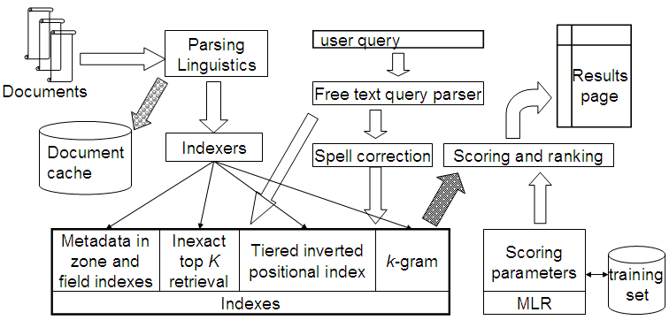
Putting it all together
Sec. 7.2.4

